Slide 1
Principles of
Data Science
John P Dickerson
Lecture #8 – 10/17/2018
CMSC641
Wednesdays
7:00pm – 9:30pm

Slide 2
Announcements
Mini-Project #2 is out!
It is linked to from ELMS; also available at: https://github.com/umddb/cmsc641-fall2018/tree/master/project2
Deliverable is a .ipynb file submitted to ELMS
Due Wednesday, October 24th

Slide 3
Wrap-up From last Lecture …
Data collection
Data processing
Exploratory analysis
&
Data viz
Analysis, hypothesis testing, & ML
Insight & Policy Decision

Slide 4
Wrapping Up:
Graphs, & Networks

Slide 5
Storing a Graph
Three main ways to represent a graph in memory:
Adjacency lists
Adjacency dictionaries
Adjacency matrix
The storage decision should be made based on the expected use case of your graph:
Static analysis only?
Frequent updates to the structure?
Frequent updates to semantic information?

Slide 6
Adjacency Lists
For each vertex, store an array of the vertices it connects to
Pros: ????????
Iterate over all outgoing edges; easy to add an edge
Cons: ????????
Checking for the existence of an edge is O(|V|), deleting is hard
A
C
Vertex | Neighbors
A | [C]
B | [C, D]
C | [A]
D | []
B
D

Slide 7
Adjacency Dictionaries
For each vertex, store a dictionary of vertices it connects to
Pros: ?????????
O(1) to add, remove, query edges
Cons: ?????????
Overhead (memory, caching, etc)
A
C
Vertex | Neighbors
A | {C: 1.0}
B | {C: 1.0, D: 1.0}
C | {A: 1.0}
D | {}
B
D

Slide 8
Adjacency Matrix
Store the connectivity of the graph in a matrix
Cons: ?????????
O(|V|²) space regardless of the number of edges
Almost always stored as a sparse matrix
From
A
C
 | A | B | C | D
A | 0 | 0 | 1 | 0
B | 0 | 0 | 0 | 0
C | 1 | 1 | 0 | 0
D | 0 | 1 | 0 | 0
To
B
D

Slide 9

The value of a vertex

Slide 10
Importance of vertices
Not all vertices are equally important
Centrality Analysis:
Find out the most important node(s) in one network
Used as a feature in classification, for visualization, etc …
Commonly-used Measures
Degree Centrality
Closeness Centrality
Betweenness Centrality
Eigenvector Centrality

Slide 11
Strength of relationships

Slide 12
Weak and Strong Ties
In practice, connections are not of the same strength
Interpersonal social networks are composed of strong ties (close friends) and weak ties (acquaintances).
Strong ties and weak ties play different roles for community formation and information diffusion
Strength of Weak Ties [Granovetter 1973]
Occasional encounters with distant acquaintances can provide important information about new opportunities for job search

Slide 13
Connections in Social Media
Social media allows users to connect to each other more easily than ever.
One user might have thousands of friends online
Who are the most important ones among your 300 Facebook friends?
Imperative to estimate the strengths of ties for advanced analysis
Analyze network topology
Learn from User Profiles and Attributes
Learn from User Activities

Slide 14
Learning from Network Topology
Bridges connecting two different communities are weak ties
An edge is a bridge if its removal results in disconnection of its terminal vertices
  Bridge edge(s) ?????
  Bridge edge(s) ?????

Slide 15
“shortcut” Bridge
Bridges are rare in real-life networks
Idea: relax the definition by checking if the distance between two terminal vertices increases if the edge is removed
The larger the distance, the weaker the tie is
Example:
d(2,5) = 4 if (2,5) is removed
d(5,6) = 2 if (5,6) is removed
(5,6) is a stronger tie than (2,5)

Slide 16
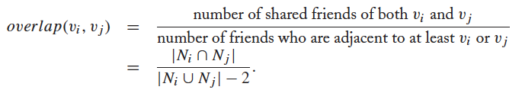

Neighborhood Overlap
Tie strength can be measured based on neighborhood overlap; the larger the overlap, the stronger the tie is.
(-2 in the denominator is to exclude v_{i} and v_{j})
Example:

Slide 17
Learning from Profiles and Interactions
Twitter: one can follow others without followee’s confirmation
The real friendship network is determined by the frequency two users talk to each other, rather than the follower-followee network
The real friendship network is more influential in driving Twitter usage
Strengths of ties can be predicted accurately based on various information from Facebook
Friend-initiated posts, message exchanged in wall post, number of mutual friends, etc.
Learning numeric link strength by maximum likelihood estimation
User profile similarity determines the strength
Link strength in turn determines user interaction
Maximize the likelihood based on observed profiles and interactions

Slide 18
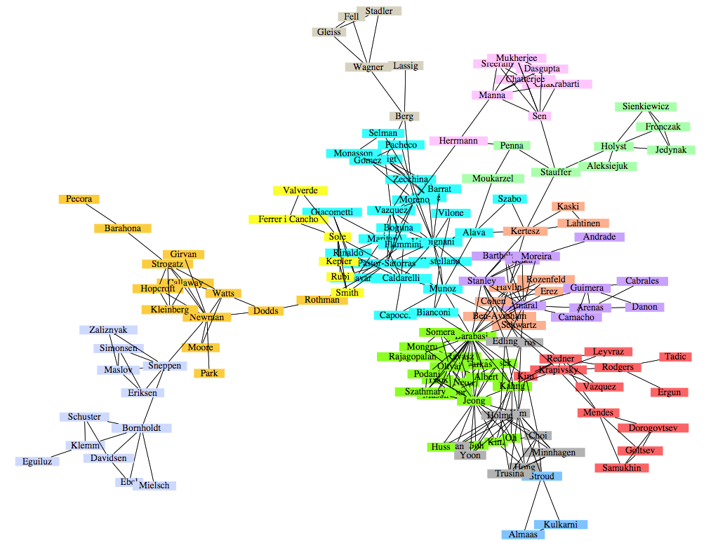
Community detection
A co-authorship network of physicists and mathematicians
(Courtesy: Easley & Kleinberg)

Slide 19
What is a community?
Informally: “tightly-knit region” of the network.
How do we identify this region?
How do we separate tightly-knit regions from each other?
It depends on the definition of tightly knit.
Regions can be nested
Examples ?????????
How do bridges fit into this ?????????

Slide 20
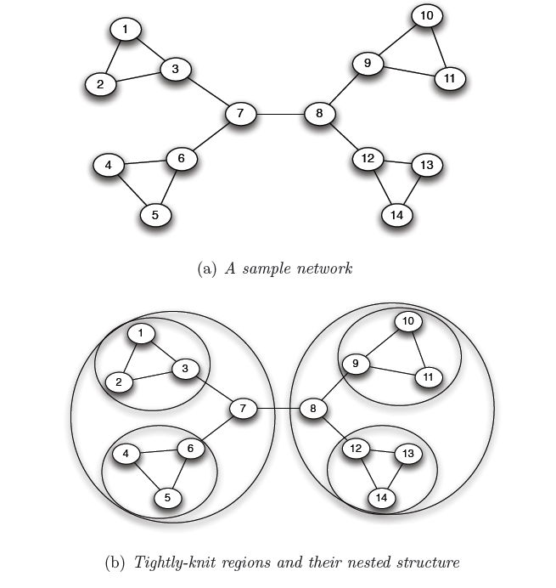
What is a community?
Removal of a bridge separates the graph into disjoint components
bridges
An example of a nested structure of the communities
(Courtesy: Easley & Kleinberg)

Slide 21
Community detection
Girvan-Newman Method
Remove the edges of highest betweenness first.
Repeat the same step with the remainder graph.
Continue this until the graph breaks down into individual nodes.
As the graph breaks down into pieces, the tightly knit community structure is exposed.
Results in a hierarchical partitioning of the graph

Slide 22
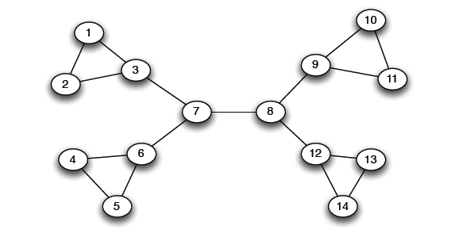
Girvan-Newman method
Betweenness(7-8)= 7*7 = 49
Betweenness(1-3) = 1*12 = 12
Betweenness(3-7) = Betweenness(6-7) =
Betweenness(8-9) = Betweenness(8-12) = 3*11= 33

Slide 23
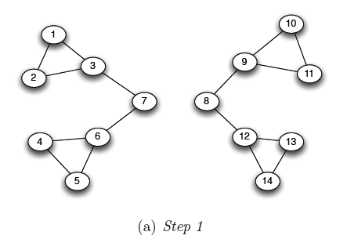
Girvan-Newman method
Betweenness(1-3) = 1*5=5
Betweenness(3-7) = Betweenness(6-7) =
Betweenness(8-9) = Betweenness(8-12) = 3*4 = 12

Slide 24
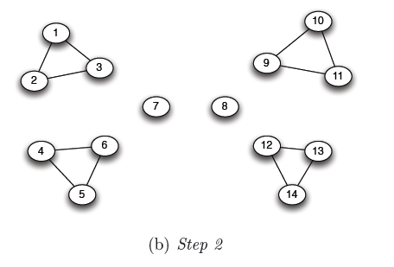
Girvan-Newman method
???????????????????
Betweenness of every edge = 1

Slide 25
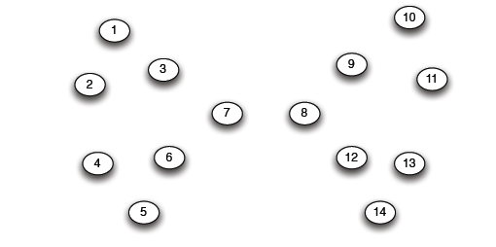
Girvan-Newman method
G=nx.Graph()
# Returns an iterator over partitions at
# different hierarchy levels
nx.girvan_newman(G)

Slide 26
NetworkX: Viz
Can render via Matplotlib or GraphViz
Many different layout engines, aesthetic options, etc
https://networkx.github.io/documentation/networkx-1.10/reference/drawing.html
https://networkx.github.io/documentation/development/gallery.html
import matplotlib.pyplot as plt
G=nx.Graph()
nx.draw(G, with_labels=True)
# Save to a PDF
plt.savefig(“my_filename.pdf”)

Slide 27
Networkx: Viz
# Cycle with 24 vertices
G=nx.cycle_graph(24)
# Compute force-based layout
pos=nx.spring_layout(G,
iterations=200)
# Draw the graph
nx.draw(G,pos,
node_color=range(24),
node_size=800,
cmap=plt.cm.Blues)
# Save as PNG, then display
plt.savefig(”graph.png")
plt.show()

Slide 28
Networkx: Viz
# Branch factor 3, depth 5
G = nx.balanced_tree(3, 5)
# Circular layout
pos = graphviz_layout(G,
prog='twopi', args='')
# Draw 8x8 figure
plt.figure(figsize=(8, 8))
nx.draw(G, pos,
node_size=20,
alpha=0.5,
node_color="blue",
with_labels=False)
plt.axis('equal')
plt.show()

Slide 29
And now:
Words words words!
Free text and natural language processing in data science
Bag of words and TF-IDF
N-Grams and language models
Sentiment mining
Thanks to: Zico Kolter (CMU) & Marine Carpuat’s 723 (UMD)

Slide 30
Precursor to Natural language processing
For we can easily understand a machine's being constituted so that it can utter words, and even emit some responses to action on it of a corporeal kind, which brings about a change in its organs; for instance, if touched in a particular part it may ask what we wish to say to it; if in another part it may exclaim that it is being hurt, and so on.
(But it never happens that it arranges its speech in various ways, in order to reply appropriately to everything that may be said in its presence, as even the lowest type of man can do.)
-- René Descartes, 1600s
Notes:
Precursor to the Turing Test – Descartes seems to think we’ll never pass it

Slide 31
Precursor to Natural Language processing
Turing’s Imitation Game [1950]:
Person A and Person B go into separate rooms
Guests send questions in, read questions that come out – but they are not told who sent the answers
Person A (B) wants to convince group that she is Person B (A)
We now ask the question, "What will happen when a machine takes the part of [Person] A in this game?" Will the interrogator decide wrongly as often when the game is played like this as he does when the game is played between [two humans]? These questions replace our original, "Can machines think?"

Slide 32
Precursor to Natural language processing
Mechanical translation started in the 1930s
Largely based on dictionary lookups
Georgetown-IBM Experiment:
Translated 60 Russian sentences to English
Fairly basic system behind the scenes
Highly publicized, system ended up spectacularly failing
Funding dried up; not much research in “mechanical translation” until the 1980s …

Slide 33
Statistical Natural Language Processing
Pre-1980s: primarily based on sets of hand-tuned rules
Post-1980s: introduction of machine learning to NLP
Initially, decision trees learned what-if rules automatically
Then, hidden Markov models (HMMs) were used for part of speech (POS) tagging
Explosion of statistical models for language
Recent work focuses on purely unsupervised or semi-supervised learning of models
We’ll cover some of this in the machine learning lectures!

Slide 34
NLP in Data Science
In Mini-Project #1, you used requests and BeautifulSoup to scrape structured data from the web
Lots of data come as unstructured free text: ???????????
Facebook posts
Amazon Reviews
Wikileaks dump
Data science: want to get some meaningful information from unstructured text
Need to get some level of understanding what the text says

Slide 35
Understanding language is hard
One morning I shot an elephant in my pajamas.
How he got into my pajamas, I'll never know.
Groucho Marx
?

Slide 36
Understanding language is hard
The Winograd Schema Challenge:
Proposed by Levesque as a complement to the Turing Test
Formally, need to pick out the antecedent of an ambiguous pronoun:
Levesque argues that understanding such sentences requires more than NLP, but also commonsense reasoning and deep contextual reasoning
The city councilmen refused the demonstrators a permit because they [feared/advocated] violence.
Terry Winograd

Slide 37
Understanding language is hard?
I haven't played it that much yet, but it's shaping to be one of the greatest games ever made! It exudes beauty in every single pixel of it. It's a masterpiece. 10/10
fabchan, March 3, 2017, Metacritic
a horrible stupid game,it's like 5 years ago game,900p 20~30f, i don't play this **** anymore it's like someone give me a **** to play ,no this time sorry,so Nintendo go f yourself pls
Nsucks7752, March 6, 2017, Metacritic
Perhaps we can get some signal (in this case, sentiment) without truly understanding the text …

Slide 38
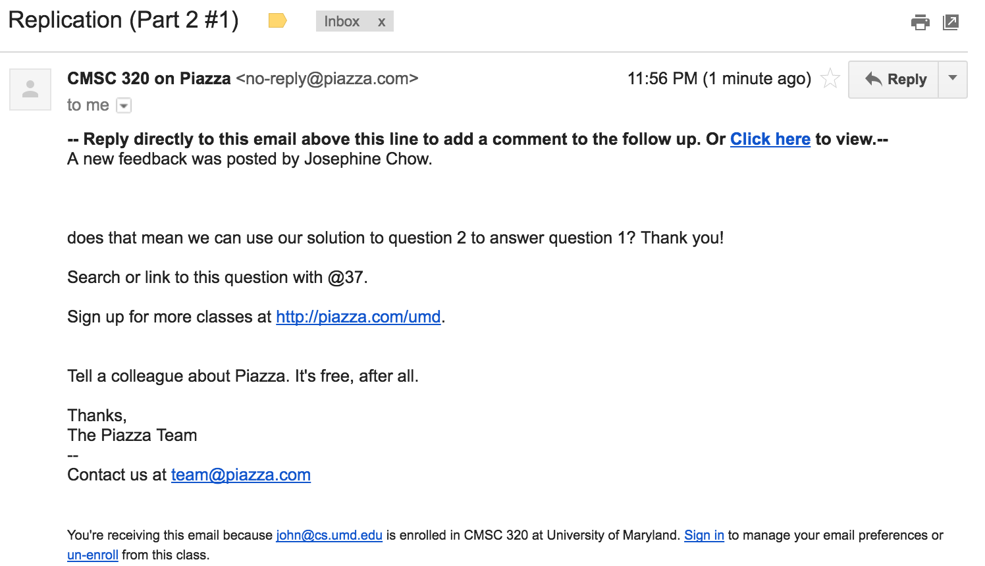
“Some Signal”
or
Possible signals ?????????

Slide 39

“Some Signal”
What type of article is this?
Sports
Political
Dark comedy
What entities are covered?
And are they covered with positive or negative sentiment?
Possible signals ????????

Slide 40
Aside: Terminology
Documents: groups of free text
Actual documents (NYT article, journal paper)
Entries in a table
Corpus: a collection of documents
Terms: individual words
Separated by whitespace or punctuation

Slide 41
NLP Tasks
Syntax: refers to the grammatical structure of language
The rules via which one forms sentences/expressions
Semantics: the study of meaning of language
John is rectangular and a rainbow.
Syntactically correct
Semantically meaningless

Slide 42
Syntax
Tokenization
  Splitting sentences into tokens
Lemmatization/Stemming
  Turning “organizing” and “organized” into “organiz”
Morphological Segmentation
  How words are formed, and relationships of different parts
  Easy for English, but other languages are difficult
Part-of-speech (POS) Tagging
  Determine whether a word is a noun/adverb/verb etc.
Parsing
  Create a “parse tree” for a sentence

Slide 43
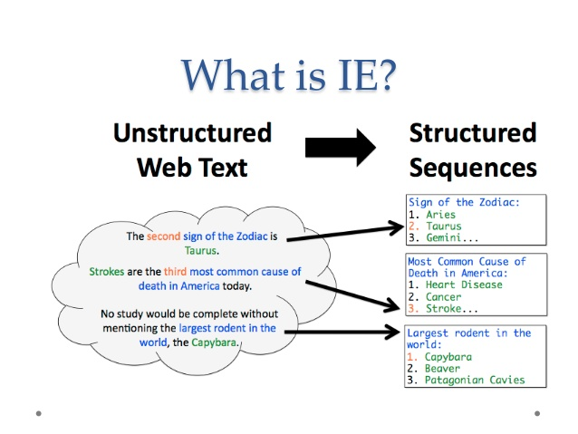
Semantics: information extraction

Slide 44
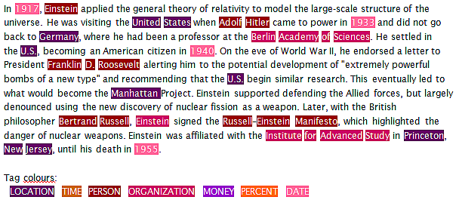
Semantics: named entity recognition
Identifying key entities in text

Slide 45
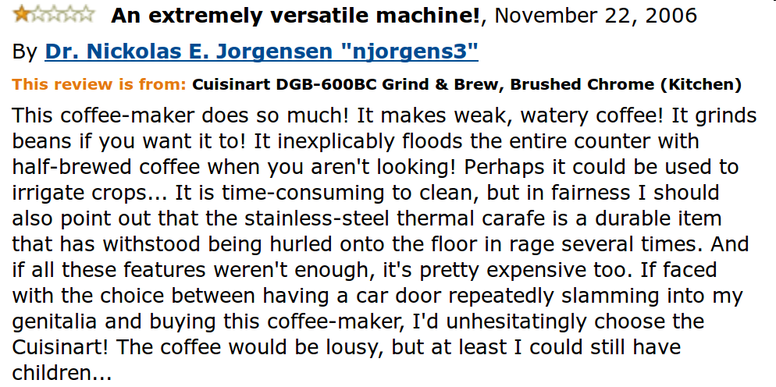
Semantics: sentiment analysis
Deciding if reviews/opinions are positive or negative
Heavily used by ad industry today

Slide 46
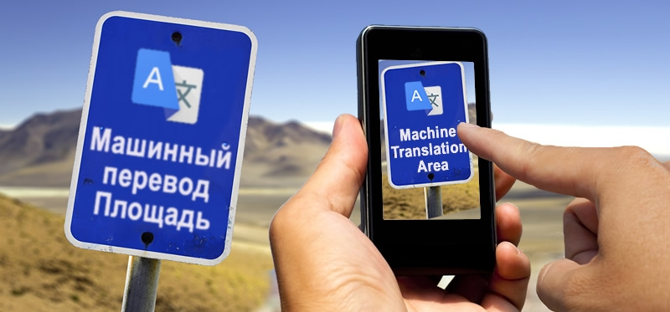
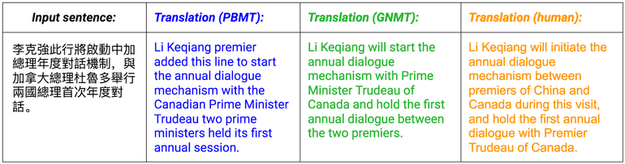
Semantics: Machine translation
Translating from one language to another
Simple substitution of words doesn’t work very well
(Image: Google)

Slide 47
Semantics: Machine translation
0> how long before the next flight to Alice Springs?
1> wie lang vor dem folgenden Flug zu Alice Springs?
2> how long before the following flight to Alice jump?
3> wie lang vor dem folgenden Flug zu Alice springen Sie?
4> how long before the following flight to Alice do you jump?
5> wie lang, bevor der folgende Flug zu Alice tun, Sie springen?
6> how long, before the following flight to Alice does, do you jump?
7> wie lang bevor der folgende Flug zu Alice tut, tun Sie springen?
8> how long before the following flight to Alice does, do you jump?
9> wie lang, bevor der folgende Flug zu Alice tut, tun Sie springen?
10> how long, before the following flight does to Alice, do do you jump?
11> wie lang bevor der folgende Flug zu Alice tut, Sie tun Sprung?
12> how long before the following flight does leap to Alice, does you?
From NLTK Book

Slide 48
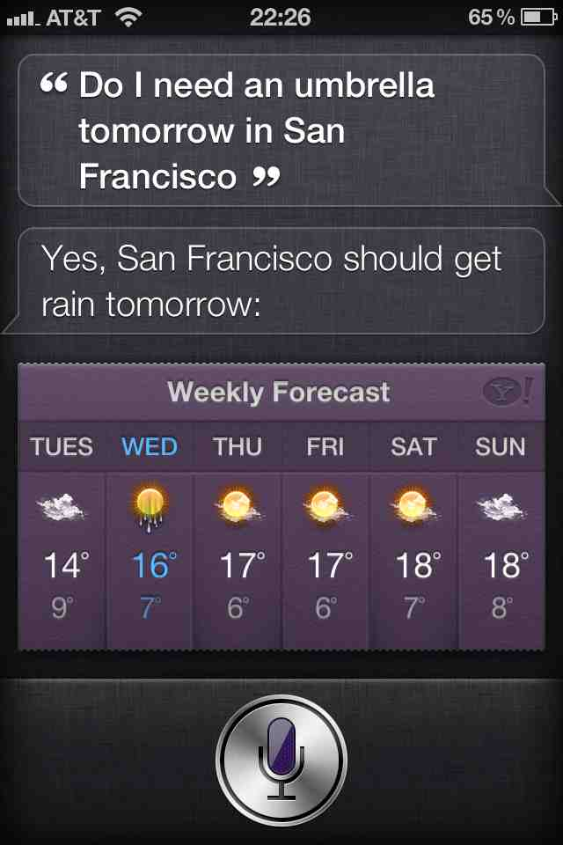
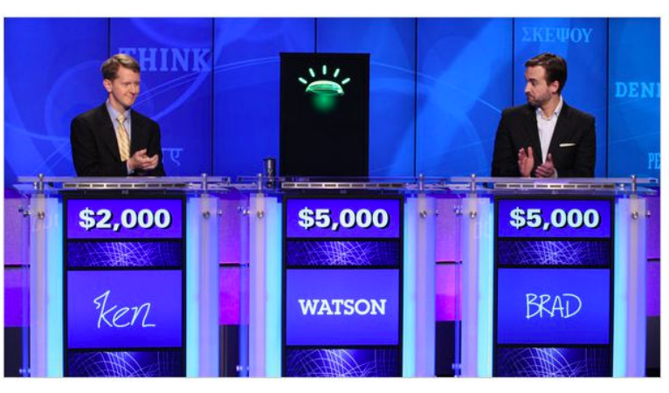
Semantics: question answering
Answer questions posed a user with specific answers
WILLIAM WILKINSON’S
“AN ACCOUNT OF THE PRINCIPALITIES OF
WALLACHIA AND MOLDOVIA”
INSPIRED THIS AUTHOR’S
MOST FAMOUS NOVEL
Bram Stoker

Slide 49
Semantics: question answering
Answer questions posed a user with specific answers
Factoid questions
  Who wrote “The Universal Declaration of Human Rights”?
  How many calories are there in two slices of apple pie?
  What is the average age of the onset of autism?
  Where is Apple Computer based?
Complex (narrative) questions:
  In children with an acute febrile illness, what is the efficacy of acetaminophen in reducing fever?
  What do scholars think about Jefferson’s position on dealing with pirates?

Slide 50
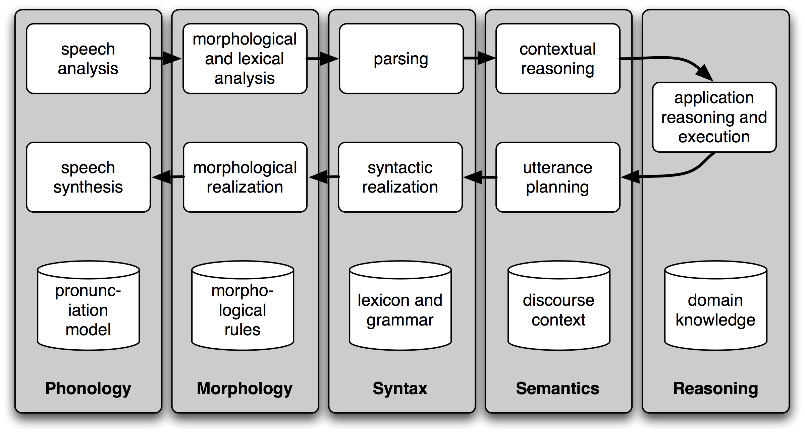
Semantics: Spoken Dialogue Systems

Slide 51
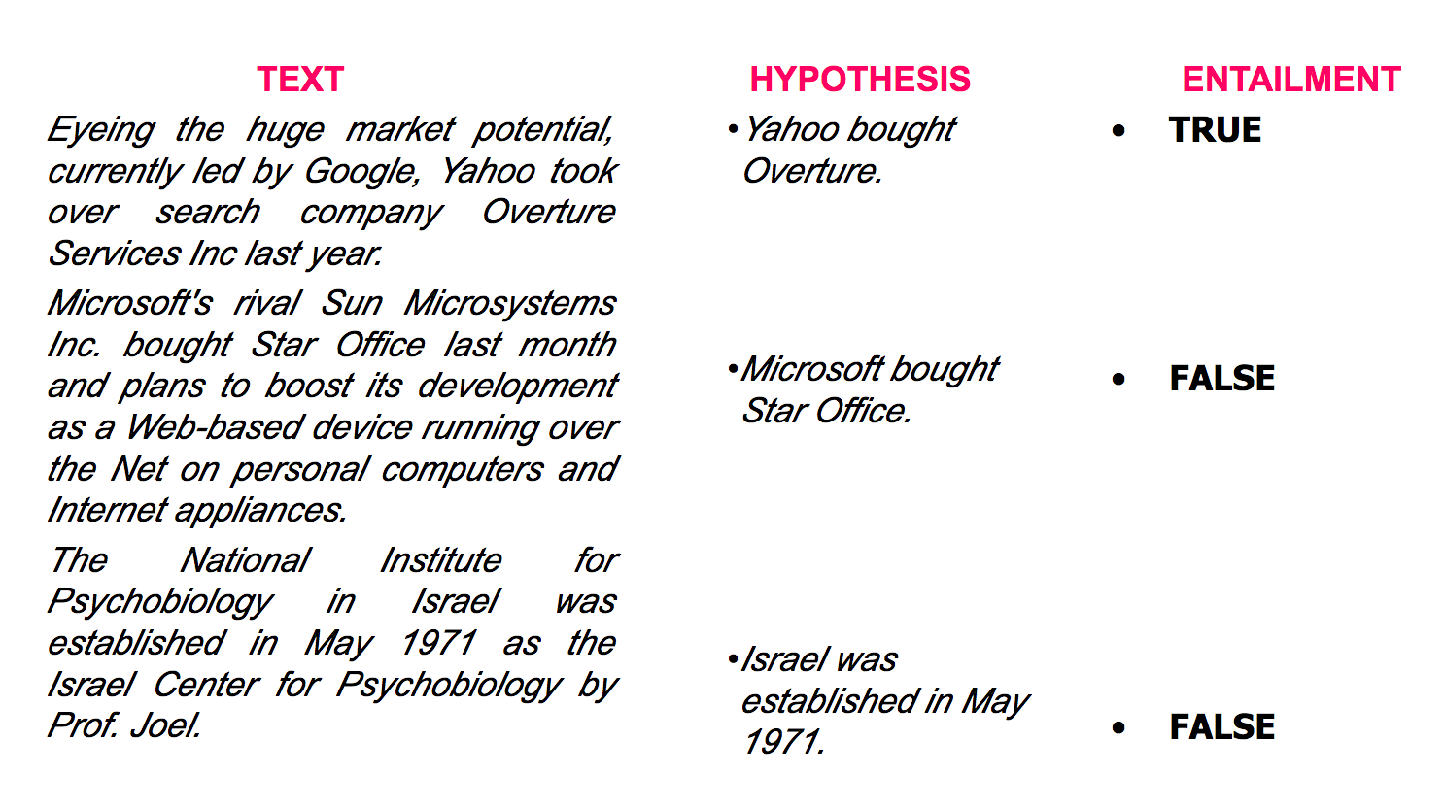
Semantics: textual entailment
Given two text fragments, determine if one being true entails the other, entails the other's negation, or allows the other to be either true or false

Slide 52
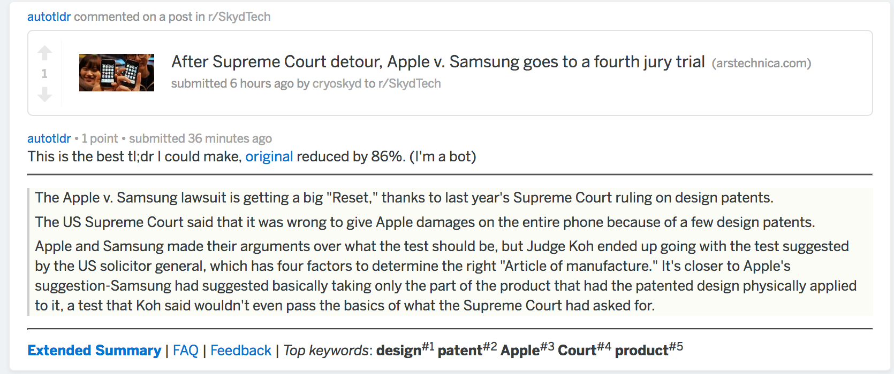
Semantics: document summarization
Quite a few tools out there today… e.g., SMMRY

Slide 53
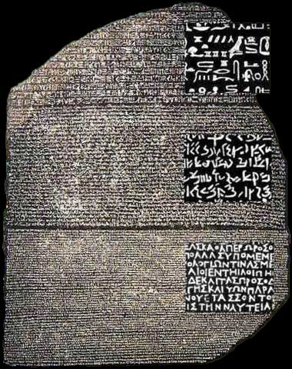
Other tasks
Speech Recognition
Caption Generation
Natural Language Generation
Optical Character Recognition
Word Sense Disambiguation
  serve: help with food or drink; hold an office; put ball into play
…
Doing all of these for many different languages

Slide 54
Semantics: Text classification
Is it spam?
Who wrote this paper? (Author identification)
https://en.wikipedia.org/wiki/The_Federalist_Papers#Authorship
https://www.uwgb.edu/dutchs/pseudosc/hidncode.htm
¡Identificación del idioma!
Sentiment analysis
What type of document is this?
When was this document written?
Readability assessment

Slide 55
Text classification
Input:
A document w
A set of classes Y = {y₁, y₂, …, y_{J}}
Output:
A predicted class y ∈ Y
(You will spend much more time on classification problems throughout the program, this is just a light intro!)

Slide 56
Text classification
Hand-coded rules based on combinations of terms (and possibly other context)
If email w:
Sent from a DNSBL (DNS blacklist) OR
Contains “Nigerian prince” OR
Contains URL with Unicode OR …
Then: y_{w} = spam
Pros: ?????????
Domain expertise, human-understandable
Cons: ?????????
Brittle, expensive to maintain, overly conservative

Slide 57
Text classification
Input:
A document w
A set of classes Y = {y₁, y₂, …, y_{J}}
A training set of m hand-labeled documents
{(w₁, y₁), (w₂, y₂), …, (w_{m}, y_{m})}
Output:
A learned classifier w → y
This is an example of supervised learning

Slide 58
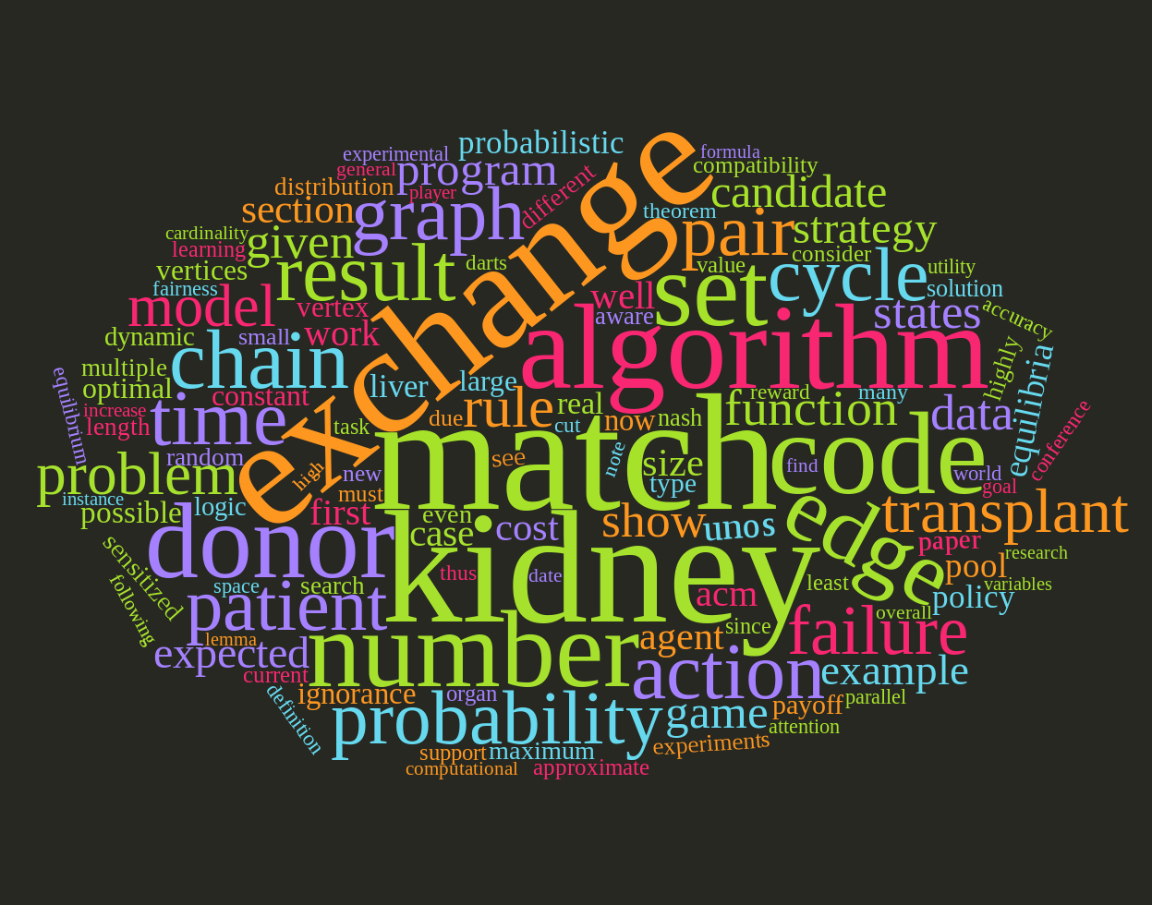
Representing a document “in math”
Simplest method: bag of words
Represent each document as a vector of word frequencies
Order of words does not matter, just #occurrences

Slide 59
Bag of words Example
the quick brown fox jumps over the lazy dog
I am he as you are he as you are me
he said the CMSC641 is 510 more CMSCs than the CMSC131
the | CMSC641 | you | he | I | quick | dog | me | CMSCs | … | than
2 | 0 | 0 | 0 | 0 | 1 | 1 | 0 | 0 | … | 0
0 | 0 | 2 | 2 | 1 | 0 | 0 | 1 | 0 |  | 0
2 | 1 | 0 | 1 | 0 | 0 | 0 | 0 | 1 |  | 1
Document 1
Document 2
Document 3

Slide 60
Term Frequency
Term frequency: the number of times a term appears in a specific document
tf_{ij}: frequency of word j in document i
This can be the raw count (like in the BOW in the last slide):
tf_{ij} ∈ {0,1} if word j appears or doesn’t appear in doc i
log(1 + tf_{ij}) – reduce the effect of outliers
tf_{ij} / max_{j} tf_{ij} – normalize by document i’s most frequent word
What can we do with this?
Use as features to learn a classifier w → y …!

Slide 61
Defining features From Term Frequency
Suppose we are classifying if a document was written by The Beatles or not (i.e., binary classification):
Two classes y ∈ Y = { 0, 1 } = { not_beatles, beatles }
Let’s use tf_{ij} ∈ {0,1}, which gives:
Then represent documents with a feature function:
f(x, y = not_beatles = 0) = [x^{T}, 0^{T}, 1]^{T}
f(x, y = beatles = 1) = [0^{T}, x^{T}, 1]^{T}
the | CMSC641 | you | he | I | quick | dog | me | CMSCs | … | than
1 | 0 | 0 | 0 | 0 | 1 | 1 | 0 | 0 | … | 0
0 | 0 | 1 | 1 | 1 | 0 | 0 | 1 | 0 |  | 0
1 | 1 | 0 | 1 | 0 | 0 | 0 | 0 | 1 |  | 1
x₁^{T} =
y₁ = 0
x₂^{T} =
y₂ = 1
x₃^{T} =
y₃ = 0

Slide 62
Linear classification
We can then define weights θ for each feature
θ = { <CMSC641, not_beatles> = +1,
<CMSC641, beatles> = -1,
<walrus, not_beatles> = -0.3,
<walrus, beatles> = +1,
<the, not_beatles> = 0,
<the, beatles>, 0, … }
Write weights as vector that aligns with feature mapping
Score 𝝍 of an instance x and class y is the sum of the weights for the features in that class:
𝝍_{xy} = Σ θ_{n} f_{n}(x, y)
= θ^{T} f(x, y)

Slide 63
Linear classification
We have a feature function f(x, y) and a score 𝝍_{xy} = θ^{T} f(x, y)
And return the class with highest score!
Compute the score of the document for that class
For each class y ∈ { not_beatles, beatles }
Where did these weights come from? We’ll talk about this in the ML lectures …
(… and also this whole “linear classifier” thing.)

Slide 64
Inverse Document Frequency
Recall:
tf_{ij}: frequency of word j in document i
Any issues with this ??????????
Term frequency gets overloaded by common words
Inverse Document Frequency (IDF): weight individual words negatively by how frequently they appear in the corpus:
IDF is just defined for a word j, not word/document pair j, i

Slide 65
Inverse Document Frequency
the | CMSC641 | you | he | I | quick | dog | me | CMSCs | … | than
2 | 0 | 0 | 0 | 0 | 1 | 1 | 0 | 0 | … | 0
0 | 0 | 2 | 2 | 1 | 0 | 0 | 1 | 0 |  | 0
2 | 1 | 0 | 1 | 0 | 0 | 0 | 0 | 1 |  | 1
Document 1
Document 2
Document 3

Slide 66
TF-IDF
How do we use the IDF weights?
Term frequency inverse document frequency (TF-IDF):
TF-IDF score: tf_{ij} x idf_{j}
This ends up working better than raw scores for classification and for computing similarity between documents.
the | CMSC641 | you | he | I | quick | dog | me | CMSCs | … | than
0.8 | 0 | 0 | 0 | 0 | 1.1 | 1.1 | 0 | 0 | … | 0
0 | 0 | 2.2 | 0.8 | 1.1 | 0 | 0 | 1.1 | 0 |  | 0
0.8 | 1.1 | 0 | 0.4 | 0 | 0 | 0 | 0 | 1.1 |  | 1.1
Document 1
Document 2
Document 3

Slide 67
Similarity between Documents
Given two documents x and y, represented by their TF-IDF vectors (or any vectors), the cosine similarity is:
Formally, it measures the cosine of the angle between two vectors x and y:
cos(0º) = 1, cos(90º) = 0 ??????????
Similar documents have high cosine similarity;
dissimilar documents have low cosine similarity.

Slide 68
Tokenization
First step towards text processing
For English, just split on non-alphanumerical characters
  Need to deal with cases like: I’m, or France’s, or Hewlett-Packard
  Should “San Francisco” be one token or two?
Other languages introduce additional issues
  L'ensemble → one token or two?
  German noun compounds are not segmented
    Lebensversicherungsgesellschaftsangestellter
  Chinese/Japanese more complicated because of white spaces

Slide 69
Other basic terms
Lemmatization
  Reduce inflections or variant forms to base form
    am, are, is → be
    car, cars, car's, cars' → car
  the boy's cars are different colors → the boy car be different color
Morphology/Morphemes
  The small meaningful units that make up words
  Stems: The core meaning-bearing units
  Affixes: Bits and pieces that adhere to stems
    Often with grammatical functions

Slide 70
Stemming
Reduce terms to their stems in information retrieval
Stemming is crude chopping of affixes
  language dependent
  e.g., automate(s), automatic, automation all reduced to automat.
for example compressed
and compression are both
accepted as equivalent to
compress.
for exampl compress and
compress ar both accept
as equival to compress

Slide 71
(Minimum) Edit distance
How similar are two strings?
Many different distance metrics (as we saw earlier when discussing entity resolution
  Typically based on the number of edit operations needed to transform from one to the other
Useful in NLP context for spelling correction, information extraction, speech recognition, etc.

Slide 72
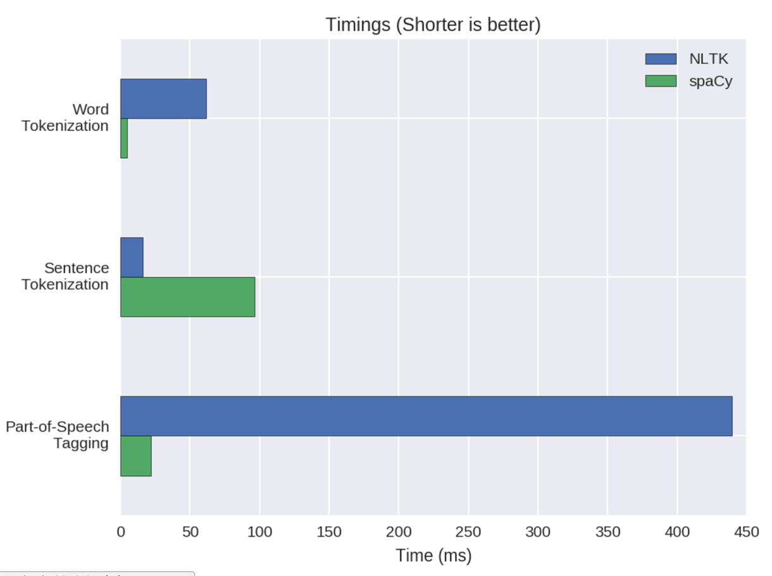
NLP in Python
Two majors libraries for performing basic NLP in Python:
Natural Language Toolkit (NLTK): started as research code, now widely used in industry and research
Spacy: much newer implementation, more streamlined
Pros and cons to both:
NLTK has more “stuff” implemented, is more customizable
  This is a blessing and a curse
Spacy is younger and feature
sparse, but can be much faster
Both are Anaconda packages

Slide 73
NLTK examples
import nltk
# Tokenize, aka find the terms in, a sentence
sentence = ”A wizard is never late, nor is he early. He arrives precisely when he means to.”
tokens = nltk.word_tokenize(sentence)
LookupError:
**********************************************************************
Resource 'tokenizers/punkt/PY3/english.pickle' not found.
Please use the NLTK Downloader to obtain the resource: >>>
nltk.download()
Searched in:
- '/Users/spook/nltk_data'
- '/usr/share/nltk_data'
- '/usr/local/share/nltk_data'
- '/usr/lib/nltk_data'
- '/usr/local/lib/nltk_data'
- ''
**********************************************************************
Fool of a Took!

Slide 74
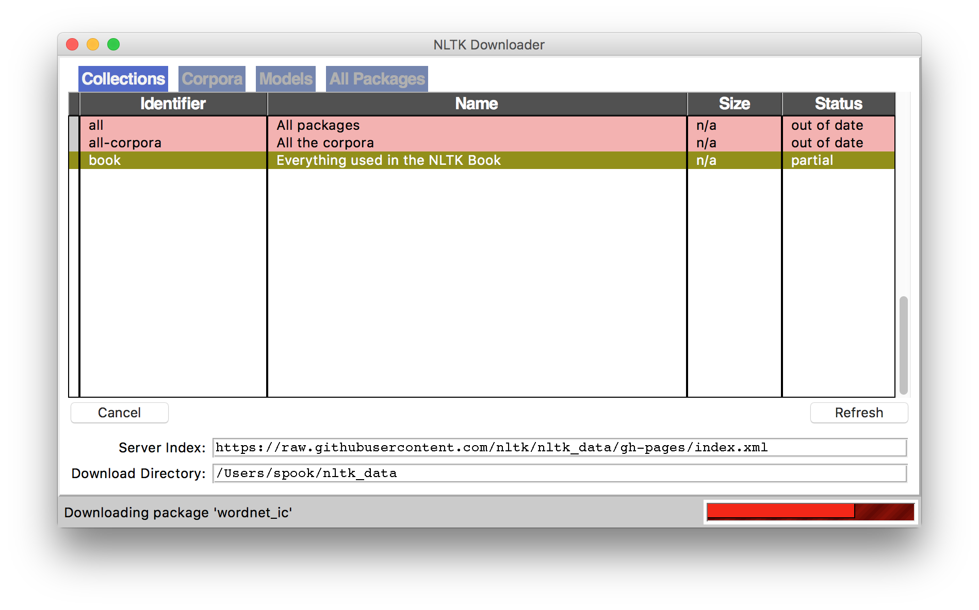
NLTK Examples
Corpora are, by definition, large bodies of text
NLTK relies on a large corpus set to perform various functionalities; you can pick and choose:
# Launch a GUI browser of available corpora
nltk.download()
# Or download everything at once!
nltk.download(“all”)

Slide 75
NLTK Examples
import nltk
# Tokenize, aka find the terms in, a sentence
sentence = ”A wizard is never late, nor is he early. He arrives precisely when he means to.”
tokens = nltk.word_tokenize(sentence)
['A', 'wizard', 'is', 'never', 'late', ',', 'nor', 'is', 'he', 'early', '.', 'He', 'arrives', 'precisely', 'when', 'he', 'means', 'to', '.']
(This will also tokenize words like “o’clock” into one term, and “didn’t” into two term, “did” and “n’t”.)

Slide 76
NLTK Examples
# Determine parts of speech (POS) tags
tagged = nltk.pos_tag(tokens)
tagged[:10]
[('A', 'DT'), ('wizard', 'NN'), ('is', 'VBZ'), ('never', 'RB'), ('late', 'RB'), (',', ','), ('nor', 'CC'), ('is', 'VBZ'), ('he', 'PRP'), ('early', 'RB')]
Abbreviation | POS
DT | Determiner
NN | Noun
VBZ | Verb (3rd person singular present)
RB | Adverb
CC | Conjunction
PRP | Personal Pronoun
Full list: https://cs.nyu.edu/grishman/jet/guide/PennPOS.html

Slide 77
NLTK Examples
# Find named entities & visualize
entities = nltk.chunk.ne_chunk( nltk.pos_tag( nltk.word_tokenize(“””
The Shire was divided into four quarters, the Farthings already referred to. North, South, East, and West; and these again each into a number of folklands, which still bore the names of some of the old leading families, although by the time of this history these names were no longer found only in their proper folklands. Nearly all Tooks still lived in the Tookland, but that was not true of many other families, such as the Bagginses or the Boffins. Outside the Farthings were the East and West Marches: the Buckland (see beginning of Chapter V, Book I); and the Westmarch added to the Shire in S.R. 1462.
“””)))
entities.draw()

Slide 78
Brief Aside: n-grams
n-gram: Contiguous sequence of n tokens/words etc.
Unigram, bigram, trigram, “four-gram”, “five-gram”, …
Text: David Golinkin is the editor or author of eighteen books, and over 150 responsa, articles, sermons and books

Slide 79
Language Modeling
Assign a probability to a sentence
  Machine Translation:
    P(high winds tonite) > P(large winds tonite)
  Spell Correction
    The office is about fifteen minuets from my house
      P(about fifteen minutes from) > P(about fifteen minuets from)
  Speech Recognition
    P(I saw a van) >> P(eyes awe of an)
  + Summarization, question-answering, etc., etc.!!

Slide 80
Language Modeling
Goal: compute the probability of a sentence or sequence of words:
P(W) = P(w₁,w₂,w₃,w₄,w₅…w_{n})
Related task: probability of an upcoming word:
P(w₅|w₁,w₂,w₃,w₄)
A model that computes either of these:
P(W) or P(w_{n}|w₁,w₂…w_{n-1}) is called a language model.
(We won’t talk about this much further in this class.)

Slide 81
Simplest case:
Unigram model
Some automatically generated sentences from a unigram model
fifth, an, of, futures, the, an, incorporated, a, a, the, inflation, most, dollars, quarter, in, is, mass
thrift, did, eighty, said, hard, 'm, july, bullish
that, or, limited, the

Slide 82
Bigram Model
Condition on the previous word:
texaco, rose, one, in, this, issue, is, pursuing, growth, in, a, boiler, house, said, mr., gurria, mexico, 's, motion, control, proposal, without, permission, from, five, hundred, fifty, five, yen
outside, new, car, parking, lot, of, the, agreement, reached
this, would, be, a, record, november

Slide 83
N-gram models
We can extend to trigrams, 4-grams, 5-grams
In general this is an insufficient model of language
  because language has long-distance dependencies:
  “The computer which I had just put into the machine room on the fifth floor crashed.”
But we can often get away with N-gram models

