Slide 1
Principles of
Data Science
John P Dickerson
Lecture #9 – 10/24/2018
CMSC641
Wednesdays
7:00pm – 9:30pm

Slide 2
Announcements
Mini-Project #2 was due today!
Mini-Project #3 is not out yet! But will be soon …
It is linked to from ELMS; will be available at: https://github.com/umddb/cmsc641-fall2018/tree/master/project3
Deliverable is a .ipynb file submitted to ELMS
Due Wednesday, November 14th
After this: final tutorials!

Slide 3
The Mini-Tutorial
In lieu of a final exam, you’ll create a mini-tutorial that:
Identifies a raw data source
Processes and stores that data
Performs exploratory data analysis & visualization
Derives insight(s) using statistics and ML
Communicates those insights as actionable text
Individual or group project
Will be hosted publicly online (GitHub Pages) and will strengthen your portfolio.

Slide 4
Ready-Made Dataset repositories
https://www.data.gov/
US-centric agriculture, climate, education, energy, finance, health, manufacturing data, …
https://cloud.google.com/bigquery/public-data/
BigQuery (Google Cloud) public datasets (bikeshare, GitHub, Hacker News, Form 990 non-profits, NOAA, …)
https://www.kaggle.com/datasets
Microsoft-owned, various (Billboard Top 100 lyrics, credit card fraud, crime in Chicago, global terrorism, world happiness, …)
https://aws.amazon.com/public-datasets/
AWS-hosted, various (NASA, a bunch of genome stuff, Google Books n-grams, Multimedia Commons, …)

Slide 5
New Dataset Ideas
Fraternal Order of Police vs Black Lives Matter
Linking finance data to ${anything_else}
Something having to do with Pokémon statistics?
Look through http://www.alexa.com/topsites and scrape something interesting!
University of Maryland-related, or College Park-related, stuff
Check out http://umd.io/ – open source project; maybe your data collection and cleaning scripts can be added to this!
Honestly, pretty much anything! Just document everything.
Reproducibility!

Slide 6
Final Tutorial
Deliverable: URL of your own GitHub Pages site hosting an .ipynb/.html export of your final tutorial
https://pages.github.com/ – make a GitHub account, too!
https://github.com/blog/1995-github-jupyter-notebooks-3
The project itself:
~1500+ words of Markdown prose
~150+ lines of Python
Should be viewable as a static webpage – that is, if I (or anyone else) opens the link up, everything should render and I shouldn’t have to run any cells to generate output

Slide 7
Final Tutorial Rubric
I will grade on a scale of 1-10:
Motivation: Does the tutorial make the reader believe the topic is important (a) in general and (b) with respect to data science?
Understanding: After reading the tutorial, does the reader understand the topic?
Further resources: Does the tutorial “call out” to other resources that would help the reader understand basic concepts, deep dive, related work, etc?
Prose: Does the prose in the Markdown portion of the .ipynb add to the reader’s understanding of the tutorial?
Code: Does the code help solidify understanding, is it well documented, and does it include helpful examples?
Subjective Evaluation: If somebody linked to this tutorial from Hacker News, would people actually read the whole thing?

Slide 8
Wrap-up From last Lecture …
Data collection
Data processing
Exploratory analysis
&
Data viz
Analysis, hypothesis testing, & ML
Insight & Policy Decision

Slide 9
Continuing from last class …
Words words words!
Free text and natural language processing in data science
Bag of words and TF-IDF
N-Grams and language models
Information extraction & sentiment mining
Thanks to: Zico Kolter (CMU), Dan Jurafsky (Stanford), & Marine Carpuat’s 723 (UMD)

Slide 10
Text classification
Input:
A document w
A set of classes Y = {y₁, y₂, …, y_{J}}
A training set of m hand-labeled documents
{(w₁, y₁), (w₂, y₂), …, (w_{m}, y_{m})}
Output:
A learned classifier w → y
This is an example of supervised learning

Slide 11
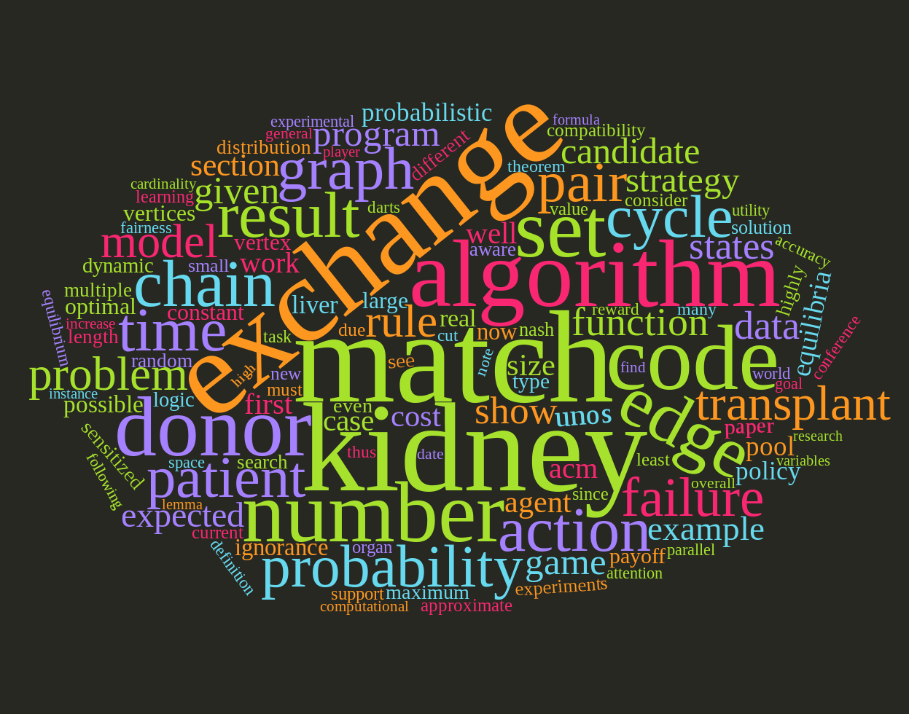
Representing a document “in math”
Simplest method: bag of words
Represent each document as a vector of word frequencies
Order of words does not matter, just #occurrences

Slide 12
Bag of words Example
the quick brown fox jumps over the lazy dog
I am he as you are he as you are me
he said the CMSC641 is 510 more CMSCs than the CMSC131
the | CMSC641 | you | he | I | quick | dog | me | CMSCs | … | than
2 | 0 | 0 | 0 | 0 | 1 | 1 | 0 | 0 | … | 0
0 | 0 | 2 | 2 | 1 | 0 | 0 | 1 | 0 |  | 0
2 | 1 | 0 | 1 | 0 | 0 | 0 | 0 | 1 |  | 1
Document 1
Document 2
Document 3

Slide 13
Term Frequency
Term frequency: the number of times a term appears in a specific document
tf_{ij}: frequency of word j in document i
This can be the raw count (like in the BOW in the last slide):
tf_{ij} ∈ {0,1} if word j appears or doesn’t appear in doc i
log(1 + tf_{ij}) – reduce the effect of outliers
tf_{ij} / max_{j} tf_{ij} – normalize by document i’s most frequent word
What can we do with this?
Use as features to learn a classifier w → y …!

Slide 14
Defining features From Term Frequency
Suppose we are classifying if a document was written by The Beatles or not (i.e., binary classification):
Two classes y ∈ Y = { 0, 1 } = { not_beatles, beatles }
Let’s use tf_{ij} ∈ {0,1}, which gives:
Then represent documents with a feature function:
f(x, y = not_beatles = 0) = [x^{T}, 0^{T}, 1]^{T}
f(x, y = beatles = 1) = [0^{T}, x^{T}, 1]^{T}
the | CMSC641 | you | he | I | quick | dog | me | CMSCs | … | than
1 | 0 | 0 | 0 | 0 | 1 | 1 | 0 | 0 | … | 0
0 | 0 | 1 | 1 | 1 | 0 | 0 | 1 | 0 |  | 0
1 | 1 | 0 | 1 | 0 | 0 | 0 | 0 | 1 |  | 1
x₁^{T} =
y₁ = 0
x₂^{T} =
y₂ = 1
x₃^{T} =
y₃ = 0

Slide 15
Linear classification
We can then define weights θ for each feature
θ = { <CMSC641, not_beatles> = +1,
<CMSC641, beatles> = -1,
<walrus, not_beatles> = -0.3,
<walrus, beatles> = +1,
<the, not_beatles> = 0,
<the, beatles>, 0, … }
Write weights as vector that aligns with feature mapping
Score 𝝍 of an instance x and class y is the sum of the weights for the features in that class:
𝝍_{xy} = Σ θ_{n} f_{n}(x, y)
= θ^{T} f(x, y)

Slide 16
Linear classification
We have a feature function f(x, y) and a score 𝝍_{xy} = θ^{T} f(x, y)
And return the class with highest score!
Compute the score of the document for that class
For each class y ∈ { not_beatles, beatles }
Where did these weights come from? We’ll talk about this in the ML lectures …
(… and also this whole “linear classifier” thing.)

Slide 17
Explicit Example
We are interested in classifying documents into one of two classes y ∈ Y = { 0, 1 } = { hates_cats, likes_cats}
Document 1: I like cats
Document 2: I hate cats
Now, represent documents with a feature function:
f(x, y = hates_cats = 0) = [x^{T}, 0^{T}, 1]^{T}
f(x, y = likes_cats = 1) = [0^{T}, x^{T}, 1]^{T}
I | like | hate | cats
1 | 1 | 0 | 1
1 | 0 | 1 | 1
x₁^{T} =
y₁ = ?
x₂^{T} =
y₂ = ?

Slide 18
Explicit Example
I | like | hate | cats
1 | 1 | 0 | 1
1 | 0 | 1 | 1
f(x, y = 0) = [x^{T}, 0^{T}, 1]^{T}
f(x, y = 1) = [0^{T}, x^{T}, 1]^{T}
x₁^{T} =
y₁ = ?
x₂^{T} =
y₂ = ?
y=0: hates_cats
y=1: likes_cats
(1)
I | like | hate | cats | I | like | hate | cats | --
1 | 1 | 0 | 1 | 0 | 0 | 0 | 0 | 1
0 | 0 | 0 | 0 | 1 | 1 | 0 | 1 | 1
1 | 0 | 1 | 1 | 0 | 0 | 0 | 0 | 1
0 | 0 | 0 | 0 | 1 | 0 | 1 | 1 | 1
f(x₁, y = hates_cats = 0) =
f(x₁, y = likes_cats = 1) =
f(x₂, y = hates_cats = 0) =
f(x₂, y = likes_cats = 1) =

Slide 19
Explicit Example
Now, assume we have weights θ for each feature
θ = { <I, hates_cats> = 0, <I, likes_cats> = 0,
<like, hates_cats> = -1, <like, likes_cats> = +1,
<hate, hates_cats> = +1, <hate, likes_cats> = -1,
<cats, hates_cats> = -0.1, <cats, likes_cats = +0.5> }
Write weights as vector that aligns with feature mapping:
y=0: hates_cats
y=1: likes_cats
(1)
Parameter vector θ ^{T} =
0 | -1 | 1 | -0.1 | 0 | 1 | -1 | 0.5 | 1
I | like | hate | cats | I | like | hate | cats | --
1 | 1 | 0 | 1 | 0 | 0 | 0 | 0 | 1
0 | 0 | 0 | 0 | 1 | 1 | 0 | 1 | 1
1 | 0 | 1 | 1 | 0 | 0 | 0 | 0 | 1
0 | 0 | 0 | 0 | 1 | 0 | 1 | 1 | 1
f(x₁, y = hates_cats = 0) =
f(x₁, y = likes_cats = 1) =
f(x₂, y = hates_cats = 0) =
f(x₂, y = likes_cats = 1) =

Slide 20
Explicit example
Score 𝝍 of an instance x and class y is the sum of the weights for the features in that class:
𝝍_{xy} = Σ θ_{n} f_{n}(x, y)
= θ^{T} f(x, y)
Let’s compute 𝝍_{x1,y=hates_cats} …
𝝍_{x1,y=hates_cats} = θ^{T} f(x₁, y = hates_cats = 0)
= 0*1 + -1*1 + 1*0 + -0.1*1 + 0*0 + 1*0 + -1*0 + 0.5*0 + 1*1
= -1 - 0.1 + 1 = -0.1
1 | I
1 | like
0 | hate
1 | cats
0 | I
0 | like
0 | hate
0 | cats
1 | –
hates_cats
likes_cats
θ ^{T} =
0 | -1 | 1 | -0.1 | 0 | 1 | -1 | 0.5 | 1
(1)
f(x₁, y = 0)

Slide 21
Explicit example
Saving the boring stuff:
𝝍_{x1,y=hates_cats} = -0.1; 𝝍_{x1,y=likes_cats} = +2.5
𝝍_{x2,y=hates_cats} = +1.9; 𝝍_{x2,y=likes_cats} = +0.5
We want to predict the class of each document:
Document 1: argmax{ 𝝍_{x1,y=hates_cats}, 𝝍_{x1,y=likes_cats} } ????????
Document 2: argmax{ 𝝍_{x2,y=hates_cats}, 𝝍_{x2,y=likes_cats} } ????????
Document 1: I like cats
Document 2: I hate cats

Slide 22
Inverse Document Frequency
Recall:
tf_{ij}: frequency of word j in document i
Any issues with this ??????????
Term frequency gets overloaded by common words
Inverse Document Frequency (IDF): weight individual words negatively by how frequently they appear in the corpus:
IDF is just defined for a word j, not word/document pair j, i

Slide 23
Inverse Document Frequency
the | CMSC641 | you | he | I | quick | dog | me | CMSCs | … | than
2 | 0 | 0 | 0 | 0 | 1 | 1 | 0 | 0 | … | 0
0 | 0 | 2 | 2 | 1 | 0 | 0 | 1 | 0 |  | 0
2 | 1 | 0 | 1 | 0 | 0 | 0 | 0 | 1 |  | 1
Document 1
Document 2
Document 3

Slide 24
TF-IDF
How do we use the IDF weights?
Term frequency inverse document frequency (TF-IDF):
TF-IDF score: tf_{ij} x idf_{j}
This ends up working better than raw scores for classification and for computing similarity between documents.
the | CMSC641 | you | he | I | quick | dog | me | CMSCs | … | than
0.8 | 0 | 0 | 0 | 0 | 1.1 | 1.1 | 0 | 0 | … | 0
0 | 0 | 2.2 | 0.8 | 1.1 | 0 | 0 | 1.1 | 0 |  | 0
0.8 | 1.1 | 0 | 0.4 | 0 | 0 | 0 | 0 | 1.1 |  | 1.1
Document 1
Document 2
Document 3

Slide 25
Tokenization
First step towards text processing
For English, just split on non-alphanumerical characters
  Need to deal with cases like: I’m, or France’s, or Hewlett-Packard
  Should “San Francisco” be one token or two?
Other languages introduce additional issues
  L'ensemble → one token or two?
  German noun compounds are not segmented
    Lebensversicherungsgesellschaftsangestellter
  Chinese/Japanese more complicated because of white spaces

Slide 26
Other basic terms
Lemmatization
  Reduce inflections or variant forms to base form
    am, are, is → be
    car, cars, car's, cars' → car
  the boy's cars are different colors → the boy car be different color
Morphology/Morphemes
  The small meaningful units that make up words
  Stems: The core meaning-bearing units
  Affixes: Bits and pieces that adhere to stems
    Often with grammatical functions

Slide 27
Stemming
Reduce terms to their stems in information retrieval
Stemming is crude chopping of affixes
  language dependent
  e.g., automate(s), automatic, automation all reduced to automat.
for example compressed
and compression are both
accepted as equivalent to
compress.
for exampl compress and
compress ar both accept
as equival to compress

Slide 28
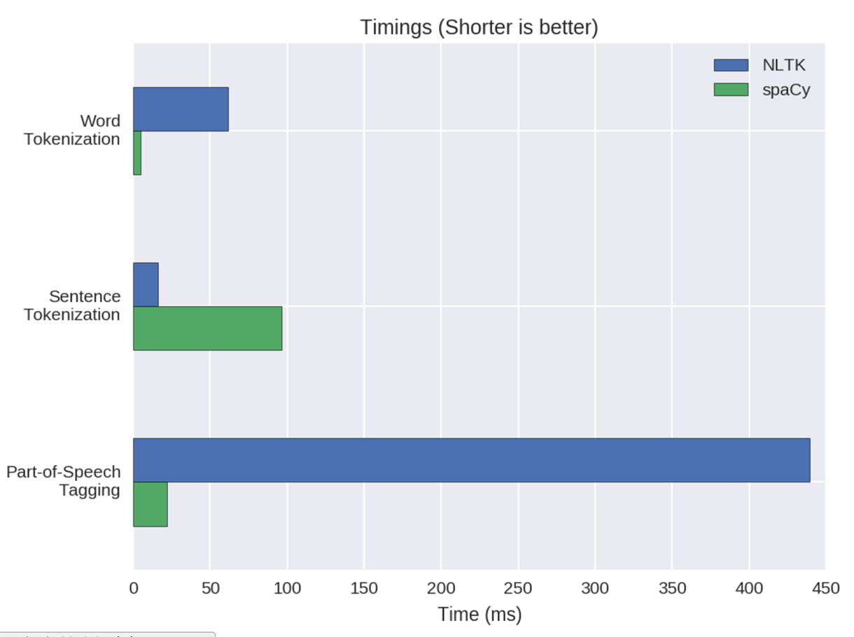
NLP in Python
Two majors libraries for performing basic NLP in Python:
Natural Language Toolkit (NLTK): started as research code, now widely used in industry and research
Spacy: much newer implementation, more streamlined
Pros and cons to both:
NLTK has more “stuff” implemented, is more customizable
  This is a blessing and a curse
Spacy is younger and feature
sparse, but can be much faster
Both are Anaconda packages

Slide 29
NLTK examples
import nltk
# Tokenize, aka find the terms in, a sentence
sentence = ”A wizard is never late, nor is he early. He arrives precisely when he means to.”
tokens = nltk.word_tokenize(sentence)
LookupError:
**********************************************************************
Resource 'tokenizers/punkt/PY3/english.pickle' not found.
Please use the NLTK Downloader to obtain the resource: >>>
nltk.download()
Searched in:
- '/Users/spook/nltk_data'
- '/usr/share/nltk_data'
- '/usr/local/share/nltk_data'
- '/usr/lib/nltk_data'
- '/usr/local/lib/nltk_data'
- ''
**********************************************************************
Fool of a Took!

Slide 30
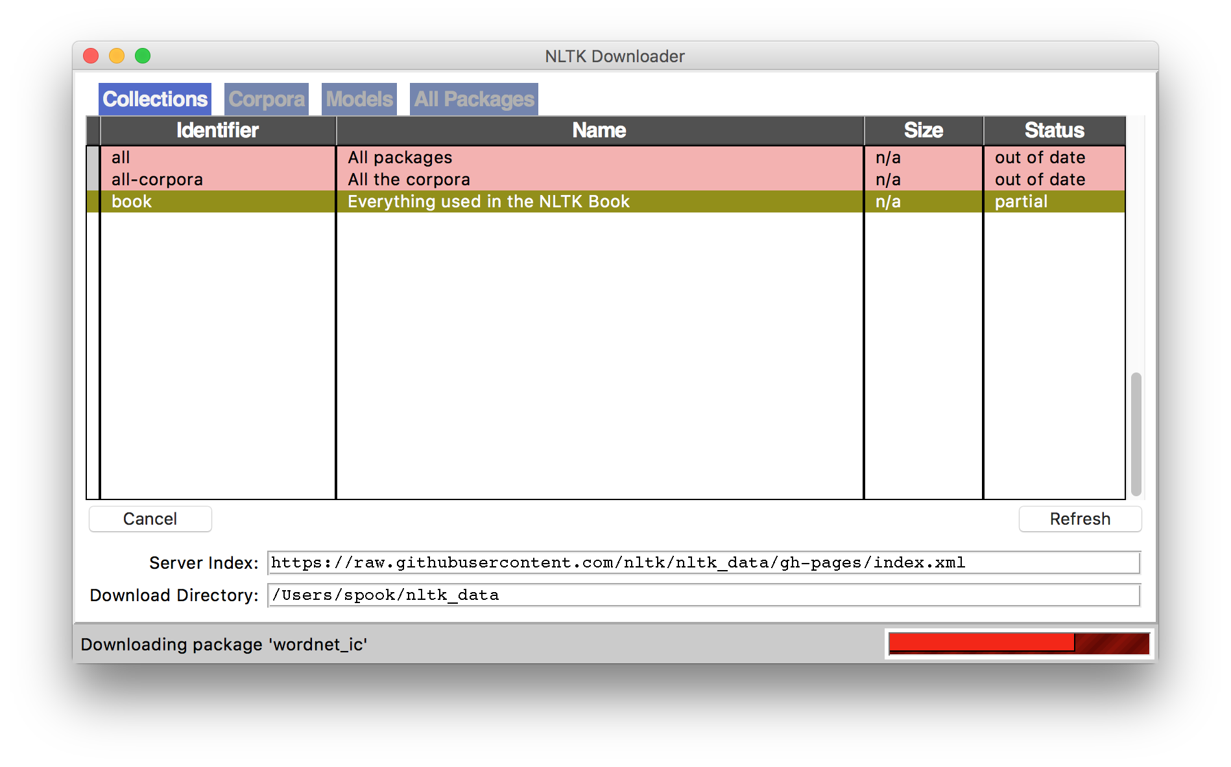
NLTK Examples
Corpora are, by definition, large bodies of text
NLTK relies on a large corpus set to perform various functionalities; you can pick and choose:
# Launch a GUI browser of available corpora
nltk.download()
# Or download everything at once!
nltk.download(“all”)

Slide 31
NLTK Examples
import nltk
# Tokenize, aka find the terms in, a sentence
sentence = ”A wizard is never late, nor is he early. He arrives precisely when he means to.”
tokens = nltk.word_tokenize(sentence)
['A', 'wizard', 'is', 'never', 'late', ',', 'nor', 'is', 'he', 'early', '.', 'He', 'arrives', 'precisely', 'when', 'he', 'means', 'to', '.']
(This will also tokenize words like “o’clock” into one term, and “didn’t” into two term, “did” and “n’t”.)

Slide 32
NLTK Examples
# Determine parts of speech (POS) tags
tagged = nltk.pos_tag(tokens)
tagged[:10]
[('A', 'DT'), ('wizard', 'NN'), ('is', 'VBZ'), ('never', 'RB'), ('late', 'RB'), (',', ','), ('nor', 'CC'), ('is', 'VBZ'), ('he', 'PRP'), ('early', 'RB')]
Abbreviation | POS
DT | Determiner
NN | Noun
VBZ | Verb (3rd person singular present)
RB | Adverb
CC | Conjunction
PRP | Personal Pronoun
Full list: https://cs.nyu.edu/grishman/jet/guide/PennPOS.html

Slide 33
NLTK Examples
# Find named entities & visualize
entities = nltk.chunk.ne_chunk( nltk.pos_tag( nltk.word_tokenize(“””
The Shire was divided into four quarters, the Farthings already referred to. North, South, East, and West; and these again each into a number of folklands, which still bore the names of some of the old leading families, although by the time of this history these names were no longer found only in their proper folklands. Nearly all Tooks still lived in the Tookland, but that was not true of many other families, such as the Bagginses or the Boffins. Outside the Farthings were the East and West Marches: the Buckland (see beginning of Chapter V, Book I); and the Westmarch added to the Shire in S.R. 1462.
“””)))
entities.draw()

Slide 34
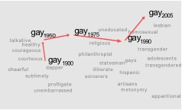
Brief Aside: vector Semantics of Docs/terms
“fast” is similar to “rapid”
“tall” is similar to “height”
Question answering:
Q: “How tall is Mt. Everest?”
Candidate A: “The official height of Mount Everest is 29029 feet”
[Kulkarni, Al-Rfou, Perozzi, Skiena 2015]
Many thanks to Dan Jurafsky here!

Slide 35
Distributional models of meaning
Distributional models of meaning
= vector-space models of meaning
= vector semantics
Intuitions: Zellig Harris (1954):
  “oculist and eye-doctor … occur in almost the same environments”
  “If A and B have almost identical environments we say that they are synonyms.”
Firth (1957):
  “You shall know a word by the company it keeps!”
[DJ]

Slide 36
Intuition of distributional word similarity
    A bottle of tesgüino is on the table
    Everybody likes tesgüino
    Tesgüino makes you drunk
    We make tesgüino out of corn.
From context words humans can guess tesgüino means
  an alcoholic beverage like beer
Intuition for algorithm:
  Two words are similar if they have similar word contexts.
[DJ]

Slide 37
Four kinds of vector models
Sparse vector representations
  Mutual-information weighted word co-occurrence matrices
Dense vector representations:
  Singular value decomposition (and Latent Semantic Analysis)
  Neural-network-inspired models (skip-grams, CBOW)
  Brown clusters
    Won’t go into these much – basically, classify terms into “word classes” using a particular clustering method
    Hard clustering due to Brown et al. 1992, embed words in some space and cluster. Generally, better methods out there now …
[DJ]

Slide 38
Shared intuition
Model the meaning of a word by embedding in a vector space.
The meaning of a word is a vector of numbers
  Vector models are also called “embeddings”.
Contrast: word meaning is represented in many computational linguistic applications by a vocabulary index (“word number 545”)
[DJ]

Slide 39
Reminder: Term-document matrix
Each cell: count of term t in a document d: tf_{t,d}:
  Each document is a count vector in ℕv: a column below
[DJ]

Slide 40
Reminder: Term-document matrix
Two documents are similar if their vectors are similar
[DJ]

Slide 41
The words in a term-document matrix
Each word is a count vector in ℕ^{D}: a row below
[DJ]

Slide 42
The words in a term-document matrix
Two words are similar if their vectors are similar
[DJ]

Slide 43
Term-context matrix for word similarity
Two words are similar in meaning if their context vectors are similar
[DJ]

Slide 44
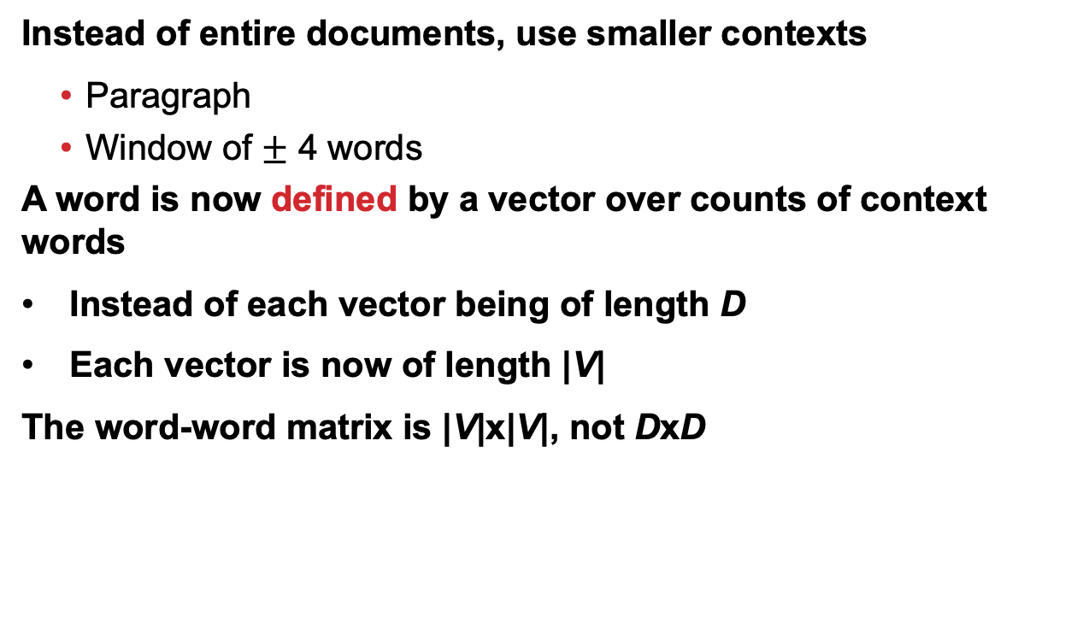
The word-word or word-context matrix
Instead of entire documents, use smaller contexts
  Paragraph
  Window of $±$ 4 words
A word is now defined by a vector over counts of context words
Instead of each vector being of length D
Each vector is now of length |V|
The word-word matrix is |V|x|V|, not DxD
[DJ]

Slide 45

Word-Word matrix
Sample contexts $±$ 7 words
…
…
[DJ]

Slide 46
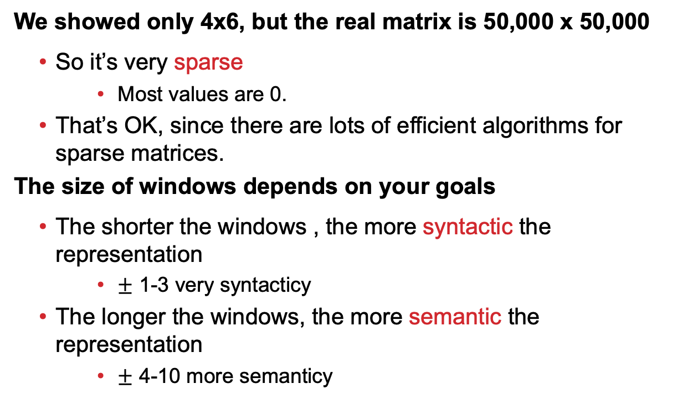
Word-word matrix
We showed only 4x6, but the real matrix is 50,000 x 50,000
  So it’s very sparse
    Most values are 0.
  That’s OK, since there are lots of efficient algorithms for sparse matrices.
The size of windows depends on your goals
  The shorter the windows , the more syntactic the representation
    $±$ 1-3 very syntacticy
  The longer the windows, the more semantic the representation
    $±$ 4-10 more semanticy
[DJ]

Slide 47
Measuring similarity
Given 2 target words v and w
Need a way to measure their similarity.
Most measure of vectors similarity are based on the:
Dot product or inner product from linear algebra
  High when two vectors have large values in same dimensions.
  Low (in fact 0) for orthogonal vectors with zeros in complementary distribution
[DJ]

Slide 48
Problem with dot product
Dot product is longer if the vector is longer. Vector length:
Vectors are longer if they have higher values in each dimension
That means more frequent words will have higher dot products
That’s bad: we don’t want a similarity metric to be sensitive to word frequency
[DJ]

Slide 49
Solution: cosine
Just divide the dot product by the length of the two vectors!
This turns out to be the cosine of the angle between them!

Slide 50
Similarity between Documents
Given two documents x and y, represented by their TF-IDF vectors (or any vectors), the cosine similarity is:
Formally, it measures the cosine of the angle between two vectors x and y:
cos(0º) = 1, cos(90º) = 0 ??????????
Similar documents have high cosine similarity;
dissimilar documents have low cosine similarity.

Slide 51

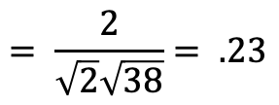

Example
 | large | data | computer
apricot | 2 | 0 | 0
digital | 0 | 1 | 2
information | 1 | 6 | 1
Which pair of words is more similar?
cosine(apricot,information) =
cosine(digital,information) =
cosine(apricot,digital) =
$$2+0+0$$
$$= \frac{2}{\sqrt{2}\sqrt{38}}= .23$$
$$\sqrt{2+0+0 }$$

Slide 52
(Minimum) Edit distance
How similar are two strings?
Many different distance metrics (as we saw earlier when discussing entity resolution
  Typically based on the number of edit operations needed to transform from one to the other
Useful in NLP context for spelling correction, information extraction, speech recognition, etc.

Slide 53
Brief Aside: n-grams
n-gram: Contiguous sequence of n tokens/words etc.
Unigram, bigram, trigram, “four-gram”, “five-gram”, …

Slide 54
Language Modeling
Assign a probability to a sentence
  Machine Translation:
    P(high winds tonite) > P(large winds tonite)
  Spell Correction
    The office is about fifteen minuets from my house
      P(about fifteen minutes from) > P(about fifteen minuets from)
  Speech Recognition
    P(I saw a van) >> P(eyes awe of an)
  + Summarization, question-answering, etc., etc.!!

Slide 55
Language Modeling
Goal: compute the probability of a sentence or sequence of words:
P(W) = P(w₁,w₂,w₃,w₄,w₅…w_{n})
Related task: probability of an upcoming word:
P(w₅|w₁,w₂,w₃,w₄)
A model that computes either of these:
P(W) or P(w_{n}|w₁,w₂…w_{n-1}) is called a language model.
(We won’t talk about this much further in this class.)

Slide 56
Simplest case:
Unigram model
Some automatically generated sentences from a unigram model
fifth, an, of, futures, the, an, incorporated, a, a, the, inflation, most, dollars, quarter, in, is, mass
thrift, did, eighty, said, hard, 'm, july, bullish
that, or, limited, the

Slide 57
Bigram Model
Condition on the previous word:
texaco, rose, one, in, this, issue, is, pursuing, growth, in, a, boiler, house, said, mr., gurria, mexico, 's, motion, control, proposal, without, permission, from, five, hundred, fifty, five, yen
outside, new, car, parking, lot, of, the, agreement, reached
this, would, be, a, record, november

Slide 58
N-gram models
We can extend to trigrams, 4-grams, 5-grams
In general this is an insufficient model of language
  because language has long-distance dependencies:
  “The computer which I had just put into the machine room on the fifth floor crashed.”
But we can often get away with N-gram models

Slide 59
Moving on …
Words words words!
Free text and natural language processing in data science
Bag of words and TF-IDF
N-Grams and language models
Information extraction & sentiment mining
Thanks to Amol Deshpande (UMD)

Slide 60
Information Extraction (IE)
Information extraction (IE) systems
  Find and understand limited relevant parts of texts
  Gather information from many pieces of text
  Produce a structured representation of relevant information:
    relations (in the database sense), a.k.a.,
    a knowledge base
  Goals:
    Organize information so that it is useful to people
    Put information in a semantically precise form that allows further inferences to be made by computer algorithms
Notes:
Now let's define information extraction! a more general task
Goal: get semantic information out of documents, esp. web pages
Defined as a dumbing-down of more lofty goal of Natural Language Understanding -- more technologically manageable
we're often interested in learning about particular relations (in DB sense)
e.g. scouring financial news for movements of executives
e.g. [person] [assumes/loses] [role] at [company]
I want to scour through text, find relation instances, suck out, put in DB
you're allowed to do domain- and problem-specific customization
lots of potential applications
- business/financial context
- biomedical context, clinical medicine
there's all this unstructured text data about research and patients -- you'd like to be able to get structured information out of it
could lead to other automated information finding: trends, correlations, drug interactions, impact of some protein on expression of a gene, ...

Slide 61
Information Extraction (IE)
IE systems extract clear, factual information
  Roughly: Who did what to whom when?
E.g.,
  Gathering earnings, profits, board members, headquarters, etc. from company reports
    The headquarters of BHP Billiton Limited, and the global headquarters of the combined BHP Billiton Group, are located in Melbourne, Australia.
    headquarters(“BHP Biliton Limited”, “Melbourne, Australia”)
  Learn drug-gene product interactions from medical research literature
Notes:
Now let's define information extraction! a more general task
Goal: get semantic information out of documents, esp. web pages
Defined as a dumbing-down of more lofty goal of Natural Language Understanding -- more technologically manageable
we're often interested in learning about particular relations (in DB sense)
e.g. scouring financial news for movements of executives
e.g. [person] [assumes/loses] [role] at [company]
I want to scour through text, find relation instances, suck out, put in DB
you're allowed to do domain- and problem-specific customization
lots of potential applications
- business/financial context
- biomedical context, clinical medicine
there's all this unstructured text data about research and patients -- you'd like to be able to get structured information out of it
could lead to other automated information finding: trends, correlations, drug interactions, impact of some protein on expression of a gene, ...

Slide 62
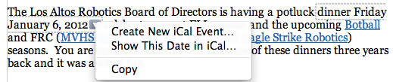
Low-level information extraction
Is now available and popular in applications like Apple or Google mail, and web indexing
Often seems to be based on regular expressions and name lists
Notes:
low-level information extraction:
mail programs extracting times, dates, phone numbers, events
these are specialized kinds of relations
done using regular expressions

Slide 63
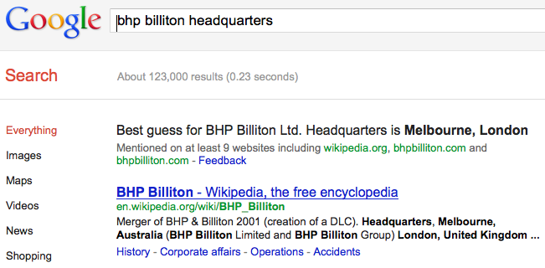
Low-level information extraction
Notes:
low-level information extraction:
mail programs extracting times, dates, phone numbers, events
these are specialized kinds of relations
done using regular expressions

Slide 64

Why is IE hard on the web?
A book,
Not a toy
Title
Need this
price
Notes:
this task is actually a surprisingly difficult task
you might think, how hard can it be: you look at the web page, find out how much, … but there's actually a lot of subtlety in getting it right
here's a product web page -- it's probably pretty obvious to you guys that this is a book, right? but for the computer, it's sort of subtle to tell this
because although the top-level category is "English Books” it's inside subcategory "Toys" -- you might think it's a toy
that's what's more common on shopping sites: if you're on a site that sells home furnishings, and you're in a subcategory "flatware", you assume that a product you see there is an instance of flatware
the title isn't labeled as a title, it's just bold and big font
and then prices -- very typically you see multiple prices
here, prices for different countries
also: list price vs. our price, or previously vs. marked down
somehow you need to figure out that this is the price you want
so to do this with accuracy over different websites is quite tough

Slide 65
Why doesn’t text search (IR) work?
What you search for in real estate advertisements:
Town/suburb. You might think easy, but:
  Real estate agents: Coldwell Banker, Mosman
  Phrases: Only 45 minutes from Parramatta
  Multiple property ads have different suburbs in one ad
Money: want a range not a textual match
  Multiple amounts: was $155K, now $145K
  Variations: offers in the high 700s [but not rents for $270]
Bedrooms: similar issues: br, bdr, beds, B/R
Notes:
why did the text search engine work so badly?
not only does it not give you geocoding, open house planning
couldn't even successfully deliver basic functionality of search
if you want to search for property, what do you care about?
you probably care about size (# bedrooms), price range, location
none of those are well supported by basic text search
you might think town or suburb would work OK -- and it is the one that comes closest
but still lots of problems:
mention location of real estate office
45 minuts from Parramatta
multiple locations in a single ad
prices -- people want to search for price range, and text search doesn't do that
multiple prices: was X, now Y
rent vs buy

Slide 66
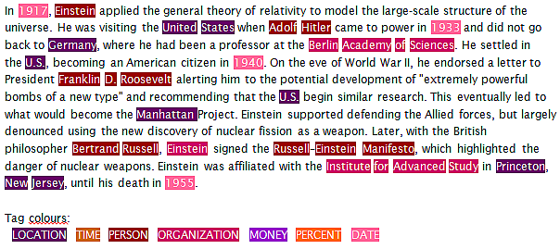
Named Entity Recognition (NER)
A very important sub-task: find and classify names in text
Notes:
so let's talk a bit more about NER and how it's evaluated, and then we'll talk about two approaches for doing it
so I already defined NER. you have a piece of text, and you want to:
1. find things that are names: European Commission, John Lloyd Jones, etc.
2. give them labels: ORG, PERS, etc.
note that in this particular example "Thursday" was not labeled

Slide 67
Named Entity Recognition (NER)
The uses:
  Named entities can be indexed, linked off, etc.
  Sentiment can be attributed to companies or products
  A lot of IE relations are associations between named entities
  For question answering, answers are often named entities.
Concretely:
  Many web pages tag various entities, with links to bio or topic pages, etc.
    Reuters’ OpenCalais, Evri, AlchemyAPI, Yahoo’s Term Extraction, …
  Apple/Google/Microsoft/… smart recognizers for document content
Notes:
First, let's define NER!
go through pages, recognize the names of things: "Bill MacCartney", "Stanford University"
the people who came up with this task had a rather precise, philosophically motivated meaning in mind
entity: a discrete, actual thing: Bill MacCartney, but not calcium carbonate or Tuesday or Viagra
named entity: an entity with a name, in a philosophical, Kripke-like sense
(this water bottle is an entity, but not a NAMED entity)
but in practice the definition has been expanded quite a bit in later work
we routinely include dates & times, proteins, drug names
but still, loosely, things that have a name
but NOT references to entities which are not names: "this university", "it”
first task in NER: identifying occurrences of named entities
looking for capital letters is a really good clue! at least in English! but not so much in Hebrew, Chinese, ... non-Latinate alphabets also doesn't really work in German -- all nouns are capitalized!
so that's a pretty useful base-level task -- widely deployed and used
you've probably seen web pages that do this
e.g. financial web sites often mark up stock symbols, names of companies
Microsoft has done work with this, smart tags, entities tagged with metadata
Reuters has web service OpenCalais, you send them docs, they send back NER markup

