Slide 1
Principles of
Data Science
John P Dickerson
Lecture #10 – 10/31/2018
CMSC641
Wednesdays
7:00pm – 9:30pm

Slide 2
Today’s Lecture
Data collection
Data processing
Exploratory analysis
&
Data viz
Analysis, hypothesis testing, & ML
Insight & Policy Decision

Slide 3
Today’s lecture
Overview
A visualization framework
A visualization workflow
Evaluation research of information visualization
Quick Matplotlib/Seaborn overview
Some extra resources
Huge thanks: AI Laboratory at Arizona State University

Slide 4
What is Visualization?
Visualization is any technique for creating images, diagrams, or animations to communicate a message.
Visualization through visual imagery has been an effective way to communicate both abstract and concrete ideas since the dawn of humankind.
Cave paintings
Hieroglyphs
Maps
…
Message: “Don’t touch the spiky hedgehogs” …

Slide 5
Brief History
First known map: 12th century [Tegarden 1999]
First presentation graphics: William Playfair (1786)
Multidimensional representations appeared in 19th century [Tufte 1983]
Examples:
William Playfair (1786, 1821) – founder of graphical methods for statistics & economist
John Snow (1854) – Cholera Map in London
Charles Joseph Minard (1861) – Napoleon and The Russian Campaign of 1812
“… the best statistical graphic ever drawn.” -- Tufte

Slide 6
Brief History
William Playfair (1786)

Slide 7
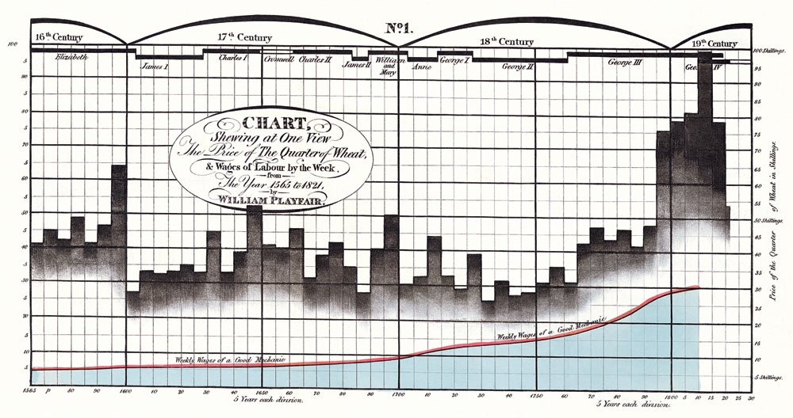
Brief History
Time-series comparison, aimed to show wheat price declined regarding the increase of wages
Integration of bar charts and line graph
William Playfair (1821)
Notes:
Labor wages (red line+blue) vs. price of wheat (black bars)

Slide 8
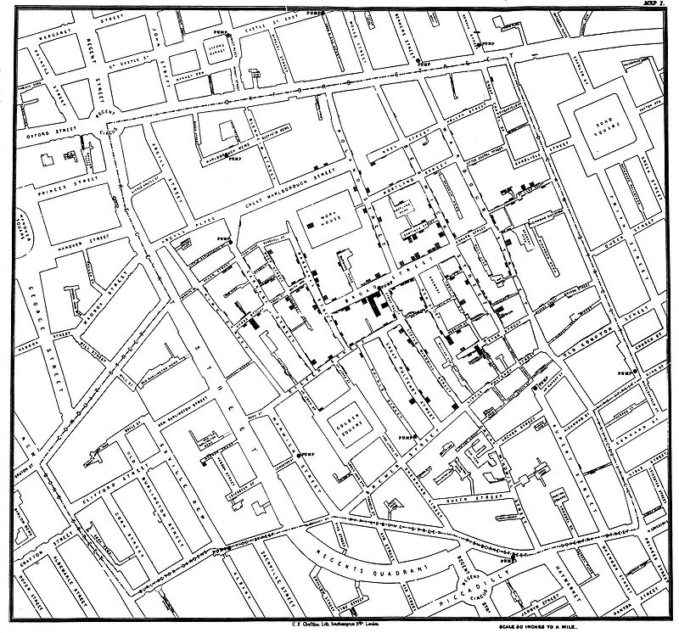
Brief History
John Snow mapped the cholera cases on the map. The cases were clustered around the pump in Broad street.
Each death case is a bar
“Spot map” – Geo-spatial based mapping
John Snow (1854)

Slide 9
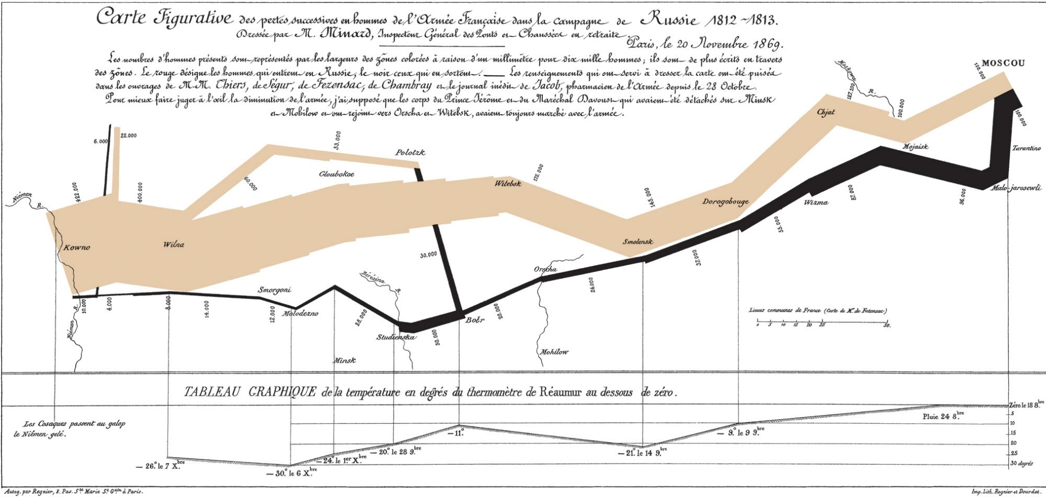
Brief History
In this visualization, Minard visualized:
Napoleon’s marching and retreat routes
Army Size
Temperature during retreat
Charles Joseph Minard (1861)

Slide 10
Today’s lecture
Hockey Stick Graph:
Temperature Change over last 1000 years
Overview of Information Visualization
Key Concepts
Tableau
Interactive Web-based Visualizations

Slide 11
Brief History
Modern Visualization
1985: NSF Workshop on Scientific Visualization
1987: Special issue of Computer Graphics on Visualization in Scientific Computing
1990: IEEE 1st visualization conference
2000s: Public media started to integrate infographics into TV news, newspaper/ magazine publication
2004: Pak Chung Wong and J. Thomas (2004). ”Visual Analytics”. in: IEEE Computer Graphics and Applications, Volume 24, Issue 5, Sept.-Oct. 2004 Page(s): 20–21.
Visualizations become popular on social networks
Techniques such as HTML5, CSS3, D3 enabled interactive visualizations on mobile devices

Slide 12
Visualization Classification
Visualization can be classified as software visualization, scientific visualization, and information visualization.
Software Visualization
  Software visualization helps people understand and use computer software effectively [Stasko et al. 1998]
Scientific Visualization
  Visualizing three-dimensional phenomena (architectural, meteorological, medical, biological, etc.), where the emphasis is on realistic renderings of volumes, surfaces, illumination sources, and so forth [Friendly 2008]

Slide 13
Visualization Classification
Information Visualization
  Information visualization is the two-way and interactive interface between humans and their information resources. Visualization technologies meld the human’s capacity with the computational capacity for analytical computing. (P1000 report)
  Information visualization concentrates on the use of computer-supported tools to explore large amount of abstract data. The abstract data include both numerical and non-numerical data, such as text and geographic information.

Slide 14
Value of Information Visualization
Exploring information collections becomes increasingly difficult as the volume grows
With minimal effort, the human visual system can process a large amount of information in a parallel manner
The occurrence of advanced graphical software and hardware enables the large-scale visualization and the direct manipulation of interfaces

Slide 15
Goals for Information Visualization
Provide insight
Explain data to solve specific problems
Support the analytical task, showing the comparison or causality
Explore large data sets for better understanding
Relieve the cognitive overload
Conveying abstract information in intuitive ways

Slide 16
How to Organize Visualizations?
By
User task type?
User insight need?
Data to be visualized?
Data transformation?
Visualization techniques?
Visual mapping transformation?
Interaction techniques?
…?

Slide 17
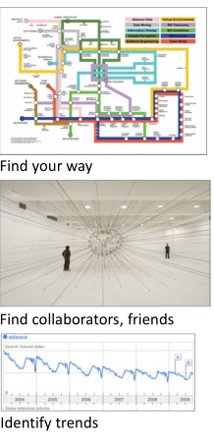
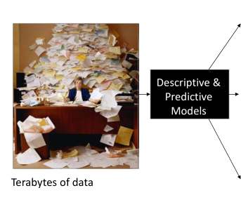
Different Question Types

Slide 18
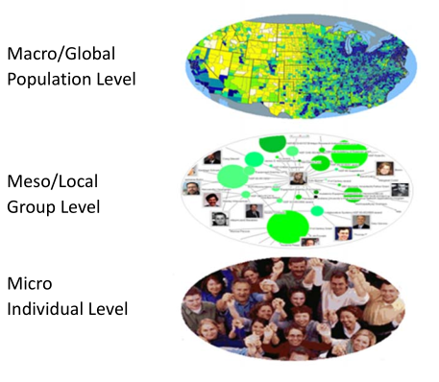
Different Levels of Analysis

Slide 19
Framework by Börner (2014)
Level of Analysis
Type/Question | Micro/Individual (1-100 records) | Meso/Local (100-10k records) | Macro/Global (10,000+ records)
Statistical Analysis/Profiling | Individual person and their expertise profiles | Larger labs, centers, universities, research domains, or states | All of NSF, all of USA, all of science.
Temporal Analysis (When) | Funding portfolio of one individual | Mapping topic bursts in 20 years of PNAS | 113 years of physics research
Geospatial Analysis (Where) | Career trajectory of one individual | Mapping a state’s intellectual landscape | PNAS publications
Topical Analysis (What) | Base knowledge from which one grant draws | Knowledge flows in chemistry research | VxOrd/Topic maps of NIH funding
Network Analysis (With Whom) | NSF Co‐PI network of one individual | Co‐author network | NIH’s core competency
Notes:
Describe various visualization techniques (what they are, why they are useful, various applications, pros and cons, tips for each one):
Line, bar, scatter plots charts (2-3 slides)
Dashboards (2-3 slides)
Networks (2-3 slides)
Map based visualizations (2-3 slides)
Temporal visualizations (2-3 slides)
…
Also provide a taxonomy succinctly summarizing each of these visualizations strengths, weaknesses, and the type of data that should be used for the visualization (e.g., graph data for network visualizations)

Slide 20
Comparing Two Workflows
Börner (2014) – Visual Insights
Read data
Analyze data
Visualize
  Select vis. types
  Overlay data
  Visually encode data
Deploy
Fry (2007) – Visualizing Data
Acquire
Parse
Filter
Mine
Represent
Refine
Interact

Slide 21
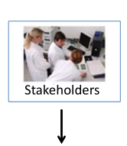

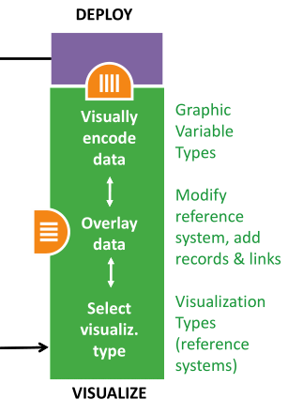

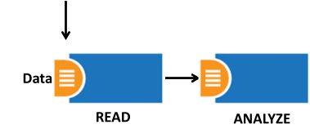
Needs-Driven Workflow
Börner (2014)

Slide 22
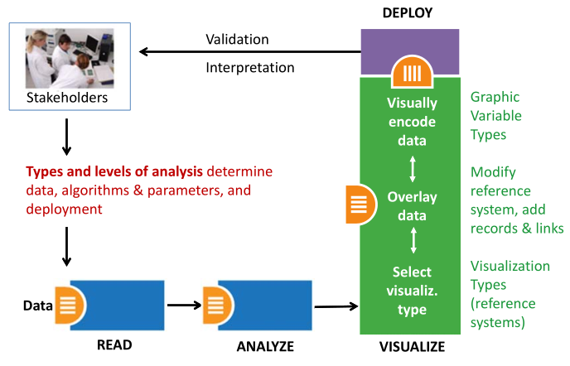
Needs-Driven Workflow: Select Visualization Type
Börner (2014)

Slide 23
Visualization Types
Shneiderman (1996) proposed seven types of representation methods:
1-D
To represent information as one-dimensional visual objects in a linear [Eick et al. 1992; Hearst 1995] or a circular [Salton et al. 1995] manner.
Textual documents, source codes, name lists, …
2-D
To represent information as two-dimensional visual objects
Geographic maps, floor plans, newspaper layouts, …
3-D
To represent information as three-dimensional visual objects
Molecules, human bodies, buildings and etc.
Multi-dimensional
To represent information as multidimensional objects and projects them into a three-dimensional or a two-dimensional space.
Relational and statistical database.
This slide is a terrible example of visualizing information …

Slide 24
Visualization Types
Shneiderman (1996) proposed seven types of representation methods (cont’d):
Temporal
To represent information based on temporal order
Medical records, project management, historical presentations, …
Tree
To represent hierarchical relationship
Network
To represent complex relationships that a simple tree structure cannot capture

Slide 25
Visualization Types
Börner (2014) emphasized five major types:
Charts
No reference system—e.g., Wordle.com, pie charts
Tables
Categorical axes that can be selected, reordered; cells can be color coded and might contain proportional symbols. Special kind of graph.
Graphs
Quantitative or qualitative (categorical) axes. Timelines, bar graphs, scatter plots.
Geospatial maps
Use latitude and longitude reference system. World or city maps.
Network graphs
Node position might depends on node attributes or node similarity.
Tree graphs: hierarchies, taxonomies, genealogies.
Networks: social networks, migration flows.

Slide 26
Visualization Type Selection: Temporal
Temporal data analysis and visualization answer the when question, and can help to :
Understand the temporal distribution of datasets
Identify growth rates, latency to peak times, or decay rates
See patterns in time-series data, such as trends, seasonality, or bursts.

Slide 27
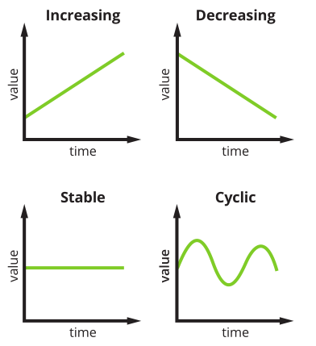
Visualization Type Selection: Temporal
Temporal trends
Increasing
Decreasing
Stable
Cyclic
Visualization Types
Line graph
Stacked graph
Temporal bar graph
Histograms
Small multiples

Slide 28
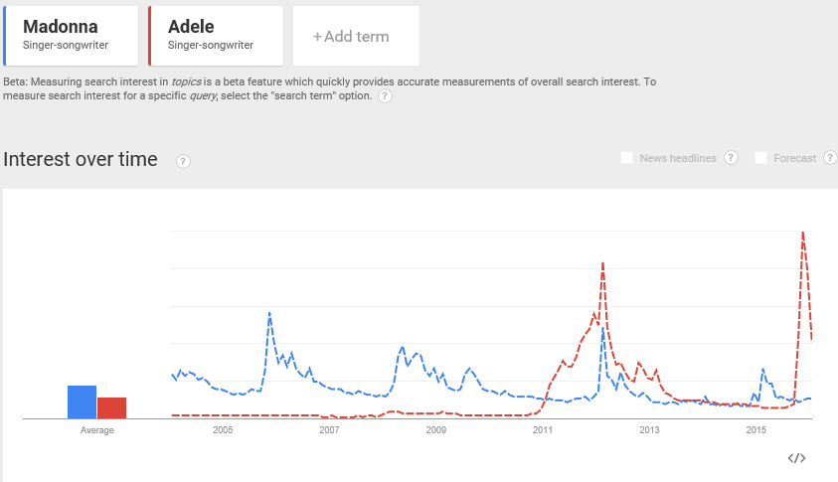
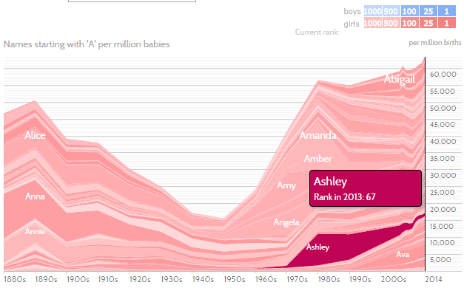
Visualization Type Selection: Temporal
Stacked graph illustrates individual and total trends.
Line graph shows the trends over time.

Slide 29
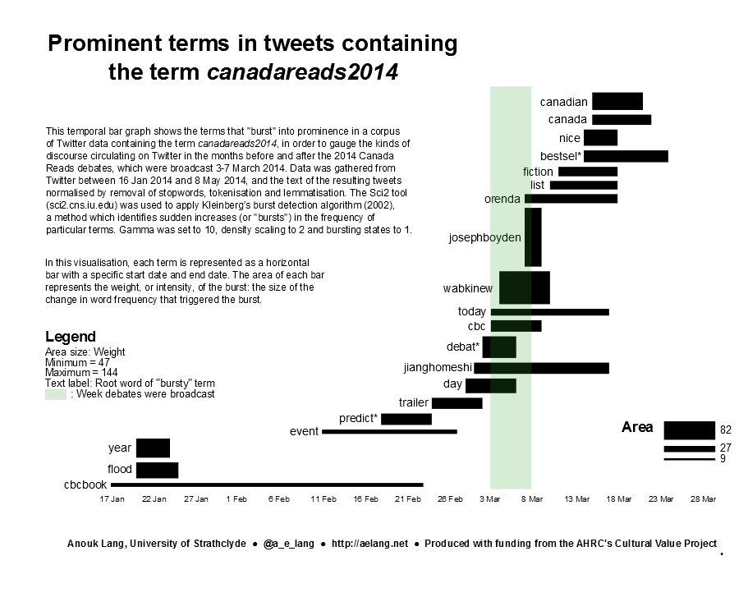
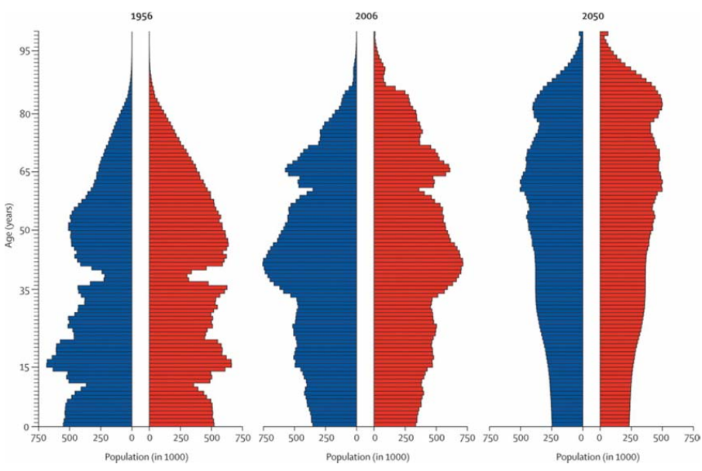
Visualization Type Selection: Temporal
Histograms represent the number of observations of a certain value have been made.
Temporal bar graph shows begin, end, and properties of events.
Christensen, Kaare, Gabriele Doblhammer, Roland Rau, and James W. Vaupel. “Ageing Populations: The Challenges Ahead.” The Lancet 374 (9696): 1196-1208.

Slide 30
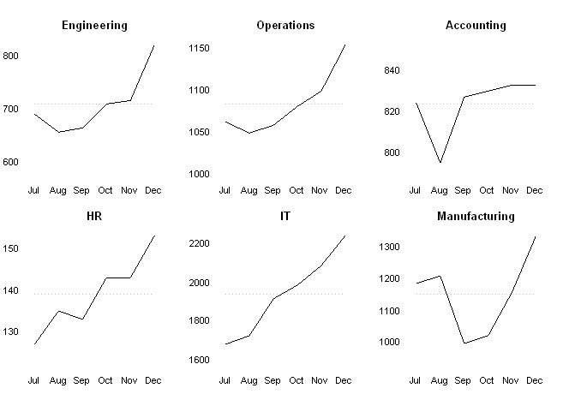
Visualization Type Selection: Temporal
A small multiple (sometimes called trellis chart, lattice chart, grid chart, or panel chart) is a series of similar graphs or charts using the same scale + axes, allowing them to be easily compared. [Tufte 1983]

Slide 31
Visualization Type Selection: Geospatial
Geospatial data analysis and visualization originated in geography and cartography, but are increasingly common in statistics, information visualization, and many other areas of science.
The analyses aim to answer where questions that use location information to identify their position or movement over geographic space.

Slide 32
Visualization Type Selection: Geospatial
General Map Types
General reference maps
Topographic maps
Thematic maps: Emphasize the spatial distribution of one or more geographic variables
  Physio-geographical:
    Maps showing the natural features of the earth's surface.
  Socio-economic:
    Maps showing political boundaries, population density, or voting behavior.
  Technical
    Maps showing navigation routes.

Slide 33
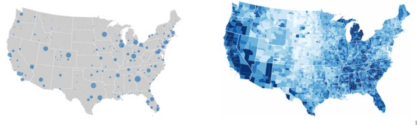
Visualization Type Selection: Geospatial
  Proportional symbol map represents data variables by symbols that are sized, colored, etc. according to their amount. Data is (or can be) aggregated at points within areas.
  Choropleth map represents data variables such as densities, ratios, or rates by proportionally colored or patterned areas.
  Mapped according to a prearranged key, e.g., districts or states

Slide 34
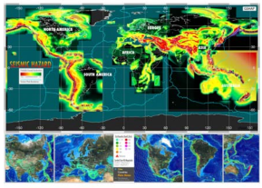
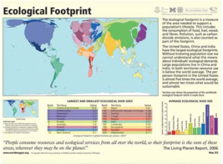
Visualization Type Selection: Geospatial
Cartograms are not drawn to scale. Instead they distort geographical areas in proportion to data values. Familiarity with region is necessary. Mostly used for world, continental, and country maps.
Heat (isopleth) maps represent continuous data variable values by colors. Heat maps might show color-based contour lines that connect points of equal value or value-by-area maps.

Slide 35

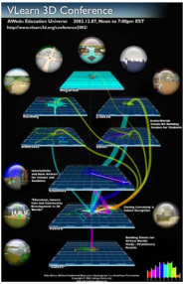
Visualization Type Selection: Geospatial
Space-time cubes display entities, locations, and events over time.
Flow maps show paths that (in)tangible object take to get from one geospatial place to another. Variables such as capacity or maximum speed are encoded proportionally by line width/color.

Slide 36
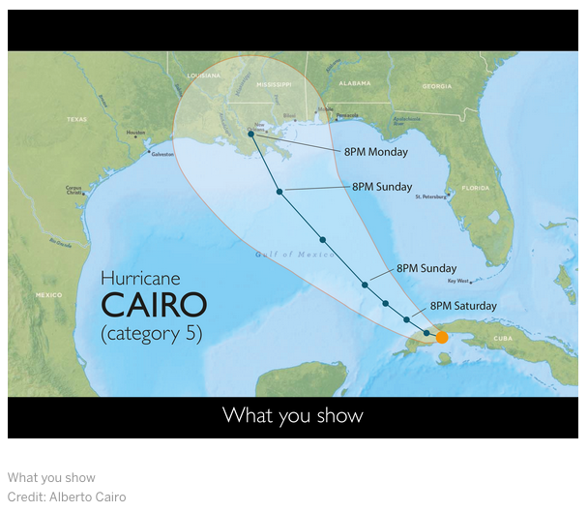
Visualizing uncertainty

Slide 37
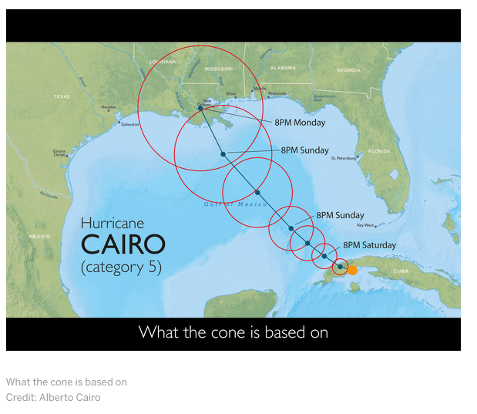
Visualizing uncertainty

Slide 38
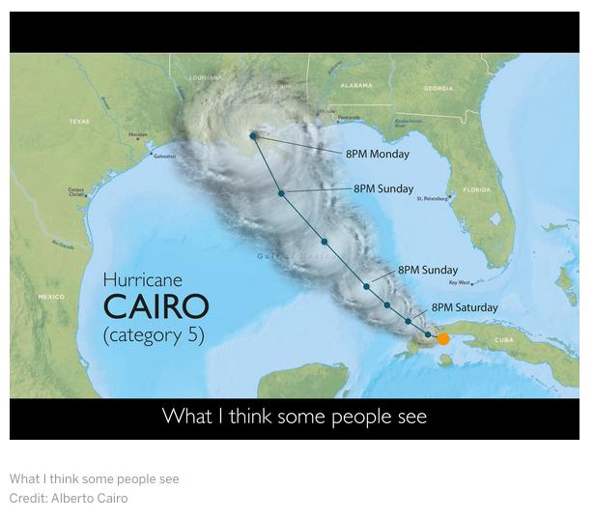
Visualizing uncertainty

Slide 39
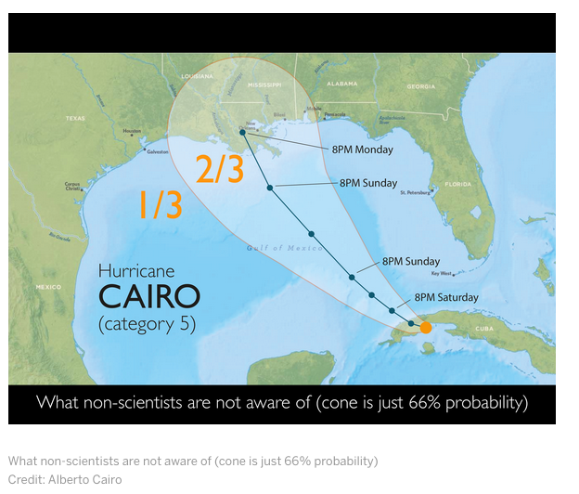
Visualizing uncertainty

Slide 40
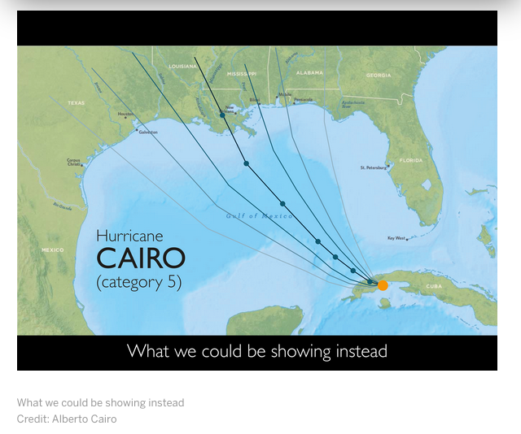
Visualizing uncertainty

Slide 41
Visualization Type Selection: Topical
To answer the what question, we will be using texts to identify major topics, their interrelations, and their evolution over time at different levels of analysis – micro to macro.
To generate visualizations from text, text processing or natural language processing is needed to generate qualitative or quantitative features of the text.
NLP lectures talk about some of this

Slide 42
Visualization Type Selection: Topical
Representations of topical data:
Charts: Word cloud, text overlay
Tables: GRIDL, Periodic table
Graphs: circular visualization, crossmaps
Geospatial maps: SOM maps
Network graphs: Tree visualizations, word co-occurrence networks, concept maps, science map overlays

Slide 43
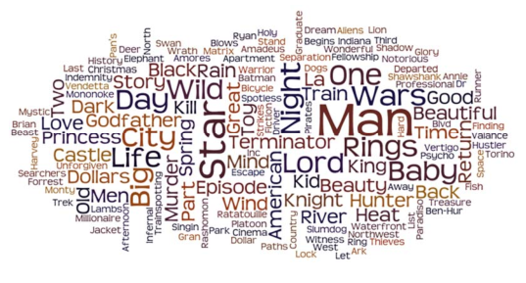
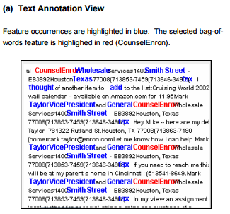
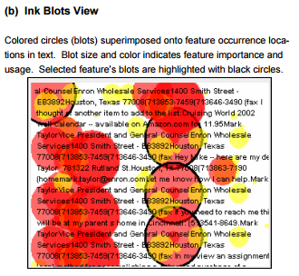
Visualization Type Selection: Topical
Text Overlay [Abbassi and Chen 2008]
Word clouds visualize the frequency of the words.
  IMDB movie titles word cloud created with Wordle.

Slide 44
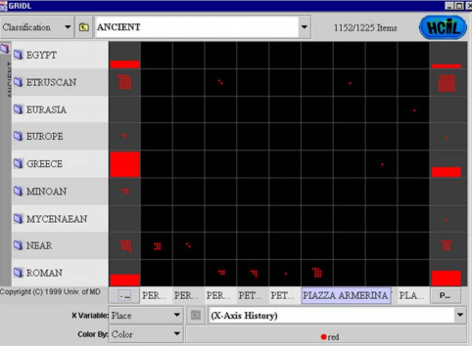
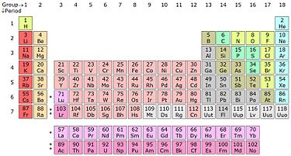
Visualization Type Selection: Topical
A Periodic Table is used to organize elements sharing similar properties.
GRIDL uses categorical and hierarchical axes to support categorical zooming.

Slide 45
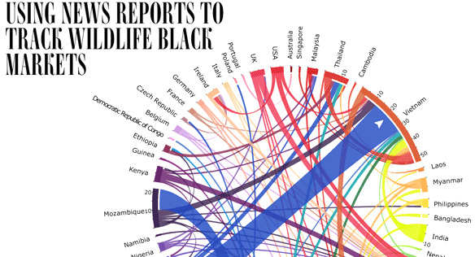
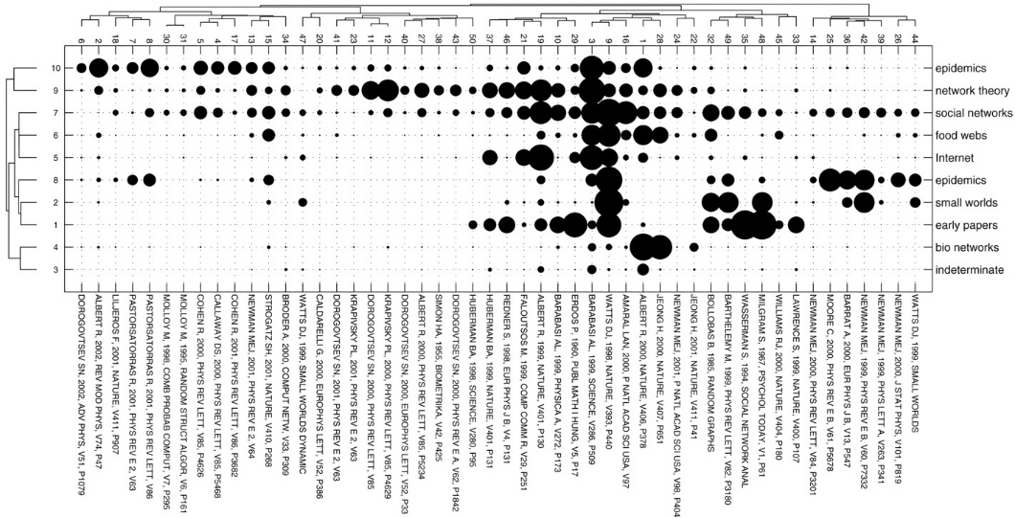
Visualization Type Selection: Topical
Crossmaps visualize multiple and overlapping relations among entity types in collections of journal articles.
Circular visualization shows the relationships between entities.

Slide 46
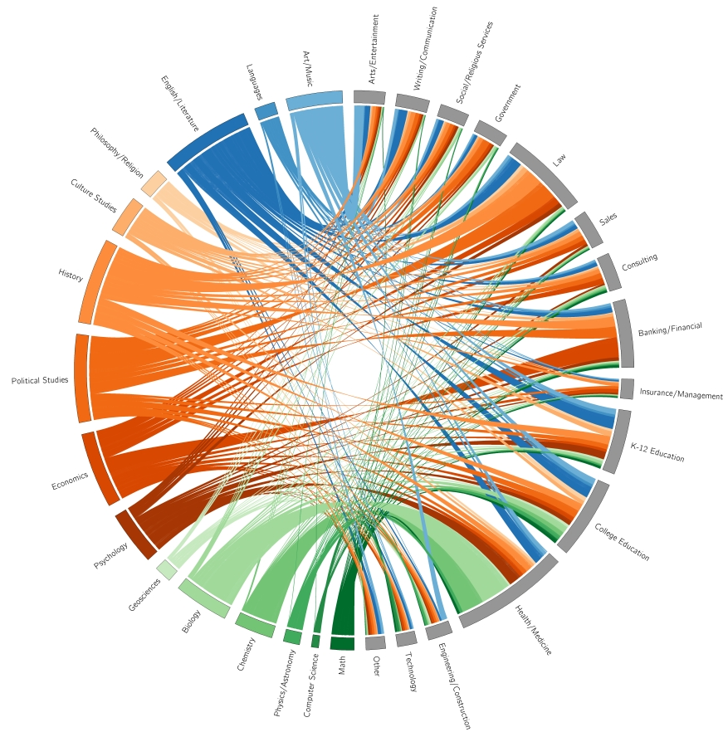
Williams College: Majors–Career
Notes:
Created by undergrad students at Williams College in Massachusetts.
Visualizes career paths of over 15,000 Williams graduates, with majors on left, careers on right.
Pretty, somewhat hard to follow.
This recently made the rounds at the Provost’s Office.
Fortunately, allows interactive filtering.

Slide 47
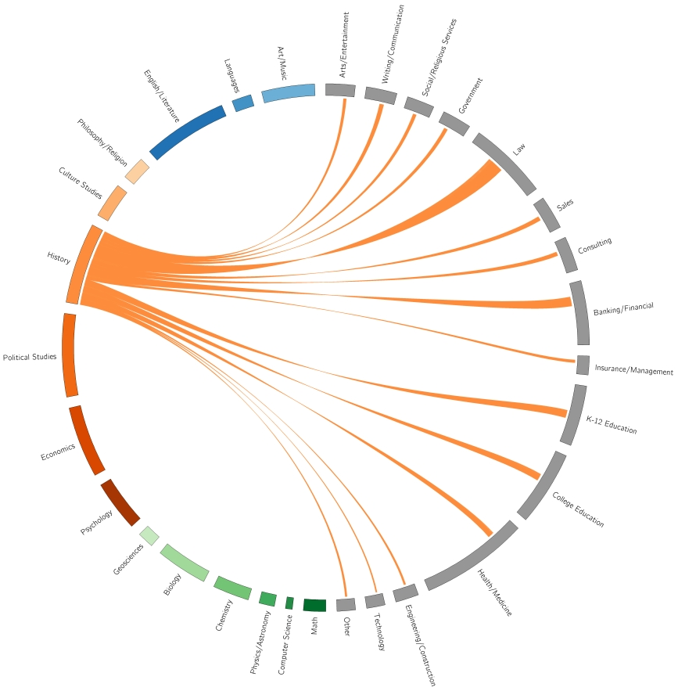
Williams College: Majors–Career
Notes:
Ah, that’s better! History majors only.
Wide variety of fields. Mostly law, but quite a few into Banking/Financial and also K-12 Education.
Setting the “pretty bar” very high! Not as concerned with “function.”
We want to create visualizations people will return to again and again.
Just like webpages that were heavy on “flash” attracted early attention, but interest faded.

Slide 48
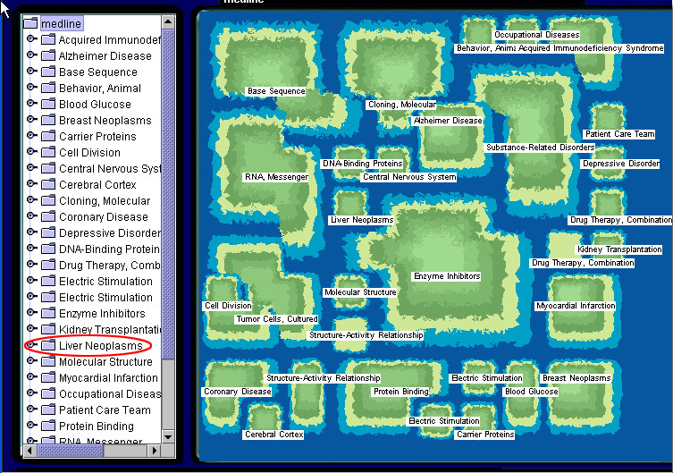
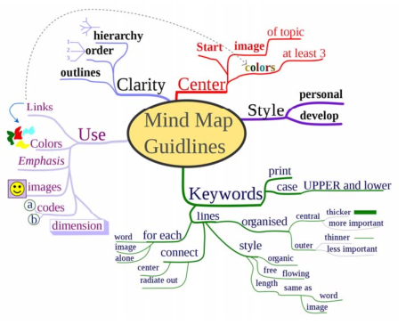
Visualization Type Selection: Topical
Concept maps are network graphs that show the relationships among concepts.
Self-organizing maps (SOMs) use geospatial metaphors to create abstract 2-D space and map elements onto the space.

Slide 49
Visualization Type Selection: Network
The with whom question can be answered by tree and network visualization.
Tree visualization utilizes structural, hierarchical data.
  Radial Tree Map
  Treemap
Network visualization can deal with more complex relationships between nodes.
  Random layout
  Circular layout
  Force directed layout
  Bipartite layout
  Subway map layout
  Network overlays on geospatial maps

Slide 50
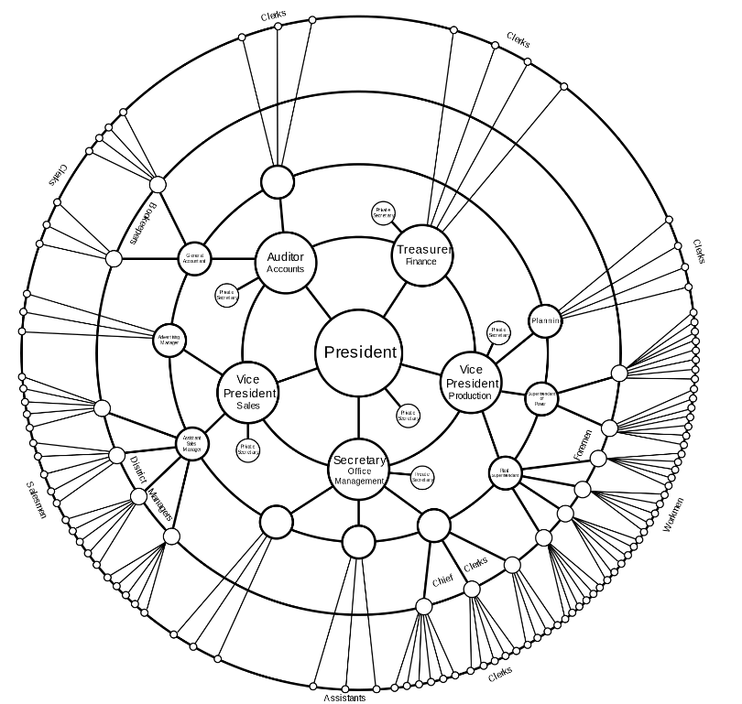
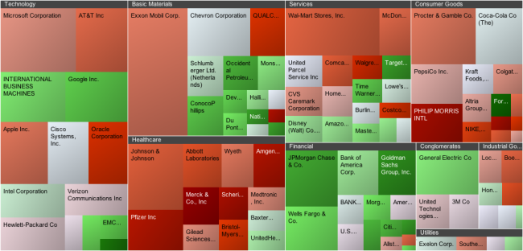
Visualization Type Selection: Network
Treemaps are a space-constrained visualization of hierarchical structure
Radial tree maps are a method of displaying a tree structure in a way that expands outwards, radially.

Slide 51
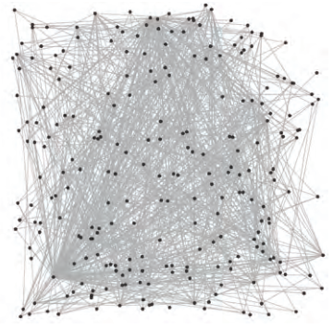
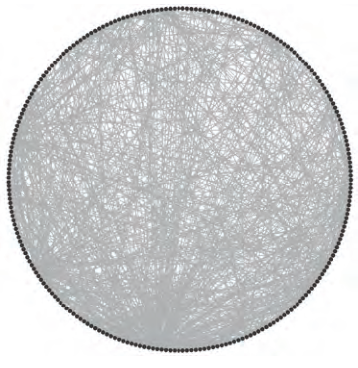
Visualization Type Selection: Network
Circular layout
  Fast
  Can provide sequential information
Random layout
  Fast
  Impression of size and density

Slide 52
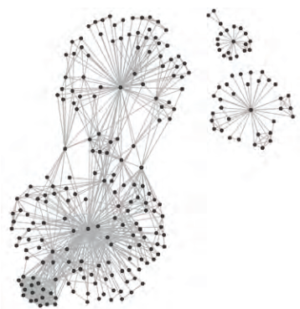
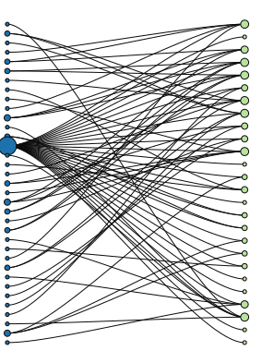
Visualization Type Selection: Network
Bipartite layout
  Renders networks with two node types as two lists.
Force-directed layout
  Utilizes similarity or distance relationships among nodes

Slide 53
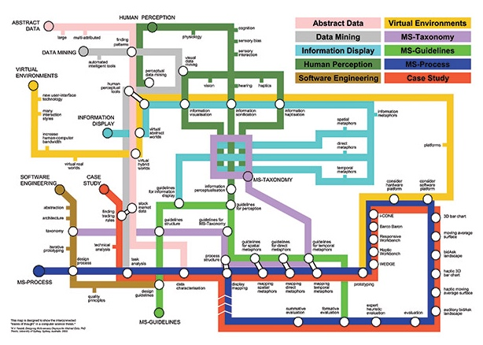
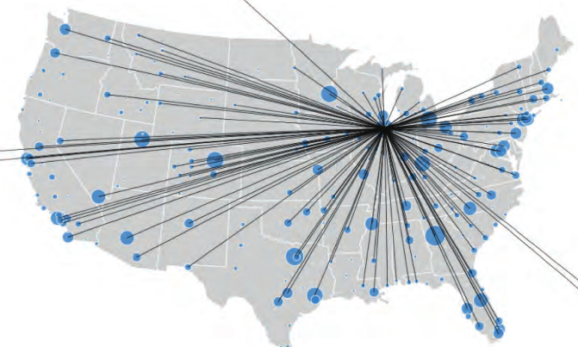
Visualization Type Selection: Network
Network overlays on geospatial maps
  Use a geospatial reference system to place nodes
  E.g., airport traffic
Subway map layout
  Aim for evenly distributed nodes, uniform edge lengths, and orthogonal drawings.
  E.g. Ph.D. Thesis map (2004)

Slide 54
Needs-Driven Model: Visually Encode data
Börner (2014)

Slide 55
Data Scale Types
Categorical (nominal): A categorical scale, also called nominal or category scale, is qualitative. Categories are assume to be non-overlapping.
Ordinal: An ordinal scale, also called sequence or ordered, is qualitative. It rank-orders values representing categories based on some intrinsic ranking but not at measureable intervals.
Interval: An interval scale, also called value scale, is a quantitative numerical scale of measurement where the distance between any two adjacent values (or intervals) is equal but the zero point is arbitrary.
Ratio: A ratio scale, also called proportional scale, is a quantitative numerical scale. It represents values organized as an ordered sequence, with meaningful uniform spacing, and has a true zero point.
More
Qualitative
More
Quantitative

Slide 56
Data Scale Types: Examples
Categorical (nominal): ????????
Words or numbers constituting the names and descriptions of people, places, things, or events.
Ordinal: ????????
Days of the week, degree of satisfaction and preference rating scores (e.g., Likert scale), or rankings such as low, medium, high.
Interval: ?????????
Temperature in degrees or time in hours. Spatial variables such as latitude and longitude are interval.
Ratio: ?????????
Physical measures such as weight, height, (reaction) time, or intensity of light; number of published papers, co-authors, citations.

Slide 57
Graphic Variable Types
Quantitative
  Position
    x, y; possibly z
  Form
    Size
  Color
    Value (Lightness, Brightness)
    Saturation (Intensity)
  Texture
    Pattern
    Rotation
    Coarseness
    Size
    Density gradient
Qualitative
  Form
    Shape
    Orientation (Rotation)
  Color
    Hue (tint)
  Optics
    Crispness
    Transparency
    Shading

Slide 58
Dynamic Visualization
Previous sections demonstrates the workflow to create a static visualization.
In order to present more information and make visualization dynamic, we can show multiple static images side by side or as an animation.
Another way to make dynamic visualization is to introduce interaction into the design process.
The final mini-project has some of this.
Your tutorial can have lots of this! E.g., with D3.js.

Slide 59
Shneiderman's Mantra
User-Interface Interaction
Immediate interaction not only allows direct manipulation of the visual objects displayed but also allows users to select what to be displayed (Card et al., 1999)
Shneiderman (1996) summarizes six types of interface functionality
  Overview
  Zoom
  Filtering
  Details on demand
  Relate
  History
Overview first,
zoom and filter,
then details-on-demand.

Slide 60
Two Interaction Approaches
User-interface interaction
Overview + detail
  First overview provides overall patterns to users; then details about the part of interest to the use can be displayed. [Card et al. 1999]
  Spatial zooming & semantic zooming are usually used
Focus + context
  Details (focus) and overview (context) dynamically on the same view. Users could change the region of focus dynamically.
  Information Landscape [Andrews 1995]
  Cone Tree [Robertson et al. 1991]
  Fish-eye [Furnas 1986]

Slide 61
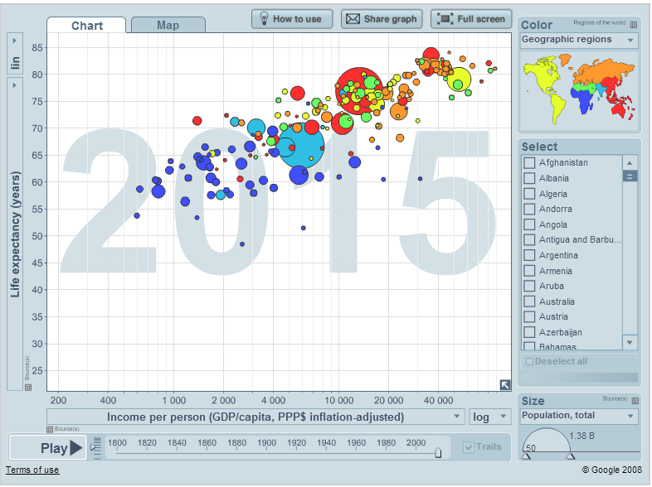
Interactive Visualization Example
http://www.gapminder.org/world/

Slide 62
Design Principles
Following design principles can help increasing the quality of visualizations in multiple ways.
Effective information presentation
Avoiding distraction and confusion, reducing cognitive load
Adding aesthetic value
Some selected principles:
Beauty of Visualization
Data-Ink Ratio
Data Density
Color Heuristics
Fitts’s Law

Slide 63
Beauty of Visualization
In Beautiful Visualization [2010], four criteria were raised to define the “beauty” of a visualization:
Informative
  Successfully convey information
Efficient
  Simple, focused, clear and straightforward
Aesthetic
  Use axes, layout, shape, colors, lines,
  and typography appropriately
Novel
  Be creative and attract readers with new design

Slide 64
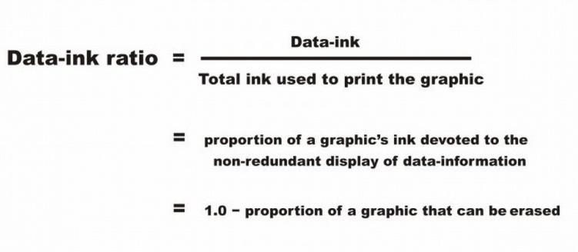
Data-Ink Ratio
Tufte [1983] claims that good graphical representations maximize data-ink and erase as much non-data-ink as possible.
Non-data-ink: Scales, borders, …

Slide 65
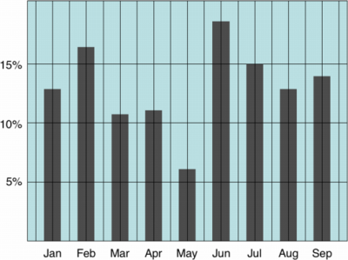
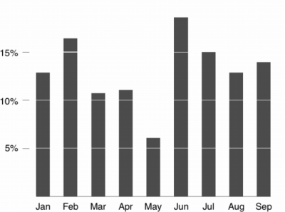
Data-Ink Ratio
Low Data-Ink Ratio
High Data-Ink Ratio

Slide 66
Data Density
The data density of a graph is the proportion of the total size of the graph that is dedicated to displaying data [Tufte 1983]
Similar to Data-Ink Ratio, Tufte prefers visualizations with high Data Density.
He claims that most graphs can be shrunk way down without losing legibility or information.

Slide 67

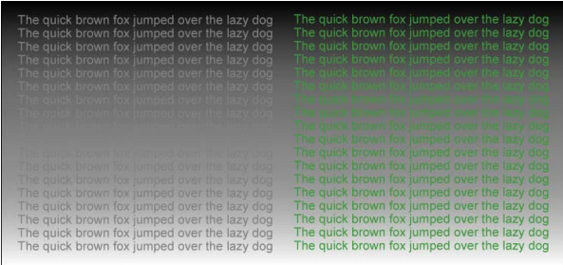
Color Heuristics
Contrast and analogy are the principles that define color design.
Contrasting colors are different, analogous colors are similar.
Contrast draws attention, analogy groups.
Color-coded information should be legible.
  Legibility: difference between foreground and background
https://www.perceptualedge.com/articles/b-eye/choosing_colors.pdf
http://cdn2.hubspot.net/hub/111084/file-708877165-pdf/docs/ebooks/eBook-UX-Color-Theory_Applying-Color-Knowledge-to-Data-Visualization.pdf

Slide 68

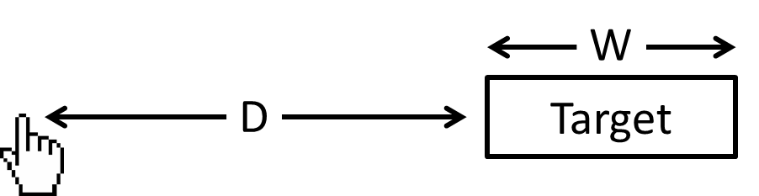
Fitts' Law
Fitts described a model of human movement primarily used in HCI and ergonomics. It may apply to interactive visualization design.
  MT: Movement time
  ID: Index of difficulty
  D: Distance
  W: Width
Fitts’ Law indicates that, to shorten the movement time and lower the index of difficulty, an HCI designer should:
Shorten the distance to the target
  Group functions/buttons together to reduce redundant movements
Enlarge the target

Slide 69
Visualization libraries

Slide 70
D3.js
JavaScript library for manipulating documents and visualizations
Made interactive via JS, CSS, SVG
Not a new visualization language – built entirely on functionality available in browsers
So, can require up-to-date browsers …
# Resize pre-defined circle element
d3.selectAll("circle").transition()
.duration(750)
.delay(function(d, i) { return i * 10; })
.attr("r", function(d) {
return Math.sqrt(d * scale);
});
https://d3js.org/

Slide 71
Matplotlib/PyPlot
Standard plotting library for Python
Meant to mimic Matlab
Built on Numpy
Quite powerful, but also fairly complex and cludgy
Rendering code serves as backend for newer viz packages
# Make a line plot
import matplotlib.pyplot as plt
plt.plot([1,2,3,4])
plt.ylabel('some numbers')
plt.show()

Slide 72
Seaborn
Complements Matplotlib; it’s built on top!
Much better defaults for aesthetics
Closer ties to numpy, pandas, scipy
More advanced functionality built in, like clustering, matrix visualization, grids of plots, etc
import seaborn as sns
# … load some data …
sns.regplot(
x="total_bill",
y="tip",
data=tips);

Slide 73
Seaborn: Types of plots
Module | Description of module
distplot | Standard histogram
barplot | Estimate of central tendency for a numeric variable
violinplot | Similar to boxplot, also shows the probability density of the data
jointplot | Scatterplot
regplot | Regression plot
pairplot | Pairplot
boxplot | Boxplot
swarmplot | Categorical scatterplot
factorplot | General categorical plot

Slide 74
ggplot
Data visualization package for R
Based on Leiland’s “grammar for graphics” paradigm that separates visualization into different semantic components, like layers, scales, etc
Easily the most used visualization package for R
Big influence on other plotting libraries and industry (e.g., Leiland went on to a VP role at Tableau)
A well-maintained adaptation for Python is available:
https://github.com/yhat/ggpy
Works well with Numpy/Pandas stack

Slide 75
Up Next:
Statistics &
Hypothesis Testing

Slide 76
Statistical Inference
Statistical inference is the discipline that concerns itself with the development of procedures, methods, and theorems that allow us to extract meaning and information from data that has been generated by stochastic (random) processes.
  Process of going from the world to the data, and then back to the world
  Often the goal is to develop a statistical model of the world from observed data
Conclusion is typically:
  an estimate;
  or a confidence interval;
  or rejection of a hypothesis
  or clustering or classification of data points into groups

Slide 77
Basic Probability I
Probability is concerned with the outcome of a trial (also called experiment or observation)
Sample Space: Set of all possible outcomes of a trial Probability of Sample Space = 1
Event is the specification of the outcome of a trial
  For example: Trial = Tossing a coin; Sample Space = {Heads, Tails}; Event = Heads
If two events E and F are independent, then: Probability of E does not change if F has already happend = P(E), i.e., P(E | F) = P(E)
Also: P(E AND F) = P(E) * P(F)
If two events E and F are mutually exclusive, then: P(E UNION F) = P(E) + P(F)

Slide 78
Basic Probability II
Bayes Theorem P(A | B) = P(B | A) * P(A) / P(B)
Simple equation, but fundamental to Bayesian inference
Conditional Independence: A and B are conditionally independent given C if: Pr(A AND B | C) = Pr(A | C) * Pr(B | C)
Powerful in reducing the computational efforts in storing and manipulating large joint probability distributions
Entropy A measure of the uncertainty in a probability distribution
Wikipedia Article

