Slide 1
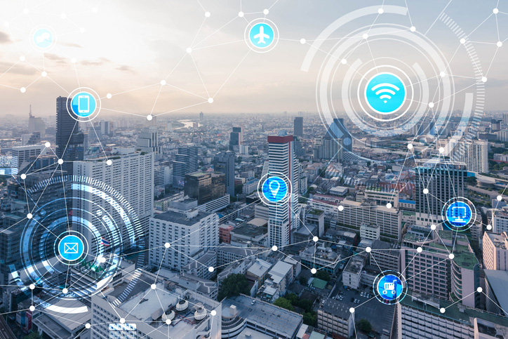
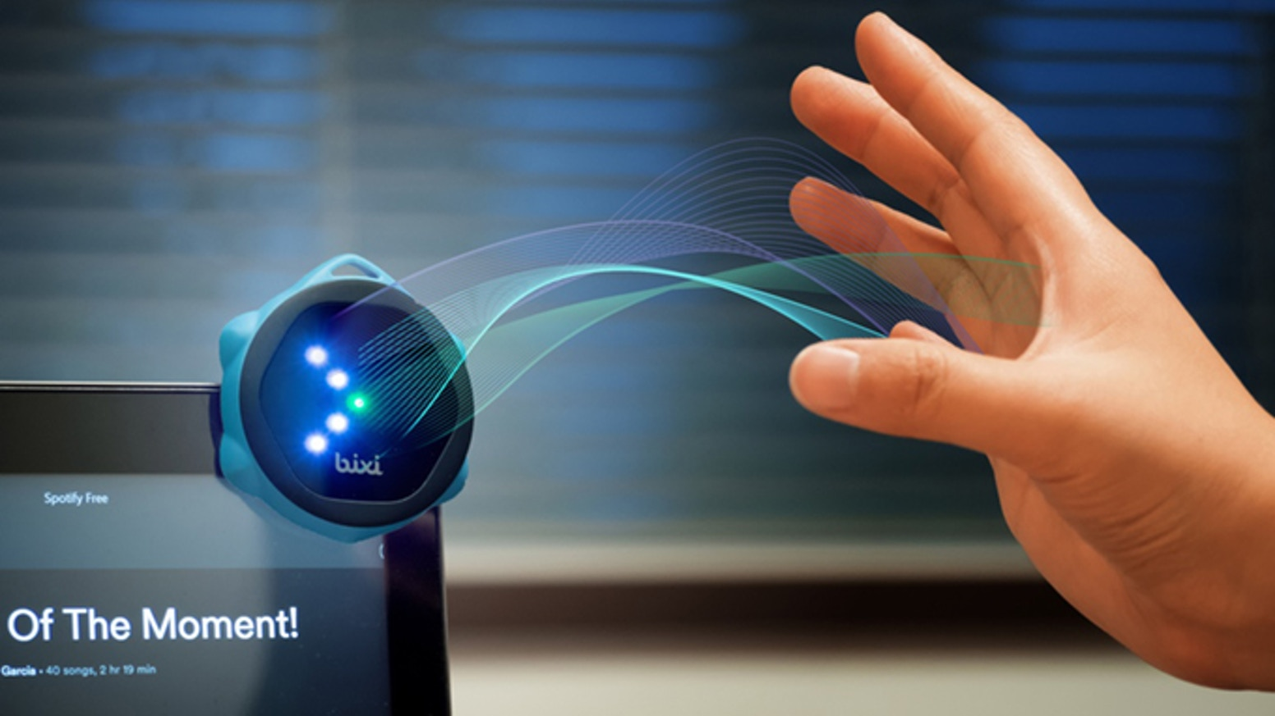
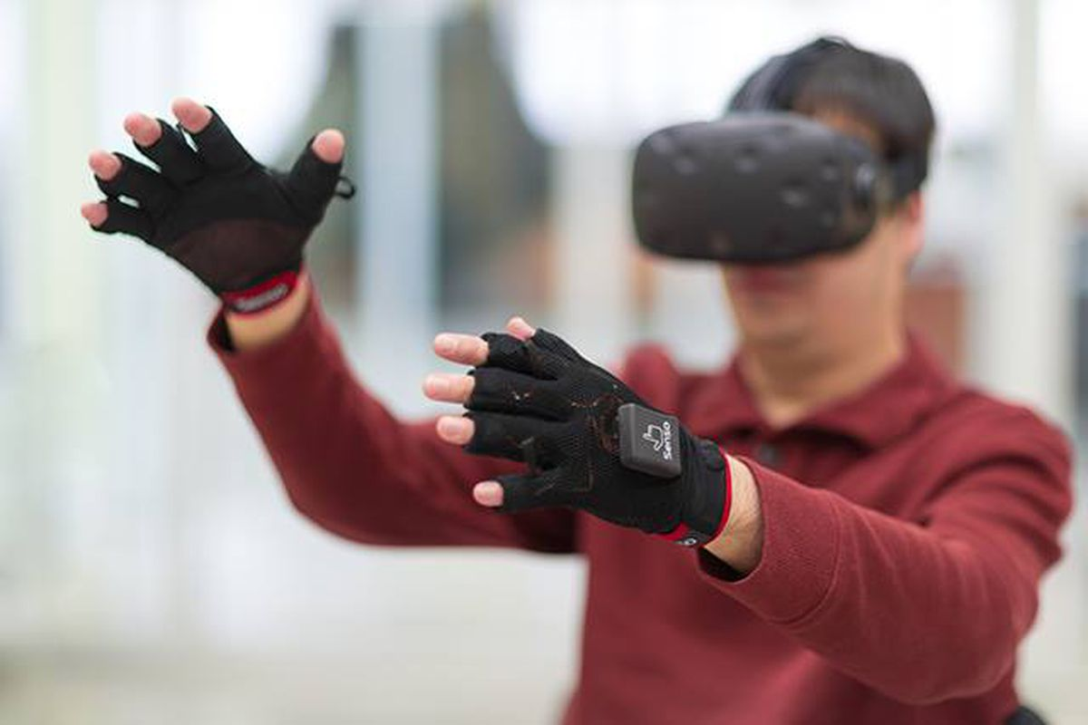
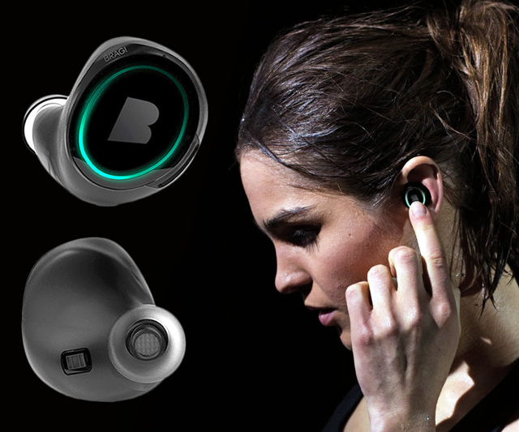
Wireless and Mobile Systems
for the IoT
CMSC 818W : Fall 2019
Lecture 1: Sensors and DSP Basics
Nirupam Roy
M-W 2:00-3:15pm
CSI 1122

Slide 2
Abstraction
Natural language
processing
Computer
vision
Networking
Data packets
Voice recording
Image/video

Slide 3
Abstraction
Natural language
processing
Computer
vision
Networking
Data packets
Voice recording
Image/video
WiFi signal
Acoustic signal
Light

Slide 4
Gesture/Motion/
Orientation
Vital signs detection
Autonomous vehicle control
Physical environment
(light, sound, speed, geomagnetism, radio waves, …)

Slide 5
Gesture/Motion/
Orientation
Vital signs detection
Autonomous vehicle control
Signal
Physical environment
(light, sound, speed, geomagnetism, radio waves, …)

Slide 6
Abstraction
Natural language
processing
Computer
vision
Networking
Data packets
Voice recording
Image/video
WiFi signal
Acoustic signal
Light

Slide 7
Project Idea: Multimodal imaging for face recognition

Slide 8
Project Idea: Multimodal imaging for face recognition
Computer
vision
Image/video
mmWave
Light

Slide 9
Sensors
- Definitions
- Generic working principle
2. Signals
- Digital abstraction
- Mathematical model

Slide 10
What is a sensor?

Slide 11
What is a sensor?
Air flow
Voltage proportional
to the speed of air-flow
Mapping
10 Miles per hour
Mapping

Slide 12
What is a sensor?
Temperature
Voltage
Thermo-couple
Time
At time t
Mapping
Temp.
40° F
(a scalar value)
Time

Slide 13
Scalar and vector output
Y
X
Global coordinate system

Slide 14
Coordinate system
Y
X

Slide 15
Coordinate system
Local coordinate system
Y
X

Slide 16
Coordinate system
Local coordinate system
Y
V_{y}
V_{X}
X

Slide 17
Coordinate system
Local coordinate system
Y
V_{y}
V_{X}
X
Output = <V_{x}, V_{y}>

Slide 18
Coordinate system
Local coordinate system
Y
V_{y}
V_{x}
X
Output at time t
<V_{x} (t), V_{y}(t)>
for a 2-axis sensor

Slide 19
Coordinate system
Local coordinate system
Y
V_{y}
V_{x}
X
Z
Output at time t
<V_{x} (t), V_{y}(t), V_{z}(t)>
for a 3-axis sensor

Slide 20
Coordinate system

Slide 21
Coordinate system
North
Y
Local coordinate system
X
Z
Global coordinate system
East

Slide 22
Sensor data
Sensor data
Sensor
Scalar
Time
Vector
Sensor data
Time
Mapping

Slide 23
How one signal is different from the other?

Slide 24
Frequency, Amplitude, and Phase

Slide 25
Definition of Frequency

Slide 26
Definition of Frequency
Frequency is the number of occurrences of a repeating event per unit of time.

Slide 27
Frequency, Amplitude, and Phase

Slide 28
Frequency, Amplitude, and Phase
Time

Slide 29
Frequency, Amplitude, and Phase
$$f cycles per second$$
$$2π angles per cycle$$
Time

Slide 30
Frequency, Amplitude, and Phase
One cycle
+A
A
0
Amplitude
-A
Time

Slide 31
Frequency, Amplitude, and Phase
$$2π angles per cycle$$
$$f cycles per second$$
A
𝚹
time = t second
$$=$$
$$A . sin⁡(θ)$$
$$=$$
$$A . sin⁡(2πft)$$

Slide 32
Frequency, Amplitude, and Phase
$$2π angles per cycle$$
$$f cycles per second$$
A
𝚹
Phase
time = t second
$$=$$
$$A . sin⁡(θ)$$
$$=$$
$$A . sin⁡(2πft)$$

Slide 33
Frequency, Amplitude, and Phase
$$2π angles per cycle$$
$$f cycles per second$$
A
𝚹
Phase
time = t second
$$=$$
$$A . sin⁡(θ)$$
$$=$$
$$A . sin⁡(2πft)$$
$$A . sin⁡(2πft+φ)$$
-- with initial/additional phase ϕ

Slide 34
Frequency, Amplitude, and Phase

Slide 35
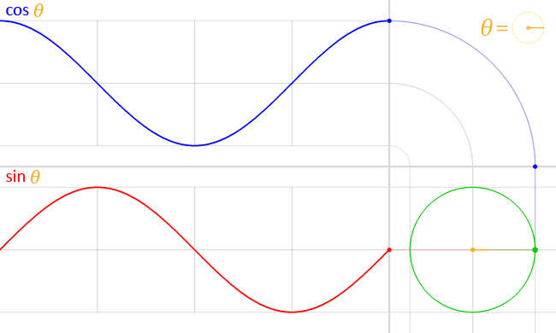
Frequency, Amplitude, and Phase
$$A . sin⁡(θ)$$
$$A . cos⁡(θ)$$

Slide 36
Frequency, Amplitude, and Phase
$$2π angles per cycle$$
$$f cycles per second$$
A
𝚹
time = t second
$$=$$
$$A . cos⁡(θ)$$
$$=$$
$$A . cos⁡(2πft)$$
$$=$$
$$A . sin⁡(2πft+(π/2))$$

Slide 37
Frequency, Amplitude, and Phase
Frequency: 2Hz
Amplitude
Time (sec)
0.00
0.25
0.50
0.75
1.00
1.25
Notes:
1) Two common terms related to signals are amplitude and frequency. Frequency is the number of repetition of the signal per second.

Slide 38
Frequency, Amplitude, and Phase
Frequency: 2Hz
Amplitude
Time (sec)
0.00
0.25
0.50
0.75
1.00
1.25
Frequency: 4Hz
Amplitude
Time (sec)
0.00
0.25
0.50
0.75
1.00
1.25

Slide 39
Frequencies of an arbitrary signal
Frequency: 2Hz
Amplitude
Time (sec)
0.00
0.25
0.50
0.75
1.00
1.25
Amplitude
Time (sec)
0.00
0.25
0.50
0.75
1.00
1.25

Slide 40
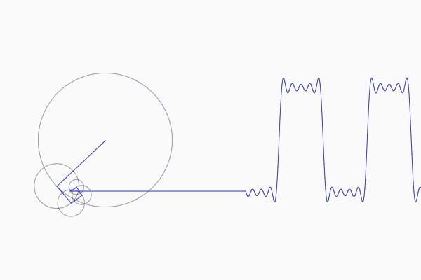
Frequencies of an arbitrary signal

Slide 41
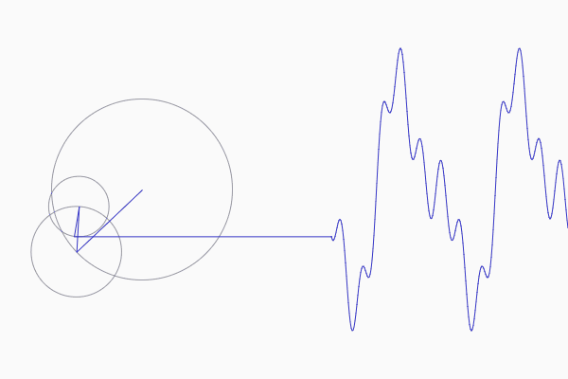
Frequencies of an arbitrary signal

Slide 42
The concept of the Fourier series
Amplitude
Time (sec)
0.00
0.25
0.50
0.75
1.00
1.25
Amplitude
Time (sec)
0.00
0.25
0.50
0.75
1.00
1.25

Slide 43
Time Domain and Frequency Domain
Approx. square wave
$$1 .\sin\left(2πft\right)$$
$$\frac{1}{3} .\sin\left(2π.3ft\right)$$
$$\frac{1}{5} .\sin\left(2π.5ft\right)$$
$$\frac{1}{7} .\sin\left(2π.7ft\right)$$

Slide 44
Time Domain and Frequency Domain
Time domain view
Frequency domain view

Slide 45
Analogy: Food coloring chart
Basis for food colors
Notes:
Emphasize basis and coefficient using Color analogy

Slide 46
Analogy: Food coloring chart
Basis for food colors
Notes:
Emphasize basis and coefficient using Color analogy

Slide 47
Analogy: Food coloring chart
Basis for food colors
Notes:
Emphasize basis and coefficient using Color analogy

Slide 48
Analogy: Food coloring chart
Basis for food colors
Notes:
Emphasize basis and coefficient using Color analogy

Slide 49
Time Domain and Frequency Domain
Amplitude
Time (sec)
0.00
0.25
0.50
0.75
1.00
1.25
$$= A1 .\sin\left(2πf1t\right)+B1 . cos⁡(2πf1t)$$
$$+ A2 .\sin\left(2πf2t\right)+B2 . cos⁡(2πf2t)$$
$$+ A3 .\sin\left(2πf3t\right)+B3 . cos⁡(2πf3t)$$
$$+ …$$

Slide 50
Time Domain and Frequency Domain
Fourier Transform
FFT
Amplitude
Amplitude
IFFT
0.00
0.25
0.50
0
2
4
6
8
Time
Frequency (Hz)
Time domain
Frequency domain
FFT = Fast Fourier Transform
IFFT = Inverse Fast Fourier Transform

Slide 51
Frequency band
Amplitude
0
2
4
6
8
Frequency (kHz)
A 4 kHz frequency band starting at 2 kHz
What is bandwidth?
What is baseband?

Slide 52
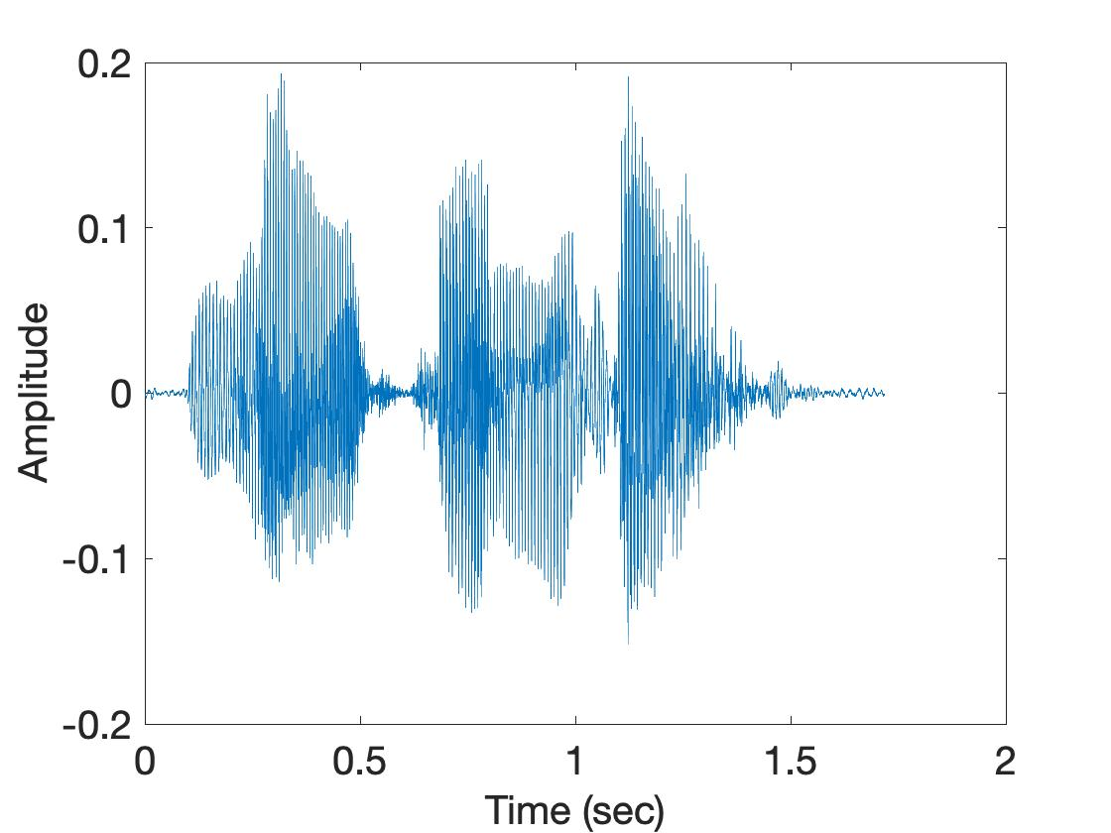
Spectrogram
U
M
D

Slide 53
Spectrogram
U
M
D
[
[
[
FFT of overlapping windows
of samples
(Spectrogram)
[
FFT
FFT
FFT
FFT

Slide 54
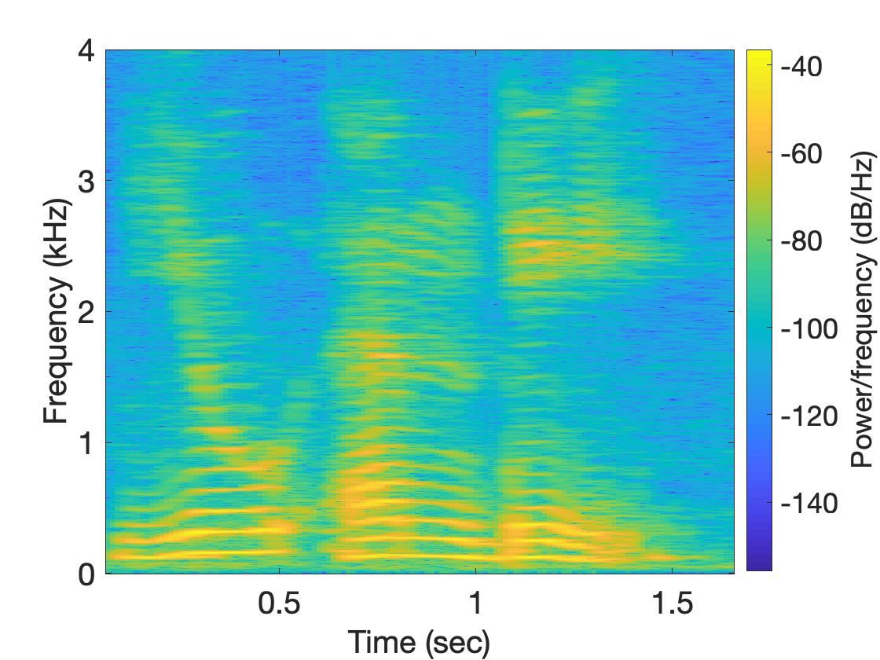
Spectrogram
U
M
D

Slide 55
Analog
Digital
Physical signal
(voice)
Spectrogram plot
on computer
FFT
Time varying voltage
signal
A collection of numbers

Slide 56
Analog vs Digital World
Temperature
Voltage
Thermo-couple
Time
Analog
Digital

Slide 57
Analog
Digital
Physical signal
(voice)
Spectrogram plot
on computer
FFT
Time varying voltage
signal
A collection of numbers
?

Slide 58
Analog
Digital
Physical signal
(voice)
Spectrogram plot
on computer
FFT
Time varying voltage
signal
A collection of numbers
ADC
Analog-to-Digital Converter

Slide 59
Sampling theorem
Amplitude
Time (sec)
0.00
0.25
0.50
0.75
1.00
1.25

Slide 60
Sampling theorem
Amplitude
Time (sec)
0.00
0.25
0.50
0.75
1.00
1.25
Amplitude
Time (sec)
0.00
0.25
0.50
0.75
1.00
1.25
[ 0.34 0.22 0.09 0.21 0.30 0.08 0.09 ]

Slide 61
Sampling theorem
Amplitude
Time (sec)
0.00
0.25
0.50
0.75
1.00
1.25
T = Sampling interval
f_{s}= 1/T = Sample rate (or sampling frequency)
Clock

Slide 62
1-dimensional sampling

Slide 63
1-dimensional sampling
2-dimensional sampling

Slide 64
1-dimensional sampling
2-dimensional sampling
3-dimensional sampling

Slide 65
Sampling theorem
Amplitude
Time (sec)
0.00
0.25
0.50
0.75
1.00
1.25
Amplitude
Time (sec)
0.00
0.25
0.50
0.75
1.00
1.25

Slide 66
Sampling theorem
Amplitude
Time (sec)
0.00
0.25
0.50
0.75
1.00
1.25
Aliasing: Two signals become indistinguishable
after sampling
Amplitude
Time (sec)
0.00
0.25
0.50
0.75
1.00
1.25

Slide 67
Aliasing
Amplitude
Time (sec)
0.00
0.25
0.50
0.75
1.00
1.25
Amplitude
Time (sec)
0.00
0.25
0.50
0.75
1.00
1.25

Slide 68
Aliasing

Slide 69
How to find a good sample rate?

Slide 70
How to find a good sample rate?
Nyquist sampling theorem:
In order to uniquely represent a signal F(t) by a set of samples, the sampling rate must be more than twice the highest frequency component present in F(t).
If sample rate is f_{s} and maximum frequency we want
record is f_{max} , then
f_{s} > 2f_{max}

Slide 71
Amplitude
Time (sec)
0.00
0.25
0.50
0.75
1.00
1.25
Nyquist frequency = Maximum alias-free frequency for a given sample rate.
Nyquist rate = Lower bound of sample rate for a signal

Slide 72
Aliasing
f_{max} = 12 Hz
f_{max} = 6000 Hz
Amplitude
Amplitude
0
4
8
12
16
0
2
4
6
8
Frequency (Hz)
Frequency (kHz)
A 4 kHz frequency band starting at 2 kHz

Slide 73
Commonly, the maximum frequency in human voice is 4 kHz, what sample rate will you use in your audio recorder?
Is there any limit on the maximum sample rate you can use?

Slide 74
Announcements
The papers will be open to view on the website today.
Please DO NOT send emails about the presentation.
We will start a poll next week (Tuesday, after the class) for paper selection.
Before that form a team of 2 and decide the papers.

Slide 75
Frequency, Amplitude, and Phase
A
$$A . sin⁡(θ)$$
𝚹
$$A . cos⁡(θ)$$

Slide 76
Frequency, Amplitude, and Phase
1
$$sin⁡(θ)$$
𝚹
$$cos⁡(θ)$$

