Slide 1

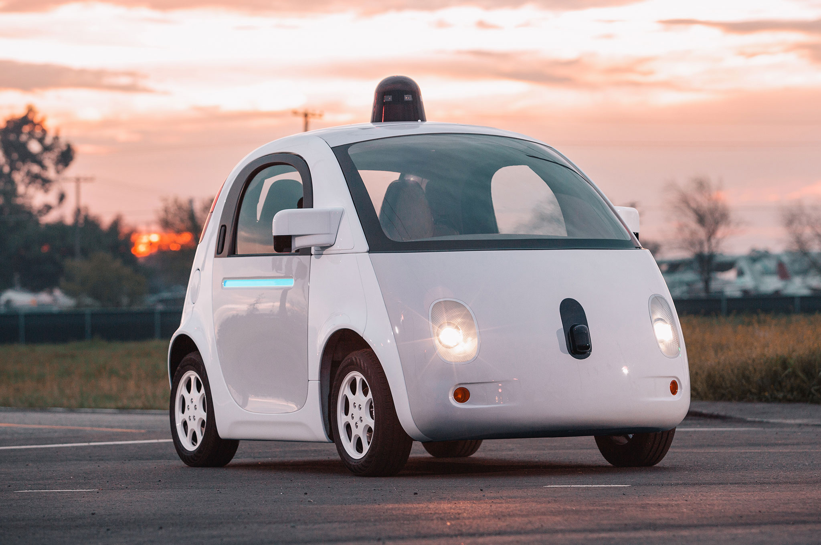

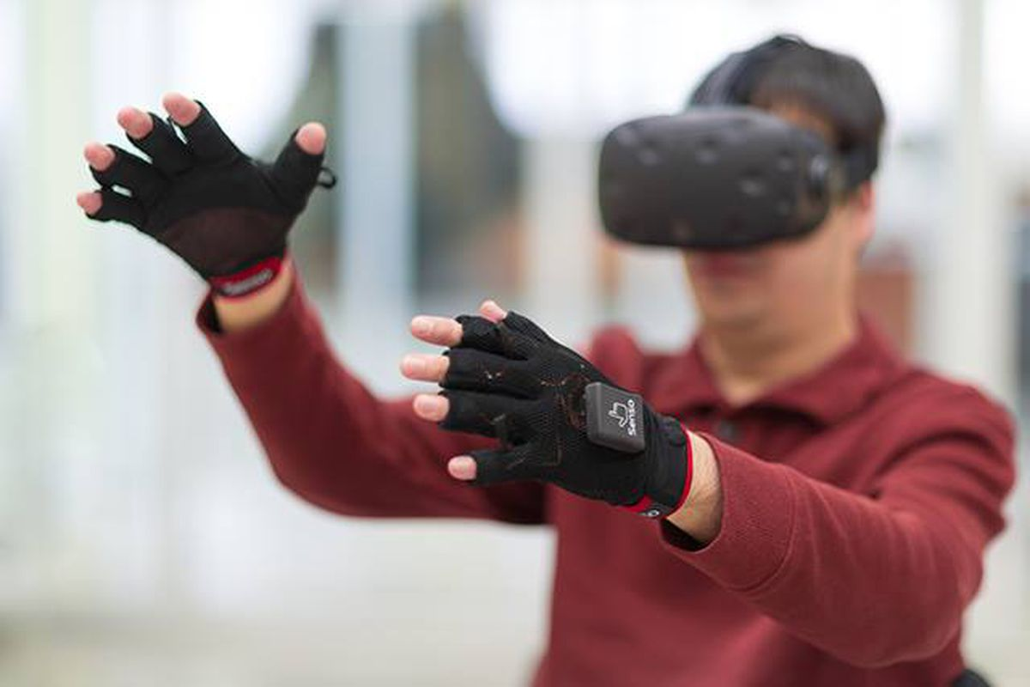

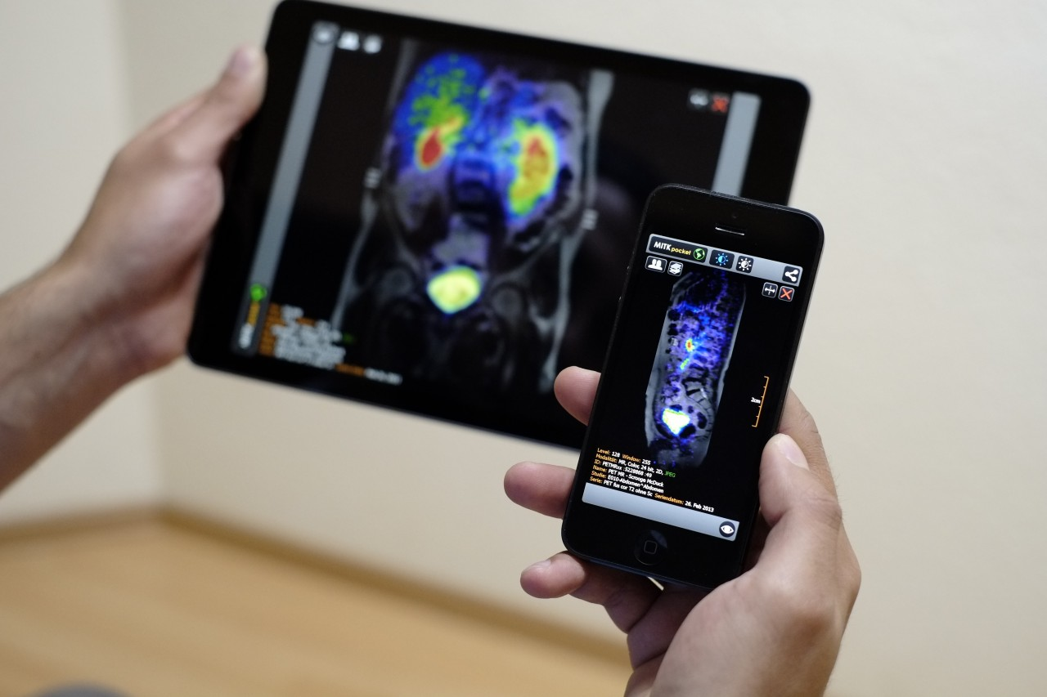
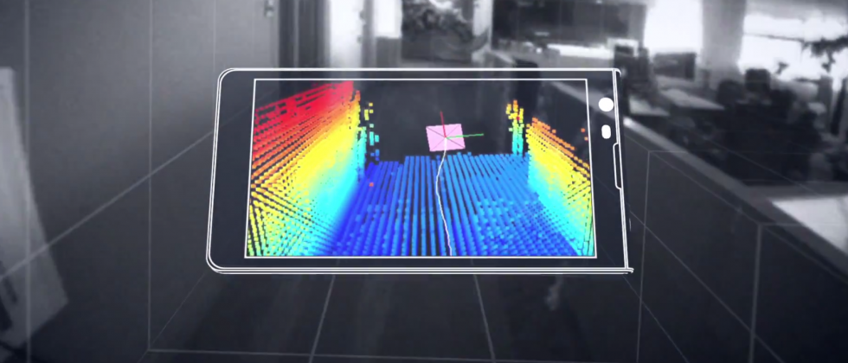

Wireless and Mobile Systems
for the IoT
CMSC 818W : Fall 2019
Lecture 1.2: Mathematical Foundations
for Signal Analysis
Nirupam Roy
M-W 2:00-3:15pm
CSI 1122

Slide 2
Mathematical abstractions

Slide 3
Mathematical abstractions
… we use them everyday to
understand our world

Slide 4
A few examples
What is a number?
What is a negative number?
What do they model?
Any other example?

Slide 5
Model for a signal (frequency, amplitude, and phase)

Slide 6


Model for a signal (frequency, amplitude, and phase)
$$A . sin⁡(θ)$$
$$A . cos⁡(θ)$$
Why not use the sinusoid as the model ?

Slide 7
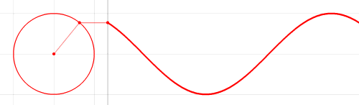

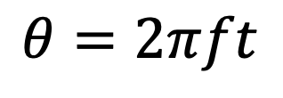



Model for a signal (frequency, amplitude, and phase)
1
$$sin⁡(θ)$$
𝚹
$$cos⁡(θ)$$
$$f cycles per second$$
$$θ=2πft$$
$$2π angles per cycle$$

Slide 8





Frequency, Amplitude, and Phase
$$2π angles per cycle$$
$$f cycles per second$$
A
𝚹
Phase
time = t second
$$=$$
$$A . sin⁡(θ)$$
$$=$$
$$A . sin⁡(2πft)$$
$$A . sin⁡(2πft+φ)$$
-- with initial/additional phase ϕ

Slide 9
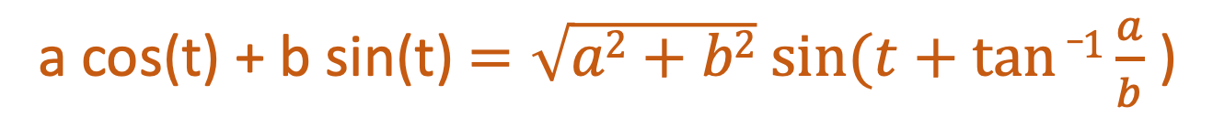
Why do we need both Sine and Cosine ?
A sine function with phase shift can be written as a weighted combination of sine and cosine:
a cos(t) + b sin(t) $=\sqrt{a2+b2} sin⁡(t+tan⁡_1\frac{a}{b}$ )

Slide 10
Model for a signal (frequency, amplitude, and phase)
1
$$sin⁡(θ)$$
𝚹
$$cos⁡(θ)$$
How can we incorporate both Sine and Cosine in the equation?

Slide 11

Model for a signal (frequency, amplitude, and phase)
1
$$sin⁡(θ)$$
𝚹
$$cos⁡(θ)$$
1.
$$\cos\left(θ\right)+sin⁡(θ)$$

Slide 12

Model for a signal (frequency, amplitude, and phase)
1
$$sin⁡(θ)$$
𝚹
$$cos⁡(θ)$$
1.
$$\cos\left(θ\right)+sin⁡(θ)$$
2.
$$<cos\left(θ\right), \sin\left(θ\right)>$$

Slide 13

Model for a signal (frequency, amplitude, and phase)
1
$$sin⁡(θ)$$
𝚹
$$cos⁡(θ)$$
1.
$$\cos\left(θ\right)+sin⁡(θ)$$
2.
$$<cos\left(θ\right), \sin\left(θ\right)>$$
3.
$$\cos\left(θ\right)+j \sin\left(θ\right)$$

Slide 14
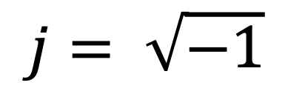
Complex numbers
Imaginary
$$j= \sqrt{−1}$$

Slide 15
Complex numbers

Slide 16
Complex numbers

Slide 17
Complex numbers

Slide 18
Complex numbers and Natural exponential
…

Slide 19
Complex numbers and Natural exponential
…
…

Slide 20
Complex numbers and Natural exponential
…
…
…

Slide 21
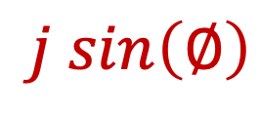

Complex numbers and Natural exponential
…
…
…
$$\cos\left(∅\right)$$
$$j sin\left(∅\right)$$

Slide 22
Complex numbers and Natural exponential

Slide 23
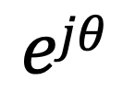
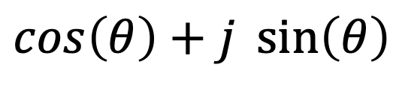

Model for a signal (frequency, amplitude, and phase)
$$\cos\left(θ\right)+j \sin\left(θ\right)$$
$$=$$
$$ejθ$$

Slide 24
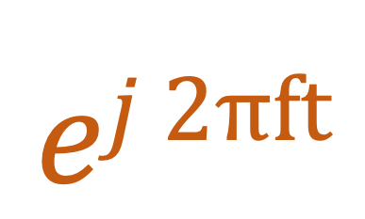

Model for a signal (frequency, amplitude, and phase)
$$ej 2πft$$
$$\cos\left(θ\right)+j \sin\left(θ\right)$$
$$=$$
$$ejθ$$
$$=$$

Slide 25
Model for a signal (frequency, amplitude, and phase)
$$ej 2πft$$
$$\cos\left(θ\right)+j \sin\left(θ\right)$$
$$=$$
$$ejθ$$
$$=$$

Slide 26
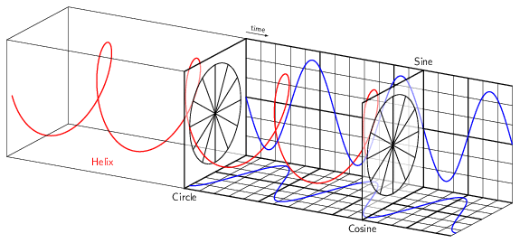
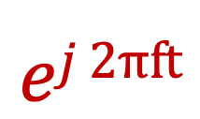
Model for a signal (frequency, amplitude, and phase)
$$ej 2πft$$

Slide 27
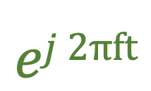
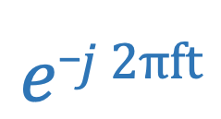
Model for a signal (frequency, amplitude, and phase)
$$ej 2πft$$
$$e_j 2πft$$

Slide 28

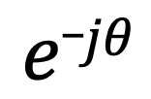


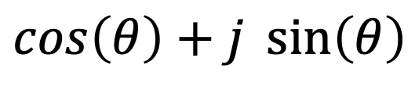

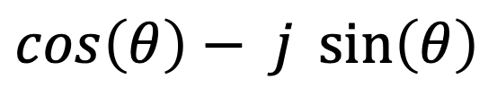

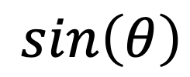
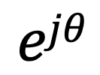

Model for a signal (frequency, amplitude, and phase)
$$ejθ$$
$$=$$
$$\cos\left(θ\right)+j \sin\left(θ\right)$$
$$e_jθ$$
$$=$$
$$\cos\left(θ\right)− j \sin\left(θ\right)$$
How about real sinusoids?
$$\cos\left(θ\right)$$
$$=$$
$$?$$
$$\sin\left(θ\right)$$
$$=$$
$$?$$

Slide 29

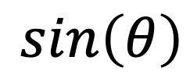



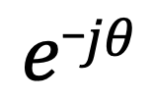
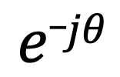
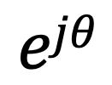
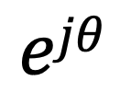
Presenting real signal with the complex model
$$ejθ$$
$$=$$
$$\cos\left(θ\right)+j \sin\left(θ\right)$$
$$e_jθ$$
$$=$$
$$\cos\left(θ\right)− j \sin\left(θ\right)$$
$$ejθ$$
$$+$$
$$e_jθ$$
$$\cos\left(θ\right)$$
$$=$$
2
$$ejθ$$
$$−$$
$$e_jθ$$
$$\sin\left(θ\right)$$
$$=$$
2j

Slide 30
Presenting real signal with the complex model

Slide 31
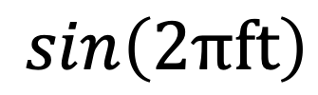
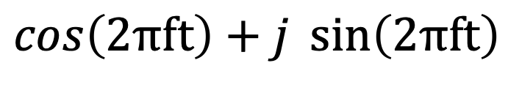


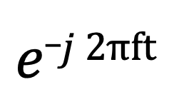
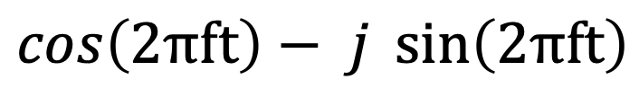
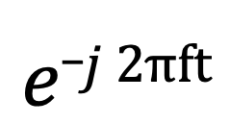
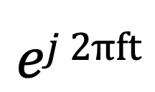
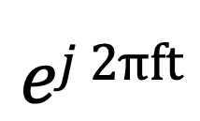
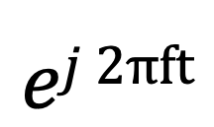
Presenting real signal with the complex model
$$ej 2πft$$
$$=$$
$$\cos\left(2πft\right)+j \sin\left(2πft\right)$$
$$e_j 2πft$$
$$=$$
$$\cos\left(2πft\right)− j \sin\left(2πft\right)$$
$$ej 2πft$$
$$+$$
$$e_j 2πft$$
$$\cos\left(2πft\right)$$
$$=$$
2
$$ej 2πft$$
$$−$$
$$e_j 2πft$$
$$\sin\left(2πft\right)$$
$$=$$
2j

Slide 32
Time Domain and Frequency Domain
Fourier Transform
FFT
Amplitude
Amplitude
IFFT
0.00
0.25
0.50
0
2
4
6
8
Time
Frequency (Hz)
Time domain
Frequency domain
FFT = Fast Fourier Transform
IFFT = Inverse Fast Fourier Transform

Slide 33
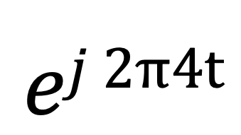
Time Domain and Frequency Domain
Fourier Transform
$$ej 2π4t$$
FFT
Amplitude
0
2
4
6
8
Frequency (Hz)
Time domain
Frequency domain
FFT = Fast Fourier Transform
IFFT = Inverse Fast Fourier Transform

Slide 34

Time Domain and Frequency Domain
Fourier Transform
FFT
?
$$\cos\left(2πft\right)$$
Amplitude
0
2
4
6
8
Frequency (Hz)
Time domain
Frequency domain
FFT = Fast Fourier Transform
IFFT = Inverse Fast Fourier Transform

Slide 35




Time Domain and Frequency Domain
Fourier Transform
FFT
?
$$\cos\left(2πft\right)$$
Amplitude
$$ej 2πft$$
$$+$$
$$e_j 2πft$$
$$=$$
2
0
2
4
6
8
Frequency (Hz)
Time domain
Frequency domain
FFT = Fast Fourier Transform
IFFT = Inverse Fast Fourier Transform

Slide 36
Time Domain and Frequency Domain
Fourier Transform
FFT
$$\cos\left(2πft\right)$$
Amplitude
$$ej 2πft$$
$$+$$
$$e_j 2πft$$
$$=$$
2
-6
-4
-2
0
2
4
6
8
Frequency (Hz)
Time domain
Frequency domain
FFT = Fast Fourier Transform
IFFT = Inverse Fast Fourier Transform

Slide 37

Time Domain and Frequency Domain
Fourier Transform
FFT
$$\cos\left(2π4t\right)$$
Amplitude
$$ej 2πft$$
$$+$$
$$e_j 2πft$$
$$=$$
2
-6
-4
-2
0
2
4
6
8
Frequency (Hz)
Time domain
Frequency domain
FFT = Fast Fourier Transform
IFFT = Inverse Fast Fourier Transform

Slide 38
Matlab demo
function fft_test()
freq = 200;
sampleRate = 1000;
time_ticks = 0:1/sampleRate:1;
realSignal = sin(2*pi*freq*time_ticks);
plot_fft(realSignal, sampleRate);
complexSignal = exp(j*2*pi*freq*time_ticks);
plot_fft(complexSignal, sampleRate);
end

