Slide 1

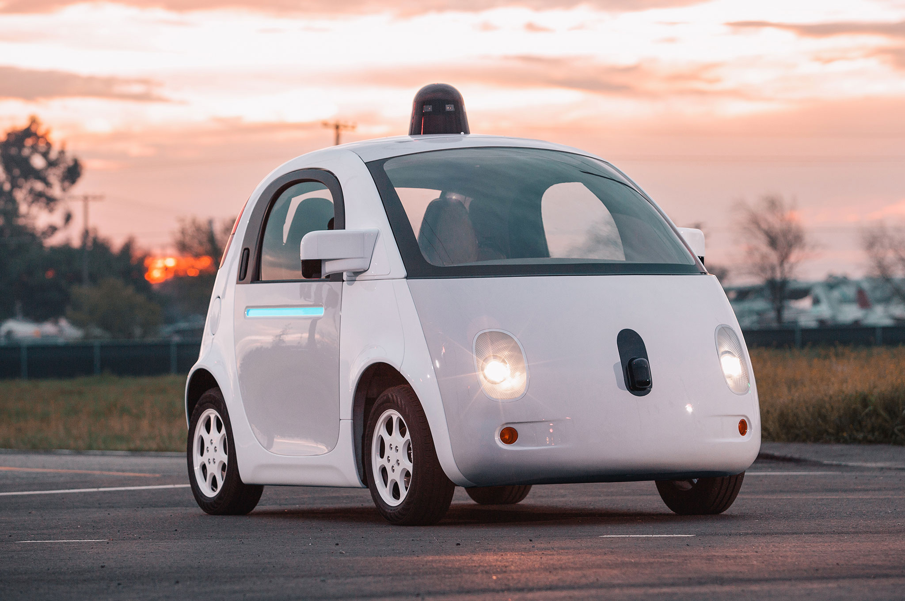

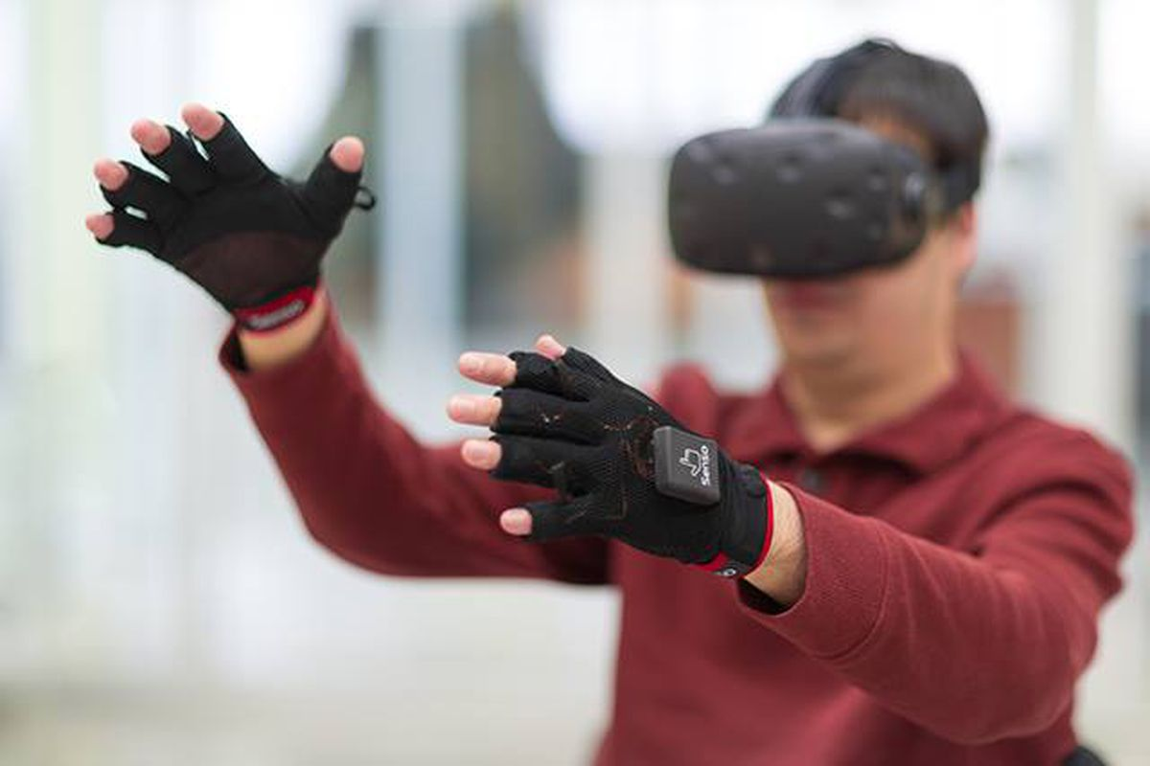

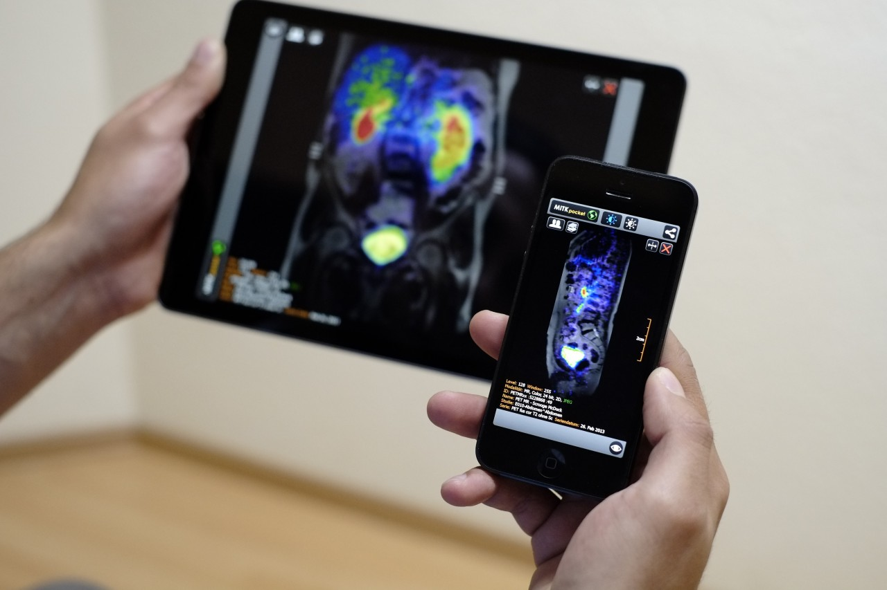
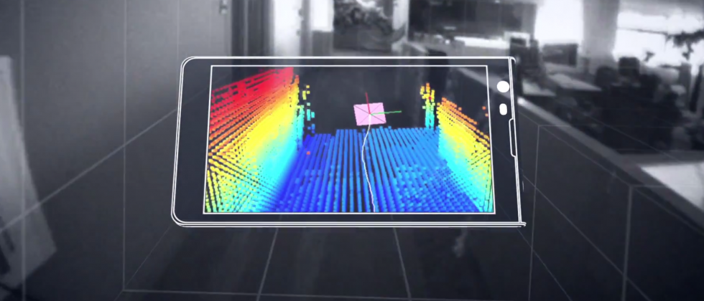
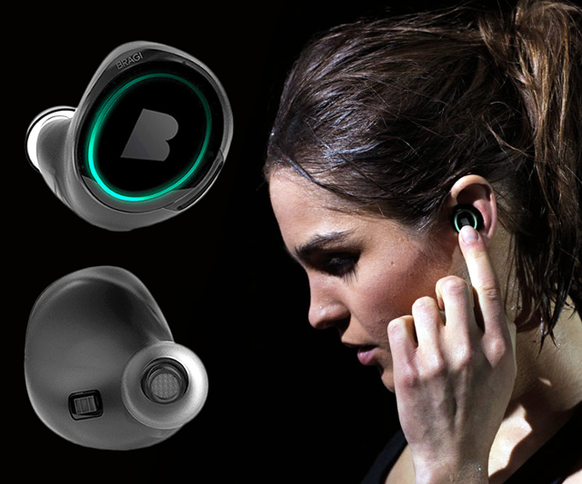
Wireless and Mobile Systems
for the IoT
CMSC 818W : Fall 2019
Lecture 1.3: Mathematical Foundations
for Signal Analysis (Part 2)
Nirupam Roy
M-W 2:00-3:15pm
CSI 1122

Slide 2
An (incomplete) overview of Linear Algebra
2. Calculating Discrete Fourier Transform (DFT)

Slide 3
An (incomplete) overview of Linear Algebra
2. Calculating Discrete Fourier Transform (DFT)

Slide 4
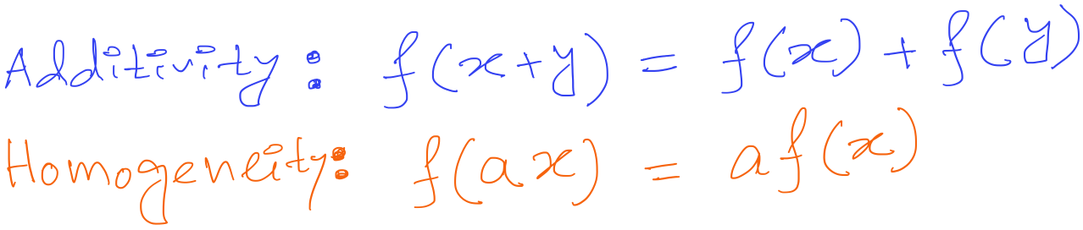
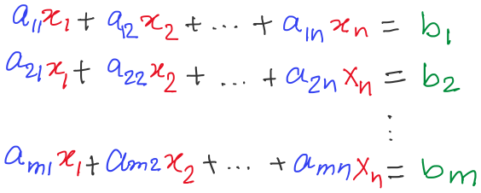
Properties of a linear function f(x)

Slide 5
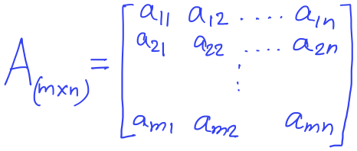
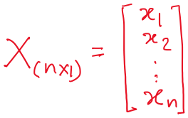
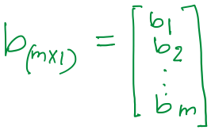

System of linear equation

Slide 6
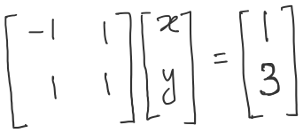
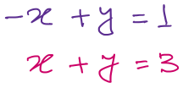
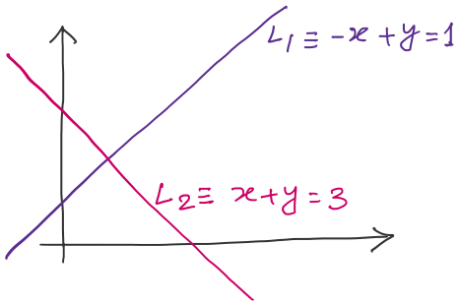
Row view
Solution, x=1, y=2

Slide 7
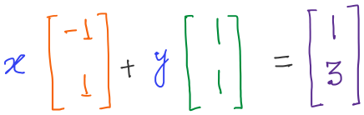
Column view

Slide 8
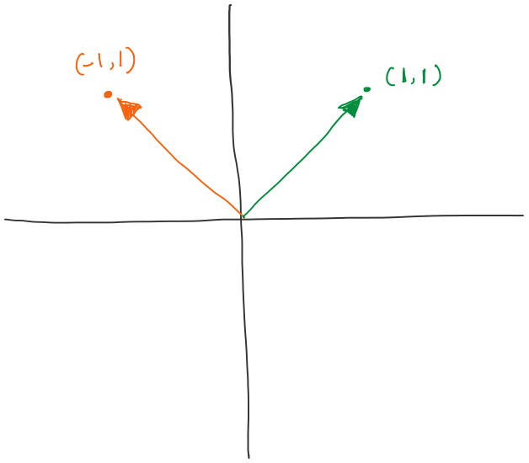
Column view

Slide 9
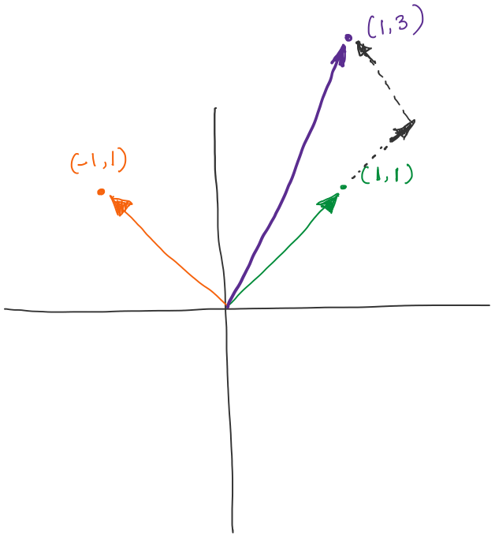
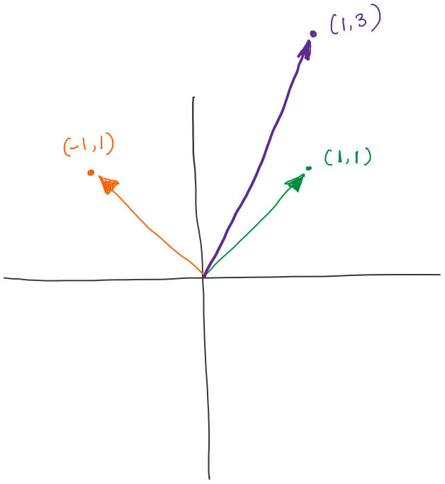
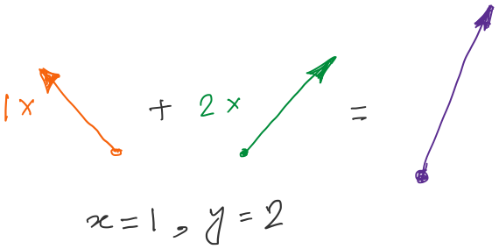
Column view
What is the solution space or the set of all candidate solutions?
Ans: All linear combinations of the columns
of the matrix A_{(m x n)}

Slide 10
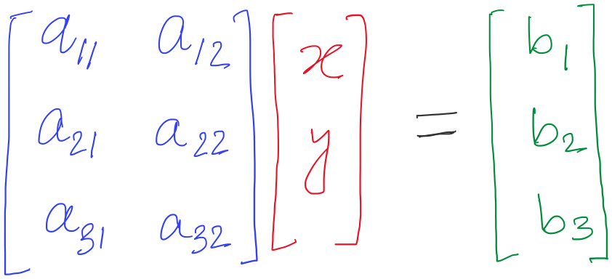
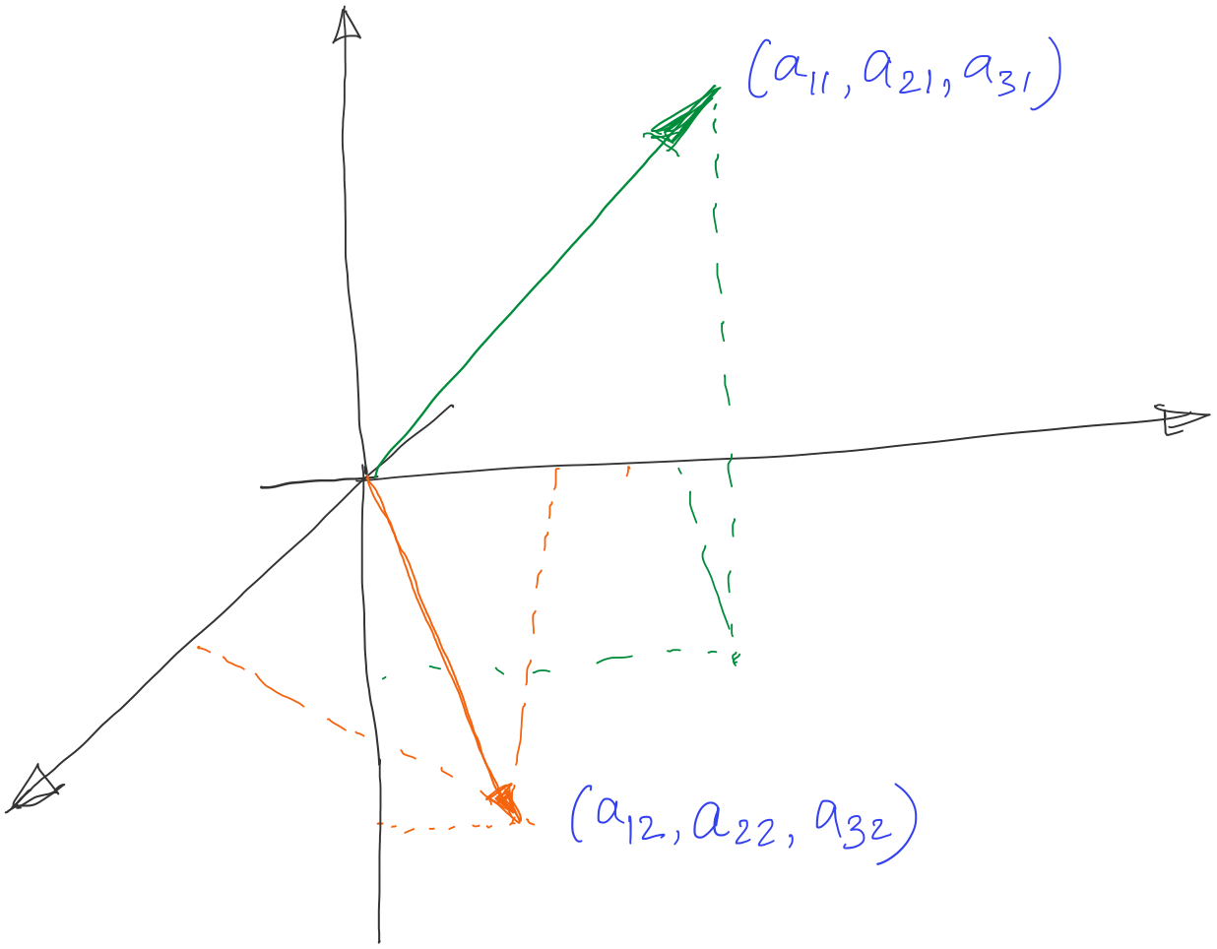
Column space

Slide 11
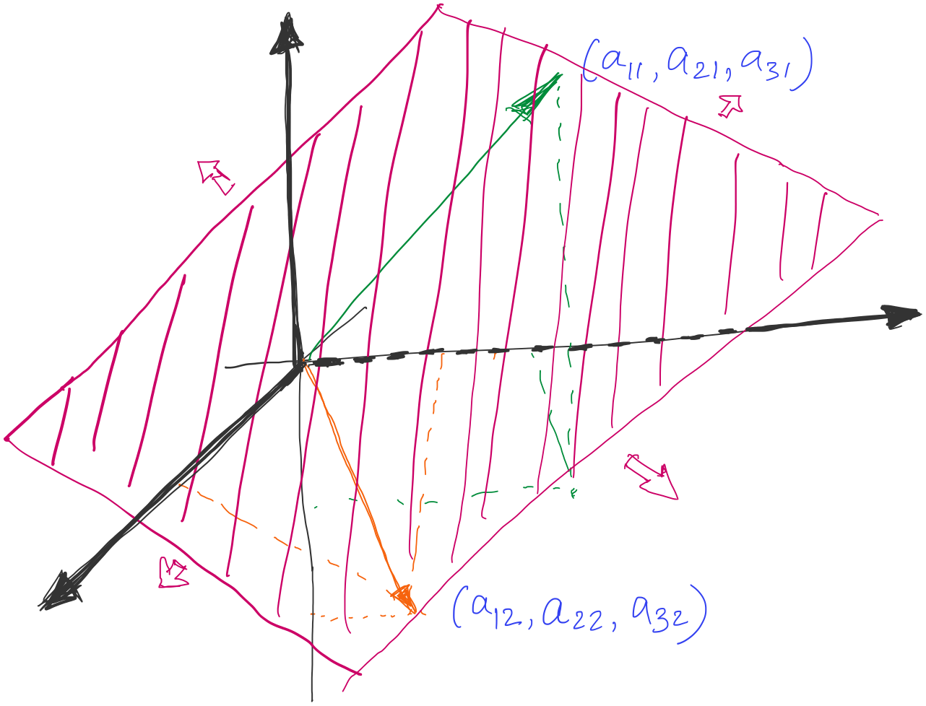
Column space
Solution space, spanned by the columns of the matrix A
( b vector should lie in this space )

Slide 12
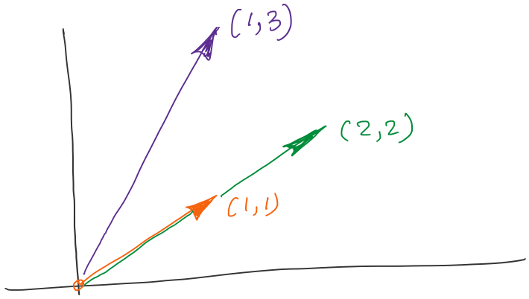
What if the vectors are aligned?
What is column rank of the matrix?
A column is a linear combination of other columns
i.e., the columns are not independent

Slide 13
Approximate solution

Slide 14
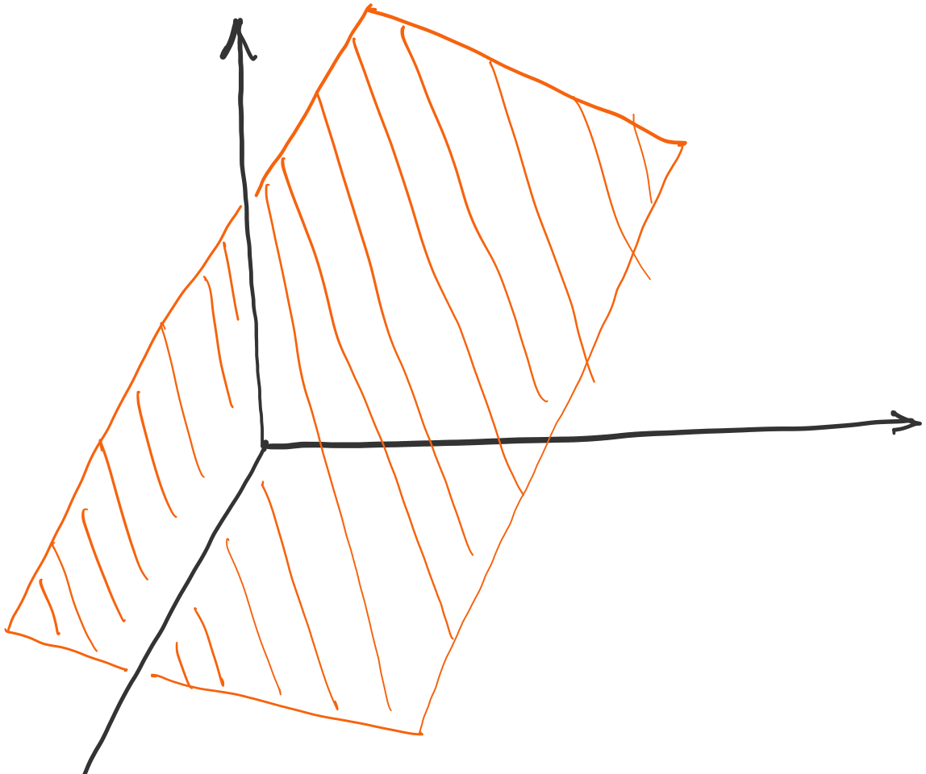
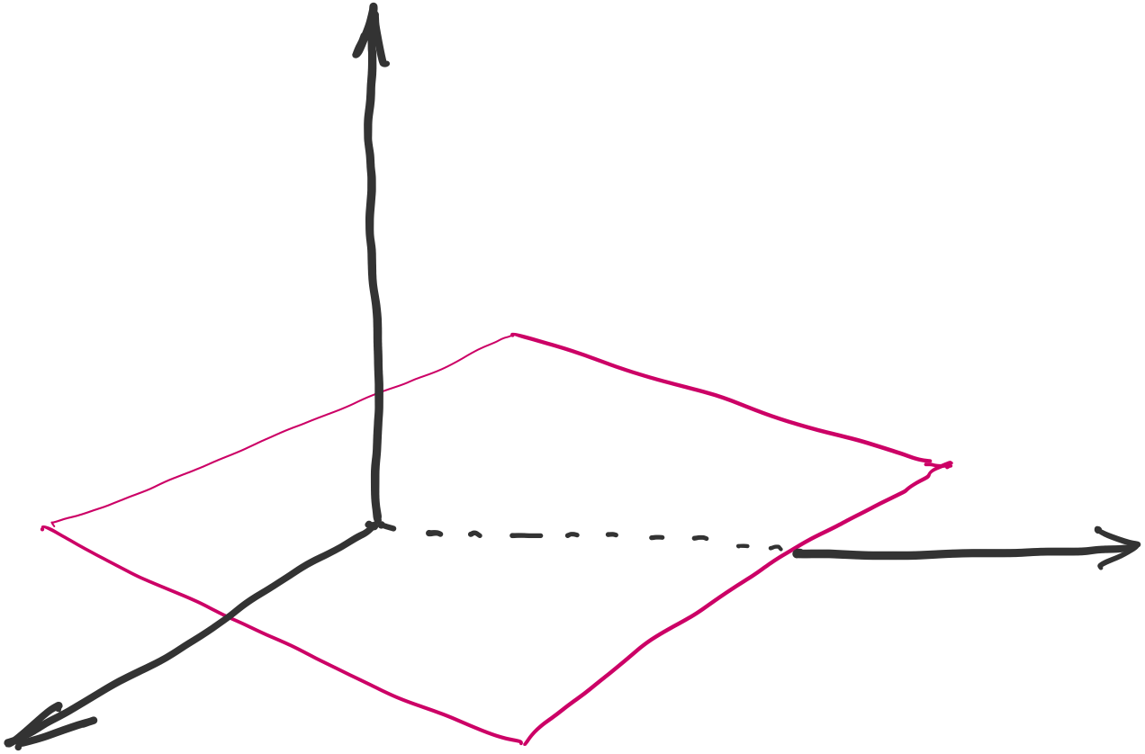
Approximate solution
Column space of the matrix A

Slide 15
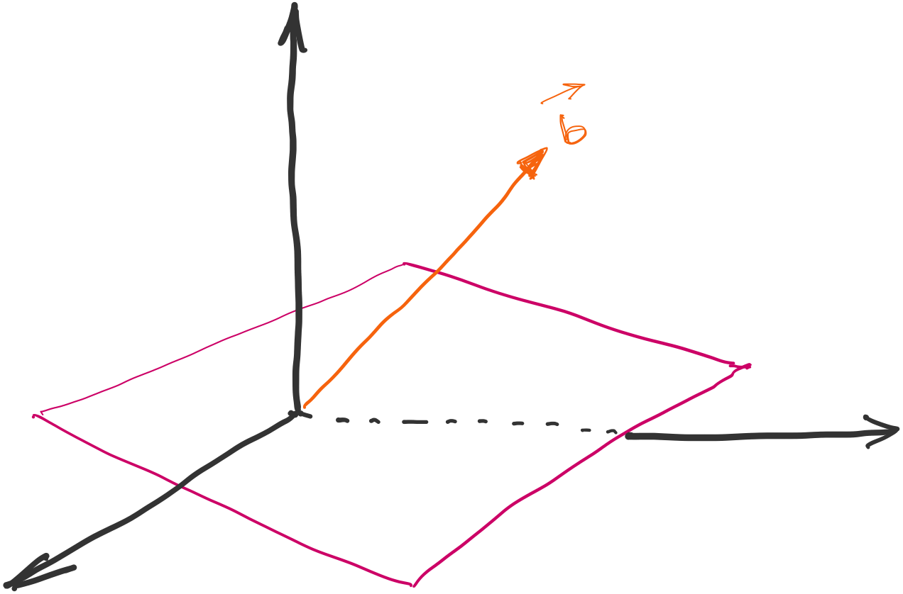
Approximate solution

Slide 16
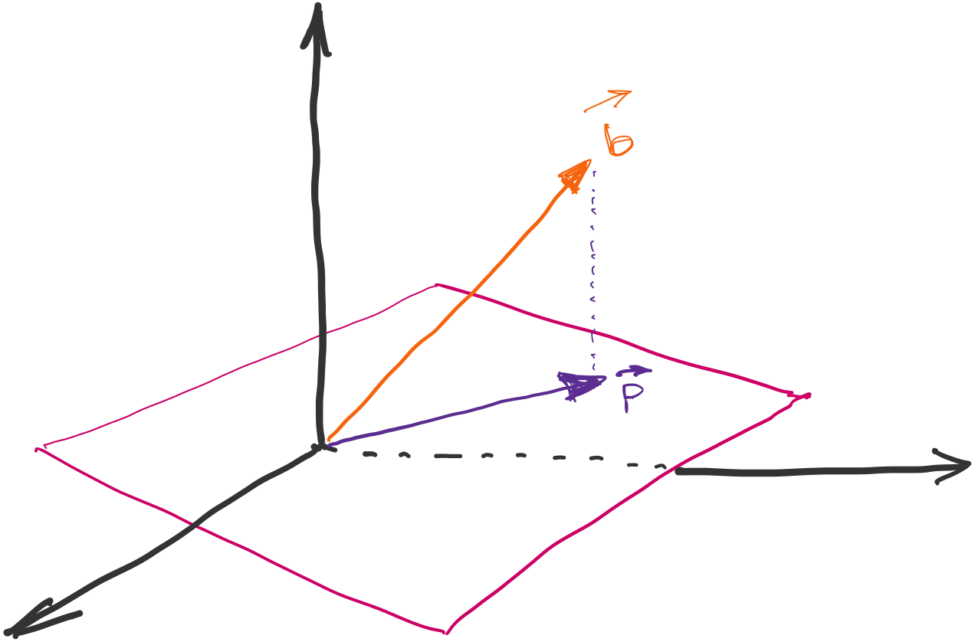
Approximate solution

Slide 17
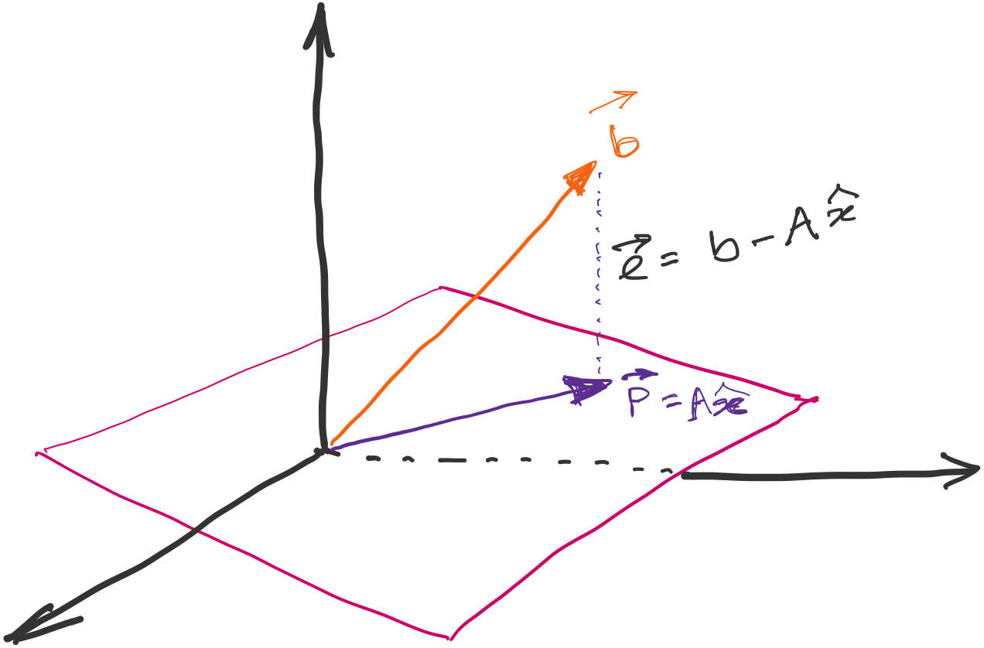
Approximate solution
Error e is orthogonal to the plane for optimal solution
Projection of the vector b on the solution plane
Two vectors a & b are orthogonal when their
dot product (a^{T} b) is zero.

Slide 18
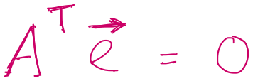
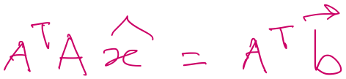
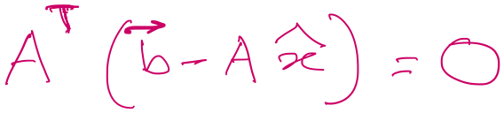
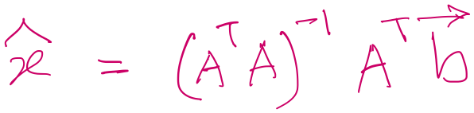
Approximate solution

Slide 19
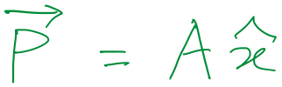
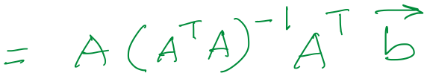
Approximate solution
Projection matrix

Slide 20
An (incomplete) overview of Linear Algebra
2. Calculating Discrete Fourier Transform (DFT)

Slide 21
Discrete Fourier Transform
…
0
1
2
3
4
5
6
N-1
Sample number
X = [ ]
x[0], x[1], x[2], x[3], x[4], … x[N-1]

Slide 22
Discrete Fourier Transform
…
0
1
2
3
4
5
6
N-1
Sample number
X = [ ]
x[0], x[1], x[2], x[3], x[4], … x[N-1]

Slide 23





Discrete Fourier Transform
…
0
1
2
3
4
5
6
N-1
Sample number
$$e^{j2.\frac{2π}{N}}$$
$$e^{j1.\frac{2π}{N}}$$
$$\frac{2π}{N}$$
$$e^{j0.\frac{2π}{N}}$$
$$e^{j(N−1).\frac{2π}{N}}$$

Slide 24



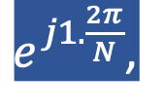
Discrete Fourier Transform
…
0
1
2
3
4
5
6
N-1
Sample number
= [ ]
Freq f₁
$$e^{j0.\frac{2π}{N}},$$
$e^{j1.\frac{2π}{N}}$,
$$e^{j2.\frac{2π}{N}},$$
…
$${,e}^{j(N−1).\frac{2π}{N}}$$
$$e^{j2.\frac{2π}{N}}$$
$$e^{j1.\frac{2π}{N}}$$
$$\frac{2π}{N}$$
$$e^{j0.\frac{2π}{N}}$$
$$e^{j(N−1).\frac{2π}{N}}$$

Slide 25

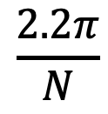


Discrete Fourier Transform
…
0
1
2
3
4
5
6
N-1
Sample number
$$e^{j1.\frac{2.2π}{N}}$$
$$\frac{2.2π}{N}$$
$$e^{j0.\frac{2.2π}{N}}$$
$$e^{j(N−1).\frac{2.2π}{N}}$$

Slide 26

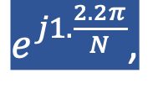


Discrete Fourier Transform
…
0
1
2
3
4
5
6
N-1
Sample number
= [ ]
Freq f₂
$$e^{j0.\frac{2.2π}{N}},$$
$e^{j1.\frac{2.2π}{N}}$,
$$e^{j2.\frac{2.2π}{N}},$$
…
$${,e}^{j(N−1).\frac{2.2π}{N}}$$
$$e^{j1.\frac{2.2π}{N}}$$
$$\frac{2.2π}{N}$$
$$e^{j0.\frac{2.2π}{N}}$$
$$e^{j(N−1).\frac{2.2π}{N}}$$

Slide 27
Discrete Fourier Transform
…
0
1
2
3
4
5
6
N-1
Sample number
What is the MINIMUM number of cycles
observable in this model?

Slide 28

Discrete Fourier Transform
…
0
1
2
3
4
5
6
N-1
Sample number
$$0$$

Slide 29



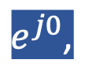
Discrete Fourier Transform
…
0
1
2
3
4
5
6
N-1
Sample number
= [ ]
Freq f₀
$$e^{j0},$$
$e^{j0}$,
$$e^{j0},$$
…
$${,e}^{j0}$$
$$0$$

Slide 30
Discrete Fourier Transform
…
0
1
2
3
4
5
6
N-1
Sample number
What is the MAXIMUM number of cycles
observable in this model?

Slide 31
Discrete Fourier Transform
…
0
1
2
3
4
5
6
N-1
Sample number
What happens when the ball rotates exactly N times?
$$0$$
We can uniquely observe up to (N-1) number of cycles.

Slide 32


Discrete Fourier Transform
Freq f₀
n=0
$$e^{j0}$$
n=1
$$e^{j0}$$
n=2
$$e^{j0}$$
…
…
n=N-1
$$e^{j0}$$

Slide 33
Discrete Fourier Transform
Number of cycles
…
…
Freq f₀
Freq f₁
Freq f_{m}
Freq f_{N-1}
n=0
$$e^{j0}$$
n=1
$$e^{j0}$$
Sample number
n=2
$$e^{j0}$$
…
…
n=N-1
$$e^{j0}$$

Slide 34












Discrete Fourier Transform
Number of cycles
…
…
Freq f₀
Freq f₁
Freq f_{m}
Freq f_{N-1}
n=0
$$e^{j0}$$
$$e^{j0.\frac{2π}{N}}$$
$$e^{j0.\frac{m.2π}{N}}$$
$$e^{j0.\frac{(N−1).2π}{N}}$$
n=1
$$e^{j0}$$
$$e^{j1.\frac{2π}{N}}$$
$$e^{j1.\frac{m.2π}{N}}$$
$$e^{j1.\frac{(N−1).2π}{N}}$$
Sample number
…
…
$$e^{j2.\frac{(N−1).2π}{N}}$$
$$e^{j2.\frac{2π}{N}}$$
$$e^{j2.\frac{m.2π}{N}}$$
n=2
$$e^{j0}$$
…
…
…
…
…
$$e^{j(N−1).\frac{2π}{N}}$$
$$e^{j(N−1).\frac{m.2π}{N}}$$
$$e^{j(N−1).\frac{(N−1).2π}{N}}$$
n=N-1
$$e^{j0}$$

Slide 35














Discrete Fourier Transform
$$e^{j0}$$
$$e^{j0.\frac{2π}{N}}$$
$$e^{j0.\frac{m.2π}{N}}$$
$$e^{j0.\frac{(N−1).2π}{N}}$$
$$e^{j0}$$
$$e^{j1.\frac{2π}{N}}$$
$$e^{j1.\frac{m.2π}{N}}$$
$$e^{j1.\frac{(N−1).2π}{N}}$$
+
$$e^{j2.\frac{2π}{N}}$$
+
$$e^{j2.\frac{m.2π}{N}}$$
+
$$e^{j2.\frac{(N−1).2π}{N}}$$
Z₀
$$e^{j0}$$
Z₁
…
Z_{m}
…
Z_{N-1}
…
…
…
…
$$e^{j(N−1).\frac{2π}{N}}$$
$$e^{j(N−1).\frac{m.2π}{N}}$$
$$e^{j(N−1).\frac{(N−1).2π}{N}}$$
$$e^{j0}$$

Slide 36














Discrete Fourier Transform
$$e^{j0}$$
$$e^{j0.\frac{2π}{N}}$$
$$e^{j0.\frac{m.2π}{N}}$$
$$e^{j0.\frac{(N−1).2π}{N}}$$
$$e^{j0}$$
$$e^{j1.\frac{2π}{N}}$$
$$e^{j1.\frac{m.2π}{N}}$$
$$e^{j1.\frac{(N−1).2π}{N}}$$
+
$$e^{j2.\frac{2π}{N}}$$
+
$$e^{j2.\frac{m.2π}{N}}$$
+
$$e^{j2.\frac{(N−1).2π}{N}}$$
Z₀
$$e^{j0}$$
Z₁
…
Z_{m}
…
Z_{N-1}
…
…
…
…
$$e^{j(N−1).\frac{2π}{N}}$$
$$e^{j(N−1).\frac{m.2π}{N}}$$
$$e^{j(N−1).\frac{(N−1).2π}{N}}$$
$$e^{j0}$$

Slide 37
Discrete Fourier Transform
$$e^{j0}$$
$$e^{j0.\frac{2π}{N}}$$
$$e^{j0.\frac{m.2π}{N}}$$
$$e^{j0.\frac{(N−1).2π}{N}}$$
$$e^{j0}$$
$$e^{j1.\frac{2π}{N}}$$
$$e^{j1.\frac{m.2π}{N}}$$
$$e^{j1.\frac{(N−1).2π}{N}}$$
+
$$e^{j2.\frac{2π}{N}}$$
+
$$e^{j2.\frac{m.2π}{N}}$$
+
$$e^{j2.\frac{(N−1).2π}{N}}$$
Z₀
$$e^{j0}$$
Z₁
…
Z_{m}
…
Z_{N-1}
…
…
…
…
$$e^{j(N−1).\frac{2π}{N}}$$
$$e^{j(N−1).\frac{m.2π}{N}}$$
$$e^{j(N−1).\frac{(N−1).2π}{N}}$$
$$e^{j0}$$
=
…
0
1
2
3
4
5
6
N-1
Sample number

Slide 38
Discrete Fourier Transform
Frequency domain coefficients
$$e^{j0}$$
$$e^{j0.\frac{2π}{N}}$$
$$e^{j0.\frac{m.2π}{N}}$$
$$e^{j0.\frac{(N−1).2π}{N}}$$
$$e^{j0}$$
$$e^{j1.\frac{2π}{N}}$$
$$e^{j1.\frac{m.2π}{N}}$$
$$e^{j1.\frac{(N−1).2π}{N}}$$
+
$$e^{j2.\frac{2π}{N}}$$
+
$$e^{j2.\frac{m.2π}{N}}$$
+
$$e^{j2.\frac{(N−1).2π}{N}}$$
Z₀
$$e^{j0}$$
Z₁
…
Z_{m}
…
Z_{N-1}
…
…
…
…
$$e^{j(N−1).\frac{2π}{N}}$$
$$e^{j(N−1).\frac{m.2π}{N}}$$
$$e^{j(N−1).\frac{(N−1).2π}{N}}$$
$$e^{j0}$$
x[0]
x[1]
=
X =
x[2]
Time domain samples
…
x[N-1]

Slide 39
Discrete Fourier Transform
_{F}
…
DFT matrix,
=
f₀
f₁
…
f_{m}
f_{N-1}

Slide 40
Discrete Fourier Transform
_{F}
…
DFT matrix,
=
f₀
f₁
…
f_{m}
f_{N-1}
_{Z}
Z₀
Fourier coefficients,
=
Z₁
…
Z_{m}
…
Z_{N-1}

Slide 41
Discrete Fourier Transform
_{F}
…
DFT matrix,
=
f₀
f₁
…
f_{m}
f_{N-1}
_{Z}
Z₀
x[0]
X =
Fourier coefficients,
=
Z₁
Time series,
…
x[1]
Z_{m}
x[2]
…
…
Z_{N-1}
x[N-1]

Slide 42
Discrete Fourier Transform
_{X}
_{F}
_{Z}
=
_{X}
_{Z}
_{F}⁻¹
=
*
_{X}
_{Z}
_{F}
=

Slide 43
Discrete Fourier Transform
_{X}
_{F}
_{Z}
=
_{X}
_{Z}
_{F}⁻¹
=
*
_{X}
_{Z}
_{F}
=
*
f₀
*
f₁
…
*
f_{m}
…
*
f_{N-1}

Slide 44
Discrete Fourier Transform
_{X}
_{F}
_{Z}
=
IDFT
_{X}
_{Z}
_{F}⁻¹
=
DFT
*
_{X}
_{Z}
_{F}
=
*
f₀
x[0]
Z₀
*
Z₁
f₁
x[1]
…
=
…
*
x[2]
Z_{m}
f_{m}
…
…
…
Z_{N-1}
*
x[N-1]
f_{N-1}

Slide 45
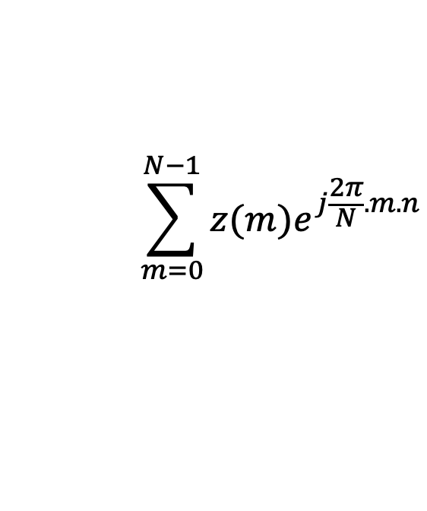
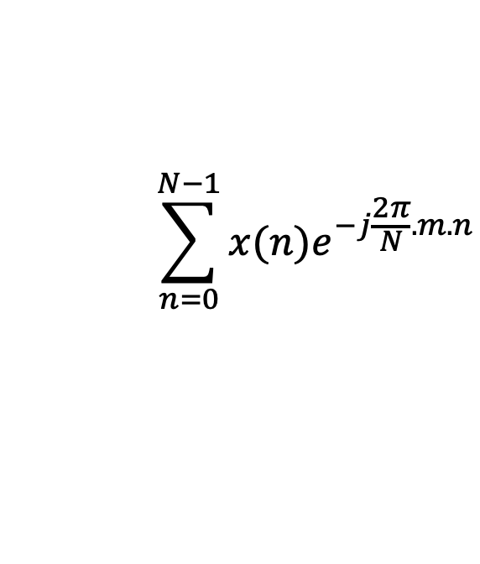
Discrete Fourier Transform
$$\sum_{n=0}^{N−1}{x(n)e^{−j\frac{2π}{N}.m.n}}$$
DFT:
z(m) =
$$\sum_{m=0}^{N−1}{z(m)e^{j\frac{2π}{N}.m.n}}$$
IDFT:
x(n) =

Slide 46
Preserving energy in time and frequency domain

Slide 47
Preserving energy in time and frequency domain
Is IDFT( DFT(x) ) = x ?

Slide 48

Preserving energy in time and frequency domain
Is IDFT( DFT(x) ) = x ?
*
_{X ?}
_{X}
_{F F}
=
*
_{N.X}
_{X}
_{F F}
=
_{F}
$$\frac{1}{\sqrt{N}}$$
…
DFT matrix,
=
f₀
f₁
…
f_{m}
f_{N-1}

Slide 49
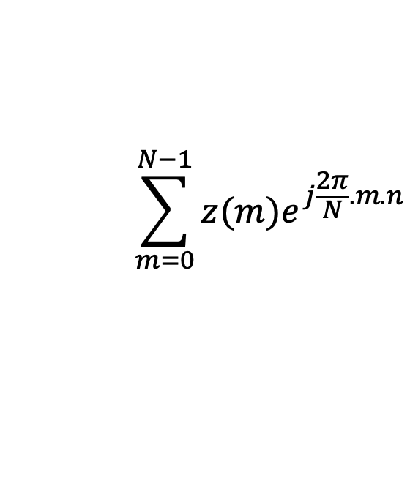
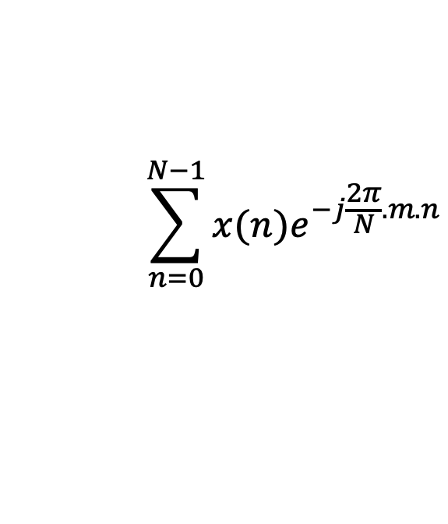


Discrete Fourier Transform
$$\sum_{n=0}^{N−1}{x(n)e^{−j\frac{2π}{N}.m.n}}$$
z(m) =
$$\frac{1}{\sqrt{N}}$$
DFT:
$$\sum_{m=0}^{N−1}{z(m)e^{j\frac{2π}{N}.m.n}}$$
x(n) =
$$\frac{1}{\sqrt{N}}$$
IDFT:

