Slide 1

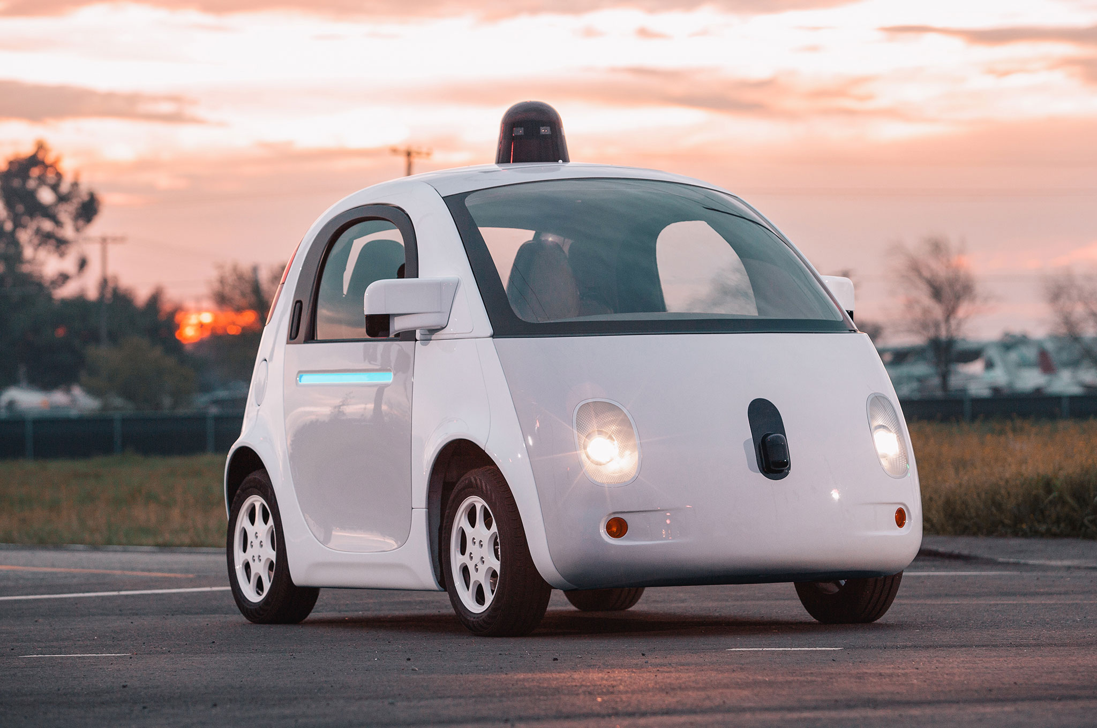



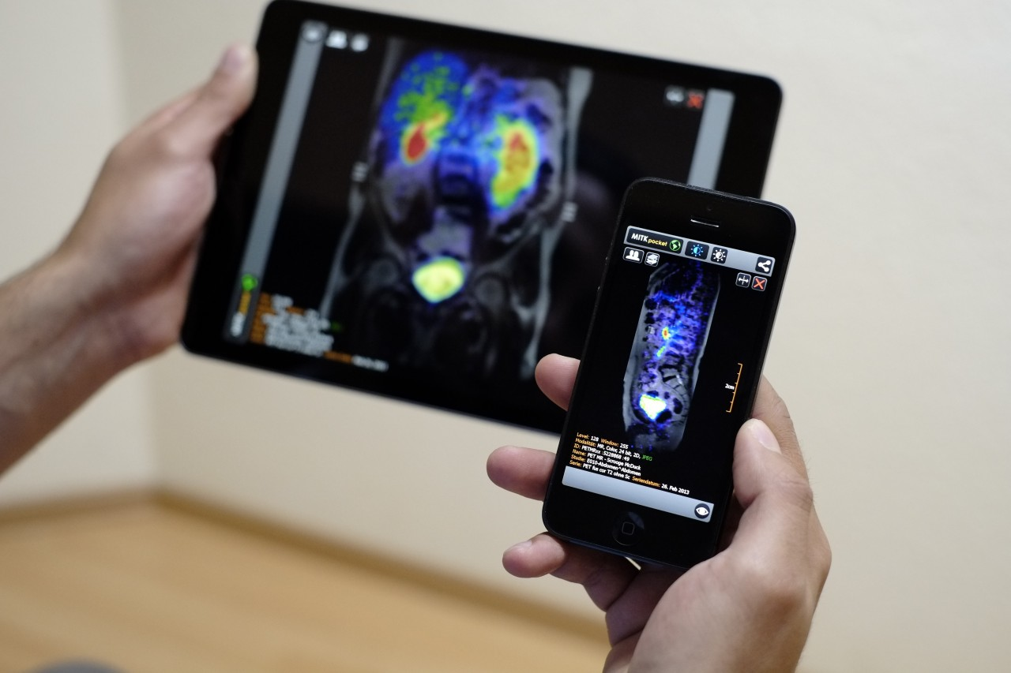
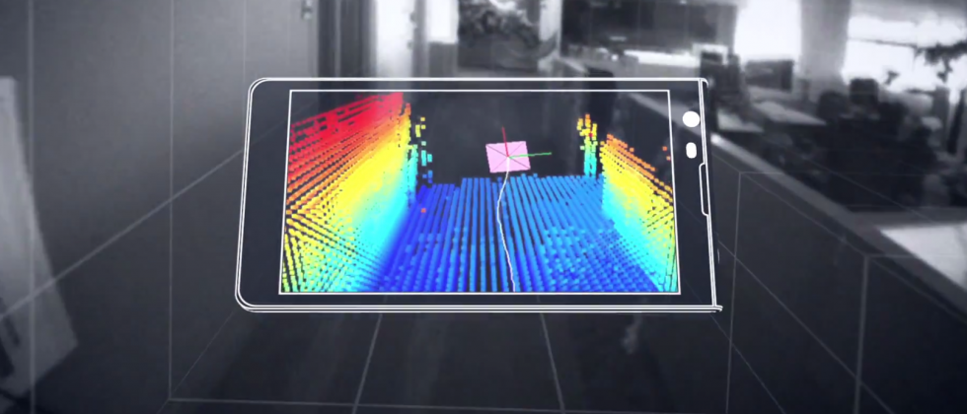
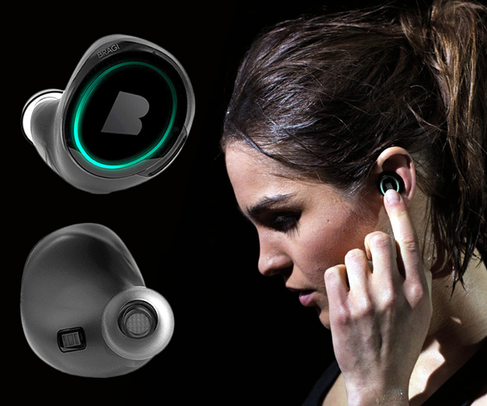
Wireless and Mobile Systems
for the IoT
CMSC 818W : Fall 2019
Lecture 1.4: Properties of the Discrete Fourier Transform
Nirupam Roy
M-W 2:00-3:15pm
CSI 1122

Slide 2
Plotting the DFT spectrum
Magnitude
|z_{m}|
m = 0
1
2
3
4
…
Frequency
N-2
N-1

Slide 3
Plotting the DFT spectrum
Magnitude
|z_{m}|
m = 0
1
2
3
4
…
Frequency
N-2
N-1
Phase
⦨ z_{m}
m = 0
1
2
3
4
…
Frequency
N-2
N-1

Slide 4

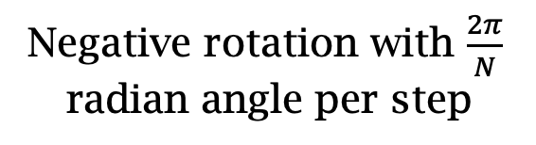

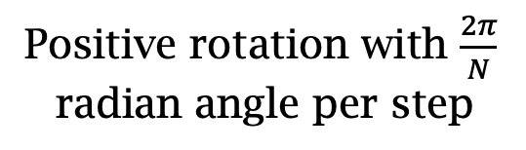
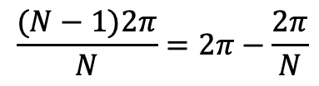
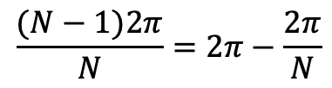
The Curious Case of “Negative frequency”
$$\frac{(N−1)2π}{N}=2π−\frac{2π}{N}$$
$$\frac{2π}{N}$$
$$\frac{2π}{N}$$
$$\frac{(N−1)2π}{N}=2π−\frac{2π}{N}$$
Positive rotation with $\frac{2π}{N}$ radian angle per step
Negative rotation with $\frac{2π}{N}$ radian angle per step

Slide 5
The Curious Case of “Negative frequency”
m = 0
1
2
3
4
…
Frequency
N-2
N-1
+
+
+
-
-
-

Slide 6
The Curious Case of “Negative frequency”
-4
-3
-2
-1
m = 0
1
2
3
4
Frequency

Slide 7
The Curious Case of “Negative frequency”
Magnitude
|z_{m}|
-4
-3
-2
-1
m = 0
1
2
3
4
Frequency
Real signal’s magnitude spectrum is symmetric.
Why?

Slide 8
The Curious Case of “Negative frequency”
Magnitude
|z_{m}|
-4
-3
-2
-1
m = 0
1
2
3
4
Frequency
Complex signal’s magnitude spectrum may or may not be symmetric.
Why?

Slide 9
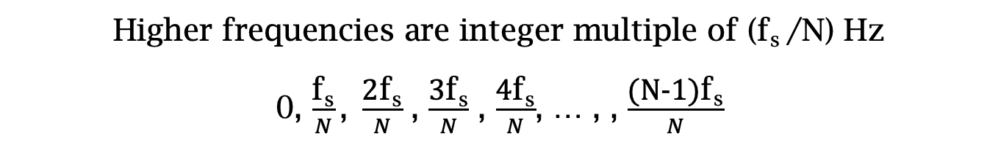
Estimating the real-world frequencies
Sampling frequency = f_{s} (i.e., f_{s} samples per second)
Slowest frequency ($\frac{2π}{N}$ radians per step) = N samples per rotation
= (N/ f_{s}) seconds per rotation
Therefore, the slowest frequency = (f_{s} /N) Hz
Higher frequencies are integer multiple of (f_{s} /N) Hz
0, $\frac{\text{f}\text{s}}{N}\text{, }\frac{\text{2}\text{f}\text{s}}{N}$ , $\frac{\text{3}\text{f}\text{s}}{N}$ , $\frac{\text{4}\text{f}\text{s}}{N}$, … , , $\frac{\text{(}\text{N}\text{−1)}\text{f}\text{s}}{N}$

Slide 10

The resolution and the highest frequency
Magnitude/Phase of z_{m}
-4
-3
-2
-1
m = 0
1
2
3
4
Frequency
Resolution
= minimum observable frequency difference =
$\frac{\text{f}\text{s}}{N}$
What if the actual frequency falls in between two frequency bins?

Slide 11
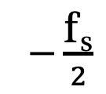
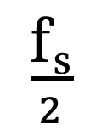
The resolution and the highest frequency
Magnitude/Phase of z_{m}
-4
-3
-2
-1
m = 0
1
2
3
4
Frequency
$−\frac{\text{f}\text{s}}{2}$
$\frac{\text{f}\text{s}}{2}$
Highest frequency =

Slide 12
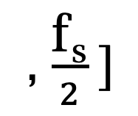
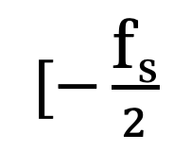
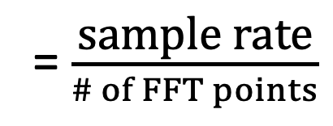
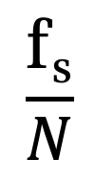
The resolution and the highest frequency
How can we increase the resolution?
$$\frac{\text{f}\text{s}}{N}$$
= $\frac{\text{sample} \text{rate}}{\# of FFT points}$
How can we increase the range of the spectrum?
$[−\frac{\text{f}\text{s}}{2}$
, $\frac{\text{f}\text{s}}{2} ]$

Slide 13
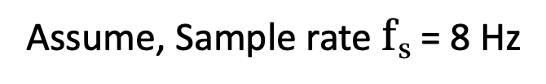
Aliasing: Different frequencies, same name!!
Magnitude/Phase of z_{m}
-4
-3
-2
-1
m = 0
1
2
3
4
Frequency
Assume, Sample rate $\text{f}\text{s}$ = 8 Hz
For a COMPLEX signal, what value will we see if the actual frequency is:
a) 3 Hz
b) -2 Hz
c) 6 Hz
d) -5 Hz
e) 4 Hz and -4Hz

Slide 14
Aliasing: Different frequencies, same name!!
Magnitude/Phase of z_{m}
-4
-3
-2
-1
m = 0
1
2
3
4
Frequency
Assume, Sample rate $\text{f}\text{s}$ = 8 Hz
For a REAL signal, what value will we see if the actual frequency is:
a) 3 Hz
b) -2 Hz
c) 6 Hz
d) -5 Hz
e) 4 Hz and -4Hz

Slide 15
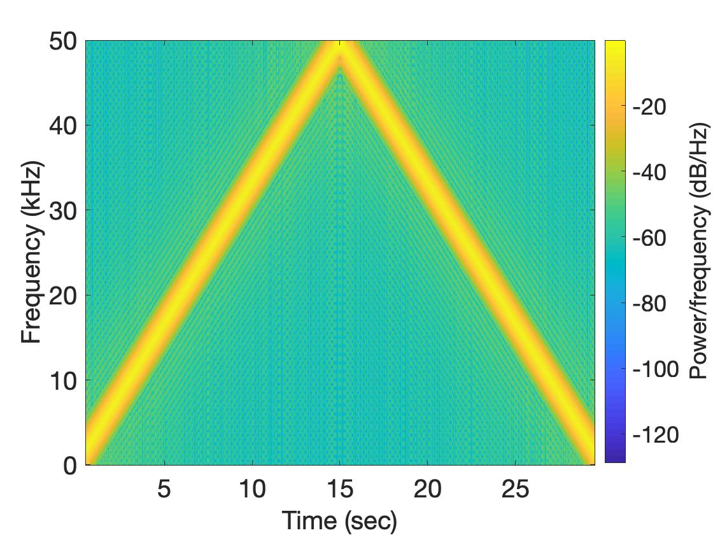
Aliasing: Spectrogram of increasing frequency

Slide 16
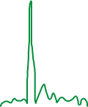

Calculating the aliased frequency value for real signals
Sampling frequency = 10Hz
Nyquist frequency = 5Hz
Amplitude
0
2
4
6
8
Frequency (Hz)

Slide 17

Calculating the aliased frequency value for real signals
Sampling frequency = 10Hz
Nyquist frequency = 5Hz
Amplitude
Received
signal
Amplitude
0
2
4
6
8
0
2
4
6
8
Frequency (Hz)
Frequency (Hz)

Slide 18
Calculating the aliased frequency value for real signals
Sampling frequency = 10Hz
Nyquist frequency = 5Hz
Amplitude
Received
signal
Amplitude
0
2
4
6
8
0
2
4
6
8
Frequency (Hz)
Frequency (Hz)
f_{s} = Sampling frequency
f = Target frequency
f_{a} = Aliased(perceived) frequency
N = Non-negative integer
f_{a} = min(abs(N*f_{s} - f))

Slide 19
Aliasing: A real life scenario
Nyquist frequency
Amplitude
10k
20k
30k
40k
50k
60k
70k
80k
90k
100k
Frequency spectrum
Notes:
to amplify the signal power …
Now, this signal typically contains many more frequencies than the sampling system can handle …

Slide 20
Aliasing: A real life scenario
Nyquist frequency
Amplitude
10k
20k
30k
40k
50k
60k
70k
80k
90k
100k
Frequency spectrum
Notes:
to amplify the signal power …
Now, this signal typically contains many more frequencies than the sampling system can handle …

Slide 21
Aliasing: A real life scenario
Nyquist frequency
Amplitude
10k
20k
30k
40k
50k
60k
70k
80k
90k
100k
Frequency spectrum
We need a “Low-pass filter”
to remove unwanted high frequency signals
Notes:
to amplify the signal power …
Now, this signal typically contains many more frequencies than the sampling system can handle …

Slide 22
Anti-aliasing filter
Nyquist frequency
Amplitude
10k
20k
30k
40k
50k
60k
70k
80k
90k
100k
Frequency spectrum
Sensor
ADC
Anti-aliasing
Filter
Notes:
to amplify the signal power …
Now, this signal typically contains many more frequencies than the sampling system can handle …

Slide 23
Anti-aliasing filter
Nyquist frequency
Amplitude
10k
20k
30k
40k
50k
60k
70k
80k
90k
100k
Frequency spectrum
Sensor
ADC
Anti-aliasing
Filter
Notes:
Hence, a low pass filter…

Slide 24
Anti-aliasing filter
Anti-aliasing
filter
Amplitude
10k
20k
30k
40k
50k
60k
70k
80k
90k
100k
Frequency spectrum
Sensor
ADC
Anti-aliasing
Filter
Notes:
removes the unwanted frequencies above 24 kHz …
And ultimately, this filtered signal is sampled by an ADC to generate digital sound samples

Slide 25
Anti-aliasing filter

Slide 26
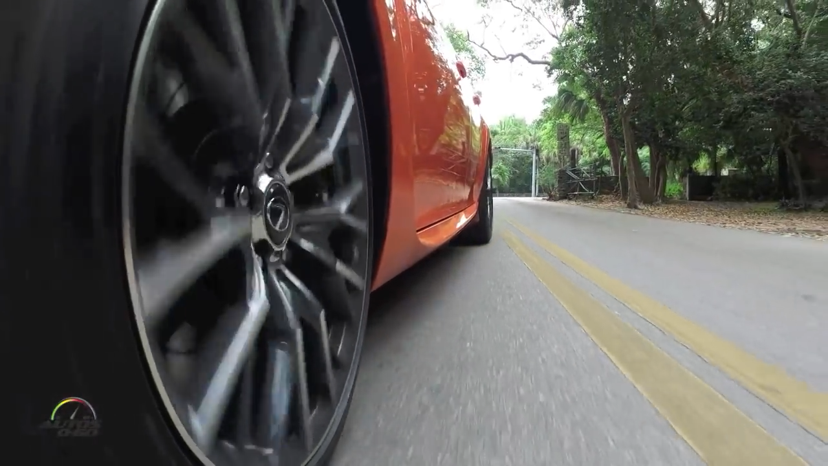
Aliasing in real life
https://www.youtube.com/watch?v=B8EMI3_0TO0

Slide 27
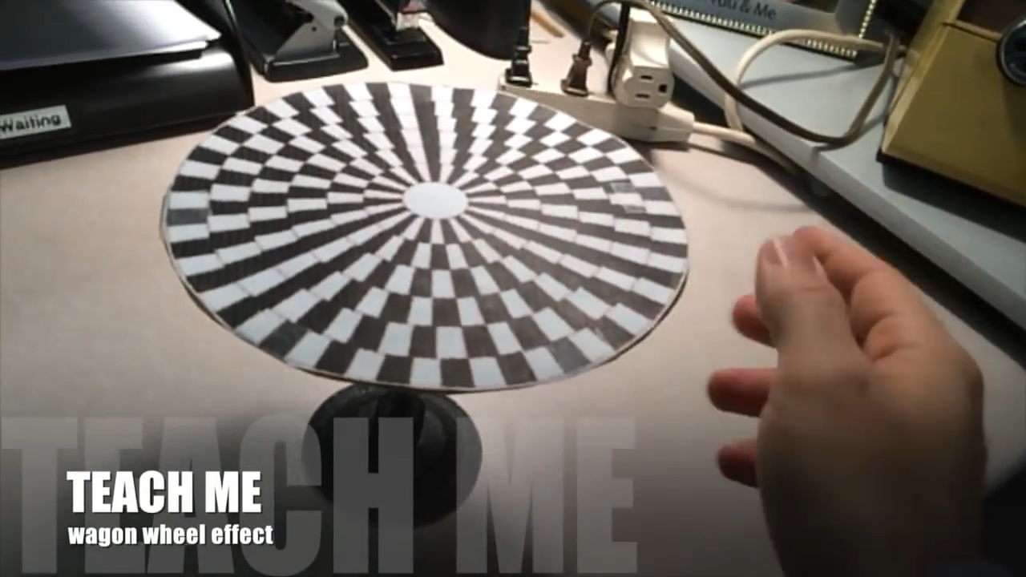
Aliasing in real life
https://www.youtube.com/watch?v=QOwzkND_ooU

Slide 28
A few more ideas…
1) Filtering frequencies
1) Filtering frequencies
2) Multiplying frequency with frequency
3) Sampling a band of frequencies

Slide 29
Matlab demo code

Slide 30
A few more ideas…
1) Filtering frequencies
2) Multiplying frequency with frequency
3) Sampling a band of frequencies

Slide 31
Multiplying two frequencies
Magnitude/Phase of z_{m}
-4
-3
-2
-1
m = 0
1
2
3
4
Frequency

Slide 32
Matlab demo code

Slide 33
A few more ideas…
1) Filtering frequencies
2) Multiplying frequency with frequency
3) Sampling a band of frequencies

Slide 34
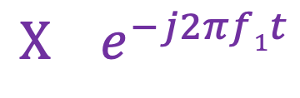
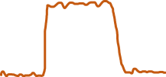



Sample Rate for a Frequency band
$$e^{j2πf1t}$$
$$e^{j2πf2t}$$
Amplitude
$${X e}^{−j2πf1t}$$
0
2
4
6
0
8
Frequency (kHz)
What should be the sample rate?

Slide 35
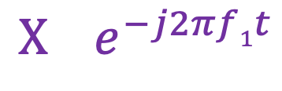
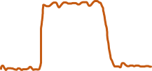

Sample Rate for a Frequency band
$${X e}^{−j2πf1t}$$
Amplitude
Frequency
down-conversion
Amplitude
0
2
4
6
8
0
2
4
6
8
Frequency (kHz)
Frequency (kHz)
What should be the sample rate?
Generally, bandwidth of the signal determines the sample rate.

Slide 36
Programming Assignment #1

Slide 37
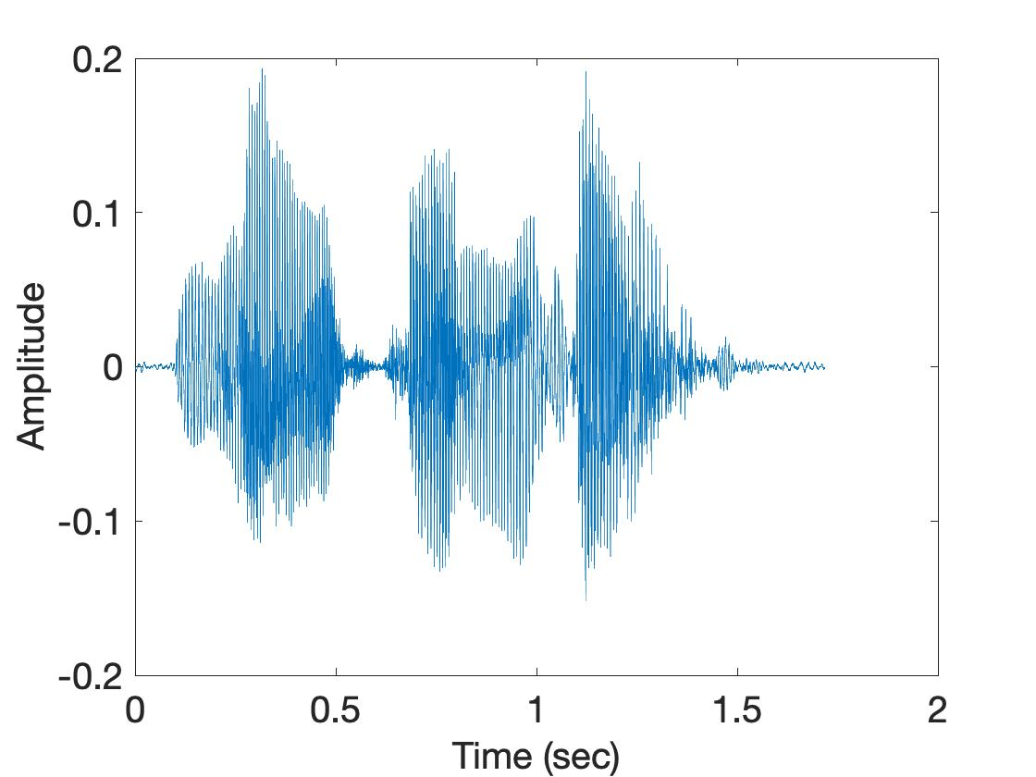
Short-time Fourier Transform (STFT)
U
M
D
[
[
[
FFT of overlapping windows
of samples
(Spectrogram/STFT)
[
FFT
FFT
FFT
FFT

Slide 38
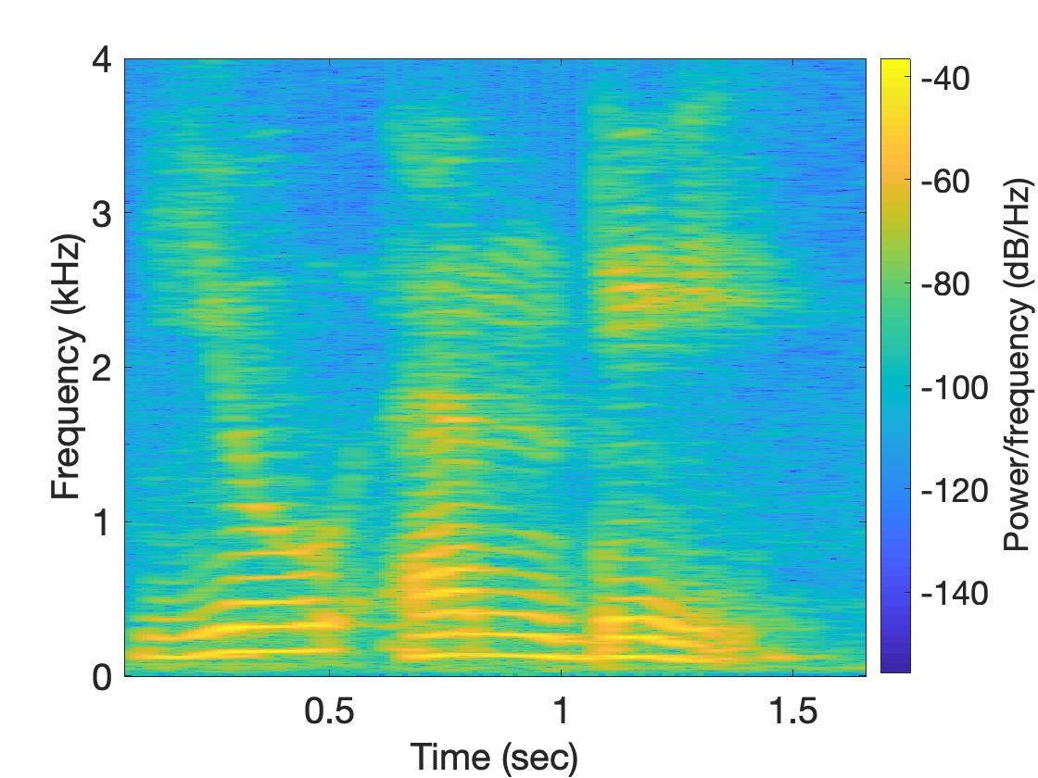
Short-time Fourier Transform (STFT)
U
M
D

Slide 39
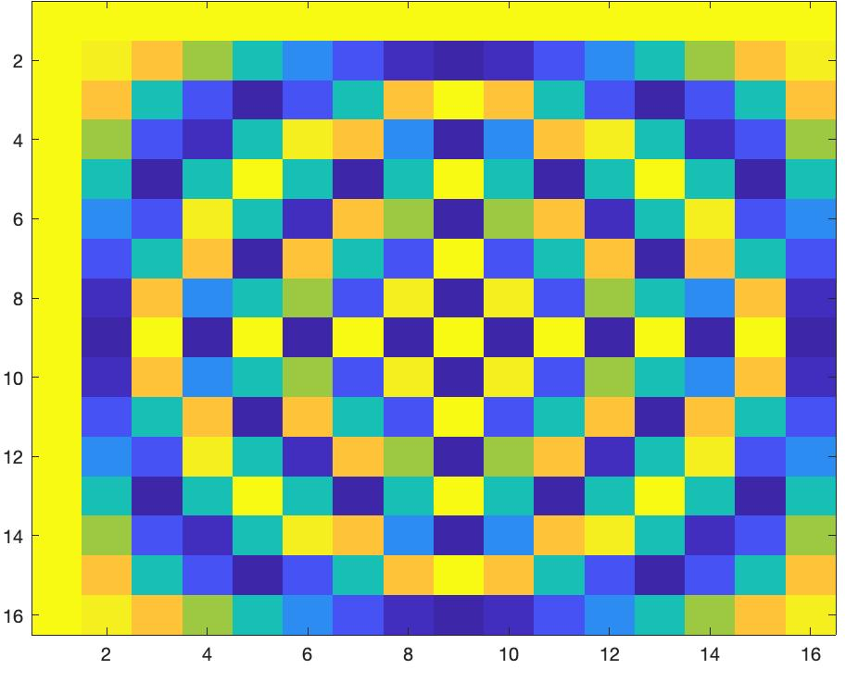
Short-time Fourier Transform (STFT)
*
_{X}
_{Z}
_{F}
=
_{F}
=
_{Matlab function: dftm(N)}
_{X}
=

Slide 40
Short-time Fourier Transform (STFT)
*
_{X}
_{Z}
_{F}
=
_{F}
_{N}
=
_{Matlab function: dftm(N)}
_{N}
_{abs(Z)}
_{X}
_{8N}
=

Slide 41
Short-time Fourier Transform (STFT)
?
_{x}
₌

