Slide 1

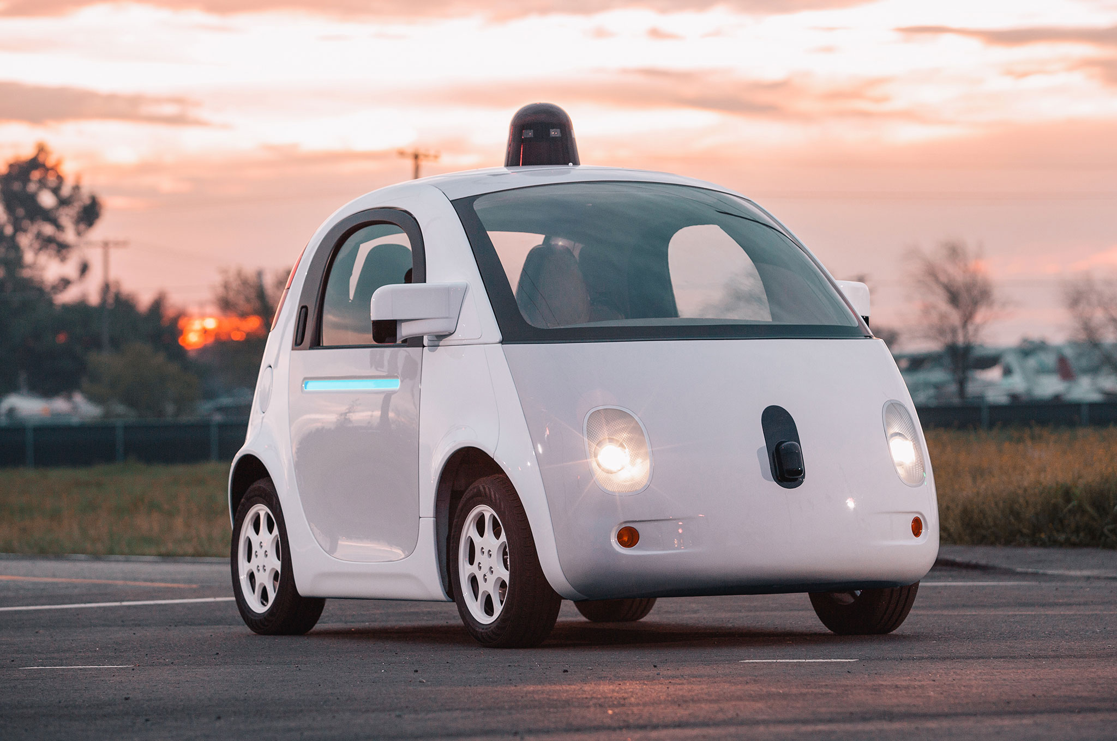
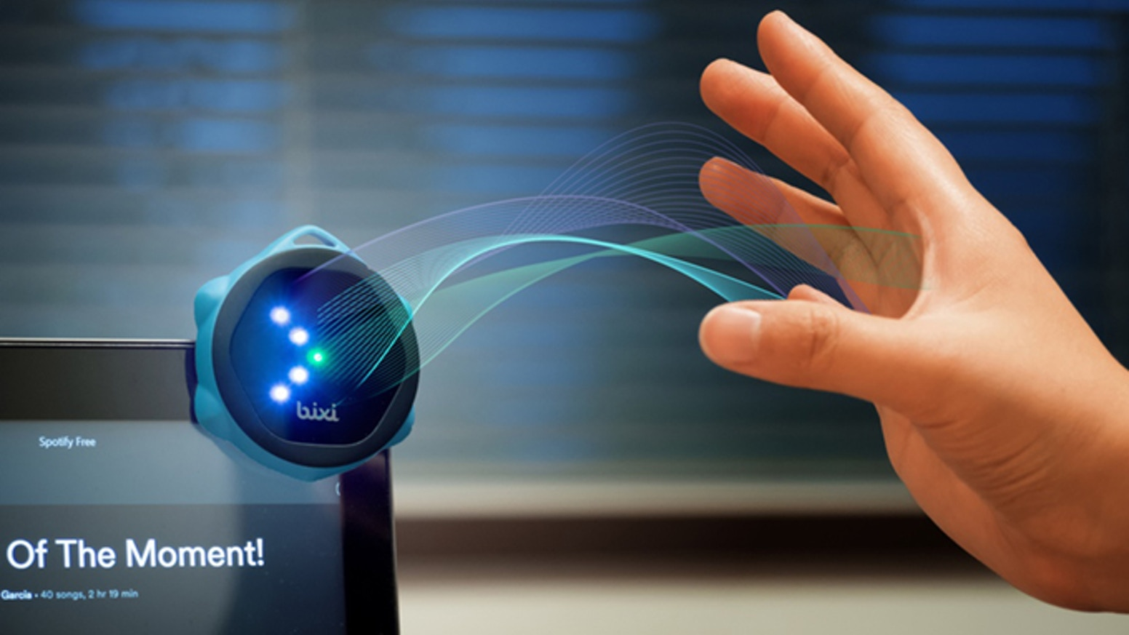
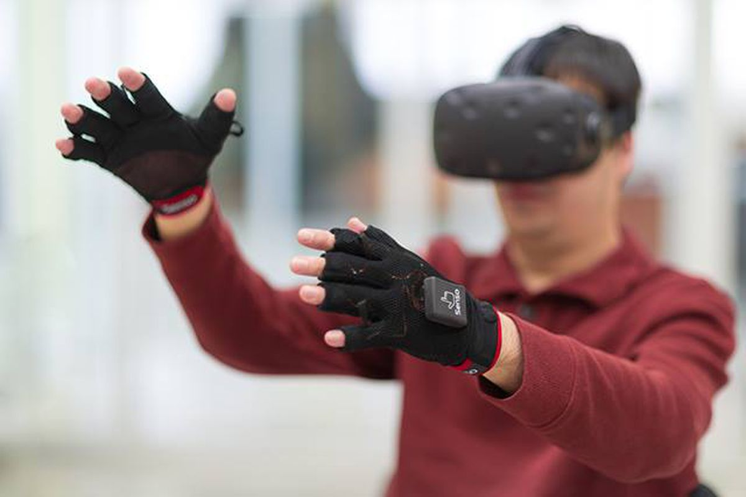

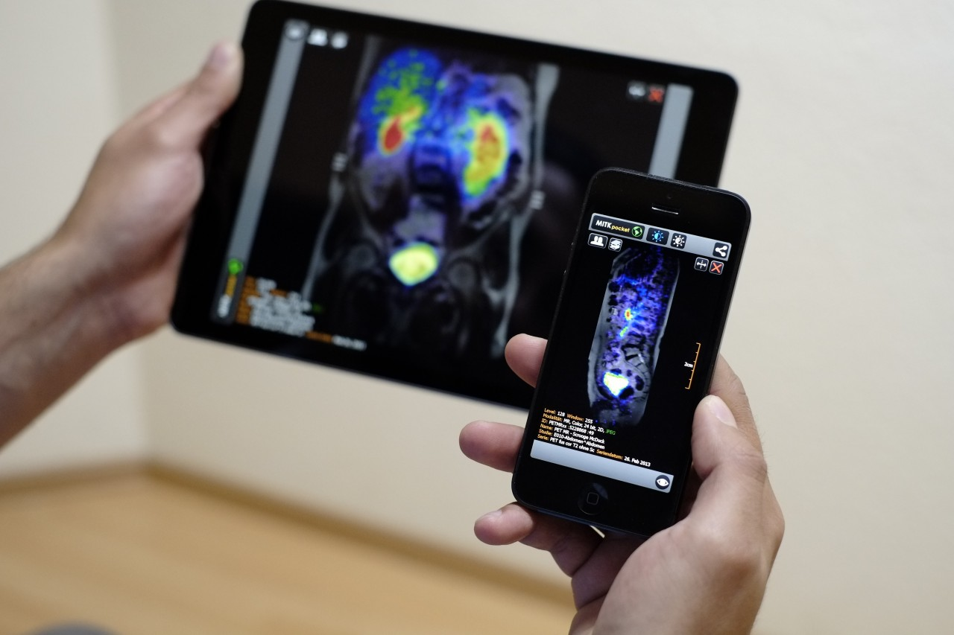
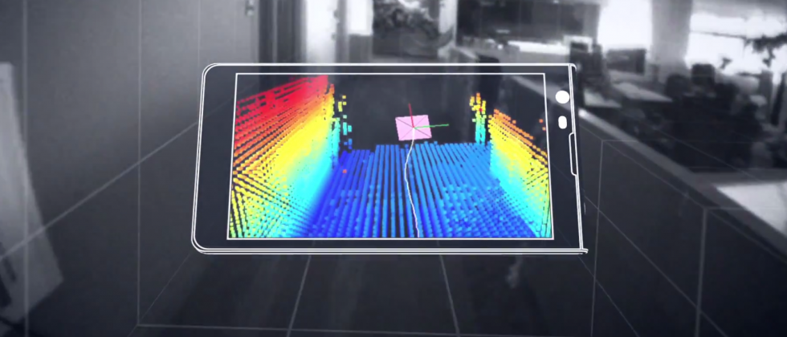
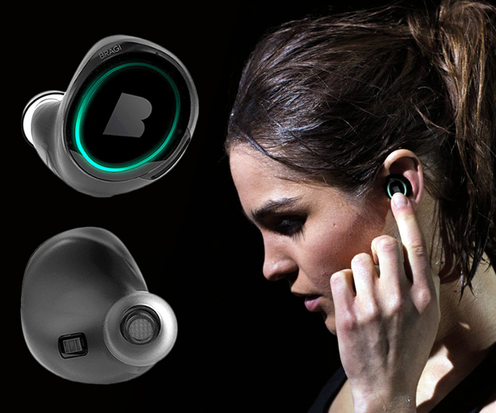
Wireless and Mobile Systems
for the IoT
CMSC 818W : Fall 2019
Lecture 2.1: Inertial Measurement Units (IMU) and sensor fusion
Nirupam Roy
M-W 2:00-3:15pm
CSI 1122

Slide 4
Inertial Measurement Unit (IMU)
Accelerometer
Gyroscope
Magnetometer (compass)

Slide 5
Inertial Measurement Unit (IMU): Applications

Slide 6
Inertial Measurement Unit (IMU)
Accelerometer
Gyroscope
Magnetometer (compass)

Slide 7
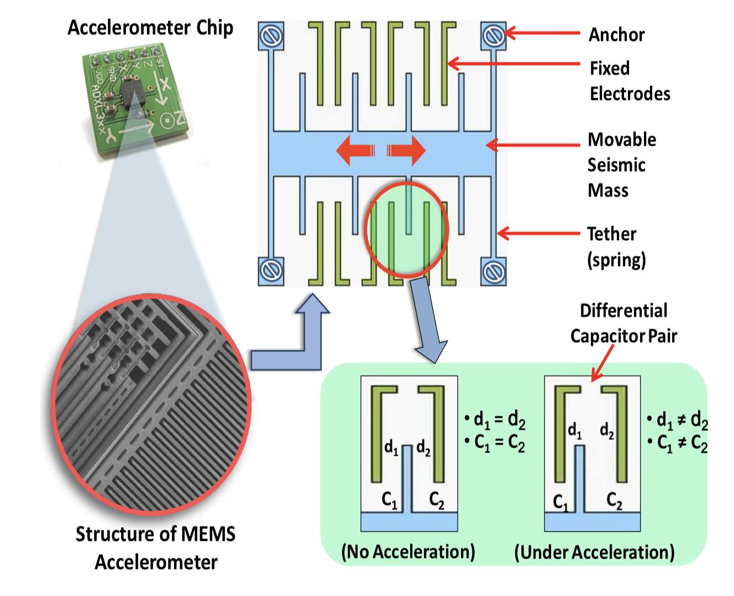
Accelerometer
Measures acceleration, not speed.
Measurements are proportional to the force. Why?

Slide 8
Accelerometer
Notes:
F = m.a = k.d (k= spring constant)
a = k.d/m, transformed the measurement of acceleration to the measurement of displacement

Slide 9
Accelerometer
Z
X
Y

Slide 10
Accelerometer
Gravity = 9.8 m/s²
What reading will you get when the device is in “free-fall”?
Old laptops had accelerometers in them. Why?

Slide 11
Accelerometer
Z
X
-Z
Y
gravity

Slide 12
Accelerometer
Z
linear acceleration
X
-Z
Y
gravity
Output = linear acceleration + gravity

Slide 13
Accelerometer Demo

Slide 14
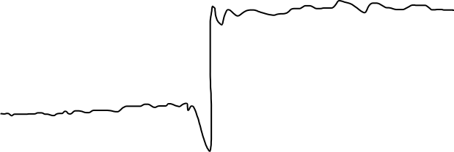
Accelerometer: Extracting gravity component
Accelerometer output
(any one of the axes)

Slide 15

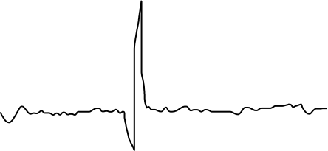
Accelerometer: Extracting gravity component
Accelerometer output
(any one of the axes)
Low frequency gravity signal
=
+
High frequency linear acceleration

Slide 16
Accelerometer: Extracting gravity component
Accelerometer output
(any one of the axes)
Low-pass filter
Low frequency gravity signal

Slide 17
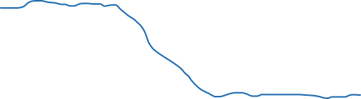
Accelerometer: Extracting gravity component
Accelerometer output
(any one of the axes)
Low-pass filter
Low frequency gravity signal
X
Y
Z

Slide 18
Accelerometer: Extracting gravity component
Z
X
-Z
Y
gravity

Slide 19
Accelerometer: Extracting gravity component
Z
X
-Z
Y
gravity

Slide 20
Accelerometer:: Extracting gravity component
Z
𝚹
X
Φ
-Z
Y
gravity

Slide 21
Accelerometer: Extracting gravity component
Accelerometer output
(any one of the axes)
Low-pass filter
Low frequency gravity signal
Do you see any
problem?

Slide 22
Inertial Measurement Unit (IMU)
Accelerometer
Gyroscope
Magnetometer (compass)

Slide 23
Gyroscope
Yaw
Roll
Pitch
Angular velocity around three axes

Slide 24
Gyroscope
Right hand rule

Slide 25
Gyroscope
Coriolis effect

Slide 26
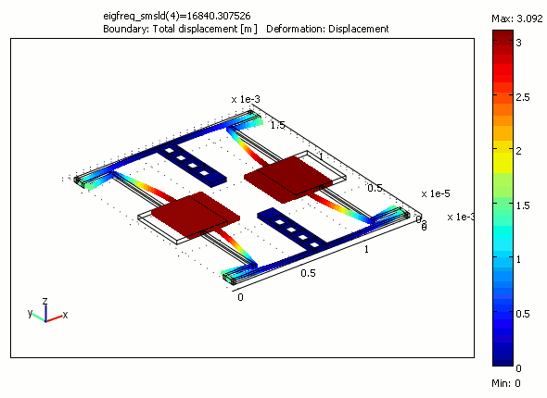
Gyroscope

Slide 27
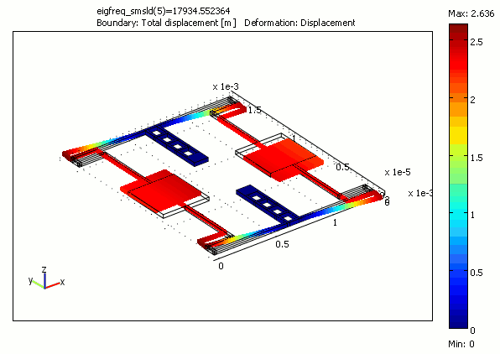
Gyroscope

Slide 28
Gyroscope Demo

Slide 29
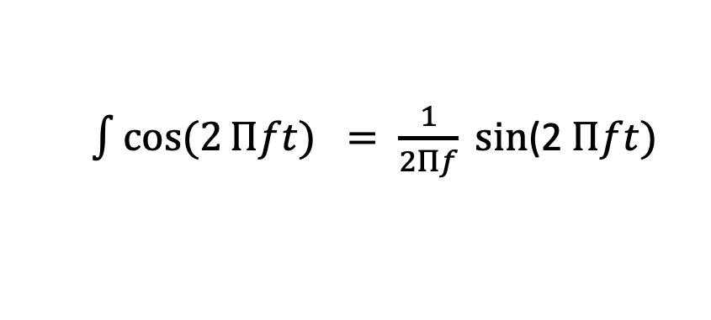
Gyroscope
Gyroscope data = angular velocity (radians or degrees per second)
⍵ = Δ𝚹/Δt
We need angle (𝚹)
Integrate the output,
𝚹 = 𝚹_{prev.} + ⍵. Δt
$\int{cos⁡(2}Πft) = \frac{1}{2Πf} sin$(2 $Πft)$

Slide 30
Gyroscope
Gyroscope data = angular velocity (radians or degrees per second)
⍵ = Δ𝚹/Δt
Calculated angle drifts over time

Slide 31
Accelerometer and Gyroscope Fusion
Z
X
Gravity vector

Slide 32
Accelerometer and Gyroscope Fusion
Z
Z
X
X
Gravity vector
Gravity vector

Slide 33
Accelerometer and Gyroscope Fusion
Z
Z
X
X
Gravity vector
Gravity vector

Slide 34
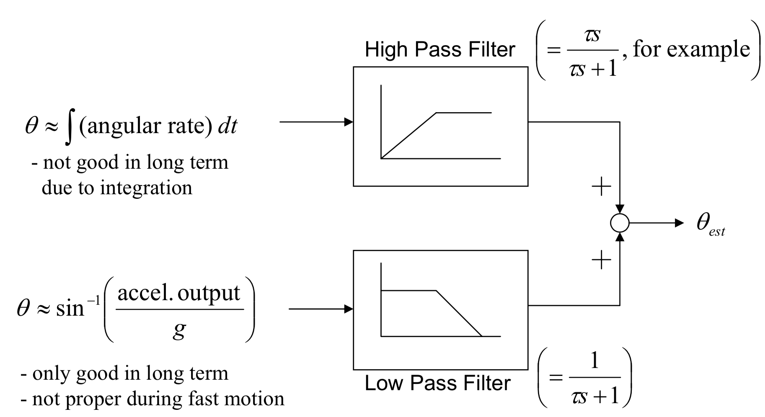
Accelerometer and Gyroscope Fusion
Complementary filter
Angle from gyro.
Angle from accel.
Angle from the gravity
vector

Slide 35
Inertial Measurement Unit (IMU)
Accelerometer
Gyroscope
Magnetometer (compass)

Slide 36
Magnetometer (the sensor behind the compass app)

Slide 37
Magnetometer (the sensor behind the compass app)
Z
Magnetic field vector
X
Y
Measures magnetic flux density (unit tesla)

Slide 38
Magnetometer Demo

Slide 39
Magnetometer (the sensor behind the compass app)
Gyroscope
Accelerometer
Tilt correction
Magnetometer
Azimuth angle
(Compass angle)

Slide 40
Axes V/S Degrees of freedom

