Slide 1
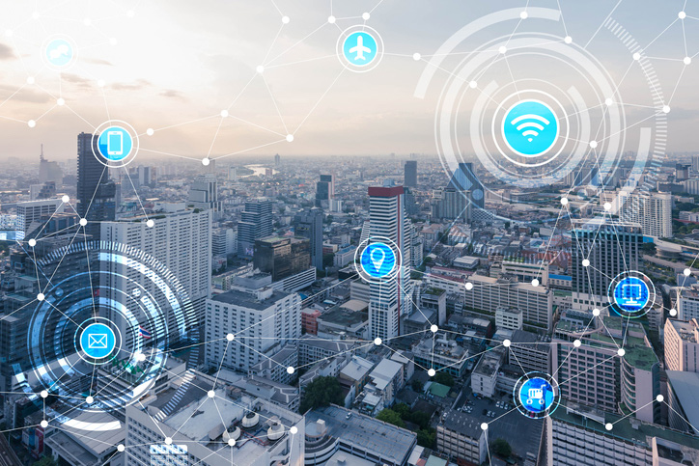
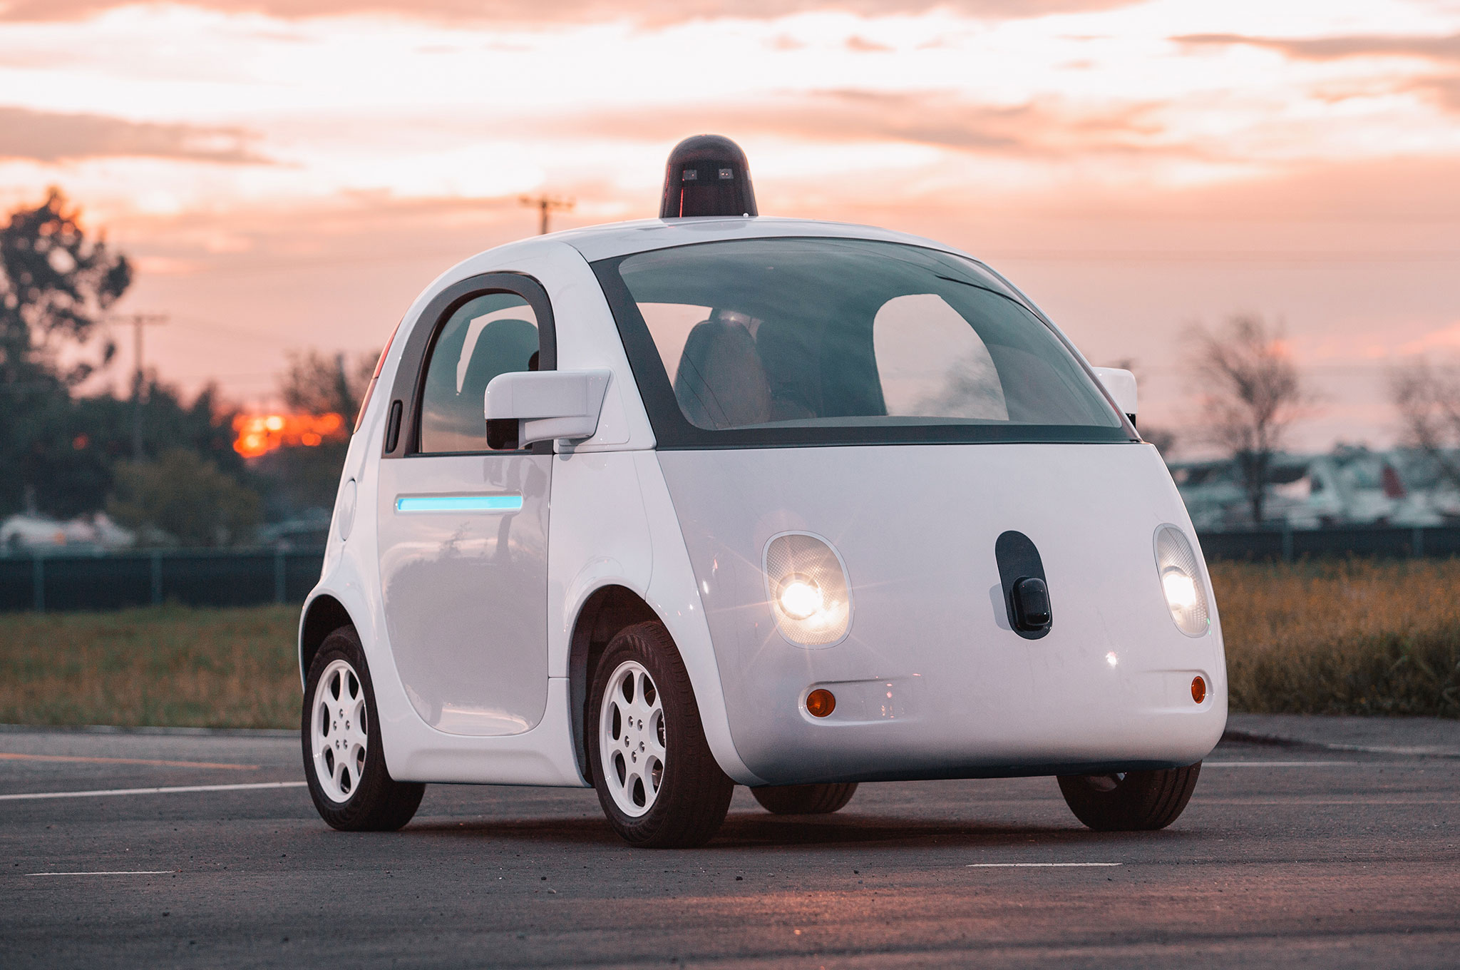
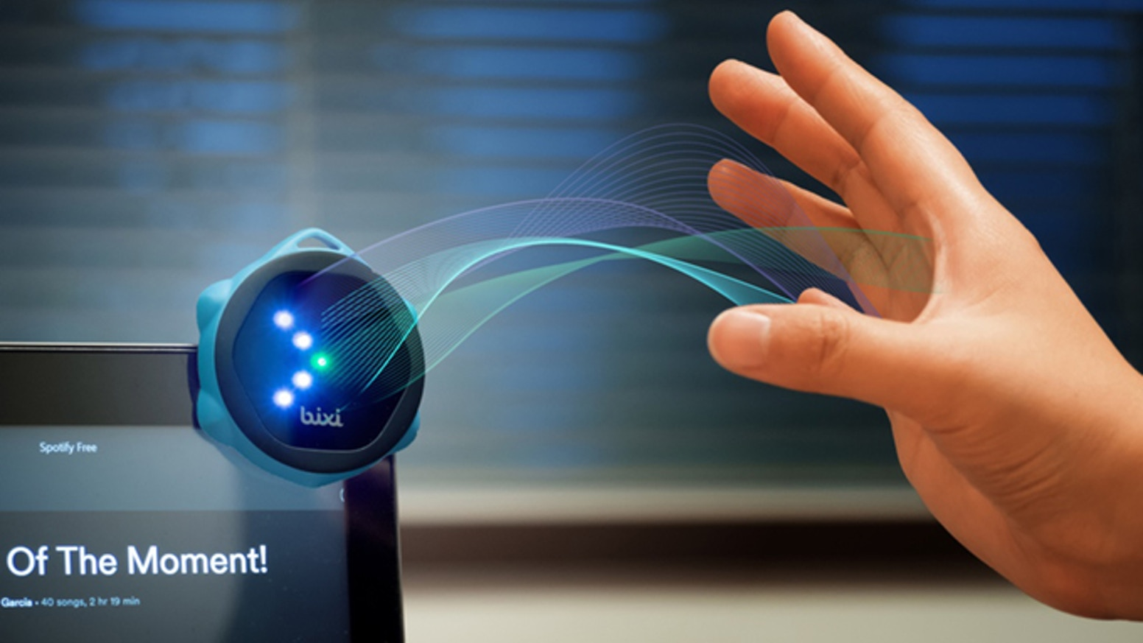
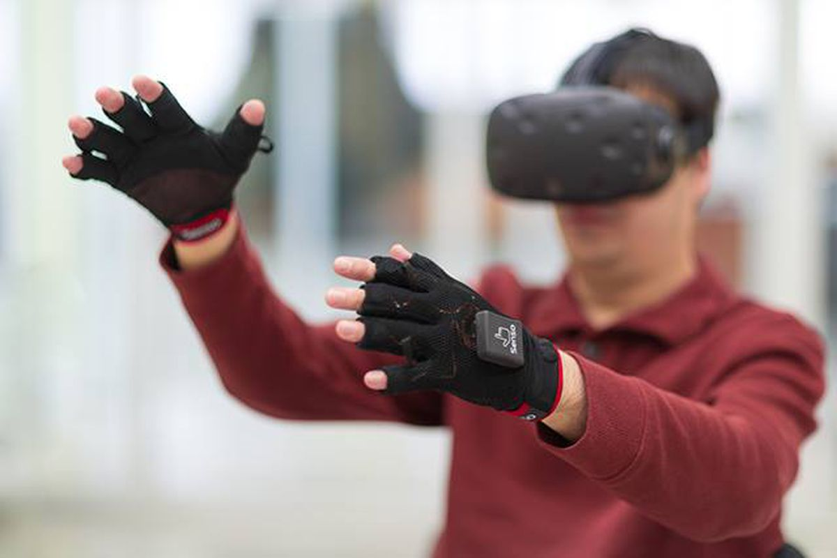

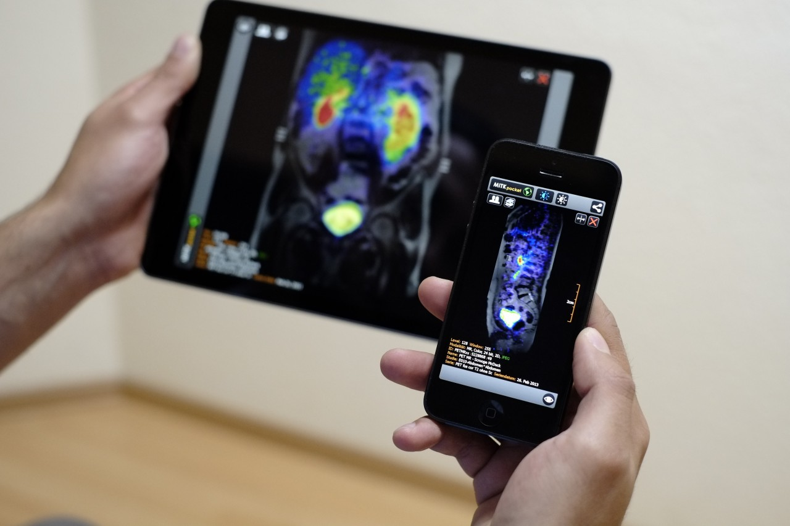
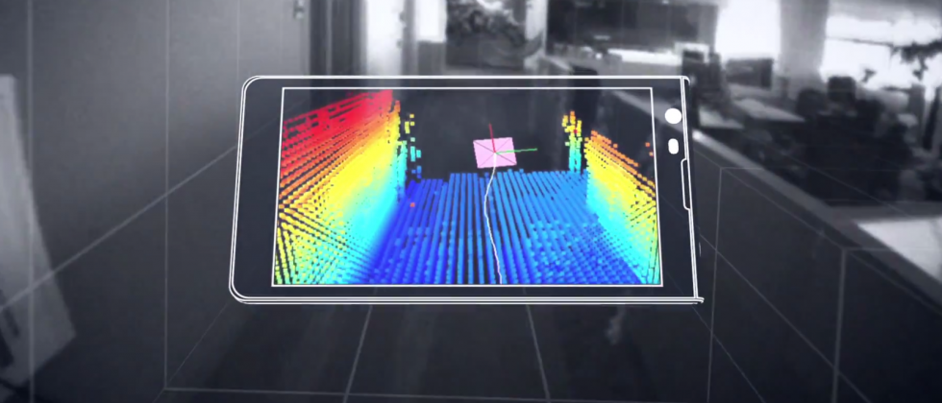
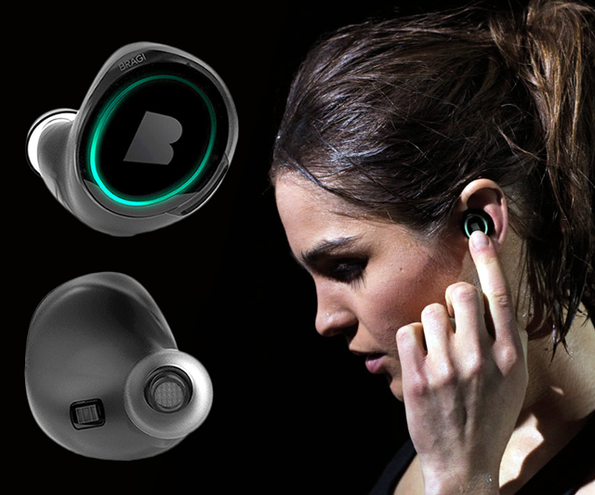
Wireless and Mobile Systems
for the IoT
CMSC 818W : Fall 2019
Lecture 2.3: Kalman Filter
Nirupam Roy
M-W 2:00-3:15pm
CSI 1122

Slide 2
Basic statistics refresher: Mean and Variance

Slide 3
Basic statistics refresher: Mean and Variance

Slide 4
Basic statistics refresher: Mean and Variance
Noisy samples

Slide 5
Basic statistics refresher: Mean and Variance

Slide 6
Basic statistics refresher: Mean and Variance

Slide 7
Basic statistics refresher: Mean and Variance

Slide 8
Basic statistics refresher: Mean and Variance

Slide 9
Basic statistics refresher: Mean and Variance
Correlation coefficient is another way to find similarity between two time series.

Slide 10
Basic statistics refresher: Probability distribution

Slide 11
Basic statistics refresher: Probability distribution

Slide 12
Basic statistics refresher: Probability distribution

Slide 13
Basic statistics refresher: Normal distribution

Slide 14
Basic statistics refresher: Normal distribution

Slide 15
Basic statistics refresher: Normal distribution

Slide 16
Basic statistics refresher: Normal distribution

Slide 17
Basic statistics refresher: Normal distribution

Slide 18
Basic statistics refresher: Normal distribution

Slide 19
Basic statistics refresher: Normal distribution

Slide 20
Basic statistics refresher: Central Limit Theorem

Slide 21
Basic statistics refresher: Central Limit Theorem

Slide 22
Basic statistics refresher: System of equations

Slide 23
Basic statistics refresher: System of equations

Slide 24
Basic statistics refresher: System of equations

Slide 25
Basic statistics refresher: System of equations

Slide 26
Basic statistics refresher: System of equations

Slide 27
Gestures
  A meaningful sequence of movements
  of the body parts
  A physics-based model of acceleration, speed, location etc.

Slide 32
Kalman Filter

Slide 33
Kalman Filter

Slide 34
Kalman Filter

Slide 35
Kalman Filter

Slide 36


Kalman Filter
Independent

Slide 37
Kalman Filter: Application scenarios

Slide 38
Kalman Filter: Application scenarios

Slide 39
Kalman Filter: Intuition

Slide 40
Kalman Filter: Intuition

Slide 41
Kalman Filter: Intuition

Slide 42
Kalman Filter: Intuition

Slide 43
Kalman Filter: Intuition

Slide 44
X

Slide 46
Kalman Filter: Intuition

Slide 49
Kalman Filter: Intuition

Slide 50
Kalman Filter: Intuition

Slide 59
Kalman Filter: Algorithm

Slide 61
Kalman Filter: Algorithm

Slide 62
Kalman Filter Demo: Vehicle position

Slide 76
Matlab code

Slide 77
Kalman Filter: Case study
Reference: https://www.cs.cornell.edu/courses/cs4758/2012sp/materials/MI63slides.pdf

Slide 81
>

Slide 82
True situation: Water level static

Slide 83
True situation: Water increasing at constant rate
Set q = .0001

Slide 84
What is wrong?
1) Correctness of our model
2) Assumption about the
reliability of the process model

Slide 85
True situation: Water increasing at constant rate
Set q = .01

Slide 86
True situation: Water increasing at constant rate
Set q = .1

Slide 87
True situation: Water increasing at constant rate
Set q = 1

Slide 91
True situation: Water increasing at constant rate
Set r = .1, q = .00001

Slide 92
True situation: Water level static
Set r = .1, q = .00001

Slide 93
Kalman Filter:
Assumptions
Linear relationships between states
Gaussian noise

Slide 94
Kalman Filter:
Assumptions
Linear relationships between states
Gaussian noise
Kalman Filter for nonlinear systems
Extended Kalman Filter
Unscented Kalman Filter

Slide 95
Kalman Filter: Summary
Improves noisy measurements
Estimates state for feedback
Computes next estimate using only most recent measurements

