Slide 1
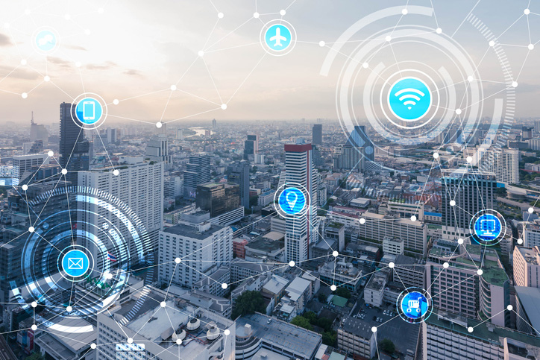
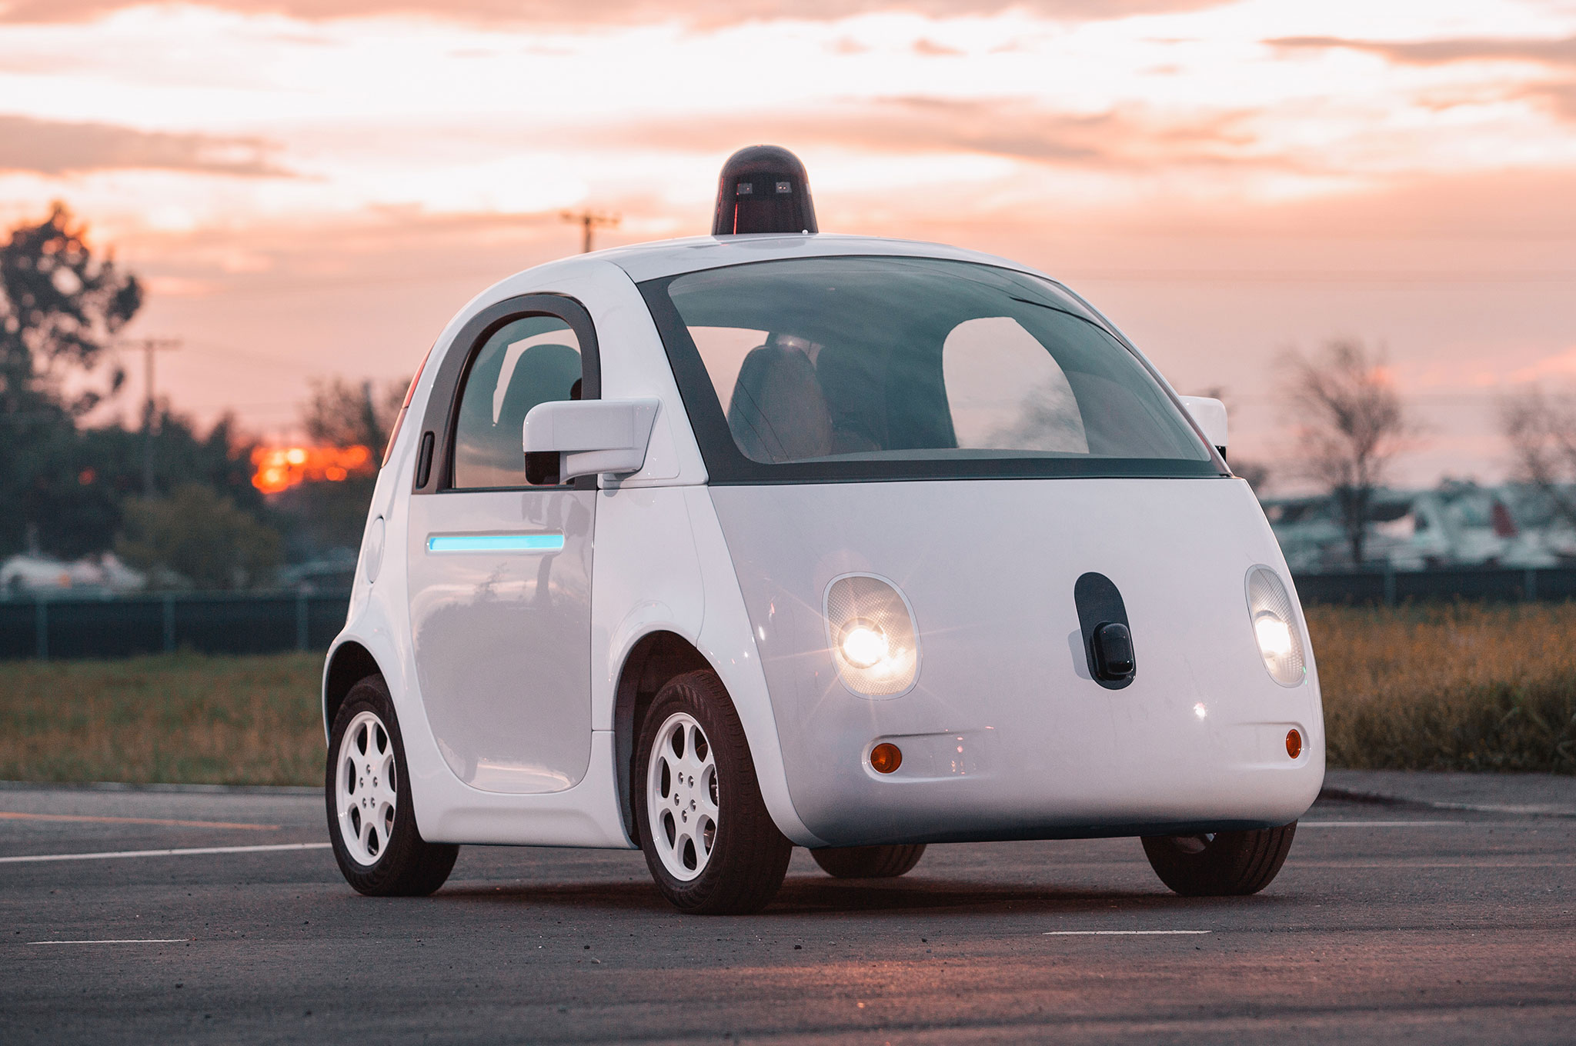
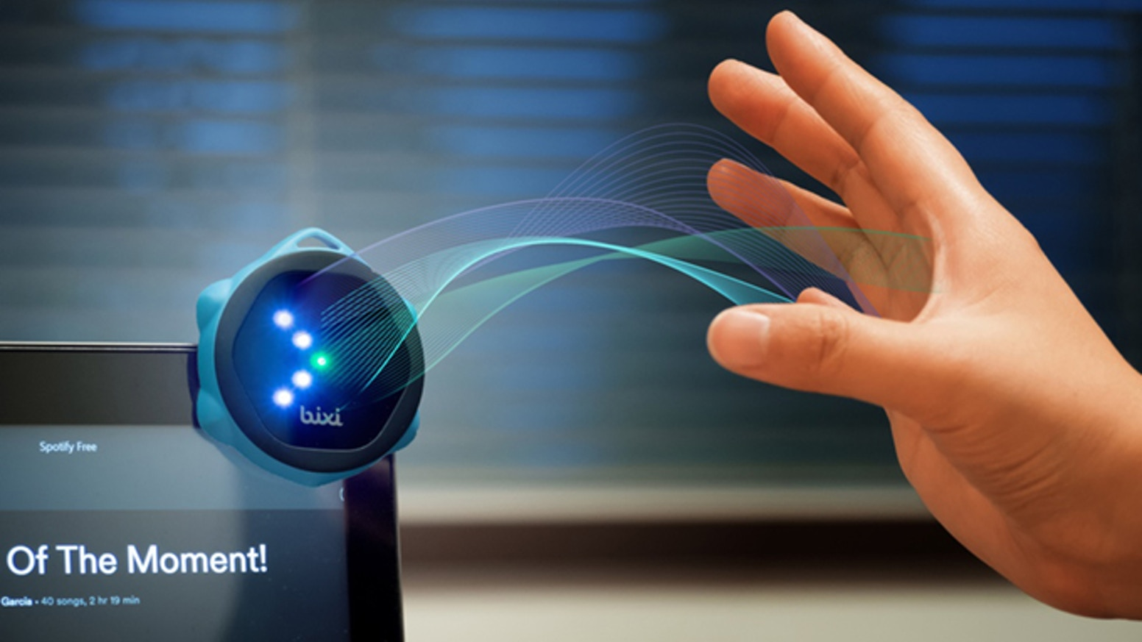
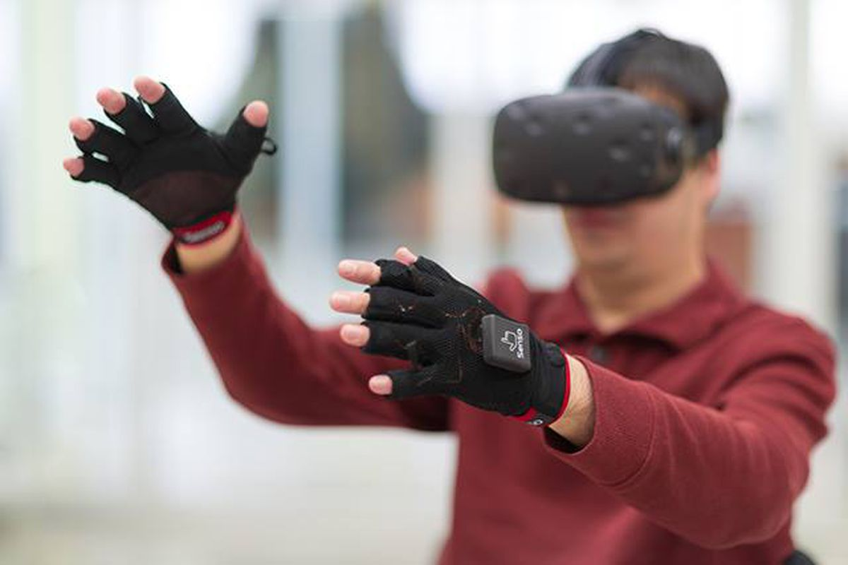

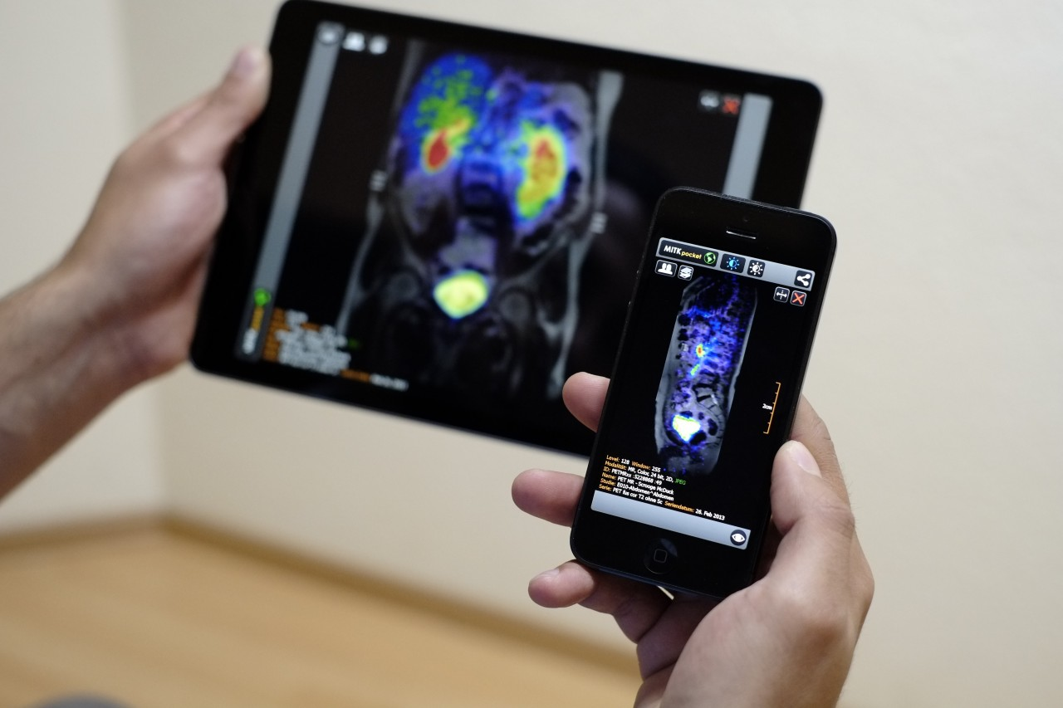
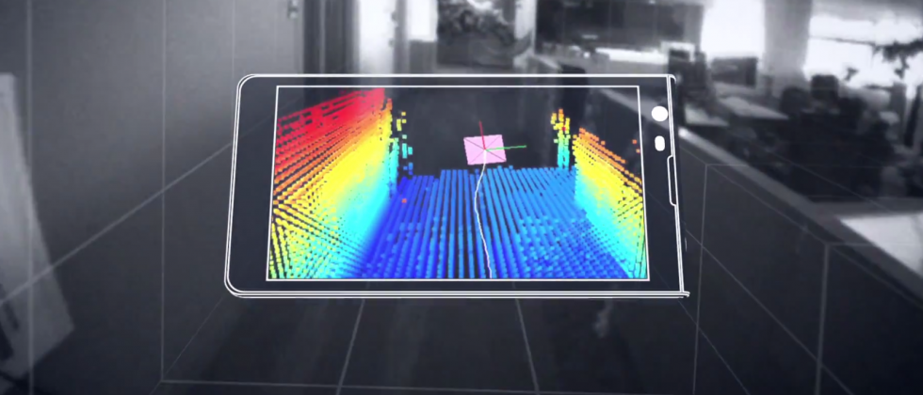
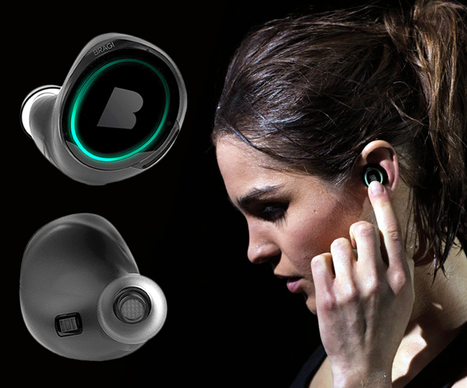
Wireless and Mobile Systems
for the IoT
CMSC 818W : Fall 2019
Lecture 3.1: Wave basics
Nirupam Roy
M-W 2:00-3:15pm
CSI 1122

Slide 2
Waves

Slide 3
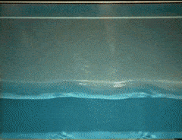
Waves: Transfer of energy, not mass

Slide 4
Sound
Visible light
Physical vibrations
WiFi signal
Ripples in water
Infrared
…
…

Slide 5
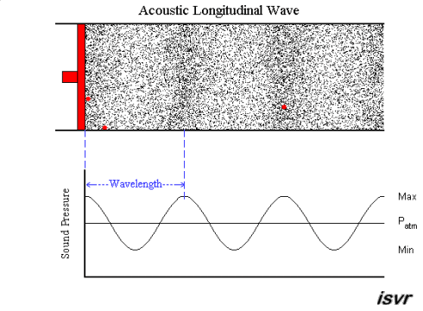
Mechanical Wave
Electromagnetic Wave
Sound
Visible light
Physical vibrations
WiFi signal
Ripples in water
Infrared
…
…

Slide 8
Waves made this possible

Slide 9
Waves made this possible

Slide 10

Equation of waves in time and space

Slide 11
Equation of waves in time and space
Temporal variation of the wave’s amplitude

Slide 12
Equation of waves in time and space

Slide 13
Frequency, Amplitude, and Phase

Slide 14
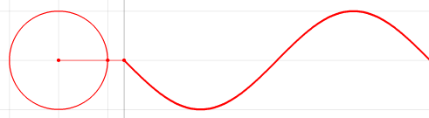


Frequency, Amplitude, and Phase
$$f cycles per second$$
$$2π angles per cycle$$
Time

Slide 15
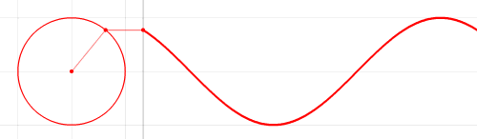
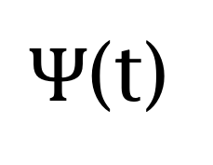
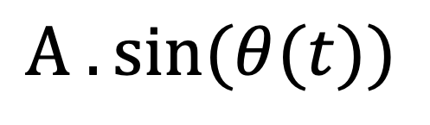


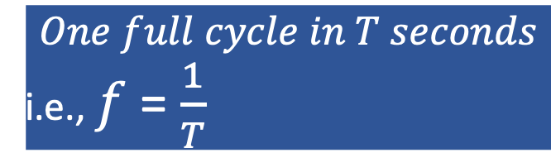
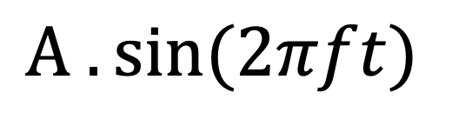
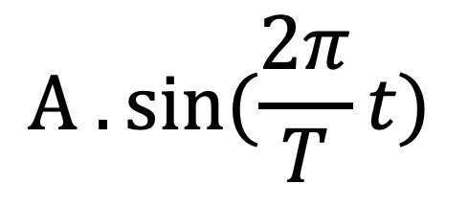


Frequency, Amplitude, and Phase
$$2π angles per cycle$$
$$f cycles per second$$
$$One full cycle in T seconds$$
i.e., $f$ = $\frac{1}{T}$
A
𝚹
Phase
time = t second
$Ψ$(t)
$$=$$
$$A . sin⁡(θ(t))$$
$$A . sin⁡(\frac{2π}{T}t)$$
$$=$$
$$A . sin⁡(2πft)$$
$$=$$

Slide 16
Equation of waves in time and space

Slide 17
Equation of waves in time and space

Slide 18
Equation of waves in time and space

Slide 19


Equation of waves in time and space
$$distance from the source (x)$$
$$space$$

Slide 20
Equation of waves in time and space
Amplitude here
$$distance from the source (x)$$
$$space$$
is a delayed version of
the amplitude here.

Slide 21
Equation of waves in time and space
Amplitude here
$$distance from the source (x)$$
$$space$$
is a delayed version of
the amplitude here.

Slide 22
Equation of waves in time and space
Amplitude here
The delay depends
on the distance.
$$distance from the source (x)$$
$$space$$
is a delayed version of
the amplitude here.

Slide 23


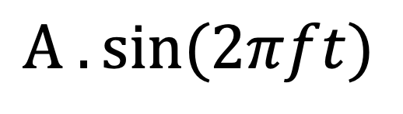

Equation of waves in time and space
Amplitude here
The delay depends
on the distance.
$$distance from the source (x)$$
$$space$$
is a delayed version of
the amplitude here.
$$A . sin⁡(\frac{2π}{T}t)$$
$Ψ$(t)
$$=$$
$$A . sin⁡(2πft)$$
$$=$$

Slide 24
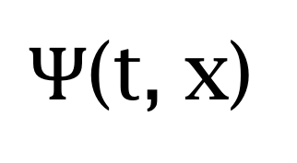
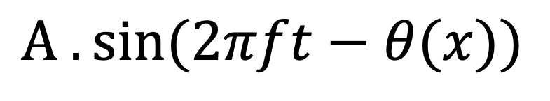

Equation of waves in time and space
Amplitude here
The delay depends
on the distance.
$$distance from the source (x)$$
$$space$$
is a delayed version of
the amplitude here.
$Ψ$(t, x)
$$=$$
$$A . sin⁡(2πft−θ(x))$$
Why is this negative?

Slide 25

Equation of waves in time and space
$wavelength$ = λ
$$distance from the source (x)$$
$$space$$
$Ψ$(t, x)
$$=$$
$$A . sin⁡(2πft−θ(x))$$

Slide 26


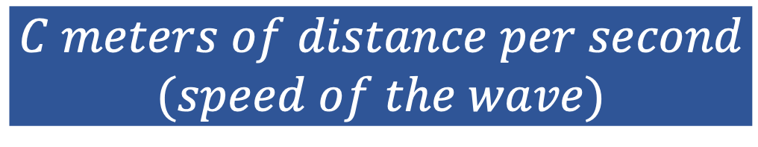
Equation of waves in time and space
$wavelength$ = λ
$$f number of cycles per second$$
$$C meters of distance per second$$
$$(speed of the wave)$$
$distance per cycle=\text{λ}$ = $C$/ $f$

Slide 27
Equation of waves in time and space
$wavelength$ = λ
$$f number of cycles per second$$
$$C meters of distance per second$$
$$(speed of the wave)$$
$distance per cycle=\text{λ}$ = $C$/ $f$
$$2π radians of angle is covered per cycle$$

Slide 28

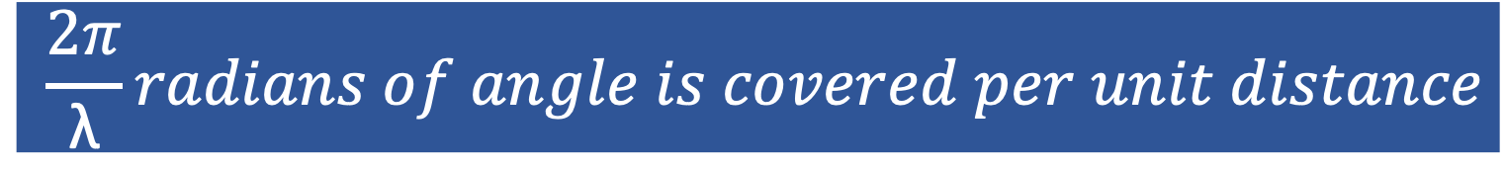


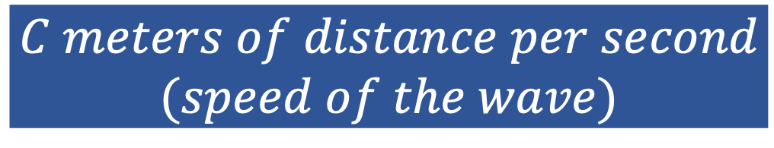
$wavelength$ = λ
Equation of waves in time and space
$$f number of cycles per second$$
$$C meters of distance per second$$
$$(speed of the wave)$$
$distance per cycle=\text{λ}$ = $C$/ $f$
$$2π radians of angle is covered per cycle$$
$$\frac{2π}{\text{λ}}radians of angle is covered per unit distance$$

Slide 29

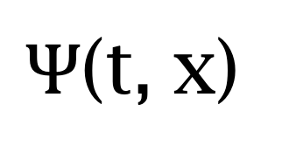
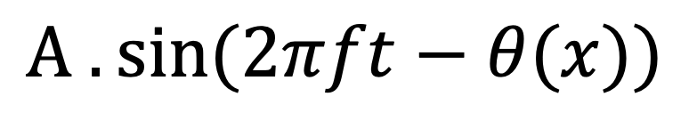
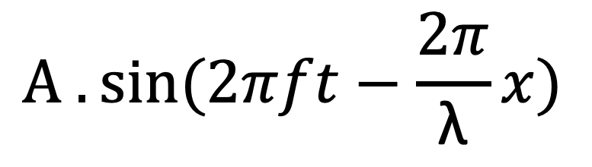
Equation of waves in time and space
$wavelength$ = λ
$$distance from the source (x)$$
$$space$$
$Ψ$(t, x)
$$=$$
$$A . sin⁡(2πft−θ(x))$$
$$A . sin⁡(2πft−\frac{2π}{\text{λ}}x)$$
$$=$$

Slide 30
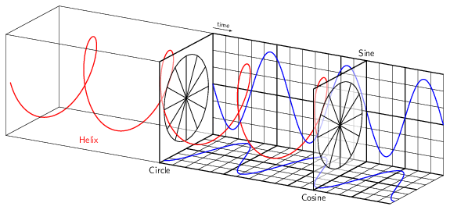
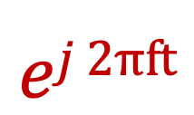
Model for a signal (frequency, amplitude, and phase)
$$ej 2πft$$

Slide 31



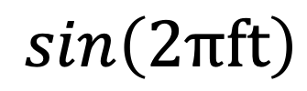
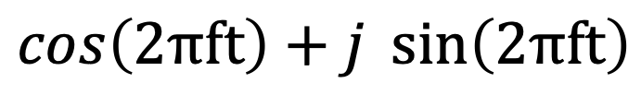




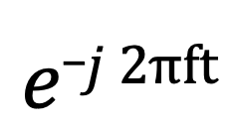
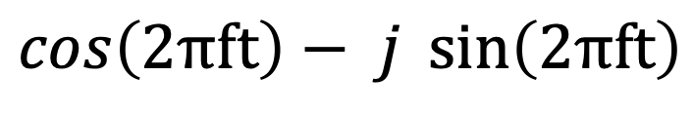
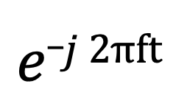
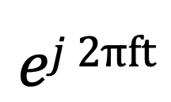
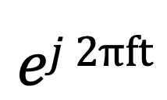
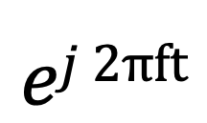
Presenting real signal with the complex model
$$ej 2πft$$
$$=$$
$$\cos\left(2πft\right)+j \sin\left(2πft\right)$$
$$e_j 2πft$$
$$=$$
$$\cos\left(2πft\right)− j \sin\left(2πft\right)$$
$$ej 2πft$$
$$+$$
$$e_j 2πft$$
$$\cos\left(2πft\right)$$
$$=$$
2
$$ej 2πft$$
$$−$$
$$e_j 2πft$$
$$\sin\left(2πft\right)$$
$$=$$
2j

Slide 32
Equation of waves in time and space
$wavelength$ = λ
$$distance from the source (x)$$
$$space$$
$$A . sin⁡(2πft−\frac{2π}{\text{λ}}x)$$
$Ψ$(t, x)
$$=$$

Slide 33
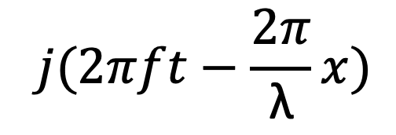
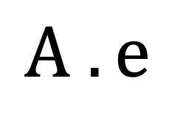
Equation of waves in time and space
$wavelength$ = λ
$$distance from the source (x)$$
$$space$$
$$⁡j(2πft−\frac{2π}{\text{λ}}x)$$
$$A . e$$
$Ψ$(t, x)
$$=$$

Slide 34
Time and space
Cycles per sec = frequency = f Hz
Distance per cycle = wavelength = λ meters
Distance per second = speed = C meters/sec
C = f . λ
Speed of sound in air: 343 m/s
Speed of sound in water: 1493 m/s
Speed of sound in iron: 5130 m/s
Speed of electromagnetic waves: 3*10⁸ m/s
(~ a million times faster than sound)

Slide 35


Time and space
$$A . sin⁡(2πft)$$

Slide 36
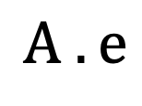

Time and space
$$⁡j(2πft)$$
$$A . e$$

Slide 37
Time and space
Distance = d meter
$$⁡j(2πft)$$
$$A . e$$

Slide 38
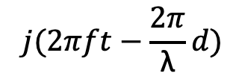
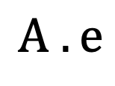
Time and space
$$⁡j(2πft−\frac{2π}{\text{λ}}d)$$
$$A . e$$
Distance = d meter
$$⁡j(2πft)$$
$$A . e$$

Slide 39
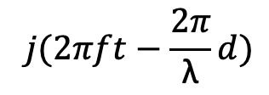
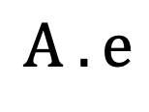
Time and space
$$⁡j(2πft−\frac{2π}{\text{λ}}d)$$
$$A . e$$
d meter
$$⁡j(2πft−\frac{2π}{\text{λ}}d)$$
$$A . e$$
Distance = d meter
$$⁡j(2πft)$$
$$A . e$$

Slide 40
Time and space
$$⁡j(2πft−\frac{2π}{\text{λ}}d)$$
$$A . e$$
d meter
$$⁡j(2πft−\frac{2π}{\text{λ}}d)$$
$$A . e$$
Distance = d meter
$$⁡j(2πft)$$
$$A . e$$

Slide 41

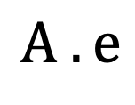
Time and space
$$⁡j(2πft)$$
$$A . e$$

Slide 42
Time and space
X meters
$$⁡j(2πft)$$
$$A . e$$

Slide 43

Time and space
X meters
$$⁡j(2πft)$$
$$Θ$$
$$A . e$$

Slide 44

Time and space
X.sin($Θ$)
X meters
$$⁡j(2πft)$$
$$Θ$$
$$A . e$$

Slide 45
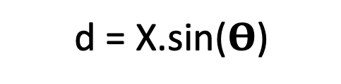
Time and space
d = X.sin($Θ$)
X meters
$$⁡j(2πft)$$
$$Θ$$
$$A . e$$

Slide 46
Time and space
d = X.sin($Θ$)
X meters
$$⁡j(2πft)$$
$$Θ$$
$$A . e$$

Slide 47
Reflection of waves

Slide 48
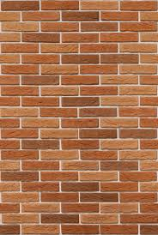
Reflection

Slide 49


Reflection
$$Θ$$
$$Θ$$

Slide 50
Reflection
d1
$$Θ$$
$$Θ$$
d2

Slide 51
Reflection
Absorption
+
Reflection
echo

Slide 52
Reflection
Time = t1

Slide 53
Reflection
Time = t1
Absorption
+
Reflection

Slide 54
Reflection
Time = t1
Absorption
+
Reflection
echo
t2

Slide 55
Reflection
Time = t1
Absorption
+
Reflection
d
echo
t2
Sound travelled (2d) distance

Slide 56
Reflection
Time = t1
Absorption
+
Reflection
d
echo
t2
Sound travelled (2d) distance
C.(t2-t1) = 2d

Slide 57
Reflection
Time = t1
Absorption
+
Reflection
d
Echolocation
echo
t2
Sound travelled (2d) distance
C.(t2-t1) = 2d

Slide 58
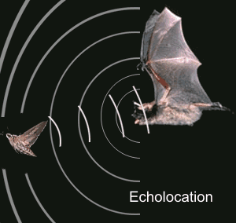
Echolocation in nature
Bat

Slide 59
Echolocation in nature
Beluga whale

Slide 60
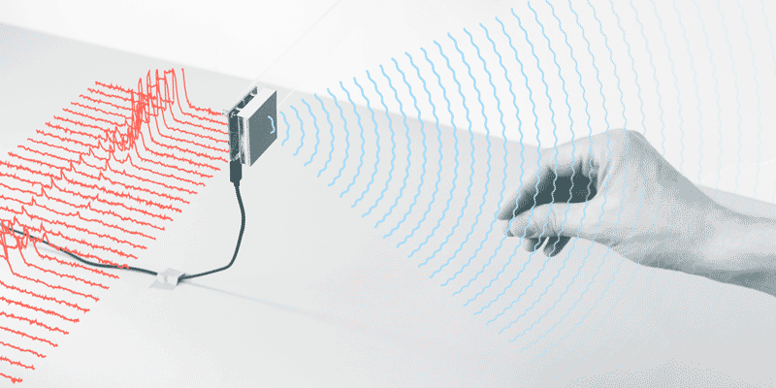
Waves for gesture detection

Slide 61
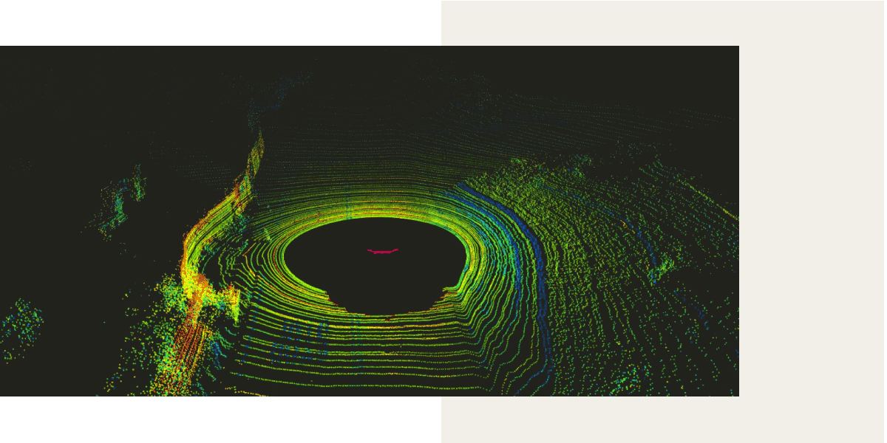
LiDAR (Light Detection and Ranging)

Slide 62
LiDAR (Light Detection and Ranging)

Slide 63
Acoustic imaging

Slide 64

Acoustic imaging
Sonogram

Slide 65
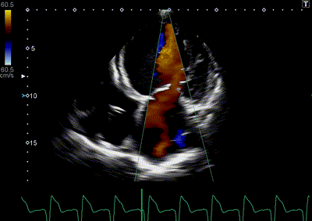
Acoustic imaging
Sonogram

Slide 66
Multipath

Slide 67

Multipath

Slide 68
Multipath

Slide 69
Multipath: Convolution
Amplitude
Time (sec)
0.00
0.25
0.50
0.75
1.00
1.25

Slide 70
Multipath: Convolution
Amplitude
Time (sec)
0.00
0.25
0.50
0.75
1.00
1.25
Direct path
Amplitude
Time (sec)
0.00
0.25
0.50
0.75
1.00
1.25

Slide 71
Multipath: Convolution
Amplitude
Time (sec)
0.00
0.25
0.50
0.75
1.00
1.25
Direct path
Echo
Amplitude
Time (sec)
0.00
0.25
0.50
0.75
1.00
1.25

Slide 72
Multipath: Convolution
Amplitude
Time (sec)
0.00
0.25
0.50
0.75
1.00
1.25
Direct path
Echo
Amplitude
Time (sec)
0.00
0.25
0.50
0.75
1.00
1.25

Slide 73
Multipath: Convolution
Amplitude
Time (sec)
0.00
0.25
0.50
0.75
1.00
1.25
Direct path
Echo
Amplitude
Time (sec)
0.00
0.25
0.50
0.75
1.00
1.25

Slide 74

Multipath: Convolution
Amplitude
Time (sec)
0.00
0.25
0.50
0.75
1.00
1.25
Amplitude
Time (sec)
0.00
0.25
0.50
0.75
1.00
1.25

Slide 75
Multipath: Convolution
Amplitude
0.00
0.75
Time (sec)

Slide 76
Multipath: Convolution
Amplitude
0.00
0.75
Time (sec)

Slide 77

Impulse response
Impulse/ Dirac delta function
$δ$(x-a)
Amplitude
Environment
(reflections, absorption, attenuation etc.)
Time (sec)
a
Impulse Response

Slide 78
Linear Time Invariant (LTI) System

Slide 79
Linear Time Invariant (LTI) System
Amplitude
0.00
0.75
Time (sec)
+
+
=

Slide 80
Impulse response

Slide 81
Impulse response
Impulse
SYSTEM
Impulse Response

Slide 82
Impulse response
Impulse Response
Input
SYSTEM
*
Input
Convolution
operator

Slide 83
Convolution operator

Slide 84


Convolution operator: Definition

Slide 85


Convolution operator: Properties

Slide 86

Convolution operator

Slide 87
A simple acoustic ranging technique
BeepBeep – SenSys 2007

Slide 88

Distance = d
Device A
Device B

Slide 89
Time = t1
Distance = d
Device A
Device B

Slide 90
Time = t1
Time = t2
Distance = d
Device A
Device B

Slide 91
Bluetooth/WiFi
Time = t1
Time = t1
Time = t2
Distance = d
Device A
Device B

Slide 92
Bluetooth/WiFi
Time = t1
Time = t1
Time = t2
Distance = d
Device A
Device B
d = C . (t2-t1)

Slide 93
Bluetooth/WiFi
Time = t1
Time = t1
Time = t2
Distance = d
Problem: Clock synchronization
Device A
Device B
d = C . (t2-t1)

Slide 94
The root cause of inaccuracy
– three uncertainties
Clock synchronization uncertainty
time

Slide 95
The root cause of inaccuracy
– three uncertainties
Clock synchronization uncertainty
Sending uncertainty
time

Slide 96
Sound production and recording

Slide 97
Sound recording with microphone
Sound

Slide 98
Sound recording with microphone
Analog signal (voltage)
Sound
ADC
ADC = Analog-to-Digital Converter

Slide 99
Sound recording with microphone
Analog signal (voltage)
Sound
ADC
S6 S5 S4 S3 S2 S1 S0
Audio Sample Buffer
ADC = Analog-to-Digital Converter

Slide 100
Sound production with speaker
S6 S5 S4 S3 S2 S1 S0
Audio Sample Buffer

Slide 101
Sound production with speaker
S6 S5 S4 S3 S2 S1 S0
Analog signal (voltage)
Audio Sample Buffer
DAC
DAC = Digital-to-Analog Converter

Slide 102
Sound production with speaker
S6 S5 S4 S3 S2 S1 S0
Analog signal (voltage)
Audio Sample Buffer
DAC
Sound
DAC = Digital-to-Analog Converter

Slide 103
The root cause of inaccuracy
– three uncertainties
Clock synchronization uncertainty
Sending uncertainty
software issuing command
...
t0 = wall_clock();
write(sound_dev, signal);
...
time

Slide 104

The root cause of inaccuracy
– three uncertainties
Clock synchronization uncertainty
Sending uncertainty
software issuing command
...
t0 = wall_clock();
write(sound_dev, signal);
...
unknown delays (software, system, driver, hardware, …) ?
sound leaves
speaker
time

Slide 105
The root cause of inaccuracy
– three uncertainties
Clock synchronization uncertainty
Sending uncertainty
Receiving uncertainty
software issuing command
...
t0 = wall_clock();
write(sound_dev, signal);
...
unknown delays (software, system, driver, hardware, …) ?
sound leaves
speaker
time

Slide 106

The root cause of inaccuracy
– three uncertainties
Clock synchronization uncertainty
Sending uncertainty
Receiving uncertainty
software issuing command
...
t0 = wall_clock();
write(sound_dev, signal);
...
unknown delays (software, system, driver, hardware, …) ?
sound leaves
speaker
sound
reaches mic
time

Slide 107
The root cause of inaccuracy
– three uncertainties
Clock synchronization uncertainty
Sending uncertainty
Receiving uncertainty
software issuing command
...
t0 = wall_clock();
write(sound_dev, signal);
...
unknown delays (software, system, driver, hardware, …) ?
sound leaves
speaker
sound
reaches mic
unknown delays (hardware, interrupt, driver, scheduling, …) ?
time

Slide 108
The root cause of inaccuracy
– three uncertainties
Clock synchronization uncertainty
Sending uncertainty
Receiving uncertainty
software issuing command
software aware of arrival
...
t0 = wall_clock();
write(sound_dev, signal);
...
...
read(sound_dev, signal);
t1 = wall_clock();
...
unknown delays (software, system, driver, hardware, …) ?
sound leaves
speaker
sound
reaches mic
unknown delays (hardware, interrupt, driver, scheduling, …) ?
time

Slide 109



Beepbeep’s basic procedure
Device A emits a beep while both recording
Device B emits another beep while both continue recording
Both devices detect TOA of the two beeps and obtain respective ETOAs
Exchange ETOAs and calculate the distance
Device A
Device B
A’s recording
B’s recording
ETOA_{A}
ETOA_{B}
D_{AB}=|ETOA_{A}-ETOA_{B}|/2

Slide 110
Timeline
Device A
Device B

Slide 111

Timeline
Device A
Device B
1st Beep
t_{A0}

Slide 112
Timeline
Device A
Device B
1st Beep
t_{A0}
t_{A1}
t_{B1}

Slide 113

Timeline
Device A
Device B
1st Beep
t_{A0}
t_{A1}
t_{B1}
2nd Beep
t_{B2}

Slide 114
Timeline
Device A
Device B
1st Beep
t_{A0}
t_{A1}
t_{B1}
2nd Beep
t_{B2}
t_{B3}
t_{A3}

Slide 115
Timeline
Device A
Device B
1st Beep
t_{A0}
t_{A1}
t_{B1}
ETOA_{A}
2nd Beep
t_{B2}
t_{B3}
t_{A3}

Slide 116
Timeline
Device A
Device B
1st Beep
t_{A0}
t_{A1}
t_{B1}
ETOA_{B}
ETOA_{A}
2nd Beep
t_{B2}
t_{B3}
t_{A3}

Slide 117
Timeline
Device A
Device B
1st Beep
t_{A0}
t_{A1}
P
t_{B1}
ETOA_{B}
ETOA_{A}
2nd Beep
t_{B2}
t_{B3}
t_{A3}

Slide 118
Timeline
Device A
Device B
1st Beep
t_{A0}
t_{A1}
P
t_{B1}
ETOA_{B}
ETOA_{A}
2nd Beep
t_{B2}
t_{B3}
P
t_{A3}

Slide 119
Timeline
Device A
Device B
1st Beep
t_{A0}
t_{A1}
P
t_{B1}
ETOA_{B}
Q
ETOA_{A}
2nd Beep
t_{B2}
t_{B3}
P
t_{A3}

Slide 120
Timeline
Device A
Device B
1st Beep
t_{A0}
t_{A1}
P
t_{B1}
ETOA_{B}
Q
|ETOA_{A}-ETOA_{B}|
ETOA_{A}
2nd Beep
t_{B2}
= (P+Q+P) – (Q)
t_{B3}
P
t_{A3}

Slide 121
Timeline
Device A
Device B
1st Beep
t_{A0}
t_{A1}
P
t_{B1}
ETOA_{B}
Q
|ETOA_{A}-ETOA_{B}|
ETOA_{A}
2nd Beep
t_{B2}
= (P+Q+P) – (Q)
t_{B3}
P
= 2P
t_{A3}
= 2 (time of flight)

Slide 126
Project ideas: Inertial motion sensing
1. Car location in multistory parking lot.
2. Driver-passenger detection using smartphone
3. Driver’s / Biker’s driving pattern detection, dangerous
driving/biking alert
4. WiFi AP hand-off based on the motion pattern
5. 3D image by combining video and motion info.

Slide 127
Sound production and recording

Slide 128
Sound recording with microphone
Sound

Slide 129
Sound recording with microphone
Analog signal (voltage)
Sound
ADC
ADC = Analog-to-Digital Converter

Slide 130
Sound recording with microphone
Analog signal (voltage)
Sound
ADC
S6 S5 S4 S3 S2 S1 S0
Audio Sample Buffer
ADC = Analog-to-Digital Converter

Slide 131
Sound production with speaker
S6 S5 S4 S3 S2 S1 S0
Audio Sample Buffer

Slide 132
Sound production with speaker
S6 S5 S4 S3 S2 S1 S0
Analog signal (voltage)
Audio Sample Buffer
DAC
DAC = Digital-to-Analog Converter

Slide 133
Sound production with speaker
S6 S5 S4 S3 S2 S1 S0
Analog signal (voltage)
Audio Sample Buffer
DAC
Sound
DAC = Digital-to-Analog Converter

Slide 134

Human hearing

Slide 135
Human hearing
20Hz – 20kHz (Human hearing range)
0
10
100
1000
10,000
100,000
Frequency (log scale)

Slide 136
Human hearing
Infra-sound
Audible sound
Ultrasound
20Hz – 20kHz (Human hearing range)
0
10
100
1000
10,000
100,000
Frequency (log scale)

Slide 137
Human hearing
Dog /Cat
(45/65kHz)
Bat/Dolphin
(120/150kHz)
Infra-sound
Audible sound
Ultrasound
20Hz – 20kHz (Human hearing range)
0
10
100
1000
10,000
100,000
Frequency (log scale)

Slide 138


Near-ultrasound
Audible
Inaudible Ultrasound
Amplitude
20k
40k
60k
Frequency

Slide 139
Near-ultrasound
Audible
Inaudible Ultrasound
Near-ultrasound
Amplitude
20k
40k
60k
Frequency

Slide 140

Mechanical waves
Transverse wave

Slide 141


Mechanical waves
Transverse wave

Slide 142


Mechanical waves
Transverse wave
Longitudinal wave

Slide 143


Mechanical waves
Transverse wave
Longitudinal wave

Slide 144
Mechanical waves

Slide 145

Mechanical waves

Slide 146
Mechanical waves

Slide 147
Mechanical waves: Time and space
Amplitude
Distance (meters)
0.00
0.25
0.50
0.75
1.00

Slide 148
Mechanical waves: Time and space
Phase of the signal changes over distance/space
Amplitude
Distance (meters)
0.00
0.25
0.50
0.75
1.00

Slide 149
Mechanical waves: Time and space
Wavelength = λ meters
Amplitude
Distance (meters)
0.00
0.25
0.50
0.75
1.00

Slide 150
Mechanical waves: Time and space

Slide 151
Mechanical waves: Time and space
Wavelength = λ meters

Slide 152
Mechanical waves: Time and space
Sound wave observed over time at a point in space

Slide 153
Mechanical waves: Time and space
Amplitude
Cycles per sec = frequency = f Hz
Time (sec)
0.00
0.50
1.00
1.50
2.00
Sound wave observed over time at a point in space

Slide 154
Time and space
Cycles per sec = frequency = f Hz

Slide 155
Time and space
Cycles per sec = frequency = f Hz
Distance per cycle = wavelength = λ meters

Slide 156
Time and space
Cycles per sec = frequency = f Hz
Distance per cycle = wavelength = λ meters
Distance per second = speed = C meters/sec

Slide 157
Time and space
Cycles per sec = frequency = f Hz
Distance per cycle = wavelength = λ meters
Distance per second = speed = C meters/sec
C = f . λ

Slide 158

Time and space
Distance = d meter
$$sin⁡(2πft)$$
Sound is delayed by = d/C sec

Slide 159
Time and space
Distance = d meter
$$sin⁡(2πft)$$
Sound is delayed by = d/C sec
= (d/C).f cycles

Slide 160

Time and space
Distance = d meter
$$sin⁡(2πft)$$
Sound is delayed by = d/C sec
= (d/C).f cycles
$$= 2π\left(\frac{d}{C}\right)f \text{radians} \text{in} \text{phase}$$

Slide 161

Time and space
Distance = d meter
$$sin⁡(2πft)$$
Sound is delayed by = d/C sec
= (d/C).f cycles
$$= 2π\left(\frac{d}{C}\right)f \text{radians} \text{in} \text{phase}$$
$$= 2πd/\text{λ} \text{radians} \text{in} \text{phase}$$

Slide 162




Time and space
$$sin⁡(2πft−2πd/\text{λ})$$
d meter
Distance = d meter
$$sin⁡(2πft−2πd/\text{λ})$$
Equation of the sine wave in time and space:
F(x,t) = $A.sin⁡(2πft±2πx/\text{λ})$
$$sin⁡(2πft)$$
Sound is delayed by = d/C sec
= (d/C).f cycles
$$= 2π\left(\frac{d}{C}\right)f \text{radians} \text{in} \text{phase}$$
$$= 2πd/\text{λ} \text{radians} \text{in} \text{phase}$$

Slide 163
Time and space
$$⁡j(2πft−\frac{2π}{\text{λ}}d)$$
$$A . e$$
Distance = d meter
$$⁡j(2πft)$$
$$A . e$$
Sound is delayed by = d/C sec
= (d/C).f cycles
$$= 2π\left(\frac{d}{C}\right)f \text{radians} \text{in} \text{phase}$$
$$= 2πd/\text{λ} \text{radians} \text{in} \text{phase}$$

