Slide 1
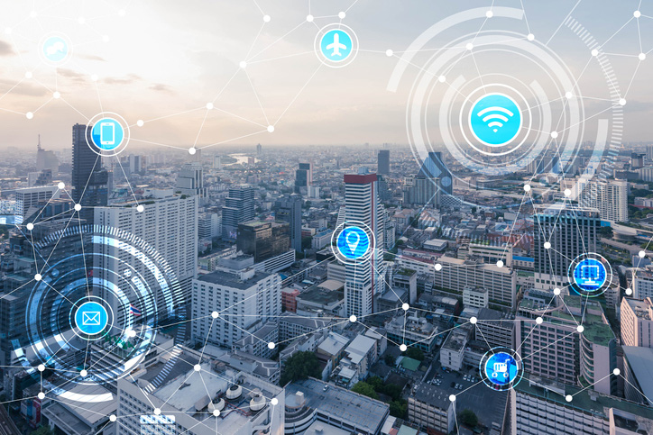
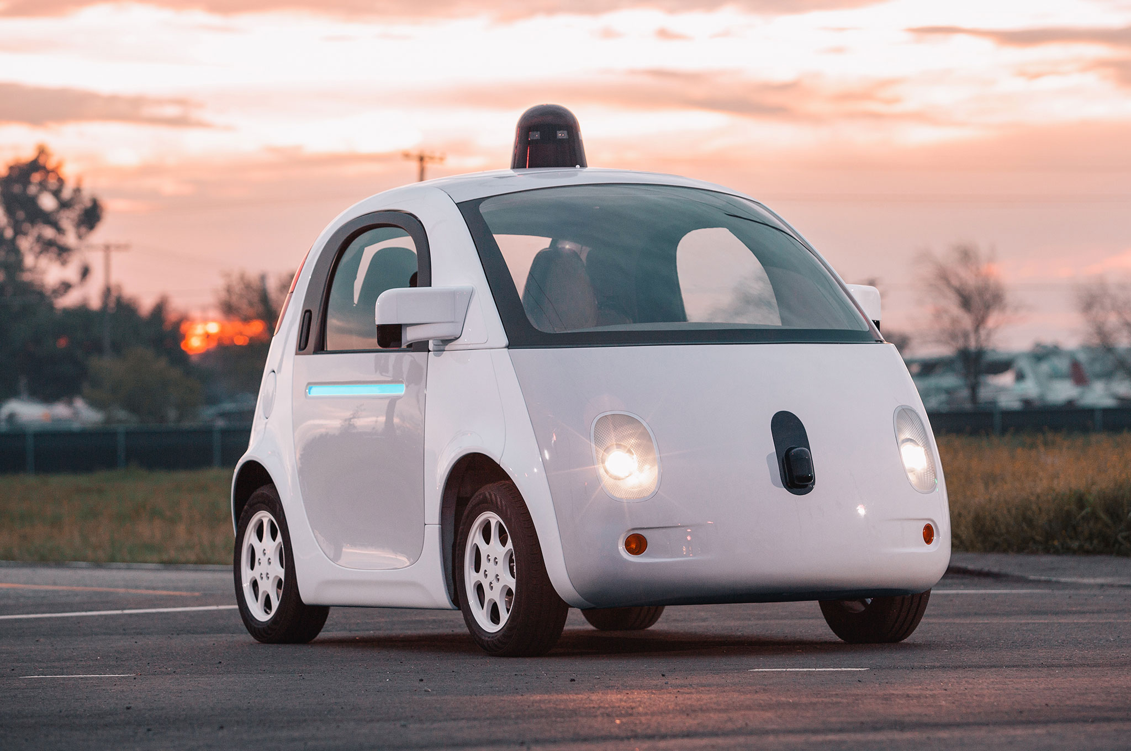
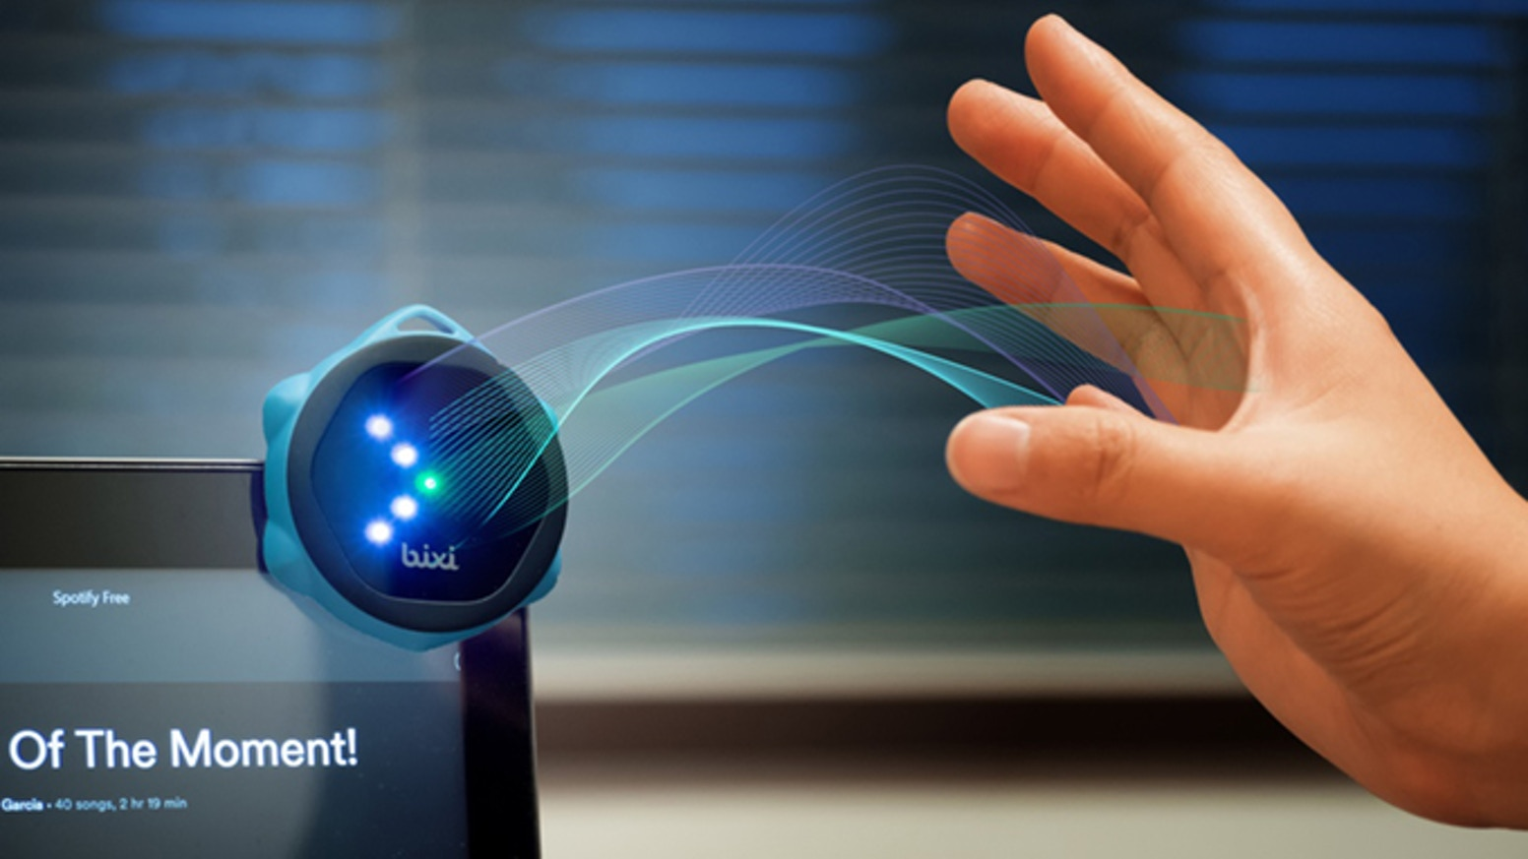
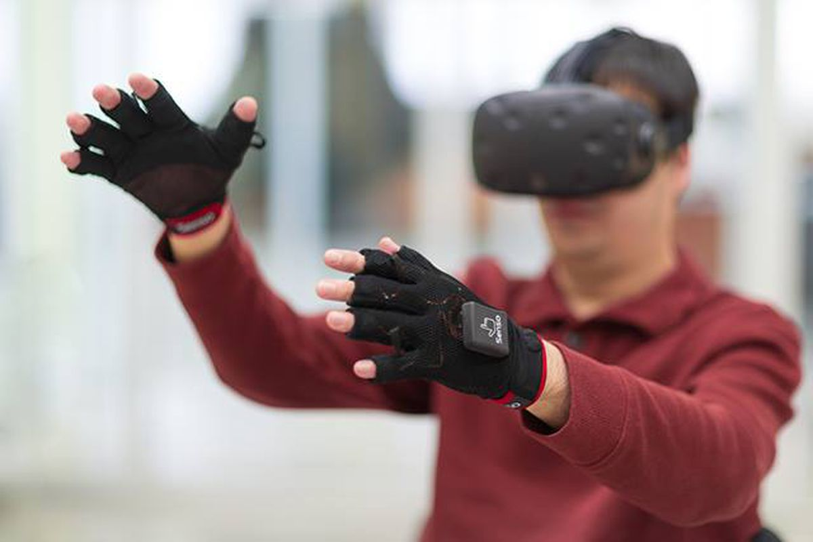

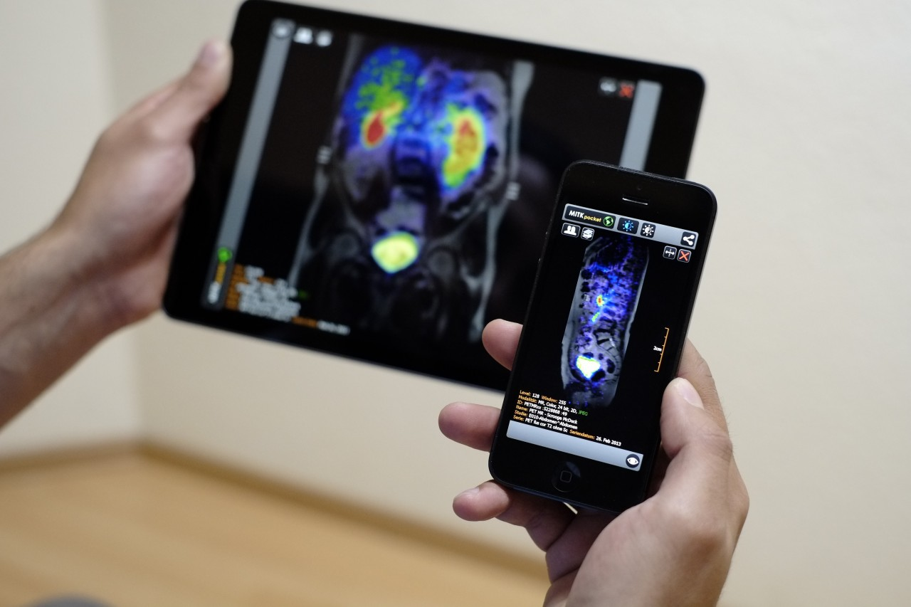
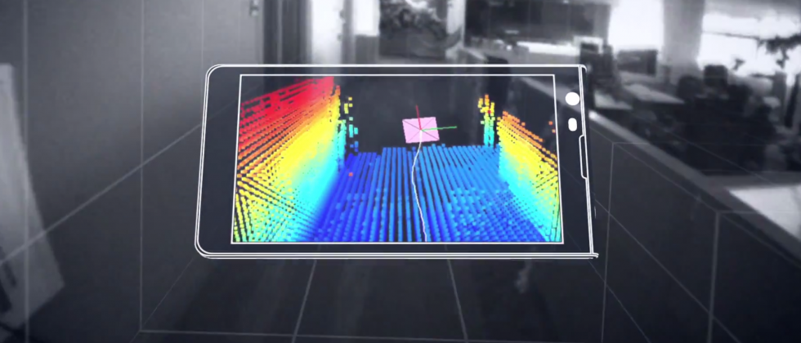
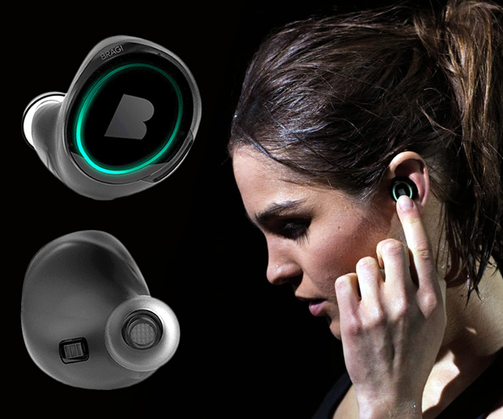
Wireless and Mobile Systems
for the IoT
CMSC 818W : Fall 2019
Lecture 3.2: Application of Waves in Detection and Ranging
Nirupam Roy
M-W 2:00-3:15pm
CSI 1122

Slide 2
Finding distance using waves
(Ranging)

Slide 3
…
SONAR
(detection)
Depth/Image
Gesture

Slide 4
…
SONAR
(detection)
Depth/Image
Gesture
Finding distance using waves
(Ranging)

Slide 5
…
SONAR
(detection)
Depth/Image
Gesture
Finding distance using waves
(Ranging)
Speed
Amplitude
Frequency
Phase

Slide 6
1. Distance from the speed information
a. Techniques
b. Signal detection
2. Distance from the amplitude information
a. Absorption
b. Propagation loss
3. Distance from the frequency information
a. Doppler effect
b. A case study (Doppler + Triangulation)
4. Distance from the phase information
a. Overview
b. Impulse function, Impulse response, Convolution
c. A case study

Slide 7
1. Distance from the speed information
a. Techniques
b. Signal detection
2. Distance from the amplitude information
a. Absorption
b. Propagation loss
3. Distance from the frequency information
a. Doppler effect
b. A case study (Doppler + Triangulation)
4. Distance from the phase information
a. Overview
b. Impulse function, Impulse response, Convolution
c. A case study

Slide 8
Distance from the speed information
Dist. = (speed) X (time of travel)
Time of Arrival (ToA)
Signal source
observer

Slide 9
Distance from the speed information
Dist. = (speed) X (time of travel)
Time of Arrival (ToA)
Signal source
observer
Signal source
Time Difference of Arrival (TDoA)
observer 1
observer2

Slide 10
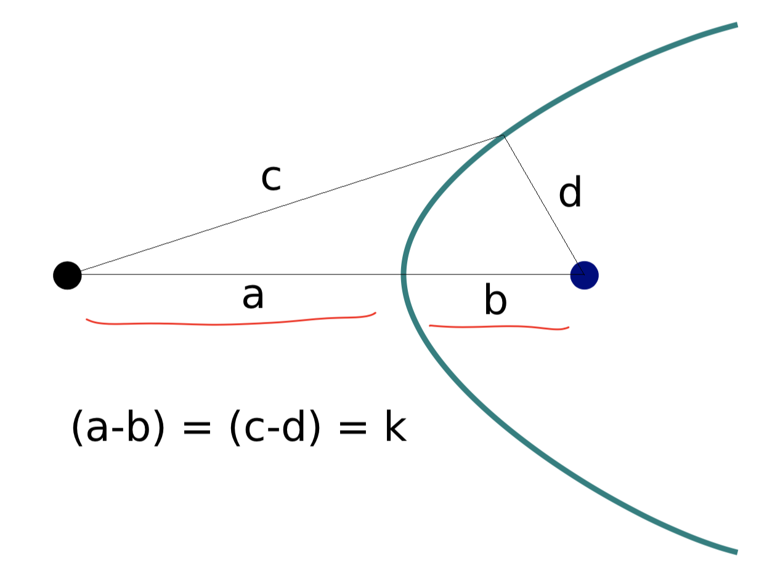
TDoA
a
b
Find the location of the wave source when (a-b) is known.

Slide 11
TDoA
a
b
c
d

Slide 12
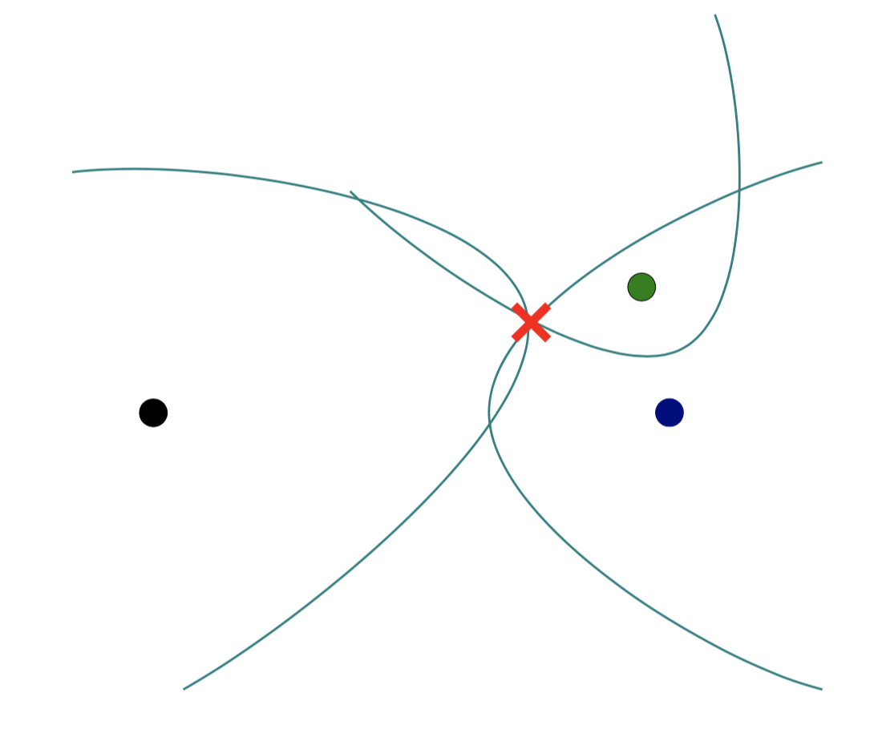
TDoA

Slide 13
Distance from the speed information
Dist. = (speed) X (time of travel)
Time of Arrival (ToA)
Signal source
observer
Signal source
Time Difference of Arrival (TDoA)
observer 1
observer2
Round-trip Time of Flight (RToF)
Signal source
+ observer
Reflector

Slide 14
Distance from the speed information
Dist. = (speed) X (time of travel)
Time of Arrival (ToA)
Signal source
observer
How to detect the signal at the receiver/observer?
Signal source
Time Difference of Arrival (TDoA)
observer 1
observer2
Round-trip Time of Flight (RToF)
Signal source
+ observer
Reflector

Slide 15
Signal detection
Amplitude
Time/Sample
Transmitter signal

Slide 16
Signal detection
Amplitude
Amplitude
Time/Sample
Time/Sample
Transmitter signal
Receiver signal

Slide 17
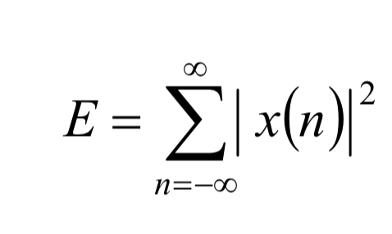
Signal detection
Amplitude
Amplitude
Time/Sample
Time/Sample
Transmitter signal
Receiver signal
Energy based signal detector
Energy of a discrete signal x(n),

Slide 18
Signal detection
Amplitude
Amplitude
Time/Sample
Time/Sample
Transmitter signal
Receiver signal

Slide 19
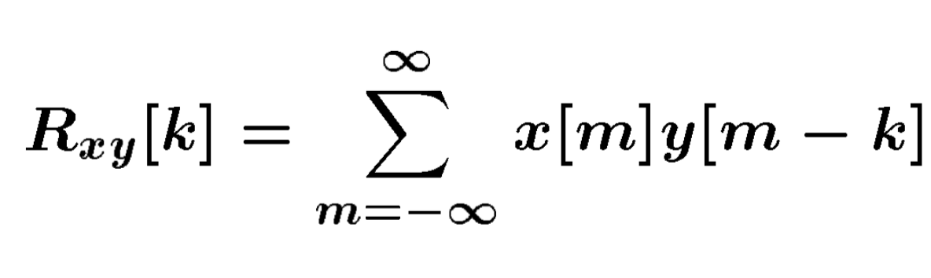
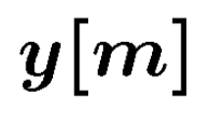
Signal detection
Received signal
Signal matching
Transmit signal template

Slide 20
Signal detection
Received signal
Signal matching
Transmit signal template
Correlation

Slide 21
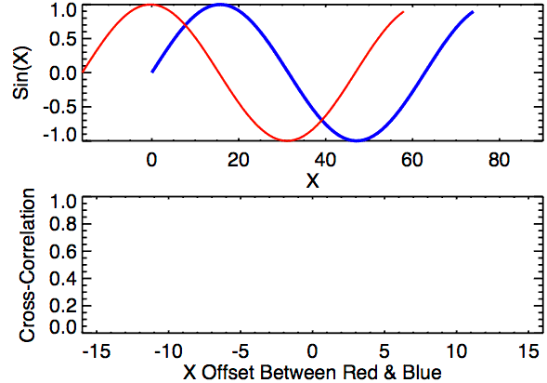
Signal detection
Correlation

Slide 22
Signal detection
Received signal
Problem: Received signal is distorted due to multipath, attenuation etc.
Signal matching
Transmit signal template
Correlation

Slide 23
Signal detection: Work-around for signal distortion
Two identical replicas
Amplitude
Time/Sample
Transmitter signal

Slide 24
Signal detection
Two identical replicas
Two similarly
distorted replicas
Amplitude
Amplitude
Time/Sample
Time/Sample
Transmitter signal
Receiver signal

Slide 25
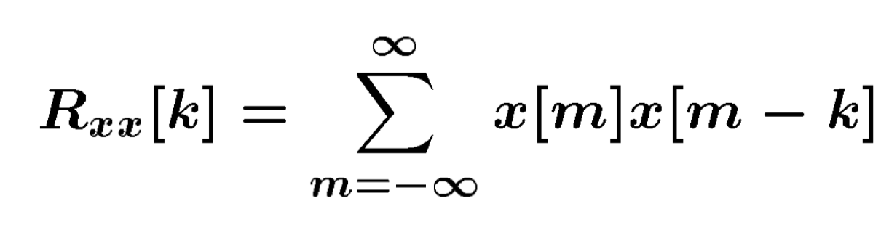
Signal detection
Received signal
Matching with itself
(window size = half of the signal length)
Auto-Correlation

Slide 26
Signal detection
Cross-Correlation
Auto-Correlation

Slide 27
Distance from the speed information
Dist. = (speed) X (time of travel)
Time of Arrival (ToA)
Signal source
observer
Time Difference of Arrival (TDoA)
Signal source
observer 1
observer2
Round-trip Time of Flight (RToF)
Signal source
+ observer
Reflector
Notes:
Slide 23: 20 minutes

Slide 28
1. Distance from the speed information
a. Techniques
b. Signal detection
2. Distance from the amplitude information
a. Absorption
b. Propagation loss
3. Distance from the frequency information
a. Doppler effect
b. A case study (Doppler + Triangulation)
4. Distance from the phase information
a. Overview
b. Impulse function, Impulse response, Convolution
c. A case study

Slide 29

Distance from the amplitude information
Amplitude
Time (sec)
$$AS . sin⁡(2πft)$$

Slide 30

Distance from the amplitude information
Dist. = d
Amplitude
Time (sec)
Amplitude
Time (sec)
$$AS . sin⁡(2πft)$$
$$AO . sin⁡(2πft)$$

Slide 31
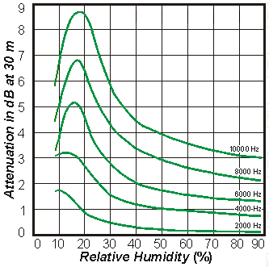
Distance from the amplitude information
Dist. = d
Amplitude
Time (sec)
Amplitude
Time (sec)
$$AS . sin⁡(2πft)$$
$$AO . sin⁡(2πft)$$
Attenuation due to atmospheric absorption and diffraction

Slide 32
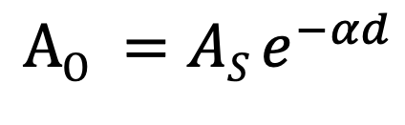
Distance from the amplitude information
Dist. = d
Amplitude
Time (sec)
Amplitude
Time (sec)
$$AS . sin⁡(2πft)$$
$$AO . sin⁡(2πft)$$
$$AO =AS e^{−αd}$$
α = attenuation coefficient
Depends on frequency and
environment ( temperature, humidity etc.)

Slide 33
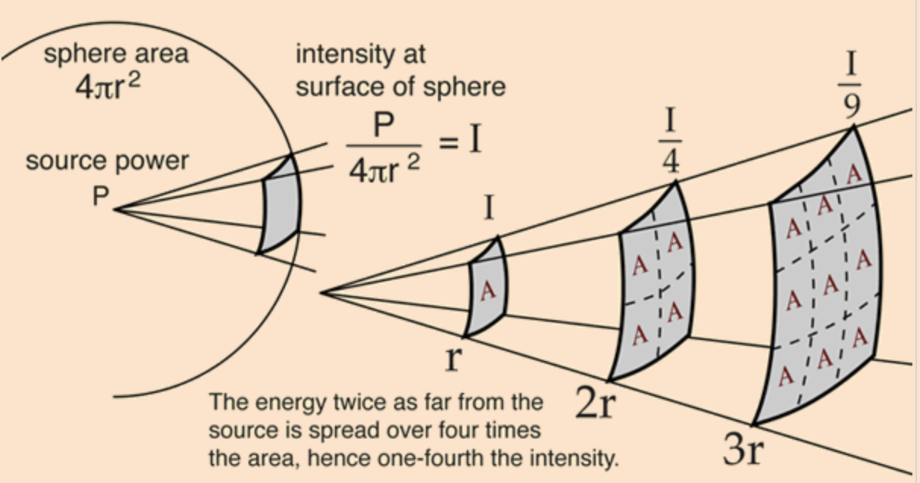
Distance from the amplitude information
Propagation loss

Slide 34
Distance from the amplitude information
Propagation loss
Notes:
Slide 30: 25 minutes

Slide 35
1. Distance from the speed information
a. Techniques
b. Signal detection
2. Distance from the amplitude information
a. Absorption
b. Propagation loss
3. Distance from the frequency information
a. Doppler effect
b. A case study (Doppler + Triangulation)
4. Distance from the phase information
a. Overview
b. Impulse function, Impulse response, Convolution
c. A case study

Slide 36
Distance from the frequency information
Motion of the sound source and/or the observer changes the frequency of the observed signal.
The change depends on the velocity of the source/observer.
This phenomena is known as Doppler effect or Doppler shift.

Slide 37
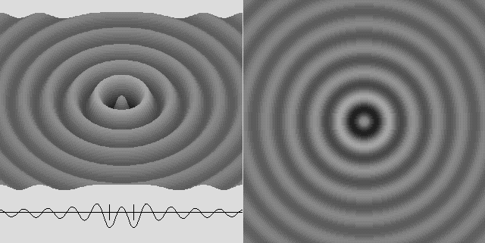
Doppler effect

Slide 38

Doppler effect

Slide 39
Doppler effect

Slide 40
Doppler effect
Simple wave model: Stationary source

Slide 41
Doppler effect
Simple wave model: Stationary source
Time = t1

Slide 42
Doppler effect
Simple wave model: Stationary source
Time = t2

Slide 43
Doppler effect
Simple wave model: Stationary source
Time = t2

Slide 44
Doppler effect
Simple wave model: Stationary source
Time = t3

Slide 45
Doppler effect
Simple wave model: Stationary source
Time = t3

Slide 46
Doppler effect
Simple wave model: Stationary source
Wavelength = λ meters
Time = t3

Slide 47
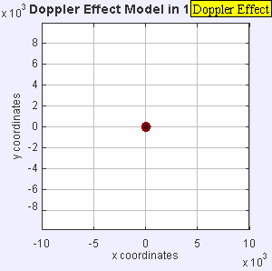
Doppler effect

Slide 48
Doppler effect
Simple wave model: Moving source

Slide 49
Doppler effect
Simple wave model: Moving source
Time = t1

Slide 50
Doppler effect
Simple wave model: Moving source
Time = t2

Slide 51
Doppler effect
Simple wave model: Moving source
Time = t2

Slide 52
Doppler effect
Simple wave model: Moving source
Time = t2

Slide 53
Doppler effect
Simple wave model: Moving source
Time = t3

Slide 54
Doppler effect
Simple wave model: Moving source
Time = t3

Slide 55
Doppler effect
Simple wave model: Moving source
Time = t3

Slide 56
Doppler effect
Simple wave model: Moving source
Actual wavelength = λ meters
Wavelength = λ₂ meters
Wavelength = λ₁ meters
Time = t3
Notes:
Slide 19: 2 minutes 30 seconds

Slide 57
Doppler effect
Simple wave model: Moving source
Actual wavelength = λ meters
Observer
Wavelength = λ₂ meters
Wavelength = λ₁ meters
Time = t3
Notes:
Slide 19: 2 minutes 30 seconds

Slide 58
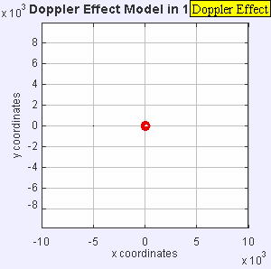
Doppler effect

Slide 59
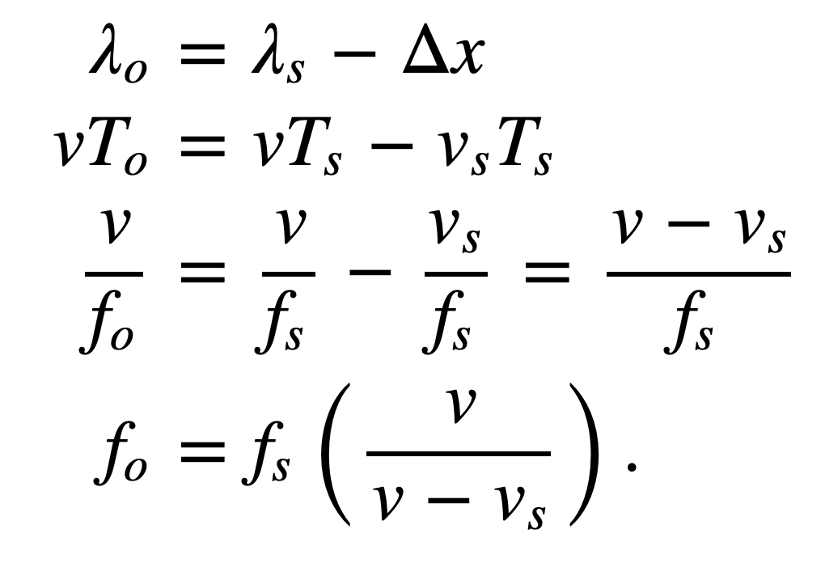
Doppler effect
Simple wave model: Moving source
Source moving towards the observer
v = Velocity of the signal (sound, light etc.)
v_{O} , T_{O} , f_{O} = Velocity of the observer and observed period and frequency
v_{S} , T_{S} , f_{S} = Velocity of the source and original period and frequency
Notes:
Slide 19: 2 minutes 30 seconds

Slide 60
Doppler effect
Simple wave model: Moving observer
Observer

Slide 61
Doppler effect
Simple wave model: Moving observer
t
t
Observer

Slide 62
Doppler effect
Simple wave model: Moving observer
t’ <t
t’ <t

Slide 63
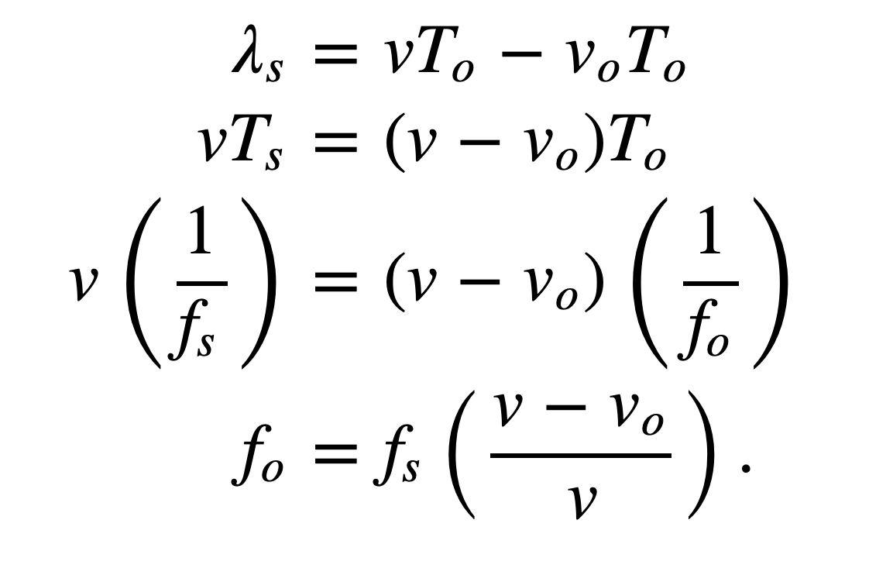
Doppler effect
Simple wave model: Moving observer
Observer moving towards the stationary source
+
+
+
+
v_{O} , T_{O} , f_{O} = Velocity of the observer and observed period and frequency
v_{S} , T_{S} , f_{S} = Velocity of the source and original period and frequency

Slide 64
Doppler effect
Simple wave model: Moving observer
Observer moving towards the stationary source
+
Doppler shift, Δf = f_{O}-f_{S} = f_{S} (v_{O}/v)
+
+
How will it change with signal’s velocity and frequency?
+
v_{O} , T_{O} , f_{O} = Velocity of the observer and observed period and frequency
v_{S} , T_{S} , f_{S} = Velocity of the source and original period and frequency

Slide 65
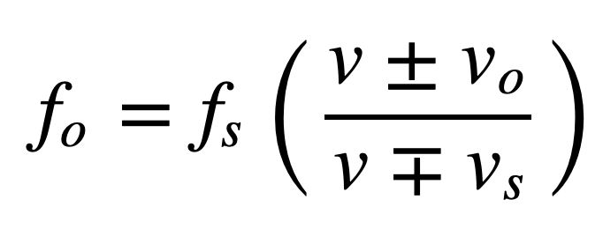
Doppler effect
Simple wave model: Moving observer
Both the source and the observer are moving
v_{O} , T_{O} , f_{O} = Velocity of the observer and observed period and frequency
v_{S} , T_{S} , f_{S} = Velocity of the source and original period and frequency
Notes:
Slide 58: 30 minutes

Slide 66
Doppler effect
Demo

Slide 67
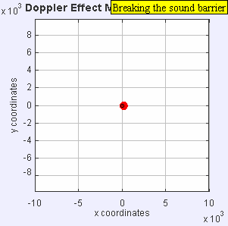
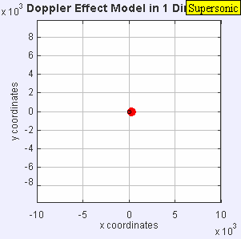
Doppler effect

Slide 68
Doppler effect

Slide 69
Turning a Mobile Device into a Mouse in the Air
Case study
Sangki Yun, Yi-Chao Chen and Lili Qiu
Department of Computer Science
The University of Texas at Austin
ACM MobiSys 2015, Florence, Italy

Slide 70

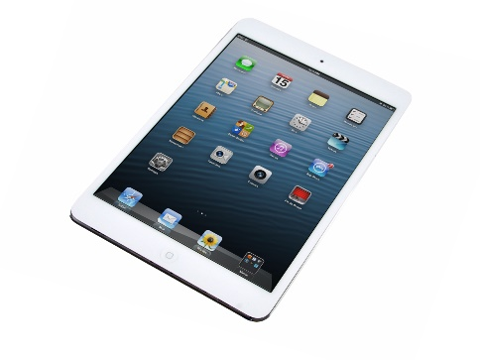
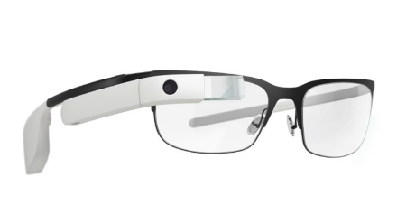
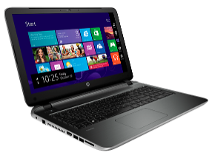
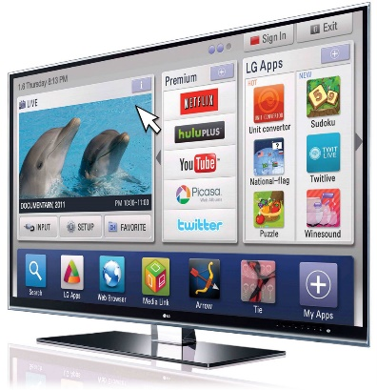
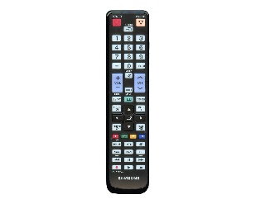
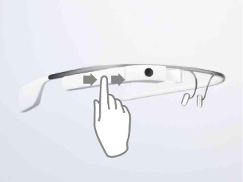
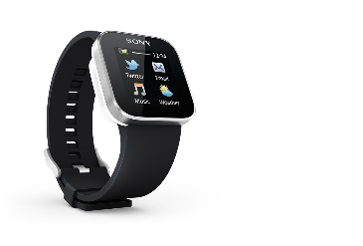
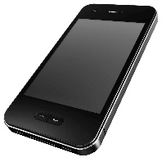
Era of Smart Devices
Smart Devices
Notes:
These days, people are surrounded by smart devices such as smart phone, laptop, smart TV and smart watch. According to some survey, a person carriers 2.9 smart devices in average. For some of the smart devices, they require sophisticated user interface to fully utilize the functionality, but the provided controller is not sufficient. For example, with smart TV, we can do almost all things we do with laptop or tablet such as web-browsing, social network and gaming, but the traditional remote controller is not good enough to utilize them. Similarly, smart glasses usually has small touch pad and we can use it to make a few simple commands such swiping and tapping, but the number of distinct gestures are limited and it significantly reduces the usability of the smart glasses.

Slide 71
Our goal
Controlling smart devices using existing mobile devices
How to enable precise mobile device position tracking?

Slide 72
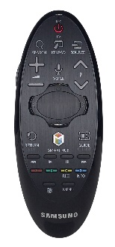
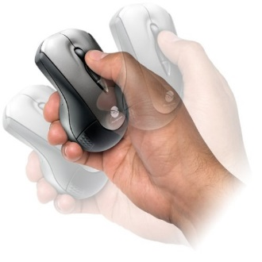
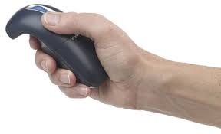
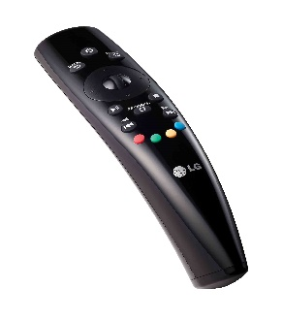
Possible solutions
WiFi signal based device localization – sub-meter level accuracy
Accelerometer based device tracking – not feasible due to large error
Gyroscope – track the rotational movement of the device
Notes:
In order to track the device movement, one possible way is using RF signal, which is very popular in indoor localization. However, it only achieves sub-meter level accuracy which our application requires cm level accuracy. Another possible way will be using the accelerometer in the mobile device. If the device is moving, the acceleration is generated and we can use it to track the position. However, the measured acceleration has huge noise and the tracking is not feasible. Using the gyroscope, we can track the rotational movement of the device. It is indeed used for commercial air mouse products and remote controllers for smart TVs. The problem of this approach is it tracks the rotational movement of our wrist while the mouse pointer is moving is 2D plane. The disparity between the rotational movement and 2D movement makes the users experience difficulties in controlling the pointer using gyroscope.

Slide 73
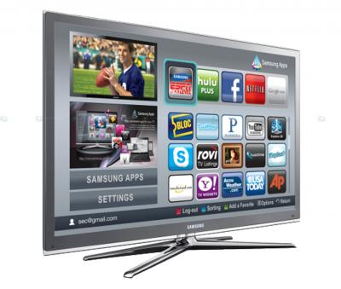
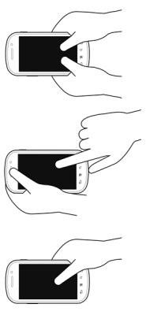
Our Approach
Audio based movement tracking using Doppler effect
Speakers emit audio signals in inaudible frequencies
The device position is tracked by the Doppler shift of the recorded audio signal
Notes:
In this work, we track the device movement using the audio signal. In particular, we use the Doppler shift generated while the device is moving. Here, the device to be tracked has two speakers, and each speaker emit pure sinusoid tones in different inaudible frequencies. The mobile device records the audio signal and sends it back to the processor, where it tracks the movement by analyzing the Doppler shift.

Slide 74
Why not accelerometer?
Small hand vibration causes non-negligible error
Track the device position by double integration of the acceleration
  Quick error accumulation
Movement estimated
from the accelerometer
Measured acceleration

Slide 75
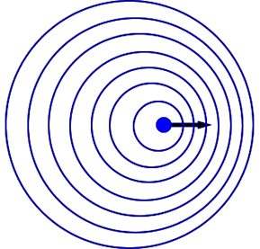
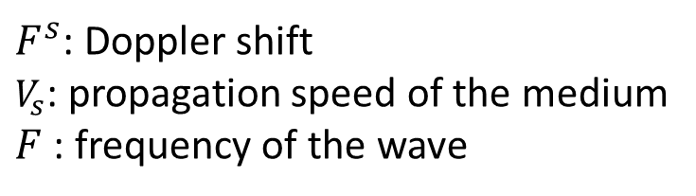
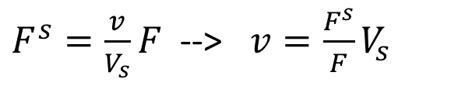
Doppler Effect
Doppler shift – change in the frequency due to the movement of the sender or the receiver
$F^{s}=\frac{v}{V_{s}}F$ --> $v=\frac{F^{s}}{F}V_{s}$
$F^{s}$: Doppler shift
$V_{s}$: propagation speed of the medium
$F$: frequency of the wave
Lower
frequency
Higher
frequency
Notes:
Doppler shift is the change of the center frequency incurred by the movement of the sender or the receiver of the wave signal. The mathematical relationship between the velocity and the frequency shift is like this. Let’s say the sender position is the fixed. The propagation speed and the center frequency of the original wave is constant, so by observing the frequency shift, we can calculate the velocity of the receiver.

Slide 76
Doppler based device tracking
From the measured Doppler shift, we can get the velocity and the moving distance of the device
`
Measured Doppler shift
Movement estimated
from Doppler shift
Notes:
Regarding the device tracking, one might wonder why don’t we simply use accelerometer instead of the Doppler. Accelerometer is equipped in almost all smart phones, and it is very cheap to read the acceleration in terms of the energy efficiency. However, the accelerometer has two fundamental problems. One is that it is easily affected by the gravity so small hand vibration causes non-negligible acceleration. And it tracks the position by the double integration where one integration of the acceleration gives the velocity and another integration gives the position. It is very sensitive to noise and small acceleration measurement error quickly explodes over time. Here we measure the acceleration while the device is moving in one direction. We see that the difference while the device is moving and stopped is small. And because of the accumulated error, the tracked position infinitely goes wrong direction even if the device has stopped. One the other hand, in the measured Doppler shift, we can clearly tell when the device is moving, and the movement distance tracked by the Doppler is much more accurate than the Doppler.

Slide 77
Outline
Accurate estimation of the Doppler shift
Locate the device
(Assume speaker distance & initial position known)
Finding the distance between speakers
Notes:
In order to enable Doppler shift

Slide 78
Outline
Accurate estimation of the Doppler shift
Locate the device
(Assume speaker distance & initial position known)
Finding the distance between speakers
Notes:
In order to enable Doppler shift

Slide 79
Doppler shift estimation
Frequency domain analysis by Short-term Fourier Transform (STFT)
Detect the Doppler shift by finding the peak frequency with maximum magnitude
Spectrogram of the audio signal
Doppler shift estimated by peak detection
Notes:
To estimate the Doppler shift, we need to analyze the signal in the frequency domain. Given the received audio signals, we perfom STFT to observe the change of the spectrum over time, and we estimate the Doppler shift by finding the frequency with the maximum magnitude. This is the spectrogram we got from STFT while device is drawing a circle. This is the Doppler shift estimated by the peak detection. By itself it has significant error so the tracking is inaccurate.

Slide 80
Improving the frequency shift estimation accuracy
Utilize larger spectrum
  Send multiple audio tones in 200 Hz interval
Outlier removal
  Doppler shift change larger than 10 Hz
Maximal Ratio Combining
Doppler shift from multiple channels
MRC with outlier removal
Notes:
So we use several techniques to improve the accuracy. First, we use larger spectrum to estimate the Doppler shift. Instead of sending one audio, we send multiple tones in different frequencies and measures Doppler shift in multiple channels, which we can achieve diversity effect. Another observation is sometimes the measured Doppler error is unreasonably high and deviates Gaussian distribution. Considering the human hand movement speed limit, we can filter out the Doppler measurement samples where the difference from the previous measurement is significant. We regard the Doppler shift change larger than 10 Hz is measurement error and remove them. After that, we perform MRC that is widely used in receiver antenna diversity. This is the measured Doppler in 5 different frequencies. This is MRC result with and without outlier removal, and you can see the result with outlier removal is more smooth, which is likely to include less amount of error.

Slide 81
Outline
Accurate estimation of the Doppler shift
Locate the device
(Assume speaker distance & initial position known)
Finding the distance between speakers
Notes:
In order to enable Doppler shift

Slide 82
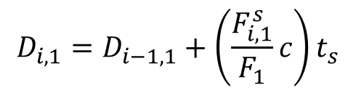
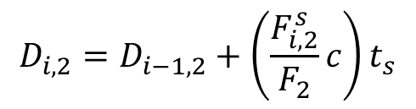
Tracking the device position - 1
Assumptions
  The distance between speakers is known
  The initial device position is known
Measure Doppler shift from two speakers
Using the previous position and Doppler, update new distance from speakers
$$D_{i,1}=D_{i−1,1}+\left(\frac{F_{i,1}^{s}}{F_{1}}c\right)t_{s}$$
$$D_{i,2}=D_{i−1,2}+\left(\frac{F_{i,2}^{s}}{F_{2}}c\right)t_{s}$$
Current distance
from speaker 1
Doppler sampling interval
Previous distance
from speaker 1
Change of the distance
tracked by Doppler
Notes:
Now I will explain how to track the position using the Doppler shift measurement. Here, I will first assume that the distance between speakers the device initial position are known, and later I will explain how to address the assumption. Given the Doppler shift estimation and the information on the current position, finding the new distance from the speakers is pretty simple. From the Doppler shift, we can calculate how much device has moved during the Doppler sampling interval, and by adding it to the previous distance. We can find the current distance from the two speakers.

Slide 83
Tracking the device position - 2
Having the distance from two speakers, finding the position is finding the intersection of two circles
Notes:
Once the distances from the two speakers are known, finding the position is finding the intersection of the two circles. Here I illustrate how to continuously track the device. For the tracking, we construct a virtual coordinate where the position of the left speaker is 0,0 and the position of the right speaker is D,0, and D is the distance between speakers. In each interval, the tracker measures the new distance from the speakers using the previous position information and Doppler shift. Using it, the tracker find the intersection of the two circles where the radius are the distance from the two speakers and the center points are the location of the speakers. In the next interval, it finds the new distances and the new position, and this is repeated until the tracking is completed.

Slide 84
Trilateration
base1
d
observer

Slide 85
Trilateration
base1
base2
d
d’
observer

Slide 86













Tracking the device position - 2
Having the distance from two speakers, finding the position is finding the intersection of two circles
$$(0,0)$$
$$(D,0)$$
$$D_{3,2}$$
$$D_{3,1}$$
$$(x_{4},y_{4})$$
$$D_{2,2}$$
$$D_{2,1}$$
$$(x_{3},y_{3})$$
$$D_{1,1}$$
$$(x_{2},y_{2})$$
$$D_{1,2}$$
$$(x_{1},y_{1})$$
$$(x_{0},y_{0})$$
Notes:
Once the distances from the two speakers are known, finding the position is finding the intersection of the two circles. Here I illustrate how to continuously track the device. For the tracking, we construct a virtual coordinate where the position of the left speaker is 0,0 and the position of the right speaker is D,0, and D is the distance between speakers. In each interval, the tracker measures the new distance from the speakers using the previous position information and Doppler shift. Using it, the tracker find the intersection of the two circles where the radius are the distance from the two speakers and the center points are the location of the speakers. In the next interval, it finds the new distances and the new position, and this is repeated until the tracking is completed.

Slide 87
Outline
Accurate estimation of the Doppler shift
Locate the device
(Assume speaker distance & initial position known)
Finding the distance between speakers
Notes:
In order to enable Doppler shift

Slide 88
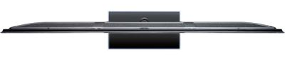




Finding the distance between speakers
Calibration to find the exact speaker distance using Doppler
Moves the device from left to right
  T₁: $F_{s}^{1}$ changes from positive to negative
  T₂: $F_{s}^{2}$ changes from positive to negative
Measure the distance using Doppler shift between T₁ and T₂
Speaker 1
Speaker 2
$$T_{1}$$
$$T_{2}$$
Notes:
Now I explain how to find the distance between the speakers. We provide a simple but effective calibration method that use can easily perform. Here, we again use Doppler shift to estimate the distance. During the calibration, the speakers are emitting the sound in inaudible frequency to estimate Doppler shift. The user goes close to the device to be tracked, and moves the mobile devices from left to right and come back to the left. From the measured Doppler shift, we can easily find the timing that the device passes the left and right speaker, because the Doppler shift changes from positive to negative. Then, we can easily find the distance from the measure Doppler shift between these two intervals.

Slide 89
Drawing evaluation
Drawing error
  The distance between original shape and the drawn image
Camera
AAMouse
Gyroscope
Samples from the 80th percentile drawing error

Slide 90
1. Distance from the speed information
a. Techniques
b. Signal detection
2. Distance from the amplitude information
a. Absorption
b. Propagation loss
3. Distance from the frequency information
a. Doppler effect
b. A case study (Doppler + Triangulation)
4. Distance from the phase information
a. Overview
b. Impulse function, Impulse response, Convolution
c. A case study

Slide 91
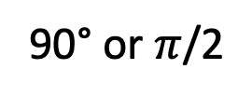

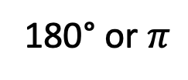

Phase
90° or $π$/2
135°or $3π$/4
180° or $π$
Amplitude
Distance or Time
$$A . sin⁡(Θ)$$

Slide 92
Distance from the phase information
Signal source
+ observer
Reflector

Slide 93


Distance from the phase information
Amplitude
Time (sec)
Amplitude
$$A . sin⁡(2πft)$$
$$A . sin⁡(2πft+Θ)$$

Slide 94
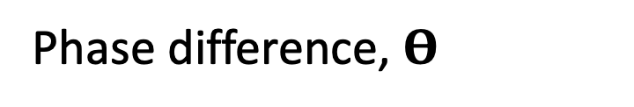
Distance from the phase information
Amplitude
Time (sec)
Amplitude
$$A . sin⁡(2πft)$$
$$A . sin⁡(2πft+Θ)$$
Phase difference, $Θ$

Slide 95





Distance from the phase information
$$A . sin⁡(2πft+Θ)$$
$$A . sin⁡(2πft)$$
Signal source
+ observer
Reflector
Phase difference, $Θ$
$$= 2π\left(\frac{d}{C}\right)f \text{radians}$$
$$= 2πd/\text{λ} \text{radians}$$

Slide 96


Distance from the phase information
Phase wrap
Phase difference, $Θ$
0 ≤ $phase \text{≤} 2Π$

Slide 97
Distance from the phase information
Phase wrap
Phase difference, $Θ$
0 ≤ $phase \text{≤} 2Π$
2Π
Phase(radian)
0
Time
Solution: Phase unwrapping

Slide 98
Convolution and Impulse response

Slide 99
Impulse response
Impulse
Room’s acoustic environment (reflections, absorption etc.)
Amplitude
Time (sec)
0.00
0.25
0.50
Impulse Response

Slide 100

Impulse response: Theory
Unit Impulse
Amplitude
Time (sec)
0.00
0.25
0.50

Slide 101

Impulse response: Theory
Unit Impulse

Slide 102

Impulse response: Theory

Slide 103

Impulse response: Theory
3.

Slide 104

Impulse response: Theory
Amplitude
Time/Sample

Slide 105
Impulse response: Theory
Amplitude
Amplitude
Time/Sample
Time/Sample

Slide 106
Impulse response: Theory
Amplitude
Amplitude
Time/Sample
Time/Sample

Slide 107
Impulse response
Impulse
SYSTEM
Impulse Response

Slide 108

Impulse response
Linear and Time-invariant (LTI) System
Input
Output
x(n)
y(n)

Slide 109



Multipath

Slide 110
Multipath: Convolution
Amplitude
Time (sec)
0.00
0.25
0.50
0.75
1.00
1.25

Slide 111
Multipath: Convolution
Amplitude
Time (sec)
0.00
0.25
0.50
0.75
1.00
1.25
Direct path
Amplitude
Time (sec)
0.00
0.25
0.50
0.75
1.00
1.25

Slide 112
Multipath: Convolution
Amplitude
Time (sec)
0.00
0.25
0.50
0.75
1.00
1.25
Direct path
Echo
Amplitude
Time (sec)
0.00
0.25
0.50
0.75
1.00
1.25

Slide 113
Impulse response: Theory
Impulse
0
Time/Sample

Slide 114
Impulse response: Theory
Impulse
0
Time/Sample
LTI System
Impulse response
0
Time/Sample

Slide 115
Impulse response: Theory
0
Time/Sample
LTI System

Slide 116
Impulse response: Theory
0
Time/Sample
LTI System

Slide 117
Impulse response: Theory
0
Time/Sample
0
Time/Sample

Slide 118
Impulse response: Theory
0
Time/Sample
0
Time/Sample
0

Slide 119
Impulse response: Theory
0
Time/Sample
0
Time/Sample
0

Slide 120
Impulse response: Theory
0
Time/Sample
0
Time/Sample

Slide 121

Impulse response: Theory

Slide 122




Impulse response: Theory
Impulse response,
Convolution

Slide 123
Impulse response
Impulse
LTI System
Impulse Response
Input
Input
LTI System
*
Impulse Response
Convolution
Output = conv (input, impulse response)

Slide 124
Impulse response
Impulse
LTI System
Impulse Response
Input
Input
LTI System
*
Impulse Response
Convolution
Output = conv (input, impulse response)
Impulse response = deconv (output, input)

Slide 125
Impulse response: Theory
Time domain
Frequency domain
Convolution
Multiplication
Deconvolution
Division
x[n]
X[f]
y = conv(x,h)
Y = X . H
h = deconv(y,x)
H = Y / X

Slide 126
Impulse response: Theory
Time domain
Frequency domain
Convolution
Multiplication
Deconvolution
Division
x[n]
X[f]
y = conv(x,h)
Y = X . H
h = deconv(y,x)
H = Y / X

Slide 127


Strata: Fine-Grained Acoustic-based Device-Free Tracking
Case study
Sangki Yun, Yi-Chao Chen, Huihuang Zheng, Lili Qiu, and Wenguang Mao
The University of Texas at Austin
Notes:
In this talk, I will introduce acoustic signal based device-free object tracking mechanism, which is very useful to design user interface for smart watch and VR devices.

Slide 128




Applications of Object tracking
Motion-based Gaming
Gesture-based Remote Controller
Notes:
These days, object tracking has huge amount of applications. It can introduce gesture based interactive game, and can intuitively control the smart appliances and VR headset.

Slide 129




Device-Free tracking
With Device
Device-Free
Notes:
For emerging techniques such as smart watch and VR device, device free object tracking is particularly useful. For example, AR and VR users wears the headset, so tracking controller position and controlling the device based on it can uncomfortable to user, because it is difficult to grab the device. In such environment, it is more desirable if we can find the finger or hand location, and track the device based on it.

Slide 130


Device-Free tracking: challenge
Both transmitter and receiver are static
Should rely on the reflected signal
Notes:
Unfortunately, enabling device free tracking is very challenging. For the device tracking, we mostly rely on the directly received wireless signal. But in case of device-free tracking, we should use the signal reflected from the target object, which is weak, and overlapped with many other reflections.

Slide 131



Strata: Acoustic based Fined grained tracking
Device-free passive tracking only relying on mobile device
Track the small object such as finger
All implemented in software
Notes:
In this talk, we introduce strata that enables device-free finger tracking only using the commercial smartphone. Using the speaker and microphones of the smartphone, we send and receive audio signal in inaudible frequency band, and track the movement of small object such as finger. The tracking algorithm is all implemented in software.

Slide 132



Acoustic based object tracking
Phase change proportional to the
(distance change$/$wavelength) (1.7 cm in 20 kHz)
Tracking phase enables very fine-grained positioning
Finger movement of 1mm changes the phase 0.2$π$!
Notes:
Basically, tracking object with acoustic signal have several advantages. One of the important advantages is that it have small wavelength, so small travel distance change causes significant phase change. For example, when we use 20 KHz band, the wavelength is 1.7 cm, so changing the distance of the object only by 1 mm causes the phase change of 0.2pi, which is large enough to detect and monitor. By observing the phase change, we can track the movement of the target in fine resolution.

Slide 133
Impulse response: Theory
Impulse
0
Time/Sample
Phase changes for one of the reflections
Linear System
Impulse response
0
Time/Sample

Slide 134


Challenges
Reflections from multiple objects
Notes:
But in practice, there are several challenges in acoustic passive tracking. First of all, the received signals from the microphone is the combination of all of the reflected signal including the signal reflected by the finger. Therefore, even if the finger movement causes the phase change, it is difficult to observe it because of the other reflections

Slide 135

Challenges
Reflections from multiple dynamic objects
Notes:
Moreover, what makes it more difficult is when there are multiple moving objects. If multiple objects cause different phase change, it becomes really challenging to separately observe them. Considering that this tracking technique will be used for smart watch and VR devices that are exposed to the movement of the surrounding objects, this is very serious problem that we have to address in practice.

Slide 136








Our solution
Tracking from the channel impulse response (CIR)
Can distinguish multiple reflections in different ranges
Represented as a vector $H=\left\{h\left[0\right], h\left[1\right], …,h\left[n\right]\right\}$
  Each $h[k]$ captures reflections with different delay
0.6 ms
Amplitude
0.3 ms
0.3 ms
0.8 ms
0.6 ms
Time
0.8 ms
$$h[0]$$
$$h[1]$$
$$h[2]$$
$$h[3]$$
Notes:
In Strata, we address these challenges by tracking the object using the channel impulse response. CIR is characterization of all of the reflected paths between transmitter and the receiver. It is represented as the complex vector h[n], where each element includes the signal path information in different delays. Let’s say there are three different reflecting objects in the channel. Depending on the delay of them, they are represented in different elements in the channel impulse response vector. This is a general mathematical representation of the channel. It is represented as a complex number where the magnitude is determined by the strength of the reflected signal, and the phase is determined by the delay. Here I presented only 3 reflector, but in practice, there are much more reflectors, and the profile of the multiple reflectors in a single element are linearly added.
In the remainder the talk, I will explain how to get the CIR from the acoustic channel, and how to track the finger movement using it.

Slide 137

Impulse response
0
Time/Sample

Slide 138
RADAR
(RAdio Detection And Ranging)

Slide 139
RADAR

Slide 140

RADAR: Principle
d
Time to receive the reflection: t
d = c.t/2

Slide 141
RADAR: Principle
d
Reflector

Slide 142


RADAR: Principle
d
Self
interference
Reflector

Slide 143
Pulsed RADAR

Slide 144
Pulsed RADAR
Ref: https://fas.org/man/dod-101/navy/docs/es310/radarsys/radarsys.htm

Slide 145
Pulsed RADAR
Ref: https://fas.org/man/dod-101/navy/docs/es310/radarsys/radarsys.htm

Slide 146
Pulsed RADAR
What is the maximum unambiguous range?
Ref: https://fas.org/man/dod-101/navy/docs/es310/radarsys/radarsys.htm

Slide 147
Frequency Modulated Continuous Wave (FMCW)
RADAR

Slide 148
Chirp or Frequency sweep
Sine signal
Sine sweep or
Chirp
Amplitude
Amplitude
Time (sec)
Time (sec)

Slide 149
Chirp or Frequency sweep
Sine signal
Sine sweep or
Chirp
Amplitude
Amplitude
Time (sec)
Time (sec)
Frequency
Frequency
Time (sec)
Time (sec)

Slide 150
FMCW principle
Frequency
Reflector
Time (sec)

Slide 151
f_{e}
(f_{e} - f_{s})
= B
Frequency
f_{s}
T_{sweep}
Time (sec)

Slide 152
f_{e}
(f_{e} - f_{s})
= B
f_{d}
Frequency
t_{d}
f_{s}
T_{sweep}
Time (sec)

Slide 153
f_{e}
f_{d}
(f_{e} - f_{s})
= B
B
Frequency
t_{d}
f_{s}
T_{sweep}
Time (sec)
f_{d}/t_{d} = B/T_{sweep}
f_{d} = (B t_{d}) /T_{sweep}

Slide 154
FMCW principle
D
f_{d}
X
Reflector
f_{d} = (B t_{d}) /T_{sweep}
t_{d} = 2D/C C = speed of the signal

Slide 155
FMCW principle

Slide 156
Project Ideas

Slide 157
1. Making pedestrians to talk to smart cars

Slide 158
2. Exoskeleton for all

Slide 159
Thanks

