Slide 1
Wireless and Mobile Systems
for the IoT
CMSC 818W : Fall 2019
Lecture 3.3: Sensor Array
Nirupam Roy
M-W 2:00-3:15pm
CSI 1122

Slide 2
Spatial filtering
Omni-directional

Slide 3
Spatial filtering

Slide 4
Spatial filtering

Slide 5
Spatial filtering

Slide 6
Spatial filtering

Slide 7
Applications of spatial filtering

Slide 8
Interference of Waves
[Reference] https://www.youtube.com/watch?v=Iuv6hY6zsd0

Slide 9
Definition of superimposition of signals.

Slide 10
Superimposition of sinusoids
$$A1 . sin⁡(2πf1t+Θ1)$$
Amplitude
Amplitude
$$A2 . sin⁡(2πf2t+Θ2)$$

Slide 11
Superimposition of sinusoids
$$A1 . sin⁡(2πf1t+Θ1)$$
Amplitude
Amplitude
$$A2 . sin⁡(2πf2t+Θ2)$$
$Received signal= A1 .\sin\left(2πf1t+Θ1\right)$ $+A2 . sin⁡(2πf2t+Θ2)$

Slide 12
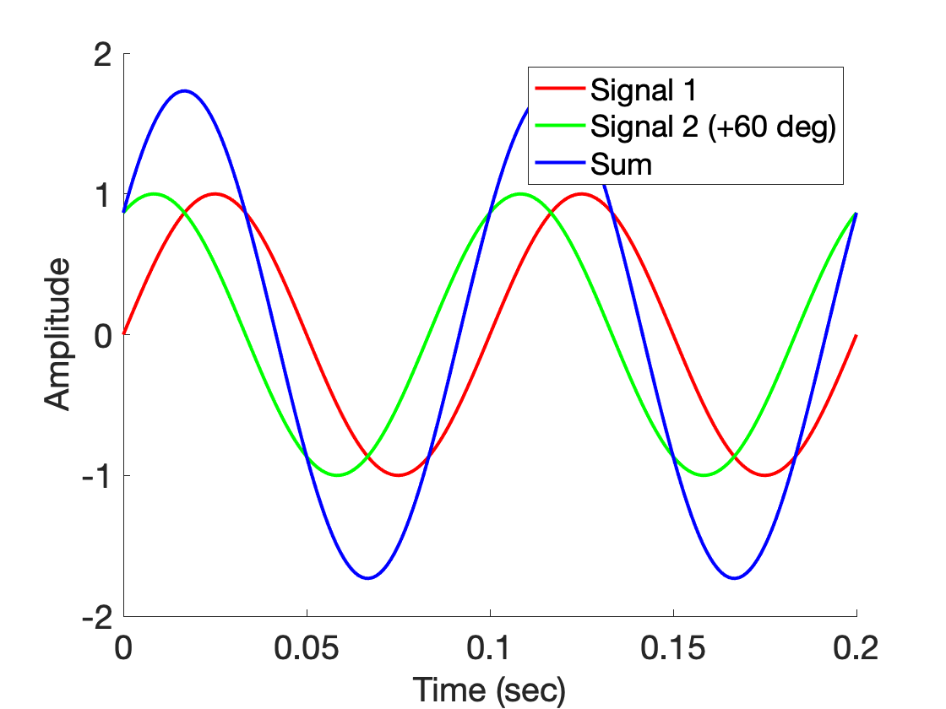
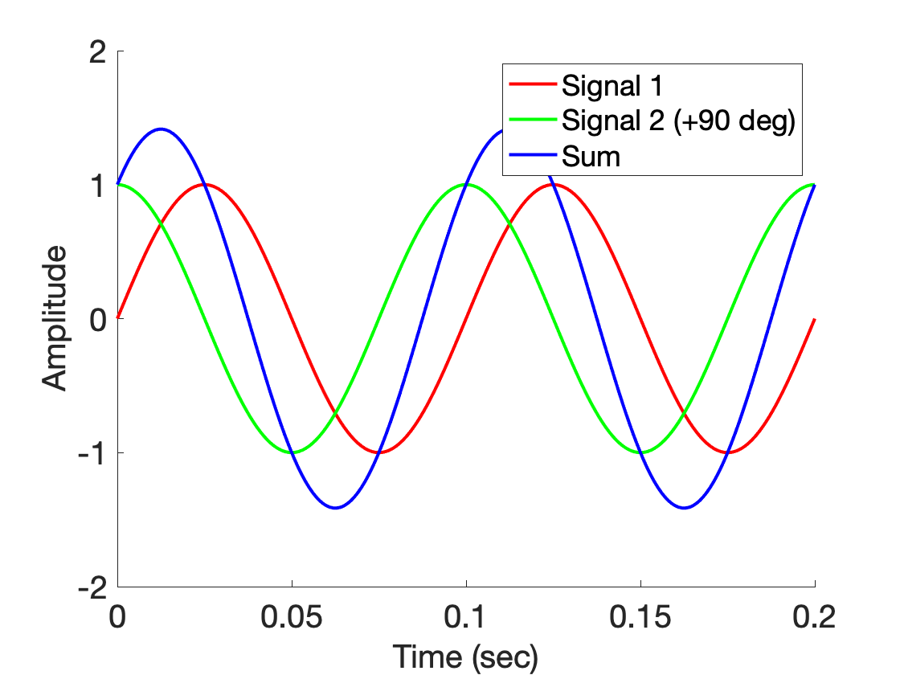
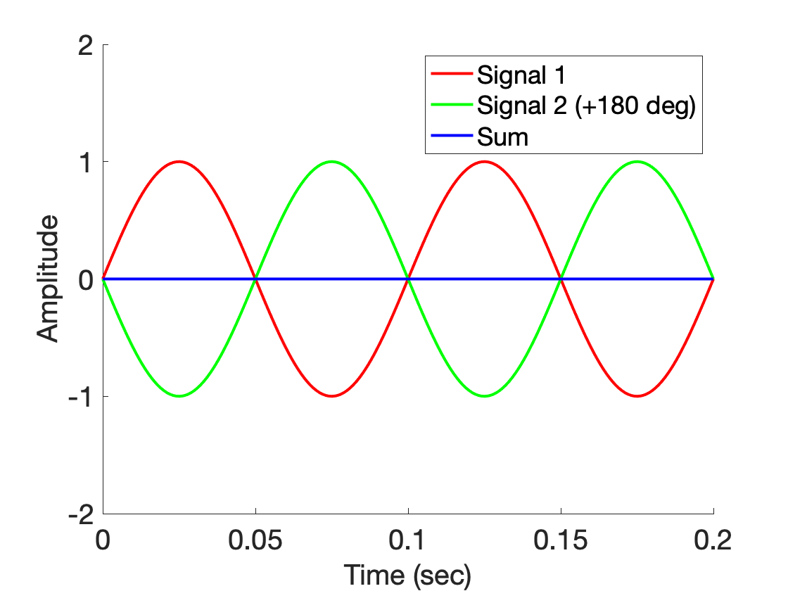
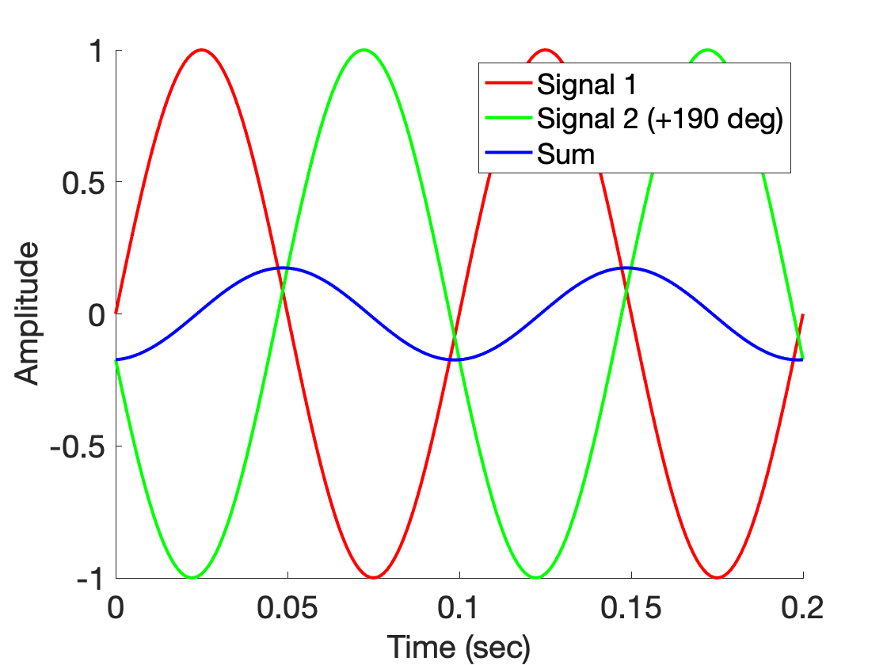
Superimposition of sinusoids

Slide 13
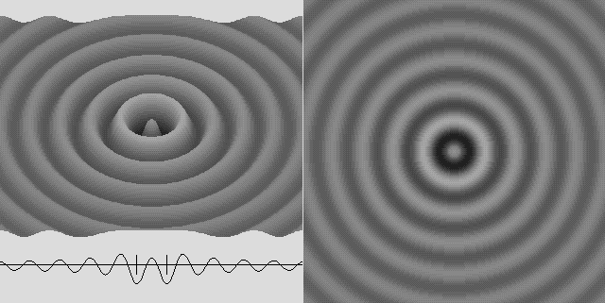
Superimposition of sinusoids

Slide 14
Superimposition of sinusoids
$$sin⁡(2πft)$$

Slide 15
Superimposition of sinusoids
$$sin⁡(2πft)$$
$$d$$
$$sin⁡(2πft+2πd/λ)$$

Slide 16
Superimposition of sinusoids
Signal amplified
(perfect constructive interference)
$$sin⁡(2πft)$$
$$d=λ/2$$
$$\sin\left(2πft+\frac{2πd}{λ}\right)$$
= $\sin\left(2πft+π\right)$
= $− sin\left(2πft\right)$
Signal nullified
Signal nullified

Slide 17
Superimposition of sinusoids: Gain
Power gain due to the array structure
Distance from the center of the array
$$−λ/4$$
$$0$$
$$λ/4$$
$$d=λ/2$$
Constant phase difference of $\frac{2πd}{λ}$

Slide 18
Superimposition of sinusoids: Gain
Beamforming in 1D space
Power gain due to the array structure
Distance from the center of the array
Controlling spatial signal gain using multiple signal sources or receivers.
$$−λ/4$$
$$0$$
$$λ/4$$
The gain depends on distance between the elements and signal wavelength.
$$d=λ/2$$
Constant phase difference of $\frac{2πd}{λ}$

