Slide 1

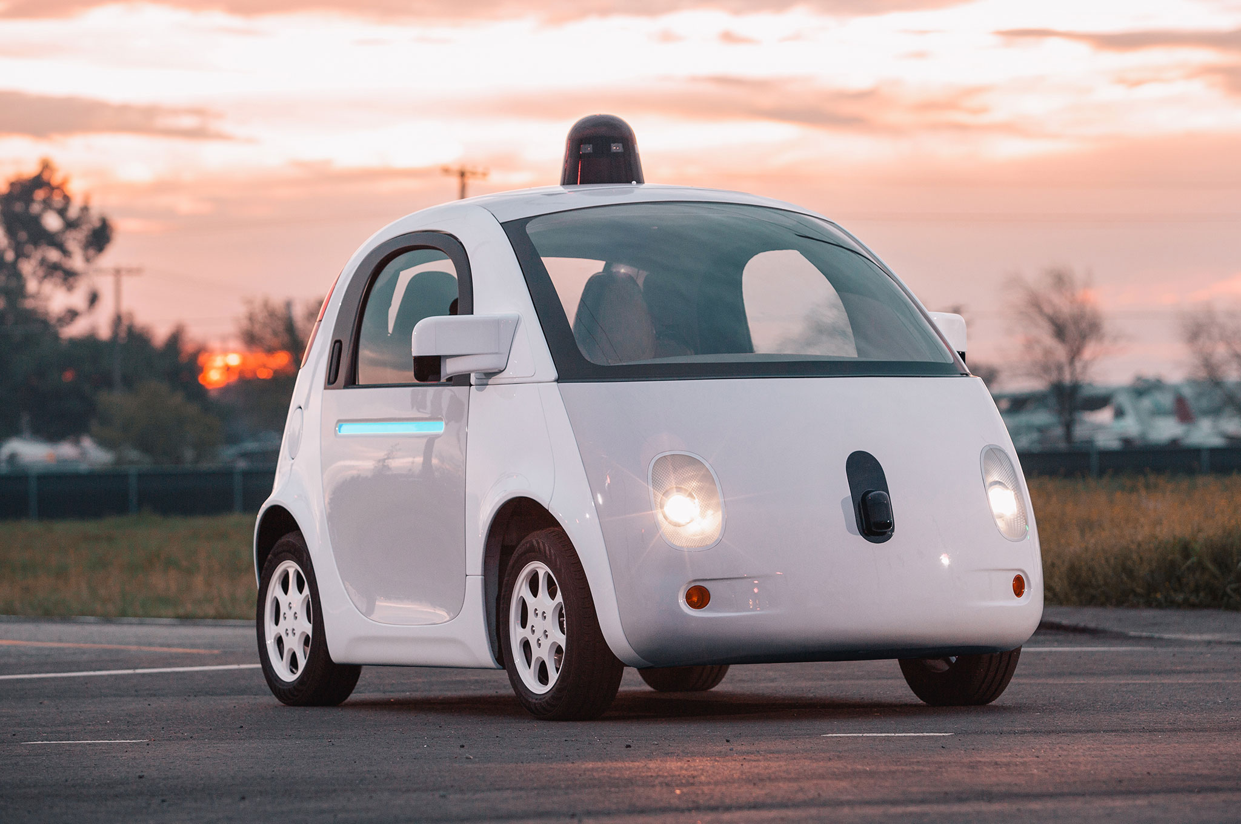



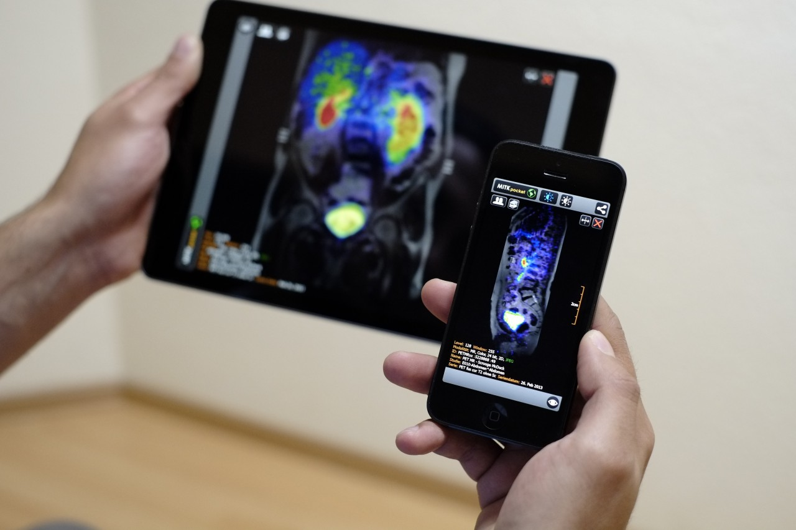
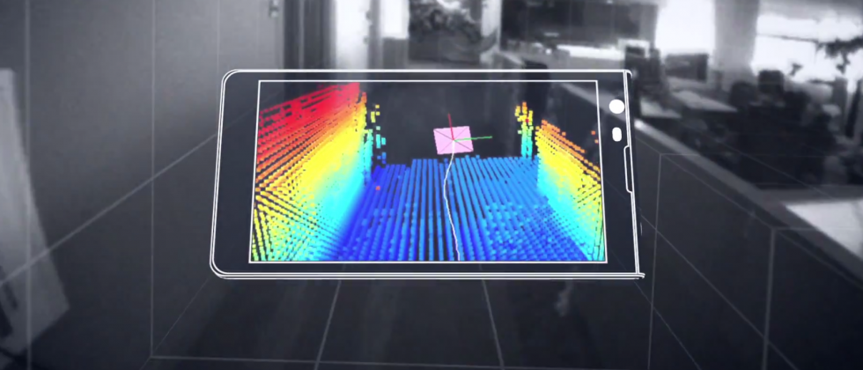

Wireless and Mobile Systems
for the IoT
CMSC 818W : Fall 2019
Lecture 5.3: GPS
Nirupam Roy
M-W 2:00-3:15pm
CSI 1122

Slide 2
Notes:
The nominal GPS configuration consists of a network of 24 satellites in high orbits around the Earth, but up to 30 or so satellites may be on station at any given time. Each satellite in the GPS constellation orbits at an altitude of about 20,000 km from the ground, and has an orbital speed of about 14,000 km/hour (the orbital period is roughly 12 hours - contrary to popular belief, GPS satellites are not in geosynchronous or geostationary orbits). The satellite orbits are distributed so that at least 4 satellites are always visible from any point on the Earth at any given instant (with up to 12 visible at one time).
Geostationary orbits are near the equator and hence does not provide enough coverage.

Slide 4
Triangulation vs Trilateration

Slide 5
Triangulation
base1
base2
𝚹₁
𝚹₂
𝚹₁
𝚹₂
observer

Slide 6
Trilateration
base1
base2
d
d’
observer

Slide 7
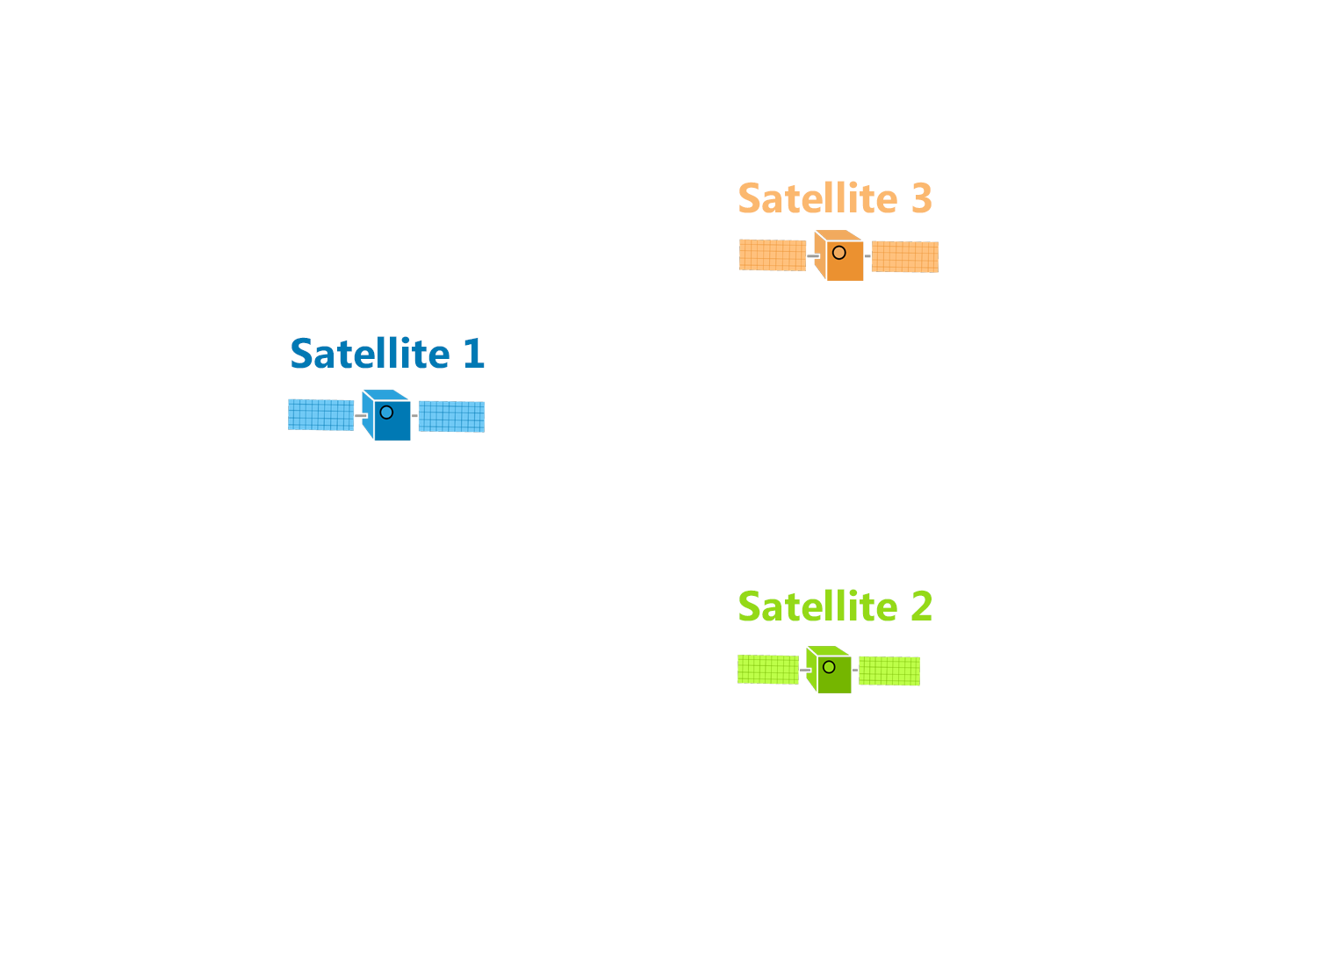

Trilateration

Slide 8
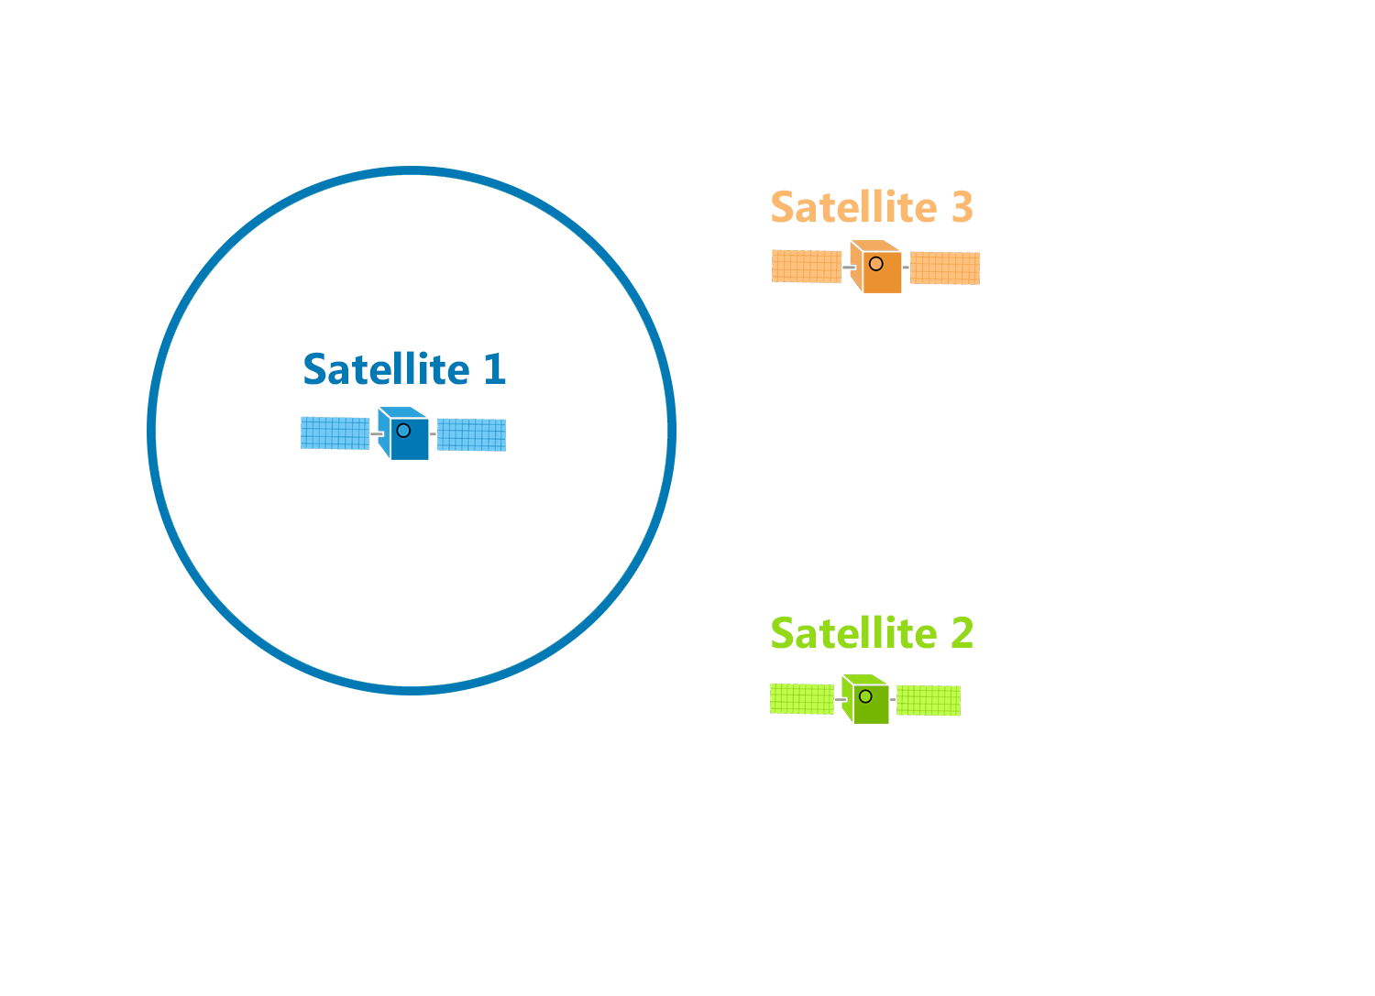
Trilateration
d

Slide 9
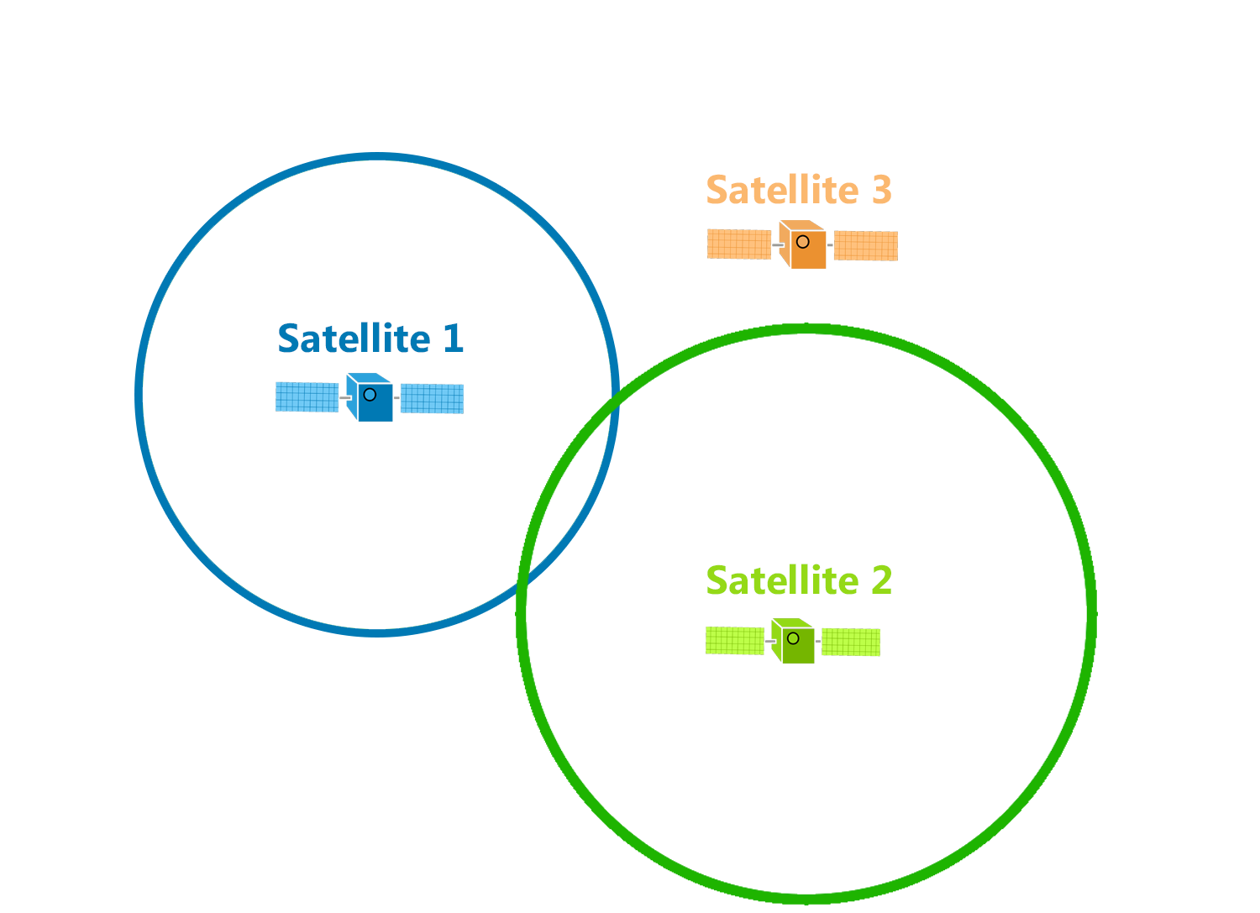
Trilateration
d

Slide 10
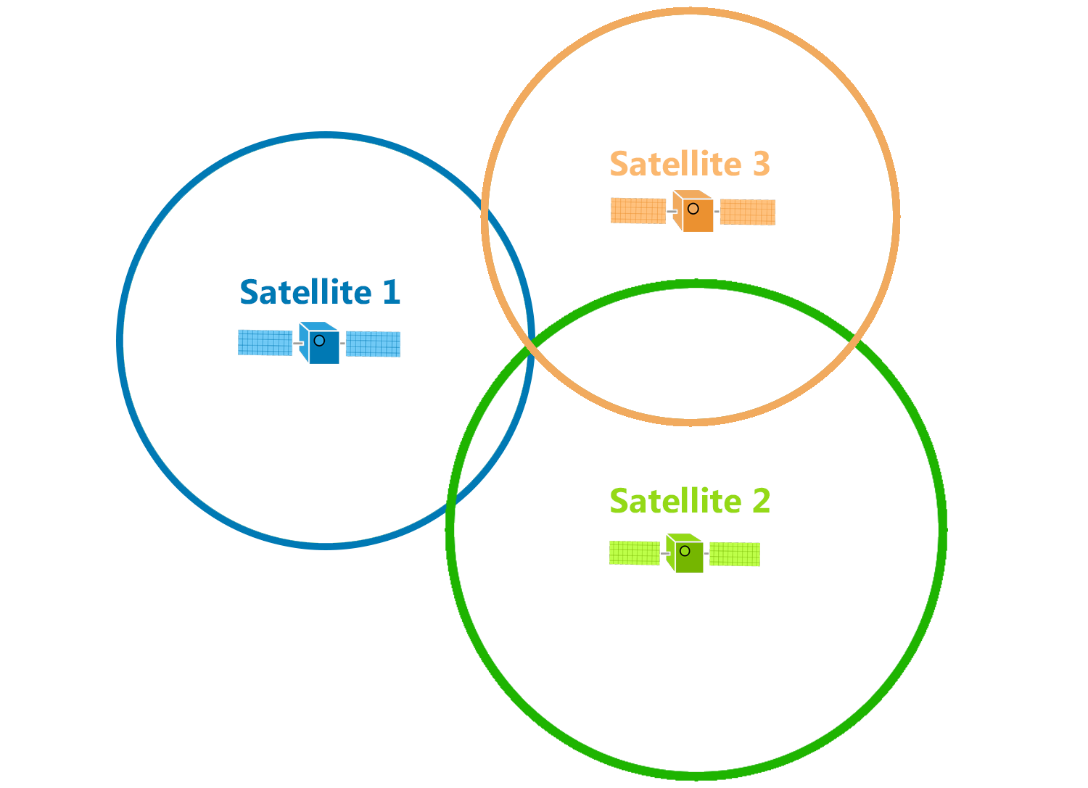
Trilateration
d

Slide 11
Trilateration

Slide 12
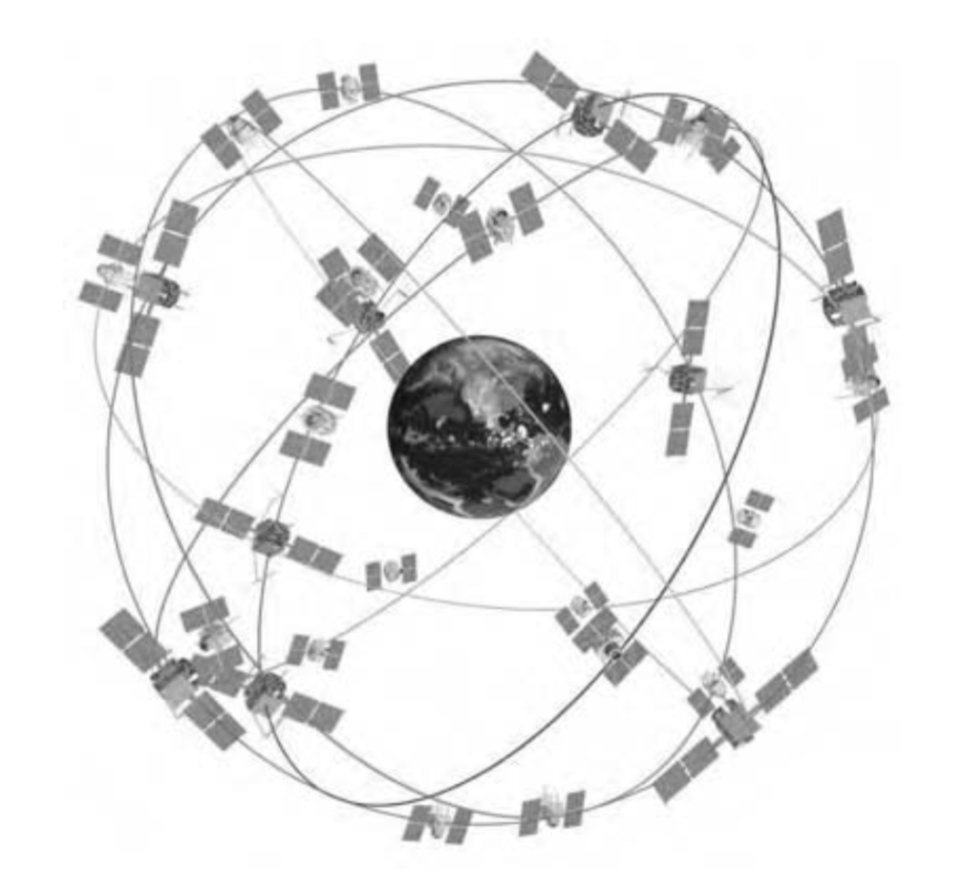
GPS Satellite Constellation
Baseline configuration
-- 24 satellites
-- 6 orbital planes, 4 satellites in each plane
-- 60° separation between planes
-- Orbital radius approx. 26,600 km
Geo-stationary ?
Notes:
https://www.gpsworld.com/origins-gps-part-1/
https://pdfs.semanticscholar.org/d6f5/812c9f91d68862cf3e2a8af6a3f9db14ba2b.pdf

Slide 13
GPS Satellite Constellation
Baseline configuration
-- 24 satellites
-- 6 orbital planes, 4 satellites in each plane
-- 60° separation between planes
-- Orbital radius approx. 26,600 km
-- Orbital period 11h 58m (half day)
at a speed of around 14000km/s

Slide 14
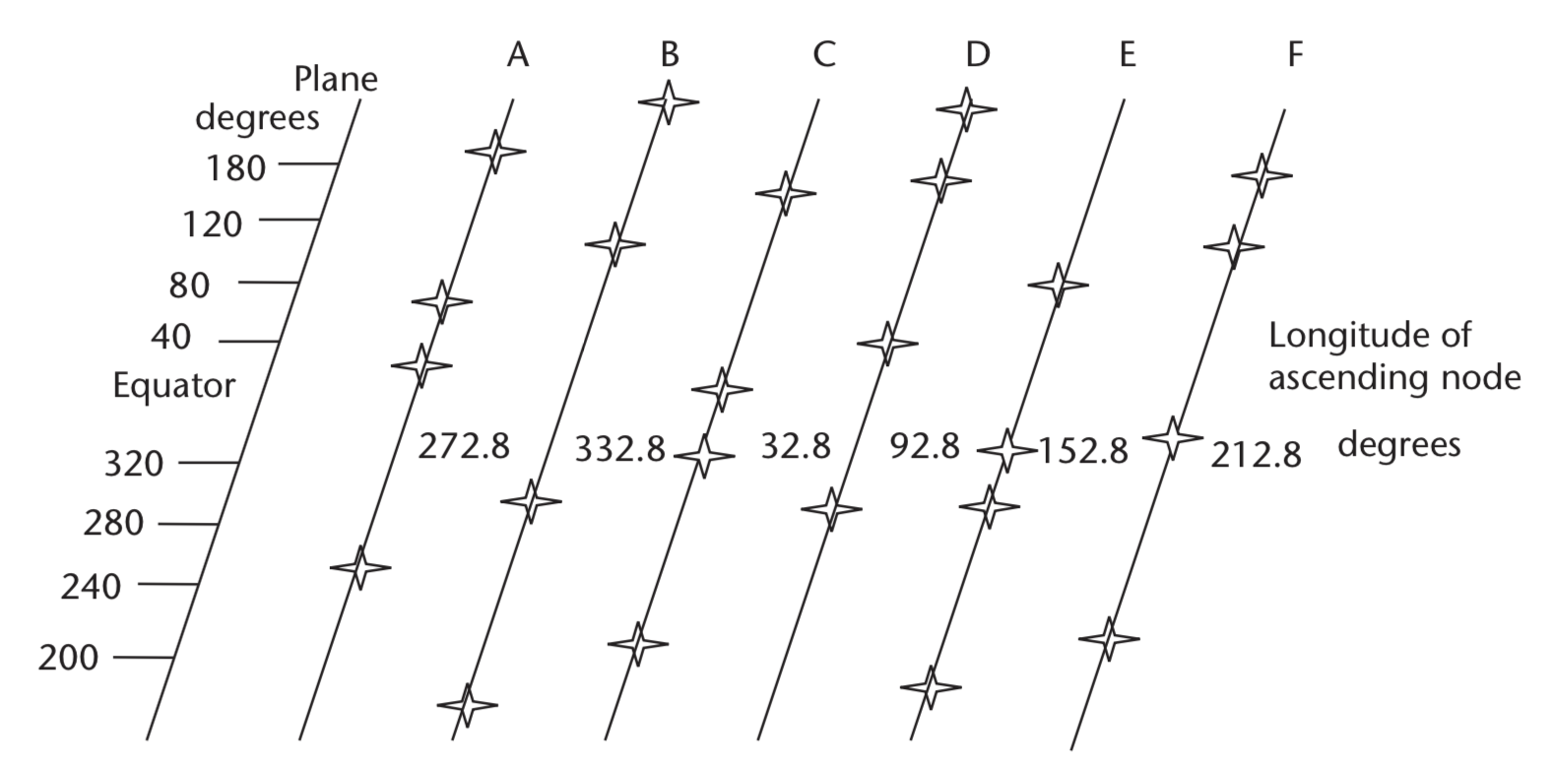
GPS Satellite Constellation
Planar projection of the constellation
( 0000h, July 1, 1993 UTC)
Notes:
The nominal GPS configuration consists of a network of 24 satellites in high orbits around the Earth, but up to 30 or so satellites may be on station at any given time. Each satellite in the GPS constellation orbits at an altitude of about 20,000 km from the ground, and has an orbital speed of about 14,000 km/hour (the orbital period is roughly 12 hours - contrary to popular belief, GPS satellites are not in geosynchronous or geostationary orbits). The satellite orbits are distributed so that at least 4 satellites are always visible from any point on the Earth at any given instant (with up to 12 visible at one time).
Geostationary orbits are near the equator and hence does not provide enough coverage.

Slide 15
GPS Satellite Constellation
At least 4 satellites are always visible from any point on the Earth at any given instant
Planar projection of the constellation
( 0000h, July 1, 1993 UTC)
Notes:
The nominal GPS configuration consists of a network of 24 satellites in high orbits around the Earth, but up to 30 or so satellites may be on station at any given time. Each satellite in the GPS constellation orbits at an altitude of about 20,000 km from the ground, and has an orbital speed of about 14,000 km/hour (the orbital period is roughly 12 hours - contrary to popular belief, GPS satellites are not in geosynchronous or geostationary orbits). The satellite orbits are distributed so that at least 4 satellites are always visible from any point on the Earth at any given instant (with up to 12 visible at one time).
Geostationary orbits are near the equator and hence does not provide enough coverage.

Slide 16
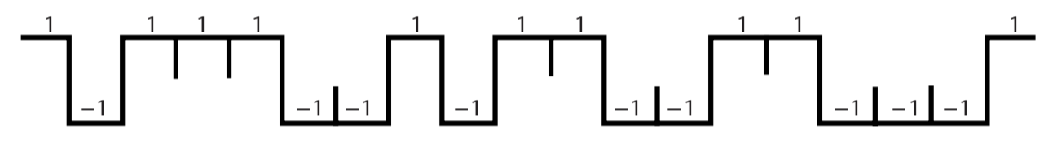
Pseudo-Random Noise (PRN) code
Each satellite is assigned a unique CDMA code.
PRN code (Coarse/Acquisition or C/A code)
Notes:
In 1928, Warren Marrison of Bell Telephone Laboratories developed the first quartz-crystal clock. With accuracies of up to 1 second in 30 years
Atomic clock:
Use of GPS clock: Wireless communication, TV broadcast, timestamping business transaction, frequency hopping

Slide 17
Signal detection
Amplitude
Amplitude
Time/Sample
Time/Sample
Transmitter signal
Receiver signal

Slide 18
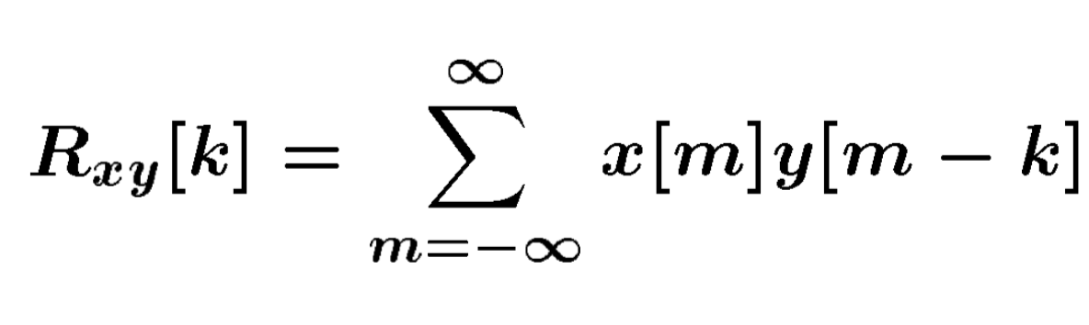
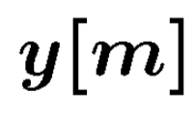
Signal detection
Received signal
Signal matching
Transmit signal template

Slide 19
Signal detection
Received signal
Signal matching
Transmit signal template
Correlation

Slide 20
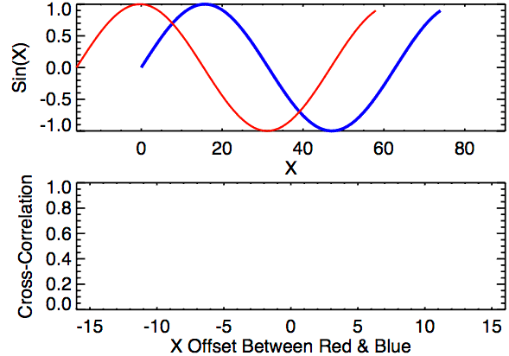
Signal detection
Correlation

Slide 21
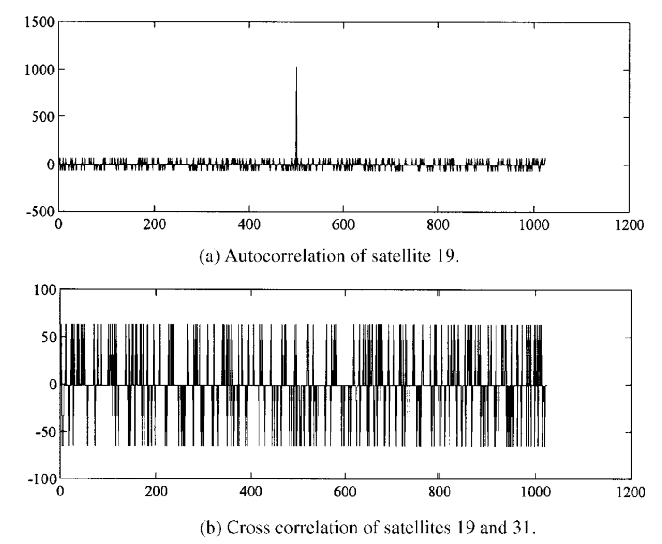
Pseudo-Random Noise (PRN) code
Notes:
In 1928, Warren Marrison of Bell Telephone Laboratories developed the first quartz-crystal clock. With accuracies of up to 1 second in 30 years
https://pdfs.semanticscholar.org/d6f5/812c9f91d68862cf3e2a8af6a3f9db14ba2b.pdf
Atomic clock:
Use of GPS clock: Wireless communication, TV broadcast, timestamping business transaction, frequency hopping

Slide 22
Propagation Delay
or
Time of Flight (ToF)

Slide 23
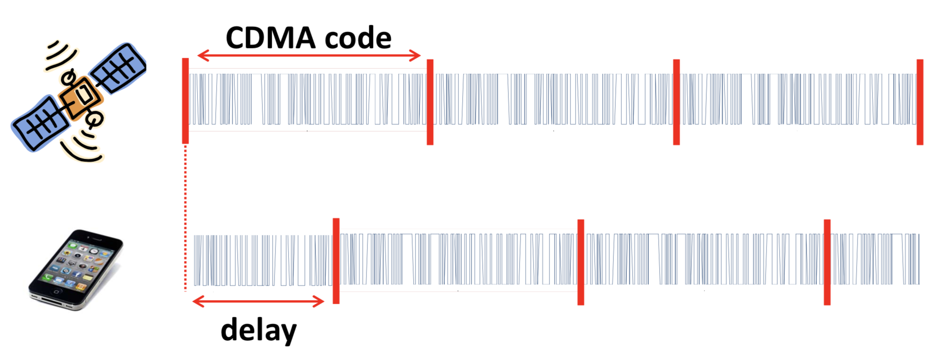
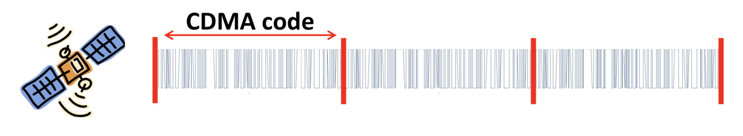
Time of Flight (ToF)
Known starting time of the code

Slide 24
Time of Flight (ToF)

Slide 25
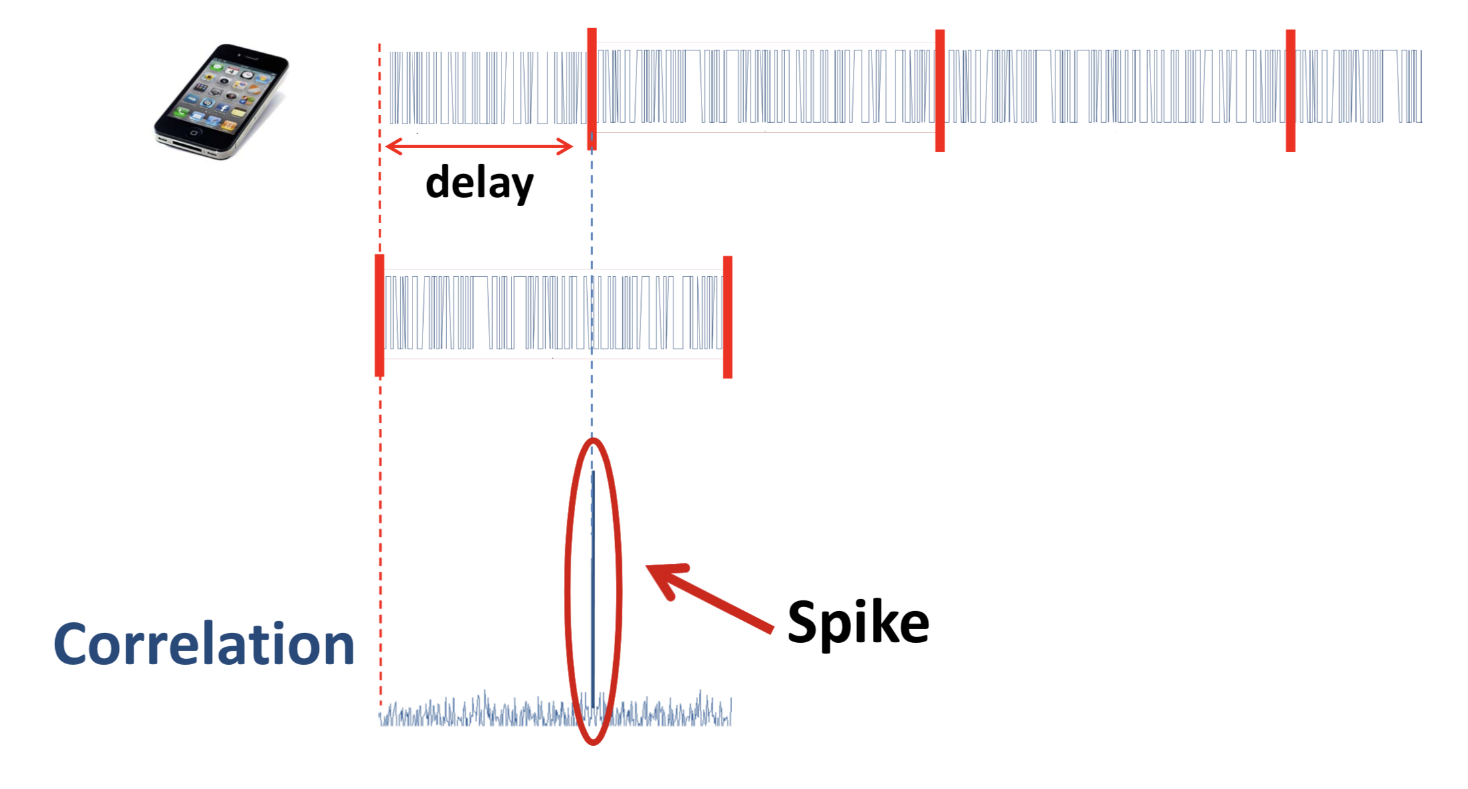
Time of Flight (ToF)

Slide 26
Time of Flight (ToF)
Δt

Slide 27
Range = propagation delay X speed of light
= Δt x C (C = speed of light, ~ 3x10⁸ m/s)

Slide 28
Time of Flight (ToF)
Starting time, t
Δt

Slide 29
Pseudo-Random Noise (PRN) code
PRN code
Clock period t
Notes:
In 1928, Warren Marrison of Bell Telephone Laboratories developed the first quartz-crystal clock. With accuracies of up to 1 second in 30 years
Atomic clock:
Use of GPS clock: Wireless communication, TV broadcast, timestamping business transaction, frequency hopping

Slide 30
Clock
Mechanical clock: Oscillation of pendulum
Crystal clock: Electrical circuit that uses a piezoelectric crystal vibrating at a precise frequency.
(accuracy of 1 second in 30 years)
Atomic clock: Duration of 9,192,631,770 periods of the radiation from a Cesium 133 atom.
(accuracy of 1 second in more than 100 million years)
Notes:
In 1928, Warren Marrison of Bell Telephone Laboratories developed the first quartz-crystal clock. With accuracies of up to 1 second in 30 years
Atomic clock:
Use of GPS clock: Wireless communication, TV broadcast, timestamping business transaction, frequency hopping

Slide 31
Satellite clock and receiver clocks are not synchronized
Estimated propagation delay X speed of light
= Pseudo-Range

Slide 32
Calculating range
Pseudo-range from i^{th} satellite = 𝝆_{i}
Satellite’s location = (x_{i}, y_{i}, z_{i})
User’s true location = (x_{u}, y_{u}, z_{u})

Slide 33
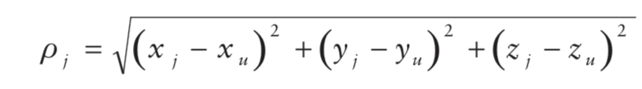
Calculating range
Pseudo-range from i^{th} satellite = 𝝆_{i}
Satellite’s location = (x_{i}, y_{i}, z_{i})
User’s true location = (x_{u}, y_{u}, z_{u})

Slide 34
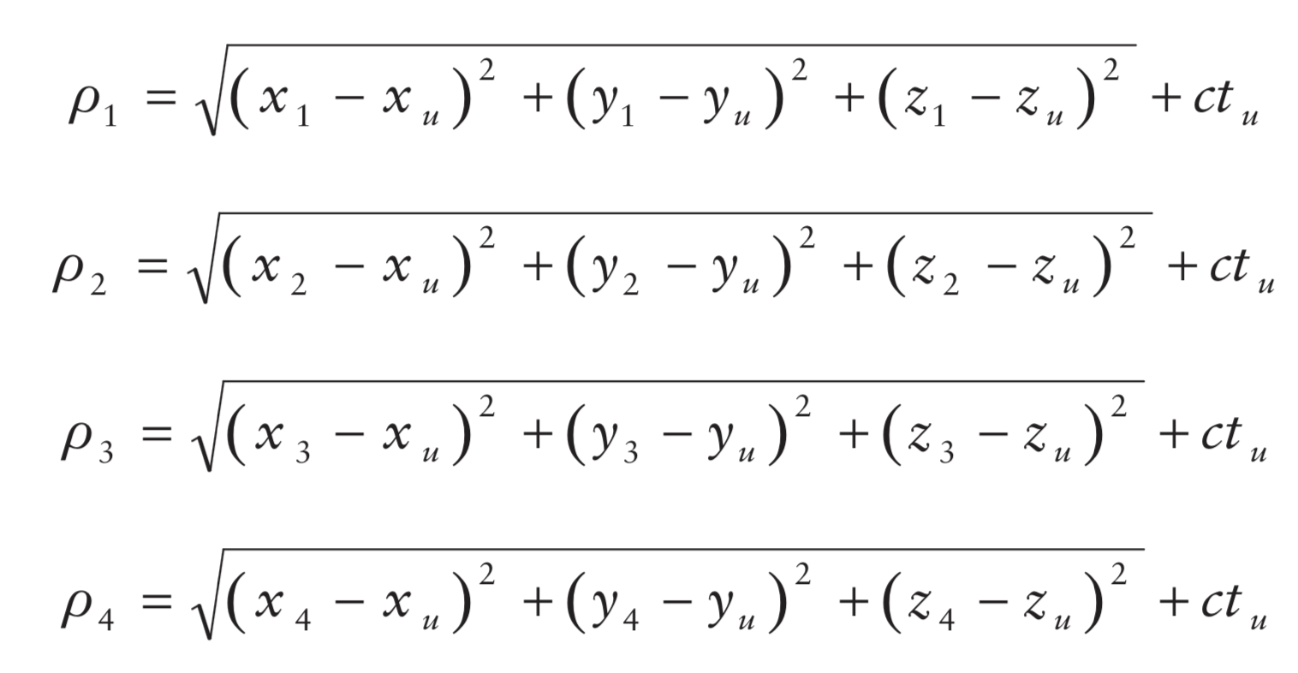
Calculating range
Pseudo-range from i^{th} satellite = 𝝆_{i}
Satellite’s location = (x_{i}, y_{i}, z_{i})
User’s true location = (x_{u}, y_{u}, z_{u})

Slide 35
Calculating range
Pseudo-range from i^{th} satellite = 𝝆_{i}
Satellite’s location = (x_{i}, y_{i}, z_{i})
User’s true location = (x_{u}, y_{u}, z_{u})
User’s time offset from satellite = t_{u}

Slide 36
Calculating range
Pseudo-range from i^{th} satellite = 𝝆_{i}
Satellite’s location = (x_{i}, y_{i}, z_{i})
User’s true location = (x_{u}, y_{u}, z_{u})
User’s time offset from satellite = t_{u}

Slide 37
Calculating range
Pseudo-range from i^{th} satellite = 𝝆_{i}
Satellite’s location = (x_{i}, y_{i}, z_{i})
User’s true location = (x_{u}, y_{u}, z_{u})
User’s time offset from satellite = t_{u}

Slide 38
How to find the satellite’s location
Ephemeris and Almanac
Information about the satellite’s precise location and trajectory are embedded in the transmitted data.

Slide 39
GPS signal modulation

Slide 40
Time-to-First-Fix
Time-To- First-Fix (TTFF) is the elapsed time between turning on a receiver and obtaining the first location fix.

Slide 41
Time-to-First-Fix
Time-To- First-Fix (TTFF) is the elapsed time between turning on a receiver and obtaining the first location fix.
1. Satellite Acquisition
Search with all satellites PRN codes (Coarse/Acquisition or C/A code) to find which satellites are visible at that time. Once found need to decode ephemeris and timing information. Need to adjust for unknown Doppler shifts.

Slide 42
Time-to-First-Fix
Time-To- First-Fix (TTFF) is the elapsed time between turning on a receiver and obtaining the first location fix.
1. Satellite Acquisition
Search with all satellites PRN codes (Coarse/Acquisition or C/A code) to find which satellites are visible at that time. Once found need to decode ephemeris and timing information. Need to adjust for unknown Doppler shifts.
2. Location estimation
Finding propagation delay and solve the set of equations for location.

Slide 43
Time-to-First-Fix
Time-To- First-Fix (TTFF) is the elapsed time between turning on a receiver and obtaining the first location fix.
1. Satellite Acquisition
Doppler freq.
Code delay
Satellite Acquisition is a computationally intensive process due to the large code phase and Doppler search space. It may take more than 5 minutes.

Slide 44
GPS Signal and Packet

Slide 45
C/A code, repeats every 1ms

Slide 46
C/A code, repeats every 1ms
Preamble + C/A code + Navigation data
GPS packet

Slide 47
Modulation

Slide 48
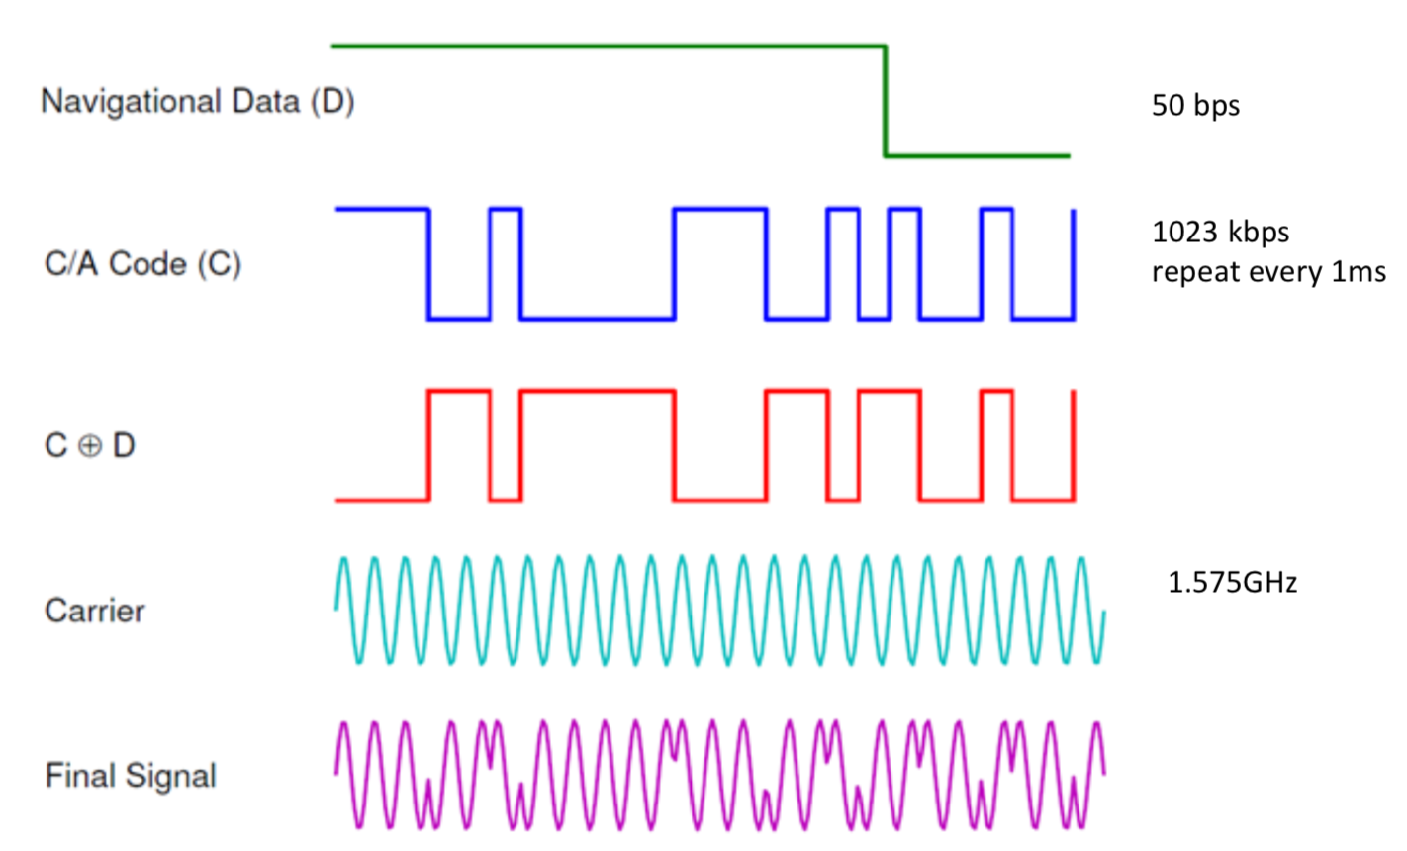
An illustration of GPS signal modulation scheme
Notes:
L1 =1.575 GHz towards the Earth. The bit-rate of data packets is a mere 50 bps, but the bits are modulated with a higher frequency (1MHz) signal for detecting propagation delays.

Slide 49
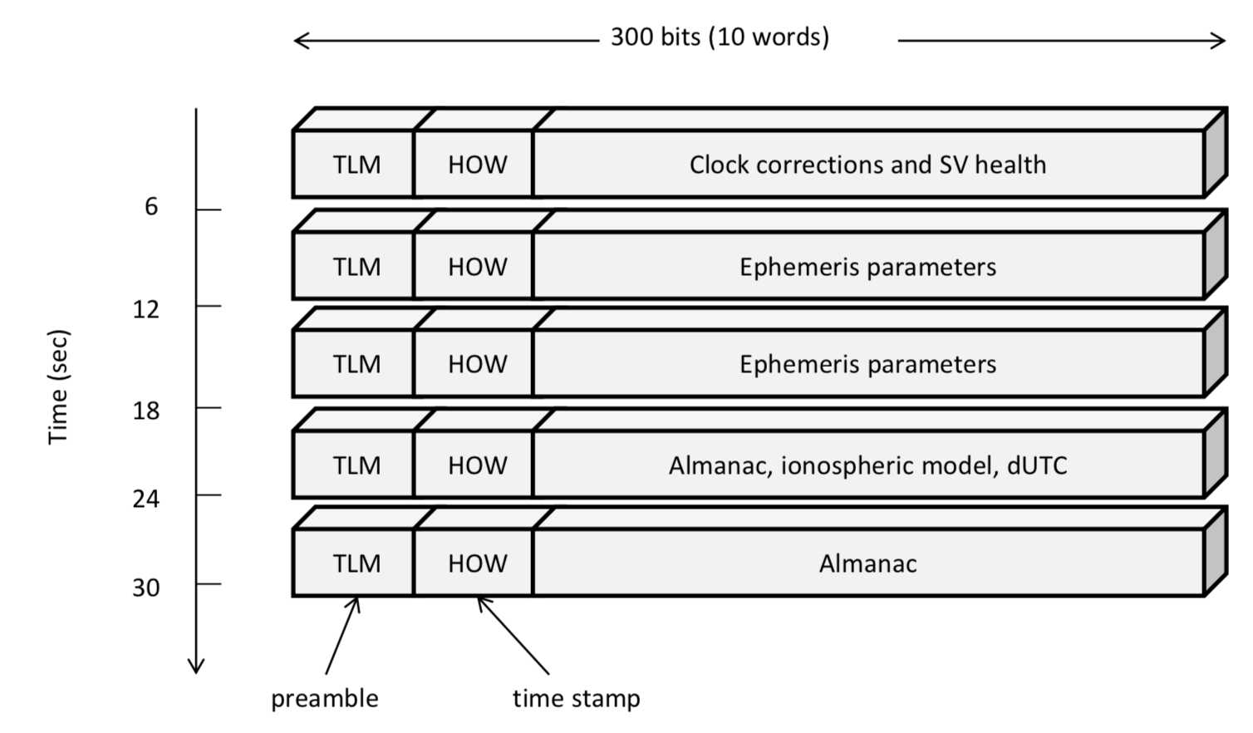
The frame content of a GPS packet of length 1500 bits
Notes:
Thus, the C/A code repeats every millisecond, resulting in 20 repetitions of the C/A code for each data bit sent. The purpose of the C/A code is to allow a receiver to identify the sending satellite and to estimate how long it took the signal to propagate from that satellite to the receiver. Typically, the GPS signals take from 64 to 89 milliseconds to travel from a satellite to the Earth’s surface. Since light travels at 300 km/ms, in order to obtain an accurate distance measurement, the receiver must estimate the signal propaga- tion delay to the microsecond level. The millisecond (NMS) and sub-millisecond (subMS) parts of the propagation time are derived very differently: the NMS is decoded from the packet frames, while the subMS propagation time is detected at the C/A code level using correlations.

Slide 50
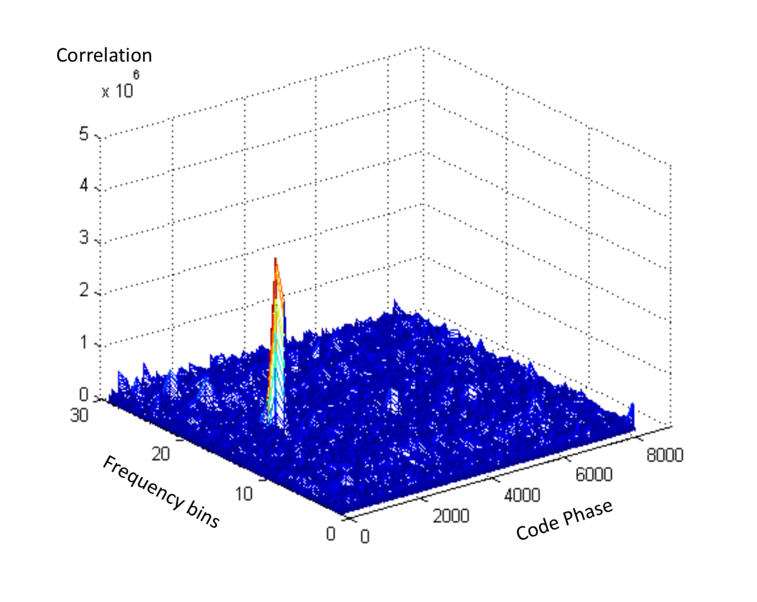
An example of acquisition result
Notes:
For example, a rising GPS satellite can move at up to 800m/s towards a receiver, causing a frequency shift of L1 · 800/c = 4.2kHz, where c is the speed of light. A shift of the same magnitude occurs in the opposite direction for a setting satellite. To reliably compute a correction under this shift, the receiver must generate the C/A code within 500Hz of the shifted fre- quency. Therefore, in the frequency dimension, the receiver needs to search up to 18 bins. Most GPS receivers use 25 to 40 frequency bins to accommodate local receiver motion and to provide better receiver sensitivity.

Slide 51
Assisted GPS (A-GPS or aGPS)

Slide 52
Notes:
MSC = Mobile Switching Center

Slide 53
Differential GPS

Slide 54
GPS ranging error

Slide 55
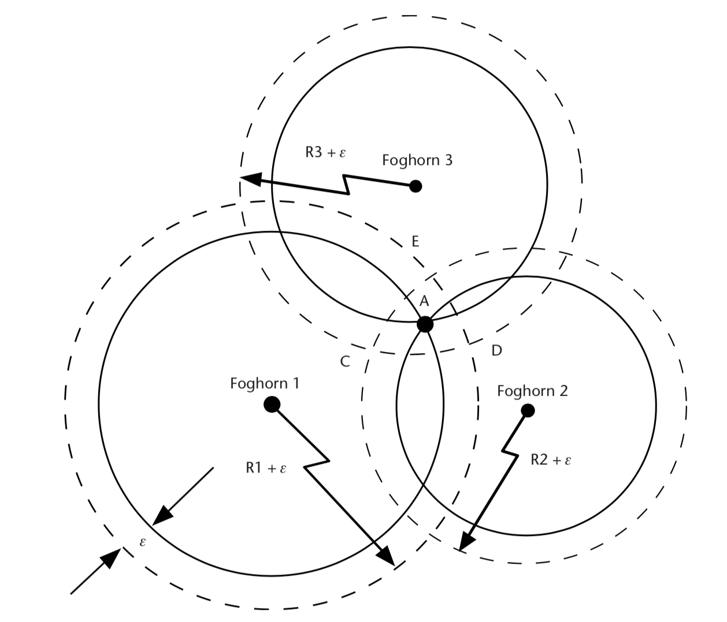
GPS ranging error
Error due to unpredictable signal delay

Slide 56
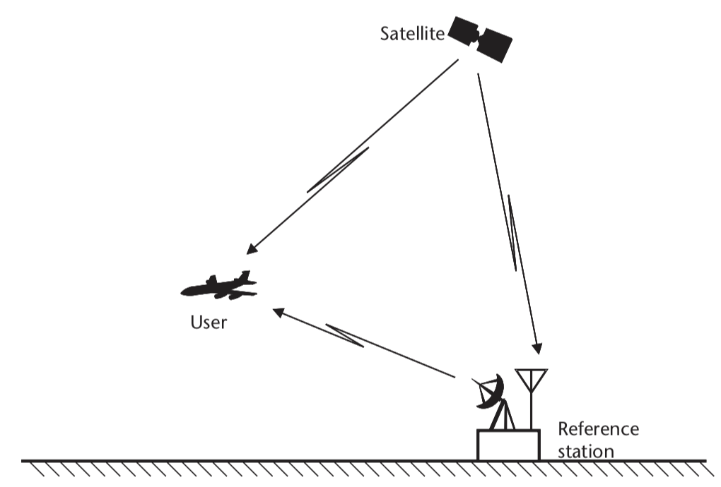
Differential GPS

Slide 57
Differential GPS
(1) Estimate the correct location of the reference
e.g., long term average of GPS location
24 hour estimated location scatter plot

Slide 58
Differential GPS
(1) Estimate the correct location of the reference
e.g., long term average of GPS location

Slide 59
Differential GPS
(2) Estimate the error in received GPS signal using the location of the base station and location of the satellite.
Repeat for all visible satellites
Error

Slide 60
Differential GPS
(3) Apply adjustment to the received GPS signal to reduce error
Send the adjustment info.

Slide 61
Differential GPS
Regular GPS estimate (red)
Differential GPS
with geo-stationary satellite (green)
meter
Differential GPS
with static base station (purple)
meter
24 hour estimated location scatter plot

Slide 62
Inertial Sensor (IMU) Integrated GPS

Slide 63
GPS blockage and multipath in cities

Slide 64
GPS blockage and multipath in cities
Regions of unreliable GPS location

Slide 65
Dead reckoning
Location estimate drifts
-- Use reliable GPS estimates to correct inertial drift
-- Use inertial dead-reckoning in GPS regions
Track movements with inertial sensors

Slide 66
Summary of localization techniques

Slide 67
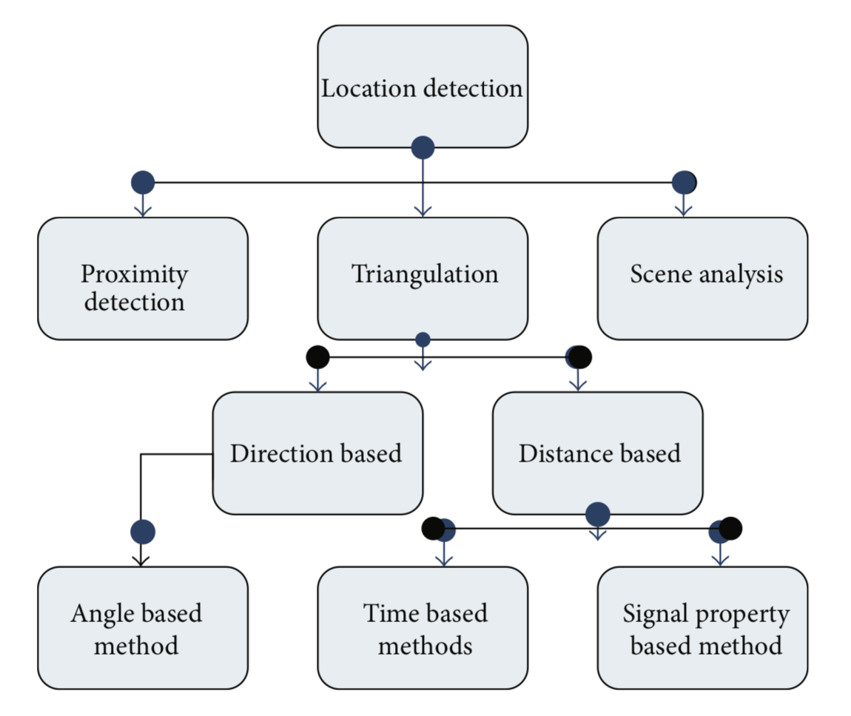
Localization techniques
[Ref] http://downloads.hindawi.com/journals/jcnc/2013/185138.pdf

Slide 68
Localization techniques
Inertial tracking

Slide 69
Localization techniques: Proximity

Slide 70

Localization techniques: Scene analysis

Slide 71
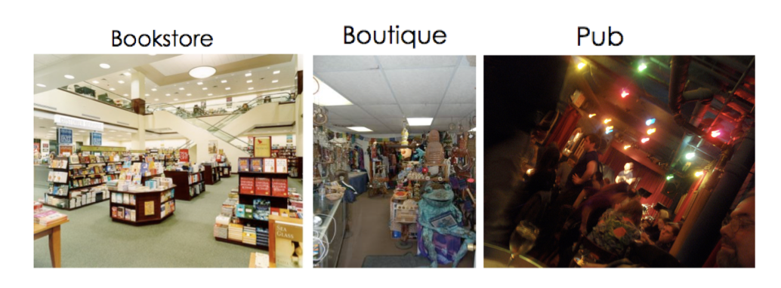
Localization techniques: Scene analysis

Slide 72
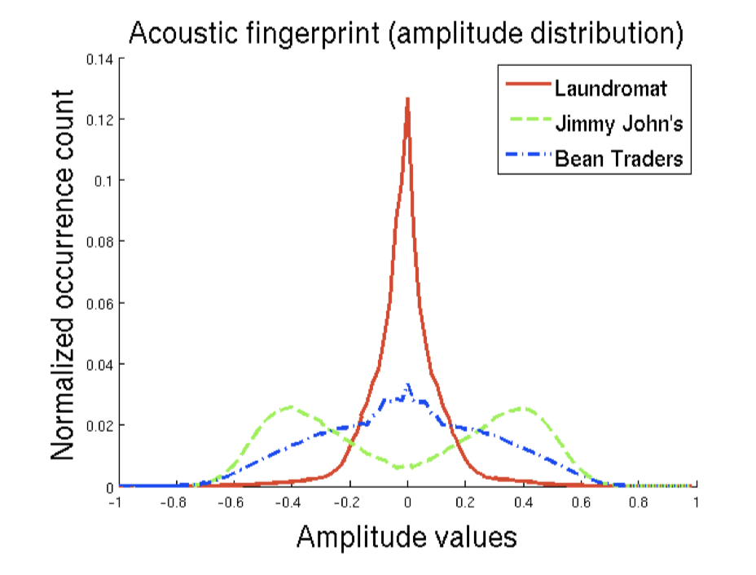
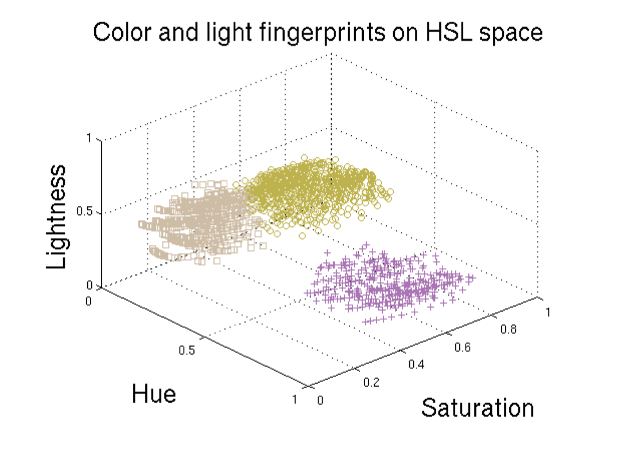
Localization techniques: Scene analysis

Slide 73
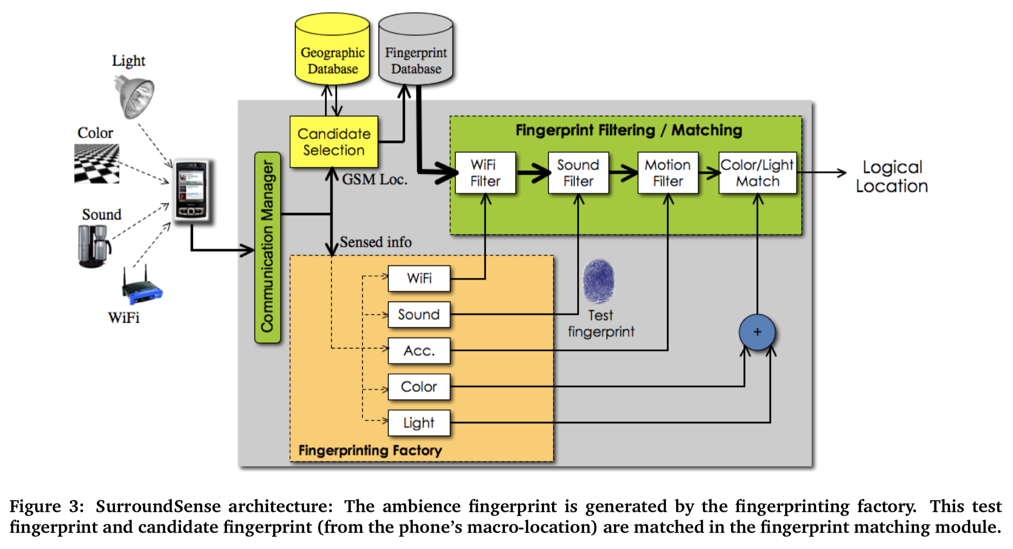
Localization techniques: Scene analysis

Slide 74
Localization techniques
Inertial tracking

