Slide 1
COIN-GPS: Indoor Localization from Direct GPS Receiving
Case Study
Shahriar Nirjon
University of Virginia
Jie Liu, Gerald DeJean, Bodhi Priyantha,
Yuzhe Jin, and Ted Hart
Microsoft Research, Redmond

Slide 2
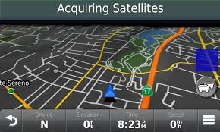
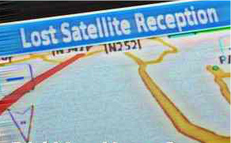
‘GPS does not work indoors’ - Everyone
Why?

Slide 3
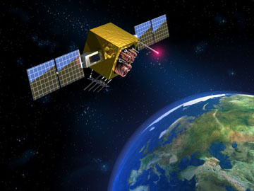
GPS Signal-Strength
500 W
1.4 x 10⁻¹⁶ W

Slide 4
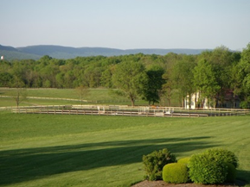
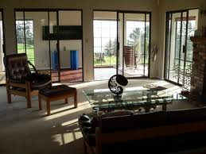
GPS Signal-Strength Indoors
100 attowatts
1 to 10 attowatts
We cannot decode packets (e.g. time stamps, navigational data)
Notes:
Atto = 10^-18

Slide 5

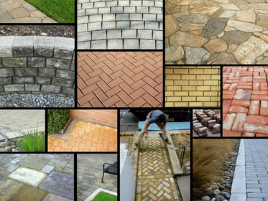
Heterogeneous Building Materials
Concrete
Wood
Glass
Steel
…

Slide 6
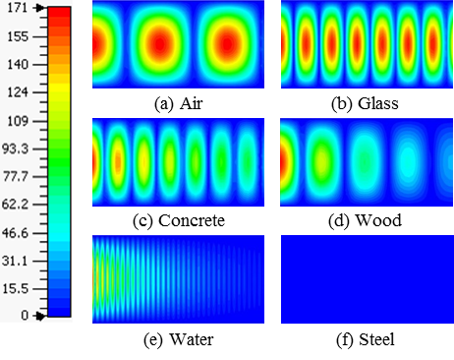
GPS Signals Thorough Building Materials
E⁺
E⁻
Good
Bad
2D electric field plots of a GPS signal propagating
through different materials

Slide 7

Strategy and Leverages
Use no data from the GPS packets.
GPS
Opportunistically sample signals from multiple directions.

Slide 8


Strategy and Leverages
Leverage the slow movement of indoor receivers
Leverage the power of cloud computing

Slide 9
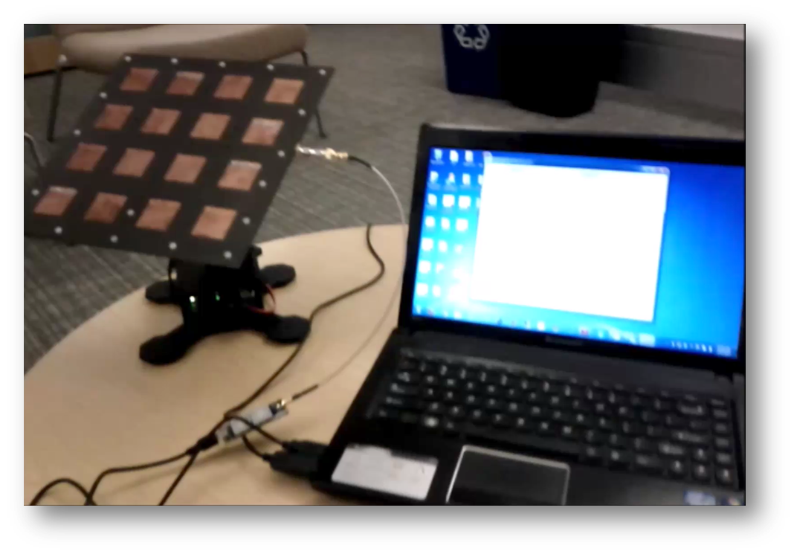
COIN-GPS: Cloud Offloaded Indoor GPS
We mechanically steer the antenna with a PC and collect GPS samples for offline processing

Slide 10
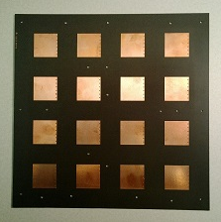
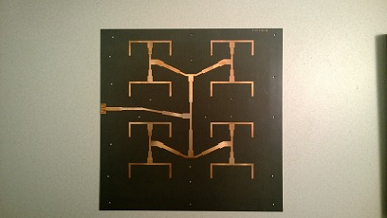
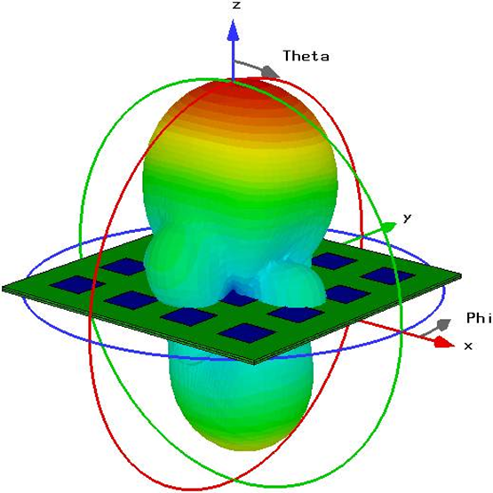
1. The Front End
We use a high-gain, directional antenna to get GPS signals from a certain direction.
Properties:
10 x 10 Sq. Inch
1575.42 MHz
12.3 dBi gain
Half power beam width: 35°

Slide 11
2. The Back-End Processing
Satellite
Acquisition
From
Weak Signals
Location
Estimation
From
Inadequate
Satellites

Slide 12
Detecting Satellites Indoor

Slide 13
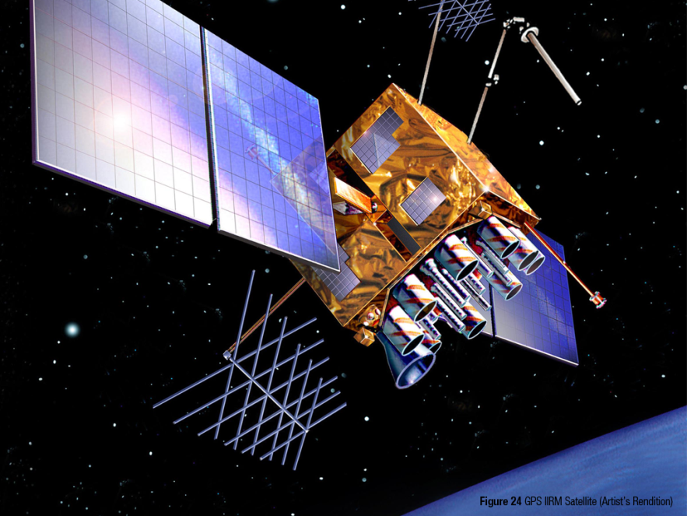
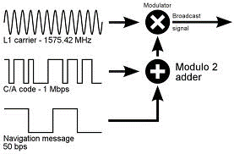
Detecting Satellites
The standard acquisition process:
The Sender

Slide 14
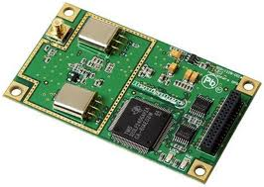
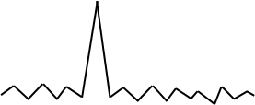


Detecting Satellites (Instant GPS)
The standard acquisition process: (Instant GPS)
The Receiver
1 ms
demodulated GPS signals
Code Phase
Sat 01
*
…
Sat 32
*
Local C/A codes

Slide 15
Satellite Acquisition from Weak Signals
The correlation plot in reality:
K = 1

Slide 16
Satellite Acquisition from Weak Signals
The correlation plot (integrated over multiple ms)
K = 1
K = 2
K = 4
K = 8

Slide 17
2. The Back-End Processing
Satellite
Acquisition
From
Weak Signals
Location
Estimation
From
Inadequate
Satellites

Slide 18
Required Satellites
How many satellites do we need?

Slide 19
Required Satellites (in Various Techniques)
How many satellites do we need?
Type | How Fast? | Unknowns
GPS | 30 sec
COIN-GPS | 1 ms

Slide 20
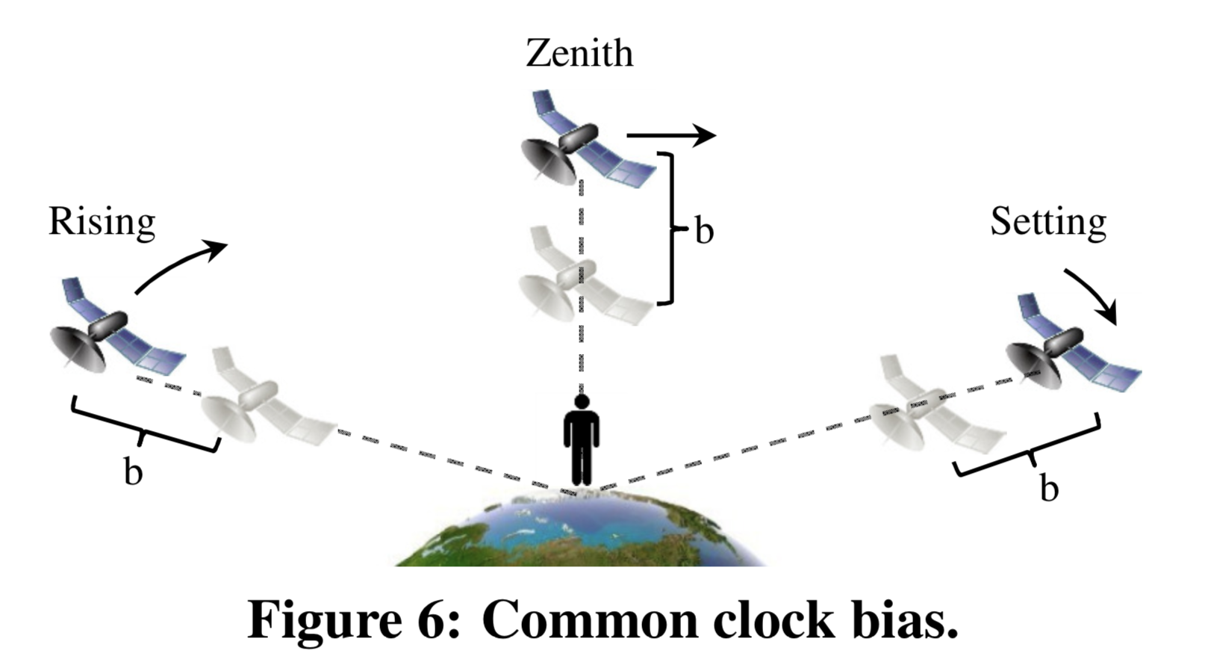
Required Satellites (in Various Techniques)

Slide 21
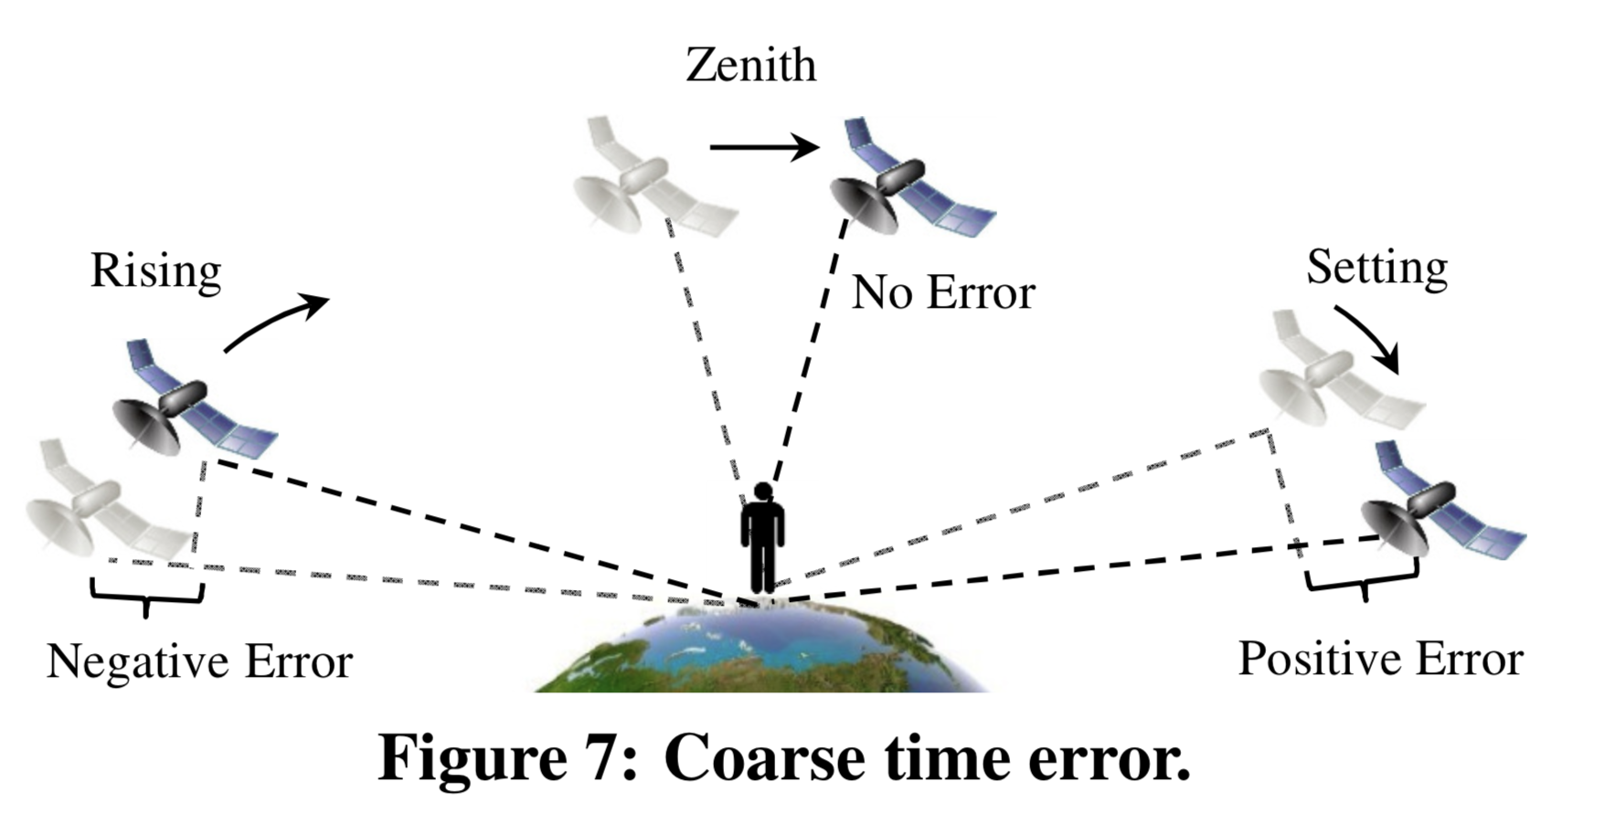
Required Satellites (in Various Techniques)

Slide 22

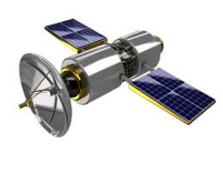


Required Satellites (in Various Techniques)
How many satellites do we need?
Type | How Fast? | Unknowns
GPS | 30 sec | X, Y, Z, B, C
COIN-GPS | 1 ms
Fig. Common bias error

Slide 23



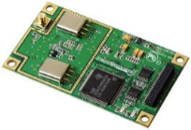
Required Satellites (in Various Techniques)
How many satellites do we need?
Actual
Wrong
Type | How Fast? | Unknowns
GPS | 30 sec | X, Y, Z, B, C
COIN-GPS | 1 ms
800 m/s
C
dt
Fig. Coarse time error

Slide 24
Required Satellites (in Various Techniques)
How many satellites do we need?
Actual
Wrong
Type | How Fast? | Unknowns
GPS | 30 sec | X, Y, Z, B, C
COIN-GPS | 1 ms | X, Y, Z, B, C
800 m/s
C
dt
Fig. Coarse time error

Slide 25
Required Satellites (in Various Techniques)
How many satellites do we need?
Actual
Wrong
Type | How Fast? | Unknowns
GPS | 30 sec | X, Y, Z, B, C
COIN-GPS | 1 ms | X, Y, Z, B, C
800 m/s
C
dt
Fig. Coarse time error
So… for instant GPS, we need 5 visible satellites

Slide 26
Acquired Satellites (Indoors)
How many satellites do we see indoors?

Slide 27
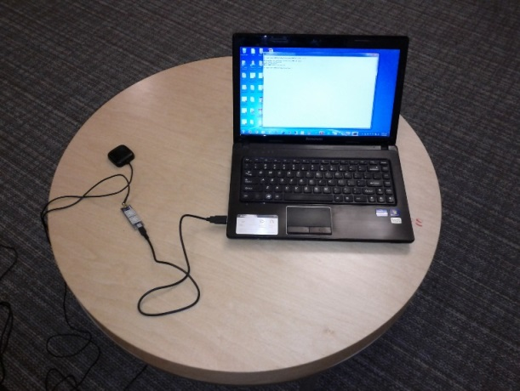
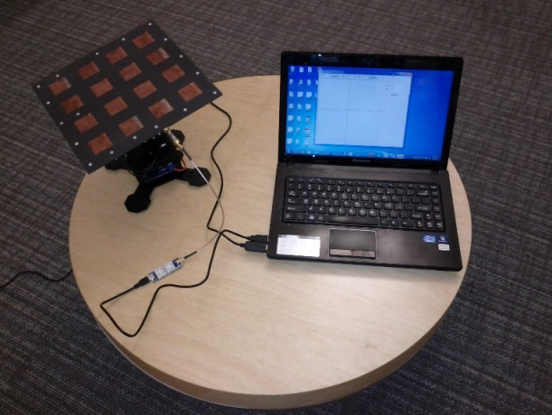
Acquired Satellites (Indoors)
How many satellites do we see indoors?
Garmin Antenna
Our Antenna

Slide 28
Acquired Satellites (Indoors)
How many satellites do we see indoors?
Garmin Antenna
%
N or more visible satellites
Our Antenna
But … 3 < 5

Slide 29
Handling Inadequate Satellites Problem
Our Approach: Receive, Wait and Receive again

Slide 30

Handling Inadequate Satellites Problem
Our Approach: Receive, Wait and Receive again
10:30.000 AM

Slide 31

Handling Inadequate Satellites Problem
Our Approach: Receive, Wait and Receive again
10:30.000 AM

Slide 32

Handling Inadequate Satellites Problem
Our Approach: Receive, Wait and Receive again
10:30.000 AM
10:30.500 AM

Slide 33
Handling Inadequate Satellites Problem
Our Approach: Receive, Wait and Receive again
10:30.000 AM
10:30.500 AM

Slide 34





Handling Inadequate Satellites Problem
Our Approach: Receive, Wait and Receive again
$$\left[\begin{aligned}E_{1} (x, y, z, b1, c1) \\ E_{2} (x, y, z, b1, c1) \\ E_{3} (x, y, z, b1,c1) \\ ? \\ ?\end{aligned}\right]$$
10:30.000 AM
$$\left[\begin{aligned}E_{4} (x, y, z, b2, c2) \\ E_{5} (x, y, z, b2, c2) \\ E_{6} (x, y, z, b2, c2) \\ E_{7} (x, y, z, b2, c2) \\ ?\end{aligned}\right]$$
10:30.500 AM

Slide 35

Handling Inadequate Satellites Problem
Our Approach: Receive, Wait and Receive again
$$\left[\begin{aligned}E_{1} (x, y, z, b1, c1) \\ E_{2} (x, y, z, b1, c1) \\ E_{3} (x, y, z, b1,c1) \\ ? \\ ?\end{aligned}\right]$$
$$\left[\begin{aligned}E_{1} (x, y, z, b1, c1,b2,c2) \\ E_{2} (x, y, z, b1, c1,b2,c2) \\ E_{3} (x, y, z, b1, c1,b2,c2) \\ E_{4} (x, y, z, b1, c1,b2,c2) \\ E_{5} (x, y, z, b1, c1,b2,c2) \\ E_{6} (x, y, z, b1, c1,b2,c2) \\ E_{7} (x, y, z, b1, c1,b2,c2)\end{aligned}\right]$$
10:30.000 AM
$$\left[\begin{aligned}E_{4} (x, y, z, b2, c2) \\ E_{5} (x, y, z, b2, c2) \\ E_{6} (x, y, z, b2, c2) \\ E_{7} (x, y, z, b2, c2) \\ ?\end{aligned}\right]$$
10:30.500 AM

Slide 36
Handling Inadequate Satellites Problem
The COIN-GPS formula:
For a stationary receiver, the required total number of visible GPS satellites for COIN-GPS is 2n + 3, where n is the number of independent readings and the same satellite acquired in different readings is considered different.
n | 2n+3
1 | 5
2 | 7
3 | 9
4 | 11

Slide 37





Experimental Setup
5 places
35 indoor locations
8 – 10 directions

Slide 38
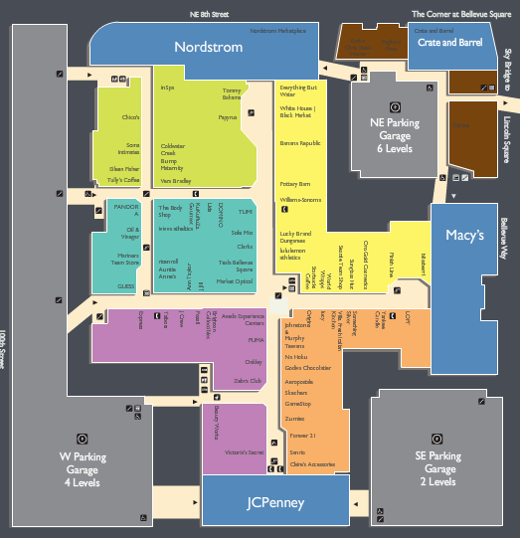
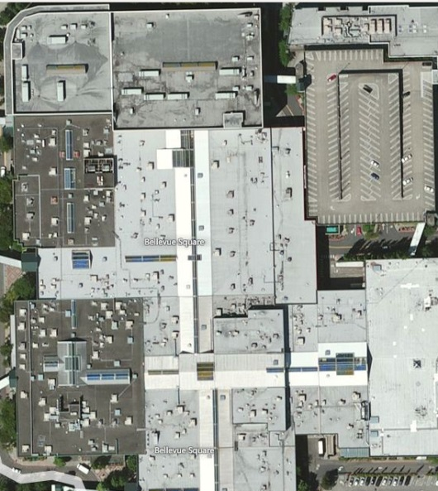
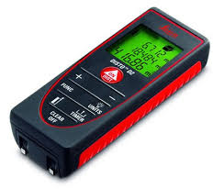
Experimental Setup
5 places
35 indoor locations
8 – 10 directions
Ground truth:
  Floor map
  Bing maps
  Laser pointer

Slide 39
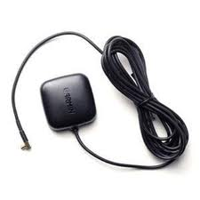
Experimental Setup
5 places
35 indoor locations
8 – 10 directions
Ground truth:
  Floor map
  Bing maps
  Laser pointer
Baseline:
  Garmin antenna with CO-GPS.
Garmin

Slide 40
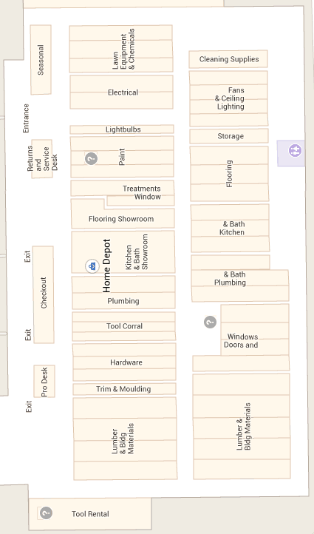
Results: Home Depot
A
System | Total Locations | Got Estimates
Garmin | 4 | None
Proposed | 4 | 4
B
D
C

Slide 41
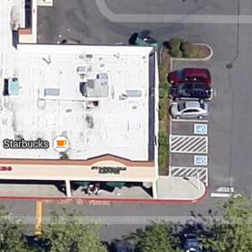
Results: Starbucks
System | Total Locations | Got Estimates
Garmin | 2 | None
Proposed | 2 | 2
A
B

Slide 42
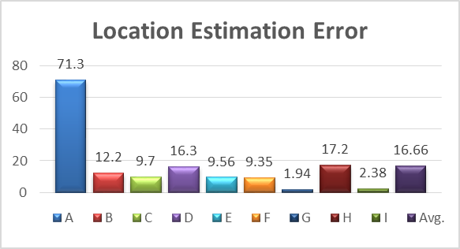
Results: Bellevue Square Mall
E
F
System | Total Locations | Got Estimates
Garmin | 16 | None
Proposed | 16 | 9
G
H
I
A
B
D
C

Slide 43
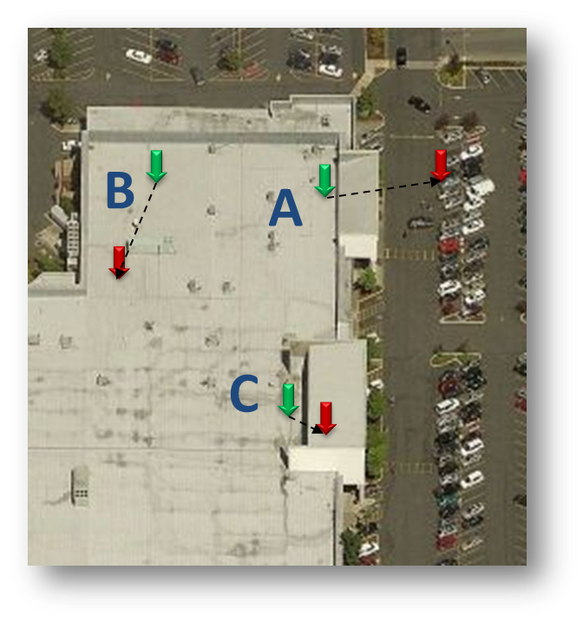
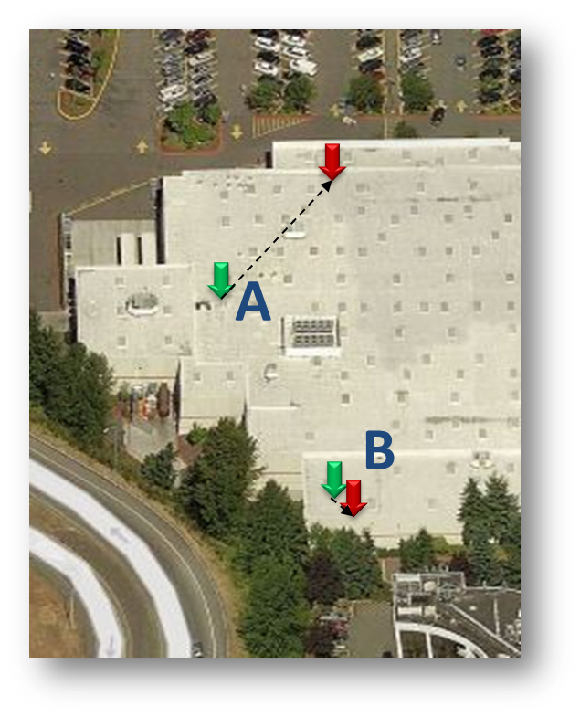
Results: Fred Meyer and Costco
System | Total Locations | Got Estimates
Garmin | 13 | None
Proposed | 13 | 5

Slide 44
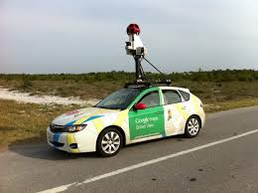
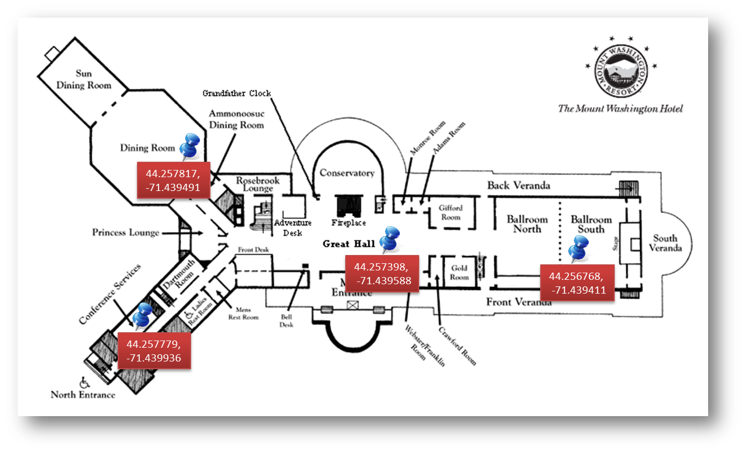
Concluding Remarks
If not for consumers, how about indoor profiling?

Slide 45
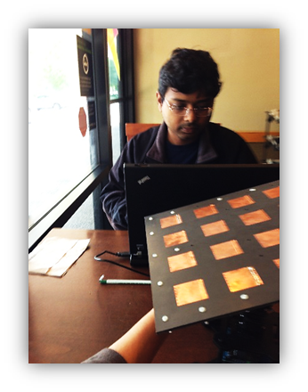
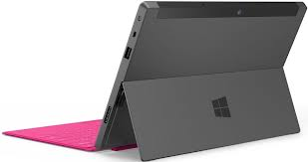
Concluding Remarks
Size does matter, if not phones – how about tabs?
Surface Pro Next ?

Slide 46
Thank You

