Slide 1
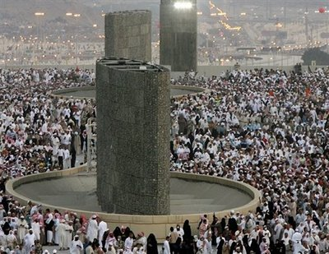
Continuum Crowds
Notes:
NEED IMAGE

Slide 2
Agenda
Motivation
Introduction to Agent Based Models
Introduction to Continuum Models
Specific Continuum Models
  The flow of Human Crowds- Hughes, et. al., 2002
  Continuum Crowds- Treuille, et. al., 2006
  Aggregate Dynamics for Dense Crowd Simulation- Narain, et. al., 2009

Slide 3
Crowd Simulation: Motivation
Video games
Virtual Reality
Studying crowd behavior
Transportation research
Traffic engineering
Architecture design and urban planning
Designing evacuation plans for large structures
Notes:
From a grpahics perspective, …
From a psychology perspective,

Slide 4
Agent Based Models
Motion is computed separately for each agent
Model is usually decoupled into a global planner and a local planner
Environment
Agents
Local Planner
Global Planner
Environment
Agents
Local Planner
Global Planner
Preferred Velocity
Preferred Velocity

Slide 5
Agent Based Models
Advantages
  Capture each agent’s unique situation
  Can simulate complex heterogeneous motion
Disadvantages
  Local path planning may result in less realistic crowd behavior
  Computationally expensive for dense crowds

Slide 6
Continuum Models
Inspired by fluid dynamics
Aggregate view of the crowd
Basic Assumption
  In a dense crowd, individual agents have a reduced freedom of movement
Unifies global path planning and local collision avoidance
  Density field & velocity field
  Potential function
  Discomfort function
Applicability
  Medium-High density crowds
  Open & Familiar Domain

Slide 7
Continuum Models
Advantages
  Relatively inexpensive for dense crowds
  Congestion avoidance is simpler
  Smoother trajectories
Disadvantages
  Homogeneous behavior
  Assumes full knowledge of the environment
  Pedestrians have a common goal
  Dependent on grid resolution
Notes:
.

Slide 8
The Flow of Human Crowds - Hughes, 2003
When?
  Characteristic distance scale between pedestrians is less than the characteristic distance scale of the region
Governing equations are non linear partial differential equations
Theoretical model
Applied in analysis of the Jamarat Bridge
Different groups of people possible
Notes:
1. Not low density and not too high density

Slide 9


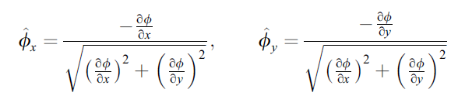
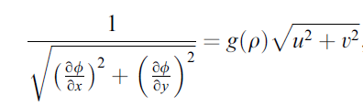
Governing eQUATIONS
Conservation of pedestrians
Hypothesis 1: Speed is a function of density and behavioral characteristics
Hypothesis 2: Decisions based on potential which is measured by remaining time
Hypothesis 3: Pedestrians aim to minimize travel time & avoid extreme densities
Density ρ, Speed field f, Discomfort field g, Potential Function ϕ, Velocity Components u,v
Notes:
ADD EQUATIONS
Rate of accumulation of pedestrians = net flow of pedestrians
Direction cosines
Unit vector giving the direction of steepest descent
Sepearable i..e. minimize the product of time and density

Slide 10
Applications: Jammarat Bridge

Slide 11
Continuum Crowds – Treuille, et. al., 2006
Directly inspired by Hughes’ model
Uses concept of particle representation
Similar concepts of potential field and discomfort fields
Individual speed is a function of crowd flow in addition to density
Optimal path takes into account distance
Cost depends on grid size

Slide 12

Hypothesis
Hypothesis 1: Each person is trying to reach a geographic goal G(x,y)
Hypothesis 2: People move at the maximum speed possible, considering environmental conditions
$\dot{x}=f\left(x,θ\right)∗nθ$
f is the maximum speed field (x, $θ$), $nθ$ is a unit vector $θ$ in & $\dot{x}$ is the velocity
Hypothesis 3: There exists a discomfort field g so that, all things being equal, people would prefer to be at point x rather than x’ if g(x’)>g(x)
Notation: G(x,y) defines the goal pt. and g(x,y) refers to the discomfort field

Slide 13

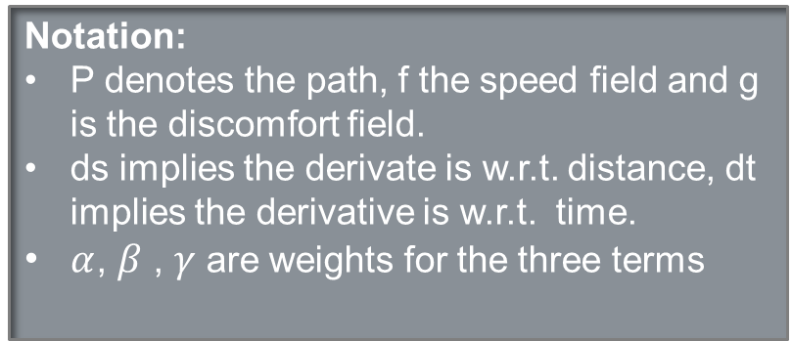
Cost Function
People choose paths so as to minimize a linear combination of:
  Length of the path
  Amount of time to the destination
  Discomfort felt, per unit time, along the path
  $$Total Cost=α\int_{P}{1ds}+β\int_{P}{1dt}+γ\int_{P}{gdt}$$
  Let C be the unit cost field such that $C≡\frac{αf+β+γg}{f}$
  $Total Cost=\int_{P}{Cds}$
Notation:
P denotes the path, f the speed field and g is the discomfort field.
ds implies the derivate is w.r.t. distance, dt implies the derivative is w.r.t. time.
$α$, $β$, $γ$are weights for the three terms

Slide 14

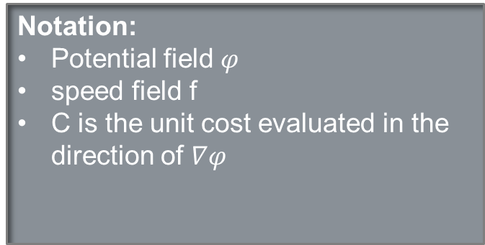
Optimal Path Computation
Potential Field, $φ:R^{2}→R$
  Denotes the cost of the optimal path to the goal for given point
  Satisfies the equation: $\left|\left|∇φ\left(x\right)\right|\right|=C$
  So velocity $\dot{x}$ at any given point can be computed as
    $$\dot{x}=−f\left(x,θ\right)∗\frac{∇φ\left(x\right)}{\left|\left|∇φ\left(x\right)\right|\right|}$$
    Reducing Computation Cost
      Cluster individuals having identical speed field, discomfort and goal into groups
      At each timestep, construct a potential field for each group
      This is the slowest step of the simulation
Notation:
Potential field $φ$
speed field f
C is the unit cost evaluated in the direction of $∇φ$

Slide 15
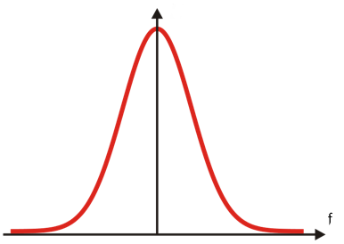

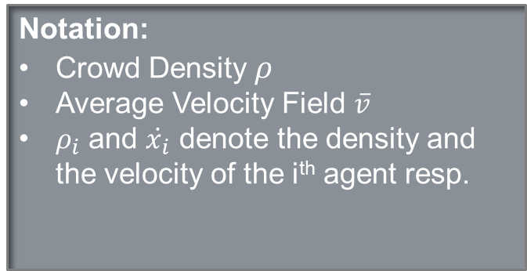
Density and Velocity Fields
Crowd density field. Ρ
  Let ρ_{i} denote the density field of the ith function
  $$ρ=\sum_{i}{\text{ρ}i}$$
  Average Velocity field
    Indicates the overall speed and direction of crowd flow
    $$\overline{v}=\frac{\sum_{i}{\dot{x}\text{i}\text{ρ}i}}{ρ}$$
Notation:
Crowd Density $ρ$
Average Velocity Field $\overline{v}$
$ρ_{i}$ and $\dot{x_{i}}$ denote the density and the velocity of the i^{th} agent resp.
Notes:
Summing across groups

Slide 16


Speed Field
Differs from Hughes Model
Speed field f($x,θ$) measures the maximum permissible speed of movement for every point and every direction in the domain.
If ρ≤ρ_{min}, f = $fτ$
$fτ\left(x,θ\right)=fmax+(\frac{∇h\left(x\right)nθ−smin}{smax−smin})(fmin−fmax)$
If ρ> ρ_{max}, f = $f_{\overline{v}}$
$$f_{\overline{v}}\left(x,θ\right)=\overline{v}\left(x+rnθ\right).nθ$$
Else, linearly interpolate between $fτ$and $f_{\overline{v}}$
Notation:
$∇h\left(x\right)nθ$ is the slope of the height field h in direction $θ$.
Position x
Offset r
Density ρ
Topographical Speed $fτ$
Flow Speed $f_{\overline{v}}$
$smax , smin$ denote the max. and min. slope
Notes:
Speed varies inversely with the slope

Slide 17
Implementation
For each timestep
    Convert the crowd to a density field
    Also compute the average velocity field
    For each group
      Construct the unit cost field C
        Compute the maximum speed field f
      Construct the potential and its gradient
      Update locations
      Enforce minimum distance between people

Slide 18
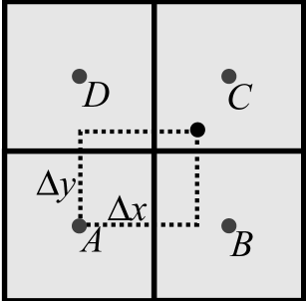

1. Density Conversion
Requirements
  Density field must be continuous
  Each person should contribute no less than $\overline{ρ}$ to their own grid cell and no more than $\overline{ρ}$ to any neighboring grid cell
  Density Contribution for each person
  ρ_{A}=min(1-∆x,1- ∆y)^{λ}
  ρ_{B}=min(∆x,1- ∆y) ^{λ}
  ρ_{C}=min(∆x, ∆y) ^{λ}
  ρ_{D}=min(1-∆x, ∆y) ^{λ}
  $\overline{ρ}$ =1/2^{λ}
  Simultaneously calculate average velocity field
Notation: $λ$is the density exponent and $ρ$ is the density

Slide 19
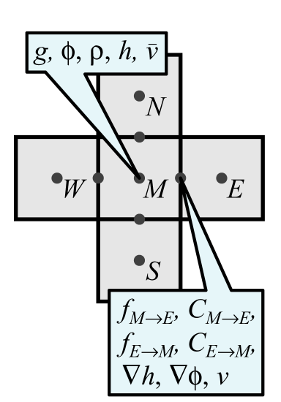

2. Unit Cost Field
Compute maximum speed field f
Compute Cost using f
Keep in mind they are anisotropic
Anticipate obstructions ahead
Notation:
Discomfort field g
Potential field $φ$
Density ρ
Height field h
Average Velocity field $\overline{v}$
Velocity v
Speed field f
Unit cost C

Slide 20
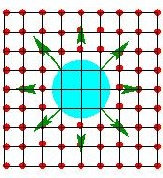
3. Dynamic Potential Field Construction
Fast Marching Method
Cells grouped as KNOWN, UNKNOWN and CANDIDATE
Initially Populate the KNOWN list with goal cells
Loop Until UNKNOWN list is empty
  Estimate potential at CANDIDATE cells using finite difference approximation
  Add the CANDIDATE cell with the lowest potential to the list of KNOWN cells and its adjacent ‘unknown’ cells to the CANDIDATE list
Running time : O(NlogN)
Notes:
Finite Difference Approximation

Slide 21

4. Update Locations
We now have potential field $φ$, its gradient $∇φ\left(x\right)$ and the speed field f
Each persons position is displaced by their velocity
Minimum Distance Enforcement
  All fields dependent on resolution of grid
  Enforce pedestrians to maintain minimum distance from each other
  Simple and Linear in complexity
  Introduces artifacts

Slide 22
https://www.youtube.com/watch?v=lGOvYyJ6r1c
Notes:
Agents!
People avoid collision smoothly, not too early
Use of discomfort field
Generalized objective

Slide 23
Advantages
Unifies global planning and local collision avoidance
Smoother motion
Accounts for crowd flows and includes distance in cost function
Capable of being integrated with agents
Results close to actual observations of large crowds
DISADVANTAGES
Not designed for very high density scenarios
Does not take into account uncertainty
People can change direction without respect to inertia
Uniform Grids
Does not have the flexibility and individual variability of the agent-based approach

Slide 24
Aggregate Dynamics for Dense Crowd Simulation - Narain et. al.
Focusses on simulating inter-agent dynamics of large, dense crowds
Combines a Lagrangian representation of individuals with a coarser Eulerian crowd model
Decouples the computational cost of local planning from the number of agents
Overcomes Treuille’s incapability to prevent intersections in very dense crowds

Slide 25
Discrete & Continuous Crowds
Does not combine global and local planners
Augments a continuous representation
Solves for collision avoidance in continuous domain using a variational constraint on the crowd flow, called Unilateral Incompressibility Constraint (UIC).

Slide 26

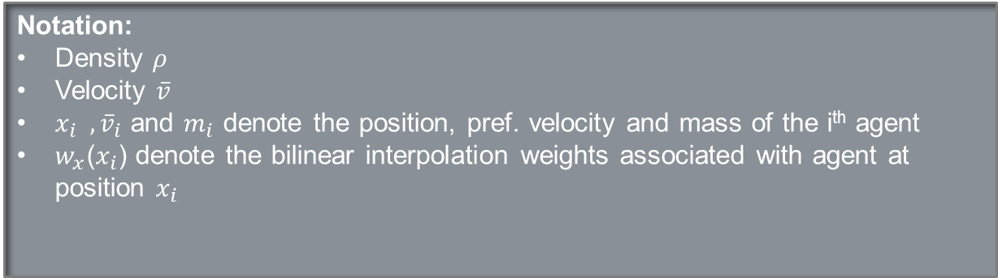
Agents & the Grid
Accumulate the values carried by nearby agents, weighted by the bilinear interpolation weights
$$ρ\left(x\right)=\sum_{i}{w_{x}\left(x_{i}\right)m_{i}}$$
$$\overline{v}\left(x\right)=\frac{\sum_{i}{w_{x}\left(x_{i}\right){\overline{v}}_{i}}}{\sum_{i}{w_{x}\left(x_{i}\right)}}$$
Thus, the crowd is converted to a continuous representation
Notation:
Density $ρ$
Velocity $\overline{v}$
${x_{i} , \overline{v}}_{i}$ and $m_{i}$ denote the position, pref. velocity and mass of the i^{th} agent
$w_{x}$($x_{i}$) denote the bilinear interpolation weights associated with agent at position $x_{i}$

Slide 27

Unilateral incompressibility constraint (UIC)
Crowd is unlike any physical fluid i.e. it should be treated as a hybrid of purely compressible and purely incompressible
Impose UIC - an inequality constraint
$$ρ≤ρmax=\frac{2α}{\sqrt{3}{dmin}^{2}}$$
Where $α$ $≤$1
Determining corrected velocity v subject to UIC
Assume that the agents will try to make as much progress in their desired direction as possible
$$v=vmax\frac{v−∇p}{||v−∇p||}$$
For some scalar “pressure” p>=0 satisfying:
$$ρ<ρ\max{⇒ }p=0$$
$$p>0⇒∇.v=0$$
Notes:
Div(v) = 0 implies that if the density is greater than threshold, the crowd flow experiences a pressure s.t. the flow is incompressible i.e. crowd is not allowd to converge to a higher density.
Only acts in regions where the condition is met

Slide 28

Agent Motion
We now have a flow field through v & $ρ$ which prevents inter agent collision
In dense regions, use continuum velocity
  v=v(x_{i})
  In low density regions, interpolate between continuum velocity and agents preferred velocity
  $$vi=\overline{v}i+\frac{ρ\left(xi\right)}{ρmax}(v\left(xi\right)−\overline{v}i)$$
  Enforce minimum distances for each pair of individual agents
Notes:
Notation

Slide 29

Algorithm
At the beginning of each time step
  Global planning is performed to determine the preferred velocity $\overline{v}$ of each agent
  The agent positions x and preferred velocities $\overline{v}$ are transferred to the simulation grid
  If there are moving obstacles in the environment, the free area of each grid cell is recomputed.
  The UIC solve is performed, giving the corrected velocity field v.
  Each agent determines its actual velocity $v$ taking the corrected flow and updates its position for the next timestep as x = x + $v ∇$t.
  Finally, pairwise collision resolution is performed on the new x to handle inter-agent collisions.

Slide 30
https://www.youtube.com/watch?v=pqBSNAOsMDc

Slide 31
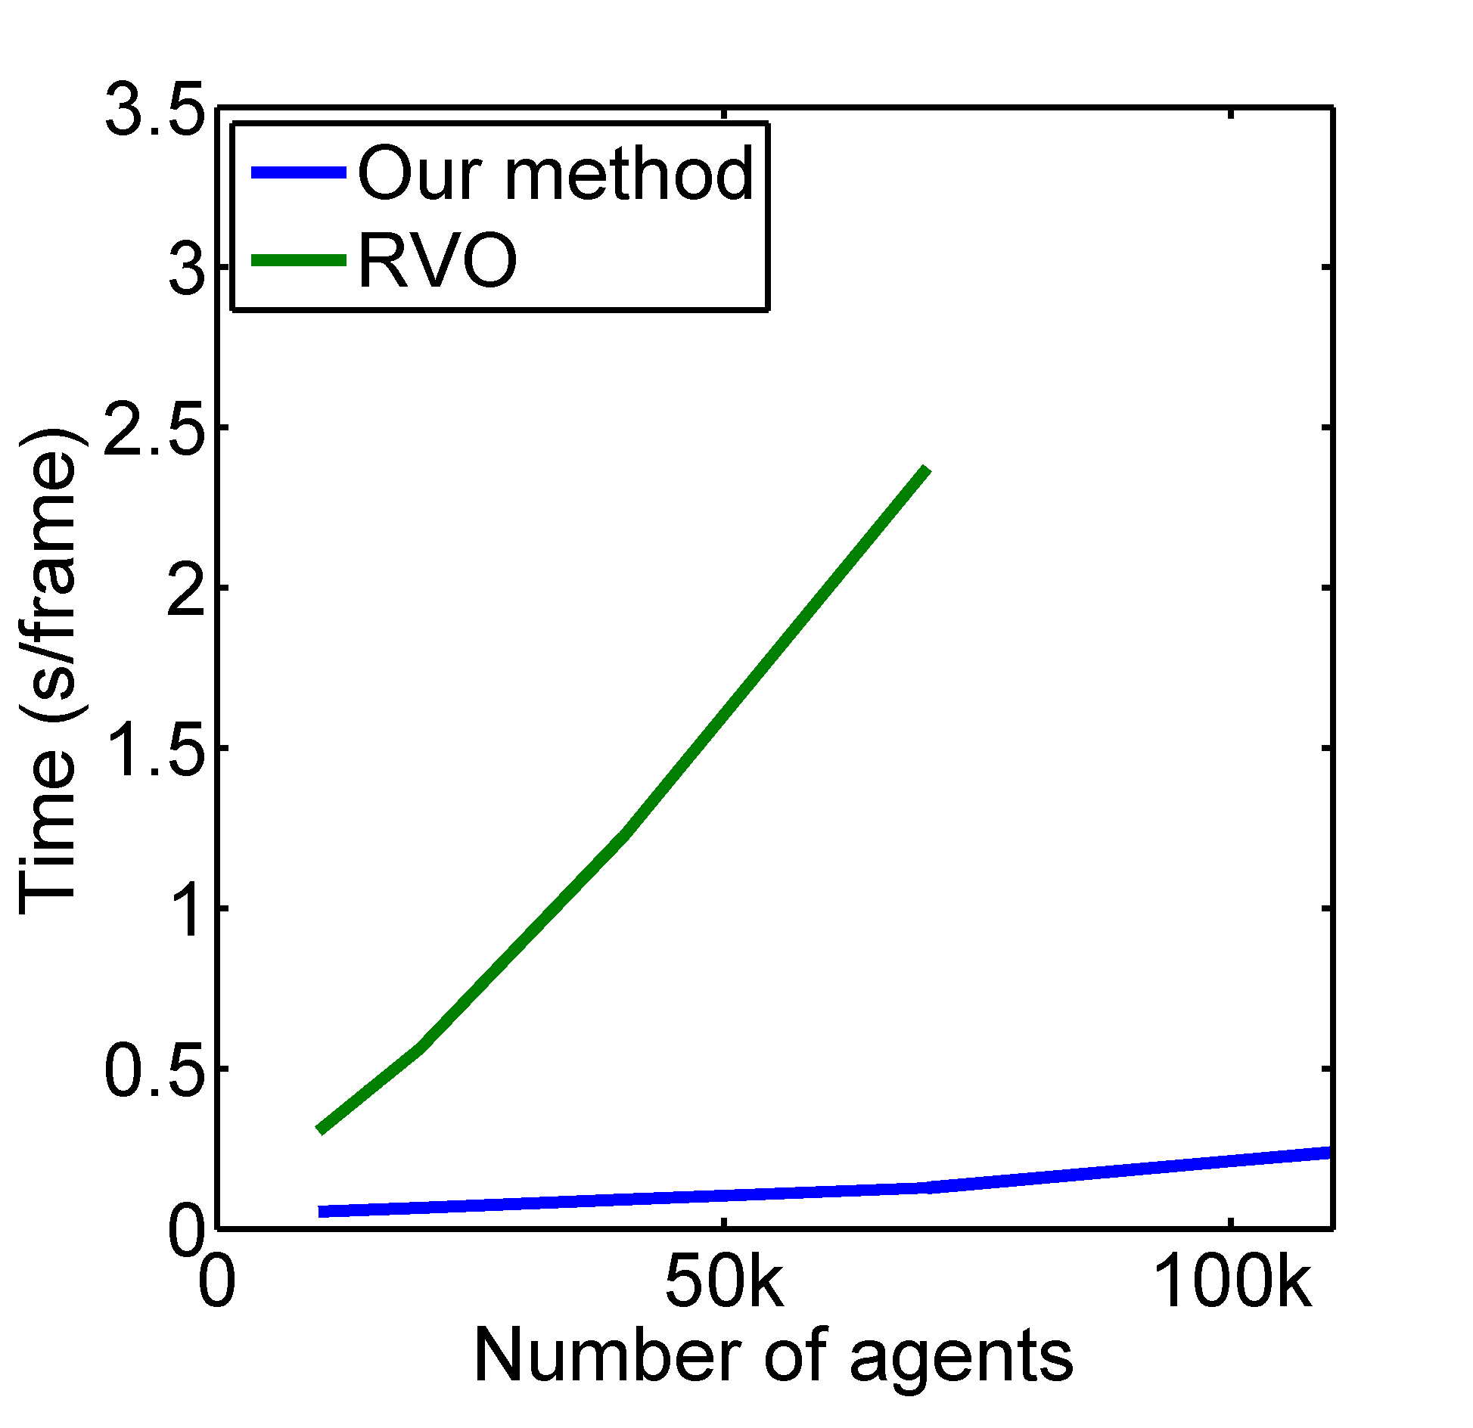
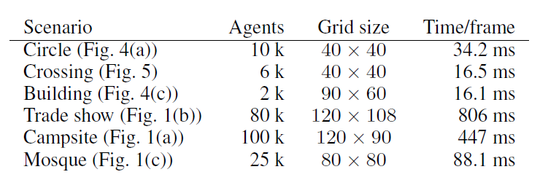
Performance
Notes:
And Video

Slide 32
Drawbacks
Pressure projection only looks at local information
No discomfort field i.e. assumption that people aim to maximize progress in the desired direction.
Not as detailed as a purely agent based model

Slide 33
sUMMARY
The Flow of Human Crowds – Hughes et. al. , 2003
  Unifies global and local path planning
  Purely theoretical
  Time based potential function and density based discomfort and speed field
Continuum Crowds - Treuille et. al. , 2006
  Adapts Hughes’s model for simulation
  Potential function based on distance in addition to time and discomfort
  Discomfort field can be arbitrarily defined
  Speed depends on crowd flow in dense conditions
Aggregate Dynamics for Dense Crowd Simulation - Narain et. al., 2009
  Congestion avoidance on a aggregate level
  Separate global and local planners
  No notion of discomfort field

Slide 34
References
HUGHES, R. L. 2002. A continuum theory for the flow of pedestrians. Transportation Research Part B 36, 6 (july), 507535.
HUGHES, R. L. 2003. The flow of human crowds. Annu. Rev. Fluid Mech. 35, 169–182.
Treuille, A. Cooper, S. Popović, Z., Continuum Crowds, ACM Transactions on Graphics 25(3) (SIGGRAPH 2006)
Rahul Narain, Abhinav Golas, Sean Curtis, and Ming C. Lin, 2009. Aggregate Dynamics for Dense Crowd Simulation. In ACM Transactions on Graphics (Proceedings of SIGGRAPH Asia), vol. 28, no. 5, pp. 122:1–122:8.
Abhinav Golas, Rahul Narain, and Ming C. Lin, 2013. Hybrid Long-Range Collision Avoidance for Crowd Simulation. In ACM SIGGRAPH Symposium on Interactive 3D Graphics and Games (I3D) 2013.

Slide 35
QUESTIONS ?

