Slide 1
Cosmological Simulations

Slide 2
Motivation
Improve our understanding of the universe
Reason about models that are intractable from an analytic point of view
Verify/compare different models/theories by simulating them computationally and comparing to observational results.
  Ex: the Lambda-Cold Dark Matter model developed into the leading theoretical paradigm of structure formation in large part because of simulation results
Create visualizations of distant/unobservable phenomena.

Slide 3
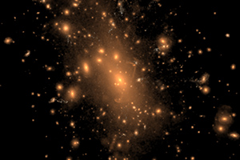
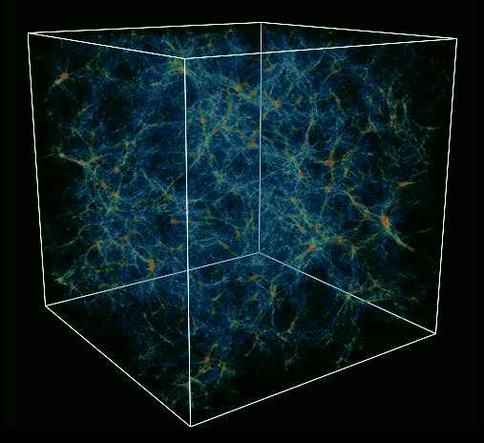
Motivation

Slide 4
Challenges
The N-body problem is PSPACE-hard
Modelling the universe takes an enormous amount of computation
Until recently, could only perform very small simulations
Advances in hardware and methods allow us to simulate much larger systems much more accurately

Slide 5
Methodology
Most simulations need to describe 2 primary components:
  Collisionless dynamics (dark matter and stars in galaxies)
  Fluid simulation of an ideal gas (baryonic matter, primarily hydrogen and helium)
Require a solve method for each of these two components to accurately simulate the universe
Additional physics may be optionally added (radiative cooling, star formation methods, cosmic rays, supermassive black hole growth, stellar winds, etc.)

Slide 6
Collisionless Dynamics
Best solved by N-body methods, where space is sampled with a finite number of tracer particles
Difficulty: the number of interactions increases with N², which can be very expensive
Main forms of approximating the simulation:
  Particle mesh methods
  Tree methods
  Hybrid

Slide 7

Theoretical Basis
Assumption is that dark matter does not interact appreciably except through gravity.
In order for the collisionless assumption to hold, simulation time should be much shorter than relaxation time
  $t_{relax}∝\frac{N}{8∗lnN }∗t_{cross}$
  For galaxy clusters, this time period is on the order of 10¹² years, or 100 times the age of the universe
Simplifying assumption: dark matter particles (which constitute the vast majority of this category) only interact via gravity

Slide 8

Equations of Motion
Collisionless Boltzmann Equation:
  $\frac{df}{dt}=\frac{∂f}{∂t}+\frac{∂f}{∂x}∙v+\frac{∂f}{∂v}∙\left(−\frac{∂Φ}{∂x}\right)=0$
    $Φ(x,t)$ is the gravitational field potential
Poisson Equation:
  $∇^{2}Φ\left(x, t\right)=4πG\int{f\left(x, v,t\right)dv}$
    $f\left(x, v,t\right)$ is the single particle distribution function
Solution for the Equations of Motion:
  ${\ddot{x}}_{i}=−∇_{i}Φ\left(x_{i}\right)$
  $Φ\left(x\right)=−G\sum_{j=1}^{N}{\frac{m_{j}}{{\left({\left(x −x_{j}\right)}^{2}+ε^{2}\right)}^{\frac{1}{2}}}}$
    $ε$ is a gravitational softening constant; prevents large angle scattering and bound pairs, and assures that the two-body relaxation time is large; allows low order integration

Slide 9
Particle Mesh Methods
System of particles converted into a grid of density values
Forces are applied to a body based on which cell it is in, and where in the cell it is
Particles do not interact directly, but rather through a mean field
Typically solved via Fast Fourier Transform
Time is linear in particles and O(n log n) in cells
Fastest method available, but force is suppressed below one to two mesh cells; leads to bad spatial accuracy

Slide 10
Tree Methods
Recursively divide the N bodies into groups
Each node represents a region (root is the whole simulation)
For an internal node whose center of mass is sufficiently far from a body being simulated, the entire node is treated as a single body with mass equal to the total mass of the bodies under the node
O(n log n) time in number of particles
Much better accuracy, but also much slower

Slide 11
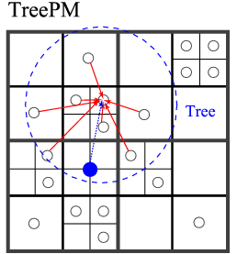
Hybrid Methods
Tree – PM:
  Restrict the tree algorithm to short-range scales
  Uses particle mesh method to compute long-range gravitational force
  Most commonly used method today; very well suited for cosmological simulation (available in both GADGET and AREPO)

Slide 12
Fluid Simulation (Basic Methods)
Eulerian (mesh): discretize space and represent fluid variables on a mesh
  Very good for capturing hydrodynamical shocks
  Suboptimal for the large dynamic range inherent in cosmology
  Can’t track history of individual fluid elements
  Adaptive Mesh Refinement is used in modern implementations
Lagrangian (SPH): discretize mass using a set of fluid particles (used in the GADGET code)
  Well suited to follow gravitational growth of structure
  Automatically increase resolution in critical regions
  Does not handle shocks well: relies on injection of artificial viscosity
  Can’t represent the discontinuous nature of shocks (due to smoothing)
Both widely used

Slide 13
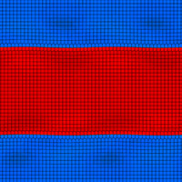
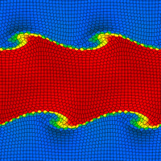
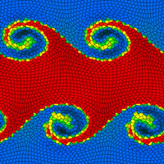
Fluid Simulation (Moving Mesh)
  Uses unstructured mesh defined by Voronoi tessellation of a set of points
  The points are allowed to move with the fluid to give accuracy where it is needed
  Can be thought of as a sort of hybrid between AMR and SPH
  Mitigates the noise and diffusiveness of SPH
  Handles self-gravity better than AMR

Slide 14
Fluid Simulation (Moving Mesh)
The mesh is defined by a set of points
If the points are fixed, then the method is the standard Eulerian method
If the points are allowed to move freely with the fluid being simulated, then it becomes a Lagrangian method
There is usually a correction factor to prevent the mesh from over-distorting:
  Threshold of the density of the cells
  Threshold of the distance between the geometric distance from the center of the cell to the point
  Threshold the angle between the cell walls

Slide 15

Integration
Adaptive timesteps given by
  $∆t_{grav}=min⁡[∆t_{max}, {\left(\frac{2ηε}{\left|a\right|}\right)}^{\frac{1}{2}}]$
  $η$ is an accuracy parameter, $ε$ is the gravitational softening, and$\left|a\right|$ is the acceleration of the particle

Slide 16
Current State of the Art Methods
SPH-based method: GADGET (2001) / GADGET-II (2005)
Moving mesh method: AREPO (2009)
These two currently dominate most large-scale simulation tasks in cosmology.

Slide 17
GADGET / GADGET-II
One of the most widely used simulation programs
Uses smoothed particle hydrodynamics for fluid simulation
Introduced use of entropy as an independent variable in fluid simulation
Improved on time-step implementation

Slide 18
AREPO
Relatively new implementation
Uses moving mesh methods for fluid simulation
Can refine/de-refine the mesh cells based on density
Has begun to gain widespread use
Is slightly slower than GADGET-II, but has been shown to be more accurate in many applications
  Angular momentum is modelled more accurately
  Gas mixture handled more efficiently, which models the cooling of hot halos more accurately
  Does not show clumps due to cooling instability

Slide 19
Notable Simulations
Millenium (2005)
Bolshoi (2010)
Illustris (2014)

Slide 20
Millenium
Completed in 2005, first truly gigantic cosmological simulation
Simulates from the epoch when the cosmic background radiation was emitted
Traced 10 billion particles across a cubic region of space 2 billion light years in length
Ran using the GADGET code on a supercomputer for over a month, producing 25 terabytes of data
The data has been used in over 650 papers
One of the highest impact astronomy simulations
Initial results were able to reconcile observations by the Sloan Digital Sky Survey (SDSS) with model of the universe
  SDSS observed very bright quasars at large distances, which implied that they were formed much earlier than originally theorized; this challenged then-current understanding of cosmology
  Simulation was able to reproduce the early formation of such quasars and showed that these objects are not at odds with our models of the universe

Slide 21
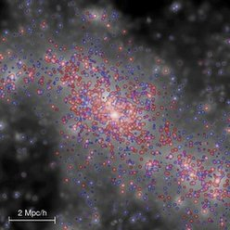
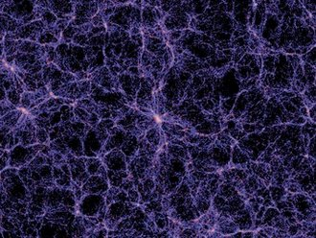
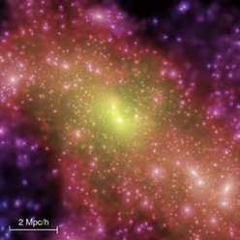
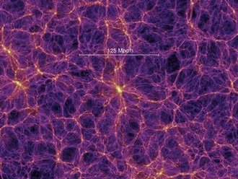
Millenium

Slide 22
Bolshoi Simulation
Completed in 2010
At the time, it was the most accurate simulation of the evolution of the large scale structure of the universe
Traced 8.6 billion particles of dark matter across a cubic region of space 1 billion light years in length
Ran using a adaptive mesh refinement method called Adaptive Refinement Tree
  Used density as decision factor for subdividing
  Neighboring cells are kept to within one subdivision level of each other to prevent discontinuity
Very close agreement with SDSS observations

Slide 23
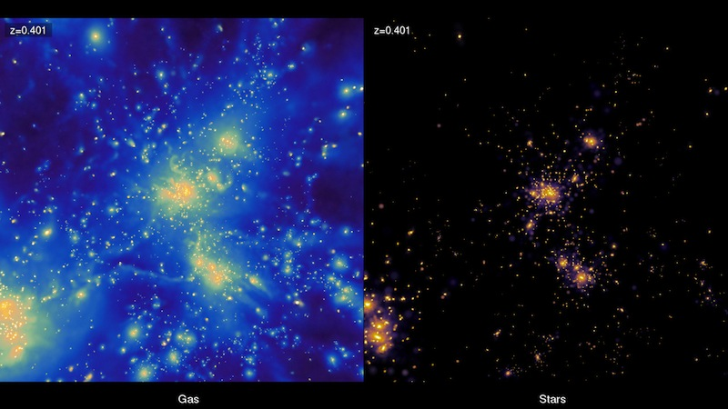
Bolshoi Simulation

Slide 24
Illustris
Completed in 2014
Uses the AREPO moving mesh code
Follows 18 billion particles on a ~350 million light year cube
Results are still being released
Initial results show very good agreement with observable metrics in:
  Ratio of dark matter to baryonic matter
  Star formation rate
  Distributions of various types/sizes of galaxies
  Gas distribution

Slide 25
References
http://www.mpa-garching.mpg.de/gadget/
http://www.mpa-garching.mpg.de/~volker/arepo/
http://www.mpa-garching.mpg.de/millennium/
http://hipacc.ucsc.edu/Bolshoi/
http://www.illustris-project.org/
http://www.cfa.harvard.edu/itc/research/movingmeshcosmology/
http://obswww.unige.ch/lastro/conferences/sf2013/pdf/lecture1.pdf
http://www.scholarpedia.org/article/N-body_simulations
http://www.usm.uni-muenchen.de/people/puls/lessons/numpraktnew/nbody/nbody_manual.pdf

