Slide 1
Simulating Elasto-plastic Material

Slide 2
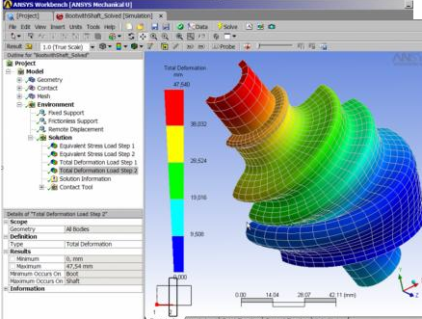
Applications
Researched by Material Science.
ANSYS Software:
Professional to evaluate how one object deforms. High accuracy and time consuming.

Slide 3
Applications
Computer games or simulators, demand a continuously growing degree of visual realism and technical sophistication.
Intuitive Examples:
http://www.youtube.com/watch?v=660snbFDmJw
Vehicle Collision Deformation Simulation,(like many race games)
Soil
Other Ductility and malleability Materials

Slide 4
Some Papers on Real Time Method
Müller, Matthias, and Markus Gross. "Interactive virtual materials." Proceedings of Graphics Interface 2004. Canadian Human-Computer Communications Society, 2004.
Müller, Matthias, et al. "Real-time simulation of deformation and fracture of stiff materials." Computer Animation and Simulation 2001 (2001): 113-124.

Slide 5
Problems need to be solved
The simulation contains three steps as follow:
Elastc Simulation
Using FEM method to compute elastic force.
Plastic Simulation
Elasto-plastic material stores part of the deformation and returns to a configuration between the deformed and un-deformed state when the external forces are removed. Compute the Plastic Forces.
Fracture Simulation
For animating material tearing and fracture if internal stresses exceed a fracture threshold.

Slide 6
Elastic Simulation Using FEM
We use the Finite Element Method (FEM) with linear displacement tetrahedra to solve the governing partial differential equations.
In continuum elasticity theory the deformation of an object is described by a vector ﬁeld u(x) = [u(x), v(x), w(x)]T meaning that every point x = [x, y, z]T in the undeformed body corresponds to point x + u(x) in the deformed body.
Ke = VeB^{T}eEBe
fe = Keˆu
Ke is the stiffness matrix and Ve the volume of the element.
Be is a constant 6 × 12 matrix, which can be pre computed for every tetrahedron.
E is a 6 × 6 matrix which – for isotropic materials – only depends on two scalars, Young’s modulus and Poisson’s ratio
u = [u1, v1, w1, . . . , u4, v4, w4]T is the collection of the displacement vectors at the four vertices of the tetrahedron.

Slide 7
Elastic Simulation
Mx¨ + Cx˙ +K(x − x0) = fext, (5)
where x˙ and x¨ are the first and second derivatives of x with respect to time, M is the mass matrix, C the damping matrix and fext a vector of external forces. It defines a coupled system of 3n linear ordinary differential equations for the n position vectors contained in x.
The 3n×3n dimensional stiffness matrix K of the entire mesh is an assembly sum of the individual Ke of all the elements.

Slide 8


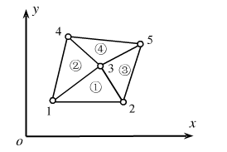
Solve mesh stiffness matrix
How to assembly sum the individual Ke of all the elements to get a mesh stiffness matrix ?
A simple 2-D example
Displacement Matrix is:

Slide 9
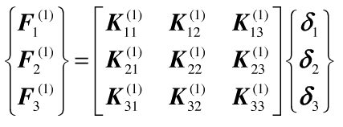
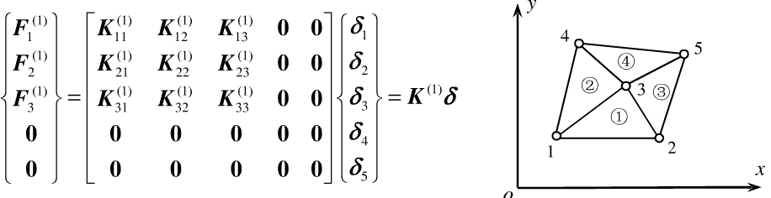
Solve mesh stiffness matrix
If we choose the
It’s just like the matrix has been “expanded”, only set the correspond position, the rest are set to zero.

Slide 10

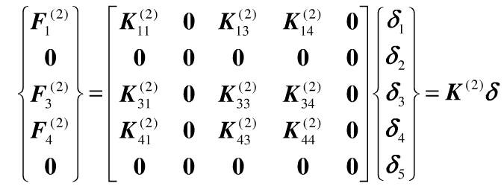
Solve mesh stiffness matrix
If we choose the

Slide 11
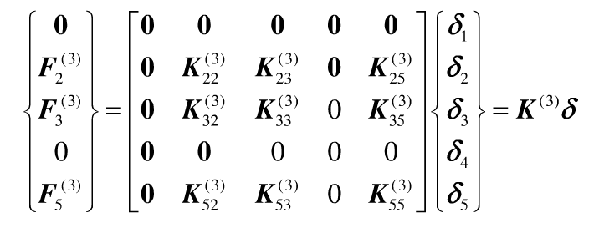

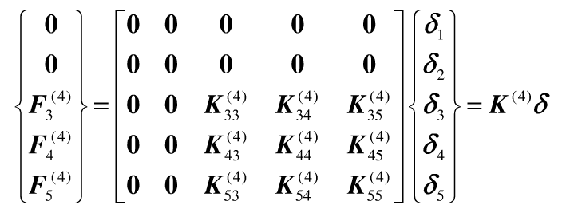
Solve mesh stiffness matrix

Slide 12
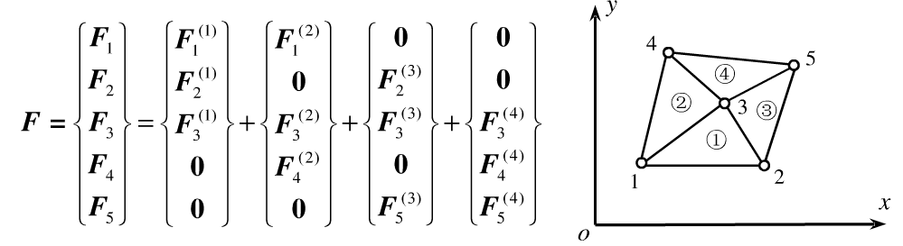
Solve mesh stiffness matrix
Sum up all the external forces act on each node.
Note: we only consider the external forces because all inner forces sum up to
zero in the whole mesh.

Slide 13
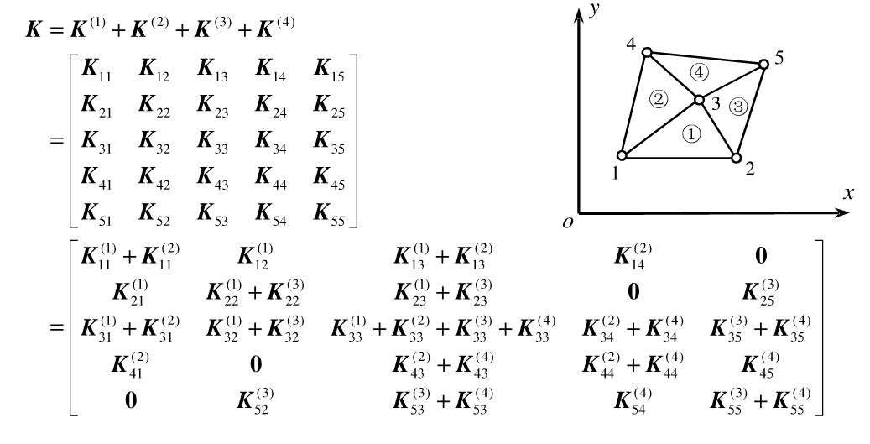
Solve mesh stiffness matrix
Sum up all the expanded stiffness matrix of each element
How to define K in each time step? Should it be updated?

Slide 14
Approach 1 Using linearized elastic forces
The advantages of using linearized elastic forces are, ﬁrst, that the stiffness matrix K is constant and can be pre-computed before the simulation starts. When an implicit scheme is used to solve elastic model, a purely linear system has to be solved at every time step.
We choose implicit Euler integration because unlike explicit schemes it is unconditionally stable. Unconditional stability is essential in an interactive system.
if the tetrahedra in the original mesh are well shaped, the system matrix is well conditioned throughout the simulation.
On contrast, when non-linear elastic forces are used, a stiffness matrix has to be computed at every time step and the system matrix can become arbitrarily ill-conditioned because it depends on the deformed model

Slide 15
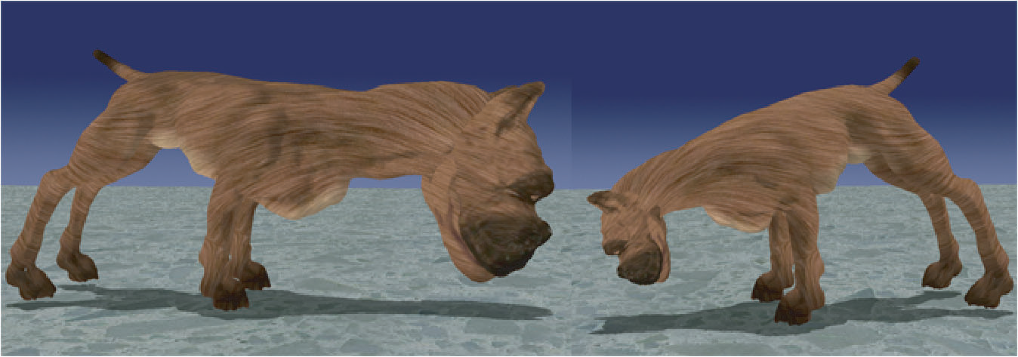
Approach 1 Using linearized elastic forces
Disadvantages:
Linearized elastic forces are, however, only valid close to the equilibrium configuration. Under large rotational deformations, they cause unrealistic growth in volume as demonstrated Below:
The pitbull with its inflated head (left) shows the artifact of linear FEM under large rotational deformations. The correct deformation is shown on the right.

Slide 16
Approach 2 Element-Based Warped Stiffness
We solve these problems by extracting rotations of elements rather than rotations of vertices. Contrary to the vertex-based approach, our method also allows the integration of the plasticity model described in the next section. For a single tetrahedral element with stiffness matrix Ke, the forces fe acting at its four vertices are
fe = Ke ・ (x − x0) = Ke ・ x + f0e,
Now let us assume that we know the rotational part Re of the deformation of the tetrahedron. Then, using the warped stiffness concept adopted to elements, we compute the forces as
fe = ReKe ・ (R _{e} ⁻¹ x − x0)

Slide 17
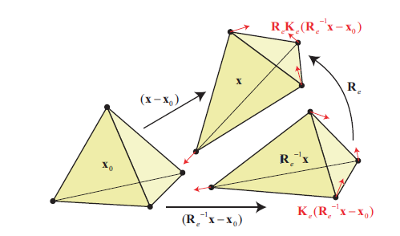
Approach 2 Element-Based Warped Stiffness
To compute the elastic forces acting at the vertices of a tetrahedron, its deformed coordinates x are rotated back to an un-rotated frame R ⁻¹ _{e} x. There the displacements R _{e} ⁻¹ x- x0 are multiplied with the stiffness matrix yielding the forces Ke(R _{e}⁻¹ x- x0) that are finally rotated back to the frame of the deformed tetrahedron by multiplying them with Re.

Slide 18
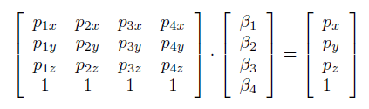
Compute Rotations Re
There is a simple way to compute rotations Re of tetrahedral elements. Let us look at a tetrahedron whose vertices have coordinates p1, . . . , p4 in the undeformed state and q1, . . . , q4 in the deformed state. There is a 4x4 matrix A which satisfies:
The barycentric coordinates β1, . . . , β4 of a point p with respect to the undeformed tetrahedron satisfy
q = Ap.
Pβ = p is :
(9)

Slide 19
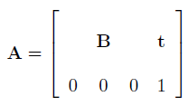
Compute Rotations Re
with respect to the deformed tetrahedron
Qβ = q
(10)
and, thus, combining Eqn. 9 and 10 we get
q = Qβ = QP−1p = Ap.
The unique matrix A = QP−1 that describes the transformation of the tetrahedron has the form
Finally, the rotational part of the transformation can be extracted by a polar decomposition of B

Slide 20
Advantages of Element-Based Warped
Stiffness
http://www.youtube.com/watch?v=TzzGxdGZ_6Y
No ghost forces: Since the individual fe all sum to zero, the forces in f sum to zero, too, which means the method does not produce ghost forces.
Stability: With this method, the local system matrices of elements are only rotated which does not change their condition.
Speed: In contrast to non-linear FEM, the element’s stiffness matrices Ke can be pre-computed and reused saving a considerable amount of computation time
Quality: If all the Re are the same but follow the rigid body transformation of the entire mesh, our method outperforms linear FEM because it produces the same forces as if the linear model was re-computed in the rotated frame for every time step and, thus, correctly produces zero forces for pure rigid body transformations.

Slide 21
Plasticity Model
So far, our model is perfectly elastic, i.e. when external forces are removed, the model returns to its original shape. In contrast, an elasto-plastic material stores part of the deformation and returns to a conﬁguration between the deformed and un-deformed state when the external forces are removed.
A plastic element stores plastic strain in a state variable plastic and only the difference between the total strain and the plastic strain – the elastic strain – causes internal elastic forces

Slide 22
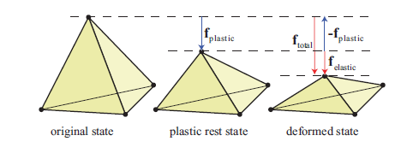
Plasticity Model
Relative to the original state the deformation of the tetrahedron yields a force of ftotal. In a plastic material only the offset force ftotal − fplastic relative to the plastic rest state acts as elastic force felastic. Here, the stiffness is chosen such that displacement equals force.

Slide 23
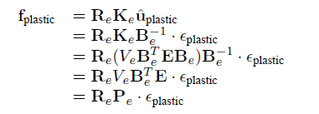
Plasticity Model
We integrate the effect of the plastic strain into Eqn. (5) via corresponding plastic forces. We use the definition of the stiffness matrix to compute the plastic forces fplastic
Mx¨ + Cx˙ +K(x − x0) = fext, (5)
The plasticity matrix Pe that maps the plastic strain to plastic forces is constant and can be precomputed for each element.

Slide 24

Plasticity Model
At every time step we compute the sum of the plastic forces coming from all elements and simply subtract them from Eqn. 5 to get
Since we only add a force vector fplastic to the equation of motion at every time step, plasticity does not change the condition of the linear system which needs to be solved

Slide 25
Fracture Model
When to Split the mesh?
Thus, at every time step we compute, for each tetrahedron, the stress tensor σ = EBe(R⁻¹_{e} x- x0), its largest eigenvalue σmax and its corresponding eigenvector nmax
Find the maximum tensile stress σmax and its direction nmax
If σmax exceeds the fracture threshold of the material, we split the mesh

Slide 26
Method to Split the Mesh
First, we select randomly one of the tetrahedron’s vertices that is marked as a crack tip. If none of them are marked, we randomly make a choice amongst all four vertices.
it is more likely that an existing crack propagates than that a new one is formed.
because in real materials, randomly located microscopic imperfections are the points where cracks are initiated.

Slide 27
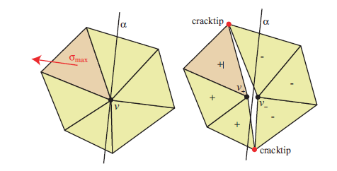
Method to Split the Mesh
v1
v1
v2
v2
Once a vertex v is selected to be split, we virtually put a plane α through v perpendicular to nmax. Then v is split into two new vertices v+ and v−. For all tetrahedra adjacent to v, their vertex v is replaced by either v+ or v− depending on whether their center lies on the positive or negative side of α. For all pairs of tetrahedra lying on opposite sides of α who shared a common face (v, v1, v2) before the split, two sides (v+, v1, v2) and (v−, v1, v2) get exposed after the split and v1 and v2 are marked in the above figure.

Slide 28
Advantages
it is very fast because the manipulations in the mesh are minimal.
The stiffness matrices Ke of the elements do not change. The way they are added to the global stiffness matrix does change but the summation is done at every time step anyway. Fracture, thus, causes no computational overhead other than some updates in the adjacency lists of the mesh.
Also, as with the plasticity modifications, fracture does not introduce any instability to the linear system to be solved.

Slide 29
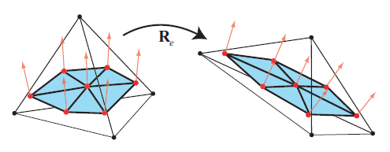
Surface Mesh Animation
Even though our method is fast enough to animate a few thousand volumetric elements at interactive rates , a tetrahedral mesh with a resolution of this order cannot represent a surface of appealing quality. A natural way to solve this problem is to work with two different representations for the same object, a low resolution volumetric mesh for the FEM simulation and a high resolution surface mesh for rendering.

Slide 30
Mesh Coupling
To animate a surface mesh consistently with a volumetric mesh, we ﬁrst link every vertex of the surface mesh to the closest tetrahedron in the volumetric mesh and store its bary-centric coordinates with respect to that tetrahedron.
During the simulation, the position of each vertex of the surface mesh is interpolated from the positions of the linked tetrahedron using the stored barycentric coordinates.
An advantage of the warped stiffness algorithm is that it computes the rotation Re of every tetrahedral element which can directly be used to transform the normals stored in the undeformed surface mesh.
This simple algorithm works very well with elastic and elasto-plastic deformation

Slide 31
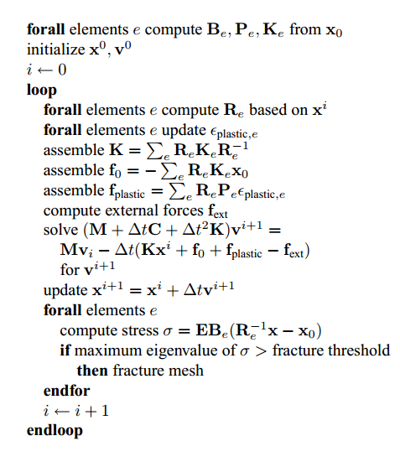
Algorithm

Slide 32
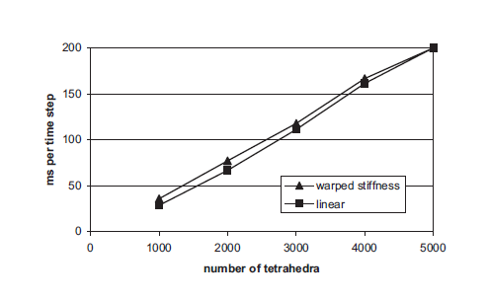
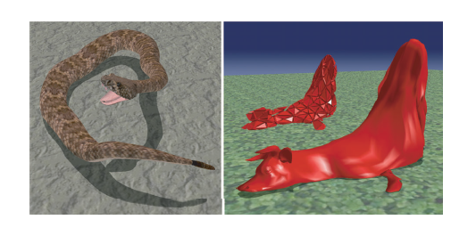
Result

Slide 33
Thanks

