Slide 1
Sound Propagation and Geometric Acoustics

Slide 2

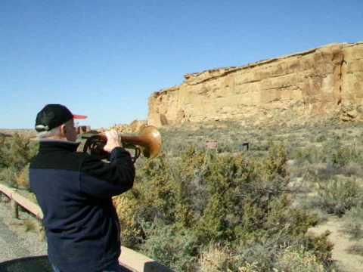
Acoustics
The spatial effects on sound

Slide 3
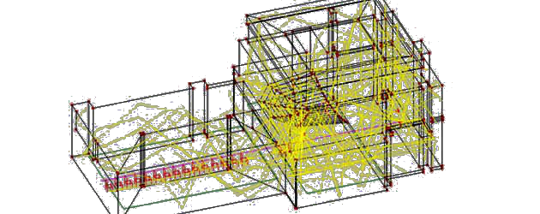
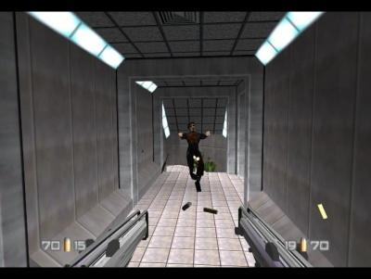
Why Model Acoustics?
Model acoustics of existing or future architecture (offline)
Increase immersion in Virtual Environments (real-time)

Slide 4

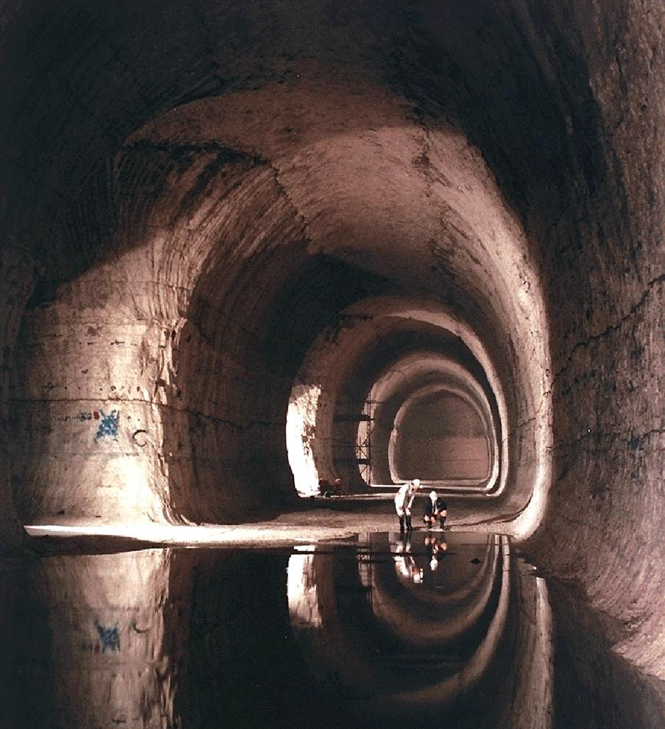
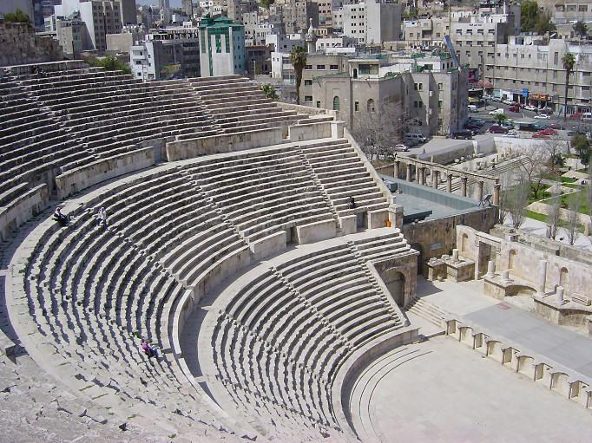
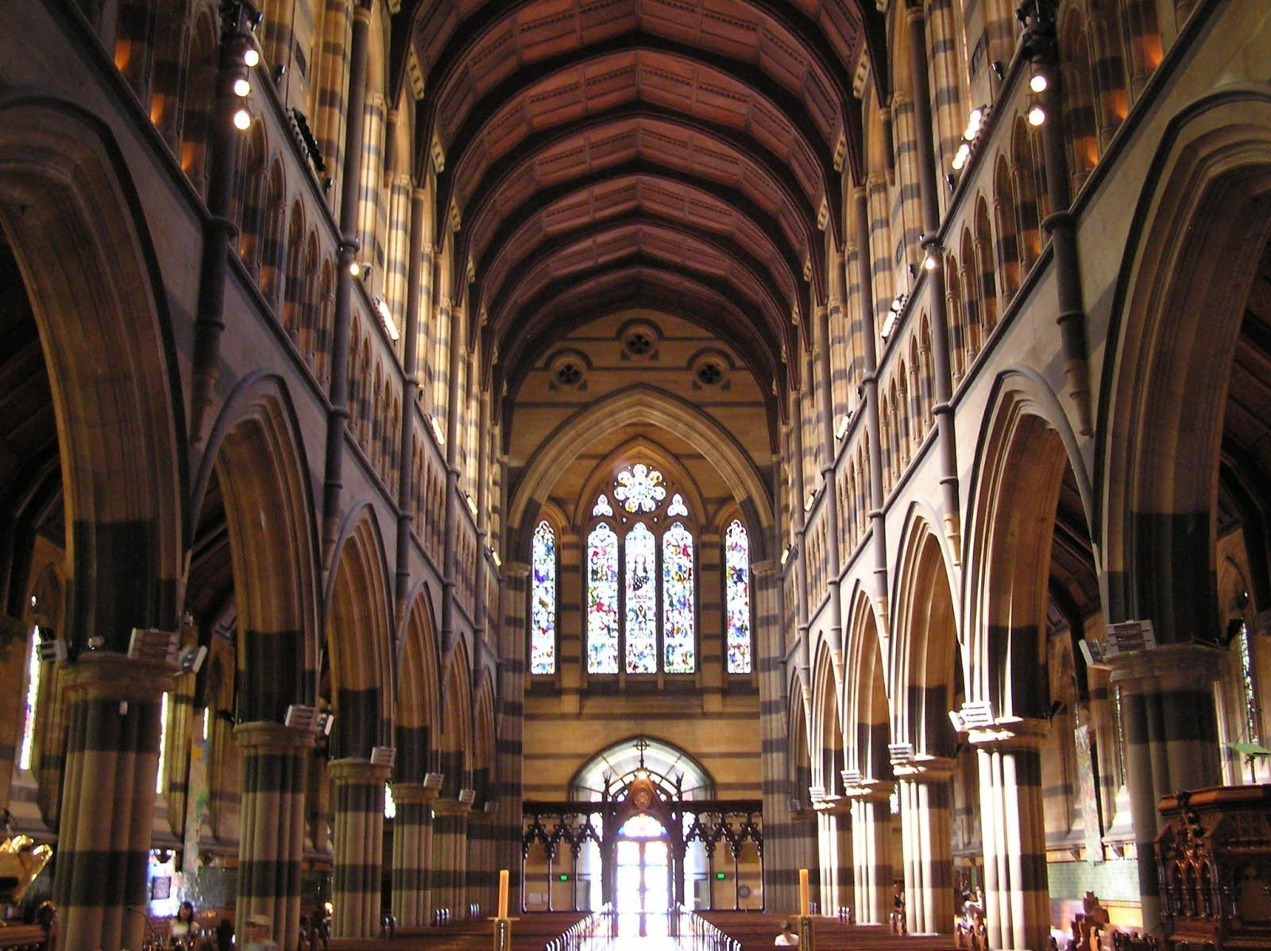
Affected by Size and Shape of Space

Slide 5
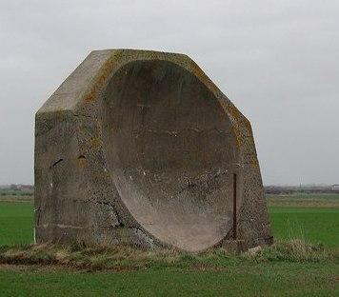
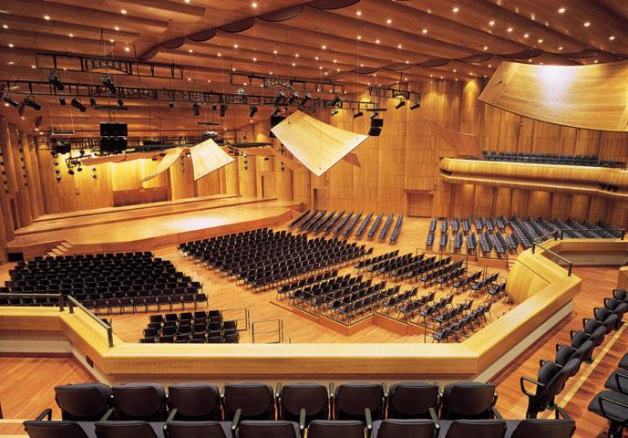
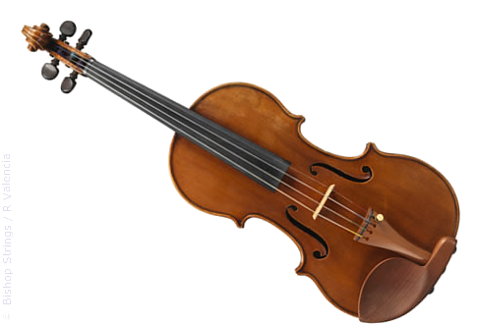
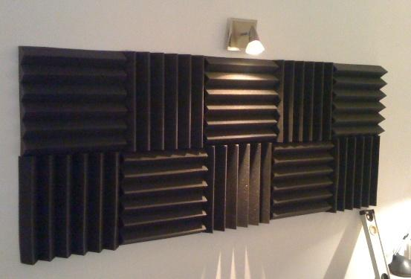
Also Affected by Material's Stiffness

Slide 6
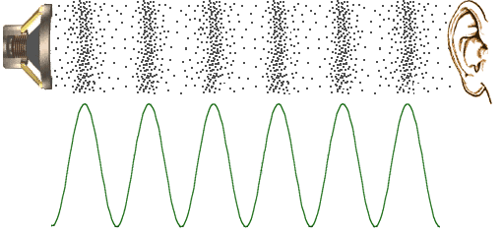
Why? Sound is comprised of waves
Similar to light:
Radiates outward from source
Can be absorbed or reflected by surfaces

Slide 7
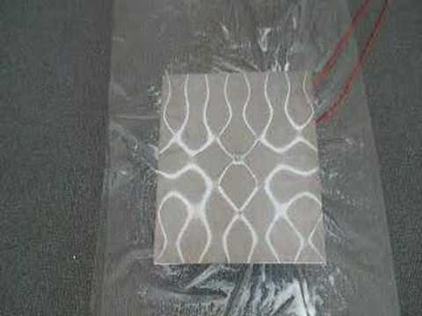
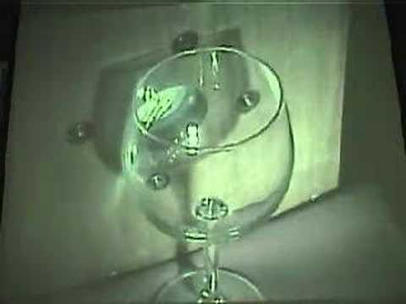
Pressure Waves, not EM
Different than light:
Travels much slower
  arrival times
Can cause surfaces to resonate

Slide 8
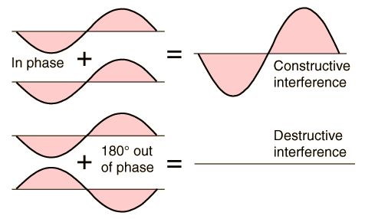
Sound -- Coherent Waves
Must consider wave phase
phase cancellation can occur

Slide 9
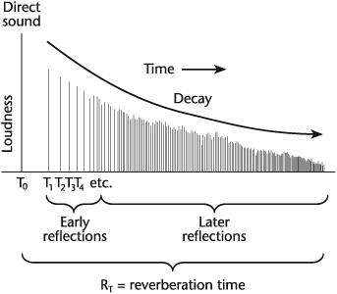
Types of Reverberations
Direct - Line of sight sound
Early - Blends with direct (within 50 - 80 ms)
Late - Perceived as separate from direct

Slide 10
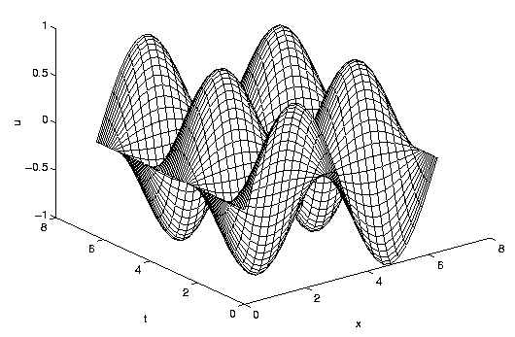
The Wave Equation
∂²p − c²∇²p = f (x, t)
∂t2
How to solve?
Fourier Transform
Very Expensive, often not solved exactly
  requires too much memory & computation

Slide 11
Why so Expensive?
Solvers require 6-10 samples per wavelength
Audible range: 20 Hz - 22 kHz
Speed of sound is ~350 m / s
  smallest wavelength is ~ 350 m / 22,000 = 15 mm
We must sample at roughly every 2mm!
  That means (500 x 500 x 500) = 125 Million samples per m³!

Slide 12
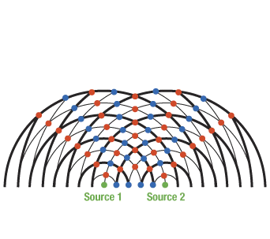
Linear Equation -- Superposition
Since wave equation is linear...
We can sum contributions from sources independently
Enables us to calculate an 'Impulse Response' offline to convolve the input audio signal

Slide 13
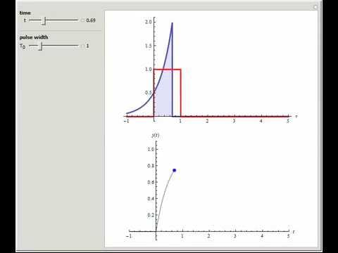
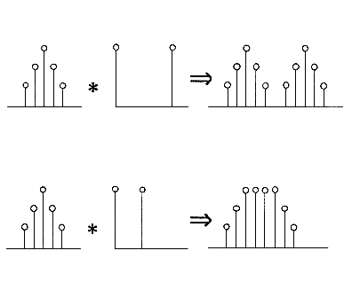
Audio Convolution
Sum of Area under curves as you 'slide' two signals past each other

Slide 14
Simplified Acoustic Model
Only Compute Direct and Early response
  Ignore late
Assume Rigidity of Surfaces
  Ignore resonance
Only Calculate Specular Reflections
  Ignore diffuse reflections, diffraction, transmission...
Piecewise Planar Environment Model
  May have other restrictions: Convexity, etc.

Slide 15
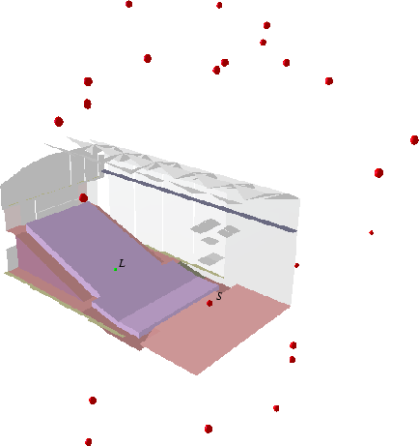
Image Source Method
Only consider direct paths, create Virtual Sources for specular reflection paths

Slide 16
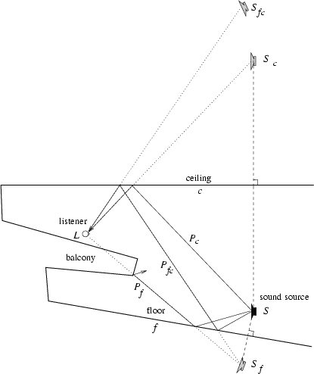
Creating Virtual Sources (VS)
Reflect sources across geometry
Must recursively reflect each new Virtual Source
  Bound by order or distance

Slide 17
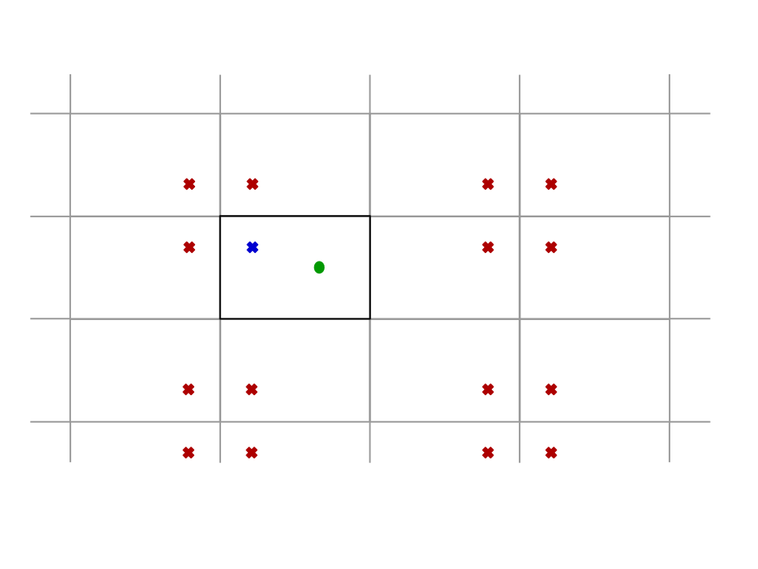
Simple Case -- Rectangular Room
Recursively reflect source across room walls
Results in regular lattice of Virtual Sources

Slide 18
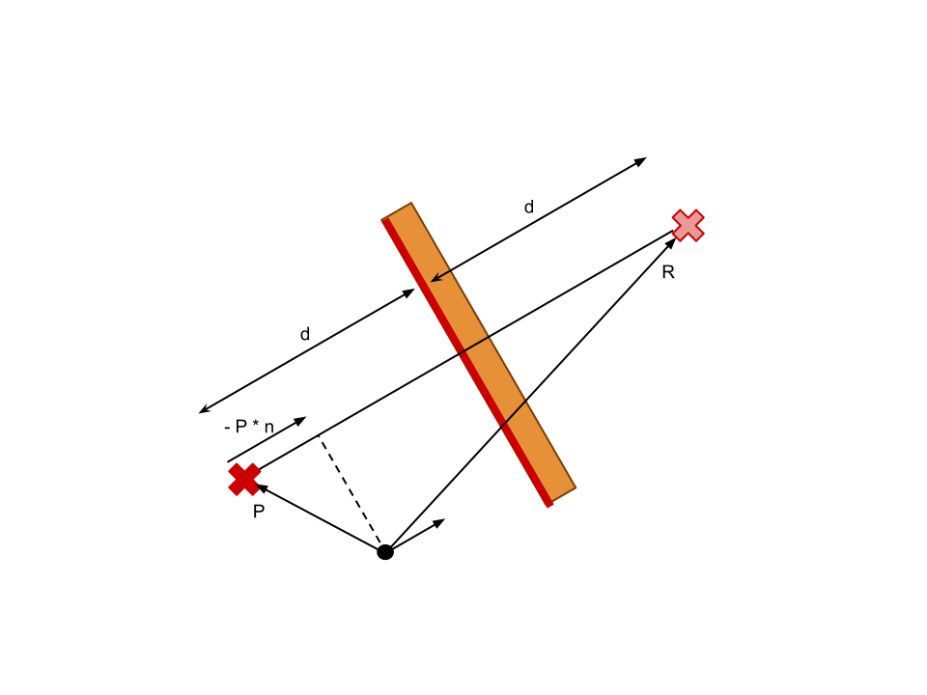
General Case -- Arbitrary Polyhedra
Math:
  d = p - P * n
  R = P + 2dn
Not all Virtual Sources are valid!
  Validity and Visibility!

Slide 19
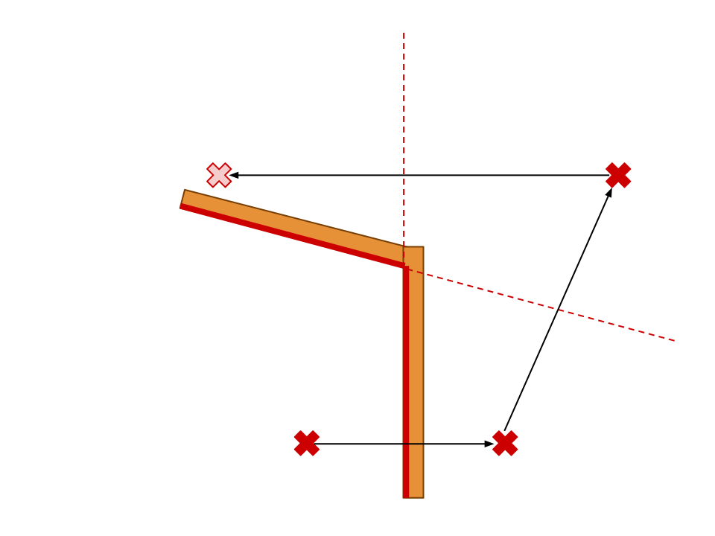
Validity Check
Treat walls as 1-sided mirrors
  Only reflect across front face
Toss out invalid sources

Slide 20
Visibility Check
Most complicated check
Can a specific listener 'see' a source?
Must still reflect 'invisible' sources to create new Virtual Sources

Slide 21
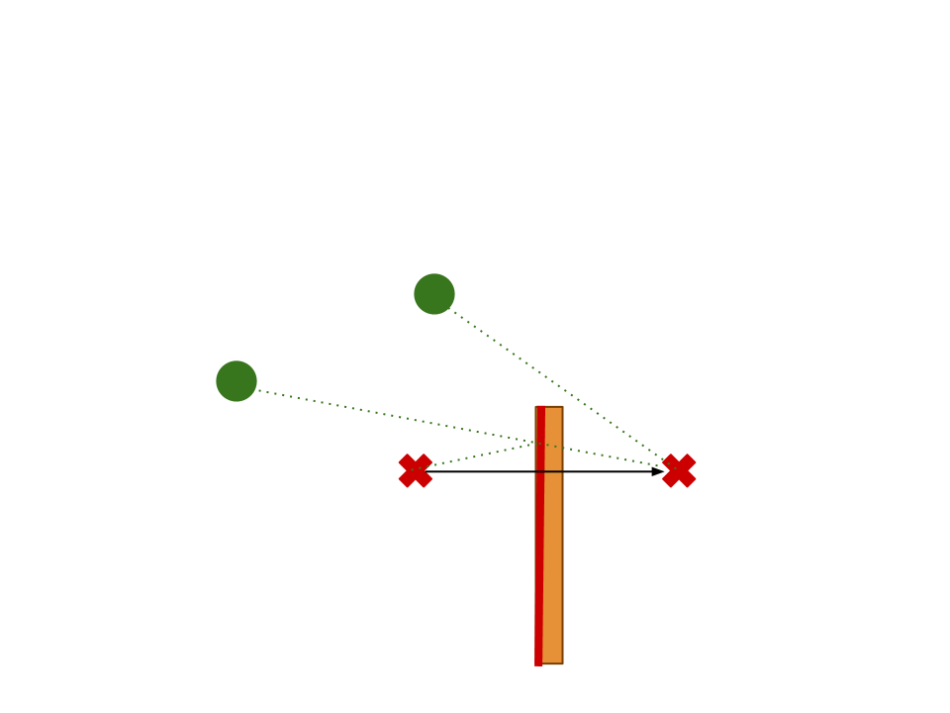
Visibility Check -- Simple Case
First Order VS:
  Segment between source and receiver intersects reflecting polygon

Slide 22
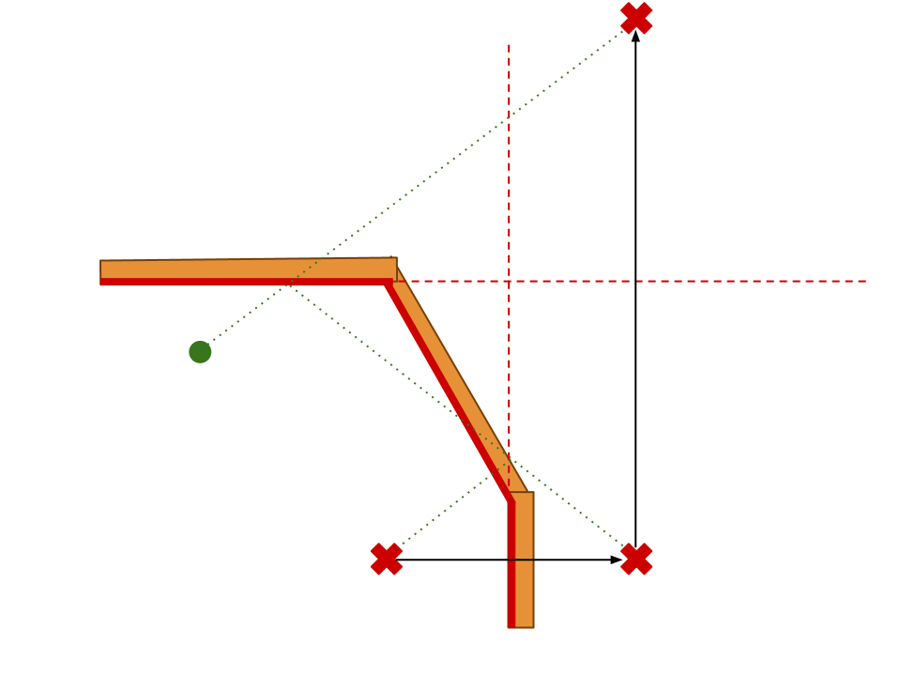
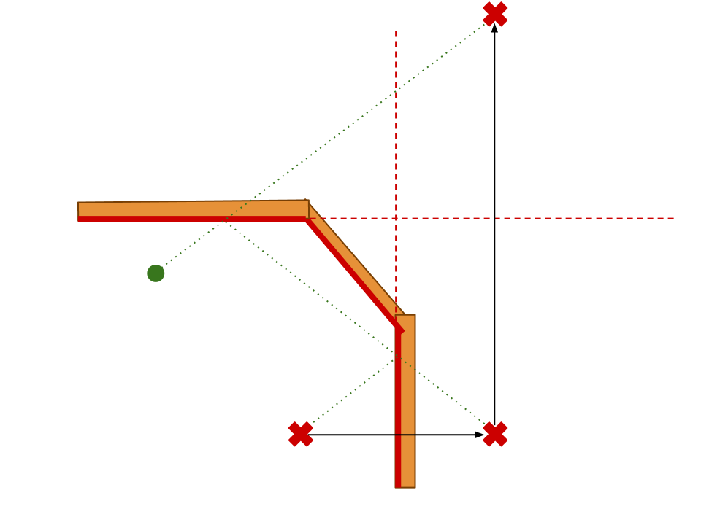
Visibility Check -- General Case
Higher Order VS:
  Must check every reflecting surface to ensure visibility

Slide 23
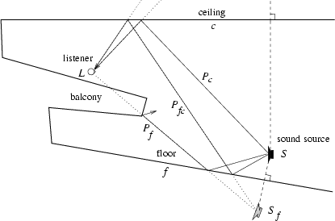
Obstructions
Must consider if environment is non-convex
  Flag edges as 'obstructing'
  Check these edges for occlusion when adding sound components

Slide 24
Image Source -- Complexity
| VS | = N^{k}
N - number of polygons in scene
k - order of VS recursion
Can be precomputed!
Assuming sources don't move

Slide 25
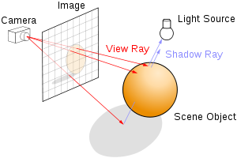
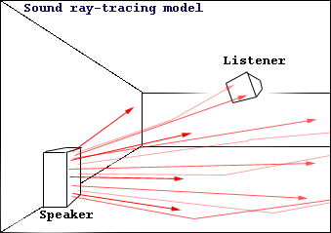
Ray Tracing -- Just like Graphics!
Treat waves as rays and sum contributions

Slide 26
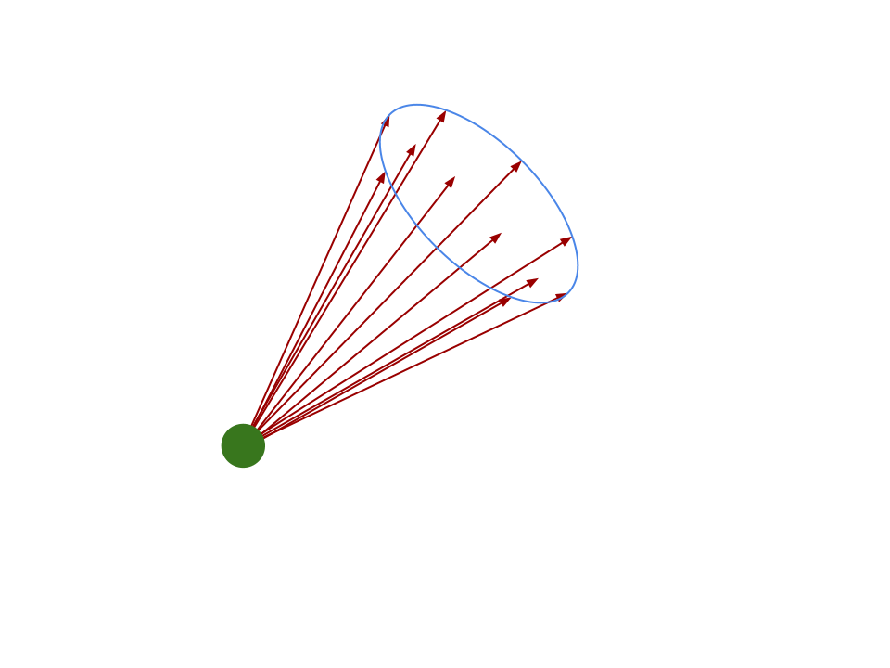
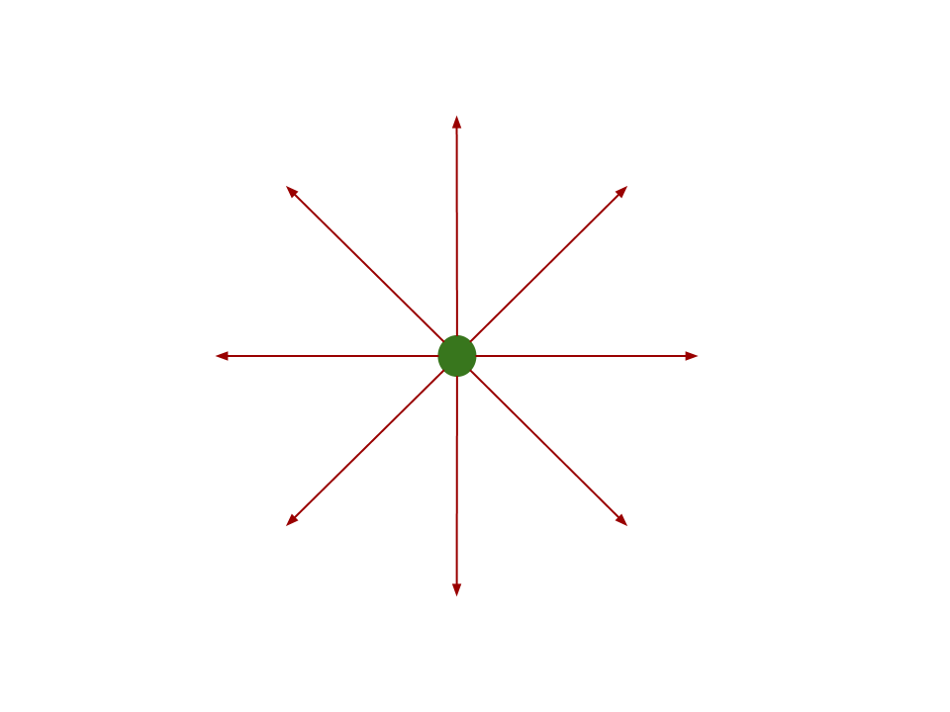
Ray Tracing -- Source
Treat sound source as point and uniformly cast finite rays

Slide 27
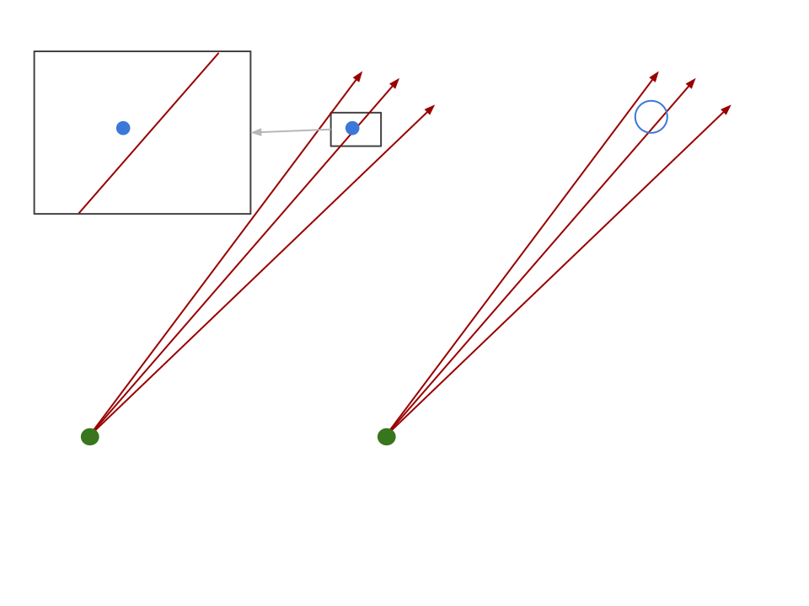
Ray Tracing -- Receiver
Treat receivers as spheres
  Impossible for rays to hit points!

Slide 28
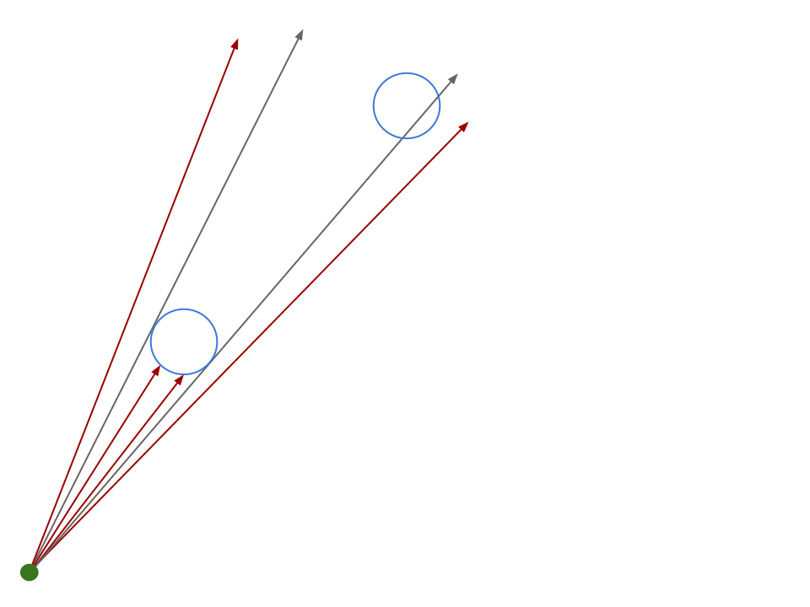
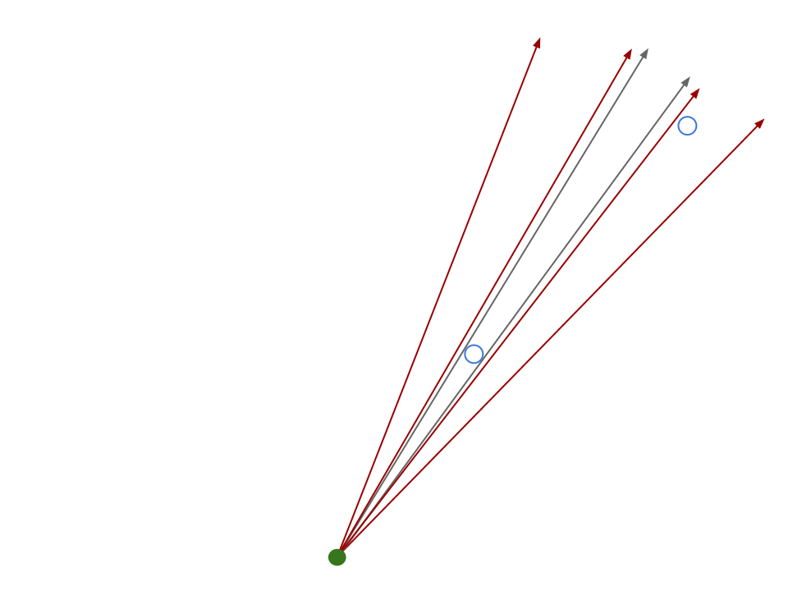
Receiver Size: Design Tradeoff
Too Large:
Creates 'shadows', occluding receivers further away
Too Small:
Unlikely to be hit by rays

Slide 29
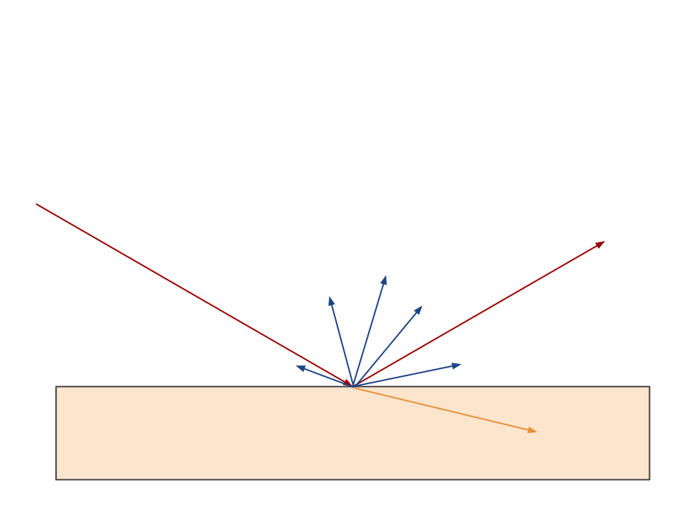
Multiple Reflection Types
Can consider diffuse, specular, transmission, etc.
Can't split, too many rays
Do so stochastically

Slide 30
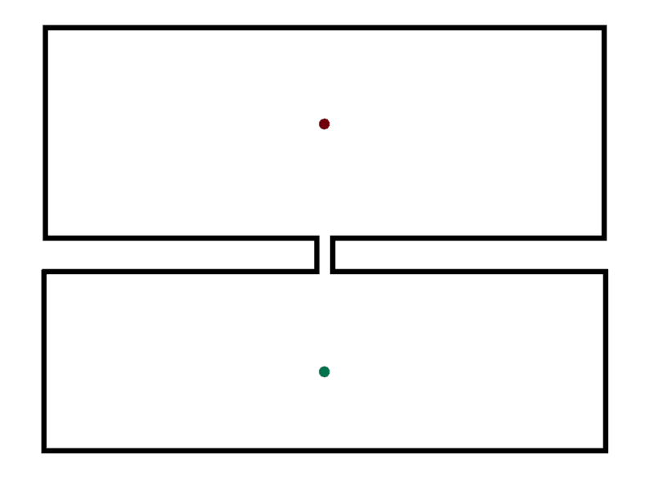
Ray Tracing Issues
May miss sound paths!
Can't tell if missing

Slide 31
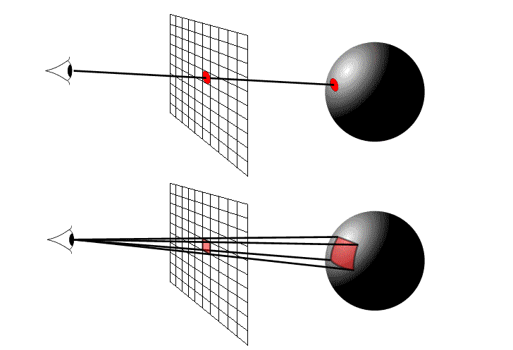
Beam Tracing -- Also from Graphics
Replace rays with beams
  have cross sectional area
Replace receiver spheres with points

Slide 32
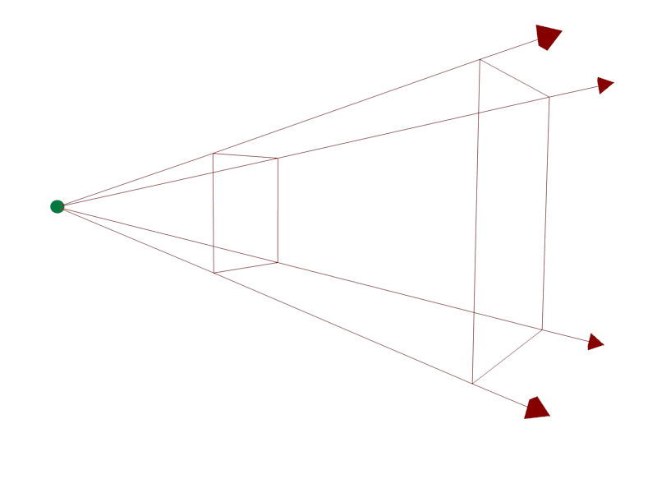
Representing a Beam
Set of expanding rays
Share common origin

Slide 33
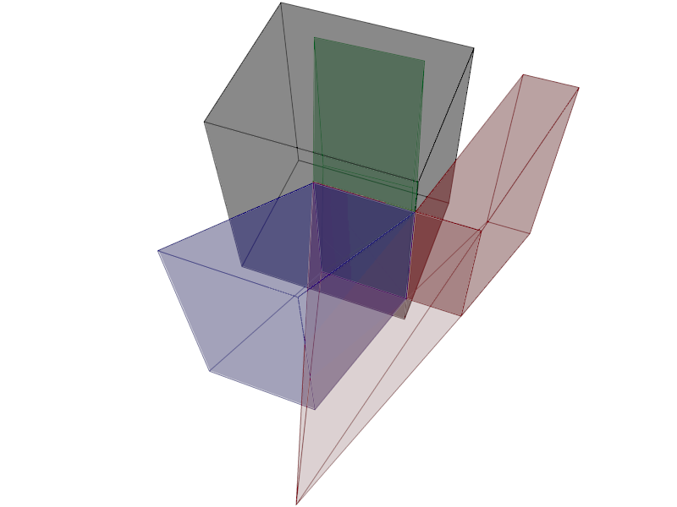
Intersecting a Beam
Beams are split on intersection:
Shadowed part becomes transmission beam
Reflection beam created
Remaining section is propagated

Slide 34
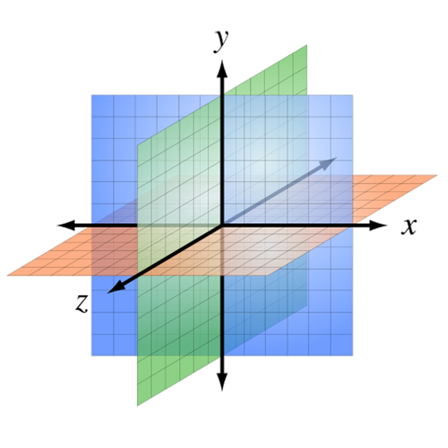
Benefits of Beams over Rays
Ignore tradeoff of receiver size
Finite set of beams can fully cover space

Slide 35
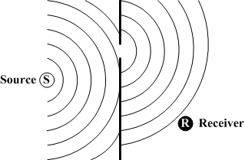
Recent Work
Realtime Ray and Beam Tracing
Some with GP-GPU acceleration
Inclusion of Diffraction Simulation

Slide 36
Sources
Image method for efﬁciently simulating small-room acoustics.
J. B. Allen and D. A. Berkley.
The Journal of the Acoustical Society of America, 65(4):943–950, April 1979.
Extension to the image model to arbitrary polyhedra.
J. Borish.
The Journal of the Acoustical Society of America, 75(6):1827–1836, June 1984.
The early history of ray tracing in room acoustics.
P. Svensson.
Reﬂections on sound: In honour of Professor14 Emeritus Asbjørn Krokstad. Norwegian University of Science and Technology, 2008.
A beam tracing approach to acoustic modeling for interactive virtual environments.
T. Funkhouser, I. Carlbom, G. Elko, G. Pingali, M. Sondhi, and J. West.
In Proc. of ACM SIGGRAPH, pages 21–32, 1998.
An Efficient Time-domain Solver for the Acoustic Wave Equation on Graphics Processors
Ravish Mehra, Nikunj Raghuvanshi, Lauri Savioja, Ming C. Lin, and Dinesh Manocha

