Slide 1
flocking
Steven Love

Slide 2
https://www.youtube.com/watch?v=Mu6TL1LbsyQ

Slide 3
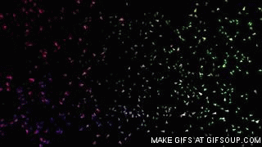
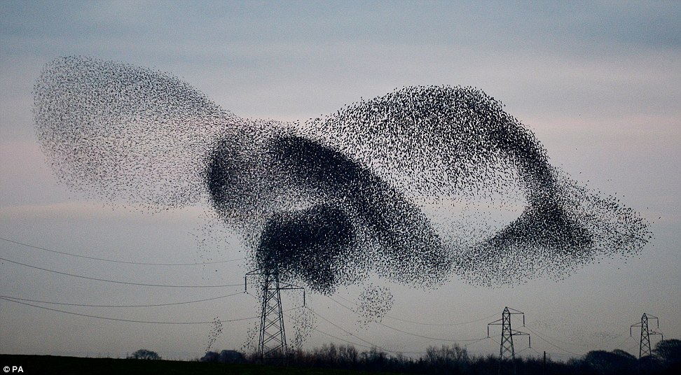
Motivation
Achieving lifelike visuals of the collective behavior of flocking
Simple-to-model agents
Credit: Softology

Slide 4
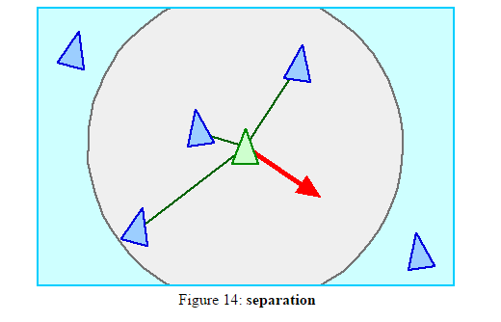
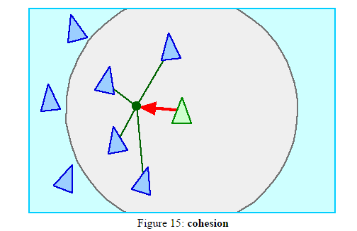
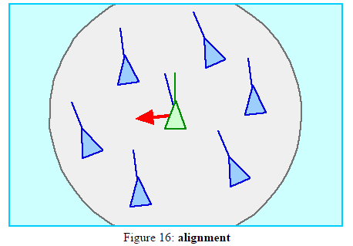
Background
Boids (Reynolds, 1987)

Slide 5
Boids
Without Separation: ?
Without Cohesion: ?
Without Alignment: ?

Slide 6
Applications
Batman Returns https://www.youtube.com/watch?v=S8nzhBCYDag&t=10m45s

Slide 7
The Agents
Little or no internal configuration details to maintain
mass scalar
position vector
velocity vector
max_force scalar
max_speed scalar
orientation N basis vectors
Some effects based on internal configuration can be simulated
Banking: set the up direction to be a weighted sum of gravitational and steering accelerations
Some other effects can also be simulated cheaply
Drag (max_speed)
Acceleration (max_force)

Slide 8
The Agents
Less complex than a model with bones and muscles that conserves energy
Less complex than a model with joints and arbitrary torques
~ Self-Propelled Particles
Somewhat more complex than a normal particle

Slide 9
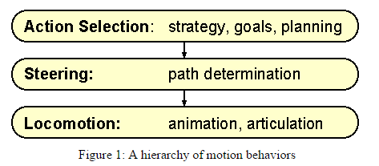
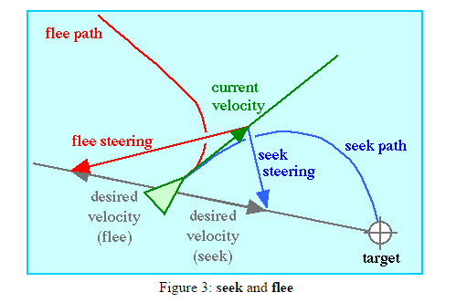
The Agents
Simple to determine path planning
Mainly concerned with steering
Simple enough to ignore animation/articulation

Slide 10
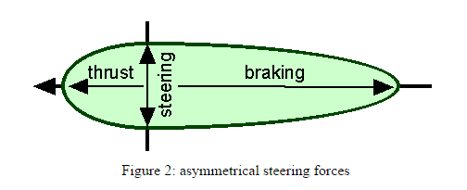
Steering Models
Simple Vehicle Model
Non-holonomic motion constraint
Simulated by restricting motion at low speeds
Forward integration to arrive at the next state
Different Models
Boids
Simple Vehicle
Simple Airplane

Slide 11
Steering Behaviors
Seeking
Fleeing
Pursuit
Offset pursuit
Arrival
Obstacle avoidance
Wandering
Path following
Wall following
Containment
Flow field following

Slide 12
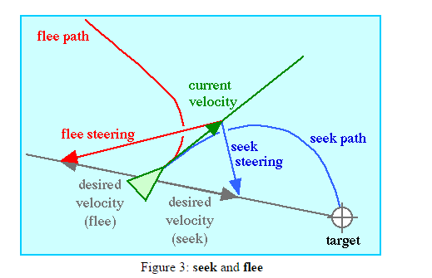
Steering Behaviors
Seeking
Fleeing
Steer vector is the difference between desired velocity and current velocity

Slide 13
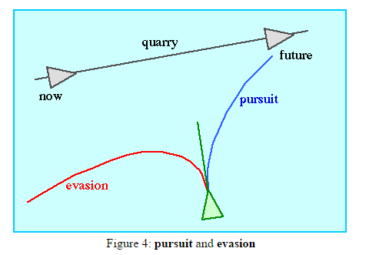
Steering Behaviors
Pursuit
Make a simple prediction about the future position of target and seek it
Evasion

Slide 14
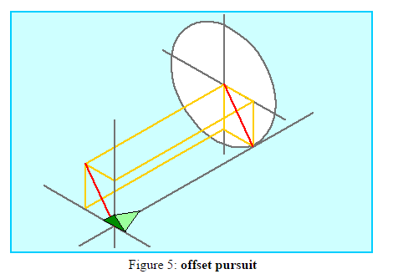
Steering Behaviors
Offset Pursuit
Birth of GTA

Slide 15
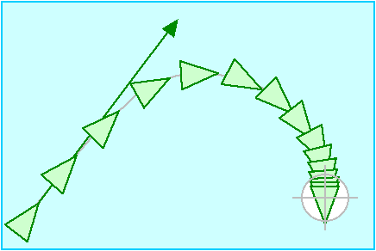
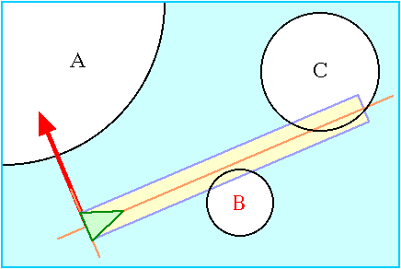
Steering Behaviors
Arrival
Clamp speed when close to target
Obstacle avoidance
Simple model to detect future collisions
Model obstacles as spheres or something simple
Cull distant obstacles

Slide 16
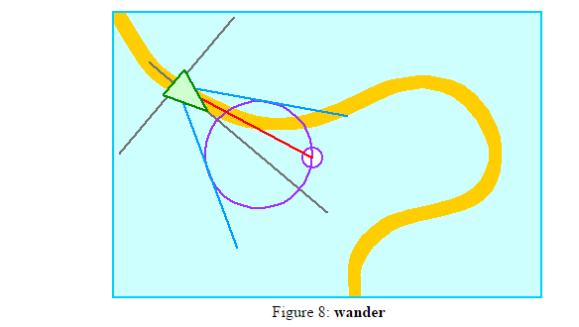
Steering Behaviors
Wander
Change steering slightly each frame

Slide 17
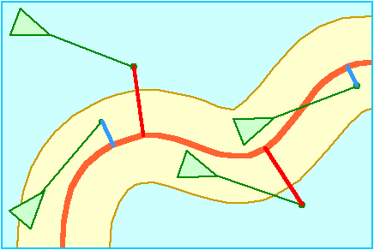
Steering Behaviors
Path Following
No change if within a radius of the path
Seek the projection of a future position onto the path

Slide 18
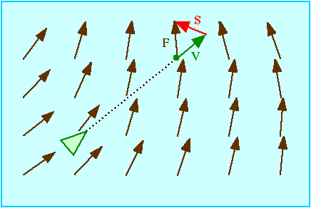
Steering Behaviors
Flow Field Following

Slide 19
Steering Behaviors
Flocking
Separation
Cohesion
Alignment

Slide 20
Combining Behaviors
Discrete behavior switches
Behavior blending
Sum results of behaviors
Rapid discrete behavior switches
Prioritize behaviors
Prioritized dithering (probabilistically)

Slide 21
References
Softology: Visualizations of Chaos - http://softology.com.au/voc.htm
Steering Behaviors For Autonomous Characters - http://www.red3d.com/cwr/steer/gdc99/
Flocks, Herds, and Schools: A Distributed Behavioral Model - http://www.red3d.com/cwr/papers/1987/boids.html
Stable Flocking of Mobile Agents, Part I: Fixed Topology - http://repository.upenn.edu/cgi/viewcontent.cgi?article=1109&context=ese_papers

