Slide 1
Precomputed Acoustic Transfer: Output-sensitive, accurate sound generation for geometrically complex vibration sources.
By Doug L. James, Jernej Barbic, and Dinesh K. Pai
Presented by
Atul Rungta

Slide 2
Why another method to generate sound?
Previous sound generation techniques do not consider radiating bodies as sound sources.
The sound’s timbre depends on the interaction with the object’s own geometry.
Radiation efficiency is an important aspect of sound generation not considered by previous techniques.
Notes:
Add diagram

Slide 3
Overview of the presentation
Background
  Modal Analysis.
  BEM.
  Spherical Harmonics.
PAT pipeline
  Precomputation.
  Runtime.
Demos

Slide 4
Modal Analysis
Sound is produced by small vibrations of objects.
Modal analysis is a way to model these vibrations that lie in the range of human hearing, i.e., 20 Hz – 20000 Hz.

Slide 5

Modal Analysis: the math
K, C, and M are the system’s stiffness, damping, and mass matrices and f is the external force
α_{1,} α₂ are the Rayleigh damping coefficients.
Eq. 1
Eq. 2
Notes:
Mention FEM…

Slide 6
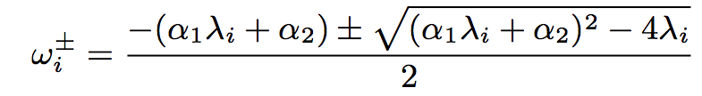
Modal Analysis: the math
Solving equation 1 gives us the modal frequencies of the object along with the modal displacements.
ω_{i} is the i^{th} complex frequency.
λ_{i} is the i^{th} eigen value of the system.

Slide 7
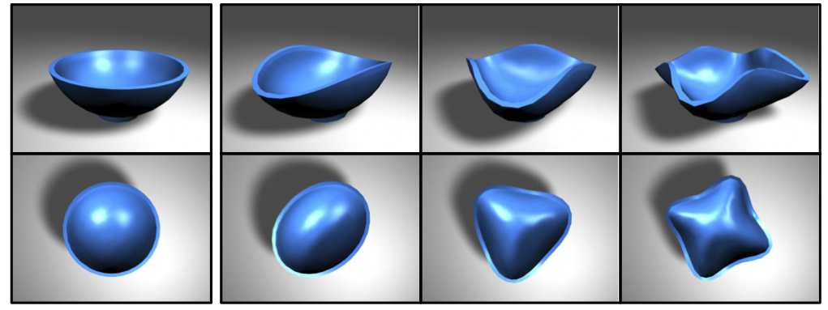
Modal Analysis: the math
This is what mode shapes look like:
Notes:
Conclude with what modal analysis buys us…

Slide 8
Boundary Element Method Overview
Some PDEs can be reformulated as a Boundary Integral equation
Solution over the whole domain can be computed using a surface integral over a boundary
Often, this requires some analytical calculation
Hence BEM can be said to be halfway between analytical methods and numerical methods

Slide 9
Boundary Element Method Overview
Instead of discretizing all space, BEM works by discretizing the boundary surface
The equivalent boundary integral eqn is solved on the surface using an idea similar to FEM
The solution is assumed to be made up of basis functions on each element on the boundary surface
Just like FEM, the eqn reduces to a linear system

Slide 10
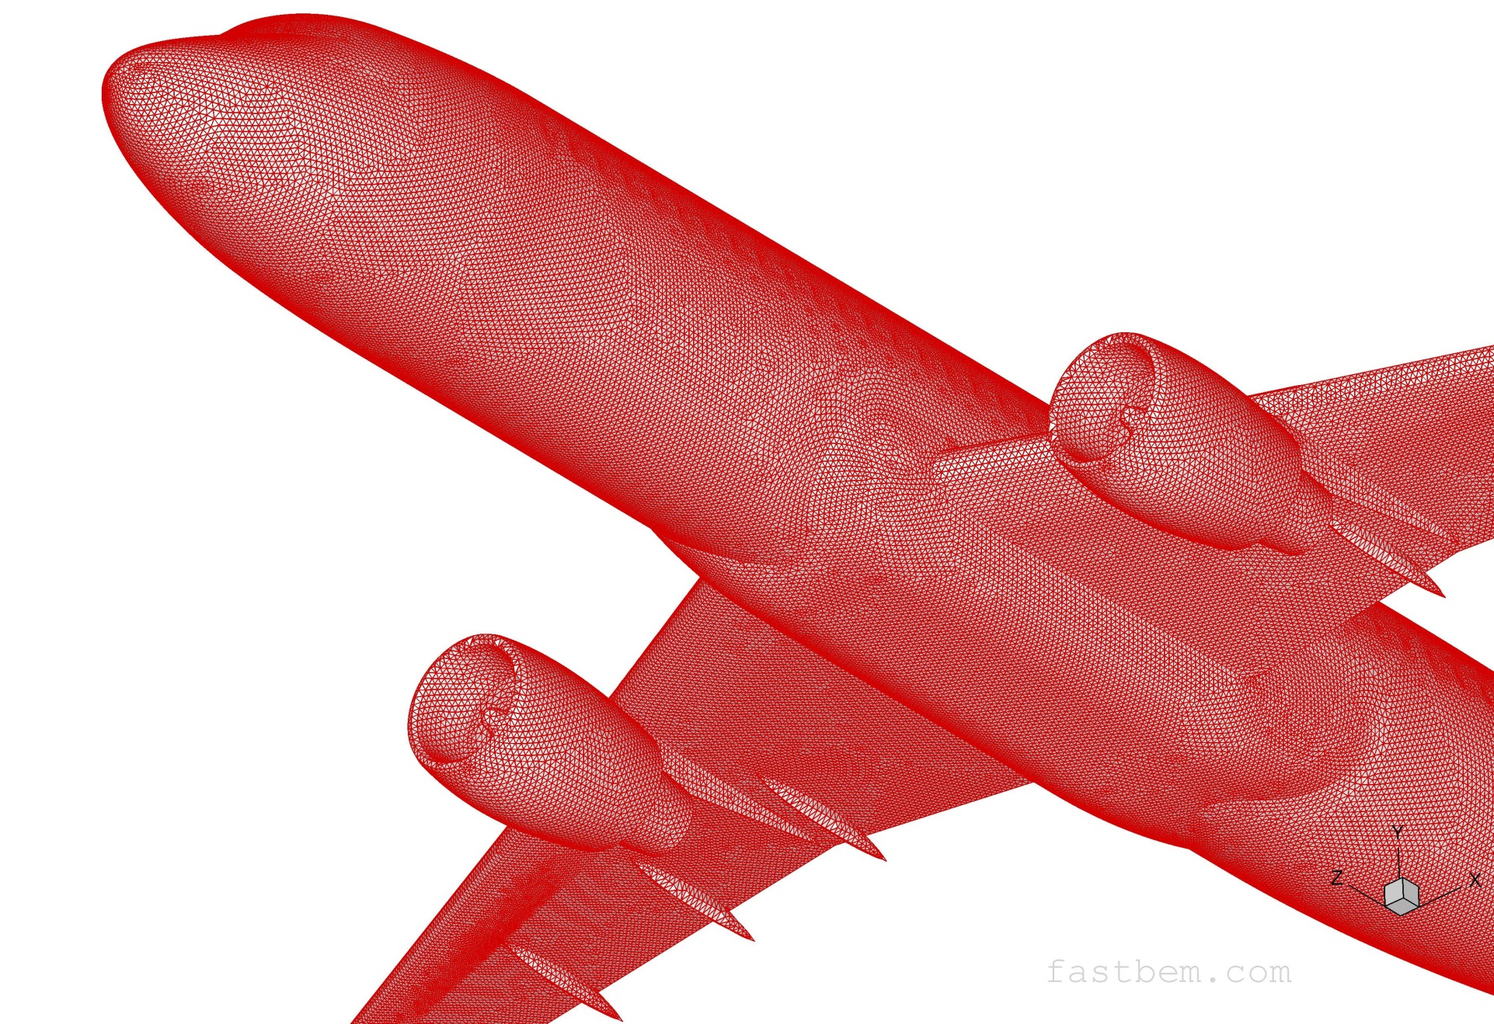
Discretization of Airplane mesh to be used for BEM calculation

Slide 11
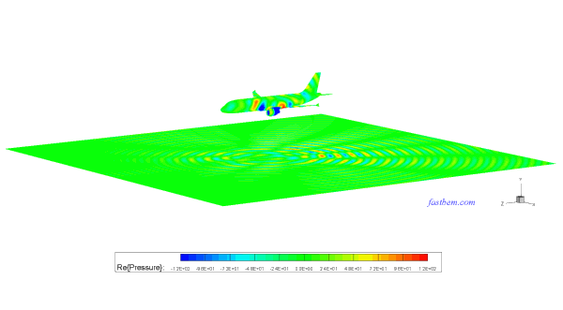
Calculation of noise at the ground due to a plane landing using BEM

Slide 12

Spherical Harmonics
Spherical harmonics, Y^{m}_{l}(Θ, Φ), are the angular portion of the solution to Laplace’s equation in spherical coordinates. Laplace equation looks like:
where Δ is the Laplace operator and φ is a scalar function.
This can be written in spherical coordinates as:
The solutions to the above PDE are called Spherical Harmonics and are defined as:
where P^{m}_{l} are the associated-Legendre Polynomials.

Slide 13
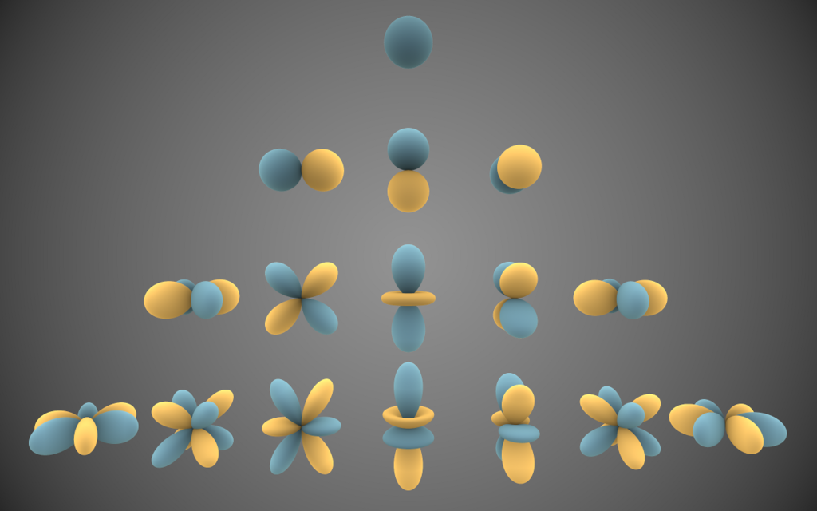
Spherical Harmonics

Slide 14
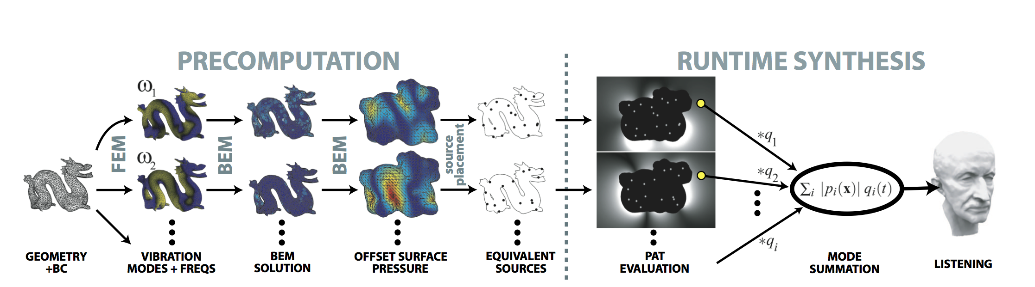
Precomputed Acoustic Transfer

Slide 15
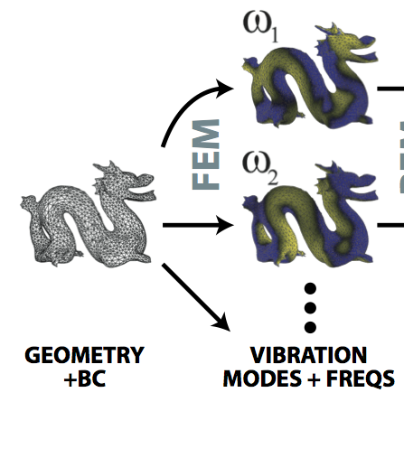

Precomputed Acoustic Transfer: Precomputation
As mentioned before, Modal analysis gives the modal frequencies ω_{i} and modal displacements.
The modal displacements can be written as:
where q_{k}(t) is the k^{th} modal amplitude, û_{k} is the k^{th} mode shape.
These modal shapes serve as input to the next stage.

Slide 16
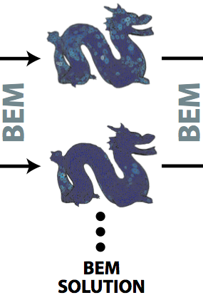

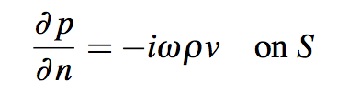

Precomputed Acoustic Transfer: Precomputation
Sound radiation is governed by the BVP for the Helmholtz equation (in freq. domain):
where k is the wavenumber given by k = ω/c, ω is the frequency of the mode, c is the speed of sound in the homogenous medium, and Ω is the surrounding medium.
In order to make sure this PDE has a unique solution, we need to specify the necessary boundary conditions:
where S = δΩ, ρ is the fluid density, and ν is the the surface’s normal velocity given by:
where n•û is the modal displacement in the normal direction.
We also need to specify the behavior of p at infinity, usually specified by the Sommerfeld radiation condition

Slide 17
Precomputed Acoustic Transfer: Precomputation
The spatial part of p(x) is called the Acoustic transfer function of a particular mode.
We can calculate the acoustic transfer of each mode using a standard numerical solver.
This is where BEM steps in:
  We solve the Helmholtz equation at the boundary of the object.
Unfortunately, solving for p(x) on any point on Ω (using BEM) is too slow: it varies linearly with N (number of boundary elements) and as O(NM) for M modes.

Slide 18
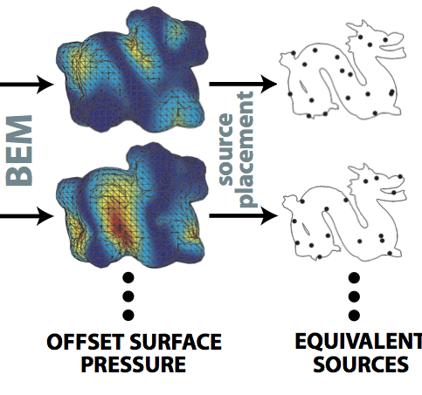
Precomputed Acoustic Transfer: Precomputation
In order to find the acoustic transfer at any point on Ω, we need to approximate p(x).
This is done through a technique known as the Equivalent Source Method.
ESM decomposes the source into a set of point sources known as equivalent sources.
The main idea behind the technique is that if the EQs match the pressure on the boundary, they match the pressure at any point on Ω.

Slide 19
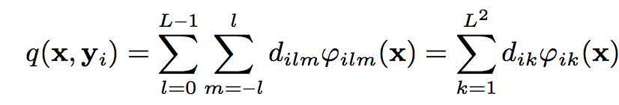

Precomputed Acoustic Transfer: Precomputation
An equivalent source q(x, y_{i}) is the solution field induced at any point x, due to a point source located at y_{i.}
This can be expressed as a sum:
where φ_{ilm}(x) is the field due to a multipole source located at y_{i}, d_{ilm} is its strength, and L is the multipole’s order (L = 1 for monopole, L = 2 for a dipole, and so on).
The field due to a multipole is defined as:
where (r_{i}, Θ_{i}, φ_{i}) is (x – y_{i}) expressed in spherical coordinates, h_{l}⁽²⁾(wr_{i}/c) is the hankel function of the 2nd kind, and ψ_{lm}(Θ_{i}, φ_{i}) are the spherical harmonic function, and Γ_{lm} is the normalizing factor for the SH.

Slide 20
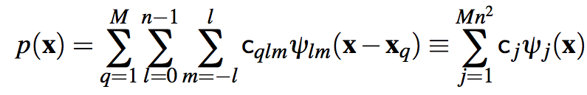
Precomputed Acoustic Transfer: Precomputation
Given a set of multipoles at discrete set of locations, all inside the source, the pressure at any point x ε Ω can be represented as:
where ψ = φ introduced earlier (sorry for the inconsistent notation).
Evaluating this sum is very fast (esp. for low L) and this makes finding p(x) very fast for an interactive runtime.

Slide 21
Precomputed Acoustic Transfer: Precomputation
Unfortunately, for all this to work, the equivalent sources have to be placed inside the object.
This is difficult most graphics objects are thin shells making this difficult.
The problem is fixed by constructing a closed offset surface around the object. This helps with:
  Providing a clear inside to place the EQs
  It also provides a boundary on which to evaluate BEM pressure.

Slide 22
Precomputed Acoustic Transfer: Precomputation
But that is not all. We still to compute the equivalent source coefficients, c_{ilm}.
And in order to do so, we need to place the EQs in such a way that they approximate the surface pressure.
We also need to figure out how many such sources we need.
Notes:
Explain the placement algorithm..

Slide 23
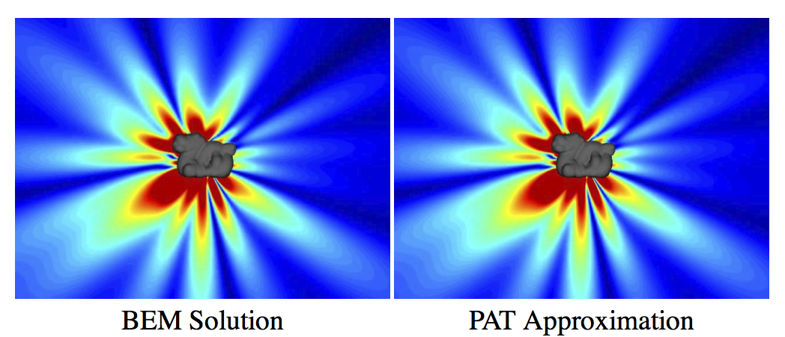
PAT vs. BEM

Slide 24
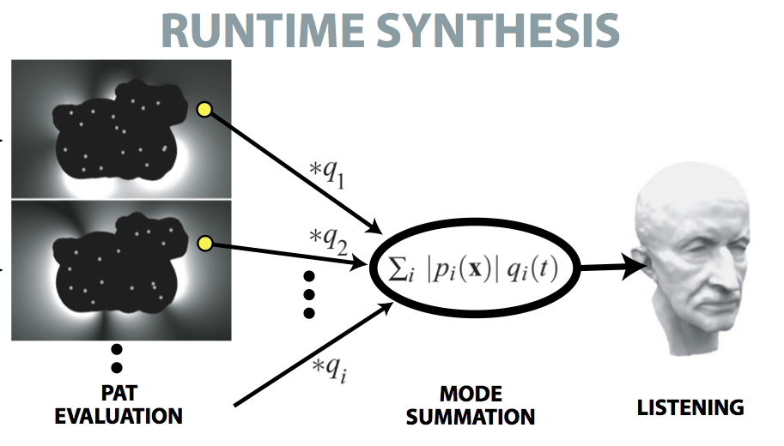
Precomputed Acoustic Transfer: Runtime

Slide 25
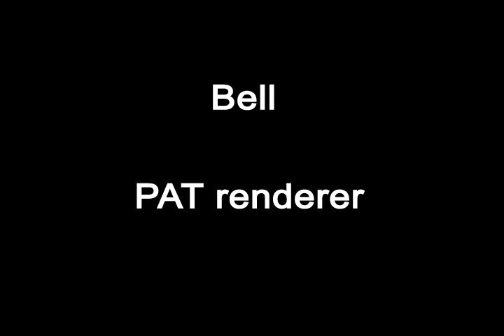
Video 1

Slide 26
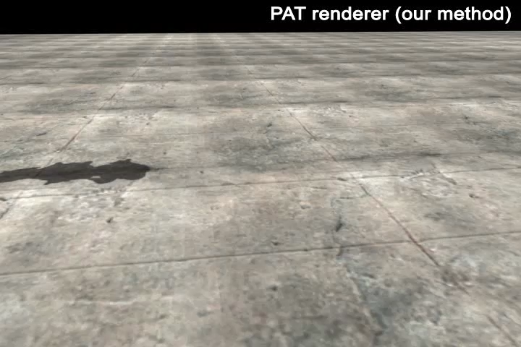
Video 2

Slide 27
Limitations
Can only model small deformations.
Handles free-space propagation only.
Redundant mode calculation.
Can handle rigid bodies only.

Slide 28
Conclusion
PAT is a very powerful technique
  First technique to introduce Equivalent sources in acoustics in Computer Graphics.
This makes it very versatile
  Mehra et al. used PAT as the basis for their ESM paper
Although, PAT doesn’t handle propagation, it can extended to do so
  Yeh et al. did that with their Wave-Ray coupling (He used a hybrid propagator!)

Slide 29
References
Precomputed Acoustic Transfer: Output-sensitive, accurate sound generation for geometrically complex vibration sources by James et al.
Synthesizing Sounds from Rigid-Body Simulations by O’Brien et al.
Wave-Based Sound Propagation in Large Open Scenes using an Equivalent Source Formulation by Mehra et al.
Wikipedia.

Slide 30
Thank you!

Slide 31
Questions?

