Slide 1
Image-based Material Retrieval
Rui Wang
Dept. of Computer Science
Univ. of North Carolina at Chapel Hill
Notes:
Introduce each part: what is 3D surface reconstruction from endoscopic video, fusion, reflectance modeling, and most importantly what is the improvement

Slide 2
Outline
Motivation
Study of physical system
Examples
  Organ elastic parameter retrieval
  Cloths elastic parameter retrieval
Limitations and open research issues

Slide 3
Motivation
Tissue elasticity properties are important parameters for developing accurate and predictive surgical simulation
Tissue stiffness gives diagnostic information about the presence or status of disease
Realistic cloth property simulation and virtual try-on

Slide 4
Study of physical system
Parameterization of the system
  discovery of a minimal set of model parameters whose values completely characterize the system.
Forward modeling
  discovery of the physical laws allowing us, for given values of the model parameters, to make predictions on the results of measurements on some observable parameters.
Inverse modeling
  use of the actual results of some measurements of the observable parameters to infer the actual values of the model parameters.

Slide 5
Examples
Acquiring elastic parameter of organs
Retrieve elastic parameters of cloths

Slide 6
Measurements
Invasive
  Rely on device to measure the displacement and force response
Noninvasive
  Based on image analysis techniques to measure the displacement

Slide 7
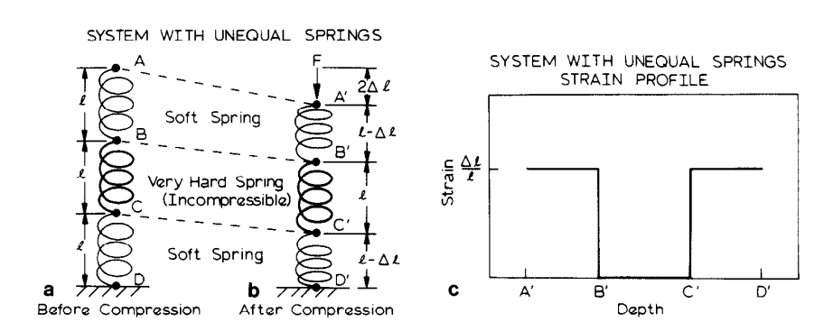
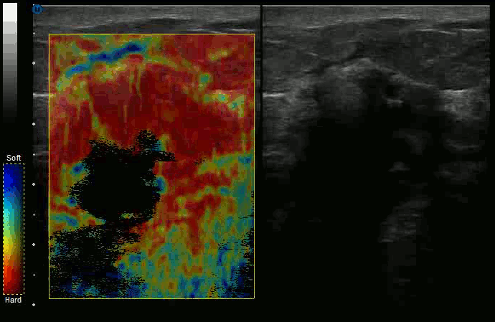
Medical applications
Ultrasound Elastography
  External compression is applied to tissue, and images before and after compression are used to generate the strain profile
[1] Ophir, J., et al. "Elastography: a quantitative method for imaging the elasticity of biological tissues." Ultrasonic imaging 13.2 (1991): 111-134.

Slide 8
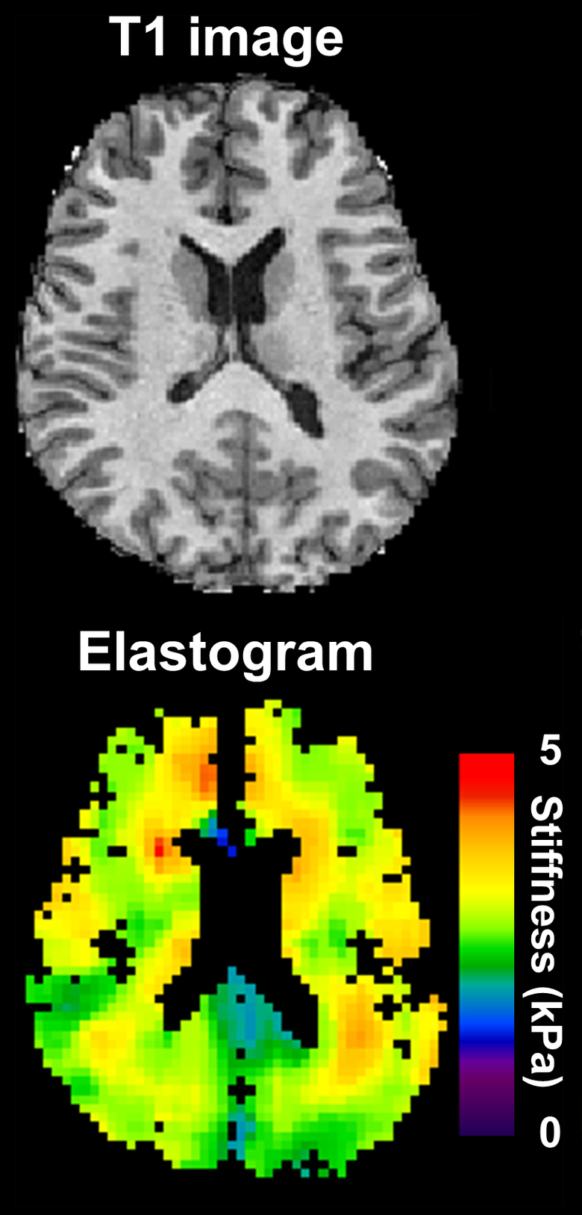
Medical applications
Magnetic Resonance Elastography
  Mechanical vibrator is used on
  the surface of the patient's body
  that creates shear waves travel
  into patient’s deeper tissues
  Direct visualization and quantitative
  measurement of tissue displacements.
  Isotropic linear elastic model
[2] Manduca, Armando, et al. "Magnetic resonance elastography: non-invasive mapping of tissue elasticity." Medical image analysis 5.4 (2001): 237-254.

Slide 9
Medical applications
These methods requires:
  Known external forces
  Accurate displacement measurement

Slide 10
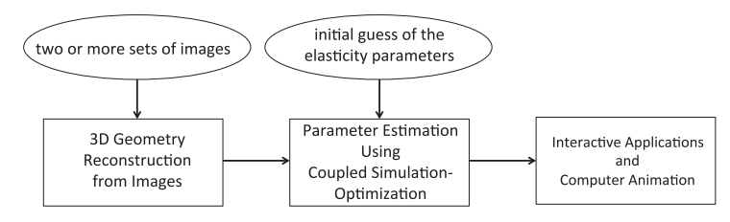
MaterialCloning: Acquiring Elasticity Parameters from Images for Medical Applications
[3] Yang, Shan, and Ming Lin. "MaterialCloning: Acquiring Elasticity Parameters from Images for Medical Applications." (2015).

Slide 11

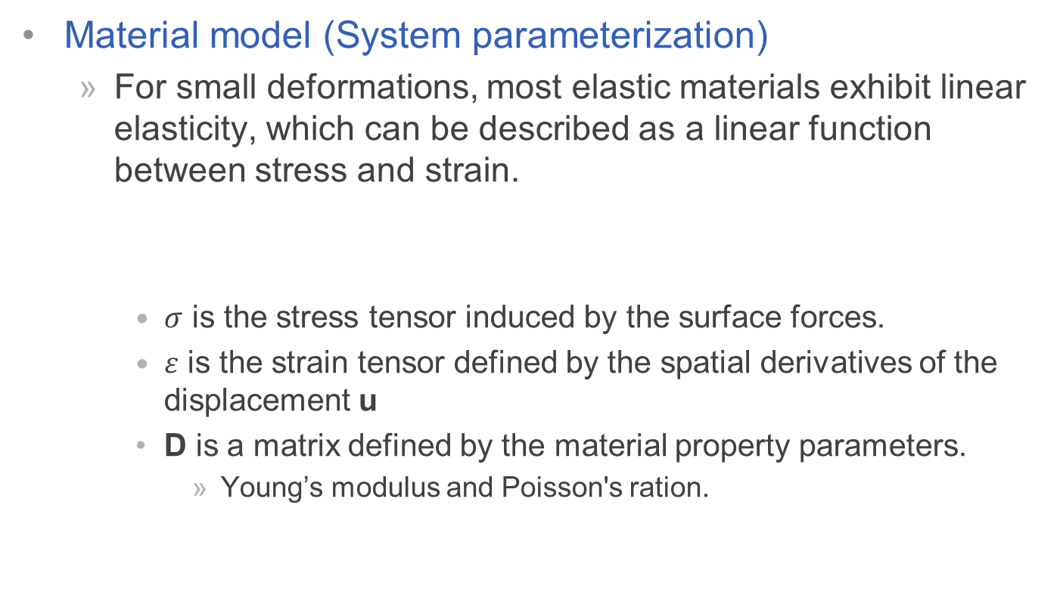
MaterialCloning: Acquiring Elasticity Parameters from Images for Medical Applications
Material model (System parameterization)
  For small deformations, most elastic materials exhibit linear elasticity, which can be described as a linear function between stress and strain.
    $σ$ is the stress tensor induced by the surface forces.
    $ε$ is the strain tensor defined by the spatial derivatives of the displacement u
    D is a matrix defined by the material property parameters.
      Young’s modulus and Poisson's ration.

Slide 12

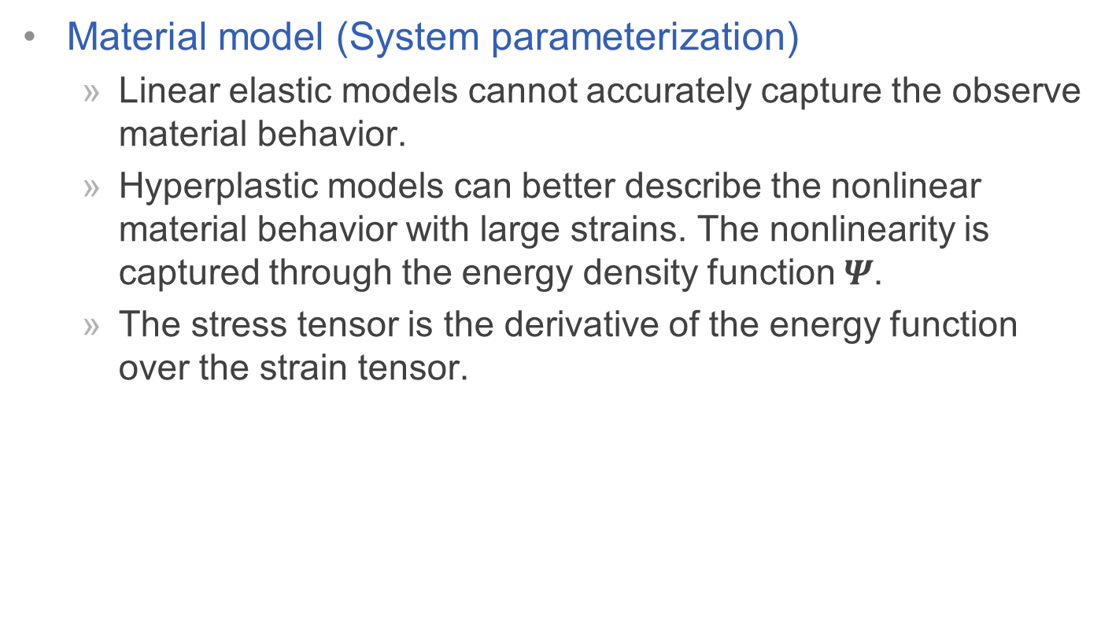
MaterialCloning: Acquiring Elasticity Parameters from Images for Medical Applications
Material model (System parameterization)
  Linear elastic models cannot accurately capture the observe material behavior.
  Hyperplastic models can better describe the nonlinear material behavior with large strains. The nonlinearity is captured through the energy density function $Ψ$.
  The stress tensor is the derivative of the energy function over the strain tensor.

Slide 13


MaterialCloning: Acquiring Elasticity Parameters from Images for Medical Applications
Material model (System parameterization)
  Energy function of Mooney-Rivlin material model
  $μ_{1},μ_{2}$ and $v_{1}$ are material parameters
  $I_{1},I_{2}$ and $I_{3}$ are the invariants of the deformation gradient $F$

Slide 14
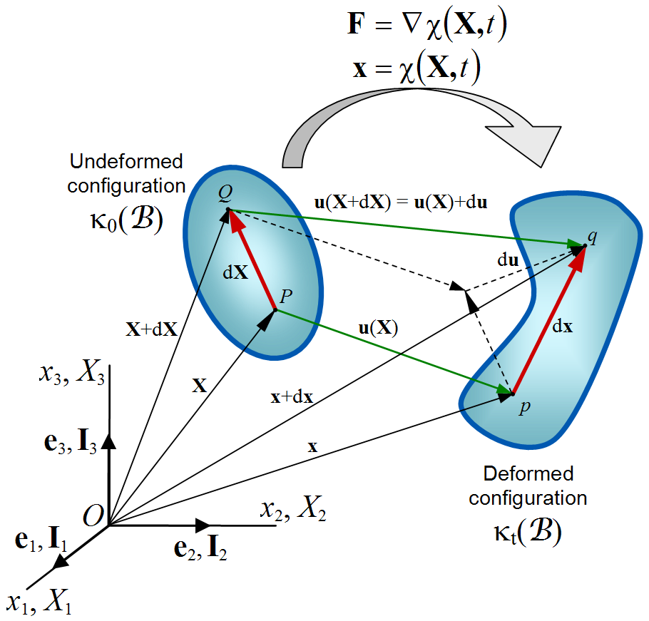

MaterialCloning: Acquiring Elasticity Parameters from Images for Medical Applications
Material model (System parameterization)
  Deformation gradient $F$

Slide 15


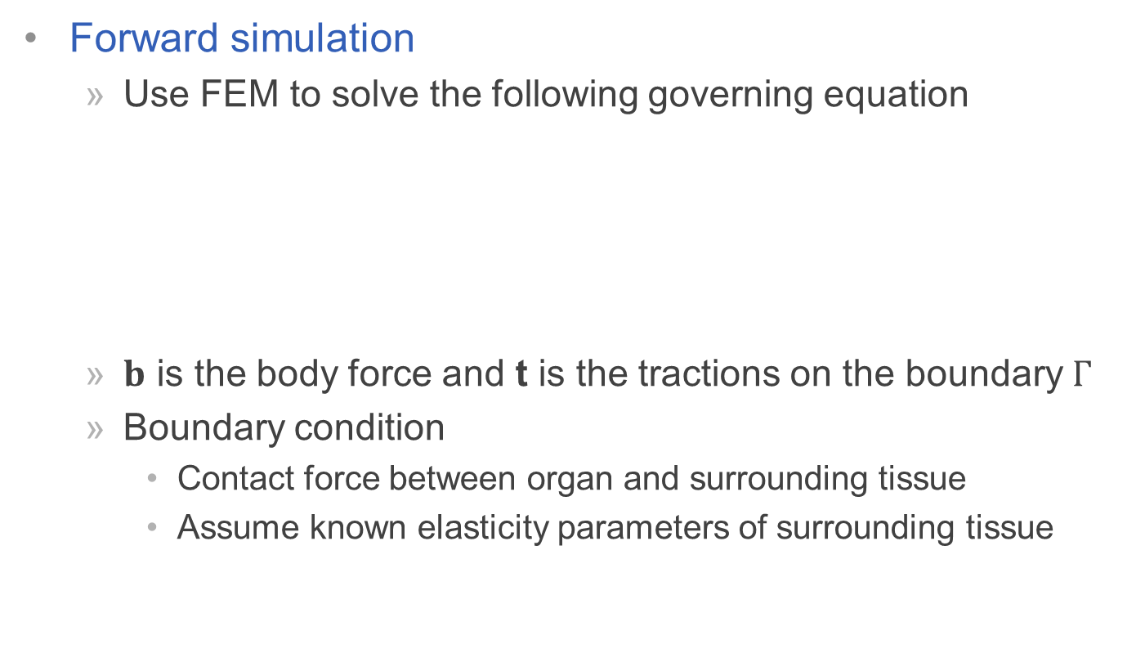
MaterialCloning: Acquiring Elasticity Parameters from Images for Medical Applications
Forward simulation
  Use FEM to solve the following governing equation
  $b$ is the body force and t is the tractions on the boundary $Γ$
  Boundary condition
    Contact force between organ and surrounding tissue
    Assume known elasticity parameters of surrounding tissue

Slide 16



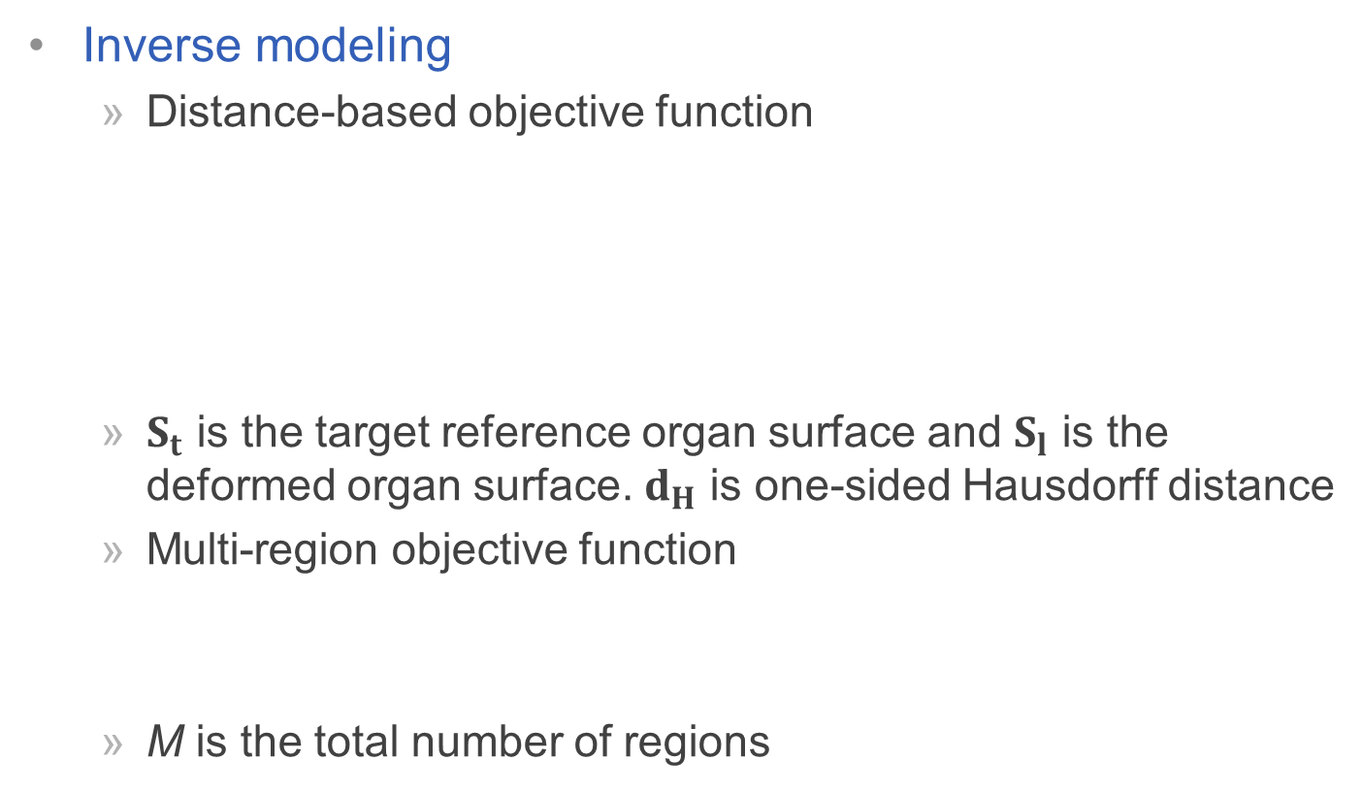
MaterialCloning: Acquiring Elasticity Parameters from Images for Medical Applications
Inverse modeling
  Distance-based objective function
  $S_{t}$ is the target reference organ surface and $S_{l}$ is the deformed organ surface. $d_{H}$ is one-sided Hausdorff distance
  Multi-region objective function
  M is the total number of regions

Slide 17
MaterialCloning: Acquiring Elasticity Parameters from Images for Medical Applications
Particle swarm optimization
  Particle swarm optimization (PSO) is a population based stochastic optimization technique developed by Dr. Eberhart and Dr. Kennedy in 1995, inspired by social behavior of bird flocking or fish schooling
  The potential solutions, called particles, fly through the problem space by following the current optimum particles

Slide 18
MaterialCloning: Acquiring Elasticity Parameters from Images for Medical Applications
What is a particle?
  A particle has five attributes:
    The position
    The velocity
    The fitness value
    The previous best position of itself
    The previous best position of its neighbors
  N is the dimension of the parameters and M is the swarm size.

Slide 19



MaterialCloning: Acquiring Elasticity Parameters from Images for Medical Applications
How does the optimization search work?
  PSO works by iteratively updating the particles’ properties
  is a randomly selected position within a D dimensional hypersphere defined as
  Where is the center and
  is the radius

Slide 20
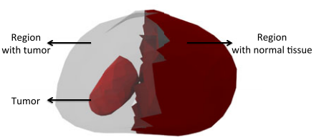
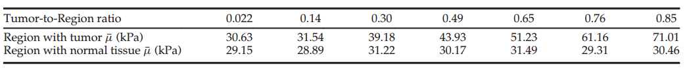
MaterialCloning: Acquiring Elasticity Parameters from Images for Medical Applications
Experimental Results
 | Tumor | Normal
Elasticity (kPa) | 70 | 30

Slide 21
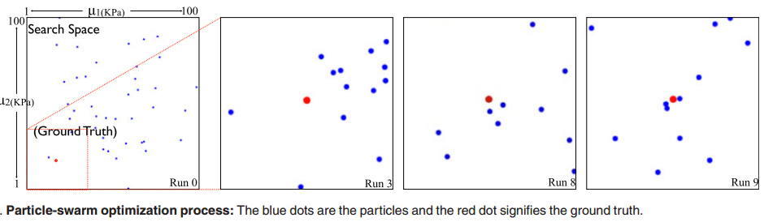
MaterialCloning: Acquiring Elasticity Parameters from Images for Medical Applications
Experimental Results

Slide 22
Data-Driven Elastic Models for Cloth: Modeling and Measurement
Invasive method
  Complicate and expensive to design a machine to measure large number of parameters.
Non-invasive method
  Diﬃcult to optimize for large number of parameters while avoiding local minima
  Robustly tracking features from unconstrained motion is challenging
Seek for balance between invasive and non-invasive methods
  Simple devices that deform samples in a controlled way so that their shapes can be easily measured
[4] Wang, Huamin, James F. O'Brien, and Ravi Ramamoorthi. "Data-driven elastic models for cloth: modeling and measurement." ACM Transactions on Graphics (TOG). Vol. 30. No. 4. ACM, 2011.

Slide 23
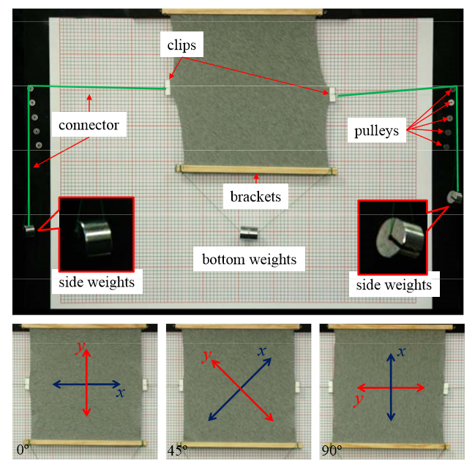

Slide 24
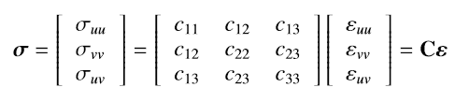

Data-Driven Elastic Models for Cloth: Modeling and Measurement
Planar stretching model (System parameterization)
  Treat cloth as two-dimensional continuum.
  The planar displacement and force can be described by strain and stress tensor.
  Start with linear anisotropic model obtained by generalizing Hooke’s law
    C is a 3x3 symmetric stiffness tensor matrix.
  Woven composite fabrics are orthotropic

Slide 25

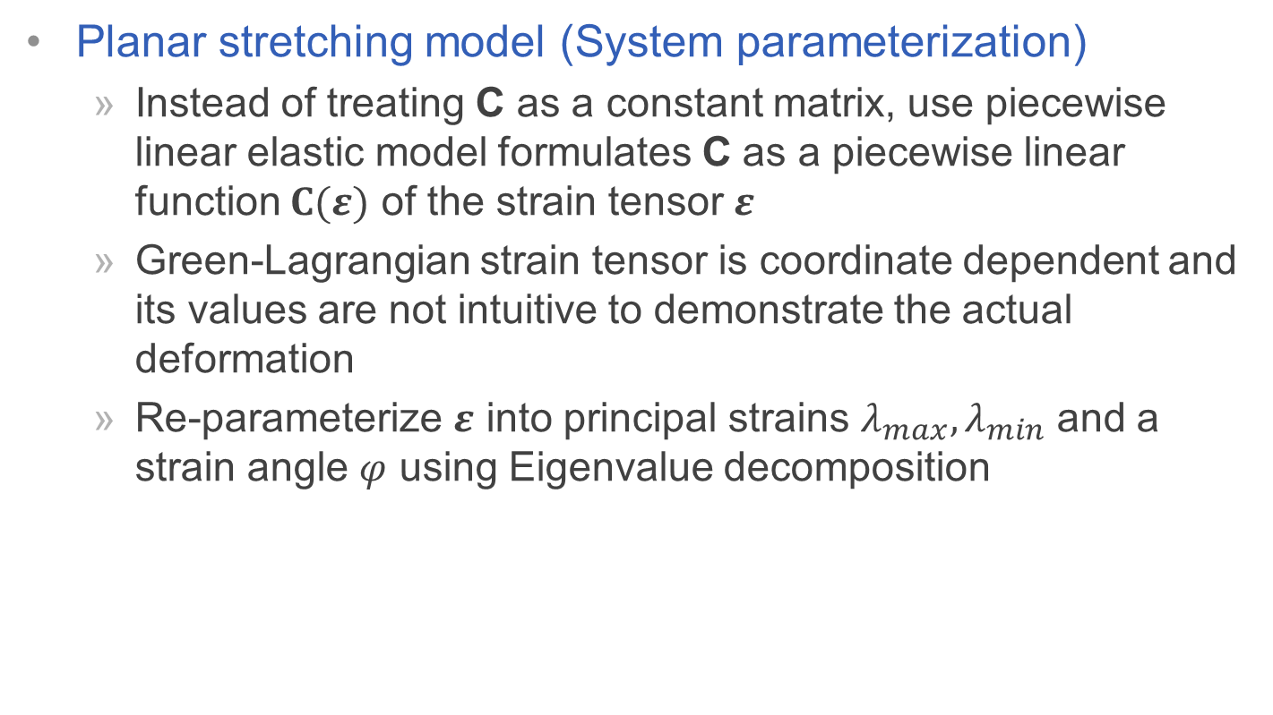
Data-Driven Elastic Models for Cloth: Modeling and Measurement
Planar stretching model (System parameterization)
  Instead of treating C as a constant matrix, use piecewise linear elastic model formulates C as a piecewise linear function $C(ε)$ of the strain tensor $ε$
  Green-Lagrangian strain tensor is coordinate dependent and its values are not intuitive to demonstrate the actual deformation
  Re-parameterize $ε$ into principal strains $λ_{max},λ_{min}$ and a strain angle $φ$ using Eigenvalue decomposition

Slide 26
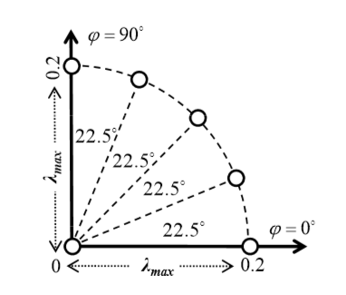

Data-Driven Elastic Models for Cloth: Modeling and Measurement
Planar stretching model (System parameterization)
  They noticed that $λ_{min}$ has significantly less influence on C
  So further simplify the parameterization of C(ε) by using only $λ_{max}$ and $φ$. And sample polar space using only six data points

Slide 27
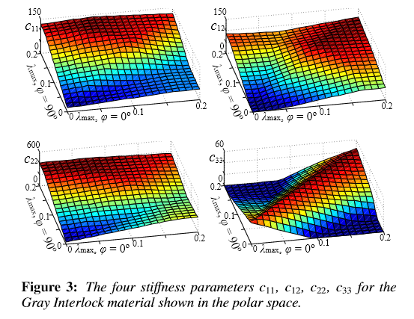

Data-Driven Elastic Models for Cloth: Modeling and Measurement
Planar stretching model (System parameterization)
  For the six data points, each has four parameters c11, c12, c22 and c33. Therefore, there are total 24 parameters for the full stretching model.
  C($λ_{max}, φ$) is then deﬁned by linearly interpolating data points over $λ_{max}$ and $φ$, respectively.

Slide 28
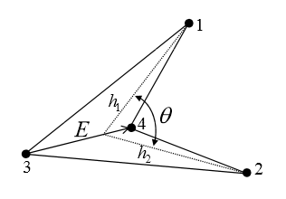
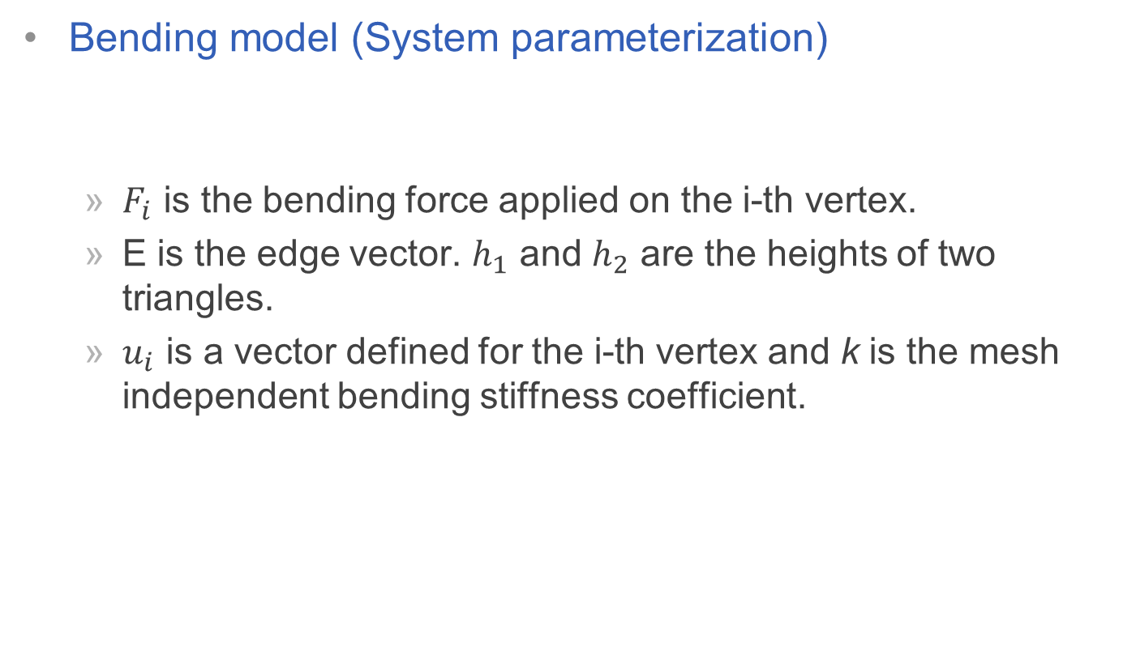
Data-Driven Elastic Models for Cloth: Modeling and Measurement
Bending model (System parameterization)
  $F_{i}$ is the bending force applied on the i-th vertex.
  E is the edge vector. $h_{1}$ and $h_{2}$ are the heights of two triangles.
  $u_{i}$ is a vector defined for the i-th vertex and k is the mesh independent bending stiffness coefficient.

Slide 29

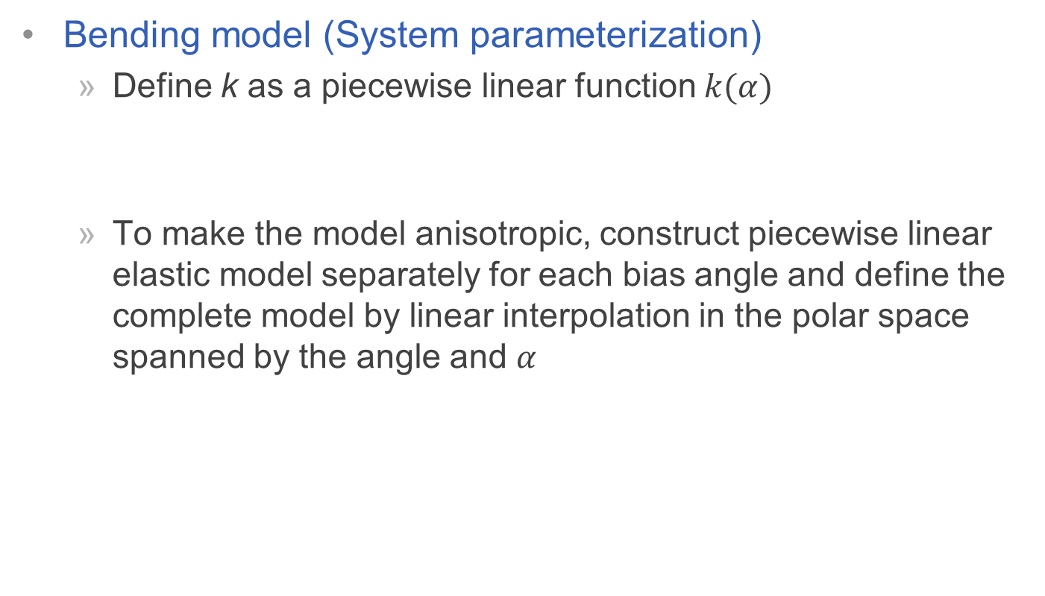
Data-Driven Elastic Models for Cloth: Modeling and Measurement
Bending model (System parameterization)
  Define k as a piecewise linear function $k(α)$
  To make the model anisotropic, construct piecewise linear elastic model separately for each bias angle and define the complete model by linear interpolation in the polar space spanned by the angle and $α$

Slide 30
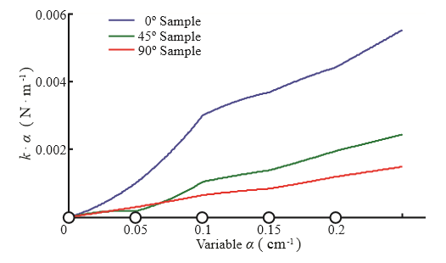

Data-Driven Elastic Models for Cloth: Modeling and Measurement
Bending model (System parameterization)
  Use five data points to sample $α$ and 15 data points in total for three samples.

Slide 31
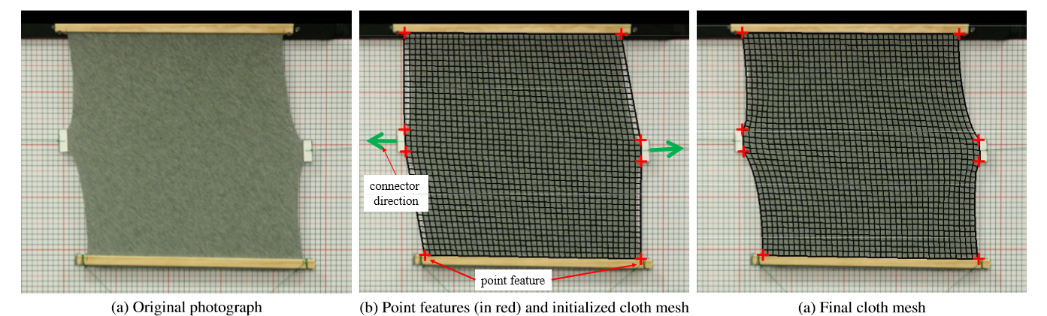
Data-Driven Elastic Models for Cloth: Modeling and Measurement
Forward simulation
  Standard Finite Element Method.
  Initial mesh is generated by first mark manually label point features and then doing a bilinear interpolation.

Slide 32
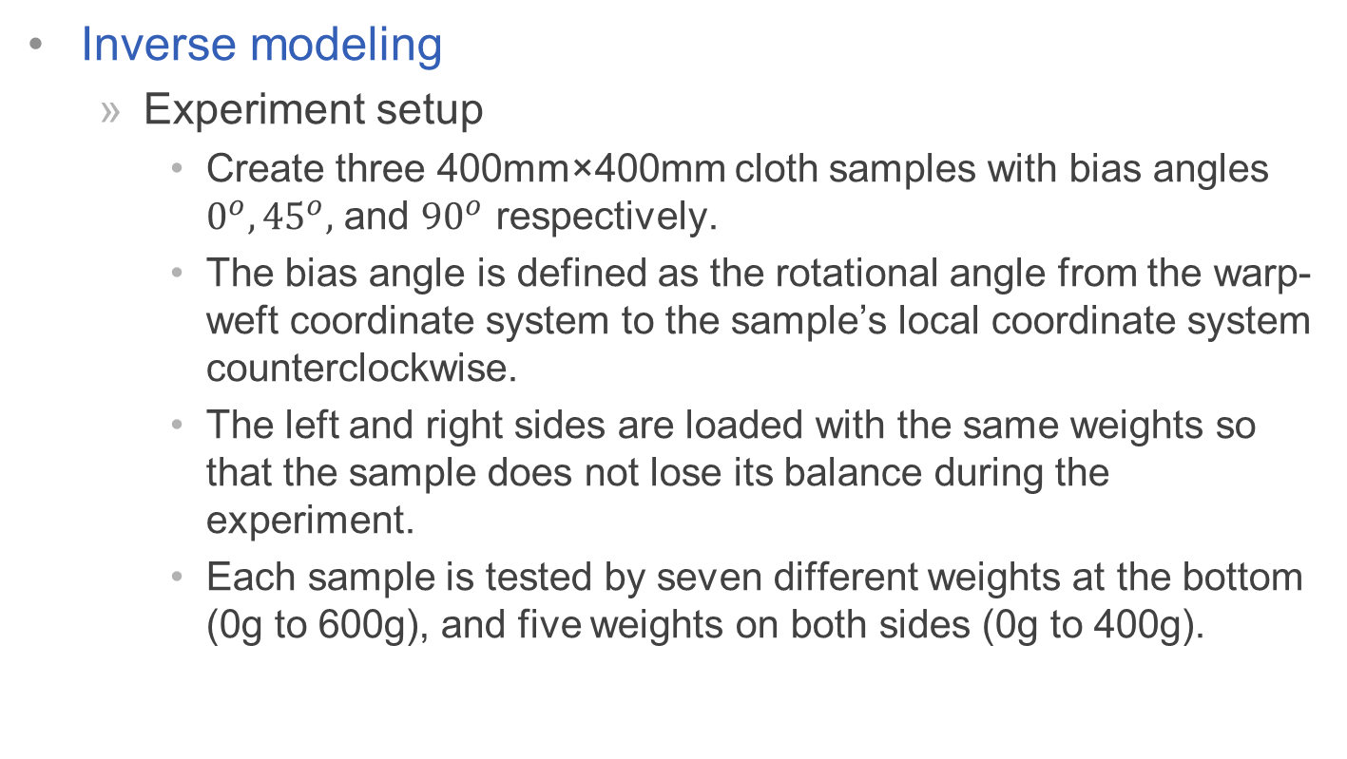
Data-Driven Elastic Models for Cloth: Modeling and Measurement
Inverse modeling
  Experiment setup
    Create three 400mm×400mm cloth samples with bias angles $0^{o},{45}^{o},$ and ${90}^{o}$ respectively.
    The bias angle is defined as the rotational angle from the warp-weft coordinate system to the sample’s local coordinate system counterclockwise.
    The left and right sides are loaded with the same weights so that the sample does not lose its balance during the experiment.
    Each sample is tested by seven different weights at the bottom (0g to 600g), and five weights on both sides (0g to 400g).
Notes:
Warp and weft directions can be recognized from thread directions in the weaving structure for most cloth materials.

Slide 33

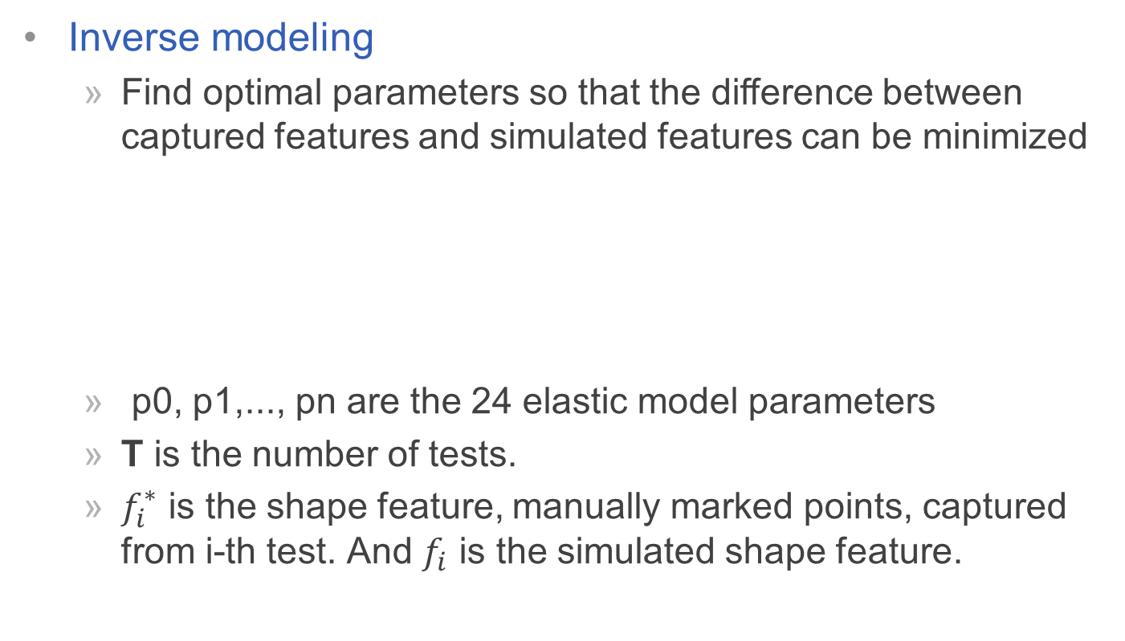
Data-Driven Elastic Models for Cloth: Modeling and Measurement
Inverse modeling
  Find optimal parameters so that the diﬀerence between captured features and simulated features can be minimized
  p0, p1,..., pn are the 24 elastic model parameters
  T is the number of tests.
  $f_{i}^{∗}$ is the shape feature, manually marked points, captured from i-th test. And $f_{i}$ is the simulated shape feature.

Slide 34
Data-Driven Elastic Models for Cloth: Modeling and Measurement
Optimization
  Use BFGS extension of the quasi-Newton to handle the optimization process in the first 10 to 20 iterations.
  Once the residual error becomes smaller, add random perturbations in order to jump away from local minima.
  Local minimum is clustered around the expected global minimum, which they believe is mainly because of the close memory property.

Slide 35
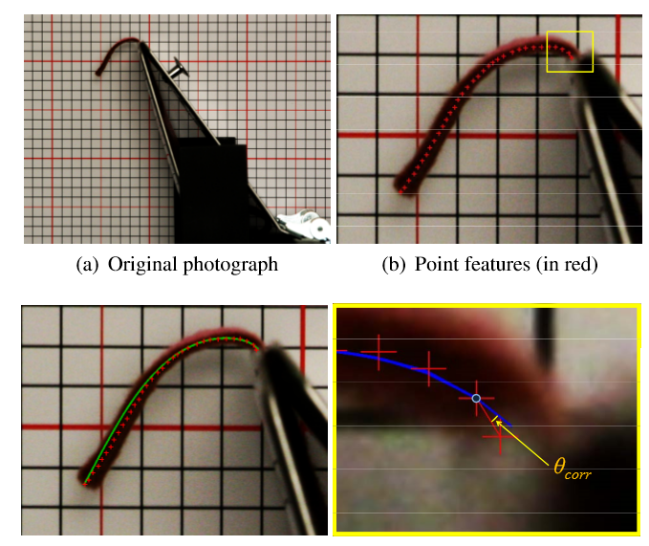

Data-Driven Elastic Models for Cloth: Modeling and Measurement
Bending measurement
  Experiment setup
    Create three 4cm-wide cloth samples with bias angles $0^{o},{45}^{o},$ and ${90}^{o}$ respectively.
    Capture draped cures from a side view and manually label the trajectory of each curve using point features.

Slide 36
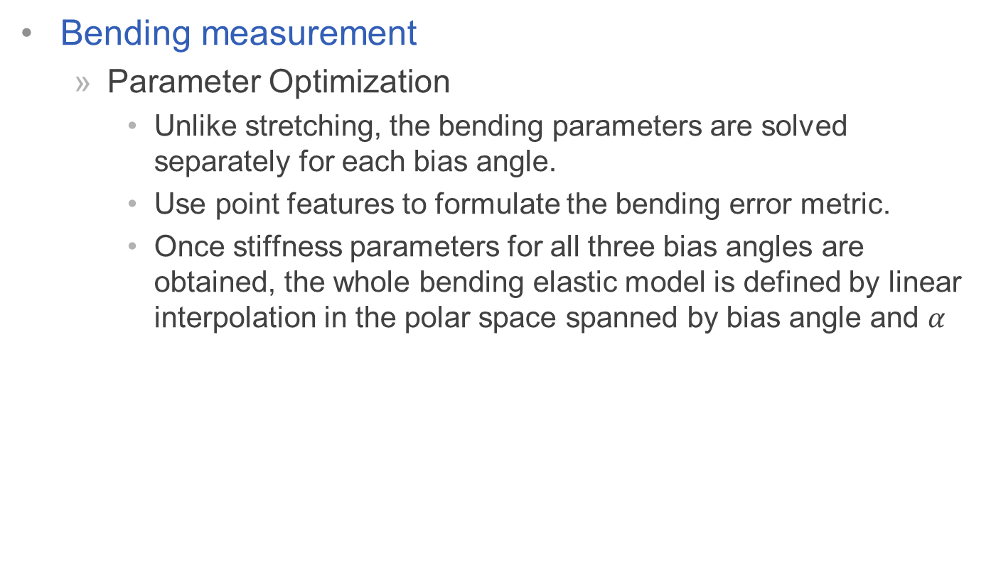
Data-Driven Elastic Models for Cloth: Modeling and Measurement
Bending measurement
  Parameter Optimization
    Unlike stretching, the bending parameters are solved separately for each bias angle.
    Use point features to formulate the bending error metric.
    Once stiffness parameters for all three bias angles are obtained, the whole bending elastic model is defined by linear interpolation in the polar space spanned by bias angle and $α$

Slide 37
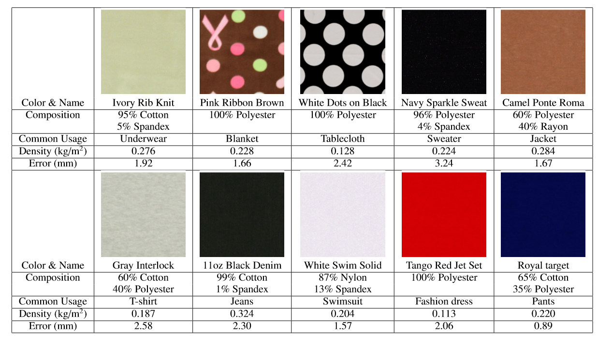
Data-Driven Elastic Models for Cloth: Modeling and Measurement
Experimental results
  Database

Slide 38
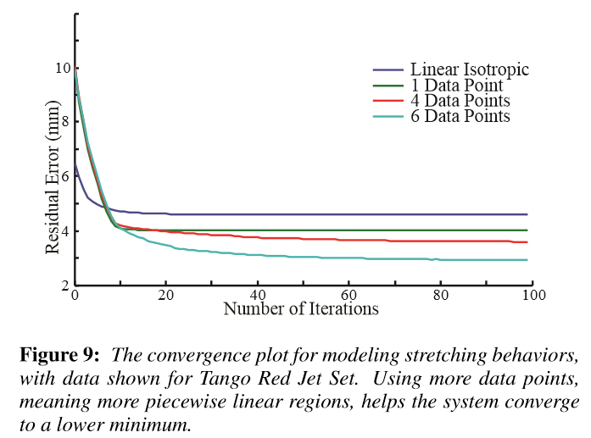
Data-Driven Elastic Models for Cloth: Modeling and Measurement
Experimental results

Slide 39
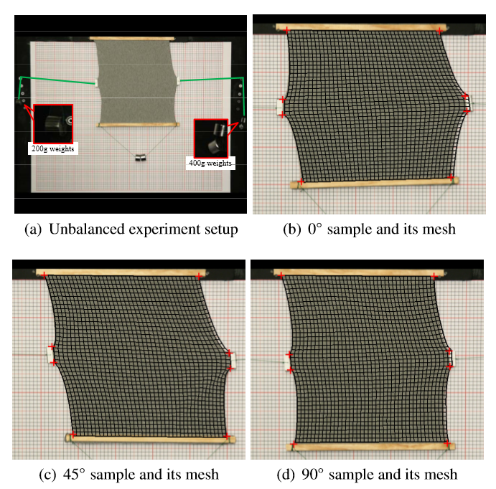
Data-Driven Elastic Models for Cloth: Modeling and Measurement
Validation 1: Unbalanced tensile tests

Slide 40
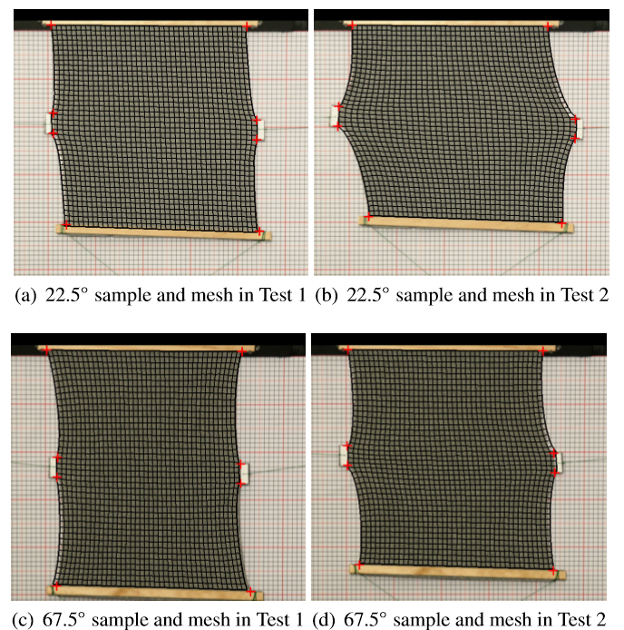
Data-Driven Elastic Models for Cloth: Modeling and Measurement
Validation 2: Different bias angle

Slide 41
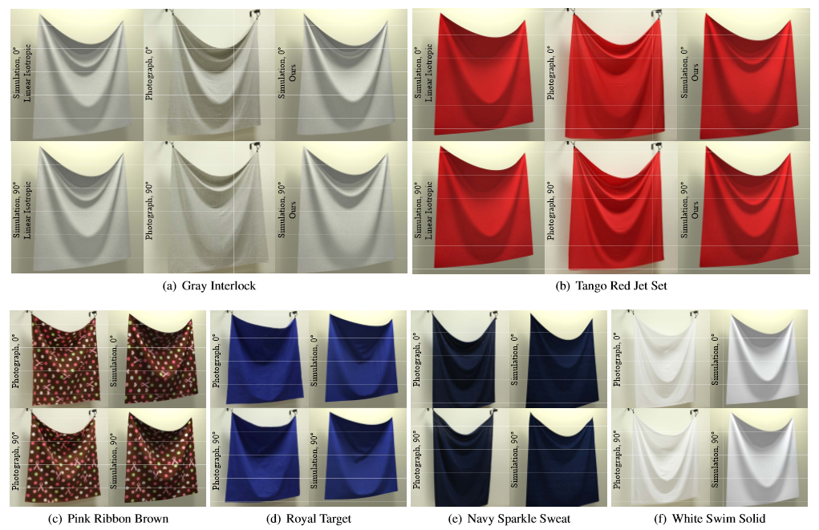
Data-Driven Elastic Models for Cloth: Modeling and Measurement
Validation 3: Hanging cloth

Slide 42
Limitations and open research
Computational expensive.
  Requires hours to obtain the model parameters.
Nonlinear anisotropic elastic model
  Detect small tumor
  Model more complex tissue property

Slide 43
Questions?

