Slide 1
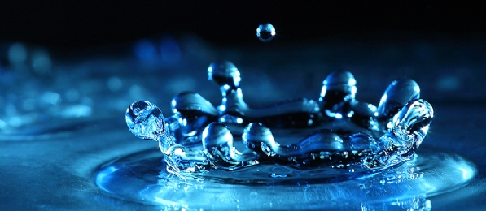
Introduction to
FLUID DYNAMICS
Presented by:
Sarah J. Andrabi

Slide 2
Outline
Introduction
Fluid Characteristics
Challenges
Mathematical Review
Navier-Stokes Equations
Different Techniques—Lagrangain and Eulerian
Building a 2D simulator
Solid-Fluid interaction
Open Issues
References
https://www.youtube.com/watch?v=DxawCFRSwts

Slide 3
Introduction
So many fluids in our surroundings
Realistic animations of water, smoke, explosions, fire and related phenomena
Evolve the motion of the fluid forward in time
Describe the physics of the fluids
Notes:
http://www.youtube.com/watch?v=0vxOhd4qlnA
Take the wave scene
71% percent of Earth is water
Human bodies can be up to 65% water

Slide 4

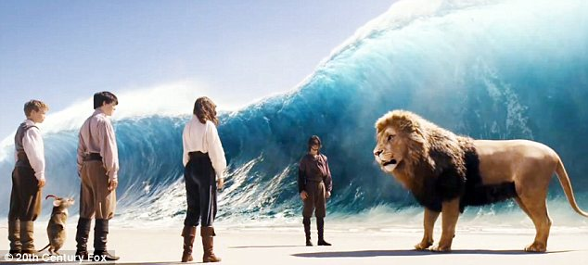
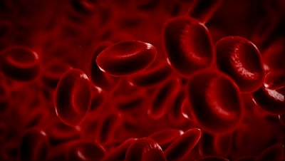
Motivation
Applications
  Games
  Medical simulation (Blood flow, etc)
  Movie special effects (Interstellar, Pirates of the Caribbean)
  Scientific visualization (Water sewage system, dam construction)

Slide 5
Fluid Characteristics
Basic properties
  Pressure
  Viscosity
  Surface tension
  Density
Notes:
Pressure—High pressure regions push on lower pressure regions
Keeps the fluid at constant volume
Viscosity—Tries to make particles move at the average velocity of the nearby particles
Tries to minimize differences in velocity between nearby bits of fluid
Surface tension-- the attractive force exerted upon the surface molecules of a liquid by the molecules beneath that tends to draw the surface molecules into the bulk of the liquid and makes the liquid assume the shape having the least surface area
Density—degree of consistency measured as mass per unit volume

Slide 6
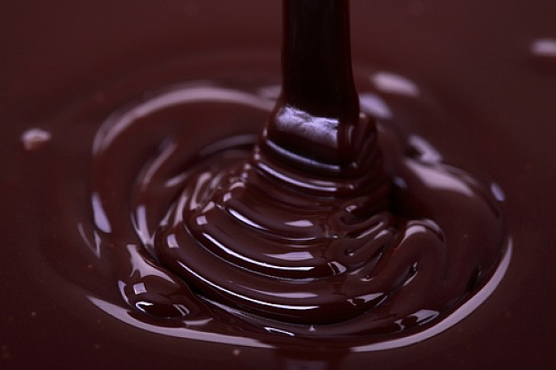
Fluid Characteristics
  Types of Fluids
    Compressible fluids: Change in density is significant with changes in pressure and temperature
    Incompressible fluids: Change in density with change in pressure and temperature is not significant
    Viscous fluids: Resist deformation
    Inviscid fluids: No viscosity
Notes:
Compressible fluid
Relative volume change
—eg smoke
Inviscid fluid (sometimes called ideal fluid) has no viscosity. In real world, if that kind of fluid exist, if you stir it and come back a week later, it’s still rotating

Slide 7
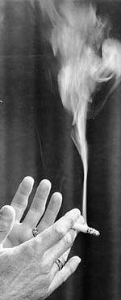
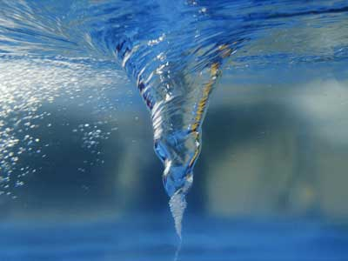
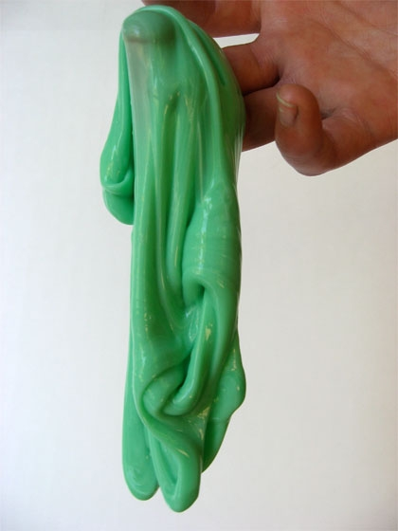
Fluid Characteristics
  Types of Fluids
    Turbulent: Flow that appears to have chaotic and random changes
    Laminar (streamline) flow: Flow that has smooth behavior
    Newtonian fluids: Fluids continue to flow, regardless of the force acting on it
    Non-Newtonian fluids: Fluids that have non-constant viscosity
  Phase Transition— Fluids may change physical behavior under different environmental conditions
Notes:
Turbulent flow: The flow appears to have chaotic behavior, usually you’ll see it spinning. Its pressure and velocity change rapidly in space and time.
Laminar flow (also called streamline flow): Relatively, the laminar fluid has a smoother and much stable behavior. This cigarette smoke demonstrates the turbulent and laminar flow at the same time.
A Newtonian fluid is any fluid that has a viscosity that remains constant regardless of stress that's placed on it like mixing
One example is water, since it flows the same way regardless of whether it is left alone or agitated vigorously. This can be contrasted with non-Newtonian fluids, which can become thicker or thinner when stress is applied

Slide 8
Challenges in Fluid Simulation
Modeling continuum fluids on discrete systems – It’s all about approximations
Topological variations and different kinds of behaviors with interacting subjects
Numerical stabilities, accuracy and convergence issues
Performance
User control
Notes:
Due to the computational
expense of capturing this complexity, fluid simulations are typically
executed off-line

Slide 9
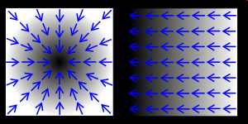
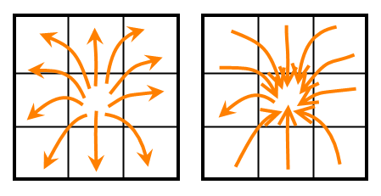

Mathematical Review
Gradient (of a scalar field): $∇g$, is a vector field
  Describes how the scalar field changes spatially
Divergence: $∇.u$, is the dot product of the gradient with a vector
  Describes the net flow out of or into points in the vector field
Laplacian: $∇^{2}=∇.∇$, is the dot product of two gradient operators
  Describes how much values in the original field differ from their neighborhood average
Notes:
The divergence operator measure the flux of a given location. If divergence > zero, it means the total quantity coming out is greater than coming in. We call it source.
The reverse case, of course, it’s a sink.

Slide 10

Navier-Stokes Equations
Describe the velocity field of a fluid, u, over time
Set of two equations
First equation—says that the amount of fluid flowing into any volume must be equal to the amount of fluid flowing out
      $∇.u=0$
      “Incompressibility equation”
  Second equation—Accounts for motion of fluid through space, accounting for internal or external forces
  $$\frac{∂u}{∂t}= υ\text{∇}\text{2}\text{u} \text{–} \text{(}\text{u}\text{⋅∇)}\text{u}\text{ – }\frac{1}{ρ}\text{∇}\text{p}\text{ +}𝓕$$
Notes:
The second equation tells how the fluid accelerates due to the forces acting on it
It basically says change in velocity depends on the viscosity diffusion+the advection+pressure+body forces

Slide 11

Navier-Stokes Equations
  $$\frac{∂u}{∂t}= \text{υ}\text{∇}\text{2}\text{u} \text{– (}\text{u}\text{⋅∇)}\text{u}\text{ –}\frac{1}{ρ}\text{ ∇}\text{p}\text{ + }𝓕$$
Derivative of velocity w.r.t. time—how fluid accelerates due to forces acting on it
Diffusion/Viscosity
Advection
Body Forces
Change in velocity
Pressure
Notes:
how the fluid accelerates due to the forces acting on it
It basically says change in velocity depends on the viscosity diffusion+the advection+pressure+body forces
Force at a point => Force per unit volume

Slide 12

Navier-Stokes Equations
  $$\frac{∂u}{∂t}= \text{υ}\text{∇}\text{2}\text{u} \text{– (}\text{u}\text{⋅∇)}\text{u}\text{ –}\frac{1}{ρ}\text{ ∇}\text{p}\text{ + }𝓕$$
Kinematic Viscosity $(\text{υ}\text{)}$–determines thickness of fluid
How much the fluid resists deformation while flowing
Acts as a force that tries to make our particle move at the average velocity of the nearby particles
Diffusion/Viscosity
Advection
Body Forces
Change in velocity
Pressure
Notes:
How difficult it is to stir
Minimize differences in velocity between nearby bits of fluid

Slide 13

Navier-Stokes Equations
  $$\frac{∂u}{∂t}= \text{υ}\text{∇}\text{2}\text{u} \text{– (}\text{u}\text{⋅∇)}\text{u}\text{ –}\frac{1}{ρ}\text{ ∇}\text{p}\text{ + }𝓕$$
Convection (or advection)—arises due to conservation of momentum
Think of it as the momentum moving or ‘convecting’ through space along with the fluid
Diffusion/Viscosity
Advection
Body Forces
Change in velocity
Pressure
Notes:
Advection term—how the quantity or molecules or particles move with the velocity field

Slide 14

Navier-Stokes Equations
  $$\frac{∂u}{∂t}= \text{υ}\text{∇}\text{2}\text{u} \text{– (}\text{u}\text{⋅∇)}\text{u}\text{ –}\frac{1}{ρ}\text{ ∇}\text{p}\text{ + }𝓕$$
Captures forces generated by pressure differences within the fluid
$ρ$ is the density of the fluid
- $\text{}\text{p}$ captures the imbalance in pressure at a specific position
Diffusion/Viscosity
Advection
Body Forces
Change in velocity
Pressure
Notes:
-gradient p ----integrate this over the volume of the fluid to get the pressure force

Slide 15

Navier-Stokes Equations
  $$\frac{∂u}{∂t}= \text{υ}\text{∇}\text{2}\text{u} \text{– (}\text{u}\text{⋅∇)}\text{u}\text{ –}\frac{1}{ρ}\text{ ∇}\text{p}\text{ + }𝓕$$
Includes external forces like gravity or contact forces
Diffusion/Viscosity
Advection
Body Forces
Change in velocity
Pressure
Notes:
In practice, this term allows us to modify or set velocities in the grid to any desired value as a simulation step
The fluid then moves naturally as though external forces have been applied on it

Slide 16
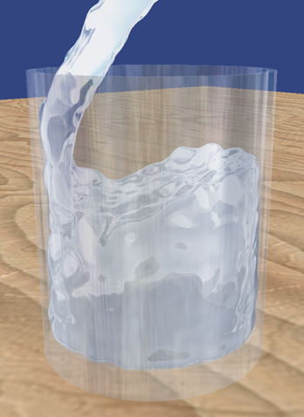
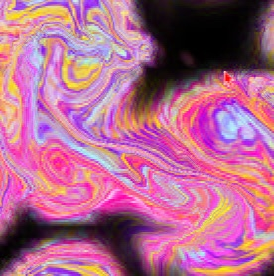
Techniques Overview
Common techniques for solving Navier-Stoke’s equation:
  Eulerian approach (grid-based)
  Lagrangian approach (particle-based)
  Spectral method
  Lattice Boltzmann method
[Stam] Stable Fluids,
SIGGRAPH 99
[Mueller, Charypar, Gross] Particle-Based Fluid Simulation for Interactive Applications, SCA03
Notes:
How to solve the Navier-Stokes equation? It’s a non-linear partial differential equation. Generally it’s very hard to find its solution analytically so we have to resort to numerical solution.
→Here are some most common techniques for solving this equation: We have eulerian grid-based approach, lagrangian particle-based approach, spectral method, and lattice boltzmann method. Due to limited amount of time, I will mostly focus on the first one, briefly talk about the second one, and hand-wave the last two.
Spectral method: Write the solution as Fourier series and substitute it into the original equation, which turns a PDE into ODE then you integrate in time to solve it.
LBM, similar to Lagrangian approach, uses particles to perform propagation and collision process over a discrete lattice mesh. It’s a fairly new technique and it handles complex boundary quite well and the algorithm is easily paralizable.

Slide 17
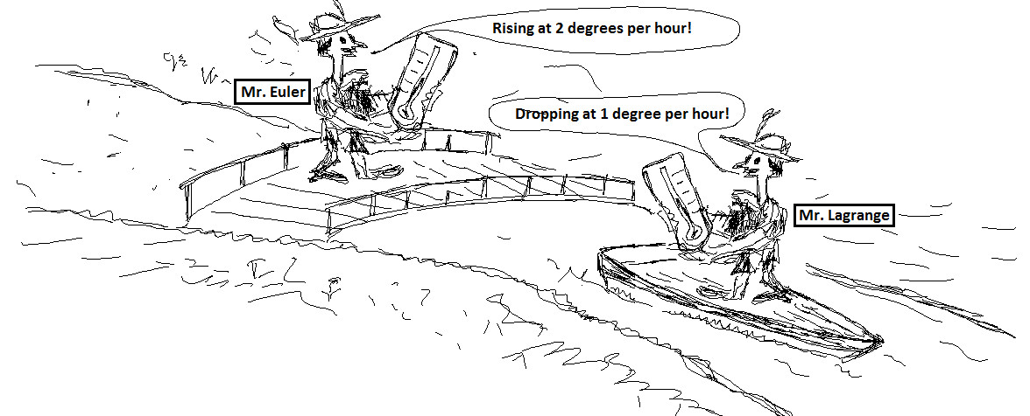
Lagrangian vs. Eulerian in One Picture
Notes:
Lagrangian—you’re riding on one of the particles and measure the variation.
Eulerian—you’re holding a meter at grid points and measure how a quantity changes over time.

Slide 18
Lagrangian Approach
Treat fluids like a particle system
Each particle has a position and a velocity
Discrete set of particles usually connected up in a mesh
Solids are almost always simulated in this way
Evaluation:
  Mass / Momentum conservation
  More intuitive
  Faster
  Need space partition structure for connectivity information
  Need for surface reconstruction
Notes:
In lagrangian approach, you treat the fluid similar to a particle systems. For each pair of particle, you then have to derive interaction forces, pressure force, and viscosity force based on some per-defined smoothing kernels.
advantages and disadvantages: It automatically achieve mass conservation because we only have discrete number of particles.
The concept is much intuitive.
fast so it’s → real-time applications. One draw back is you may need to use some space partition structure such as K-d tree to quickly figure out the connection information and also you need to reconstruct the surface when it comes to the rendering.

Slide 19
Eulerian Approach
No particle tracking
Corresponds to a fixed grid that doesn’t change in space even as the fluid flows through it
Look at specific points in space and see how at those points the fluid quantities change over time
Used mostly for fluids
Evaluation:
  Derivative approximation is easier
  Adaptive time step/solver
  Memory usage & speed
  Grid artifact/resolution limitation to capture fluid detail
Notes:
Eulerian approach is fairly similar to uniform grid space partitioning.
The grid is not moving with the fluid.
→Remember we have several terms in the equation to be solved. With this approach, we can apply operator splitting to solve each term separately. Here are some advantages of this approach:
Computing derivative is relatively easy
Just as we said, different terms can be solved with different solver or even different time step
You will have a lot of redundency in memory allocation. In other words, we don’t need cells that has no fluid in it. Large number of grids leads to slow simulation, especially in 3d.
4) Grid resolution will be a problem. In order to capture finer fluid detail, for example, thin feature, you may need a high resolution grid.
5) One thing I forgot to say: the math is much more complicated if you formulate in this way.

Slide 20
Lagrangian vs. Eulerian
Lagrangian
http://www.youtube.com/watch?v=6CP5QvfuD_w
Eulerian
  http://www.youtube.com/watch?v=Jl54WZtm0QE
Notes:
Add demos
Eulerian---1:07
Lagrangian--gear the method towards fluid simulation by deriving the force density fields directly from the Navier-Stokes equation and by adding a term to model surface tension effects. In contrast to Eulerian grid-based approaches, the particle-based approach makes mass conservation equations and convection terms dispensable which reduces the complexity of the simulation.
Eulerian--
Splatting means combining different things (textures)—splat like snowball back to front

Slide 21
Lagrangian vs. Eulerian
Lagrangian
Eulerian
Each water column contains exactly one tall cell
The tall cell is located at the bottom of the water column
Velocities are stored at the cell center for regular cells and at the top and bottom of tall cells bcoz of which there is slight volume gain over time
Notes:
Add demos
Eulerian---1:07
Lagrangian--gear the method towards fluid simulation by deriving the force density fields directly from the Navier-Stokes equation and by adding a term to model surface tension effects. In contrast to Eulerian grid-based approaches, the particle-based approach makes mass conservation equations and convection terms dispensable which reduces the complexity of the simulation.
→particles can directly be used to render the surface of the fluid. We propose methods to track and visualize the free surface using point splatting and marching cubes-based surface reconstruction
the kernel smoother represents the set of irregular data points as a smooth line or surface
Eulerian--
Splatting means combining different things (textures)—splat like snowball back to front

Slide 22
Case Study: A 2D Fluid Simulator
Focus on incompressible, viscous fluid
Consider gravity as the only external force
No inflow or outflow
Constant viscosity, constant density everywhere in the fluid
Notes:
Now we’re going to learn how to build a simple 2d fluid simulator. The technique I present here is fairly straightforward to extend to 3d. Before we jump in,
I want to remind you again about our assumption: We’re working on a incompressible, viscous fluid simulation. The body force is only gravity and there is no
Inflow or outflow. Basically, the 2nd and 3rd condition is not necessary but I add them here just to simplify our case. You can modify them to create more interesting
cases, such as setting a hole on your boundary to let the fluid goes out.

Slide 23

Simulation Loop
Advection
Body Force
Diffusion
Scalar/Vector fields defined on the grid
Pressure Solve
u_{t} = $\text{υ}$∇²u –(u⋅∇)u – $\frac{1}{ρ}$∇p + $𝓕$
∇⋅u=0
Notes:
Here is overview of a 2D simulator. We have a velocity field / scalar field as our input.
First step is advection: It governs how the fluid push around. Then is the body force. At this step, we apply external forces such as gravity to the fluid body.
diffusion. It tells how do fluid at a cell interchange with their neighbors. Usually if you’re dealing with viscous fluid, you diffuse the velocity in this step. If you have a quantity such as dye concentration you want to move with your fluid, you also need to advect and diffusion them same as the velocity.
pressure solve, which takes your current field and project onto a divergence-free field and then you go to the next iteration. You might see different ordering in some other papers. In fact, the order of these 3 are not so important as long as you can make sure it’s a divergence-free field when doing the advection. Here is the correspondence between each term and our block diagram. I will explain each term in much greater detail in later slides.

Slide 24
The Power of Operator Splitting
One complicated Multi-dimensional operator => A series of simple, lower dimensional operators
Each operator can have its own integration scheme and different time step sizes
High modularity and easy to debug
U^{n} + A + B + D + P
U*
U**
U***
U^{n+1}
Notes:
In previous slides, I implicitly told you how to solve the NSE. The technique behind that is called operator splitting. In stead of solving the entire equation in one shot, we separate it into several sub-steps and conquer them one by one. U_n is the current state and you can see that we keep modifying the state with different operators sequentially in a single iteration. You can immediately see the benefit of this strategy: You can easily swap your algorithm in and out of this sequence without modifying other operators.

Slide 25
Advection
Sometimes called “Convection” or “Transport”
Define how a quantity moves with the underlying velocity field
This term ensures the conservation of momentum
Advection equation:
Approaches:
  Forward Euler (unstable)
  Semi-Lagragian advection (stable for large time steps, but suffers from the dissipation issue)
Notes:
This step sometimes called convection or transport. It defines how a quantity moves around for a given velocity field.
This equation comes from the fact that the velocity field just moves around but not change. You can derive this equation from that point of view.
People propose many ways to solve this equation. As you may know, you can simply discretize this equation and use FE to solve it. However, it’s not stable. A more popular way to solve this equation is to use so called semi-Lagragian advection, which is claimed to be unconditionally stable and very simple to implement.

Slide 26
Advection
Forward Euler Advection
Semi-Lagragian Advection
Notes:
The left one is advection using forward euler. The orange dot is the cell you want to advection. It simply uses its current velocity to do the integration.
Semi-Lagrangian scheme, on the other hand, first tries to find the answer of the question: where do I come from by tracing backward using the current velocity. After finding
The location, do a bilinear/trilinear interpolation using the four neighboring velocities and use that velocity to do integration.
Due to the nature of back tracking, you have to be careful when it comes to the boundary cases. This method work quite well for most situations but it still suffers from dissipation issue.

Slide 27
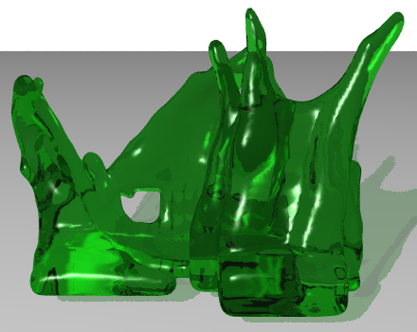
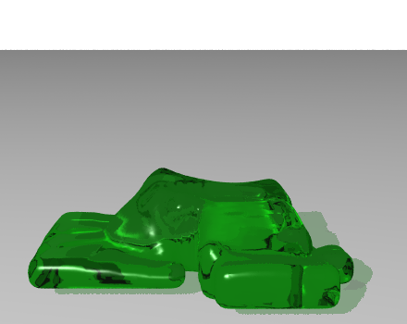
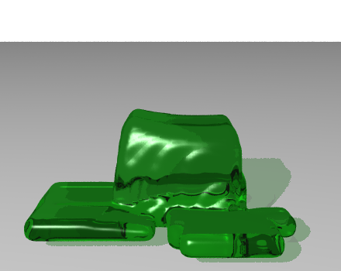
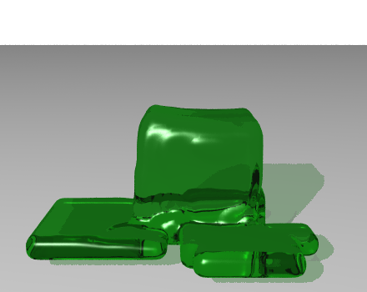
Diffusion
Define how a quantity in a cell inter-changes with its neighbors
Diffusion = Blurring
Low Viscosity
High Viscosity
Figures from [Carlson, Mucha, Turk] Melting and Flowing, SCA 02
Notes:
The diffusion defines how a quantity in a cell exchange with its direct neighbors. By applying this diffusion to the velocity field, we can have a viscous fluid. Here is a example of fluid from high viscosity to low viscosity.

Slide 28
Diffusion
Diffusion equation:
Approaches:
  Explicit formulation
  Implicit formulation
  (for high viscosity)
1
1
-4
1
1
Unknowns
Notes:
The diffusion equation: the change of the velocity field is equal to the viscosity coefficient times the laplancian of the velocity field. How do we solve it? Again we use finite difference and it ends up with applying a 1-1-1-1-4 pattern for each cell. When you have a very viscous fluid, you may want to solve this term implicitly. Your formulation becomes this:

Slide 29
Diffusion
0
0
0
0
2.5
0
0
0
5
0
0
0
2.5
-10
2.5
0
0
0
0
0
2.5
0
Before the diffusion
After the diffusion (k = 0.5, time step size =1)

Slide 30
Pressure Solve
It’s sometimes called “Pressure Projection”
What does the pressure do?
  Keep the fluid at constant volume (incompressible, conservation of mass).
  Make sure the velocity field stays divergence-free
Incompressible
Compressible
Notes:
The most complicated part:
Tries to preserve the volume of the fluid.
Remember, we are working on a incompressible flow and we had the assumption that the density is constant => That means the conservation of mass.
How can we do that? make sure the fluid field is divergence-free. As I said in the review slides, Divergence-free means the flux of all faces of a cell must be zero and this must hold for all fluid cells in our simulation. Here is two illustrations: in flux = out flux, divergence-free, incompressible, in flux is bigger than out flux, compressible

Slide 31

Pressure Solve
Equation to solve:
How to solve for pressure:
  Taking divergence of both sides of (1) we get $\frac{1}{ρ} ∇^{2}p= ∇∙u^{n}$
  Build a system of equations and solve using an iterative method such as Conjugate Gradient
  Update the velocity field from the pressure gradient
s.t.
Unknowns
• • • (1)
(Poisson Equation)
Notes:
Here is the equation we want to solve: the change of the velocity is equal to the minus pressure gradient divided by the density. We must solve this equation under the constraint that the new velocity field is divergence-free.
Then we again use finite difference to discretize re-organize them as a system of equations. We have coefficients here in matri A. It’s a spare, symetric positive definite matrix, also called 5 or 7 point laplacian matrix. p is the vector we want to solve. We can solve this efficiently by using some iterative method such as conjugate gradient or multigrid method. Finally we have p and we plug in the p into (1) to obtain our new velocity field.
CG---It’s an iterative method, meaning that we start with a guess at
the solution, and in each iteration improve that, stopping when we think we are accurate enough.

Slide 32
Fluid-Solid Interaction
The fluid shouldn’t be flowing into and out of the solid
Consider velocity and pressure of the fluids as interacting with the solid
Consider boundary conditions—
  Free surface
  Fluid in contact with a solid wall container
  Boundary between fluids
Free surface
Solid wall
Notes:
What about the boundary between two different fluids?

Slide 33

Fluid-Solid Interaction
Pressure—makes fluid incompressible and “enforces solid wall boundary conditions”
Velocity at Boundary
  Fluid needs to stay in
  ${\vec{u}}_{boundary}∙\hat{n}=0$(if the solid isn’t moving)
  Generally, ${\vec{u}}_{boundary}∙\hat{n}={\vec{u}}_{solid}∙\hat{n}$
Free surface
“No-Stick” condition
Solid wall
Notes:
Normal component of velocity needs to be zero
Normal of fluid velocity equals normal component of solid’s velocity
No stick condition---we’re restricting only the normal component of velocity, allowing fluid to freely slip past in tangential direction
For free surface boundary→ we set the pressure there to be zero so the fluid can freely splash into the air.
For the solid boundary, we need to make sure the fluid cannot penetrate the wall so the velocity on the boundary must be the same as the velocity of the solid in normal direction.

Slide 34

Fluid-Solid Interaction
Viscosity—Makes life a bit more harder
Simplest case for boundary condition:
  $\vec{u}=0$ (if solid isn’t moving)
  $\vec{u}={\vec{u}}_{solid}$ (if solid is moving)
What if the wall is a vent or drain—the fluid needs to flow through
  https://www.youtube.com/watch?v=DxawCFRSwts
“No-Slip” condition
Notes:
u . n needs to be different than the wall velocity---velocity at which the fluid is being pumped in or out at that point
http://vimeo.com/83333520

Slide 35
What’s next…
3D, Real-time and large scale scene fluid simulations
Hybrid techniques
  http://www.youtube.com/watch?v=-HzNa2PB4b0&list=UU0GpuO2aEbGMG8N0iLE9_TA
Memory savings and speed ups
Fluid Simulations on other planets, in space etc
Notes:
The vorticity (the curl of the velocity of the fluid) is very high in a core region surrounding the axis, and nearly nil in the greater vortex; and the pressure drops with proximity to the axis of the vortex
For concentrated regions of detail
Deal with issues by separately coupling fluid flux and vorticity across simulation boundaries. We propose an iterative coupling
algorithm that matches fluid flux across boundaries using appropriate
boundary conditions for grid simulations and by creating vortex
singularities on the boundary for vortex simulations
a vortex is a region, in a fluid medium, in which the flow is mostly rotating on an axis line
Vortices are a major component of turbulent flow.

Slide 36
References
R. Bridson and M. Müller-Fischer. Fluid Simulation. SIGGRAPH 07 Course Notes
David Cline, David Cardon and Parris K. Egbert. Fluid Flow for the Rest of Us: Tutorial of the Marker and Cell Method in Computer Graphics
Stam, Jos. "Stable fluids." Proceedings of the 26th annual conference on Computer graphics and interactive techniques. ACM Press/Addison-Wesley Publishing Co., 1999.
Chentanez, Nuttapong, and Matthias Müller. "Real-time Eulerian water simulation using a restricted tall cell grid." ACM Transactions on Graphics (TOG). Vol. 30. No. 4. ACM, 2011.
  http://www.youtube.com/watch?v=Jl54WZtm0QE
Müller, Matthias, David Charypar, and Markus Gross. "Particle-based fluid simulation for interactive applications." Proceedings of the 2003 ACM SIGGRAPH/Eurographics symposium on Computer animation. Eurographics Association, 2003.
  http://www.youtube.com/watch?v=6CP5QvfuD_w
Fluids presentation by Micheal Su
Golas, Abhinav, et al. "Large-scale fluid simulation using velocity-vorticity domain decomposition." ACM Transactions on Graphics (TOG) 31.6 (2012): 148.
Water of “Battleship”, https://www.youtube.com/watch?v=DxawCFRSwts

