Slide 1
Collision Detection for Deformable Models (II)
Shawn Waldon

Slide 2
Bounding Volume Hierarchies
Hierarchy must be rebuilt or updated at every timestep so that deformations may be modeled.
  Updating is about 10 times faster, but leads to ill fitting bounding volumes when there are large deformations.
  As long as the topology of the model is preserved, there is no significant performance loss in the query.

Slide 3
Bounding Volume Hierarchies for Deformable Models

Slide 4
Updating Bounding Volume Hierarchies
Similar to building the hierarchy, updates can be done top down or bottom up.
  If the collision detection uses mostly the top portions of the tree, then top down is most efficient.
  However, if the collision detection uses the lower levels of the tree more often, then bottom up is more efficient
A hybrid method developed by Larsson and Akenine-Möller which updates the top of trees top down and lazily updates the bottom of the trees as needed.

Slide 5
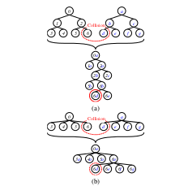
Bounding Volume Hierarchies for Deformable Models
Just as with rigid bodies, 4- and 8-trees are more efficient.
Notes:
-4 & 8 -trees have been shown to be more efficient
image from "Collision Detection for Deformable Objects" paper
---- also talk about:
if we have a limit on the deformation, we can simply make the bounding boxes that much bigger
if we have an equation in terms of displacement fields, the tree can take the displacement fields into account
- easy to do with DOPs or spheres, OBBs are harder

Slide 6


Special Cases for Updating Hierarchies
If the deformation is bounded, simply make the bounding volumes that much bigger so there is no need to update it.
If the deformation is defined by a simple transformation such as:
  We can define parameters applied to the BVH in terms of U and q so that the update is simpler.

Slide 7


Example of Updating for Simple Deformation
If we assume the deformation is defined by:
and that we are using spheres as our bounding volume with centers c and radius r.
The update becomes:

Slide 8
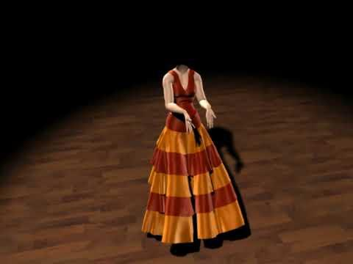
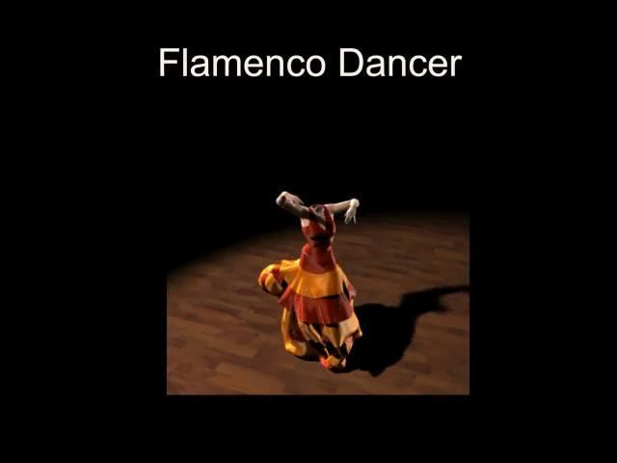
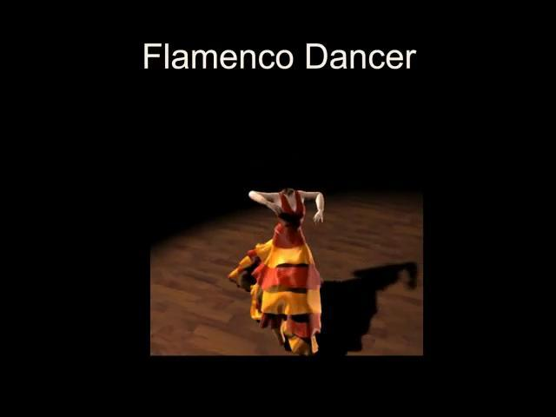


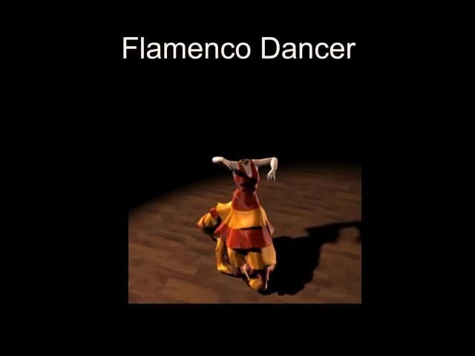
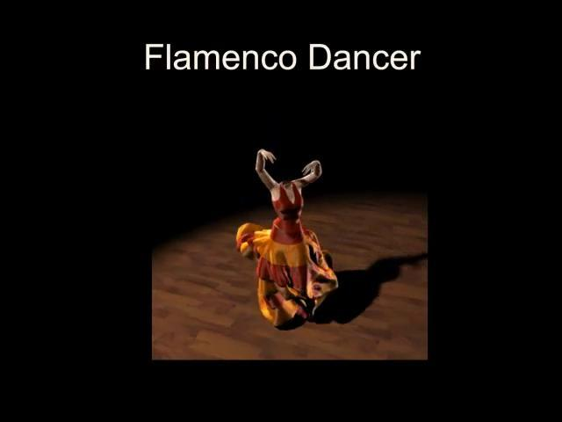
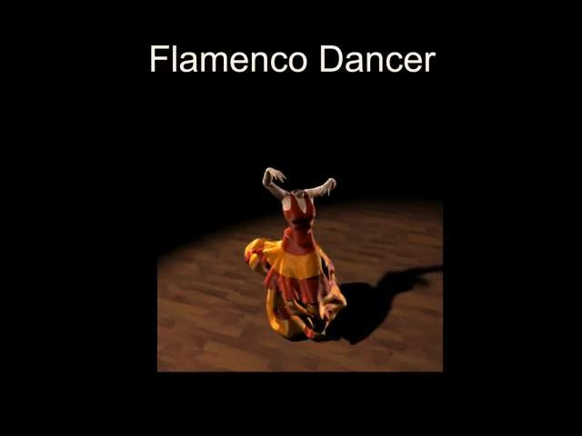




But there is a problem…
It still takes too long for interactive systems!
Notes:
Video by UNC CS GAMMA group
images are individual frames from the video set to appear every .2 seconds (a little slower than the collision detection time given)

Slide 9
Optimizing: what do we care about?
In real-time systems such as games or virtual reality, most of the time we only care that the result "looks right".
And we want it fast!
We could give collision detection a certain amount of time to run per frame… but what happens if it is interrupted in the middle?
Notes:
-we can just give collisions a certain amount of time to run... but do we get any guarantees?

Slide 10
Limiting Collision Detection Time
Several papers have been written on writing interruptible collision detection, but it is far easier to limit the time explicitly in the code.
The easiest way to do this is to limit the number of checks made by the collision detection.
We can do this by sacrificing completeness for stochastic completeness.

Slide 11
Basic Stochastic Collision Detection
Choose random pairs to test for collision between the two models.
Assuming the pairs are evenly distributed over the models, the limit of undetected collisions goes to 0 as the number of pairs tested increases.
This gives a direct trade-off between accuracy and time spent in collision detection.

Slide 12
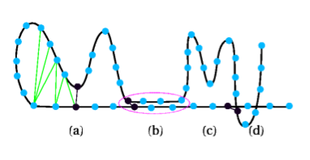
Improving on Randomness
For each pair of primitives tested, use gradient descent to find the local minima between the two objects.
Notes:
Explain image (from Hierarchy Accelerated Stochastic Collision Detection paper)
Even this is only sufficient for rigid bodies.

Slide 13
Temporal Coherence with Active Pairs
In addition to picking new pairs of points to consider each timestep, save which ones we used last time.
Only throw away a pair if it is obvious they will not be in collision soon.
Each timestep run the gradient descent on these pairs.
Notes:
Notes: this is equivalent to tracking pairs of closest features for convex rigid objects.

Slide 14
Biased Pair Generation
We only need many pairs where there are likely to be collisions.
One approach that has been successfully tried is to use a BVH to select neighborhoods in which to create more pairs.
Unfortunately, this brings back the problem of updating the BVH.
Notes:
Unfortunately, this also brings us back to the problem of rebuilding the BVHs every timestep, but reduces the number of pairs needed by a factor of 3 (Hierarchy Accelerated Stochastic Collision Detection - Kimmerle et. al.) (image also from this paper)
-the paper uses a k-DOP hierarchy built bottom up, a 4ary tree
-if the objects did not move more than a certain amount, don't bother updating that part of the hierarchy

Slide 15
Hierarchically Accelerated Stochastic Collision Detection
Kimmerle et. al. implemented a BVH accelerated stochastic collision detection.
They used a 4-tree of k-DOPs as their BVH and used a lazy bottom up updating method.
  Lazy means that if there was only a small change in position, don’t bother updating that part of the hierarchy.
  Their hierarchy is built top down with leaves containing many primitives instead of one primitive each.

Slide 16
Hierarchically Accelerated Stochastic Collision Detection (pseudocode)
update(A and B) lazily bottom-up
traverse(A,B)
if A and B do not overlap then
return
end if
if A and B are leaves then
return intersecting leaves (DOPs)
else
for all children A[i] and B[j] do
traverse(A[i],B[j])
end for
end if
Stochastic Detection as detailed in Section 3, while picking the active pairs out of the intersecting leaves of A and B.

Slide 17
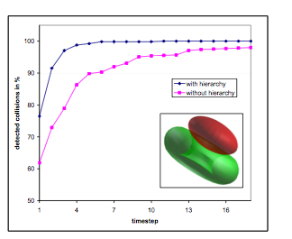
Results from Kimmerle
Adding the BVH to stochastic collision detection reduces the number of pairs needed by a factor of at least three.

Slide 18
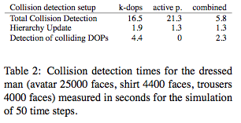
Results from Kimmerle
Combined method outperforms both individually

Slide 19
Another Approach: Using Probability
A new structure called an average-distrubution tree (ADB tree) is proposed by Klien & Zachmann.
Augments the BVH with data about the distribution primitives in each volume.
Then compute the probability of collision based on these distributions.
Notes:
This can be generalized to deformable models via changing the BVH update – see paper

Slide 20
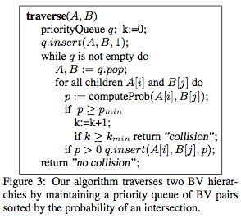
ADB-tree Collision Algorithm
Notes:
-for probability calculations – see paper

Slide 21
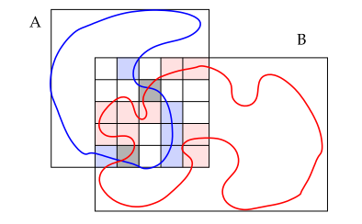
Another Approach: Using Probability
Notes:
One slide summary of "ADB-Trees: Controlling the Error of Time-Critical Collision Detection" by Jan Klien and Gabriel Zachmann
-explain ADB tree probabilistic collision detection
-at each level of BVH: compute probability of collision
-if below threshold - no collision
-if above threshold - recurse
-if above higher threshold - collision
- these thresholds can be set to get performace
-author claims 3-6x speedup with only 4% error
-other papers which cite this say many false positives are a problem

Slide 22
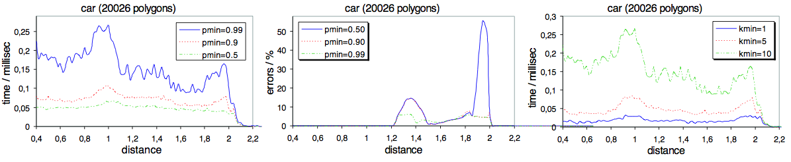
Analysis of ADB Collision Detection
Changing the constants p_{min} and k_{min} affects the running time and accuracy.
In general, as they increase accuracy goes up and time gets longer.

Slide 23
Analysis of ADB Collision Detection
Papers that cite this work state that this method produces many false positives, which may explain small gains for large changes in the parameters.

Slide 24
References
Kimmerle, S., Nesme, M., Faure, F.: Hierarchy accelerated stochastic collision detection. In: Proceedings of Vision, Modeling, Visualization, pp. 307–314 (2004)
KLEIN J., ZACHMANN G.: Adb-trees: Controlling the error of time-critical collision de- tection. In 8th International Fall Workshop Vision, Modeling, and Visualization (VMV) (University München, Germany, Nov.19–21 2003).
Teschner, M., Kimmerle, S., Heidelberger, B., Zachmann, G., Raghupathi, L., & Fuhrmann, A. (2005). Collision Detection for Deformable Objects, xx(x).

Slide 25
Questions?
Thank you!

