Slide 1
Simulation of Soft Tissue & Surgical Applications
Zhenlin Xu
11/11/16

Slide 2
Outline
Linear Elasticity Model
  Linear elasticity
  Finite element modeling
  Pre-computed model and tensor-mass model
Large Displacement Non-Linear Elastic
  Shortcomings of linear elasticity
  St Venant-Kirchhoff elasticity
  Finite element modeling
  Incompressibility constraint
Experimental Results
Optimization of non-linear deformations

Slide 3
Linear Elasticity Model
Elasticity :
  Deformation disappears when the applied load is removed
  Deformation is history-independent
  Potential energy exists (function of deformation)
Linear
  D is a constant

Slide 4
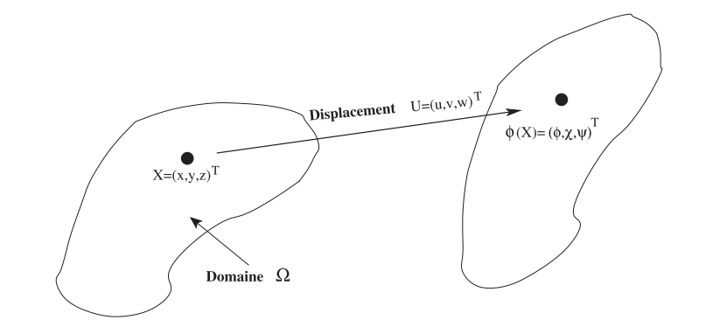


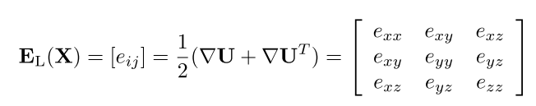
Linear Elasticity Model
Cauchy-Green strain tensor
Green Lagrange strain tensor
  Derived from the right Cauchy-Green strain tensor, allows to analyze the deformation after rigid body motion has been removed
  Linearized to infinitesimal strain tensor:
Rest position
Deformed position
[1] H. Delingette and N. Ayache, “Soft Tissue Modeling for Surgery Simulation,” in Handbook of Numerical Analysis, vol. 12, 2004, pp. 453–550.

Slide 5
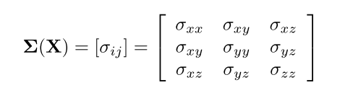
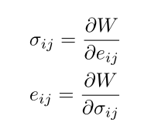

Linear Elasticity Model
Cauchy stress tensor
  The Cauchy stress Σ and infinitesimal strain $E_{L}$ are conjugated variables:
  where $W(X)$ is the amount of elastic energy per unit volume
[1] H. Delingette and N. Ayache, “Soft Tissue Modeling for Surgery Simulation,” in Handbook of Numerical Analysis, vol. 12, 2004, pp. 453–550.

Slide 6




Linear Elasticity Model
Elastic energy
  For isotropic linear elastic material:
    where $λ$ and $μ$ are the two Lame coefficients characterizing the material stiffness
    where Ε is Young’s Modulus and ν is Poisson’s Ratio
    We can derive from the that:
[1] H. Delingette and N. Ayache, “Soft Tissue Modeling for Surgery Simulation,” in Handbook of Numerical Analysis, vol. 12, 2004, pp. 453–550.

Slide 7
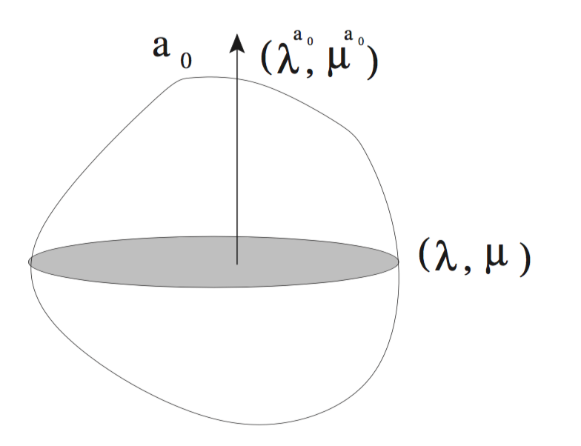
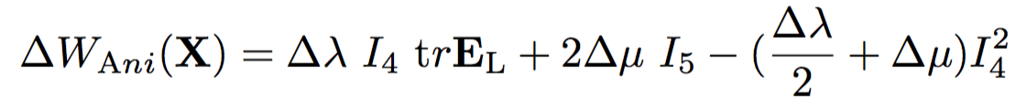
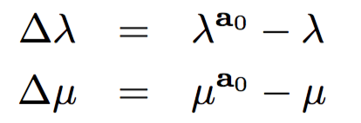
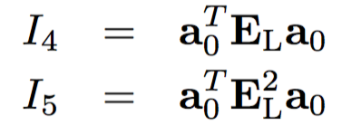
Linear Elasticity Model
Elastic energy
  For transversally isotropic linear elastic material:
    where
[1] H. Delingette and N. Ayache, “Soft Tissue Modeling for Surgery Simulation,” in Handbook of Numerical Analysis, vol. 12, 2004, pp. 453–550.
Notes:
a0 along which the material stiffness differs from the stiffness in the orthogonal plane.
a corrective term
I4 I5 Amount of stretch in a0

Slide 8
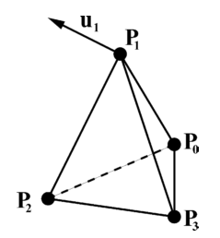

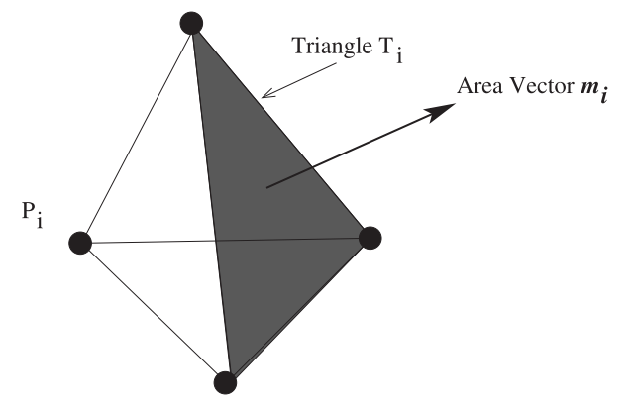



Linear Elasticity Model
Finite element modeling
  We use $P_{1}$ finite element (linear tetrahedron):
  The shape function
  where
[1] H. Delingette and N. Ayache, “Soft Tissue Modeling for Surgery Simulation,” in Handbook of Numerical Analysis, vol. 12, 2004, pp. 453–550.

Slide 9

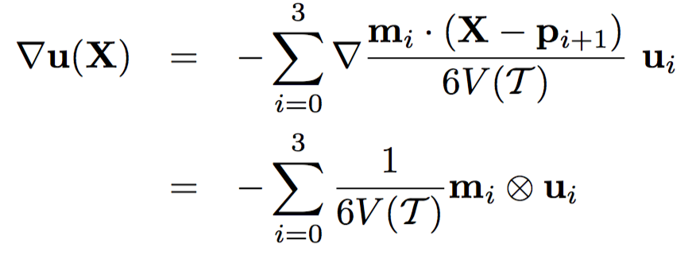
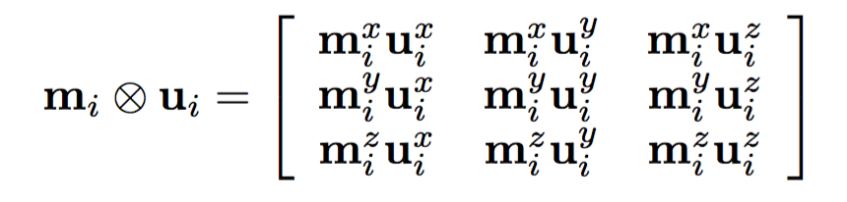
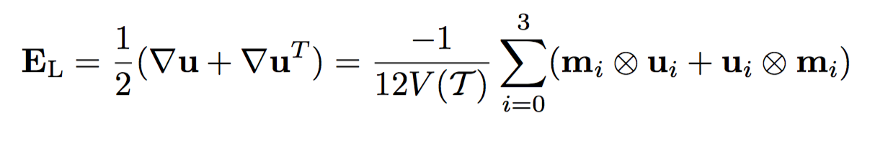
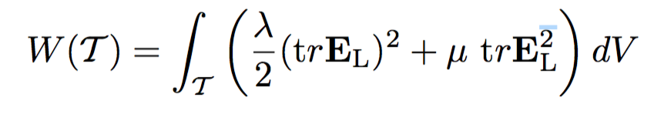
Linear Elasticity Model
Computation of stiffness Matrix (isotropic case)
  The gradient of the displacement is constant inside :
  The Infinitesimal strain tensor is also constant inside
  The linear isotropic elastic energy is equal to
[1] H. Delingette and N. Ayache, “Soft Tissue Modeling for Surgery Simulation,” in Handbook of Numerical Analysis, vol. 12, 2004, pp. 453–550.

Slide 10
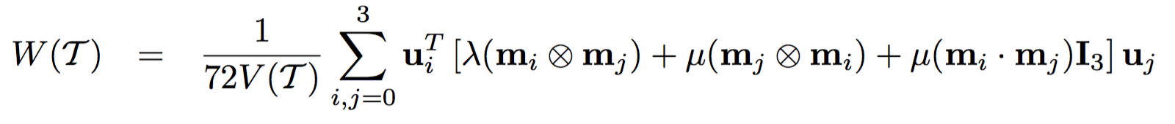
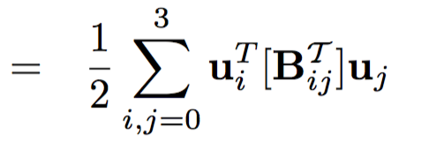

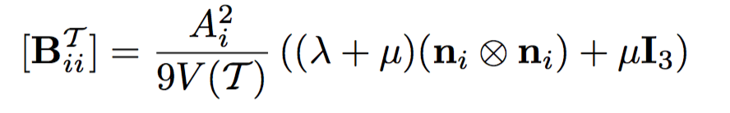
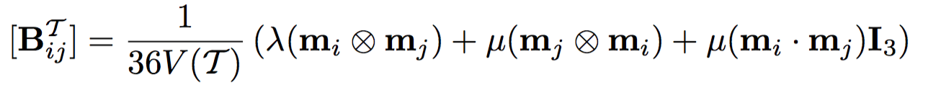
Linear Elasticity Model
Computation of stiffness Matrix (isotropic case)
  Finally the linear elastic energy is a quadratic function of the displacement:
  where is the 3 × 3 stiffness matrix of tetrahedron between vertices i and j.
    when i = j , local vertex stiffness matrix
    when i ≠ j , local edge stiffness matrix
[1] H. Delingette and N. Ayache, “Soft Tissue Modeling for Surgery Simulation,” in Handbook of Numerical Analysis, vol. 12, 2004, pp. 453–550.

Slide 11
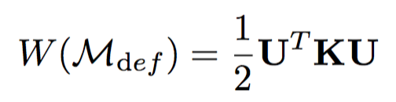



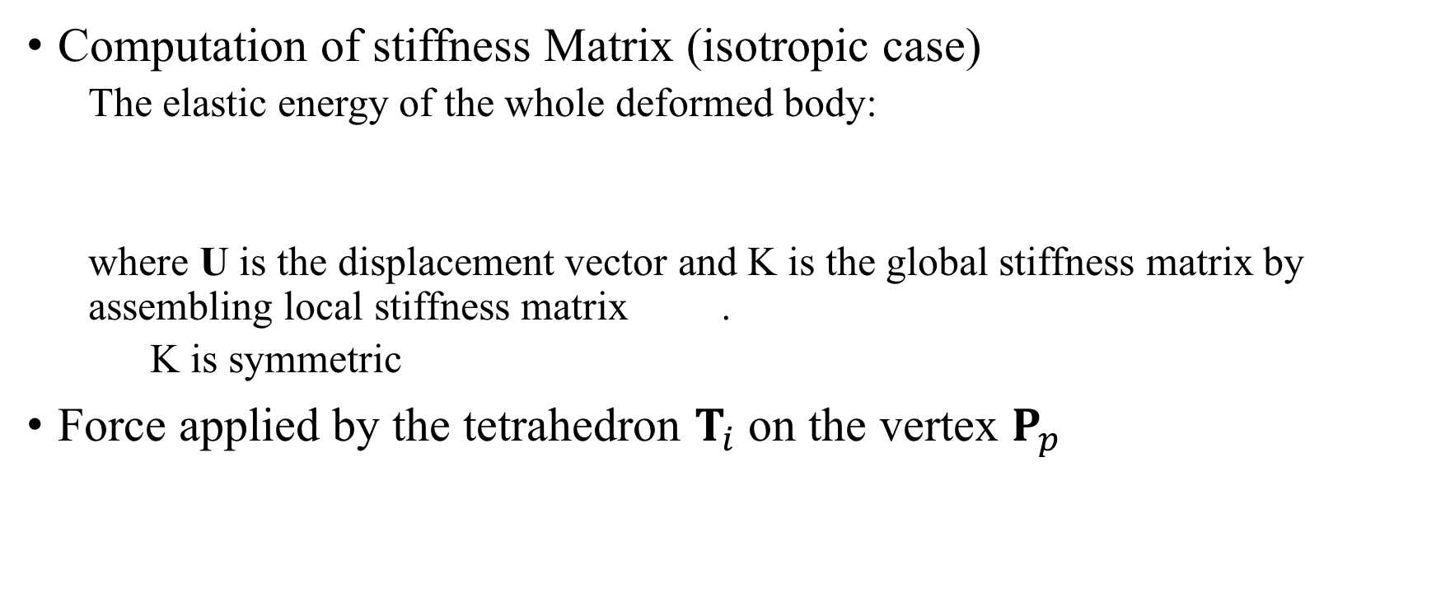
Linear Elasticity Model
Computation of stiffness Matrix (isotropic case)
  The elastic energy of the whole deformed body:
  where U is the displacement vector and K is the global stiffness matrix by assembling local stiffness matrix .
  K is symmetric
Force applied by the tetrahedron $T_{i}$ on the vertex $P_{p}$
[1] H. Delingette and N. Ayache, “Soft Tissue Modeling for Surgery Simulation,” in Handbook of Numerical Analysis, vol. 12, 2004, pp. 453–550.

Slide 12
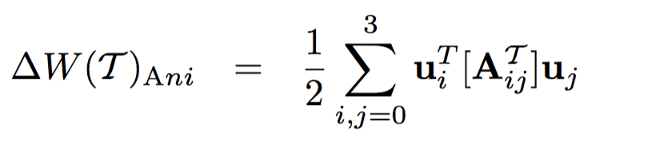
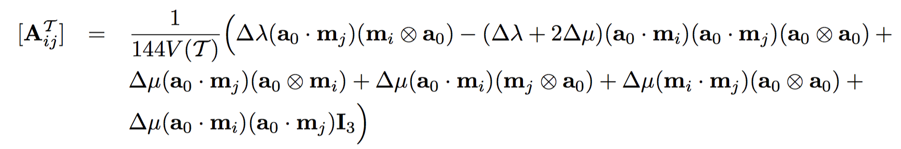
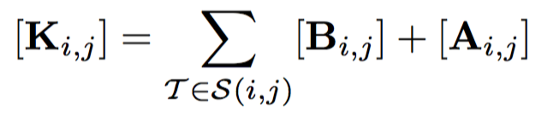
Linear Elasticity Model
Computation of stiffness Matrix (transversally isotropic case)
  The elastic energy:
  Local stiffness
  Global stiffness
[1] H. Delingette and N. Ayache, “Soft Tissue Modeling for Surgery Simulation,” in Handbook of Numerical Analysis, vol. 12, 2004, pp. 453–550.
Notes:
the global sti ness matrix K is assem- bled as the sum of local isotropic and anisotropic sti ness matrices :

Slide 13


Linear Elasticity Model
Equilibrium equations
  Static
    where R is the sum of virtual work done by gravity, boundary forces
  Dynamic(adding the inertial and damping forces)
    where M is the mass matrix and C is the damping matrix
[1] H. Delingette and N. Ayache, “Soft Tissue Modeling for Surgery Simulation,” in Handbook of Numerical Analysis, vol. 12, 2004, pp. 453–550.

Slide 14
Linear Elasticity Model
Solve the equilibrium equations (static)
  Since K is sparse, the classical method to solve this equation is to use the conjugated gradient algorithm with pre-process steps:
    Node Renumbering by using the reverse cutting McKee algorithm in order to decrease the bandwidth of the stiffness matrix.
    Matrix Preconditioning based on Cholesky factorization or incomplete LU decomposition
  Quasi-static precomputed linear elastic model:
    partially inverting the stiffness matrix K in a precomputation stage before the simulation
    quasi-static (it computes the static equilibrium position at each iteration)
    computationally very efficient (real time)
    only update the position of surface nodes
    the mesh topology is not modified during the simulation (no cutting or suturing)
[1] H. Delingette and N. Ayache, “Soft Tissue Modeling for Surgery Simulation,” in Handbook of Numerical Analysis, vol. 12, 2004, pp. 453–550.
[2] S. Cotin, H. Delingette, and N. Ayache, “Real-time elastic deformations of soft tissues for surgery simulation,” IEEE Trans. Vis. Comput. Graph., vol. 5, no. 1, pp. 62–73, 1999.
Notes:
Quasi-static Pre-compute： the computation complexity during the simulation is proportional to the cube of the number of imposed displacements.
Interaction of surrounding tissue is translated into modified bond cond only on surface nodes

Slide 15
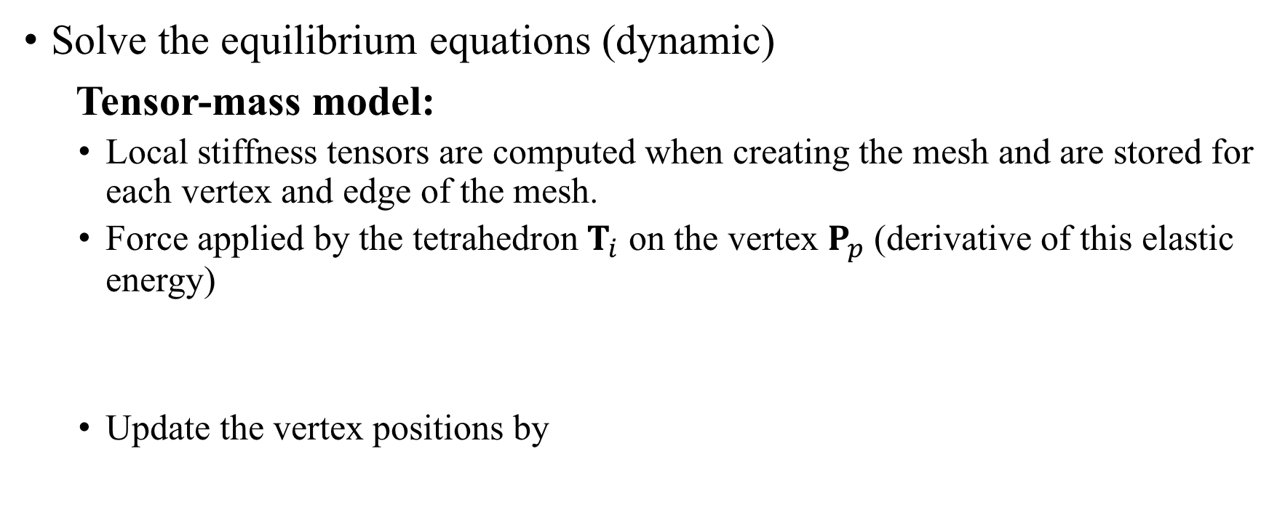
Linear Elasticity Model
Solve the equilibrium equations (dynamic)
Tensor-mass model:
  Local stiffness tensors are computed when creating the mesh and are stored for each vertex and edge of the mesh.
  Force applied by the tetrahedron $T_{i}$ on the vertex $P_{p}$(derivative of this elastic energy)
  Update the vertex positions by
[3] S. Cotin, H. Delingette, and N. Ayache, “A Hybrid Elastic Model allowing Real-Time Cutting, Deformations and Force-Feedback for Surgery Training and Simulation,” Publ. Vis. Comput. J., vol. 16, no. 8, pp. 437–452, 2000.

Slide 16
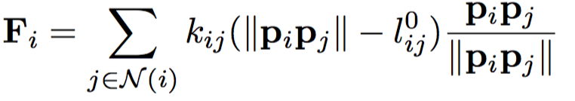
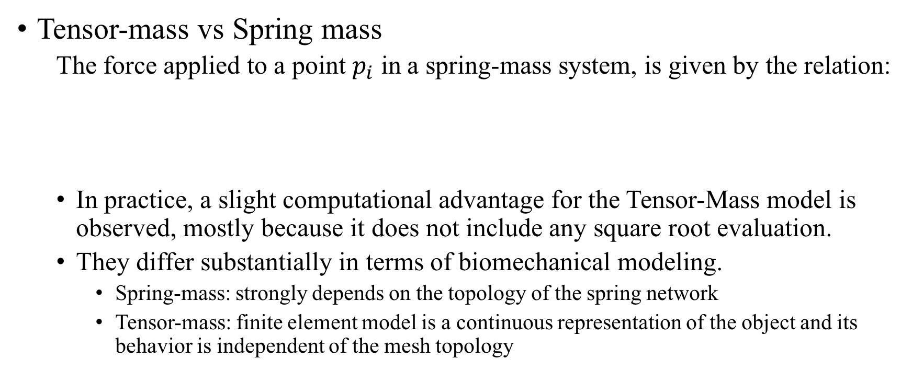
Linear Elasticity Model
Tensor-mass vs Spring mass
  The force applied to a point $p_{i}$ in a spring-mass system, is given by the relation:
  In practice, a slight computational advantage for the Tensor-Mass model is observed, mostly because it does not include any square root evaluation.
  They differ substantially in terms of biomechanical modeling.
    Spring-mass: strongly depends on the topology of the spring network
    Tensor-mass: finite element model is a continuous representation of the object and its behavior is independent of the mesh topology
[1] H. Delingette and N. Ayache, “Soft Tissue Modeling for Surgery Simulation,” in Handbook of Numerical Analysis, vol. 12, 2004, pp. 453–550.
Notes:
Spring-mass systems constitute a discrete representation of an object and their behavior strongly depends on the topology of the spring network. Adding or removing a spring may change the elastic behavior of the whole system drastically. Conversely, finite element model is a continuous representation of the object and its behavior is independent of the mesh topology (it mostly depends on the mesh resolution). This is an advantage when mesh cutting is performed since it produces continuous and natural deformations.

Slide 17
Linear Elasticity Model
Tensor-mass vs Spring mass
  All biomechanical data related to biological soft tissue are formulated as parameters found in continuum mechanics (such as Young‘s modulus or Poisson coefficients), spring-mass system is hard to model realistic soft tissue deformations.
  Linear Tensor-Mass model is only valid for small displacements. Not invariant to global rotation
Comparison between the three soft tissue models [1]
[1] H. Delingette and N. Ayache, “Soft Tissue Modeling for Surgery Simulation,” in Handbook of Numerical Analysis, vol. 12, 2004, pp. 453–550.

Slide 18
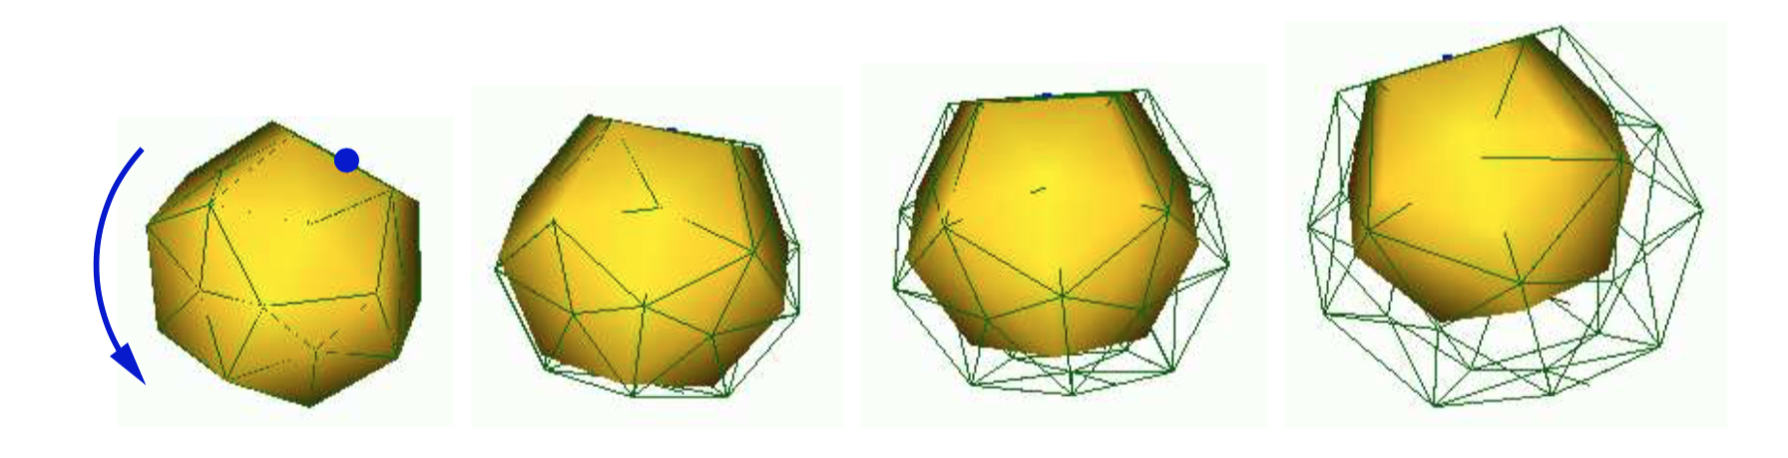




Large Displacement Non-Linear Elastic Model
Shortcomings of linear elasticity
  Infinitesimal strain (small displacement) hypothesis: typically less than 10% of the mesh size.
  The problem of rotational invariance:
    Example 1: When an object undergoes a global rotation, its elastic energy increases, leading to a large variation of volume
Global rotation of the linear elastic model (wireframe)
[1] H. Delingette and N. Ayache, “Soft Tissue Modeling for Surgery Simulation,” in Handbook of Numerical Analysis, vol. 12, 2004, pp. 453–550.
[4] G. Picinbono, H. Delingette, and N. Ayache, “Non-linear anisotropic elasticity for real-time surgery simulation,” Graph. Models, vol. 65, no. 5, pp. 305–321, 2003.

Slide 19
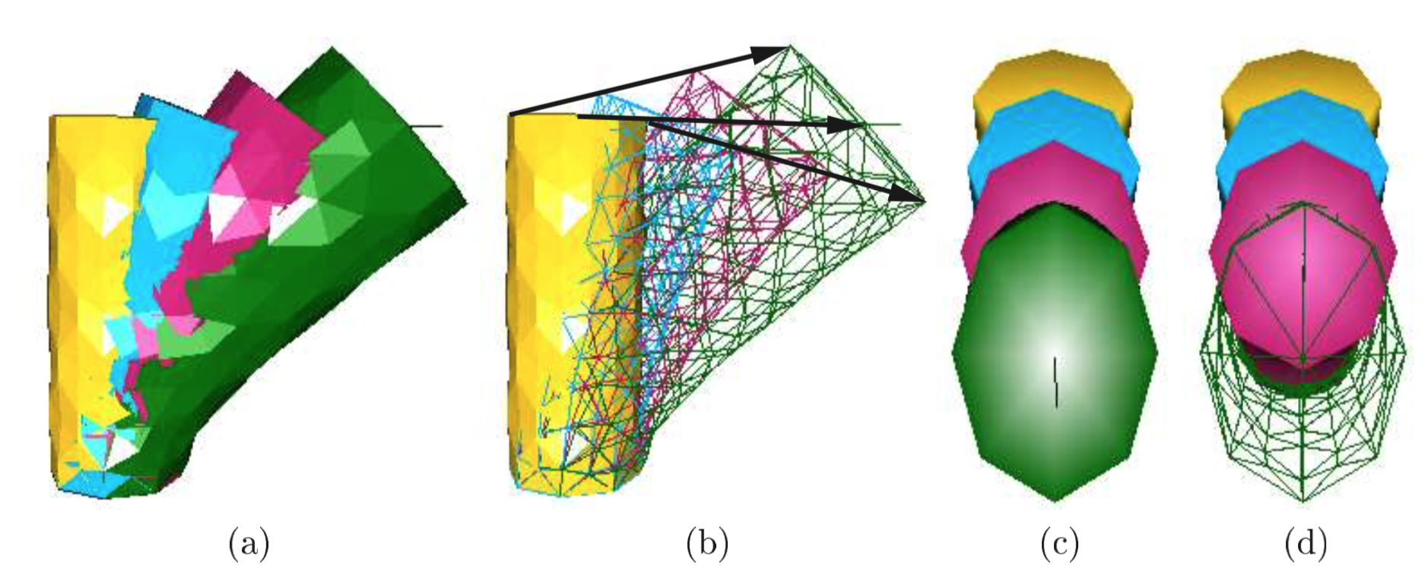
Large Displacement Non-Linear Elastic Model
Shortcomings of linear elasticity
  The problem of rotational invariance:
    Example 2: the effect of linear elasticity when only one part of an object undergoes a large rotation.
Successive deformations of a linear elastic cylinder
(a) and (b): side view. (c) and (d): top view
[1] H. Delingette and N. Ayache, “Soft Tissue Modeling for Surgery Simulation,” in Handbook of Numerical Analysis, vol. 12, 2004, pp. 453–550.
[4] G. Picinbono, H. Delingette, and N. Ayache, “Non-linear anisotropic elasticity for real-time surgery simulation,” Graph. Models, vol. 65, no. 5, pp. 305–321, 2003.
Notes:
bottom face fixed while a force is being applied at the central top vertex The arrows correspond to the trajectories of some vertices : because of the linear elastic hypothesis, these trajectories are straight lines.

Slide 20
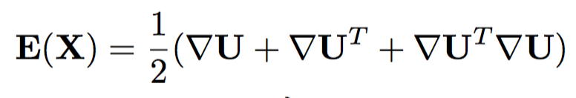
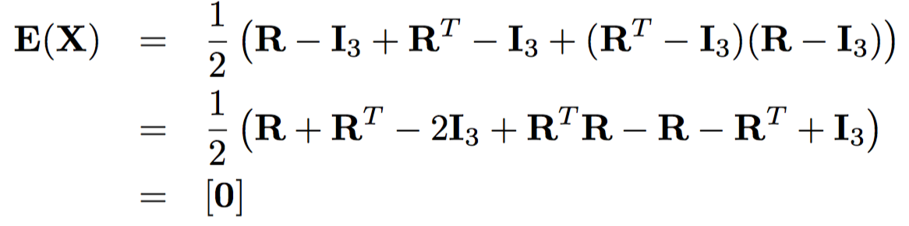
Large Displacement Non-Linear Elastic Model
St Venant-Kirchhoff elasticity
  Green-Lagrange strain tensor
    Rotation invariant : when
[1] H. Delingette and N. Ayache, “Soft Tissue Modeling for Surgery Simulation,” in Handbook of Numerical Analysis, vol. 12, 2004, pp. 453–550.
[4] G. Picinbono, H. Delingette, and N. Ayache, “Non-linear anisotropic elasticity for real-time surgery simulation,” Graph. Models, vol. 65, no. 5, pp. 305–321, 2003.

Slide 21

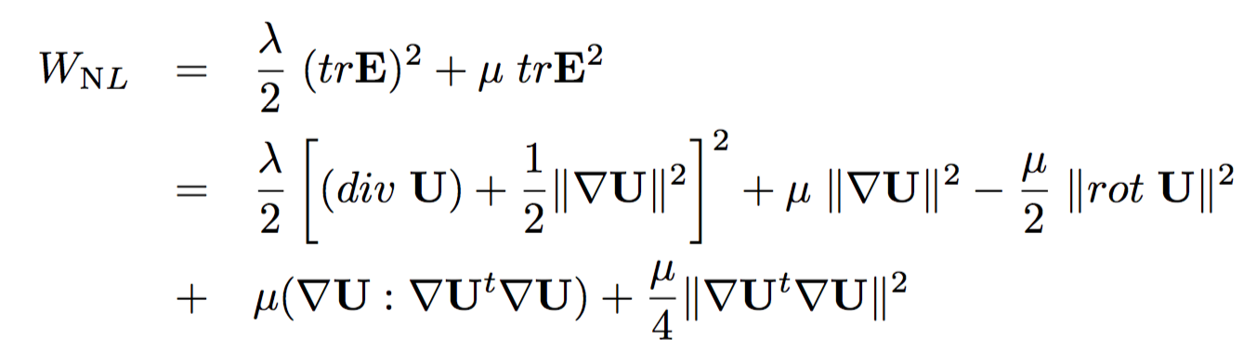
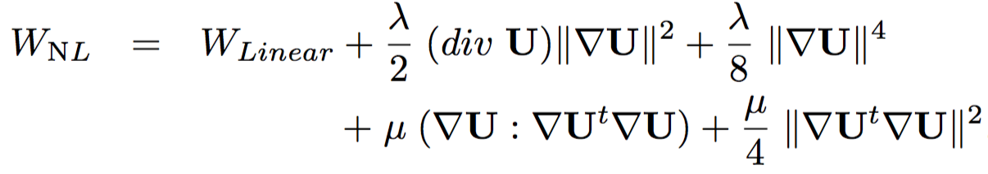
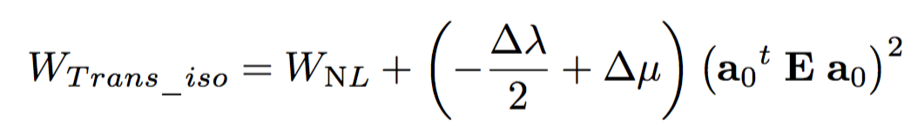

Large Displacement Non-Linear Elastic Model
St Venant-Kirchhoff elasticity
  Nonlinear elastic energy (quadratic function of )
    where div U is the divergence of the vector field U(x,y,z), rot U is the rotational matrix of U
    is the dot product of two matrices
Transversally isotropic case:
[1] H. Delingette and N. Ayache, “Soft Tissue Modeling for Surgery Simulation,” in Handbook of Numerical Analysis, vol. 12, 2004, pp. 453–550.
[4] G. Picinbono, H. Delingette, and N. Ayache, “Non-linear anisotropic elasticity for real-time surgery simulation,” Graph. Models, vol. 65, no. 5, pp. 305–321, 2003.

Slide 22
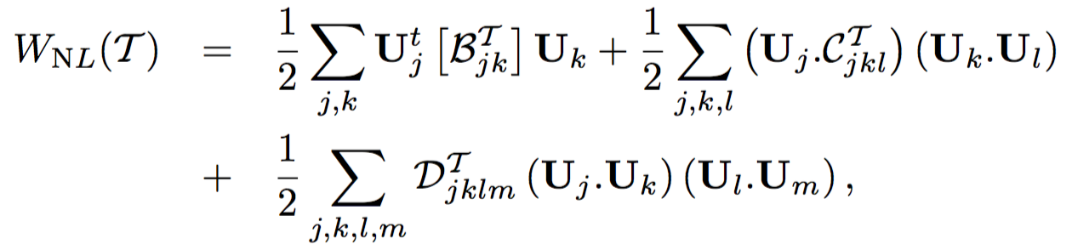



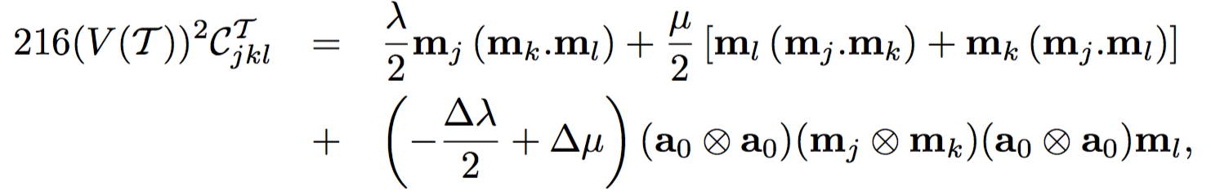
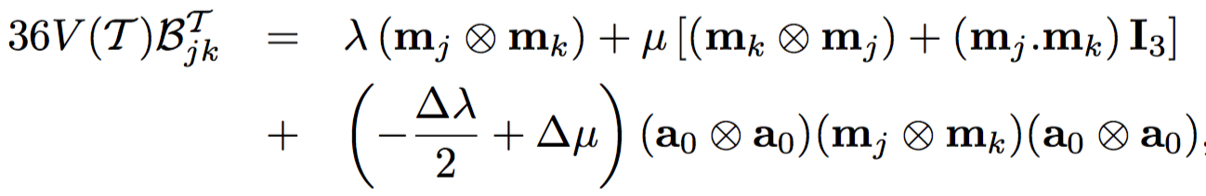
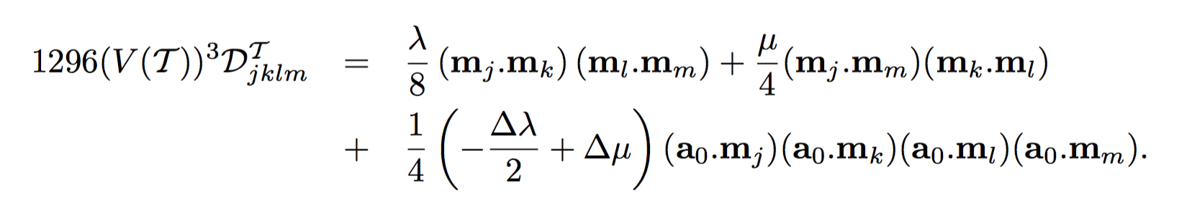
Large Displacement Non-Linear Elastic Model
Finite element modeling
  where the terms (a 3x3 matrxi ), (scalar) and (scalar) , called stiffness paramerters:
*The last term of each stiffness parameter models the anisotropic behavior of the material.
[1] H. Delingette and N. Ayache, “Soft Tissue Modeling for Surgery Simulation,” in Handbook of Numerical Analysis, vol. 12, 2004, pp. 453–550.
[4] G. Picinbono, H. Delingette, and N. Ayache, “Non-linear anisotropic elasticity for real-time surgery simulation,” Graph. Models, vol. 65, no. 5, pp. 305–321, 2003.

Slide 23
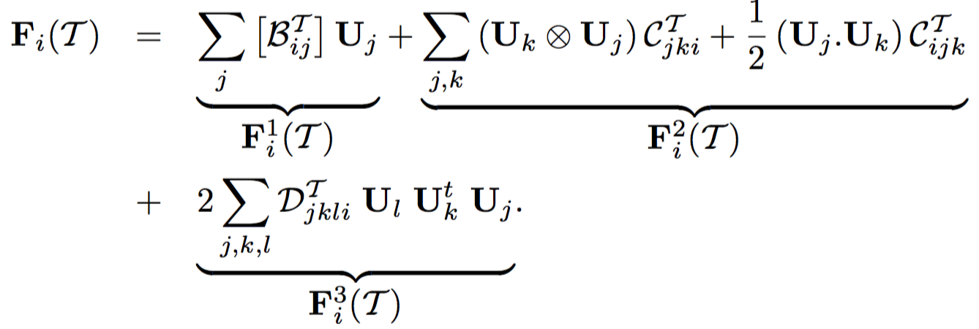

Large Displacement Non-Linear Elastic Model
Finite element modeling
  Force applied by the tetrahedron $T_{i}$ on the vertex $p_{i}$
  The first term corresponds to the force in linear elastic case
[1] H. Delingette and N. Ayache, “Soft Tissue Modeling for Surgery Simulation,” in Handbook of Numerical Analysis, vol. 12, 2004, pp. 453–550.
[4] G. Picinbono, H. Delingette, and N. Ayache, “Non-linear anisotropic elasticity for real-time surgery simulation,” Graph. Models, vol. 65, no. 5, pp. 305–321, 2003.

Slide 24

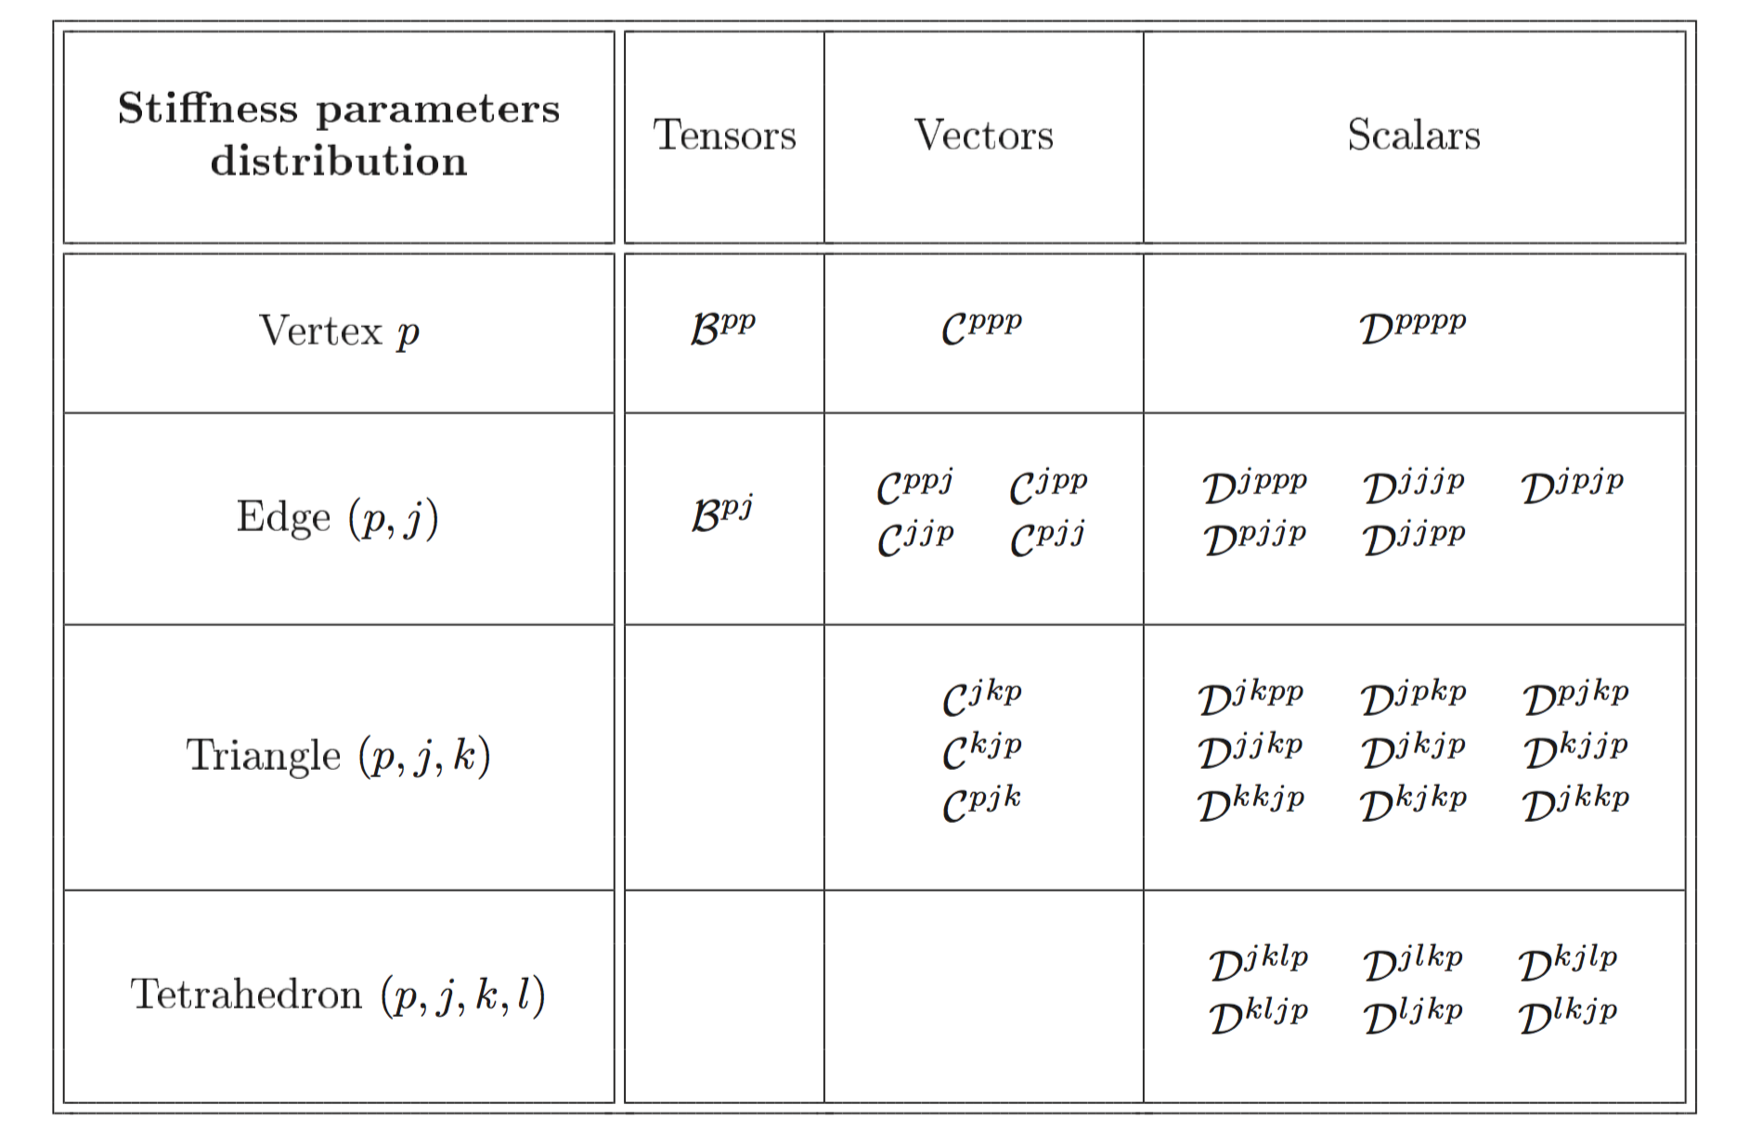
Large Displacement Non-Linear Elastic Model
Finite element modeling
  Nonlinear Tensor-Mass model
  linear case
The computation of the elastic force is performed by successively scanning tetrahedral, triangles, edges and vertices of the mesh.
When scanning triangles for instance, the contributions from the three triangles are computed and added to the elastic force of each of its three vertices.
[1] H. Delingette and N. Ayache, “Soft Tissue Modeling for Surgery Simulation,” in Handbook of Numerical Analysis, vol. 12, 2004, pp. 453–550.
[4] G. Picinbono, H. Delingette, and N. Ayache, “Non-linear anisotropic elasticity for real-time surgery simulation,” Graph. Models, vol. 65, no. 5, pp. 305–321, 2003.
Notes:
Linear we can accumulate local stiffness tensors on vertices and edges of the mesh the corre- sponding contributions to the global stiffness tensors
These stiffness tensors are computed when creating the mesh and are stored for each vertex and edge of the mesh.

Slide 25
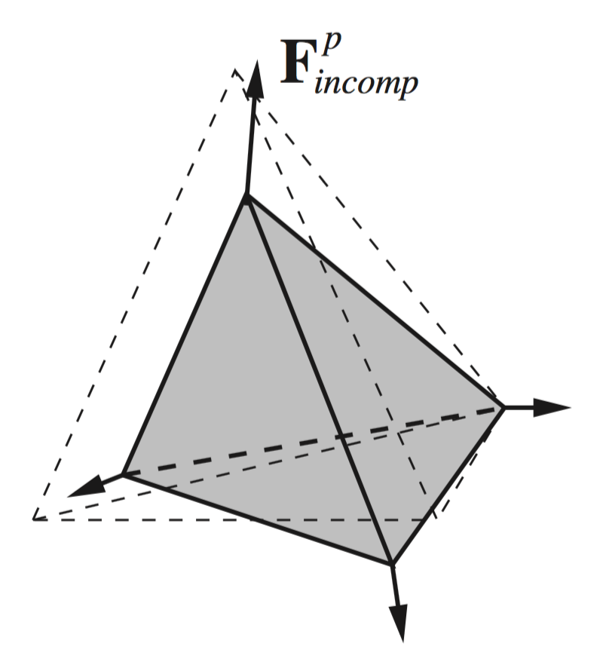
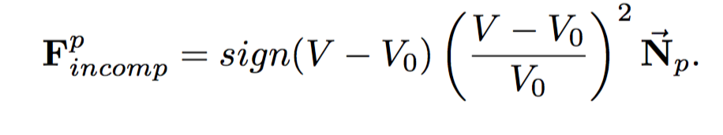

Large Displacement Non-Linear Elastic Model
Incompressibility constraint
  Living tissue, which is made essentially of water is almost incompressible
  In St Venant-Kirchho mode:
    Lamé constant λ tends towards infinity
      large λ value would impose to decrease the time step.
    The Green-Lagrange strain tensor E which is invariant with respect to rotations and also with respect to symmetries
      the reversal of some tetrahedra under strong constraints.
        is the normal of the opposite face
[1] H. Delingette and N. Ayache, “Soft Tissue Modeling for Surgery Simulation,” in Handbook of Numerical Analysis, vol. 12, 2004, pp. 453–550.
[4] G. Picinbono, H. Delingette, and N. Ayache, “Non-linear anisotropic elasticity for real-time surgery simulation,” Graph. Models, vol. 65, no. 5, pp. 305–321, 2003.
Notes:
penalize volume variation by applying to each vertex of the tetra hedron a force directed along the normal of the opposite face Np

Slide 26
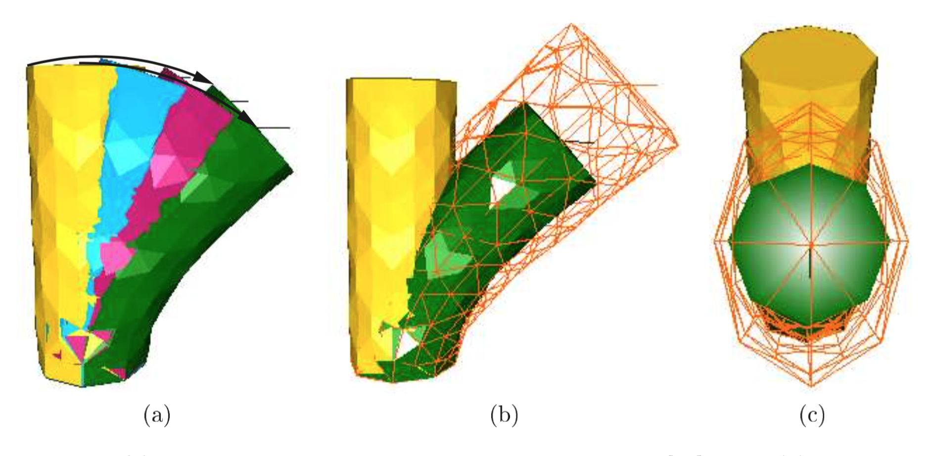
Results
Example 1: partial rotations
(a) Successive deformations of the non-linear model. Side (b) and top (c) view of the comparison between linear (wireframe) and non-linear model (solid rendering)
[1] H. Delingette and N. Ayache, “Soft Tissue Modeling for Surgery Simulation,” in Handbook of Numerical Analysis, vol. 12, 2004, pp. 453–550.
[4] G. Picinbono, H. Delingette, and N. Ayache, “Non-linear anisotropic elasticity for real-time surgery simulation,” Graph. Models, vol. 65, no. 5, pp. 305–321, 2003.

Slide 27
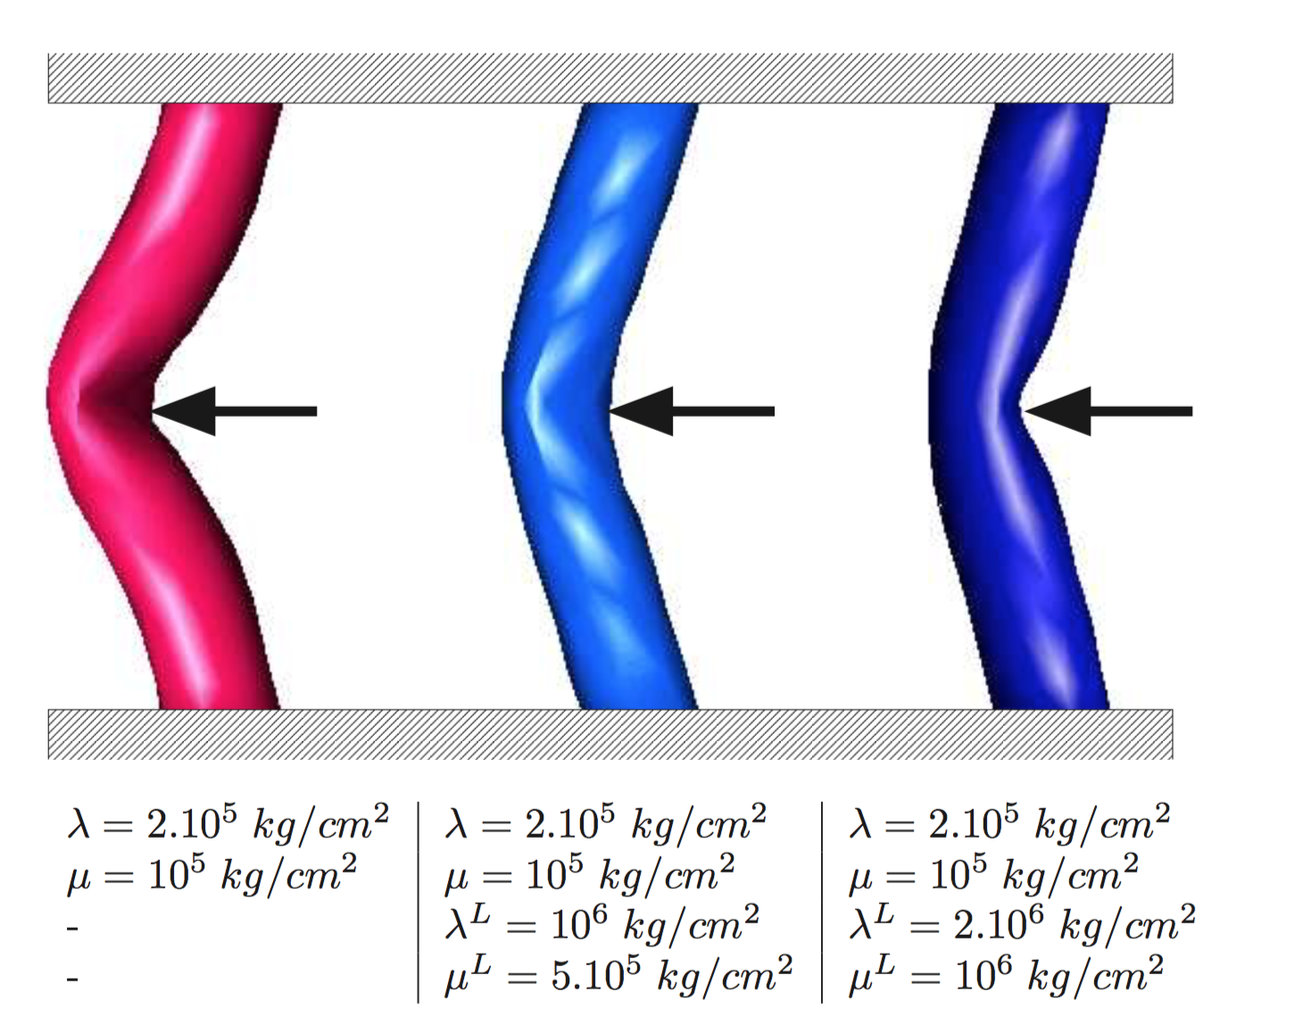
Experimental Results
Example 2: isotropic and anisotropic materials.
Deformation of tubular structures with non-linear isotropic (leftmost) and transversally isotropic (the center and rightmost ) elasticity.
[1] H. Delingette and N. Ayache, “Soft Tissue Modeling for Surgery Simulation,” in Handbook of Numerical Analysis, vol. 12, 2004, pp. 453–550.
[4] G. Picinbono, H. Delingette, and N. Ayache, “Non-linear anisotropic elasticity for real-time surgery simulation,” Graph. Models, vol. 65, no. 5, pp. 305–321, 2003.

Slide 28
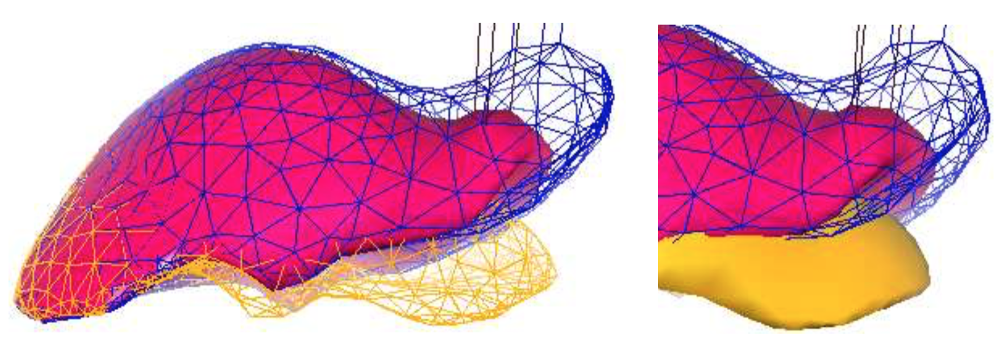
Experimental Results
Example 3: Apply a force to the right lobe of the liver
the liver is fixed in a region near the center of its back side, and Lamé coefficients are: λ = 40kPa and μ = 10kPa
Linear (wireframe), non-linear (solid) liver models, and rest shape (bottom).
[1] H. Delingette and N. Ayache, “Soft Tissue Modeling for Surgery Simulation,” in Handbook of Numerical Analysis, vol. 12, 2004, pp. 453–550.
[4] G. Picinbono, H. Delingette, and N. Ayache, “Non-linear anisotropic elasticity for real-time surgery simulation,” Graph. Models, vol. 65, no. 5, pp. 305–321, 2003.

Slide 29
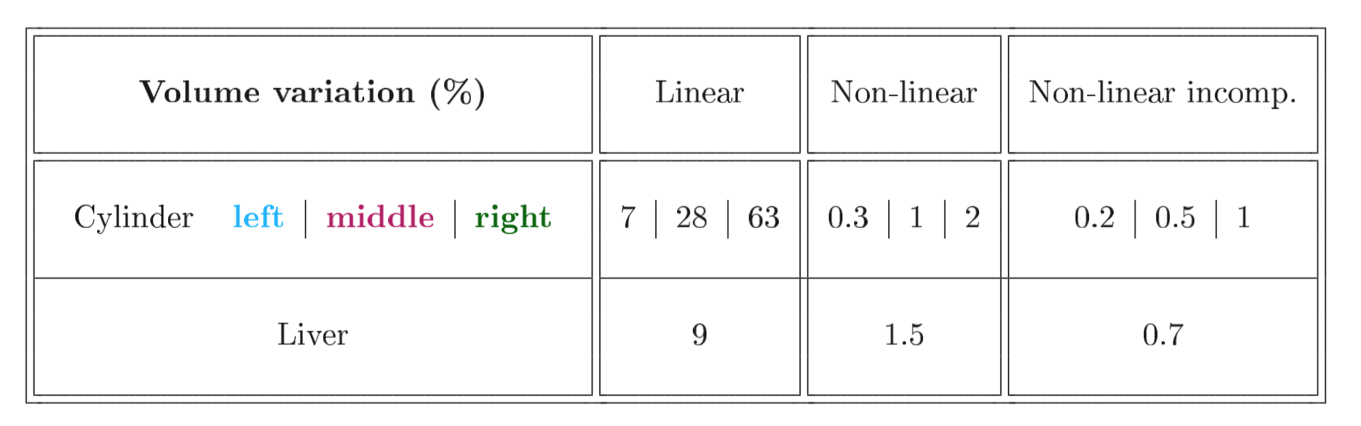
Experimental Results

Slide 30
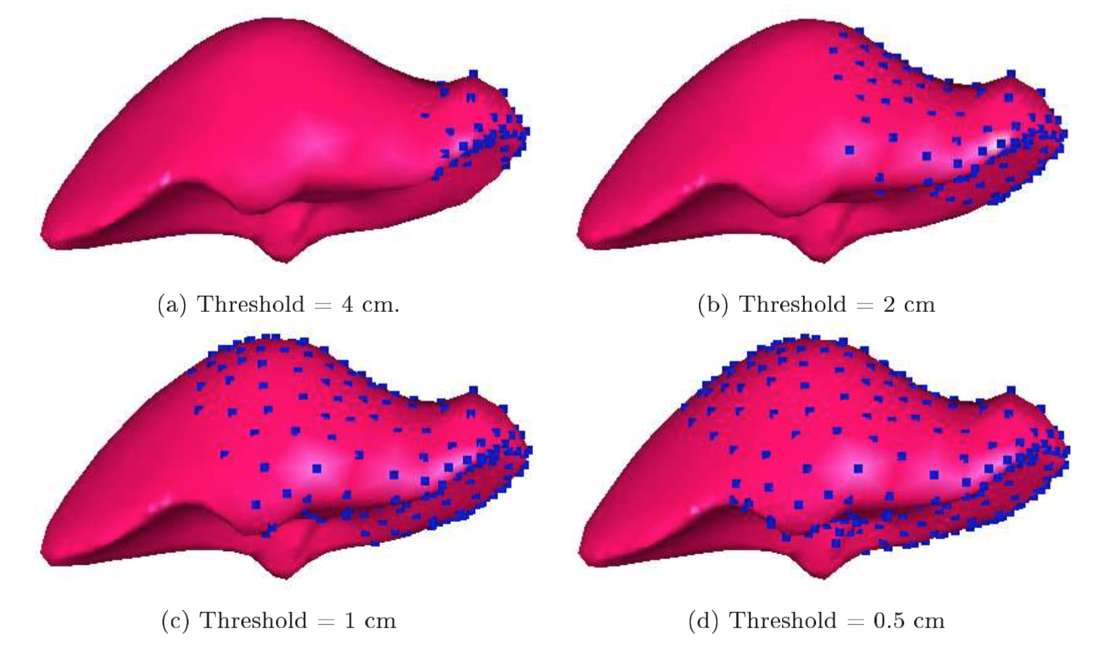

Optimization of non-linear deformations
Use nonlinear elasticity only at parts of the mesh where displacements are larger than a given threshold
Experiment: liver model is made of 6342 tetrahedra and 1394 vertices.
Updating frequencies of the adaptable model for several values of the threshold.

Slide 31
Reference
[1] H. Delingette and N. Ayache, “Soft Tissue Modeling for Surgery Simulation,” in Handbook of Numerical Analysis, vol. 12, 2004, pp. 453–550.
[2] S. Cotin, H. Delingette, and N. Ayache, “Real-time elastic deformations of soft tissues for surgery simulation,” IEEE Trans. Vis. Comput. Graph., vol. 5, no. 1, pp. 62–73, 1999.
[3] S. Cotin, H. Delingette, and N. Ayache, “A Hybrid Elastic Model allowing Real-Time Cutting, Deformations and Force-Feedback for Surgery Training and Simulation,” Publ. Vis. Comput. J., vol. 16, no. 8, pp. 437–452, 2000.
[4] G. Picinbono, H. Delingette, and N. Ayache, “Non-linear anisotropic elasticity for real-time surgery simulation,” Graph. Models, vol. 65, no. 5, pp. 305–321, 2003.

Slide 32
Questions?

