Slide 1
Fluid Simulation Fundamentals
Asad Ullah Naweed

Slide 2
Solids
Solids, both deformable and rigid, can be modeled as a set of vertices at the surface of the object.
Even deformable objects are subject to a strong set of physical constraints.
Reduced degrees of freedom.

Slide 3
Fluids
They flow. Free as a bird.
Weak inter-mollecular forces mean less constraints on movement.
Modeling the surface is no longer enough.

Slide 4
The Basic Math
The of fluid dynamics

Slide 5
The Basic Math
Simple Incompressibility condition

Slide 6
The Basic Math
My Reaction: WTH??

Slide 7
The Basic Math
And if we were in a math or physics class, I would spend the rest of the lecture rigorously deriving those equations.
Lets just gloss over them instead, so we can get to the cool stuff.

Slide 8
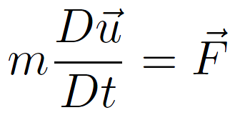
The Basic Math

Slide 9
The Basic Math
Force due to gravity

Slide 10
The Basic Math
Force due to pressure of neighboring particles.

Slide 11
The Basic Math
Force due to fluid viscosity
Viscous fluids tend to have a more “smoothed out” velocity field inside.

Slide 12
The Basic Math
Divide by V, and take the limit as V → 0

Slide 13
The Basic Math
What we just “derived”:
What I showed you at the start:

Slide 14
Frames of Reference
Lagrangian – Soup of particles all moving around. Each particle has physical quantities.
Eulerian – A fixed grid of points in space. Track physical quantities only at those fixed points.

Slide 15
Material Derivative
q can be ANY scalar, vector or matrix quantity!
Go Back

Slide 16
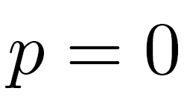
Boundary Conditions
At solid walls:
At free surfaces:

Slide 17
Questions?
Some questions you should have asked:
What exactly is the “pressure”? You described it as an arbitrary quantity and never explained how its computed.
I don’t get the whole Lagrangian and Eulerian points of view thing. Why would you do that?

Slide 18
Equations set up – Now what?
We solve them. Duh.
Unfortunately, these are not simple Newtonian mechanics.
Equations are pretty ugly too.

Slide 19
Simplification
Simple trick: Drop viscosity.
Discretize – in time and in space.

Slide 20
Space Discretization Marker-And-Cell (MAC) Grids
Not all variables are stored in the same place in the grid.
Staggered Grid.
Need to overcome the nasty shortcomings of central differences for gradient computation.

Slide 21
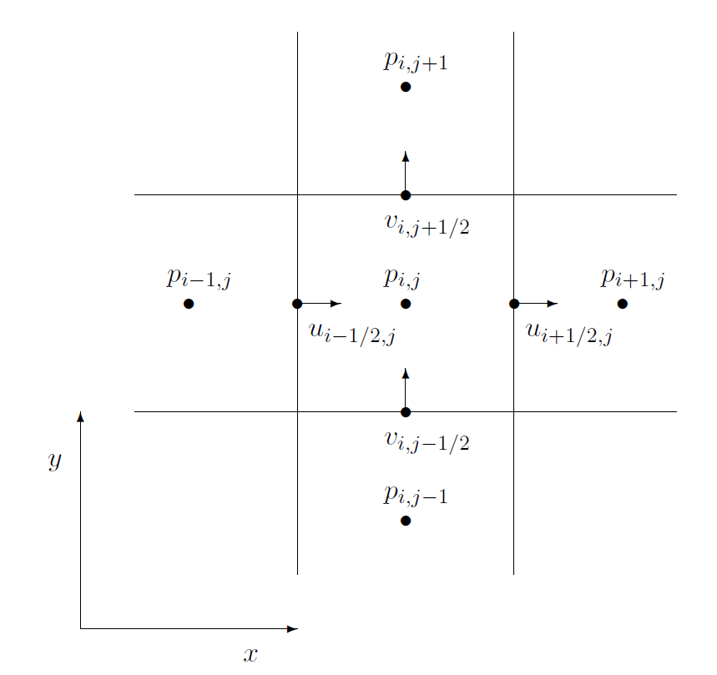
Space Discretization Marker-And-Cell (MAC) Grids

Slide 22
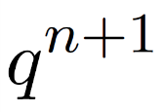
Numerical Method - Splitting
Given: and , calculate
Suggestions??

Slide 23
Numerical Method - Splitting
Given: and , calculate
Good or Bad? Why the roundabout approach?

Slide 24
Numerical Method - Splitting
Age-old principle of Divide-and-Conquer.
We might not be able to solve the WHOLE equation, but we can divide it, and invoke known numerical functions that solve the smaller pieces.
And then combine the output.

Slide 25
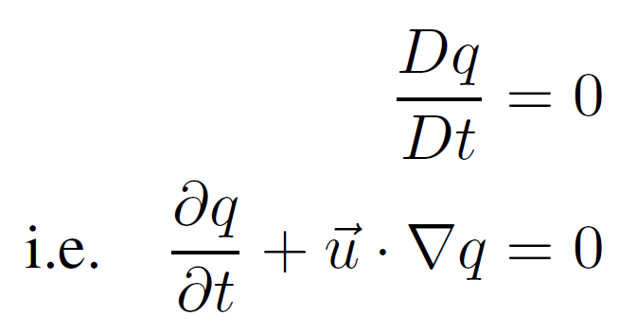
Advection
The advection equation is simply the material derivative set to zero.
Simply means that the quantity is moving around, but is not changing in the Lagrangian point of view.

Slide 26
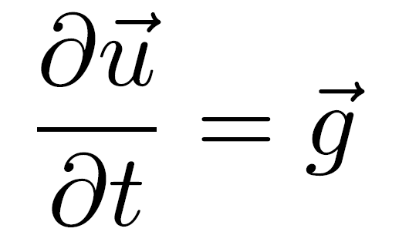
External Forces
Mostly due to gravity.

Slide 27
Projection
Calculating the pressure needed to maintain the incompressibility condition.
Result: Divergence-free velocity field.

Slide 28
Combining the three

Slide 29
Combining the three
Advection
External Forces
Projection
The order is very important!

Slide 30
Questions?

