Slide 1
Introduction to Water Simulation II
---Numerical Solution

Slide 2
Outline
Splitting the Navier-Stokes Equation
MAC Grid, a staggered grid
Algorithms details
  Advection
  Add body forces
  Make water incompressible
From velocity field to water surface

Slide 3
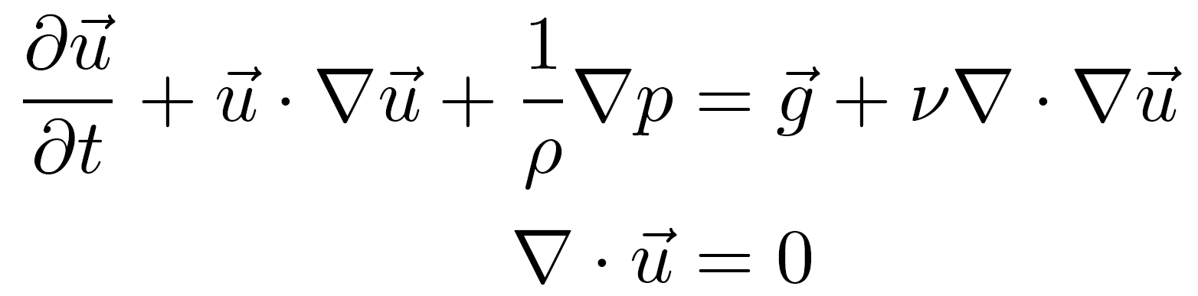
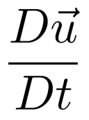


A close look at the Navier-Stokes Equation
=
Unknowns: and . is what we want.
is constrained by the incompressibility term
Viscosity term could be dropped
Still too complicated to solve it in one step. It would be nice to split it into several steps.

Slide 4
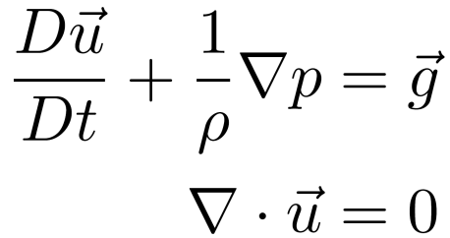
A close look at the Navier-Stokes Equation
Unknowns: and . is what we want.
is constrained by the incompressibility term
Viscosity term could be dropped
Still too complicated to solve it in one step. It would be nice to split it into several steps.

Slide 5
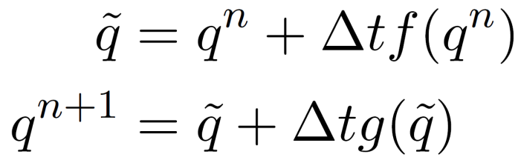
Dived and Conquer
A simple example
Euler Solution
Split it into two ODEs
Solve them sequentially

Slide 6
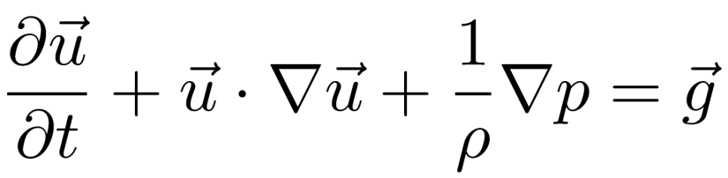
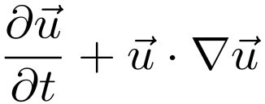


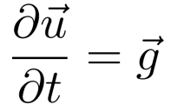
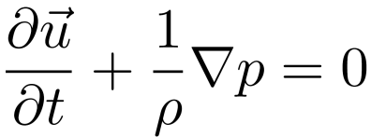

Splitting the Fluid Equations
=
=
=
Advection/Transportation
Body Forces
Pressure/Incompressiblity

Slide 7
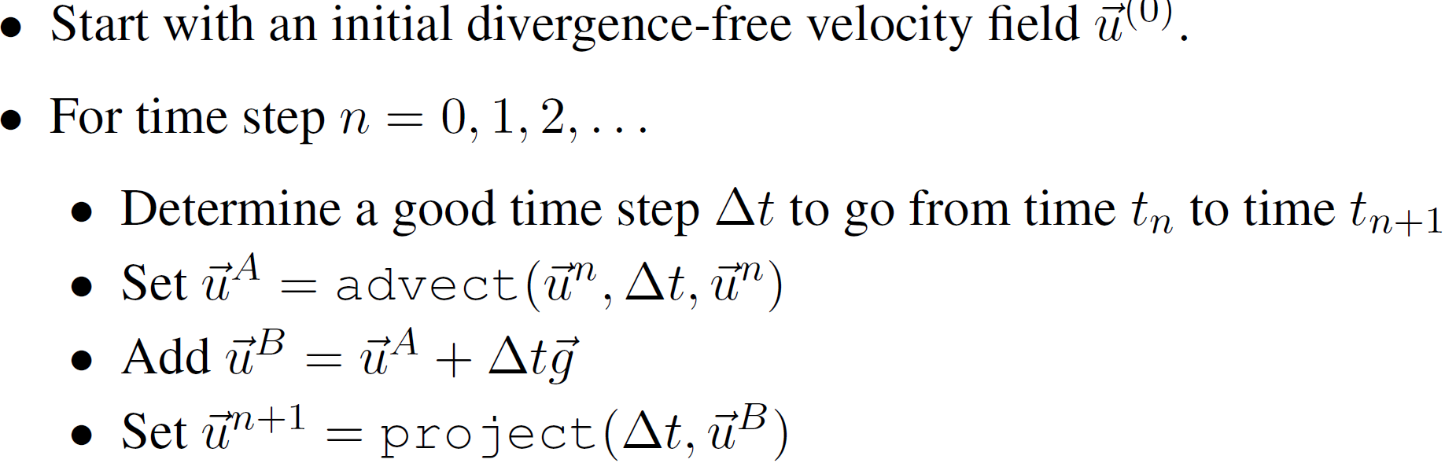
Splitting the Fluid Equations
=
=
=

Slide 8
Discretization In Space
MAC Grid (staggered grid)
Benefits
  Accurate central difference
Downsides
  Variables spread up, interpolation needed.

Slide 9
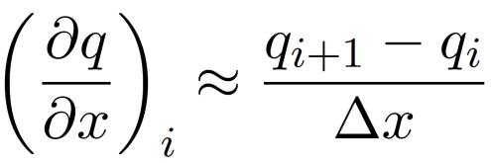
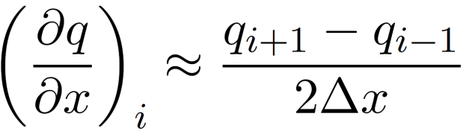
The Disaster of Simple Grid When Evaluating the Derivatives
forward or backward difference
central difference
A bad situation of central difference, zero derivative everywhere.
u
x

Slide 10
The Disaster of Simple Grid When Evaluating the Derivatives
forward or backward difference
central difference
Staggered grid hands it well
u
x

Slide 11
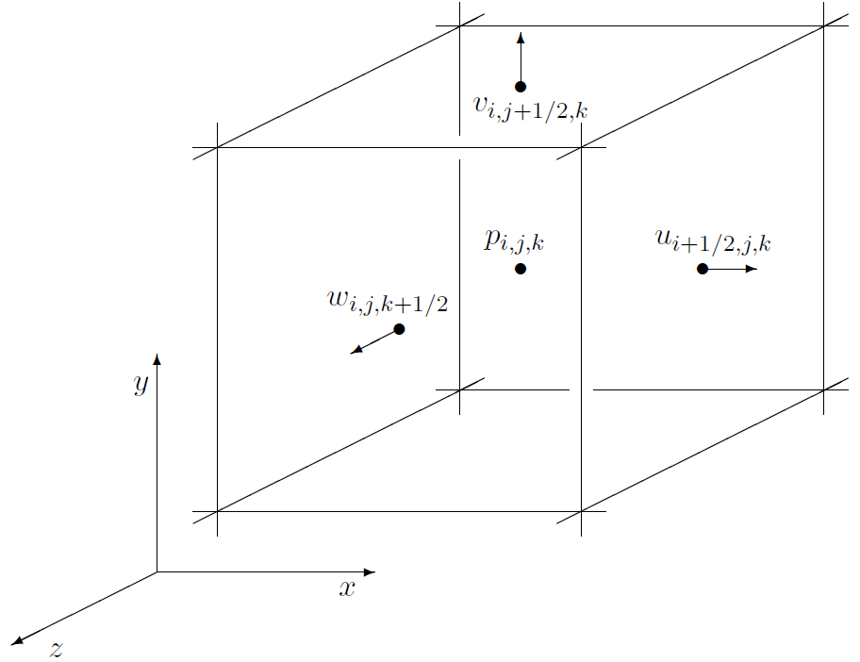
3D MAC Grid
For each Cell
  pressure locates at the center
  Each component of the velocity takes up two faces
  Each face only has one component of the velocity, interpolation needed.
Derivatives of velocity at the center of the cell…
Derivatives of pressure at the center of each facet…

Slide 12
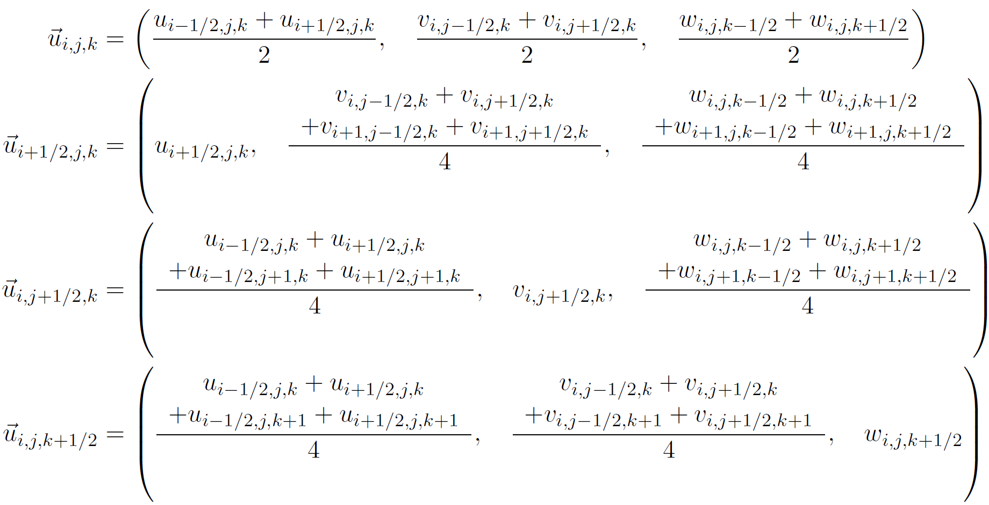
3D MAC Grid
Interpolate the velocity at the center of the cell and its facets.

Slide 13
STEP I: Advect the Velocity
or

Slide 14
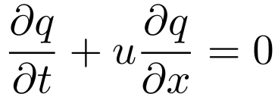
Advecting Quantities
The goal is to solve
“the advection equation” for any grid quantity q
  advect each component of velocity separately
Intead of treating it in Euler fashion by directly solving
we are using Lagrangian notion.
We’re on an Eulerian grid, though, so the result will be called “semi-Lagrangian”.
Proposed by Jos Stam, “Stable Fluids”, 1999

Slide 15
Semi-Lagrangian Algorithm
For each grid point, find X^{old}, and use the quantity (of previous time step) at this position as the new quantity of the grid point.
Interpolation may be necessary. Be careful when doing interpolation in staggered grid.
Forward Euler is adequate to find the old position.
p
q

Slide 16
Boundary Conditions
What if the particle flies out of the water boundary
  due to numeric error, just extrapolate from nearest points on the boundary;
  due to water flowing in from outside, …
p
q

Slide 17
Dissipation
Interpolation cause smoothed velocity field. Small vortices will be phased out.
It equals to simulate a fluid with viscosity.
Will be covered by the following lecture.

Slide 18
STEP II: Add Body Forces
or

Slide 19
Integrating Body Forces
Supper Easy!!!
Just add the new term at each grid point

Slide 20
STEP III: Making Fluid Incompressible
or

Slide 21
The Continuous Version
Space is continuous, but still assume the time space is discrete. Update the velocity,
To make it incompressible, the divergence should be zero.
Solve Laplace Equation to get p, then substitute p into update equation. (Right now, let’s leave out boundary conditions, and assume the water is boundless.)
Laplace Equation

Slide 22

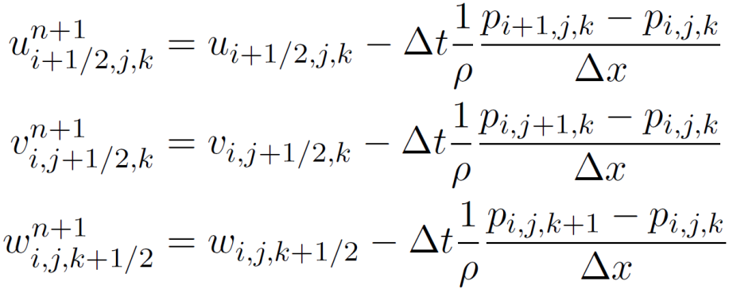



The Discrete Version
For clarity, discretize the pressure equation and the divergence constraint instead.
discretize
discretize

Slide 23
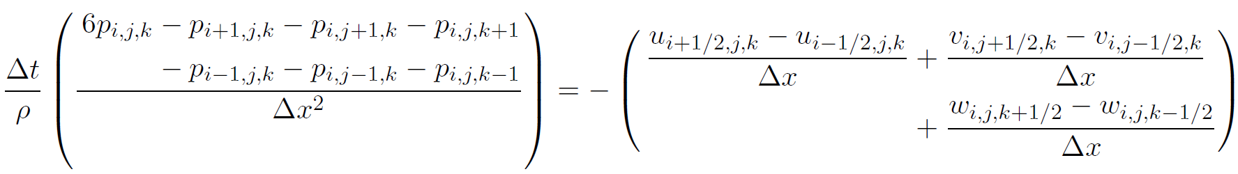
The Discrete Version
discretize
discretize
Substitute left equations into the right one

Slide 24
Putting Them In Matrix-Vector Form
Each cell has such a linear equation, combining them together we could get p at each cell.
i,j,k
Represent p of all the cells as a linear vector. Write all the linear equations into a matrix-vector form
A is a huge matrix. In a NxNxN grid, A is a N³xN³ matrix.
  100x100x100 grid results in a matrix with 10¹² elements.
A is sparse.

Slide 25
Boundary Conditions
At cell(i,j,k), the pressures from its 6 neighboring cells are needed. What if the its neighboring cell is not Fluid?
At boundary cells, some modifications on the linear equation are needed.
Each cell is either Fluid, Solid, or Empty. Since water is moving, thus the property of a cell may change (From a Empty to Fluid, or opposite) during simulating.
S
E
F
F
E
E
S
S
F
F
F
F
S
S
S
S
F
F

Slide 26
Empty Cell
Assume the pressure of the Empty Cell is zero
For example, if cell(i+1, j, k) is empty, then the linear equation at cell(i, j, k) should be:
F
E
0
=

Slide 27


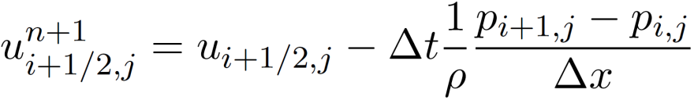


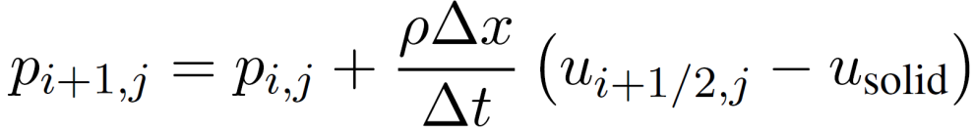
Solid Cell
The assumption
  The water do not penetrate the solid, thus
If right neighboring cell (i+1,j,k) of cell(i, j,k) is Solid,
F
S
=
( )

Slide 28
Modification on Laplace Equation
F
S
5
=
=

Slide 29
Summary
p
=
=
=
q
Advection/Transportation
Body Forces
Pressure/Incompressiblity

Slide 30
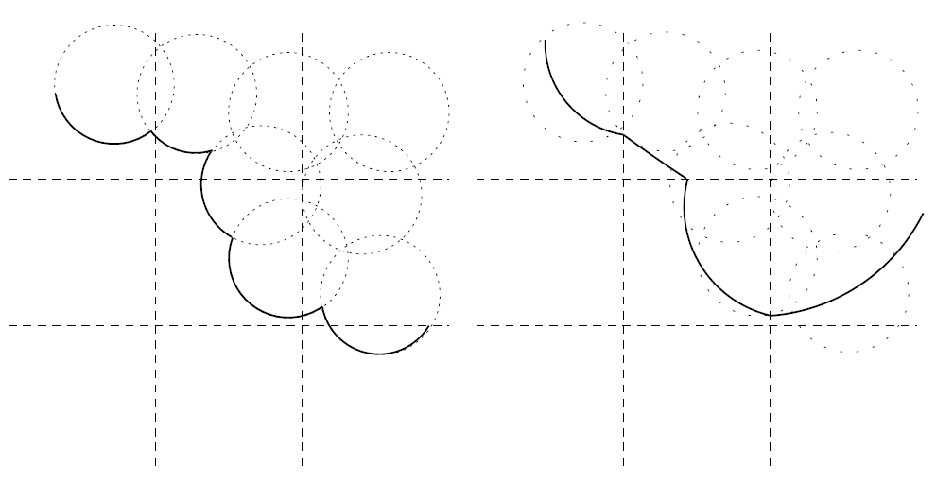
Where is the Water?
Marker particles
  initially each Fluid cell in the MAC grid will be allocated N particles (e.g. N = 4).
  Move particles in the incompressible velocity field
  update cell properties (the cell contains any particles is marked as Fluid).
From particles to Water surface
  Implicit function: f(x) = distance to the nearest particle – r
  Sample f(x) with a high resolution grid.
  Marching Cube to find Iso-surface

Slide 31



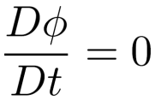
Water and Level Sets
Represent the surface using an implicit function
  One popular choice: Signed Distance Function
    Distance to the nearest point on the surface
    Positive outside, negative inside.
    Some nice properties:
Evolution of this function: advection
  Above properties may not be preserved. Periodically recalculate the distance function.

Slide 32
Reference
More details on Level Sets:
  Book: “Level Set Methods and Dynamic Implicit Surface” by Stanley Osher and Ronald Fedkiw.
A nice overview on Fluid Simulation
  SIGGRAPH 2007 Course Notes, “Fluid Simulation” by Robert Bridson and Matthias Muller-Fischer.
Libraries to Solve Sparse Linear System
  SparseLib: http://math.nist.gov/sparselib++/
  PARDISO or IML (Intel Mathematic Library).
Surface Reconstruction
  Marching Cube, http://local.wasp.uwa.edu.au/~pbourke/geometry/polygonise/
  Poisson Surface Reconstruction, http://www.cs.jhu.edu/~misha/

Slide 33
Thanks!

