Slide 1
Haptic Rendering
Ernest Cheung
COMP768 Presentation

Slide 2
Introduction

Slide 3
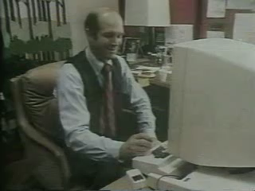
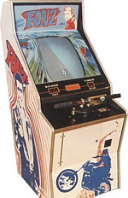
How do computers talk to us?
Sound (First commercial digital recording in 1971)
Graphics (Alto computer, first GUI in 1973)
Haptic – Vibrations (Fonz in 1976)
Haptic – Force feedback
(Phantom arm in 1993)
Notes:
Recording: research started in 1938 , 1971: Denon, Japanese company
Graphics :

Slide 4
Why Haptic?
Human have 5 inputs: visual, auditory, haptic, olfactory, and gustatory
Some feature in the world can only be perceived by haptics: hardness, roughness, texture, weight, and etc.
Haptic interaction of Human

Slide 5
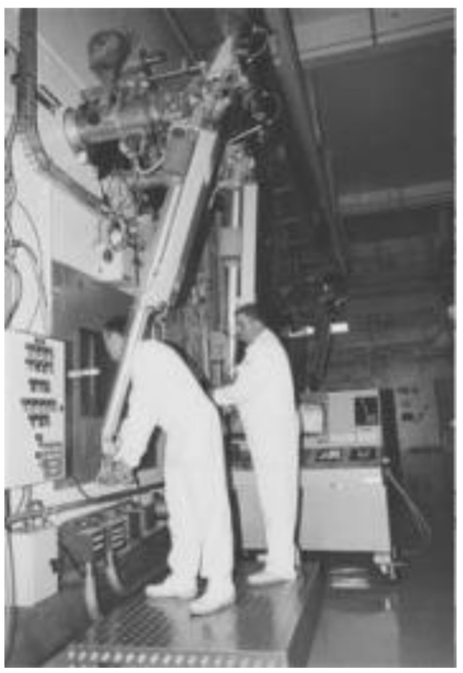
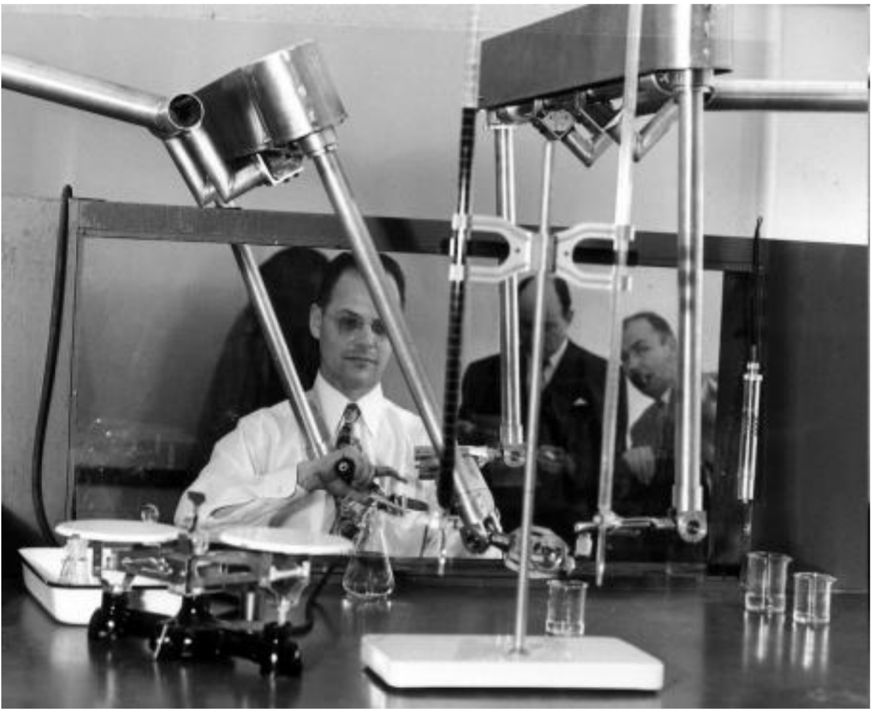
First Haptic device
Started in 1950s, first prototype is for teleoperation system in a nuclear engineering research

Slide 6
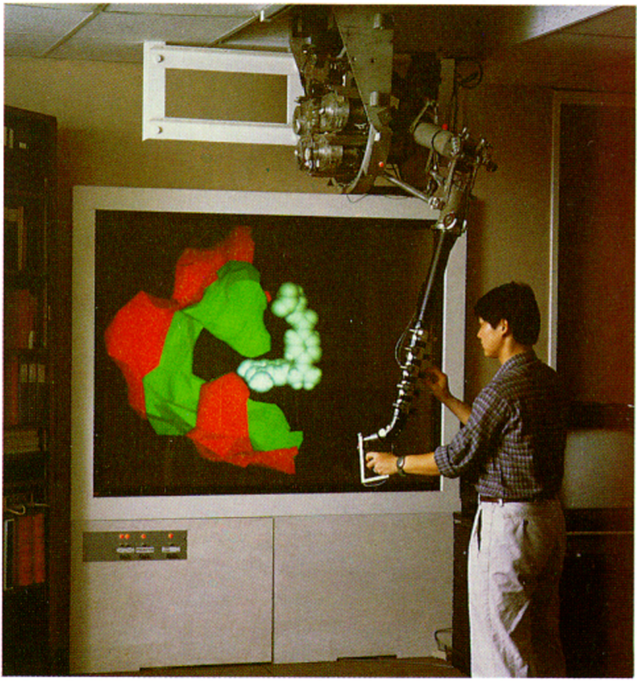
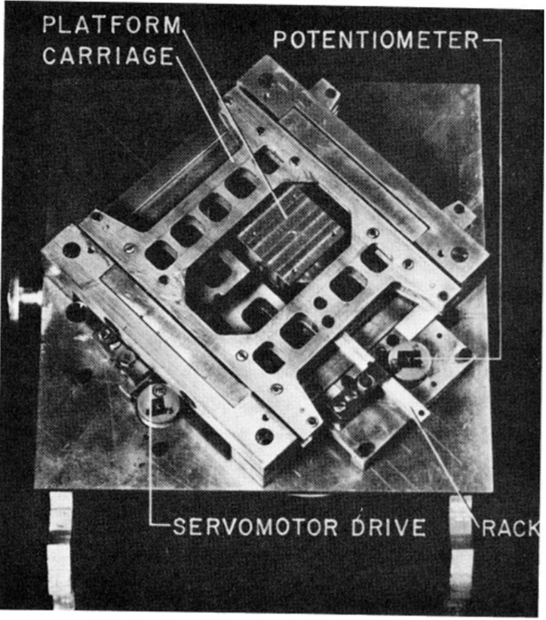
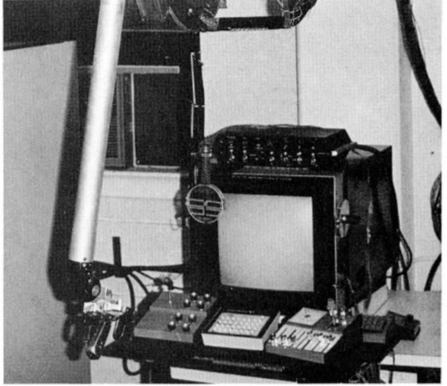
Haptic in UNC: Project GROPE
Haptic display for scientific Visualization in 1967 - 1990 by Prof. Frederick P. Brooks in UNC
Notes:
Generation 1: moving 2D on the platform
Generation 2” moving 7 virtual blocks on a virtual table using an Argonne arm
Generation 3: molecular docking task: orienting the drug and adjusting up to six of its internal twistable bonds to give the lowest potential energy

Slide 7
Applications
Medical simulation training
Remote medical (or other) operations
Virtual prototyping
Scientific visualization
Rehabilitation
Computer games
Notes:
Rehabilitation: people have stroke: therapist use hand-over-hand skilled guidance, boring, and labour intensive

Slide 8
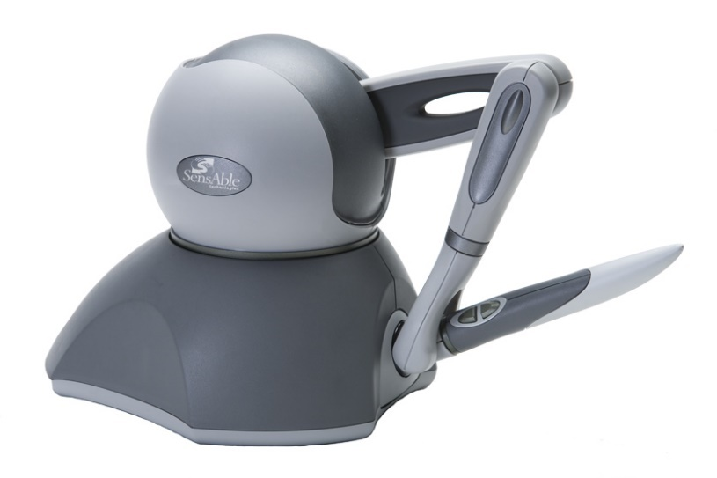
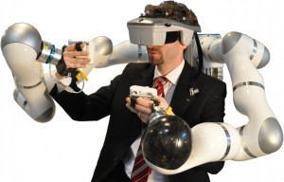
Example of Haptic devices
Notes:
LefT: medical surgey, artwork design, manifcature, research …
Right: Car assemble simulation

Slide 9
Haptic human-machine interaction (HHMI)

Slide 10
Haptic human-machine interaction (HHMI)
Goal: construct an interface between human and a virtual/remote environment
Human operator can feel force related properties: gravitational force, inertia force, friction force, contact force and reaction force

Slide 11
Research branch of HHMI
Branches of Haptic Interaction research
Notes:
Force: feel yby muscles, joints, tendors – weight, things in larger scale
Tactile: fingers- vibrations, pressure, touch, texture

Slide 12
Machine Haptics
How are the haptic device designed
Aims:
  high force bandwidth and dynamic range,
  large workspace, and
  freedom of mechanical singularity
Notes:
20~30 Hz: human sense meaningful perception
320 Hz: human finger can sense

Slide 13
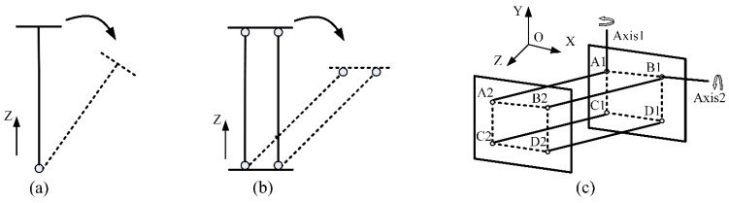
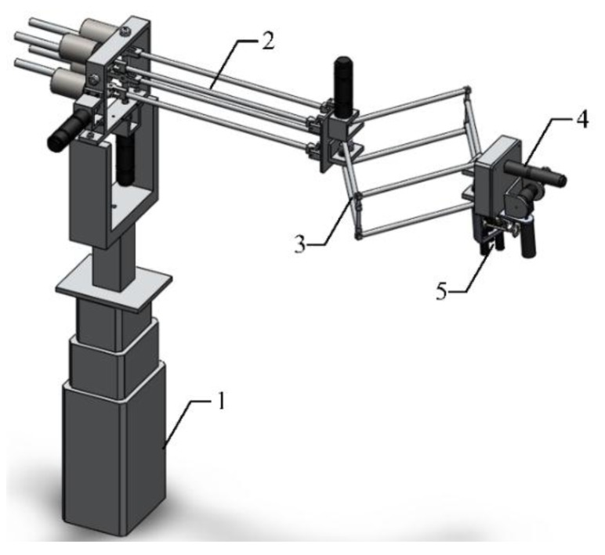
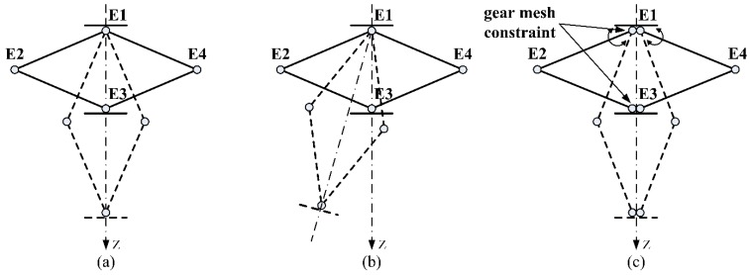
Case study of a haptic device
Notes:
rhombus linkage – fixed the rotation between two sides
Gravity elimated with weights

Slide 14
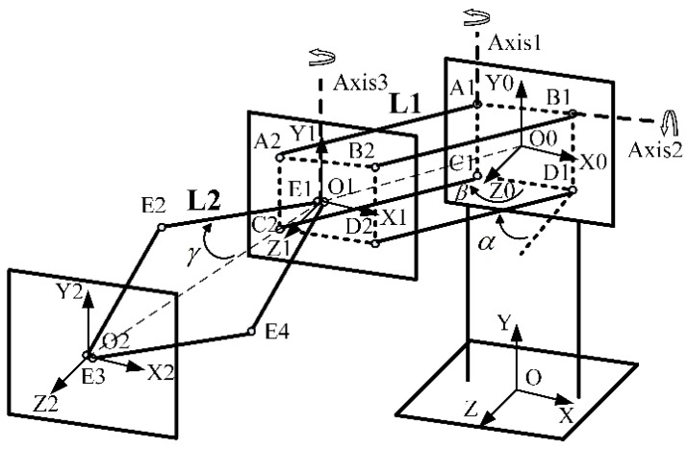
Case study of a haptic device
Motion measurement and tracking using encoders
Finding the
Location of the
end effector:
(x,y,z)

Slide 15
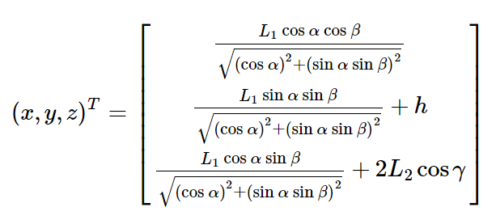
Case study of a haptic device
L1: Distance between plane ABCD1 and ABCD2
L2: Distance between E1 and E2
α, β, Ɣ: angle rotated in axes 2, 1 and 3 respectively
h: height from ground (distance between O0, O)

Slide 16

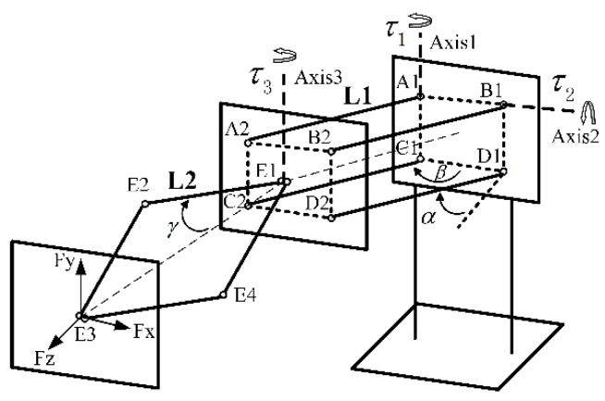
Case study of a haptic device
Force feedback rendered to user:
Convert desired force at the end effector Fx, Fy, Fz to the actuator output

Slide 17
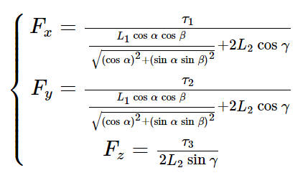
Case study of a haptic device

Slide 18

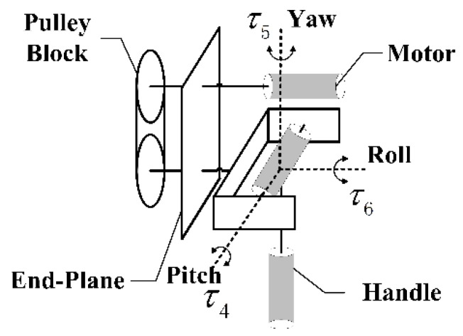
Case study of a haptic device
Each torque is controlled by an actuator’s output
Notes:
Dynamic compensations on gravity

Slide 19
Haptic rendering
Early haptic rendering algorithm focus on 3-DOF haptic rendering
In late 1990s, 6-DoF rendering has been suited to address multi-region contacts between a tool avatar

Slide 20
Terminology
Haptic Tool: Haptic device held by a user in the physical world
Graphic tool: Graphic display of the haptic tool
Collision response: The process to compute the pose of the graphic tool in contact and simulate the contact force and torque

Slide 21
General framework of 6 DOF Haptic Rendering
Optimization problem: find proper collision response model that satisfy the constrains
Environment constrains: model the geometric and physical property of objects
Force computation: models the relationship between force/
torque and the
simulated dynamic
process

Slide 22
Different haptic rendering approaches
Classify by ways to handle collision response: Penalty-based, Constraint-based, Impulse-based
Other classification can by how objects are modeled: triangle mesh, implicit surface, etc.

Slide 23
Contact constraints
Contact Constrains are modeled as equations in the configuration space T of the tools: g_{i}(T) >= 0
When tool configuration T₀ satisfy
g_{i}(T₀) = 0, the tool is in contact with the environment
Notes:
Different approach of the objective function in the optimization problem, difference between the approach lies in f
Gi(t) =0 means exact contact

Slide 24
Penalty-based approach
Contact constraints are modeled as springs
Elastic energy ↑ as penetration depth ↑ potential
Also common to apply penalty force when objects are closer than a certain threshold
  Adding this threshold can:
    Reduce object interpenetrations
    Reduce the cost of collision detection as it is easier to compute distance than penetration

Slide 25
Penalty-based approach
Advantages:
  Force model is local to each contact, so computations are simple
  Object inter-penetration is inherently allowed
  Cost of the numerical integration of computing the configuration of the virtual tool is almost insensitive to complexity of contact configuration
    making it suitable for interactive applications with high-frequency requirements

Slide 26
Penalty-based approach
Disadvantages:
  No direct control over physical parameters: e.g. coefficient of restitution
  Frictional forces are difficult to model
  Geometric discontinues at the location of contact points and/or normal lead to torque discontinues

Slide 27

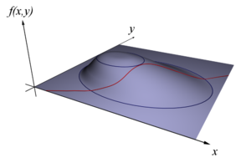
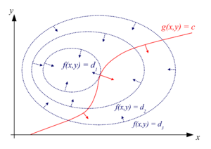
Constraint-based approach
Contact constrains is modeled by Lagrange multipliers λ by studying the Lagrange function:
Maximize f(x,y) subject to g(x,y) =c
  Evaluate the partial derivative of to find stationary points as solution candidates
Notes:
s F_C = J^T k
Lemda: workless constraint forces

Slide 28
Constraint-based approach
Advantages:
  Analytic and global method to compute collision response
  Able to achieve accurate simulation by modeling the normal and friction contact constrains as linear complementary problem

Slide 29
Constraint-based approach
Disadvantages:
  Computationally expensive
    Contact constrains are typically non-linear
    Solving constrained dynamics system can linearize the constraints, but still computationally intensive
Solution of constrained dynamics and the definition of constrains are highly intertwined

Slide 30
Impulse-based approach
Pause haptic simulation at collision event and resolve contacts solely on impulse
Advantage:
  Unification of all type of contacts under the same model: collision, sliding, etc.
Disadvantage:
  resting contact is modeled by multiple micro-collision making it inaccurate
  Constantinescu et al. proposed combining penalty force with impulsive response to solve this problem

Slide 31
Fine manipulation
Manipulations that involve:
  small movement, and/or
  accurate force control of a tool interacting with objects
Examples: grasping an egg, eating food with fork and knife or chopsticks, playing a violin, operating a needle in surgical operations

Slide 32
Fine manipulation
Example: periodontal operation, dentist try to detect and remove small-sized calculi using haptic feedback

Slide 33
Fine manipulation
Example: assemble of an aircraft engine shaft: inserting a splined shaft into a narrow splined hole
Feeling against the features is required for human to perform this task

Slide 34
Fine manipulation
More examples: Mechanical structure assembly, laparoscopic operation
Notes:
laparoscopic : minimal invasive surgery

Slide 35
Challenge of simulating fine manipulation
Frequent constraint changes or contact switches occurs during tool’s movement
Notes:
(next slide) a small movement (translation and/or rotation) of the haptic tool will lead to a change of contact constraints,

Slide 36
Challenge of simulating fine manipulation
A small translation and/or rotation of the haptic tool will lead to a change of contact constraint

Slide 37
Challenge of simulating fine manipulation
Tool-in-hole example: small rotation angle about the center can lead to large displacement on the tips on long tools
Notes:
The maximum clearance d_c between the graphic tool and the object surfaces bounding the space
maximum displacement d_h of the haptic tool per time_step

Slide 38
Fine features
Objects with small geometric features also pose challenge to haptic rendering
Example: surface of a dragon sculpture and a Happy Buddha sculpture
Notes:
Definition:
First is the ratio of the feature’s absolute size to the movement range of a haptic device per time step
In the second aspect, objects with special shapes can be treated as fine features, such as thin object and sharp features.

Slide 39
Reference
Haptic Rendering for Simulation of Fine Manipulation, by Dangxiao Wang, Jing Xiao, Yuru Zhang
http://link.springer.com/book/10.1007%2F978-3-662-44949-3
Haptic Devices, by Mimic Technologies Inc.
http://www.hitl.washington.edu/people/tfurness/courses/inde543/READINGS-03/BERKLEY/White%20Paper%20-%20Haptic%20Devices.pdf
Design and Calibration of a New 6 DOF Haptic Device, by Huanhuan Qin, Aiguo Song, Yuqing Liu, Guohua Jiang, and Bohe Zhou
https://www.ncbi.nlm.nih.gov/pmc/articles/PMC4721777/

Slide 40
Reference
Project GROPEHaptic displays for scientific visualization, by Frederick P. Brooks, Jr., Ming Ouh-Young, James J. Battert, and P. Jerome Kilpatrick
http://dl.acm.org/citation.cfm?id=97899
Industrial applications of haptic technologies, by Jerome Perret
http://www.vdc-fellbach.de/files/other/Industrial_Applications_Haptics_Perret_haption.pdf

Slide 41
Reference
Proprioception & force sensing, Jussi Rantala
http://www.uta.fi/sis/tie/hui/schedule/HUI2013-5-proprioception.pdf

