Slide 1
Physically-Based Simulation of Explosive Flames
December 4, 2012

Slide 2
Introduction
Explosions involve extreme, rapid release of energy
Create expanding wave of pressure due to the compression of air
Combustion-related explosions involve heat and gaseous products

Slide 3
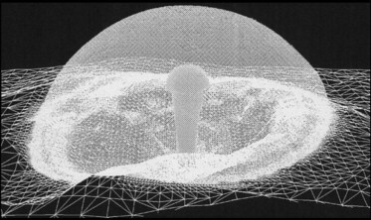
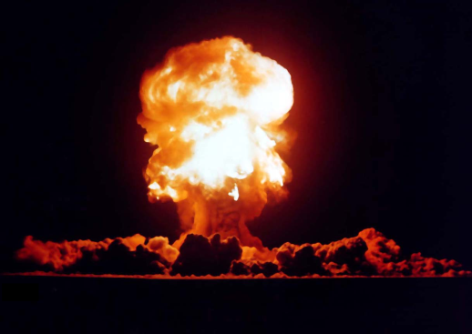
Introduction
Two easily observable effects of combustion-related explosions:
  An outwardly expanding shock wave
  A bright, rising fireball
The latter is the focus of this discussion

Slide 4
Topics to Discuss
The topics covered in this talk will be as follows:
  A brief discussion of the physical background of explosive flames
  A discussion of a method that directly uses particles to simulate flames
  A discussion of a method that uses a more traditional grid-based method

Slide 5
Physical Background of Explosive Flames

Slide 6
Physical Background
Primary factors behind behavior of explosive flames:
  Buoyancy
  Thermal Transfer
  Viscosity
  Vorticity
Gravity has small effect during the explosion

Slide 7

Buoyancy and Thermal Transfer
Heated gases rise / Less dense
Thermal transfer closely related to buoyancy
Transfer of heat occurs from:
  Thermal energy radiating to surrounding air
  Gas particles undergoing convection (via advection and diffusion)

Slide 8
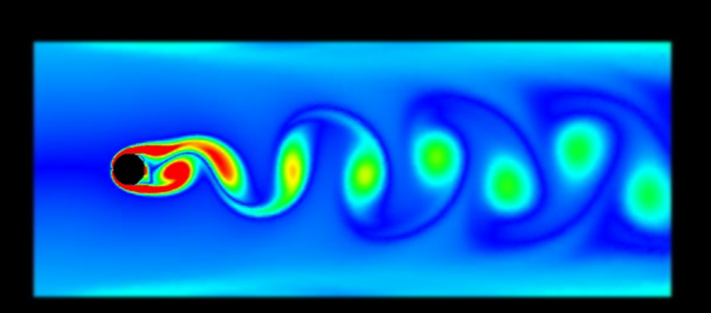
Viscosity and Vorticity
Viscosity and vorticity are closely related
Flowing gas particles experience drag forces from:
  Surrounding air
  Other heated gas particles
Creates shearing forces which can cause rotations among the gas particles

Slide 9
Particle-Based Approach to the Simulation of Explosive Flames

Slide 10
Overview of the Approach
Takeshita D, Ota S, Tamura m, et al. “Particle-based Visual Simulation of Explosive Flames”. Computer Graphics and Applications. In Proceedings 11th Pacific Conference, 2003.
Entirely particle-based system consisting of flame particles and air particles.
Approximates Navier-Stokes equations with particle interactions
Also considers buoyancy and heat conduction

Slide 11

Particle-Based Simulation
Numerically evaluates total force acting on particles as:
Buoyancy Forces
Particle Interaction Force
Viscosity

Slide 12

Buoyancy
Accounts for the rising of a fireball and updrafts of heated air
It is calculated by the force:
c is a preset constant
m is particle mass
g is gravitational acceleration
T is particle temperature
T_{env} is ambient temperature

Slide 13
Heat Conduction
Changes temperatures / affects buoyancy
This simulates:
  Cooling of flame particles by air particles
  Heating of air particles by the flame
Involves a weight function

Slide 14

The Weight Function
Weight function, ω(d_{r}), is used frequently by this method
Based on a Gaussian distribution and defined as:
d_{r} is ratio of the distance between two particles and the sum of their radii, d/(r_{i}+r_{j})

Slide 15
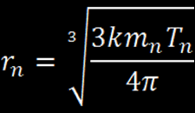
Calculating Particle Radii
Radius of a particle is determined by the equation:
M_{n} is mass of n^{th} particle
T_{n} is temperature of n^{th} particle
k is a preset constant

Slide 16

Heat Conduction
The numerical model for heat conduction is:
b is a temperature conductivity coefficient

Slide 17
Particle Interaction Force
Repulsion force acting among the particles
Represents pressure and volume in the particle system
Represents the pressure and advection terms of Navier-Stokes

Slide 18

Particle Interaction Force
This force is calculated according to the following equation:
I is a particle interaction force coefficient
d_{r} is the same as before

Slide 19

Viscosity
Represents viscosity term of the Navier-Stokes equations
It is given by:
a is the viscosity coefficient, and u is velocity

Slide 20
Grid-Based Approach to the Simulation of Explosive Flames

Slide 21
Overview of the Approach
Bryan E. Feldman, James F. O'Brien, and Okan Arikan. "Animating Suspended Particle Explosions". In Proceedings of ACM SIGGRAPH 2003, pages 708–715, August 2003.
Models behavior of suspended particle explosions
Fluid dynamics simulation computes motion of air and heated gases in explosion
Particles track motion of fuel particles and combustion products
Does not model a blast wave

Slide 22
The Gas Model
Gases treated as an incompressible, inviscid fluid
A 3D grid is used to discretize space
Cells hold the fluid velocity, pressure and temperature

Slide 23
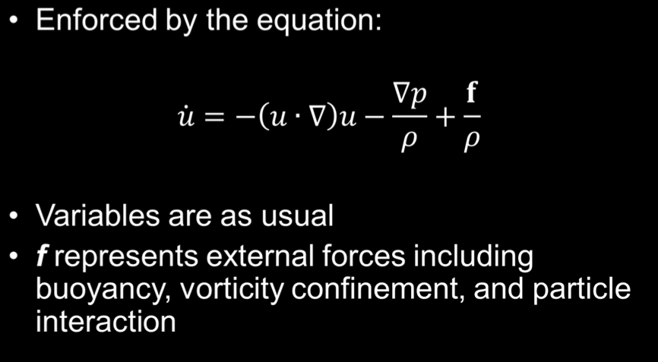
Conservation of Momentum

Slide 24
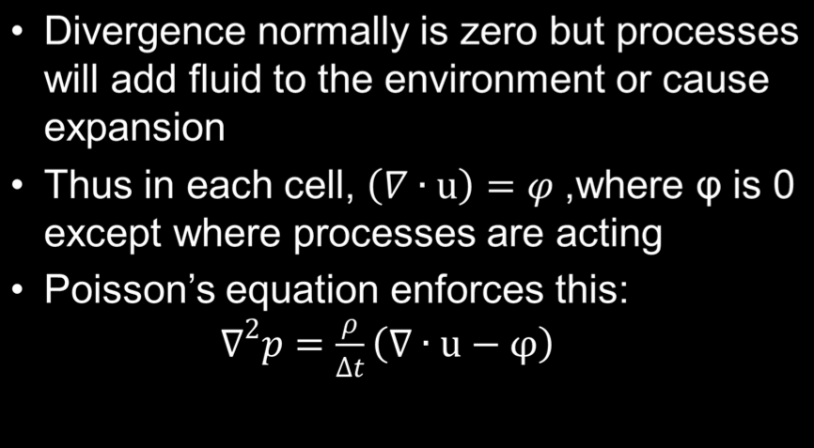
Conservation of Mass

Slide 25
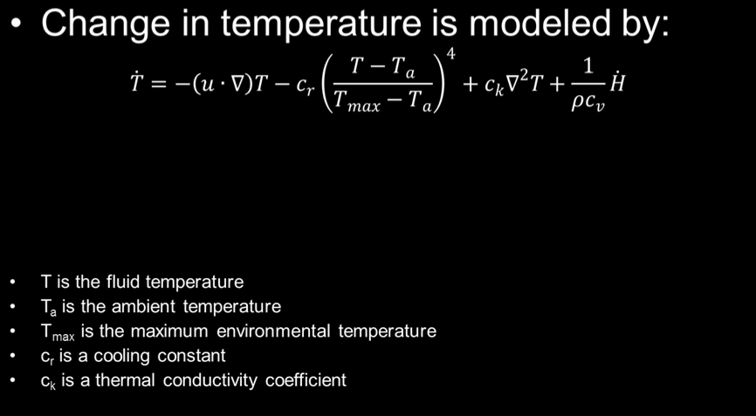
Temperature
advection
radiative loss
radiative/diffusive transfer
external heat energy transfer

Slide 26
Particle Model
Models motion of fuel and combustion particles
Attributes include: position, velocity, mass, temperature, thermal mass, volume and type
Each particle represents a group of particles

Slide 27
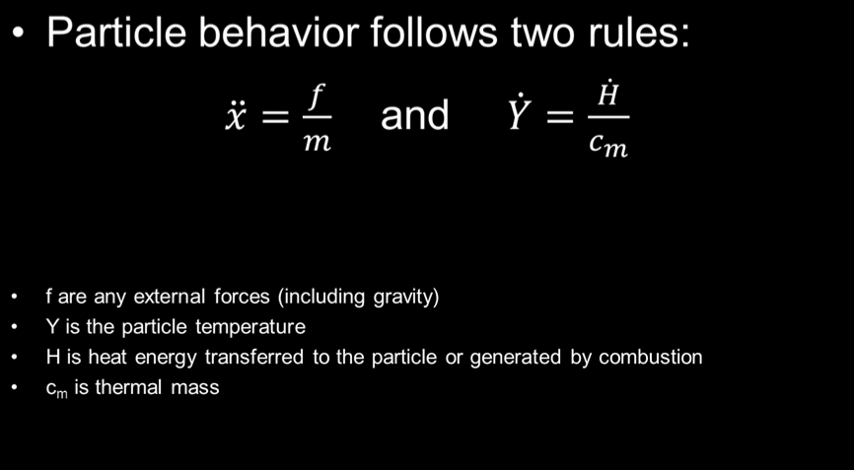
Particle Model

Slide 28
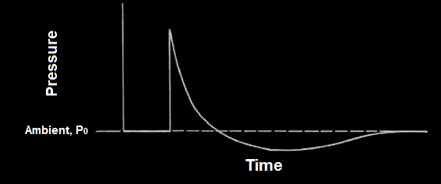
Detonation and Dispersion
In detonation region, flow modeled by altering φ in mass preserving equations
Approximates pressure profile of a detonation
Outward Flow
Inward Flow

Slide 29
Detonation and Dispersion
Detonation region might receive heat from combustion and pressure increase
Changes fluid temperature according to the temperature equation

Slide 30

Gas-Particle Interaction
Gas and fluid models interact by transferring momentum and heat energy
Particles moving in the fluid experience drag according to:
α_{d} is the drag coefficient
r is the particle radius
u is the particle velocity
Opposite force is applied to the cell holding the particle
Particles with mass below a certain threshold become massless and do not contribute

Slide 31

Gas-Particle Interaction
Heat transfer from the gases to the particles is similar
It is determined by:
α_{h} is the coefficient of thermal conductivity
T is the particle temperature
Particles with mass below a certain threshold become massless and do not contribute

Slide 32
Combustion Model
Uses three main assumptions:
  Combustion occurs without regard to the availability of oxygen
    Oxygen is always available
  Combustion rate is invariant to temperature
  Compositions of combustion products is invariant to temperature
    Convenient to ignore and insignificant

Slide 33
Combustion Model
Fuel particles ignited once past ignition point
Ignited particle will consume itself at its burn rate, z
Burning particles produce heat, gas, and solid products
Once mass is zero, it is removed

Slide 34



Combustion Model
Ignited particles generate heat at a rate:
b_{h} is amount of heat released per unit mass of fuel
Gaseous products are added to the cell containing the particle by
incrementing φ according to:
V is the cell volume
b_{g} is the volume of gas released per unit of combusted mass minus the volume of gas consumed
Soot mass is generated at a rate:
b_{s} is the mass of soot produced per unit mass of fuel
Soot mass accumulates in fuel particle variable and soot particle is added once a quantity of soot has been produced

Slide 35
References
Bryan E. Feldman, James F. O'Brien, and Okan Arikan. "Animating Suspended Particle Explosions". In Proceedings of ACM SIGGRAPH 2003, pages 708–715, August 2003.
Oleg Mazarak, Claude Martins, John Amanatides. “Animating Exploding Objects”. In Proceedings of the 1999 Conference on Graphics Interface, pages 211-218, 1999.
D. Takeshita, S. Ota, M. Tamura, et al. “Particle-based Visual Simulation of Explosive Flames”. Computer Graphics and Applications. In Proceedings 11th Pacific Conference, 2003.
Jie Tan, Xubo Yang. “Physically-based fluid animation: A Survey”. Science in China Series F: Information Sciences , Vol 52, Issue 5, pages 723-740, May 2009.

