Slide 1
Granular Simulation
Junbang Liang

Slide 2
Contents
Introduction
Motivation
Granular Modeling
Particle-based method
Fluid-based method
Others

Slide 3
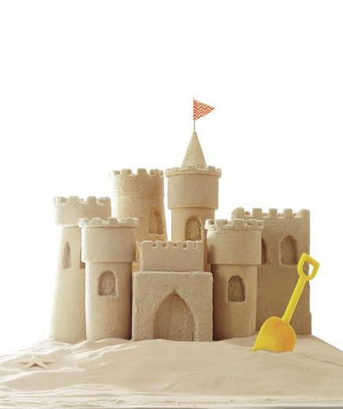
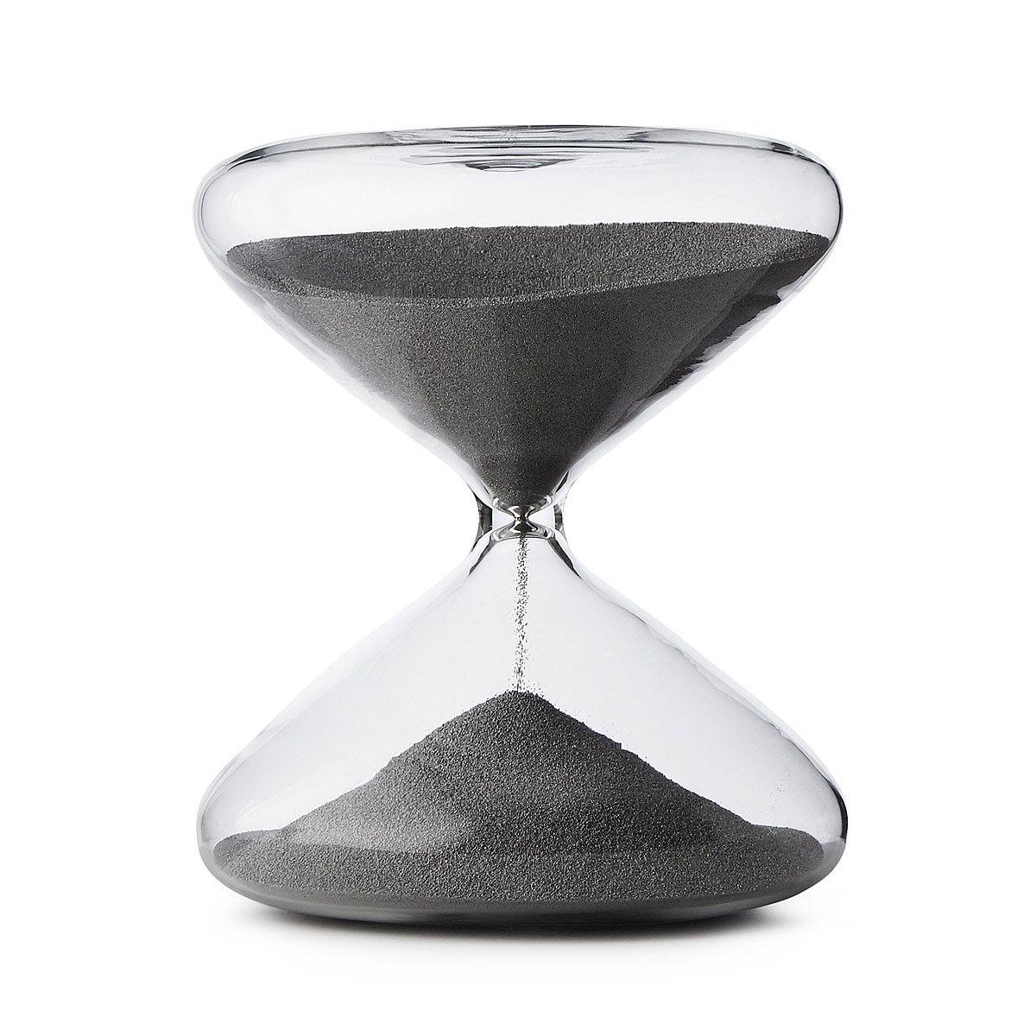
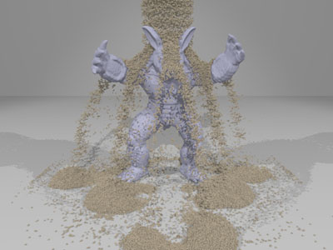
Introduction
Notes:
A set of discrete solid, each one with a very small size. Stick to each other. Flow as fluid.

Slide 4
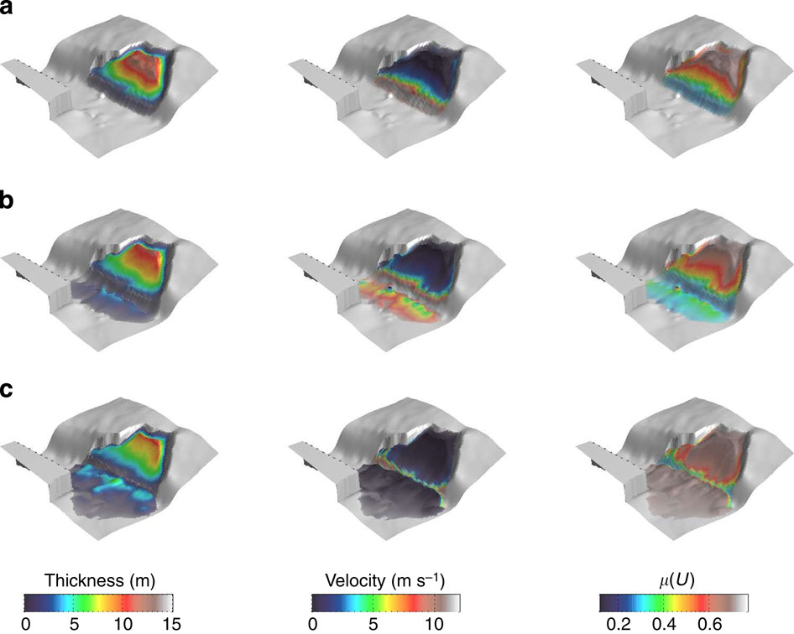
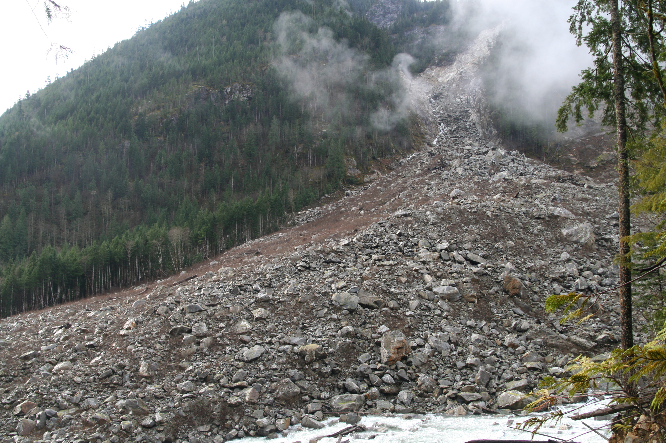
Motivation
Notes:
Software applications such as animation and gaming. Simulate large scale avalanches, better understand the geology.

Slide 5
Granular Modeling - Properties
Different from solid:
Flowing freely if in low coherence
Forms different shapes if in high coherence
Large number of small separate particles
Different from fluid:
Piling, maximum rest angle $θ_{r}$
Pressure is independent to depth
Frictional and contact forces between particles
Notes:
Which makes it challenging to model and simulate.

Slide 6
Granular Modeling - Methods
Particle-based method
Treat each one of the grain as a rigid body
Memory and computation intensive
Fluid-based method
Treat the grain as a whole
Modify fluid simulation equations
Others
Height field
Deformable body
Notes:
Lies in two categories. Many of the work simplified the particle model

Slide 7
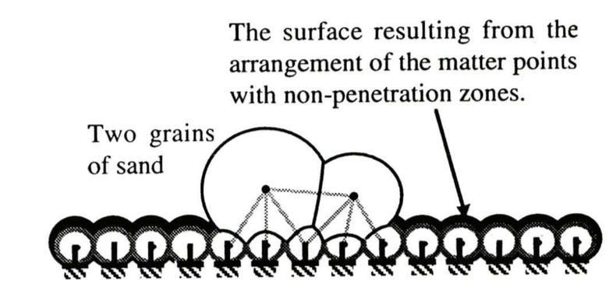
Particle-based methods
Luciani, Annie, Arash Habibi, and Emmanuel Manzotti. "A multi-scale physical model of granular materials." Graphics interface'95. 1995.
A grain is represented as a spring-mass system.
External forces are formulated as springs as well.

Slide 8
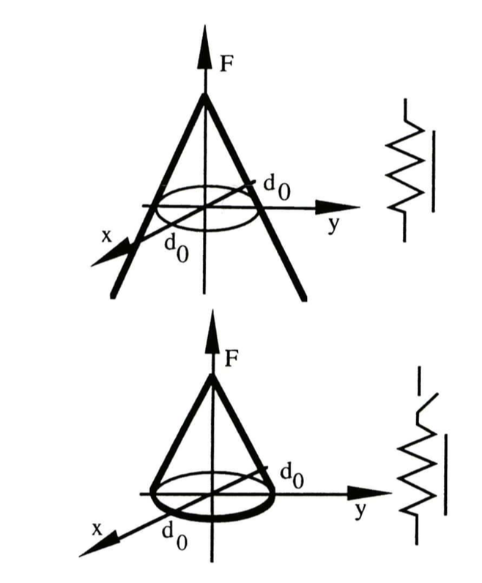
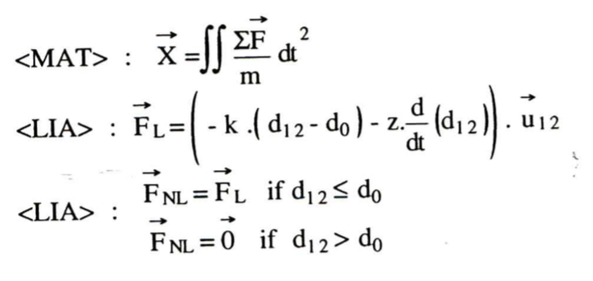
Spring-Mass System
Dynamics: Classic ODE solver
k: stiffness coefficient, z: damping coefficient
d₁₂: string length, d₀: string length at rest
x, y: displacement
F_{L} is used inside the particle, F_{NL} is used between particles.

Slide 9
Spring-Mass System
Inside the grain: linear, stiff strings
Between sand particles: nonlinear strings
Easy to implement
Only in small scale; time step is limited

Slide 10
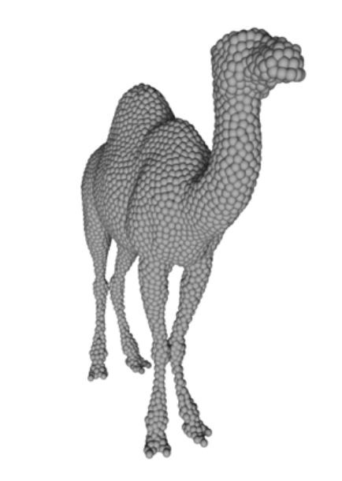
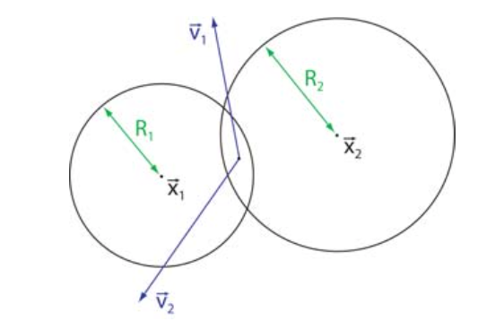
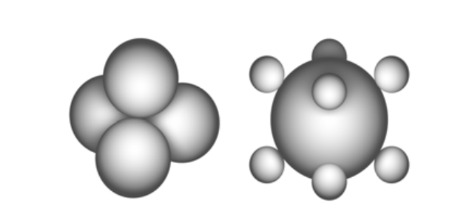
Particle-based methods(cont.)
Bell, Nathan, Yizhou Yu, and Peter J. Mucha. "Particle-based simulation of granular materials." Proceedings of the 2005 ACM SIGGRAPH/Eurographics symposium on Computer animation. ACM, 2005.
Using sphere as the primitive, defining contact forces on collision.
Model rigid bodies and grains as a collection of spheres.
Notes:
and use it as a principle method throughout the entire simulation. Interact with rigid bodies. Decompose to many little spheres and do the dynamics between each pair of them

Slide 11
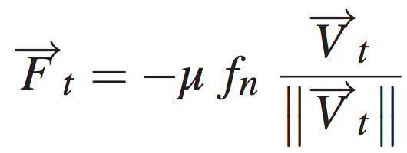
Rigid Sphere Dynamics
Particle overlap: , Normal direction:
Relative velocity: , ,
Normal forces: where
Shear forces:
Resolving static friction: using non-spherical particles
Notes:
Similar to constraint based dynamics. Tangential direction.

Slide 12
Rigid Sphere Dynamics
Efficient if given fast collision detection algorithm
The accuracy of rigid bodies are parameterized
Particles are independent: neglects the cohesive forces between particles
Notes:
Purely based on rigid body dynamics.

Slide 13
Fluid-based method
Model granular as a incompressible continuum.
Independent of the actual number of particles.
Follows the rule of simulating fluid. Flowing can be achieved naturally.
Additional check to approximate friction and contact forces.
Notes:
Because of the inefficiency of the particle-based method, people use fluid-based more often to achieve speed and also quality. But firstly we should know how to simulate a regular fluid.

Slide 14
Navier-Stokes Equation
Reynolds transport theorem: conservation of any physical property within any control volume $\text{Ω}$.
$\frac{\text{d}}{\text{d}\text{t}}\int_{\text{Ω}}{\text{ϕ}\text{dV}}\text{=}−\int_{∂Ω}{φu∙ndA}+\int_{Ω}{sdV}$
Change of $\text{ϕ}$ in $\text{Ω}$ equals to the amount of $\text{ϕ}$ that flows out of $\text{Ω}$, plus the speed of generating $\text{ϕ}$ from sources in $\text{Ω}$.
dV: infinitesimal Volume, u=$\dot{x}$(t): Flow velocity, n: Normal vector of the surface, A: Surface area, s: Property source/sink in $\text{Ω}$.
Divergence theorem, Leibniz’s rule:
$\int_{Ω}{(\frac{∂φ}{∂t}+∇∙\left(φu\right)−s)dV}=0 => \frac{∂φ}{∂t}+∇∙\left(φu\right)=s$
$φ$ can be mass($ρ$) or momentum($ρu$)
Notes:
It is the primary equation that liquid must follow.

Slide 15
Navier-Stokes Equation(cont.)
Reynolds transport theorem: $\frac{∂φ}{∂t}+∇∙\left(φu\right)=s$
Conservation of mass
$φ=ρ$, $s=0$
$\frac{∂ρ}{∂t}+∇∙\left(ρu\right)=0$
At point x, the increase of density $ρ$ plus the amount of the divergence (dissipation) of density $ρu$ at that point equals to 0.
Conservation of momentum
$φ=ρu$
$\frac{∂ρu}{∂t}+∇∙\left(ρuu\right)=s$
At point x, the increase of momentum $p_{k}$ plus the amount of the divergence of momentum $p_{k}u$, where $p_{k}$ denotes the momentum at dimension k, equals to the increase of momentum from the source at that point.
Notes:
Source or sink will not exist. Same as the com.

Slide 16
Navier-Stokes Equation(cont.)
Dyad: $ab=a∗b^{T}$
Divergence of a matrix: $∇∙A={(∇∙A_{1}^{} ∇∙A_{2}^{} ∇∙A_{3}^{})}^{T}$
A_{i} is the ith column of A
Notes:
Fortunately we have some math tools to deal with the multiplication of two vectors.

Slide 17
Navier-Stokes Equation(cont.)
$\frac{∂ρu}{∂t}+∇∙\left(ρuu\right)=s$
Split each term above:
=>
Rearrange:
Conservation of mass: $\frac{∂ρ}{∂t}+∇∙\left(ρu\right)=0$
$ρ\left(\frac{∂u}{∂t}+u∙∇u\right)=s$
$ρ\frac{Du}{Dt}=s$, where $\frac{D}{Dt}=\frac{∂}{∂t}+u∙∇$

Slide 18
Navier-Stokes Equation(cont.)
S is the source of momentum, that is, forces.
$s=∇∙σ+f_{ext}=−∇p+∇∙τ+ρg$
$σ$: Stress tensor, $f_{ext}=ρg$: External forces, e.g. gravity.
p: Pressure, $τ$: Shear stress tensor.
$σ=−pI+τ$, $p=−tr(σ)/3$
$ρ\frac{Du}{Dt}=−∇p+∇∙τ+ρg$
$τ$ is depending on the kind of fluid, e.g., for incompressible Newtonian fluid, $∇∙τ=μ∇^{2}u$.
$p$ is computed so that conservation of mass is maintained.
Notes:
Stokes’s stress constitutive equation. How sticky your fluid is.

Slide 19
Lagrangian/Eulerian reference system
Grid representation: Particle representation:
The left side is the property gradient of this specific particle, while $φ$ is originally defined in Eulerian perspective.
$φ$ could be any physical properties: temperature, density, or flow velocity
Notes:
There are two types of perspective.

Slide 20
Simulation Method
$\frac{∂ρ}{∂t}+∇∙\left(ρu\right)=0$, $ρ\frac{Du}{Dt}=−∇p+∇∙τ+ρg$
Particle based
Represent the continuum with a set of particles
Each particle carries physical properties, e.g., mass, density and velocity
Using interpolation kernel to express the continuum
Examples: Smoothed Particle Hydrodynamic.
Grid based
Hybrid approach

Slide 21
Simulation Method
$\frac{∂ρ}{∂t}+∇∙\left(ρu\right)=0$, $ρ\frac{Du}{Dt}=−∇p+∇∙τ+ρg$
Particle based
Grid based
Represent the continuum with a number of fixed grid points
Each grid point carries physical properties, e.g., mass, density and velocity
The partial differentiation is approximated as finite difference between adjacent grid points
Hybrid approach

Slide 22
Pros and Cons
$\frac{∂ρ}{∂t}+∇∙\left(ρu\right)=0$, $ρ\frac{Du}{Dt}=−∇p+∇∙τ+ρg$
Particle based
Automatically guarantees conservation of mass
Difficult to deal with partial differential equations
Grid based
Partial difference can be expressed easily
More computation to keep conservation

Slide 23
Simulation method
Hybrid approach: Particle-In-Cell (PIC), FLuid Implicit Particle (FLIP), Material Point Method (MPM).
Particles are good for moving (kinematic), grids are good for solving PDE (dynamic).
FLIP updates velocity using increments instead of direct interpolation.
MPM uses particle to carry all of the physical property including stress and forces.
Notes:
Discrete weight function.

Slide 24
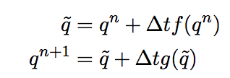
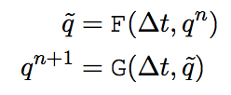
Splitting
Example equation:
Explicit Euler:
General form:
Hybrid method: $\frac{∂ρ}{∂t}+∇∙\left(ρu\right)=0$, $ρ\frac{Du}{Dt}=−∇p+∇∙τ+ρg$, q=u
f=-$u∙∇u$
g={${(−∇p+∇∙τ+ρg )}/ρ$, s.t. $\frac{∂ρ}{∂t}+∇∙\left(ρu\right)=0$}
F is done in Lagrangian frame (particles), G is done in Eulerian frame (grid).
Notes:
We do advection in the particle perspective and do dynamics in grid perspective. In that case we split the equation into two parts and take advantages in both method.

Slide 25
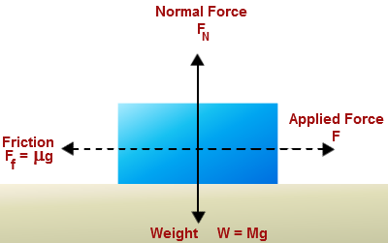
Fluid-based method
Drucker, Daniel Charles, and William Prager. "Soil mechanics and plastic analysis or limit design." Quarterly of applied mathematics 10.2 (1952): 157-165.
${\left\|τ\right\|}_{F}≤μp+c$
$τ$: shear stress, $μ$: friction coefficient, $p$: pressure, $c$: cohesion
Drucker-Prager yield condition
Notes:
Drucker and prager points out that in soil mechanics the material must follow this inequality in order not to slip against each other. It is easy to understand if we compare this idea with that in newtonian mechanics.

Slide 26
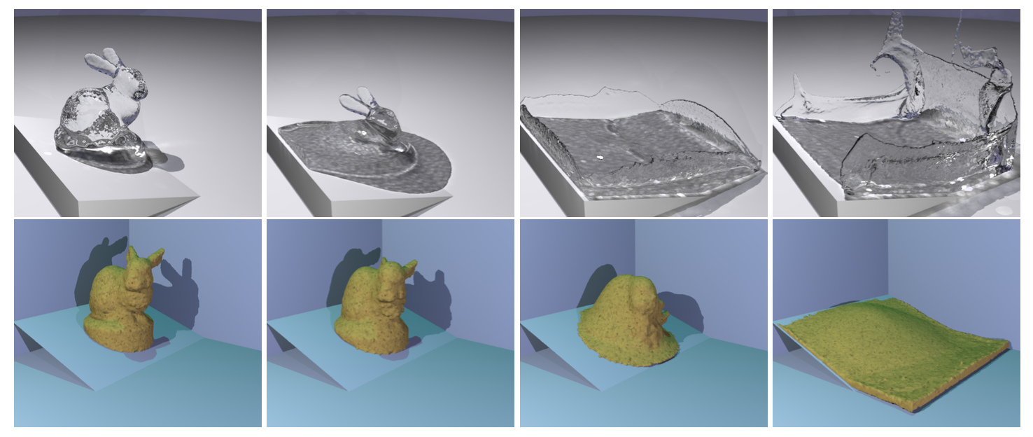
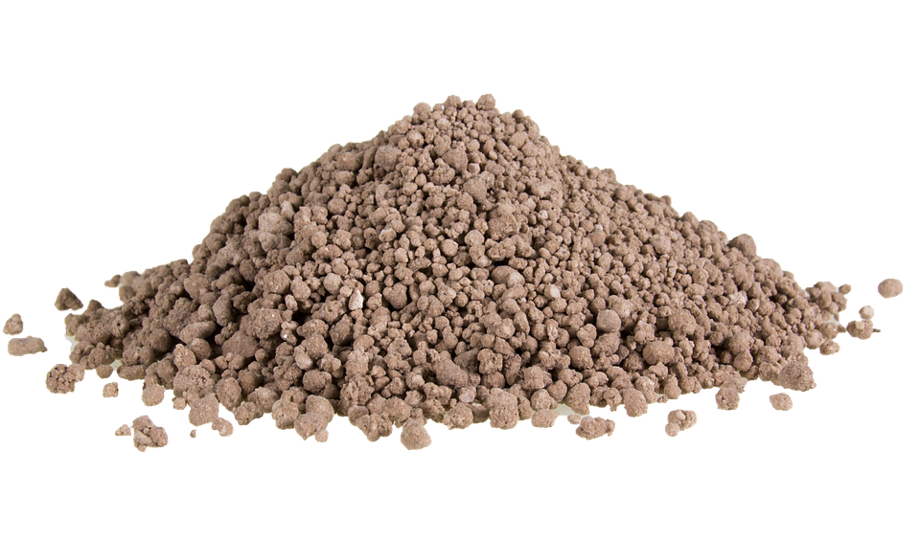
First trial(2005)
Zhu, Yongning, and Robert Bridson. "Animating sand as a fluid." ACM Transactions on Graphics (TOG). Vol. 24. No. 3. ACM, 2005.
Assumptions:
Sand pressure is the same as incompressible fluid.
If flowing, frictional stress is defined as:
$φ$: Repost (rest) angle, D: strain rate, u: velocity
Using Drucker-Prager yield condition to determine whether it is flowing or not

Slide 27
First trial(2005)
Grid length $∆x$, shear velocity $V_{r}=∆xD$, grid mass $M=ρ{∆x}^{3}$
Force to stop shearing in one time step: $F=−(∆xD)(ρ{∆x}^{3})/∆t$
Shear stress:
Classify grids with rigid and deforming ones.

Slide 28
First trial(2005)
Do advection on particles and transfer to grid
Add gravity and solve pressure to make it incompressible.
Calculate $σ_{rigid}$ using current velocity field.
Check if $σ_{rigid}$satisfies the yield condition, where $σ_{m}=p$.
If not, the grid is rigid; otherwise using $σ_{f}$ to update velocity.
Find all connected rigid grids and solve it as a rigid body.
Transfer to particles.

Slide 29
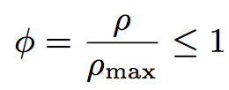
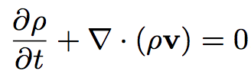
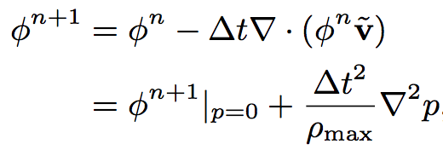
Improvements(2010)
Narain, Rahul, Abhinav Golas, and Ming C. Lin. "Free-flowing granular materials with two-way solid coupling." ACM Transactions on Graphics (TOG)29.6 (2010): 173.
Main observation: Sand cannot be compressed, but can be splashed out. $ρ≤ρ_{max}$. Internal pressure will be 0 if $ρ<ρ_{max}$.
Define density fraction:
Conservation of mass and momentum:
=>
Density fraction at time n+1:
Notes:
So it is actually a compressible fluid, to some extent. Substitute

Slide 30
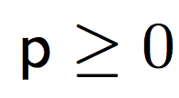
Solving pressure
Goal: calculate p, so that:
Extra conditions: Internal pressure will be 0 if $ρ<ρ_{max}$.
Linear complementary problem:
$1−φ^{n+1}≥0$: Density must not exceed maximum value
: Pressure works when flow is no more compressible
: Pressure should be non-negative
Notes:
Also we have to take care of the condition that p will not be zero only if rho is at the maximum.

Slide 31
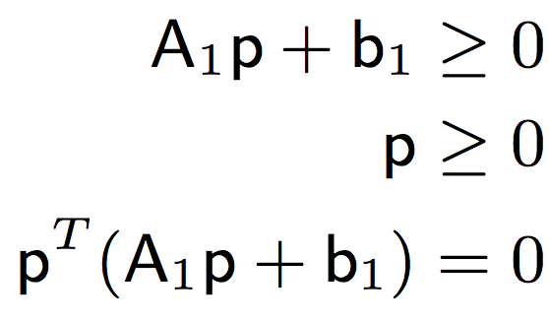
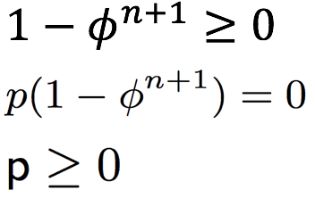
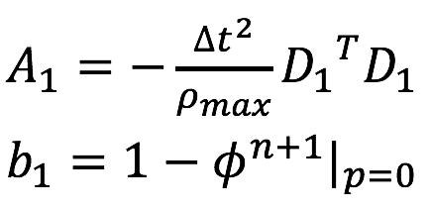
Solving pressure
Gradient matrix: $D_{i,j}=\frac{\left(j\%3\right)th dimension of ∂\left(∇p_{j/3}\right)}{∂p_{i}}(p=0)$
D is the matrix that maps the field of $p$ to the field of $∇p$
$∇p=Dp$, $∇^{2}p=D^{T}Dp$
From definition to matrix formulation:
=> where
Notes:
The value is the increase of gradient of p at jth dimension, if I raise the ith dimension of p. to be simple it is

Slide 32
Solving pressure
Asdf
Karush–Kuhn–Tucker conditions:
$−∇∙F=μ∇∙g(A_{1}p+b_{1}=μI)$, where $g\left(p\right)=−p≤0$
$μ≥0$, which means $A_{1}p+b_{1}≥0$
$μg=0$, which means $p^{T}\left(A_{1}p+b_{1}\right)=0$

Slide 33
Solving friction
Drucker-Prager yield condition: ${\left\|s\right\|}_{F}=\sqrt{\sum{s_{i,j}^{2}}}≤μp$
Linearization: $−μp/3≤s_{i,j}≤μp/3$
The principle of maximum plastic dissipation [Simo and Hughes 1998]
Maximize the dissipation of kinetic energy => minimize kinetic energy
where with
$ρ^{n}$: density, $\tilde{v}$: intermediate velocity, $s_{max}=μp/3$
Notes:
sufficient and necessary condition

Slide 34
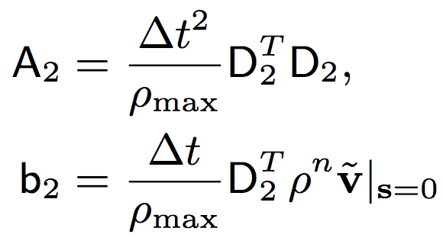
Solving friction
Linearization:
Gradient matrix: $∇∙s=D_{2}s$
Notes:
Again we linearize the energy using the same technique. We construct a different matrix that maps s to the divergence of s.

Slide 35
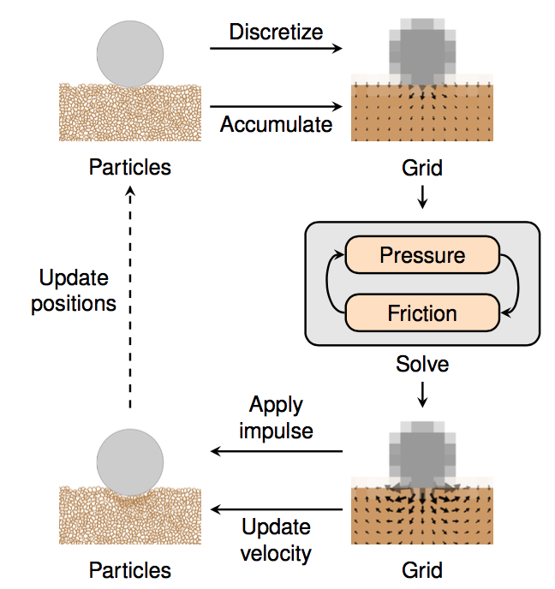
Overall process
For each time step:
Accumulate density $ρ^{n}$ and velocity $v^{n}$ onto grid.
Repeat until convergence or maximum iterations:
Compute frictions by minimizing E(s) for fixed p.
Compute pressure by minimizing f(p) for fixed s.
Find intermediate velocity v ̃.
Update particles:
(a) Update velocities using FLIP.
(b) Move particles through the velocity field v ̃.

Slide 36
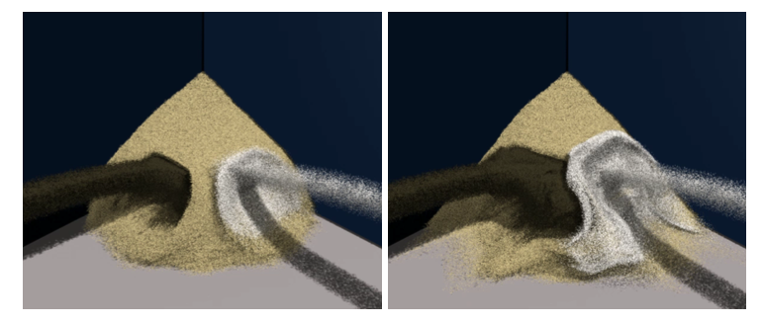
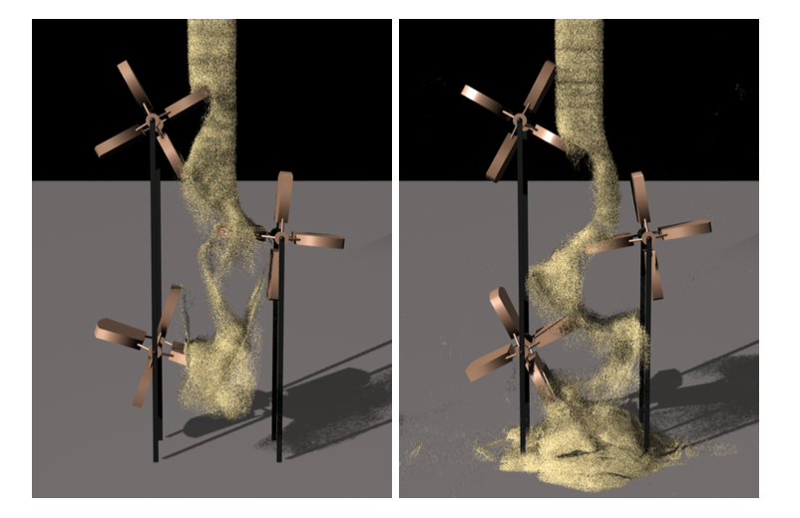
Details and Extensions
Boundary conditions
Not penetrating the wall
Interaction with solid bodies
Define the volume fraction $φ_{s}$
Add the affect to $f_{ext}$, $p$ and $s$
Multiple Material with different density
Modify the calculation of $φ$
Rendering
[Brackbill and Ruppel 1986; Zhu and Bridson 2005]

Slide 37
Further refinement
Extends Zhu’s work to SPH and adds interactions with fluids(2009)
Lenaerts, Toon, and Philip Dutré. "Mixing fluids and granular materials." Computer Graphics Forum. Vol. 28. No. 2. Blackwell Publishing Ltd, 2009.
Extends Narain’s approach to SPH and add cohesion(2011)
Alduán, Iván, and Miguel A. Otaduy. "SPH granular flow with friction and cohesion." Proceedings of the 2011 ACM SIGGRAPH/Eurographics Symposium on Computer Animation. ACM, 2011.
Uses semi-implicit integration on MPM without linearization(2016)
Daviet, Gilles, and Florence Bertails-Descoubes. "A Semi-Implicit Material Point Method for the Continuum Simulation of Granular Materials." ACM Transactions on Graphics 35.4 (2016): 13.

Slide 38
Other approaches
Uses height field to simulate tracks and footprints on sand(1999)
Sumner, Robert W., James F. O'Brien, and Jessica K. Hodgins. "Animating sand, mud, and snow." Computer Graphics Forum. Vol. 18. No. 1. Blackwell Publishers Ltd, 1999.
Uses deformable body rather than rigid particles on MPM to simulate snow(2013)(Frozen)
Stomakhin, Alexey, et al. "A material point method for snow simulation." ACM Transactions on Graphics (TOG) 32.4 (2013): 102.
Uses similar method to simulate sand(2016)
Klár, Gergely, et al. "Drucker-prager elastoplasticity for sand animation." ACM Transactions on Graphics (TOG) 35.4 (2016): 103.

Slide 39
References
Luciani, Annie, Arash Habibi, and Emmanuel Manzotti. "A multi-scale physical model of granular materials." Graphics interface'95. 1995.
Bell, Nathan, Yizhou Yu, and Peter J. Mucha. "Particle-based simulation of granular materials." Proceedings of the 2005 ACM SIGGRAPH/Eurographics symposium on Computer animation. ACM, 2005.
Drucker, Daniel Charles, and William Prager. "Soil mechanics and plastic analysis or limit design." Quarterly of applied mathematics 10.2 (1952): 157-165.
Zhu, Yongning, and Robert Bridson. "Animating sand as a fluid." ACM Transactions on Graphics (TOG). Vol. 24. No. 3. ACM, 2005.
Narain, Rahul, Abhinav Golas, and Ming C. Lin. "Free-flowing granular materials with two-way solid coupling." ACM Transactions on Graphics (TOG)29.6 (2010): 173.
Lenaerts, Toon, and Philip Dutré. "Mixing fluids and granular materials." Computer Graphics Forum. Vol. 28. No. 2. Blackwell Publishing Ltd, 2009.
Alduán, Iván, and Miguel A. Otaduy. "SPH granular flow with friction and cohesion." Proceedings of the 2011 ACM SIGGRAPH/Eurographics Symposium on Computer Animation. ACM, 2011.
Daviet, Gilles, and Florence Bertails-Descoubes. "A Semi-Implicit Material Point Method for the Continuum Simulation of Granular Materials." ACM Transactions on Graphics 35.4 (2016): 13.
Sumner, Robert W., James F. O'Brien, and Jessica K. Hodgins. "Animating sand, mud, and snow." Computer Graphics Forum. Vol. 18. No. 1. Blackwell Publishers Ltd, 1999.
Stomakhin, Alexey, et al. "A material point method for snow simulation." ACM Transactions on Graphics (TOG) 32.4 (2013): 102.
Klár, Gergely, et al. "Drucker-prager elastoplasticity for sand animation." ACM Transactions on Graphics (TOG) 35.4 (2016): 103.

