Slide 1
Modeling of granular materials

Slide 2


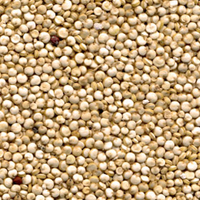
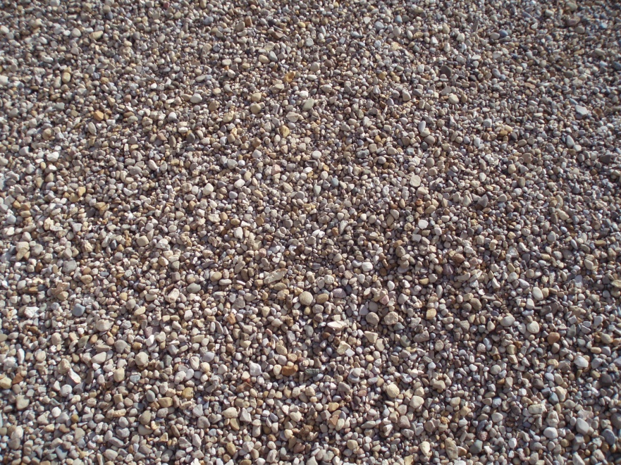
Granular materials
Sand
Powder
Cereals grains
Gravel

Slide 3
Physical behaviour
Free dispersion in free fall – no cohesion
  Dry grains apply no/negligible attractive forces
Settle in stable piles
  Height of pile – depends on friction coeff.
Flow plastically under pressure
  decided based on yield criterion
Notes:
Yield criteria violated – flow plastically

Slide 4
Motivation

Slide 5
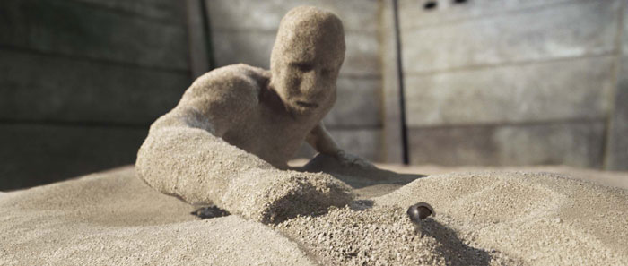

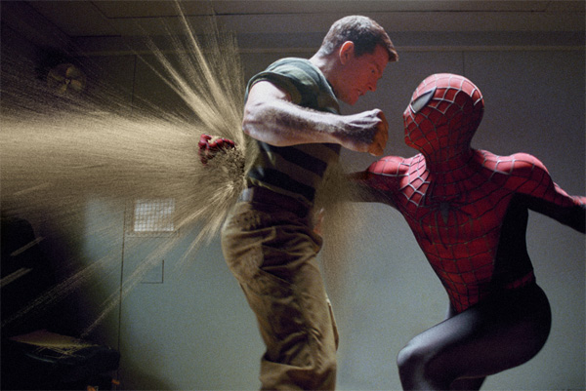
Movies and special effects
http://www.youtube.com/watch?v=shfLYWs-_QY&feature=channel
Notes:
Movies and special effects

Slide 6
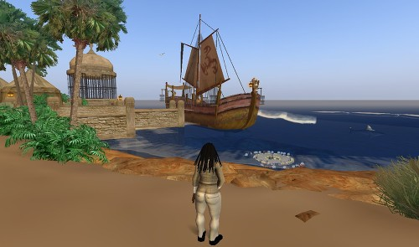

Virtual world (Second Life)

Slide 7


Games (Prince of Persia : Sands of Time)

Slide 8
The Problem
Behavioral aspects
  Behavior is not exactly like solids, liquids or gases
    No cohesion
  Friction forces (inter-grain, boundaries)
    Closely coupled with hydrostatic pressure and stress
    Friction – transmit forces over long distances
      E.g. Sand piles remain stable
  Emergent behavior
    Inelastic collisions

Slide 9
The Problem
Simulation issues
  Scale ( > 10M grains )
  Behavioral complexity
  Non-linear constraints ( yielding stress )
  Representation ( discrete, continuum )

Slide 10
Approaches
Particle-based
Surface flow
Fluid simulation
Continuum approach

Slide 11
Approaches
Particle-based
Surface flow
Fluid simulation
Continuum approach

Slide 12
Particle-based approach
Per-particle simulation
Accurate but slow
~100K particles possible (for ~1 min/frame)
Particle system → damped springs [Luciani et al. 1995]

Slide 13
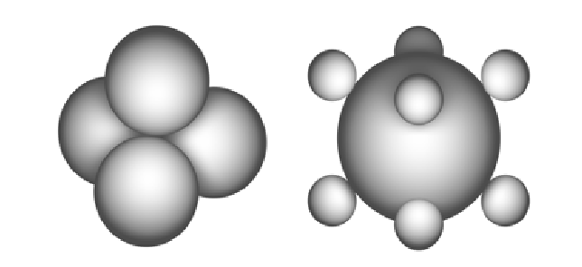
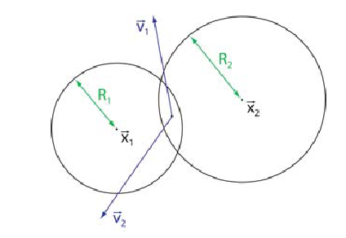
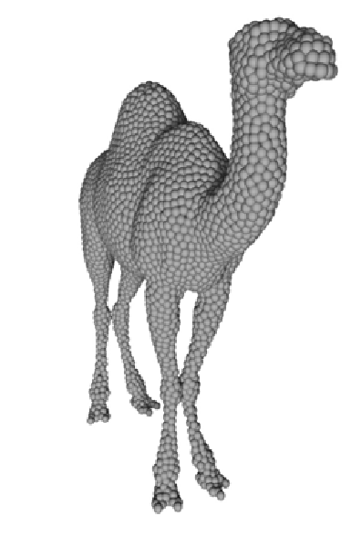
Particle-based approach
[Bell et al. 2005]
  Molecular dynamics based contact model
    grains as discrete particles
    collection spheres → interlocking allows static friction
  Compelling behavior using physical model
    contact, normal and shear forces
  Two-way coupling with rigid bodies
    surface of rigid bodes → covered with spheres

Slide 14
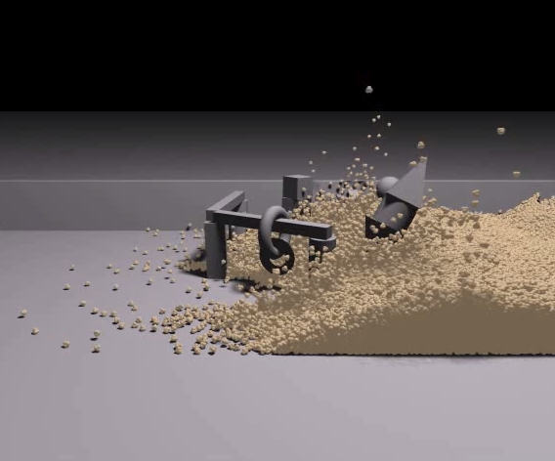
Video [Bell et al. 2005]

Slide 15
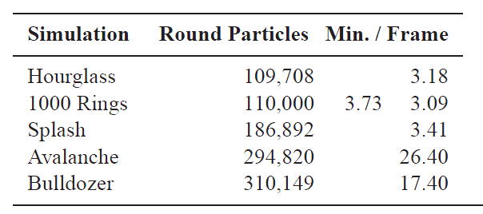
Limitation
  high computational cost,
    3-25 mins per frame
  Neglects cohesion
    cannot simulate moist sand
  Fluid-grain coupling
  Coarse grains
    [Alduan et al 2009] - Interpolate coarse grains over fine grains

Slide 16
Approaches
Particle-based
Surface flow
Fluid simulation
Continuum approach

Slide 17
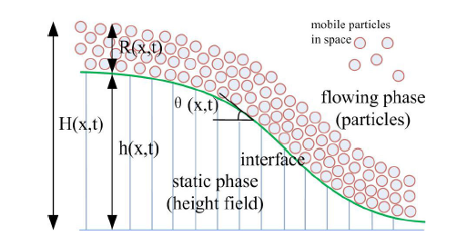
Surface flow [Zhu et al. 2010]
Sand separated into 2 layers
  Appearance
    Sand appearance – surface layer only
    Heap formation – surface layer flows, interior immobile
  Surface flowing layer – Discrete Element Method
    captures detailed flow
  Static layer – height field
  Matter transfer between layers
    surface flow equations

Slide 18
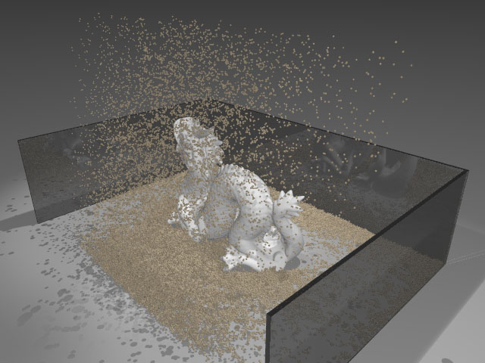
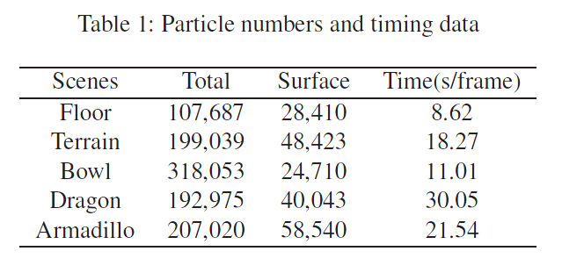
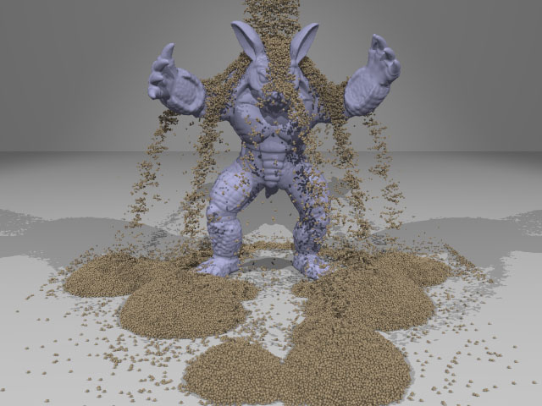
Video
http://vimeo.com/12313312

Slide 19
Approaches
Particle-based
Surface flow
Fluid simulation
Continuum approach

Slide 20
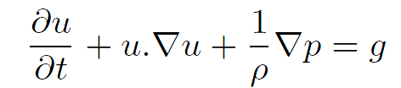



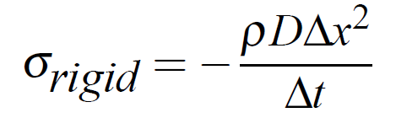



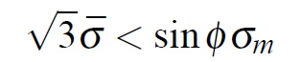


Fluid simulation [Zhu and Bridson 2005]
Adding friction to traditional fluid simulator
  Run a typical fluid simulation step
  Estimate strain tensor D at each cell assuming rigidity
  Calculate
  Yield condition
    Satisfied – mark cell as rigid
    Not satisfied – fluid cell
grid cell width
time-step

Slide 21
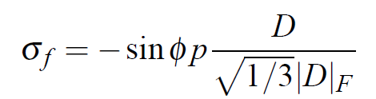

Fluid simulation [Zhu and Bridson 2005]
  Rigid cell
    Project velocities of connected components of rigid cells onto space of rigid body motions (“Rigid Fluids”)
  Fluid cell
  Calculate and store
  Update velocity

Slide 22
Animating Sand as a Fluid
[Zhu and Bridson 2005]
  Continuum formulation
  Bootstrap a fluid simulator
  Fast, but incomplete physical model
Limitations
  Incompressibility → cohesive behavior →wet sand

Slide 23
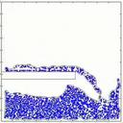
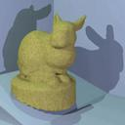
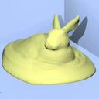
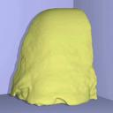
Videos

Slide 24
Approaches
Particle-based
Surface flow
Fluid simulation
Continuum approach

Slide 25
Continuum approach
Treat granular particles as continuous fluid
  Avalanches and landslides [Quecedo et al. 2004, Josserand et al. 2004]
  Sand and granular material [Narain et al 2010]
Efficient numerical methods
  Regular computational domain
  User specified resolution for simulation

Slide 26
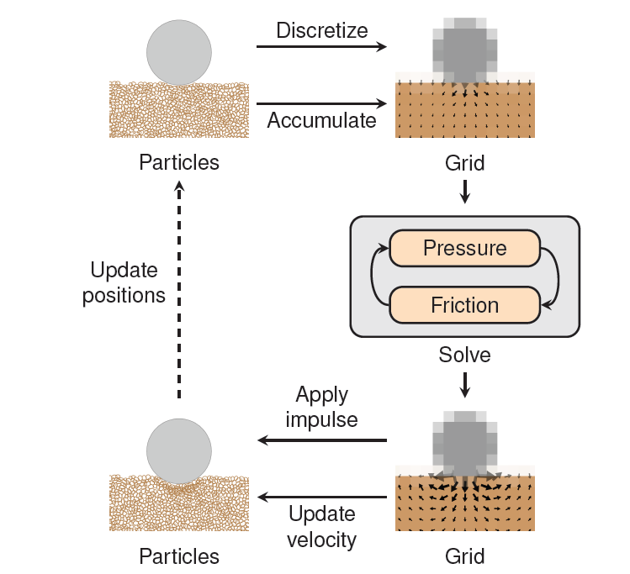
Simulation loop
Particles
  Carry mass and momentum
Grid
  Compute internal pressure and frictional stresses

Slide 27







Stress
_{y}
Stress
At equilibrium – matrix is symmetric – 6 degrees of freedom
Pressure for fluids – tr(σ)/ 3
_{z}
_{x}
_{y}
_{z}
_{x}

Slide 28


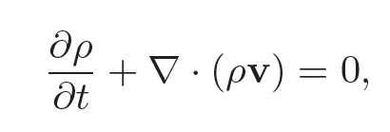


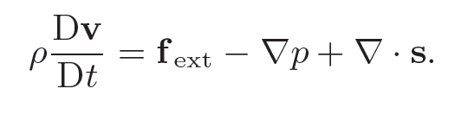



Mass transport
Forces

Slide 29

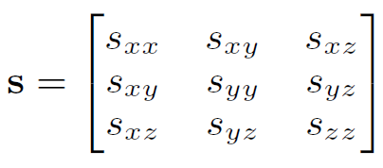
Compute pressure p
Compute friction s

Slide 30
Fluid Model
Variational approach
  Assume inelastic collisions
  Stress will work so as to minimize total energy of the system
  Implicit calculation of stress forces
  Assuming only kinetic energy
    Can be formulated as a minimization problem
    If constraints complementary  LCP

Slide 31
Simulation loop
Particles
  Carry mass and momentum
Grid
  Compute internal pressure and frictional stresses

Slide 32
Simulation particles
Represented as ellipses
  Split
    Ensure coverage of grid
    Conserve mass, volume
  Merge
    # of particles

Slide 33
Rendering
Sand rendered as point cloud
  Pixar Renderman
Render particles
  uniformly sampled distribution over simulation ellipsoid
Reduce cost
  Detect regions of high density → avoid sampling in interior

Slide 34
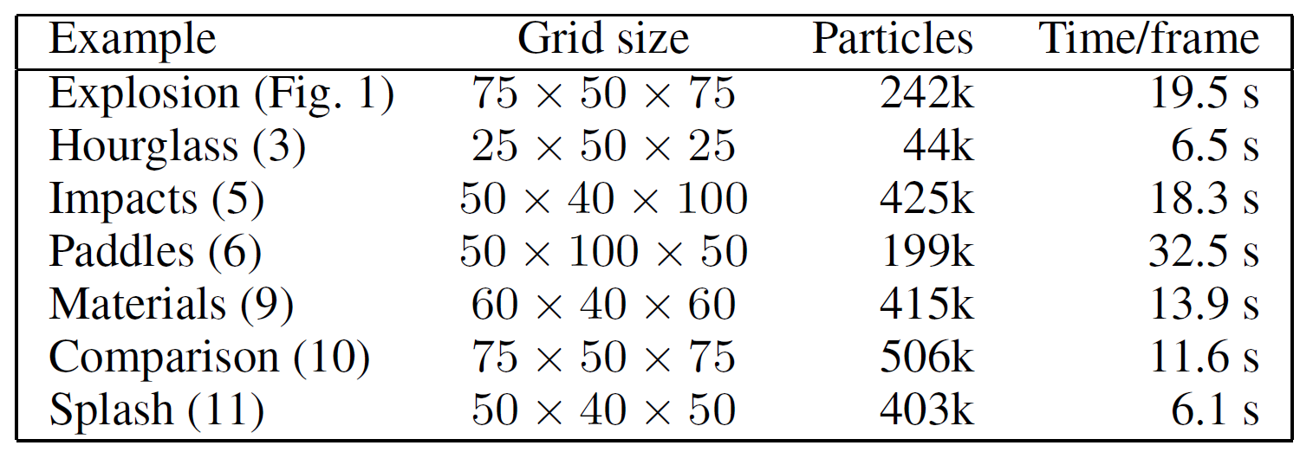
Timings

Slide 35
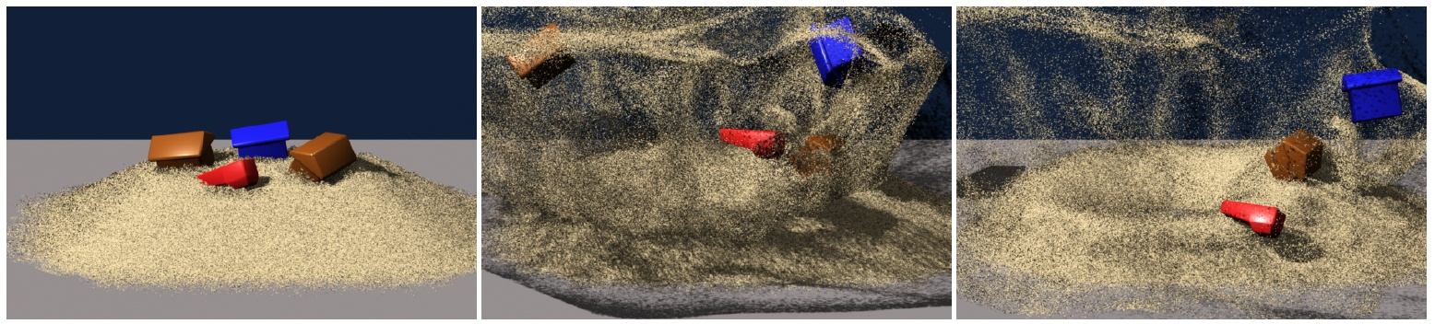
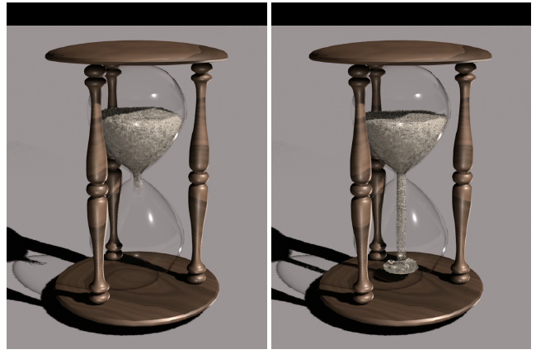
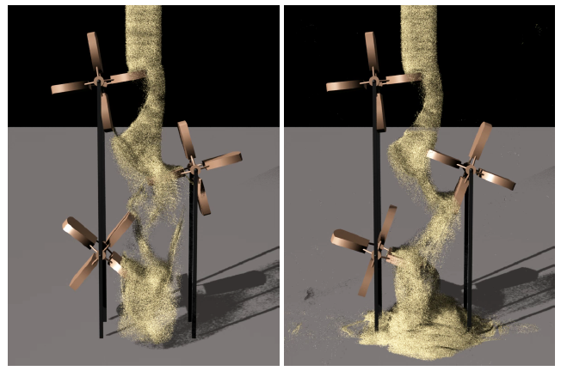
Videos

Slide 36
References
ALDU´A N, I., TENA, ., AND OTADUY, M. A. 2009. Simulation of high-resolution granular media. In Proc. of Congreso Espan˜ol de Informa´tica Gra´fica.
LUCIANI, A., HABIBI, A., AND MANZOTTI, E. 1995. A multi-scale physical model of granular materials. In Proceedings of Graphics Interface.
ZHU, Y., AND BRIDSON, R. 2005. Animating sand as a fluid. In SIGGRAPH ’05: ACM SIGGRAPH 2005 Papers, ACM, New York, NY, USA, 965–972.
JOSSERAND, C., LAGR´E 458 E, P.-Y., AND LHUILLIER, D. 2004. Stationary shear flows of dense granular materials: a tentative continuum modelling. The European Physical Journal E: Soft Matter and Biological Physics 14 (06), 127–135.
QUECEDO, M., PASTOR, M., HERREROS, M. I., AND MERODO, J. A. F. 2004. Numerical modelling of the propagation of fast landslides using the finite element method. International Journal for Numerical Methods in Engineering 59, 6,
BELL, N., YU, Y., AND MUCHA, P. J. 2005. Particle-based simulation of granular materials. In SCA ’05: Proceedings of the 2005 ACM SIGGRAPH/Eurographics symposium on Computer animation, ACM, New York, NY, USA, 77–86.
Narain R., Golas A., Lin Ming (University of North Carolina at Chapel Hill), Free-Flowing Granular Materials with Two-Way Solid Coupling, SIGGRAPH ASIA 2010.

Slide 37
The End

Slide 38
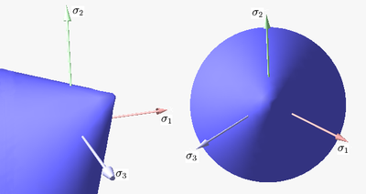
The Yield surface
Defines when a solid will yield under stress
  Condition when sand will become fluid
Mohr – Coulomb yield surface used for granular materials
where
Image courtesy: Wikipedia

Slide 39
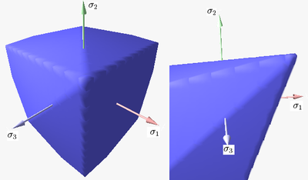
Adapting constraints
Yield condition
  Non-linear – can be approximated as an intersection of linear constraints
    Infinity norm
Unilateral incompressibility
  Hydrostatic pressure = σ_{m}
  
Boundary contact
  Contact velocity
  Frictional forces on tangential velocity
Image courtesy: Wikipedia

Slide 40
Fluid Model
v
Relevant quantities
  Velocity
  Density
  Stress
Modified Navier Stokes equation
Stress in sand
  Normal  compressive
  Shear  friction
u
σ, ρ
u
v

Slide 41
Fluid Model
Stress maintained at every cell instead of pressure
Sand can be
  Rigid  D = 0
    D_{ij} = ½(du_{i}/d_{j} + du_{j}/d_{i})
  Incompressible Fluid  .u = 0
  Loose ( gas-like )

Slide 42
Solving for friction*
Friction reduces velocity
  Minimize kinetic energy!
Yield surface restriction
Boundaries
  Can we add contact constraints?

Slide 43
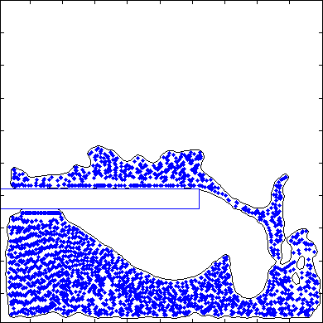
Grains
Grid not sufficient for detailed resolution
Particles in Grid
Volume particles *
  No surface representation
  Mass/Volume?
  Ellipsoid/Spherical particles
  Cheap (possibly approximate) collision avoidance
Animating Sand as a Fluid

