Slide 1
Computer Simulation of the Head-Related Transfer Function
COMP 768 Class Presentation
Alok Meshram

Slide 2
Overview
Overview of a 3d Sound System
Head Related Transfer Functions
The Acoustic Wave Equation
Numerical Methods for Acoustic Simulation
  Finite Element Method
  Boundary Element Method
  Finite Difference Time Domain Method
HRTF Calculation using Numerical Methods

Slide 3
3d Sound Systems: An Overview
3d Sound Systems simulate auditory images
This imagery must be 3-dimensional in order to accurately simulate real world environments
This is because human listeners can perceive spatial information such as location and size
Also, the shape and size of the listener’s surroundings also affects the sound they receive

Slide 4
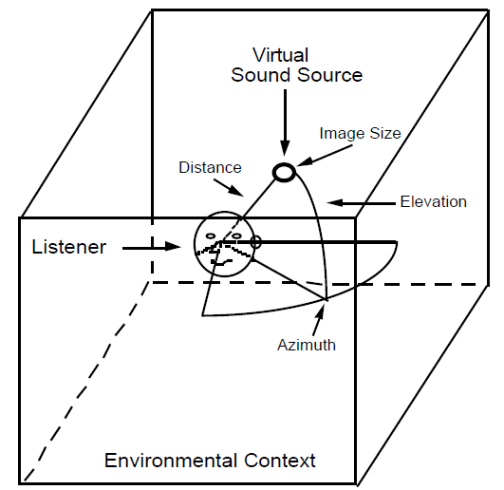
A representation of an auditory scene with relevant parameters labeled

Slide 5
3d Sound Systems
From the listener’s perspective, the important attributes of an auditory scene are:
  Sound source positions (Azimuth, Elevation)
  Sound source size and distance
  The environmental context (Reverberation)
In order to simplify things, we begin with sound sources in free space (no environmental context)
Also, we will focus only on azimuth and elevation
Environment and distance can be added later

Slide 6
3d Sound: Azimuth and Elevation
The sounds received at the ears change as the azimuth and the elevation of the source change
The difference between the signals received at the two ears are characterized by:
  The Interaural Time Difference (ITD)
  The Interaural Intensity Difference (IID)
Lord Rayleigh calculated these for a spherical head in his “Duplex Theory” (1907)

Slide 7
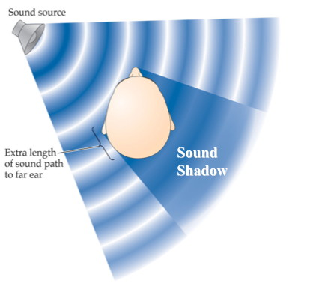
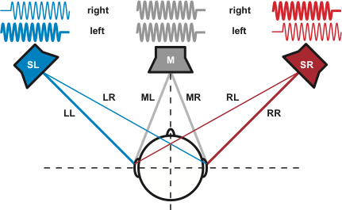
3d Sound: Azimuth and Elevation
Left: Sound reaches the two ears at different times (ITD)
Right: The Head’s “shadow” causes the intensity of the sound at one ear to be lower than the other (IID)

Slide 8
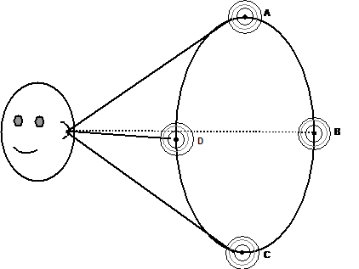
3d Sound: Azimuth and Elevation
However, ITD and IID values cannot be used to uniquely determine a source’s location
For a spherical head, points lying on the “Cone of Confusion” have the same ITD and IID values

Slide 9
Head Related Transfer Functions
ITDs and IIDs don’t account for an important part of the human auditory system: outer ears
The outer ears (pinnae) change incoming sound depending on the source’s azimuth and elevation
Like the ITD and the IID, this filtering is a cue that our auditory system uses for localization
The Head Related Transfer Function (HRTF) encodes all of these changes

Slide 10


Head Related Transfer Functions
The Head Related Transfer Function for each ear can be defined as:
Where:
  ω represents frequency and θ,φ represent elevation and azimuth respectively
  H_{L}(ω,θ,φ) and H_{R}(ω,θ,φ) are the left and right HRTFs
  X_{L}(ω) and X_{R}(ω) are the Fourier Transforms of the signals received by the Left and the Right ears
  X(ω) is the Fourier Transform of the source signal

Slide 11
Head Related Transfer Functions
HRTFs are key components of 3d Sound Systems
This is because HRTFs can be used to obtain the signals received at the listener’s ears given a sound source and its location (using convolution)
This is simple to implement and is fast as it involves simple operations (convolution)
Thus, without much cost, an HRTF based system adds location information to sound

Slide 12
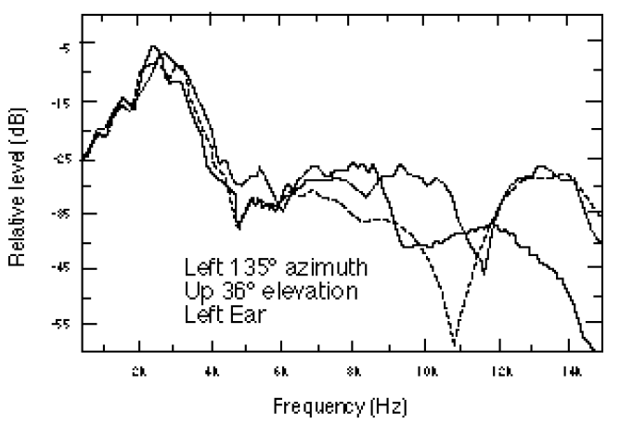
Head Related Transfer Functions
HRTFs are complicated functions that depend strongly on head and ear geometry, differing from person to person
HRTF data for 3 different people for the same source location

Slide 13
Head Related Transfer Functions
Researchers obtain HRTFs through physical measurements. This is slow and expensive.
On the other hand, commercial 3d Sound systems use simple HRTF models or measurements made on dummy heads
However, best results are obtained when the listener’s own HRTF is used. Hence there has been some focus on using computational methods to simulate HRTFs

Slide 14
Head Related Transfer Functions
Computer simulation of HRTFs use head geometry and material parameters as input
They simulate the propagation of sound around and through the head from the source (an impulse) located at various positions
The signals at the ears are Impulse Responses (HRIRs) through which we obtain the HRTFs
We’ll review some sound simulation methods to understand this better

Slide 15





The Acoustic Wave Equation
We will begin with the 1D case and extend it. Newton’s Second Law is:
Dividing both sides by Volume, we get :
We can rewrite it in terms of Pressure Gradient:
The negative sign accounts for the fact that Force due to a Pressure Gradient is in the direction of decreasing Pressure.

Slide 16



The Acoustic Wave Equation
Next, consider a small section (length Δx) of a tube (cross section A). This tube is filled with a material that has Bulk Modulus B defined as:
The Volume of the small section is:
Due to a disturbance the particles of the material move from their original position by a position dependent amount s(x). The change in Volume is:

Slide 17



The Acoustic Wave Equation
Substituting this in the Bulk Modulus equation:
Differentiating with respect to time, we get:
This is known as the continuity equation, and besides Newton’s law it establishes another relation between Pressure and particle velocity

Slide 18




The Acoustic Wave Equation
Differentiating Newton’s Law w.r.t position:
Differentiating Continuity Equation w.r.t time:
Combining, we get the Acoustic Wave Equation:

Slide 19




The Acoustic Wave Equation
Extension to 3d is simple. We use gradients and divergence instead of spatial derivatives:
Note that v is a vector here (it’s in bold). As before, we get the Acoustic Wave Equation by combining these two equations:
Where is the Laplacian

Slide 20



The Acoustic Wave Equation
Among the solutions to the Acoustic Wave Equation, of particular interest are those with sinusoidal time dependence:
Substituting this in the Acoustic Wave Equation:
This is also known as the Helmholtz equation.

Slide 21

Numerical Methods for Acoustic Simulation
We’ve studied Numerical Methods used for integrating Ordinary Differential Equations
However, the Wave Equation is a Partial Differential Equation in space and time
Here we’ll review some numerical methods used to obtain solutions for PDEs like the Wave Equation:
Here f(x,t) represents sound sources

Slide 22
Finite Element Method
The general Finite Element Method(FEM) is quite complicated and involves concepts such as Hilbert and Solobev Spaces
Here, we’ll develop a simpler version from basics
The method we’ll develop will be specifically for the acoustic wave equation
We’ll begin by looking at an overview of the general strategy of the method

Slide 23
Finite Element Method: Overview
An important point: the Acoustic Wave Equation is a PDE in space and time
This means that its solution must be calculated for spatially as well as across time
The FEM’s strategy is to use basis functions distributed spatially over the region of interest
Each of these basis functions is associated with a time-dependent coefficient

Slide 24
Finite Element Method: Overview
The overall solution is the sum of the basis functions weighted by their time dependent coefficients
The advantage of using this strategy is that we can use mathematical manipulation to reduce the time-and-space dependent PDE to a set of time-dependent ODEs
These ODEs can be solved using conventional integrators such as RK4 or the Implicit methods to get the full solution

Slide 25
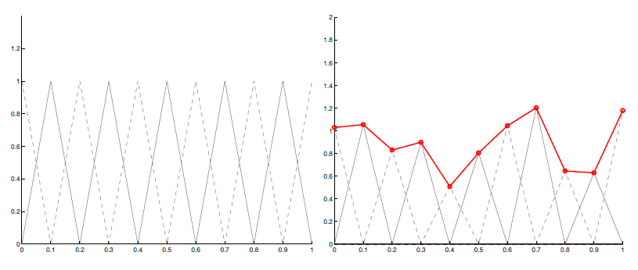
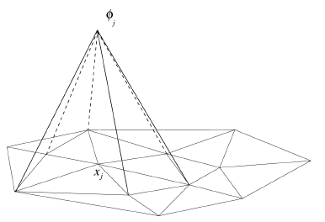
Finite Element Method: Overview
Top: “Hat” basis functions in [0,1] used to divide 1-dimensional space. Notice their overlap and their sum for some coefficients (in red).
Left: Pyramidal basis functions over a triangulation of a 2D region

Slide 26


Finite Element Method
We now discuss the actual formulation of the FEM for the acoustic equation. We start with the following representation of the solution:
Next, we consider the Acoustic Wave Equation:

Slide 27
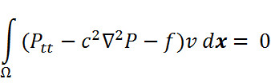
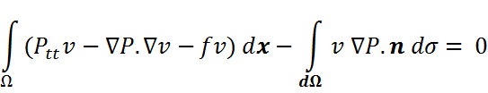
Finite Element Method
Let V be the set of bounded, continuous functions defined on Ω having piecewise continuous first derivatives and fulfilling the spatial boundary conditions of the problem, and let v be its element
Then using the fundamental theorem of calculus of variations and the wave equation, we have:
Using Gauss’ Divergence Theorem:

Slide 28
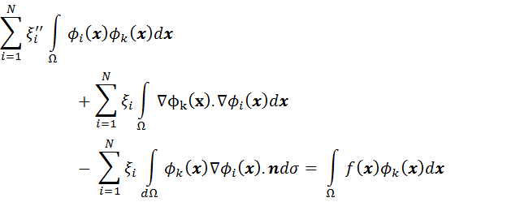
Finite Element Method
Substituting our approximation of P(t,x) into this equation, we get (after much mathematical manipulation):

Slide 29

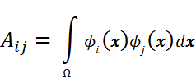
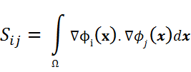
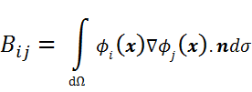
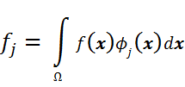
Finite Element Method
We can represent the previous equation as a Matrix equation solving N simultaneous equations (one for each basis function):
Where,

Slide 30
Finite Element Method
As mentioned earlier, we have now reduced the Wave Equation to a system of N simultaneous time-dependent ODEs that can be solved by using regular integration methods
This will give us the individual (t) that we need along with the basis functions to represent the full solution

Slide 31
Boundary Element Method Overview
Instead of discretizing all space (as in FEM), the Boundary Element Method (BEM) works on the discretization of a boundary (surface) in space
To be able to apply BEM, one must reformulate the problem as a Boundary Integral equation
Often, this requires some analytical calculation
Hence BEM can be said to be halfway between analytical methods and numerical methods

Slide 32
Boundary Element Method Overview
We’ll assume sinusoidal time dependence for our solution of the wave equation
We get the Helmholtz equation as a result
It is converted into boundary integrals using either the “direct” or the “indirect” method
To get the solution on the boundary, we use FEM on the boundary mesh. The boundary solution can then be used to get the full solution.

Slide 33

Boundary Element Method
We start with the wave equation:
As mentioned earlier, when we assume sinusoidal time dependence, we get:
Where u(x) is a complex valued function called the complex acoustic pressure
It’s magnitude and argument determines the magnitude and phase of the pressure wave at x

Slide 34

Boundary Element Method
With sinusoidal time dependence, the wave equation reduces to the Helmholtz equation:
We can convert this PDE into a boundary integral equation using the impedance boundary condition:
Here, g is 0 for a scattering problem (which we are interested in) and β(x) is the material dependent relative surface admittance of the scattering surface (usually constant)

Slide 35

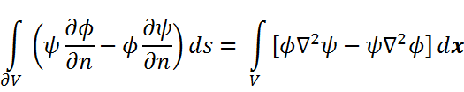
Boundary Element Method
We convert the Helmholtz equation into an integral equation by using its analytical solution for a point source in free space
For a point source at x₀, the solution at x is given by the free-field Green function:
We also use Green’s Second Theorem:

Slide 36


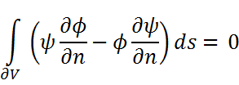
Boundary Element Method
We treat x and x₀ as constants and use y as the variable in our integral equations. We choose:
Note that u(y) is the unknown solution we’re looking for and G(y,x) is the acoustic pressure at y due to a point in x. Since both of these satisfy the Helmholtz equation, we use Green’s Second Theorem to get:

Slide 37


Boundary Element Method
Note that u(y) and G(y,x) are singular at x₀ and x respectively. Also, we’re trying to solve the problem within a bounded region D.
Using these considerations, we get (in the limit of almost including x and x₀ in D) :
Now we make use of the impedance boundary condition that we had:

Slide 38


Boundary Element Method
After substituting the boundary condition we get our first boundary integral equation that relates the solution to its values on the boundary (this equation is not valid on the boundary):
When x is on the boundary, we get a second boundary integral equation (if the boundary is smooth, i.e, without corners):

Slide 39
Boundary Element Method
We use the BEM to solve the second equation, giving us values for u(x) on the boundary
This can be used with the first equation to obtain values for all space inside the bounded region D
This was the formulation of the “interior problem” where the boundary scatters sound due to sources inside it
It can be extended for the “exterior problem”

Slide 40

Boundary Element Method
In BEM we solve the boundary integral formulation of the problem using FEM
We subdivide the boundary into N smooth pieces, γ₁,….,γ_{N}
On each of these pieces, we assume a representation for u(x) (usually polynomial)
As an example, we’ll assume that u(x) has a constant value u_{j} on the j^{th} piece

Slide 41
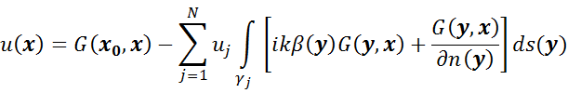

Boundary Element Method
With this approximation, the first boundary integral equation (points not on the boundary) is:
And the second boundary integral equation (for points on the boundary) is:
To solve for the u_{j}’s, we use the collocation method: we assume that the second equation holds exactly for the centroid x_{i} of each piece

Slide 42



Boundary Element Method
With this approximation, the second equation is:
Or, equivalently:
Where:
  u is a column vector consisting of u_{j}’s
  b is a column vector with i^{th} entry = G(x₀,x_{i})
  And B is a matrix with:

Slide 43
Boundary Element Method
By solving this equation for u, we get u_{j} for each of the pieces on the boundary
This could be used to solve the first boundary integral equation to get the values of u(x) for all space
Note that the integrals over γ_{j} could also be approximated. This would make the solution simpler and faster, but less accurate

Slide 44
Boundary Element Method
We changed the Helmholtz equation to Boundary Integral Equations using the “direct method”
The “indirect method” uses functions called the single-layer and double layer potentials. These and their normal derivatives have “jumps” on and across the boundary
These are expressed in boundary integral form and are automatically solutions of the Helmholtz equation. We then try to express the problem and its boundary condition in their terms

Slide 45
Finite Difference Time Domain
The Finite Difference Time Domain (FDTD) method was originally developed for Electromagnetic problems, but is also applicable to Acoustic problems
It represents relevant differentials in the PDE as Finite Differences
Unlike the BEM that we considered, FDTD is a Time Domain method, meaning that it iterates over time

Slide 46




Finite Difference Time Domain
FDTD approximates both spatial and temporal derivatives by finite differences. Consider the Taylor series expansion of a function f(x) about the point x₀ with an offset of ±δ/2 :
Subtracting:
Dividing by δ and rearranging, we get:

Slide 47


Finite Difference Time Domain
Ignoring the O(δ²) term, this is a finite difference approximation of the derivate
We’ll begin with the 1-d FDTD for simplicity. Consider the equations that resulted in the wave equation:
We’ll replace the derivatives in this equation with finite differences

Slide 48
Finite Difference Time Domain
In order to use finite differences, we’ll need to discretize time and space in the following way:
  We’ll represent space by points spread Δ_{x} apart
  We’ll represent time by points spread Δ_{t} apart
We’ll use a staggered grid over space and time
This allows us to alternate iterations over P and v and hence calculate both over space and time

Slide 49
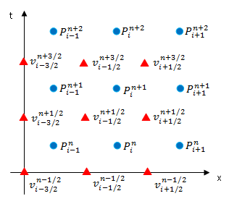
Finite Difference Time Domain
The staggered grid over space and time used in the FDTD method

Slide 50


Finite Difference Time Domain
With this staggered grid, at ((i+1/2)Δ_{x}, nΔ _{t}), using finite differences we get our first update equation
This essentially updates the value of v at a future time based on its current value and the current value of P at two neighbouring spatial positions

Slide 51


Finite Difference Time Domain
After applying the first update equation to all points in space at time n, we shift to another point (iΔ_{x}, (n +1/2) Δ_{t}) to get our second update equation :
This updates the value of P in the future based on its past value and neighbouring values of v. We apply this to all points in space

Slide 52
Finite Difference Time Domain
Alternating between these two equations allows us to calculate the values of v and P over space and time
We need to start with some initial values over space and the initial instant in order to start
Also, sources can be represented by overriding the update equations and setting values of pressure and/or velocity at certain points in space

Slide 53
Finite Difference Time Domain
When implemented this way, boundaries in space are rigid and waves are reflected back from them
This is a problem when calculating in free field or in a small space which is not a rigid wall
In that case, it would be helpful to have a boundary condition that does not reflect waves
The Perfectly Matched Layer is such a boundary condition: it absorbs incident waves

Slide 54


Finite Difference Time Domain
The Perfectly Matched Layer (PML) acts like a lossy medium which absorbs waves incident on it, reflecting only part of it
We can implement a PML for acoustics (in 1D) by using the following PDEs:
Where α is the attenuation factor. Low values give higher reflection.

Slide 55
Finite Difference Time Domain
Extension of the basic method to 3D is simple. We resolve the velocity vector into its components and apply different update equations to them
The staggered grid is a bit different, but essentially am extension of the 1D case
PML implementation for 3D is a bit more complicated than in the 1D case

Slide 56
HRTF Calculation using Numerical Methods
We have reviewed some numerical methods for solving the acoustic wave equation
As mentioned earlier, researchers have used these methods to calculate HRTFs using head geometry and material parameters
Essentially, an impulse source is placed at various locations around the head and the response is calculated at the two ears

Slide 57
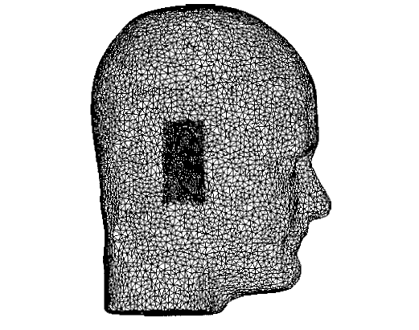
HRTF Calculation using Numerical Methods
Early work by Brian Katz focused on BEM
Head geometry used by Katz. Notice that the pinna geometry is at a higher resolution than the rest of the head

Slide 58
HRTF Calculation using Numerical Methods
Katz’s work used the indirect BEM approach as it was found to be more computationally efficient
For BEM the highest frequency at which the solution can be considered valid is determined by the length of the largest element in the mesh
Another limitation of BEM is that it is a frequency domain method, so to get the whole HRTF, the solution must be calculated repeatedly over a range of frequencies

Slide 59
HRTF Calculation using Numerical Methods
For Katz’s work, higher frequency limits meant smaller elements and more boundary elements, resulting in very large computation times
This along with the fact that the solution had to be calculated over multiple frequencies made him choose a frequency limitation of 5.4 kHz (we’re interested in values upto 20kHz)
He could provide limited comparisons with measured HRTF data only up to that frequency

Slide 60
HRTF Calculation using Numerical Methods
More recent work by Mokhtari et al. used FDTD to calculate HRTF
The primary advantage of using FDTD over BEM is that it is a Time Domain method and hence does not require repeated calculations over the frequency domain
Another advantage is that volumetric data could be directly used instead of having to discretize the surface

Slide 61
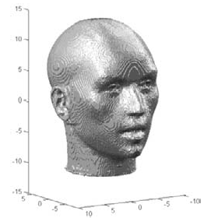
HRTF Calculation using Numerical Methods
Their work used a scanned 3D model of a KEMAR dummy head and used water as the material inside it. It was surrounded by a PML boundary to simulate free field.
KEMAR head geometry used by Mokhtari et al.

Slide 62
HRTF Calculation using Numerical Methods
The results were compared with real world measurements on the same dummy head and found to match quite well
They used a measure called the Spectral Difference (SD), which is the mean absolute difference (in dB) between two HRTFs over a range of frequency values
They found that the overall mean SD was 2.3 dB

Slide 63
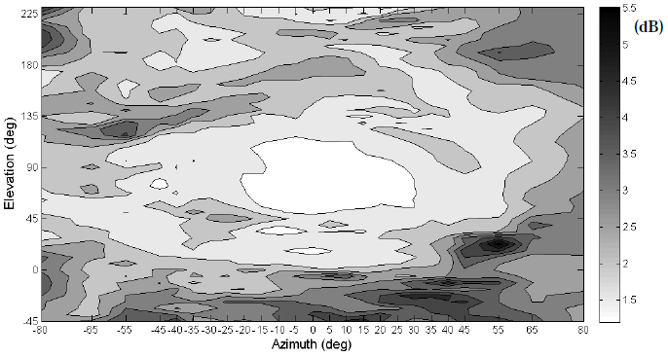
HRTF Calculation using Numerical Methods
Spectral Difference between calculated and measured HRTF over multiple source locations

Slide 64
HRTF Calculation Using Numerical Methods
Even with high precision geometry (within 2mm) their results showed some differences with measured values especially at low elevations
There were also some high error “zones” (such as the one for azimuth +53ᵒ and elevation +23ᵒ) that they could not explain

Slide 65
Summary
HRTFs are important tools in 3D Sound, usually modeled or measured
Acoustic simulations can be done through methods like FEM, BEM and FDTD
These methods can be used to obtain HRTF values
Recent work with FDTD has shown good results, but there are some unexplained inaccuracies

Slide 66
References
3D Sound for Virtual Reality and Multimedia, D.R. Begault
Derivation of the Acoustic Wave equation, J. Claerbout
Time-domain Numerical Solution of the Wave Equation, J. Lehtinen
Boundary Element Methods for Acoustics, S. Chandler-Wilde and S. Langdon
The Boundary Element Method in Acoustics, S. Kirkup
Understanding the Finite-Difference Time-Domain Method, Chapter 12, John B. Schneider

Slide 67
References
Finite Difference Time Domain Tutorial, I. Drumm
The perfectly matched layer for acoustic waves in absorptive media, Q. Liu and J. Tao
Boundary Element Method Calculation of Individual Head-Related Transfer Function. I. Rigid Model Calculation, Brian F. G. Katz
Boundary element method calculation of individual head-related transfer function. II. Impedance effects and comparisons to real measurements, Brian F.G. Katz

Slide 68
References
Computer Simulation of KEMAR's Head-related Transfer Functions: Verification With Measurements and Acoustic Effects of Modifying Head Shape and Pinna Concavity, in Principles and Applications of Spatial Hearing, P.Mokhtari, H.Takemoto, R.Nishimura and H.Kato

Slide 69
Thank You!

