Slide 1
COMP768-F16 Course Presentation
Sound Modal Analysis, Synthesis, and Fluid-Structure Interaction
Justin Wilson

Slide 2
Labeling Conventions
Upper case denotes matrix and lower case denotes vector or scalar
May see damping noted as C or D
Damping labeled as D or d in this presentation
May see displacement (current position – resting position) as x, r, or u
3D displacement labeled as u
1D displacement labeled as x
Rayleigh damping coefficients as η and δ, α and β, or α₁ and α₂
Rayleigh damping coefficients labeled as α₁ and α₂ in this presentation
May see mode space matrix as Φ or U
Mode space matrix labeled as U in this presentation
May see displacement in mode space as z or q
Displacement in mode space labeled as q in this presentation
Fluid-Structure Interaction (aka Elasto-Acoustics, aka Solid-Fluid Interface)
Notes:
Rayleigh (rey-lee)
η is lowercase eta
δ is lowercase delta
α is lowercase alpha
β is lowercase beta
Φ is uppercase phi

Slide 3
Discussion topics
Sound modal analysis
How do we hear sound?
What properties influence the sound of an object?
How can we perform sound modal analysis?
Sound modal synthesis
Fluid-Structure Interaction
What causes an object to make a sound when it is struck?

Slide 4
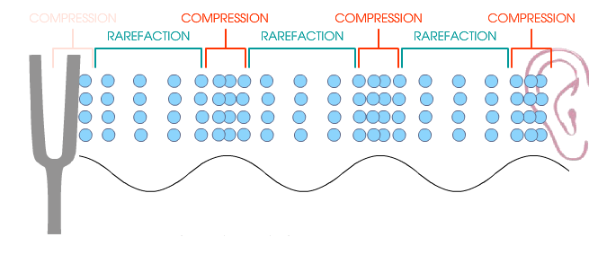
Sound waves and harmonic motion
When an object is struck, it vibrates and deforms
The surrounding air rapidly compresses (compression) and expands (rarefaction or decompression) as the object vibrates outward and inward respectively
As it oscillates periodically, pressure waves are created and air pressure amplitude changes up and down in over time (like a sine wave)
Although we may not see the vibrations or deformations, our ears hear the variation in air pressure as sound
Harmonic motion (aka harmonic oscillation) is the periodic pattern of compression and rarefaction
Pressure waves
Source: digitalsoundandmusic.com
Notes:
Tuning fork vibrates at a single frequency when struck, generating a pure tone
Source: http://digitalsoundandmusic.com/flash/?tutorial=Sound%20Waves%20and%20Harmonic%20Motion
Rarefaction (rair-uh-fak-shuh n)

Slide 5
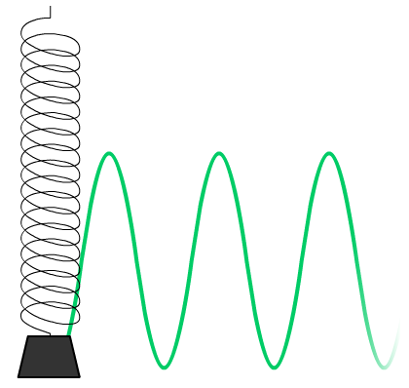
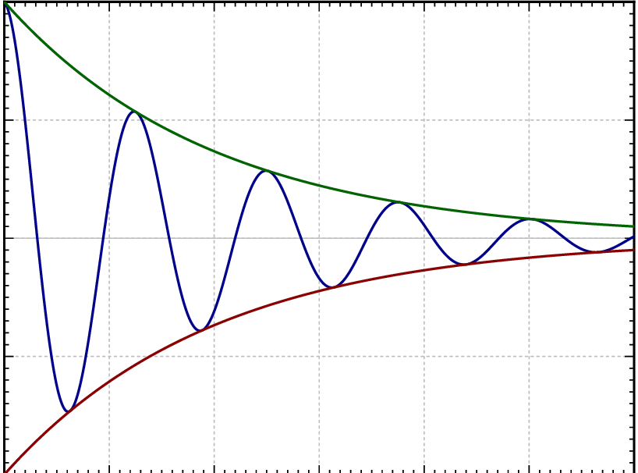
A spring-mass system is also a vibration model
Like harmonic motion, a spring mass system also responds in a periodic motion
Undamped case (d=0)
mx’’(t) + kx(t) = 0
Amplitude does not decrease with time
Damped case (d > 0)
mx’’(t) + dx’(t) + kx(t) = 0
Underdamped case (0 < d² < 4*k*m)
Amplitude vibrates but eventually stops
ω =
Critically damped case (d = 4*k*m)
Decays to zero without oscillating
Overdamped case (d > 4*k*m)
Also decays to zero without oscillating
Undamped case
Source: digitalsoundandmusic.com
Underdamped case
Notes:
Then, what properties influence the sound of an object?
ω is lowercase omega

Slide 6
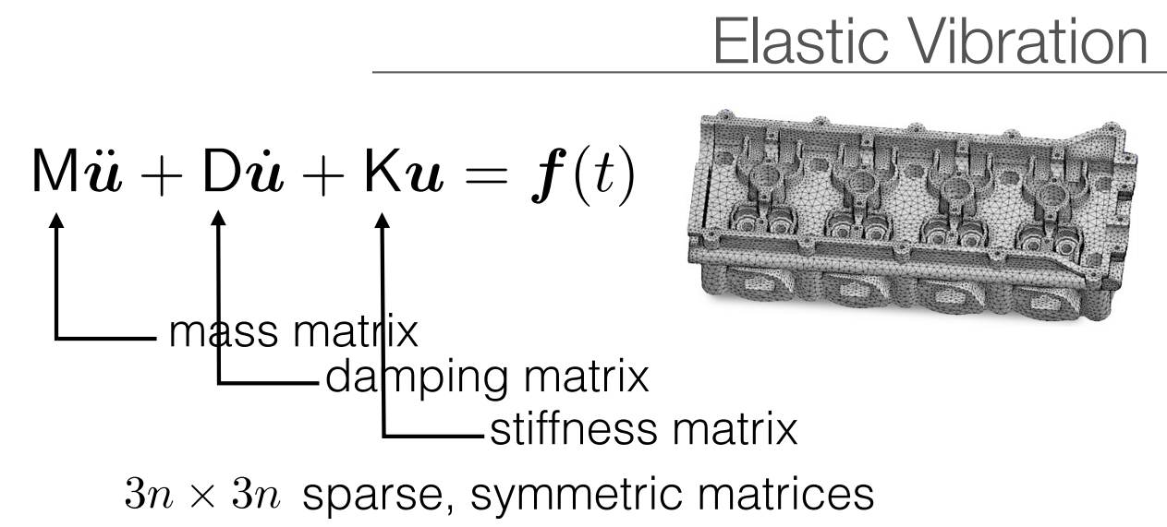
Sound dynamics equation
Mu’’ + Du’ + Ku = f
M = mass matrix, where mass is located on the object
u = vector of the displacement of each element
vector of all zeros represent object at rest
n elements for object, then u vector size = 3n (x,y,z position)
D = viscous damping matrix, how velocity decays over time
K = stiffness matrix, defines connectivity of the elements
f = vector of forces, inducing vibrations
Given these parameters, we can simulate the vibration of the solid volume body object in response to an impulse
Then, how do we represent the object and determine its parameter values (M, D, K)?
Source: SIGGRAPH 2016 Course Notes

Slide 7
Rigid body sound pipeline
Generate volumetric mesh
Construct the stiffness K, mass M, & damping D matrices
Run generalized eigen-decomposition
Construct the decoupled modal vibration equations
Numerically integrate individual modes
Notes:
So far, we have learned how to represent an object as a volumetric mesh for sound analysis.
Next, let’s better understand how to construct the object parameters, mass, damping, and stiffness
Eigen (ʌɪɡən)

Slide 8
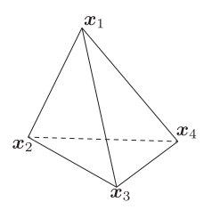
Object is a volumetric solid body
Single tetrahedron of finite element mesh
Represent surface mesh with a finite element mesh (e.g. tetrahedral)
Tetrahedral mesh has n nodes where i=1…n
X_{i} are the rest positions
x_{i}(t) is the time-varying displaced position
u_{i}(t) = (x_{i}(t) – X_{i}) is the nodal displacement
Mu’’ + Du’ + Ku = f(t)
High-dimensional equivalent to spring- mass mx’’(t) + dx’(t) + kx(t) = f(t)
M, D, and K are size 3n x 3n sparse matrices
u₁x
u₁y
u₁z
u₂x
…
u =
=
3n x 1 vector of displacement vectors u_{i} of all nodes
u_{i}
Pressure waves
x_{i}
X_{i}
Source: digitalsoundandmusic.com
Notes:
Can use tetgen to convert to tetrahedral mesh.
Tetrahedra (aka simplex), which simply means that ANY 3D volume, regardless of shape or topology, can be meshed with tets

Slide 9
Rigid body sound pipeline
Generate volumetric mesh
Construct the stiffness K, mass M, & damping D matrices
Run generalized eigen-decomposition
Construct the decoupled modal vibration equations
Numerically integrate individual modes
Notes:
So far, we have learned how to represent an object as a volumetric mesh for sound analysis.
Next, let’s better understand how to construct the object parameters, mass, damping, and stiffness

Slide 10
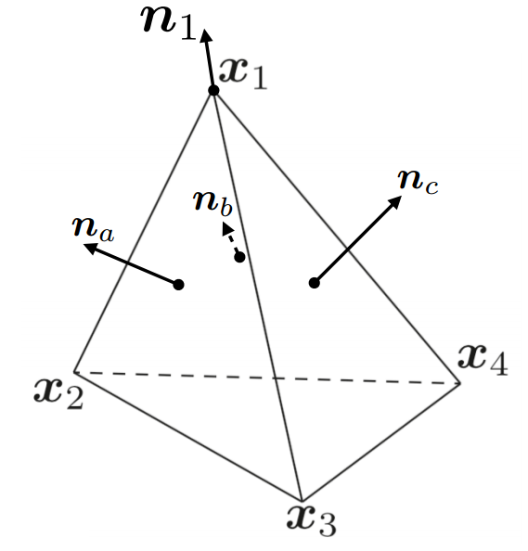
Stiffness matrix K (parameters)
Single tetrahedron of finite element mesh
Stiffness describes element connectivity
If the tetrahedra are small, then can approximate:
Deformation gradient as a constant value inside of each tetrahedron
F = [x₂ – x₁ x₃ – x₁ x₄ – x₁][X₂ – X₁ X₃ – X₁ X₄ – X₁] ⁻¹
Strain also as a constant and linearized since the vibration is very tiny
E = ½ * (F + F^{T})
Stress tensor S = -C*E (linear constitutive law, aka Hooke’s law)
Strain tensor E and stiffness tensor C (symmetric 4th order tensor)
Stiffness tensor C depends on the material; for isotropic materials:
C_{ijkl} = Kδ_{ij}δ_{kl} + µ(δ_{ik}δ_{jl} + δ_{il}δ_{jk} − 2/3*δ_{ij}δ_{kl}) where δ_{ij} is the Kronecker delta function
Given a stress tensor S & direction n, elastic force is Sn
n₁ = effective normal of node 1 = average of three adjacent triangle normals
Source: SIGGRAPH 2016 Course Notes
Notes:
Depending on specific material parameters, the stiffness tensor is symmetric with Cijkl = Cklij = Cjikl = Cijlk
Although strain tensor E is generally nonlinear, approximate as linear since vibration is very tiny
δ is lowercase delta

Slide 11
Stiffness matrix K (related to force)
Single tetrahedron of finite element mesh
Total internal force at node j = f_{j} = ∑ S_{i}n_{ji} (summed over i ∈ T_{j})
T_{j} indicates set of tetrahedral that include node j
n_{ji} is the effective normal n of node j for tetrahedron i
S_{i} is the constant stiffness tensor S for tetrahedron i
Since n_{ji} is a constant direction and S_{i} is linearly related to nodal positions x_{i}, we can express f = Ku (similar to mass-spring kx(t))
Rewrite S_{i} which is linearly related to nodal position x_{i} with K which is a linear function with respect to the displacement vectors u_{j}
Strain state in a solid medium around some point cannot be described by a single vector
f stacks internal force vectors of all finite element nodes
K is a sparse matrix because each node depends only on surrounding tetrahedra
Source: SIGGRAPH 2016 Course Notes
Notes:
∈ is epsilon

Slide 12
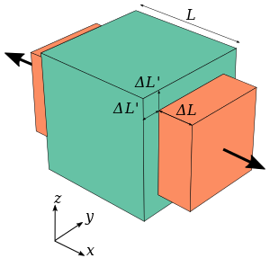
Stiffness matrix key takeaways
Based on elements of the object’s volumetric mesh & Poisson’s ratio
Poisson’s ratio for most materials range between 0 (cork) and 0.5 (rubber), typically between 0.15 and 0.35
When a material is compressed in one direction, it usually tends to expand in the other two directions
Poisson’s ratio ν = (% expansion) / (% compression)
stiffness_ssh “solver” based on UNC (Huai-Ping)
Inputs
.ele and .node files generated from Tetgen
Poisson’s ratio
Ouput
Stiffness matrix elements
Poisson’s ratio for different materials
Notes:
Poisson’s ratio ν (pronounced nu)

Slide 13
Mass matrix M
Single tetrahedron contributes a 12 x 12 submatrix to final 3n x 3n mass matrix M
B11d11 | 0 | 0 | B21d11 | 0 | 0 | B31d11 | 0 | 0 | B41d11 | 0 | 0
0 | B11d22 | 0 | 0 | B21d22 | 0 | 0 | B31d22 | 0 | 0 | B41d22 | 0
0 | 0 | B11d33 | 0 | 0 | B21d33 | 0 | 0 | B31d33 | 0 | 0 | B41d33
B12d11 | 0 | 0 | B22d11 | 0 | 0 | B32d11 | 0 | 0 | B42d11 | 0 | 0
0 | B12d22 | 0 | 0 | B22d22 | 0 | 0 | B32d22 | 0 | 0 | B42d22 | 0
0 | 0 | B12d33 | 0 | 0 | B22d33 | 0 | 0 | B32d33 | 0 | 0 | B42d33
B13d11 | 0 | 0 | B23d11 | 0 | 0 | B33d11 | 0 | 0 | B43d11 | 0 | 0
0 | B13d22 | 0 | 0 | B23d22 | 0 | 0 | B33d22 | 0 | 0 | B43d22 | 0
0 | 0 | B13d33 | 0 | 0 | B23d33 | 0 | 0 | B33d33 | 0 | 0 | B43d33
B14d11 | 0 | 0 | B24d11 | 0 | 0 | B34d11 | 0 | 0 | B44d11 | 0 | 0
0 | B14d22 | 0 | 0 | B24d22 | 0 | 0 | B34d22 | 0 | 0 | B44d22 | 0
0 | 0 | B14d33 | 0 | 0 | B24d33 | 0 | 0 | B34d33 | 0 | 0 | B44d33
12 x 12 submatrix is comprised of 3x3 diagonal matrices B_{ij} making it sparse B_{ij} = (1/20) *pV * (1+δ_{ij}) * I_{3x3}, i.e. 2nd partial derivative of kinetic energy with respect to nodal velocities

Slide 14
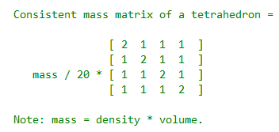
Mass matrix key takeaways
Mass matrix construction methods
Direct Mass Lumping (DML)
Variational Mass Lumping (VML)
Consistent Mass Matrix (CMM)
Template Mass Lumping (TML)
Compute mass matrix using "volumetricMesh“ library [Barbic]
This library uses consistent mass matrix (CMM) of a tetrahedron
Eigenvectors are mass-normalized

Slide 15
Damping matrix D (Rayleigh damping)
Rayleigh damping (aka linearly proportional damping) is used to model losses based on mass and stiffness
Rayleigh damping: D = α₁M + α₂K
Linear combination of mass (M) and stiffness (K) where α₁ and α₂ are real-valued parameters
Rayleigh damping is most commonly used because of ease of computation but note the following limitations:
Rayleigh damping is only a first-order approximation
Originally chosen for ease of computation, not its physical accuracy
Only produces normal modes
Other damping models
Caughey damping
Generalized proportional damping (GPD)
Notes:
Discuss pros/cons of the other damping models
Caughey damping model is more general than Rayleigh
Most general damping model that limits vibration to normal modes is generalized proportional damping (GPD)
Rayleigh (rey-lee)

Slide 16
Mass, stiffness, and damping “solvers”
Mass (M) and stiffness (K) can be constructed through knowledge of the shape and material properties of the object
Notably, its density (p), Poisson’s ratio (ν), and Young’s modulus (E)
Damping (D), how do we obtain the Rayleigh coefficients α₁ and α₂?
Instead of by hand, researchers¹ have established a method to automatically estimate them from recorded audio
Glass for example
ν = .25, E = 50e09 Pascals, p = 2500 kg/m³
α₁ = 2.0 and α₂ = 7.8e-8
¹ Example-Guided Physically Based Modal Sound Synthesis [Ren et al]
Notes:
For values of Young’s modulus by material, look at https://en.wikipedia.org/wiki/Young%27s_modulus

Slide 17
Rigid body sound pipeline
Generate volumetric mesh
Construct the stiffness K, mass M, & damping D matrices
Run generalized eigen-decomposition
Construct the decoupled modal vibration equations
Numerically integrate individual modes
Notes:
So far, we have learned how to represent an object as a volumetric mesh for sound analysis.
Next, let’s better understand how to construct the object parameters, mass, damping, and stiffness

Slide 18
Eigendecomposition
Shape and material properties of the object are analyzed to decompose the vibrations into a set of modes of vibration
Linear combination of normal modes with different amplitudes, frequencies, and phases
We perform generalized eigenvalue decomposition using KU = MUS and displacement vector u = Uq
U is the modal shape matrix of normal modes, containing the eigenvectors
S is the diagonal eigenvalue matrix
Mu’’ + Du’ + Ku = f(t), set u = Uq, and multiply by U^{T}
U^{T}MUq’’ + U^{T}DUq’ + U^{T}KUq = U^{T}f(t)
Simplify by substituting U^{T}MU = I, U^{T}DU = α₁I + α₂S, and U^{T}KU = S
q’’ + (α₁I + α₂S)q’ + Sq = U^{T}f(t)
General eigendecomposition solver using Intel MKL (Math Kernel Library) to obtain eigenvalues
Notes:
ω is radians per second and f is cycles per second

Slide 19
Rigid body sound pipeline
Generate volumetric mesh
Construct the stiffness K, mass M, & damping D matrices
Run generalized eigen-decomposition
Construct the decoupled modal vibration equations
Numerically integrate individual modes
Notes:
So far, we have learned how to represent an object as a volumetric mesh for sound analysis.
Next, let’s better understand how to construct the object parameters, mass, damping, and stiffness

Slide 20
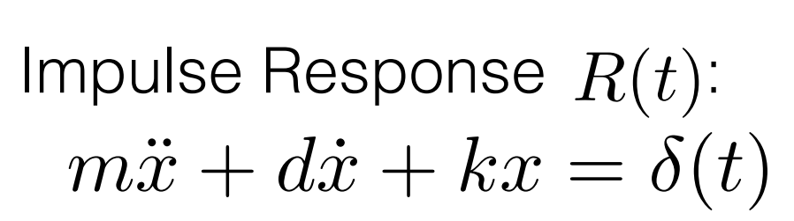
Rather than solving a set of coupled equations, we solve n damped vibration independent equations
Matrices U^{T}MU = I, U^{T}DU = α₁I + α₂S, and U^{T}KU = S are diagonal so equations about q are independent
So can solve n damped vibration equations independently
We decouple Mu’’ + Du’ + Ku = f(t) into a set of independent 1D vibration equations mx’’(t) + dx’(t) + kx(t) = 0
q’’ + (α₁I + α₂S)q’ + Sq = U^{T}f(t)
Damping d_{i} = α₁ + α₂ * eigenvalue_{i}
Stiffness k_{i} = eigenvalue_{i}
U^{T}f(t) is the force vector represented with mode coordinates
Remember, ω_{i} = 2πf_{i} and mass matrix is mass normalized so m = 1
For the purpose of sound synthesis, we are interested in the vibrational frequencies in our hearing range (20Hz to 20kHz)
Therefore, we only need to consider modes with vibrational frequencies in this range
ω =
frequency f =
π
Notes:
Resulting damping matrix is diagonal only for ideal conditions

Slide 21
Rigid body sound pipeline
Generate volumetric mesh
Construct the stiffness K, mass M, & damping D matrices
Run generalized eigen-decomposition
Construct the decoupled modal vibration equations
Numerically integrate individual modes
Notes:
So far, we have learned how to represent an object as a volumetric mesh for sound analysis.
Next, let’s better understand how to construct the object parameters, mass, damping, and stiffness

Slide 22
Numeric methods
In general, each natural mode of the system has a different natural frequency
The physical interpretation of the eigenvalues and eigenvectors which come from solving the system are that they represent the frequencies and corresponding mode shapes
Harmonic Oscillator [Barbic]
Integrates a single 1D harmonic oscillator; can timestep the following Ordinary Differential Equation: M * q''(t) + D * q'(t) + K * q(t) = f(t)
Only supports underdamped systems
Modal superposition analysis (aka modal analysis)
Modal expansion thereom
Source: MIT Open Courseware [Vandiver]
Notes:
Other numerical methods
To perform modal analysis numerically, the object is represented using a discretized model such as FEM mesh or spring-mass thin-shell
Power iteration: eigenvector computed 1st and then eigenvalue from Rayleigh quotient of the eigenvector
Hermitian matrix Schur decomposition backsubstitution

Slide 23
Summary of modal analysis steps
Analyze the vibrations of the sounding object (Mu’’ + Du’ + Ku = f(t))
Parameters based on shape and material set of properties
Stiffness matrix
Mass matrix
Using tetrahedral nodes, Poisson’s ratio, Young’s modulus, and density
Damping model: how vibrations of a modeled object will decay over time
Rayleigh damping (aka linearly proportional damping of mass and stiffness)
Mode space (q’’ + (α₁I + α₂S)q’ + Sq = U^{t}f(t))
Damping d_{i} = α₁ + α₂ * eigenvalue_{i}
Stiffness k_{i} = eigenvalue_{i}
U^{T}f(t) converts forces on elements to normal mode amplitudes
Frequency f_{i}
Dynamically create sounds at runtime with modal synthesis
=
π
Notes:
Caughey (K AW - h ee)
Caughey damping
Generalized proportional damping (GPD)

Slide 24
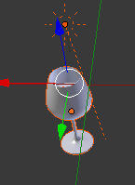
Modal sound synthesis
Simulate based on a contact point
Position (x,y,z) of where the object is struck
ANN (Approximate Nearest Neighbor) [Mount and Arya]
Impulse direction (x,y,z); e.g. usually striking the object in normal direction to the contact point but could synthesize tangentially to the object like (0,1,0)
Synthesis Toolkit in C++ (STK) [Cook and Scavone]
C++ open source audio signal processing and algorithmic synthesis
Realtime audio in C++ (RtAudio) [Scavone]
RtAudio provides a common API for realtime audio input/output

Slide 25
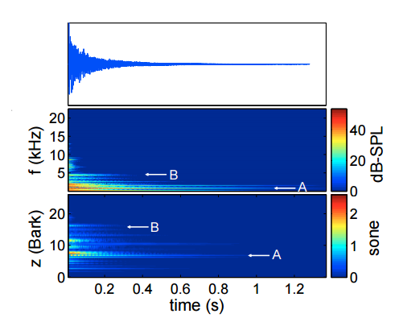
Real-time sound synthesis
To achieve real-time, these pre-processing steps are performed for a given object and material
Eigendecomposition is performed and resulting U^{T} and each mode’s damping coefficient d and damped frequency f_{i} are saved
At run-time, an applied force f is transformed to mode space U^{T}f
Resulting q vector from U^{T}f contains the amplitudes with which to scale each mode
Sampled sound equals some of the mode amplitudes
Resulting damped sinusoids q(t) can be combined and sampled at 44kHz to produce the sound
Based on Nyquist theorem should sample at double what humans can sense
For example, if we choose a samping rate of 48kHz, then deltaT = 1.0 / 48kHz ~ 0.00002
Example-Guided Physically Based Modal Sound Synthesis [Ren et al]

Slide 26
Fluid-Structure Interaction and Elasto-Acoustic coupling
Elasto-acoustic coupling may also be referred to as solid-fluid interface
It involves the interactions between the vibrations of an elastic structure and the sound field in the surrounding fluid
Weak coupling may be used if the pressure forces of the fluid on the solid are negligible, then a sequential computation can be formed
Mechanical surface vibrations are calculated first and then used as the input for an acoustic field computation
Strong coupling requires that the mechanical and acoustic field equations including couplings be solved simultaneously

Slide 27
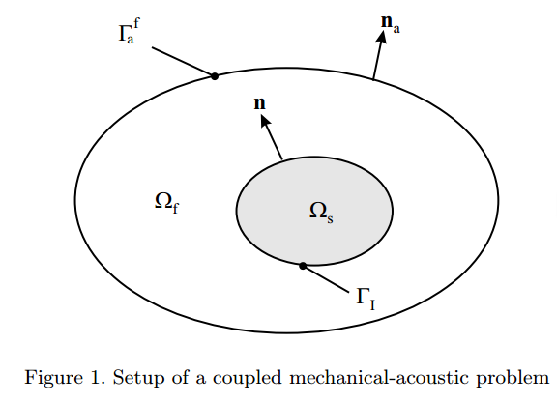
FSI overview diagram
Two independently Τ_{s} and Τ_{f} generated triangulations on Ω_{s} and Ω_{f}
Displacement u on Τ_{s}
Potential ψ on T_{f}
Two (d−1)-dimensional grids ∂Τ_{s} and ∂T_{f} on interface boundary Γ_{I}
At the interface Γ_{I} we have to consider the solid - fluid coupling
n ⋅ (v_{s} – v_{f}) = 0 = n ⋅ u’ + ∂ψ/∂n
[σ] ⋅ n + p_{f}nψ’ = 0
Τ_{s}
Τ_{f}
Γ_{I}
Elasto-Acoustic and Acoustic-Acoustic Coupling on Nonmatching Grids [Flemisch et. al]
Notes:
Τ is tau
ψ is Psi
σ is lowercase sigma
1. Normal component of mechanical surface velocity of the solid must coincide with the normal component of the acoustic velocity of the fluid
2. Ambient fluid causes a surface force f_{Γ} which acts like a pressure load on the solid

Slide 28
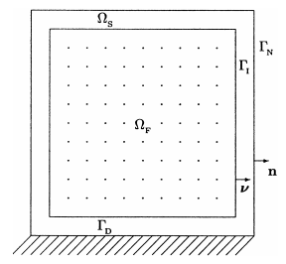
Displacement vs. potential-based formulation
So we can use standard Lagrangian nodal finite elements in both domains, we use:
Displacement-based formulation for the solid (u)
Potential-based formulation for the fluid (ψ)
If both solid and fluid used displacement-based formulations, then would require non-standard discretization by means of Raviart-Thomas
Notes:
ψ is Psi
Raviart (ra-vi-art)

Slide 29
Discretized elasto-coupling dynamics equation
M_{u} 0
0 -M_{ψ}
u’’
ψ’’
+
0 D_{uψ}
D^{T}_{uψ} -D_{ψ}
u’
ψ’
+
K_{u} 0
0 -K_{ψ}
u
ψ
=
f_{u}
0
Block diagonal entries M_{u}, M_{ψ}, D_{ψ}, K_{u}, K_{ψ} can be assembled locally without needing any information from the opposite grid
Coupling between the two grids takes place D_{uψ} and D^{T}_{uψ} which realize the boundary integrals
D_{uψ} = [D_{pq}] = ∈ R^{d}
Terms defined on next slide
Notes:
ψ is Psi

Slide 30
Algorithm
D_{uψ} = [D_{pq}] = ∈ R^{d}
is scalar basis functions associated with node p on dΤ_{s}
is scalar basis functions associated with node q on dΤ_{f}
p_{f} is the mean density of the fluid
Γ is the boundary between fluid-structure interface
Τ_{s} and Τ_{f} are surface and fluid triangulations respectively
n is the normal at the boundary point
The key to this equation/algorithm is the determination of the intersection area of two elements from the different grids
Intersection determined if a vertex lies inside the other surface element e_{n} or vice versa
For 3D, complexity order O(n^{4/3}) with n denoting total # of unknowns
It is possible to do better by incorporating neighbor relations of the surface elements and/or inheritance relations from an underlying geometrical multigrid hierarchy

Slide 31
Algorithm (continued)
for all slave elements e^{n}_{i}, i = 1, …, n_{n} do
for all master elements e^{m}_{j}, j = 1, …, n_{m} do
determine intersection are e^{nm} = e^{n}_{i} ∩ e^{m}_{j}
if e_{ij} != 0 then
_{for} all basis function N^{m}, ɸ^{n} with support ∩ e_{ij} != 0 do
add ∫e_{nm} N^{m} ɸ^{n} dΓ to M
_{end for}
_{end if}
_{end for}
_{end for}
Elasto-Acoustic and Acoustic-Acoustic Coupling on Nonmatching Grids [Flemisch et. al]

Slide 32
Research References
Physically Based Sound for Computer Animation and Virtual Environments [ACM SIGGRAPH 2016 Course]
Modal Vibration
Acoustic Transfer
Example-Guided Physically Based Modal Sound Synthesis [Ren et al]
Interactive Modal Sound Synthesis Using Generalized Proportional Damping [Sterling et al]
Elasto-Acoustic and Acoustic-Acoustic Coupling on Nonmatching Grids [Flemisch et. al]
Q. Elasto-Acoustics in Formulas of Acoustics [Maysenholder and Mechel]
Fluid-Structure Interaction: Applied Numerical Methods [Morand and Ohayon]

Slide 33
Software Libraries
Volumetric Mesh library [Barbic]
Tetgen to volumetric mesh
Computes mass matrix
Intel MKL (Math Kernel Library)
General eigendecomposition
Synthesis Toolkit in C++ (STK) [Cook and Scavone]
Set of open source audio signal processing and algorithmic synthesis C++ classes
Harmonic Oscillator [Barbic]
Integrates a single 1D harmonic oscillator; can timestep the following Ordinary Differential Equation: M * q''(t) + D * q'(t) + K * q(t) = f(t)
ANN (Approximate Nearest Neighbor) [Mount and Arya]
Supports exact and approximate nearest neighbor searching in arbitrarily high dimensions

Slide 34
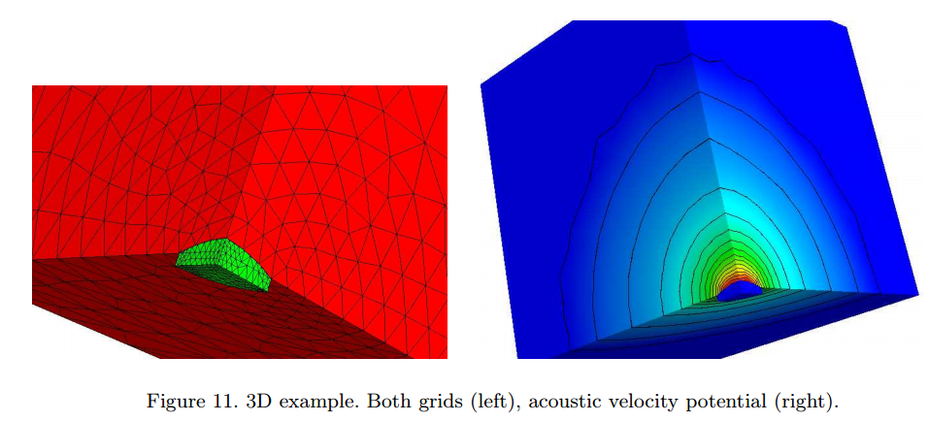
Thank You and Happy Halloween!
Questions?

