Slide 1
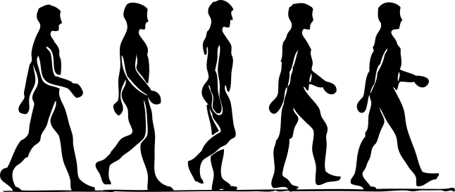
Physically-Based Locomotion
Carl Schissler
2014/11/03

Slide 2
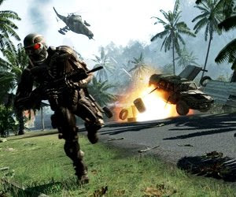
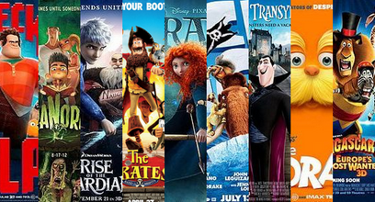
Motivation
Need for plausible animations in games, movies

Slide 3
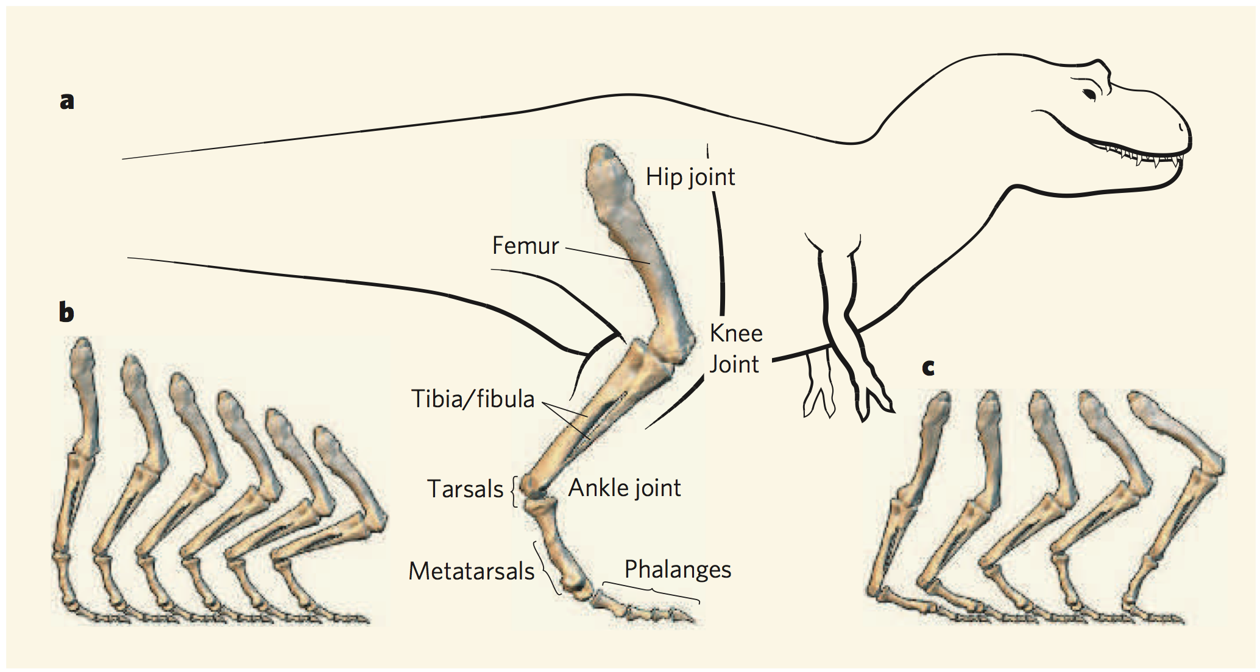
Application: Paleontology
Dinosaur Locomotion: Beyond the Bones [Hutchinson & Gatesy 2006]
Can we determine how extinct animals moved?
Given:
Muscle attachments
Joint articulation limits
Approx. mass distribution

Slide 4
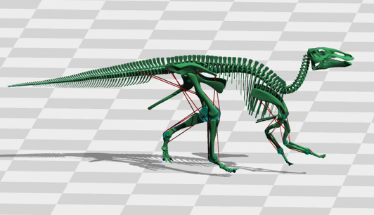
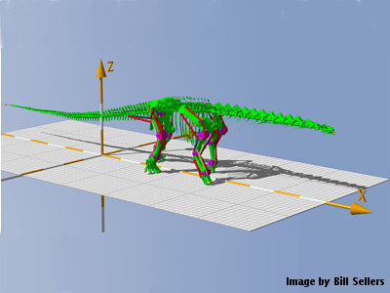
Application: Paleontology
Hard to compute for complex skeletal models
GaitSym (2013)

Slide 5
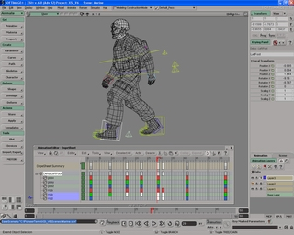
Previous Animation Techniques
Artist animation
Artist controls joint motion
Key frames
Fast runtime
Time consuming
Expensive ($)
Not flexible
Not physically-based
  Plausibility depends mostly on artist skill.

Slide 6
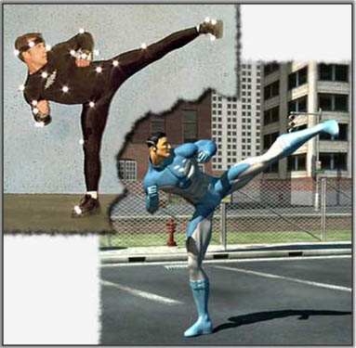
Previous Animation Techniques
Motion capture
Record the motion of markers placed on real actors
Commonly used
Fast runtime
Expensive ($)
Not flexible

Slide 7
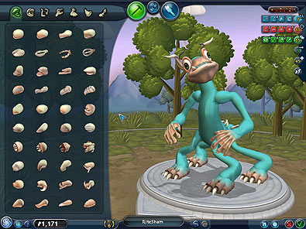
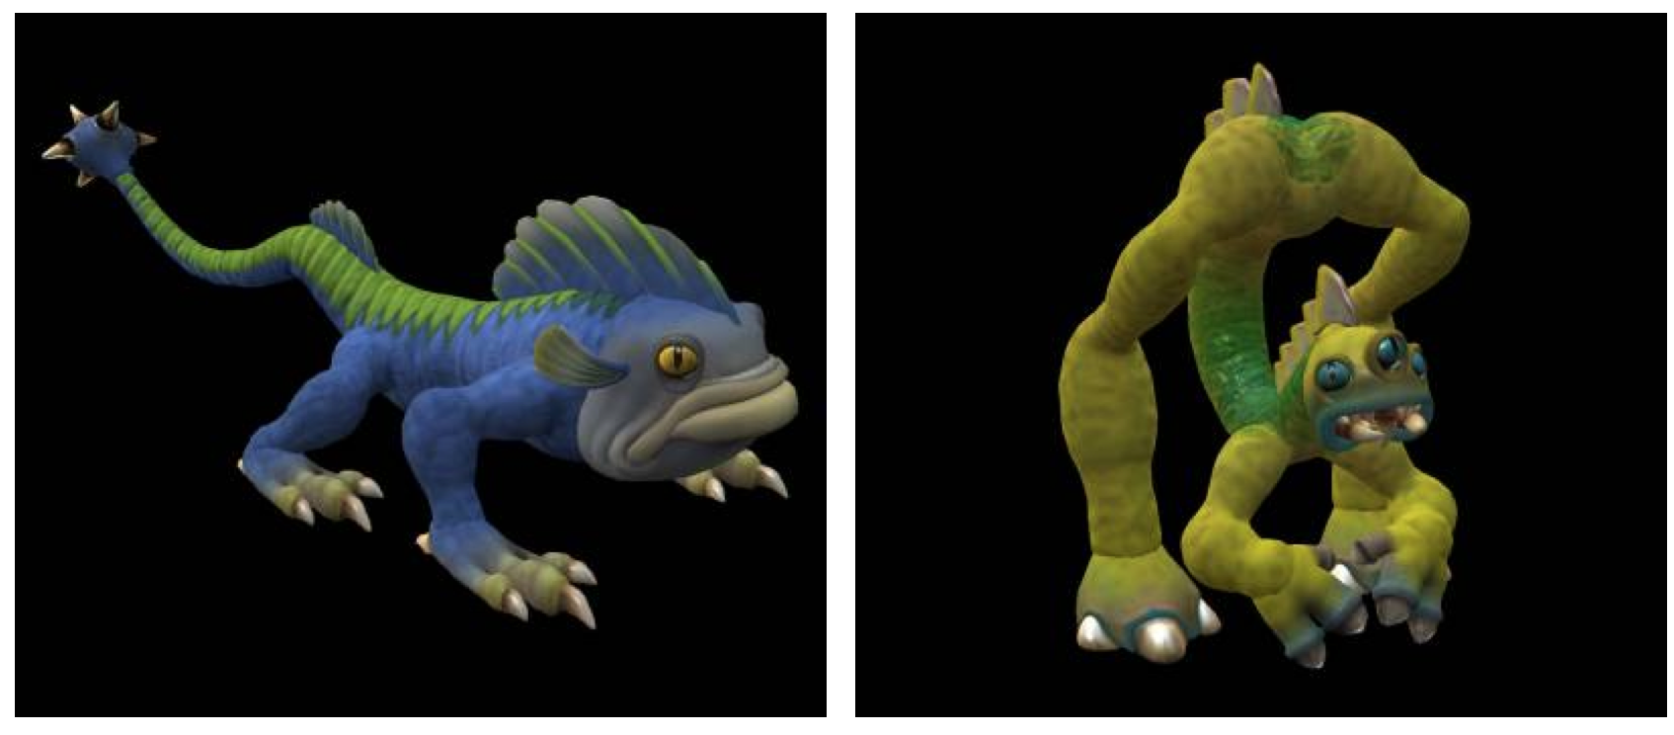
Other methods
Can modify existing motions (animated/captured) based on dynamic interaction. [Hecker 2008]
Is there a way to synthesize motion from physical parameters?
Spore®

Slide 8
Special Case: Locomotion
Common task: move from point A to point B
Considerations:
Turn towards goal
Reach the goal
Movement speed: walk, run, etc.
Dynamic stability: don't fall over
Constraints: joint limits
Skeletal layouts: biped, quadruped, etc.

Slide 9
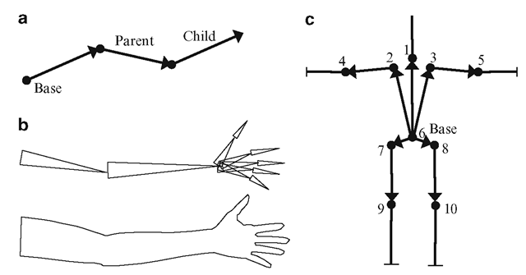
Skeletal Modeling
Model agent as hierarchy of rigid bones.

Slide 10
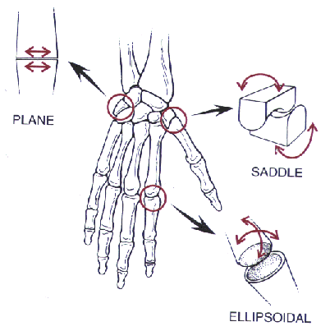
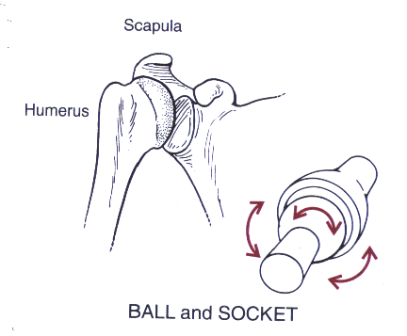
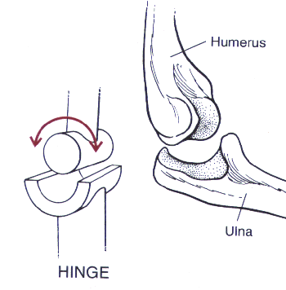
Skeletal Modeling
Various models for bone joints

Slide 11
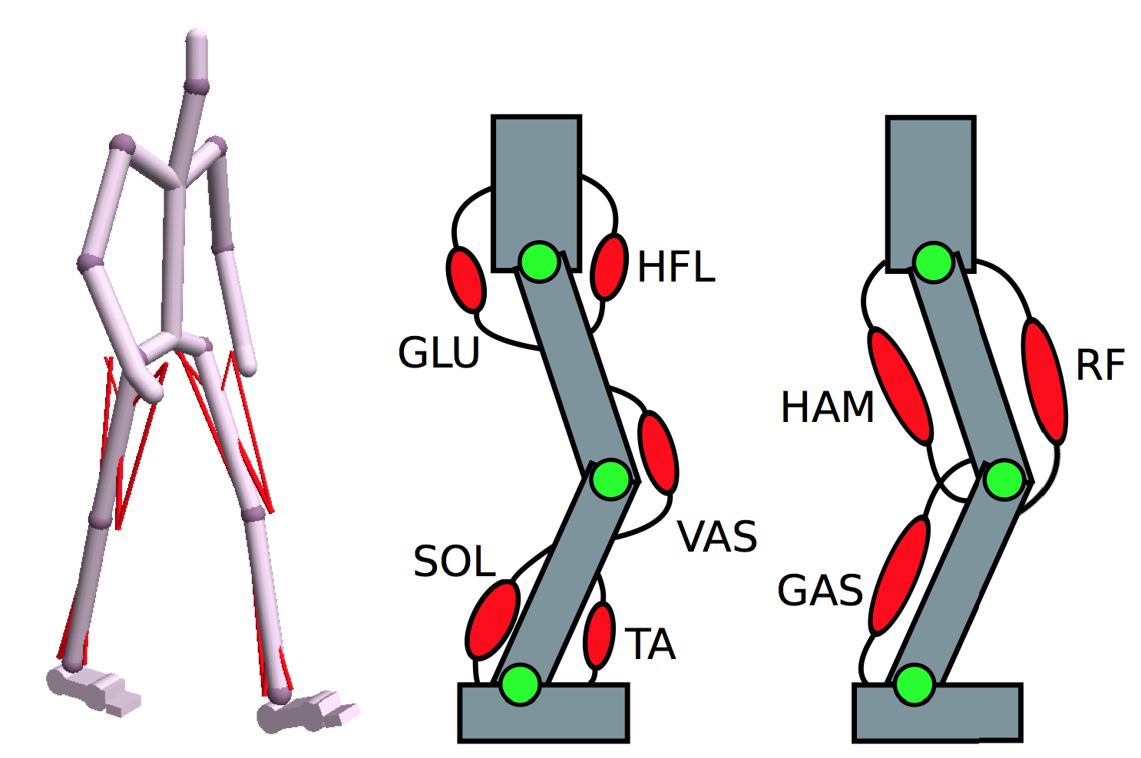
Skeletal Modeling
Muscle modeling
[Wang et al. 2012]

Slide 12
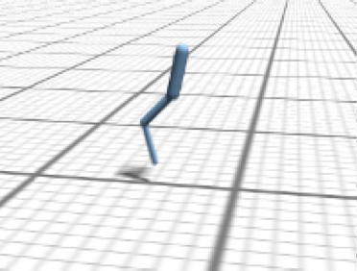
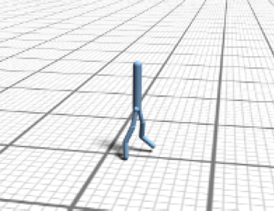
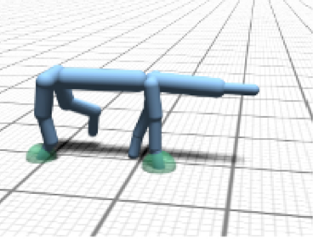
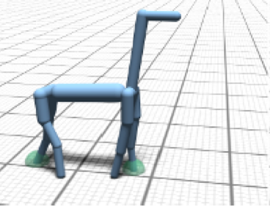
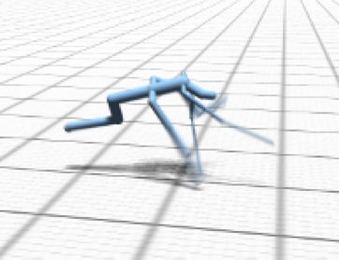
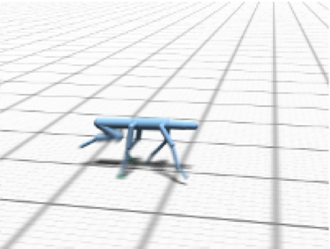
Skeletal Modeling
Various skeletal configurations

Slide 13
Problem Overview
Goal: determine each joint's torque/force at each time step.
Common approach: optimize to achieve task (walk, run)
Many DOF
Potential methods:
  Gradient descent (local minima!)
  Genetic algorithms
  Constrained optimization
  Motion planning

Slide 14
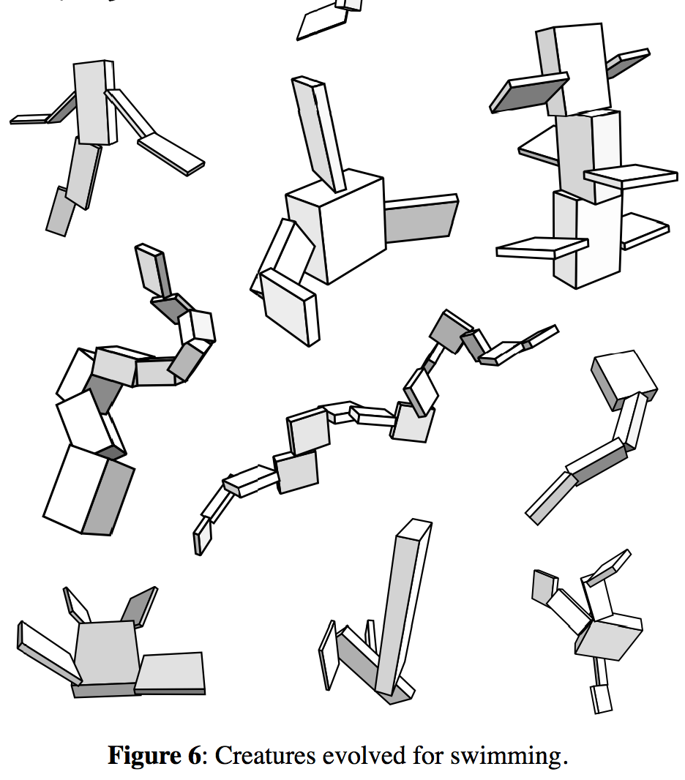
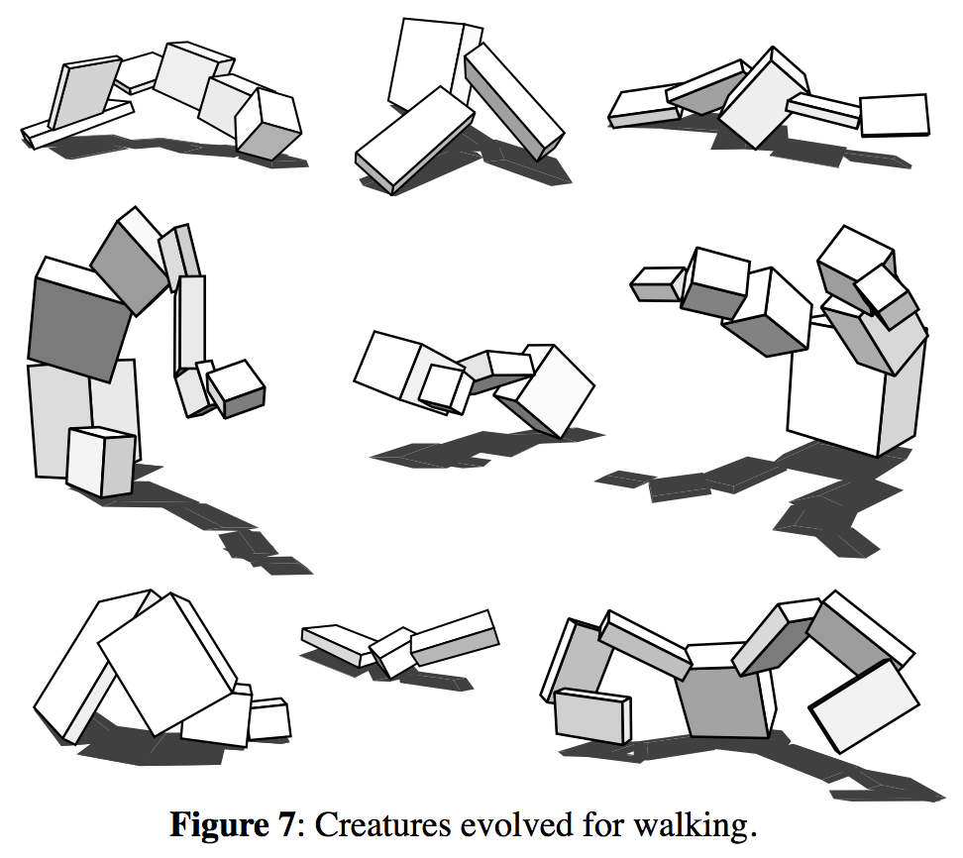
Genetic Approaches
Early work: Evolving Virtual Creatures [Sims 1994]

Slide 15
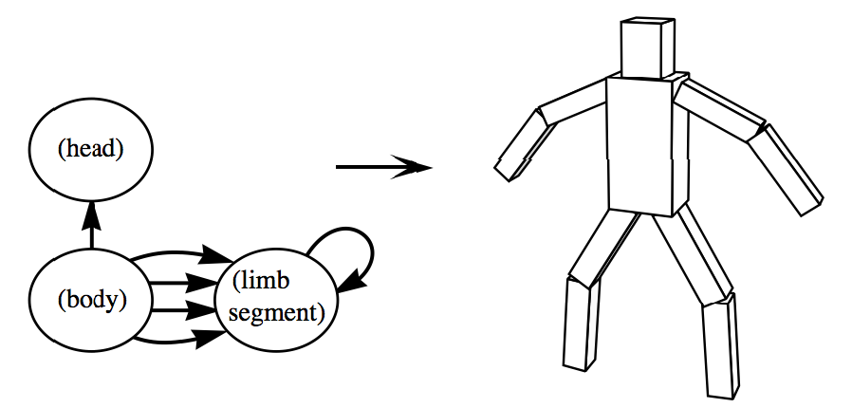
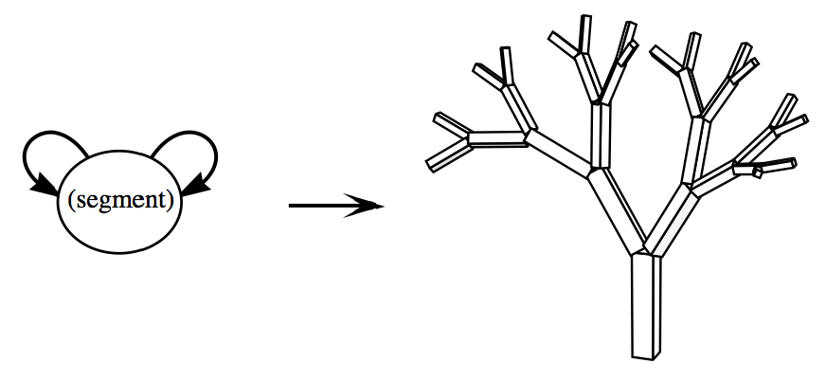
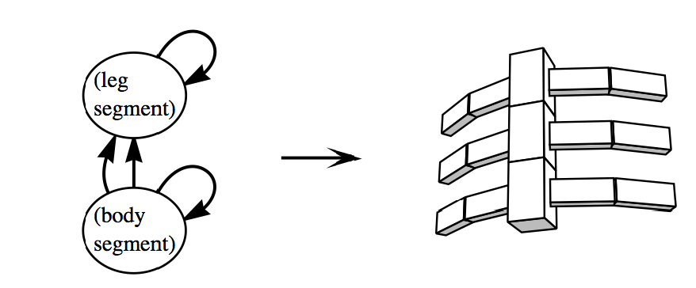
Genetic Approaches
Evolving Virtual Creatures [Sims 1994]
Main Idea: Evolve creatures to achieve task
Genetic representation of morphology
'Grow' creatures from genetic info

Slide 16
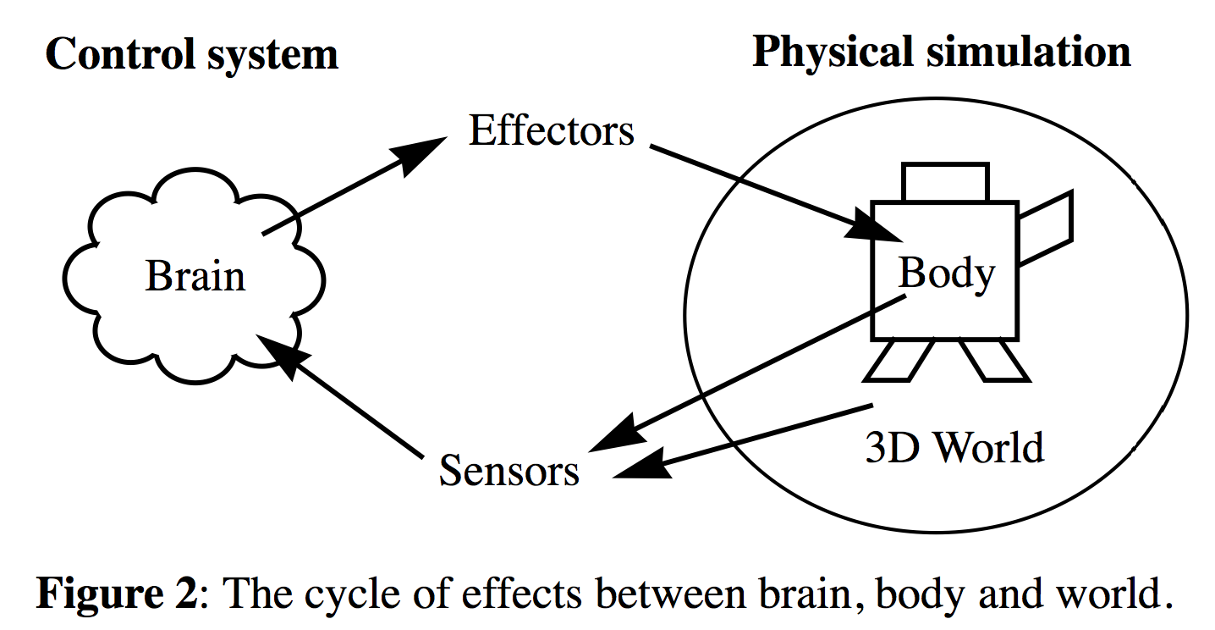
Genetic Approaches
Evolving Virtual Creatures [Sims 1994]
Neural network for motor control
Impulse/penalty-based articulated body simulation

Slide 17
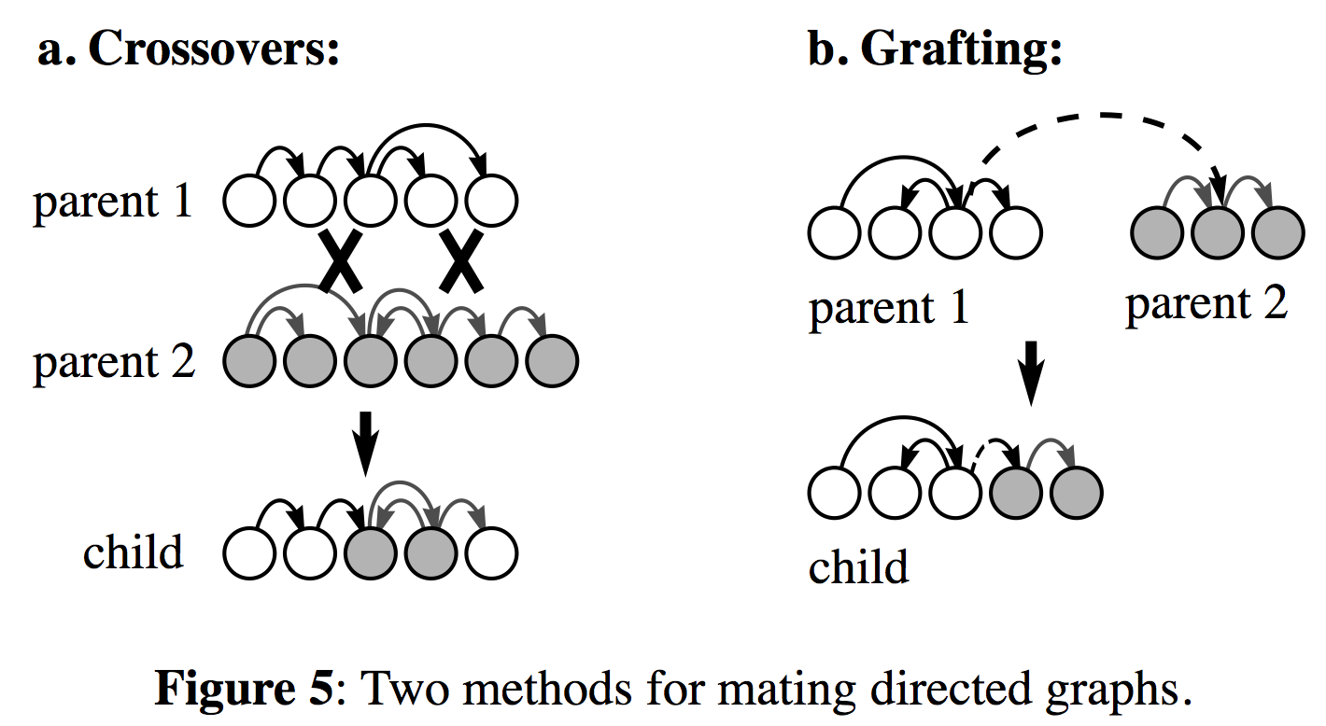
Genetic Approaches
Evolving Virtual Creatures [Sims 1994]
Evaluate fitness at each generation for population
Fitness for walking/swimming: movement speed
'Mate' best offspring for next generation.

Slide 18
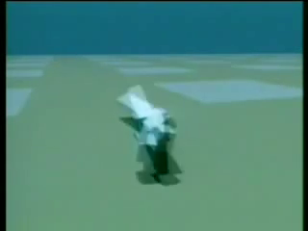
Genetic Approaches
Evolving Virtual Creatures [Sims 1994]
Results: http://www.youtube.com/watch?v=JBgG_VSP7f8

Slide 19
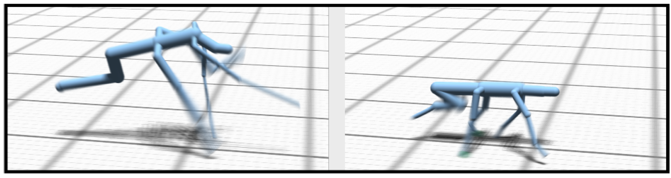
Optimization Approaches
Optimal Gait and Form for Animal Locomotion [Wampler & Popovic ́ 2008]
Terrestrial legged-animal motion on a 'treadmill'
Handles arbitrary morphologies

Slide 20
Optimization Approaches
Optimal Gait and Form for Animal Locomotion [Wampler & Popovic ́ 2008]
Optimize joint forces f and torques t at each time step
Constraints:
  Body stays mostly stationary
  No self intersection
  Motion along one axis
  Contact forces within friction cone (no sliding)

Slide 21
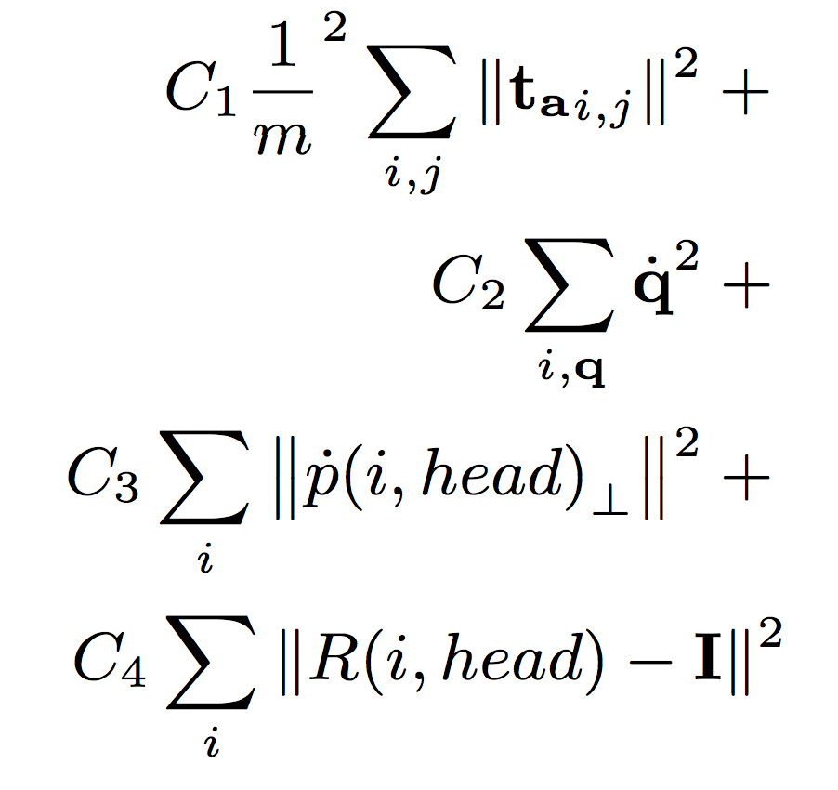
Optimization Approaches
Optimal Gait and Form for Animal Locomotion [Wampler & Popovic ́ 2008]
Optimize cost function:
Minimizes muscle exertion
t_{a} = joint j torque at frame i
m = mass
Penalizes high-velocity joints
q = joint DOF
Penalizes head translation
p = joint position
Penalizes head rotation R relative to movement direction

Slide 22
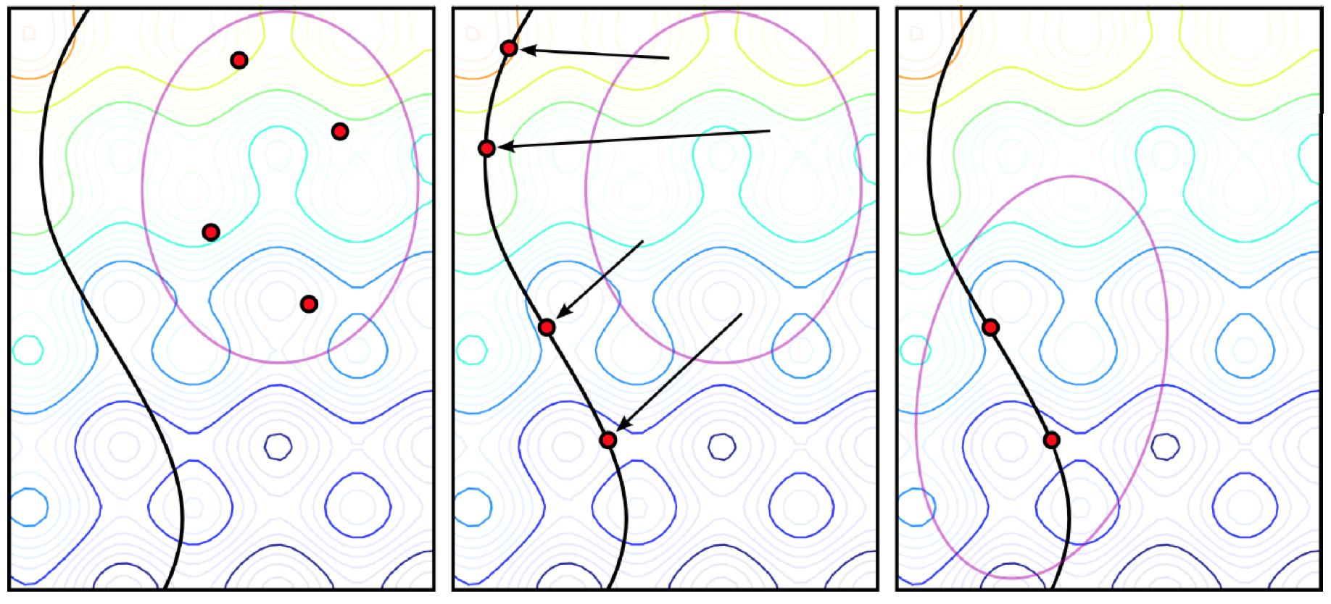
Optimization Approaches
Optimal Gait and Form for Animal Locomotion [Wampler & Popovic ́ 2008]
Hybrid iterative optimization approach to avoid local minima.
  Global optimization step – Covariance Matrix Adaptation
  Local derivative-aware search step
Constrained space
covariance
distribution
Notes:
1. take samples from current best gaussian distribution
2. project samples onto constrained space.
3. compute new distribution from the covariance matrix of best samples.

Slide 23
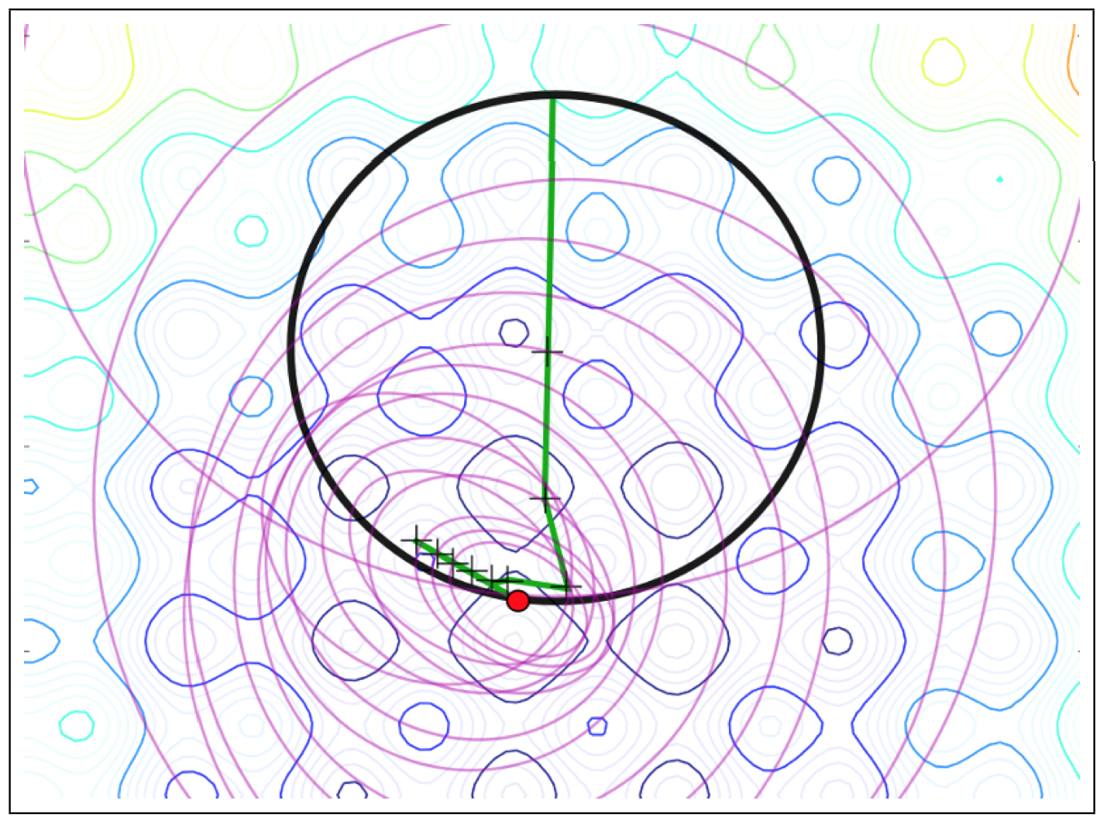
Optimization Approaches
Optimal Gait and Form for Animal Locomotion [Wampler & Popovic ́ 2008]
Covariance matrix
ellipsoids
mean
Notes:
1. take samples from current best gaussian distribution
2. project samples onto constrained space.
3. compute new distribution from the best samples.

Slide 24

Optimization Approaches
Optimal Gait and Form for Animal Locomotion [Wampler & Popovic ́ 2008]
Results: http://grail.cs.washington.edu/projects/animal-morphology/s2009/movs/morphology.avi
Notes:
1. take samples from current best gaussian distribution
2. project samples onto constrained space.
3. compute new distribution from the best samples.

Slide 25
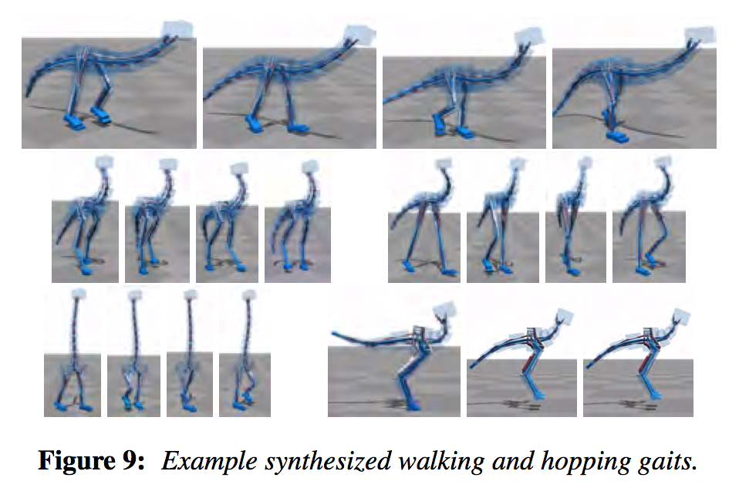
Optimization Approaches
Flexible Muscle-Based Locomotion for Bipedal Creatures
[Geijtenbeek et al. 2013]
Simulated muscles
Neural network control system, including neural delay
FSM for current leg state
Optimization similar to [Wampler & Popovic ́ 2008]

Slide 26
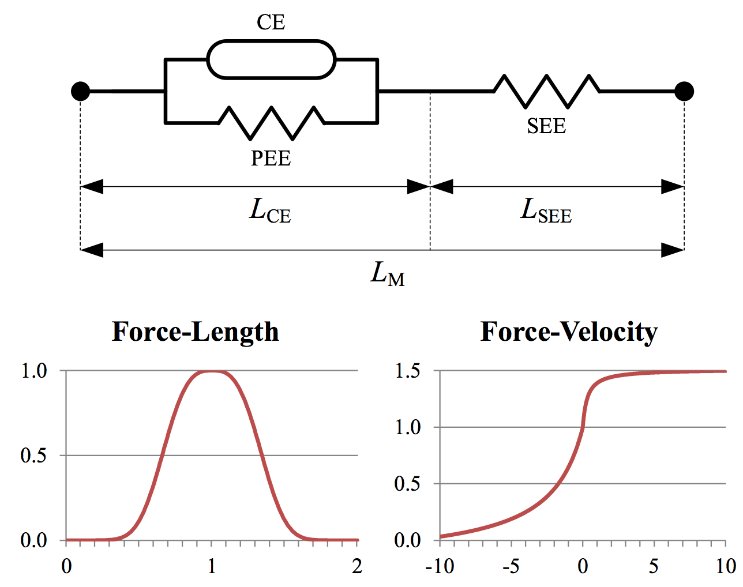
Optimization Approaches
Flexible Muscle-Based Locomotion for Bipedal Creatures
[Geijtenbeek et al. 2013]
Muscle model: Hill-type
CE: contracting element
PEE: parallel elastic element
SEE: serial elastic element

Slide 27
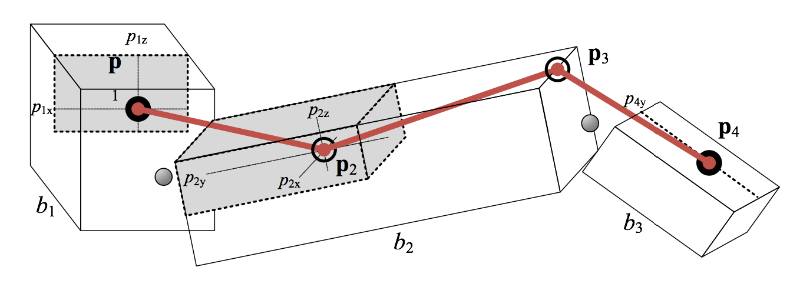
Optimization Approaches
Flexible Muscle-Based Locomotion for Bipedal Creatures
[Geijtenbeek et al. 2013]
Optimize over:
  Muscle rest length
  Max muscle force
  Muscle attachment points

Slide 28
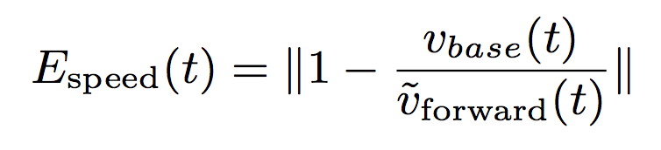

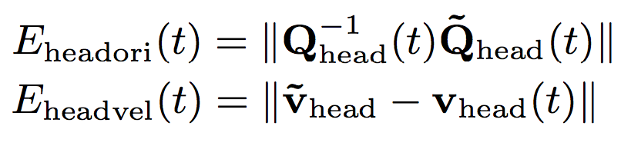
Optimization Approaches
Flexible Muscle-Based Locomotion for Bipedal Creatures
[Geijtenbeek et al. 2013]
Optimization objective function:
K = set of free parameters
Q = rotation matrix
v = velocity
= current speed
= target speed
Notes:
Eeffort = metabolic expenditure

Slide 29
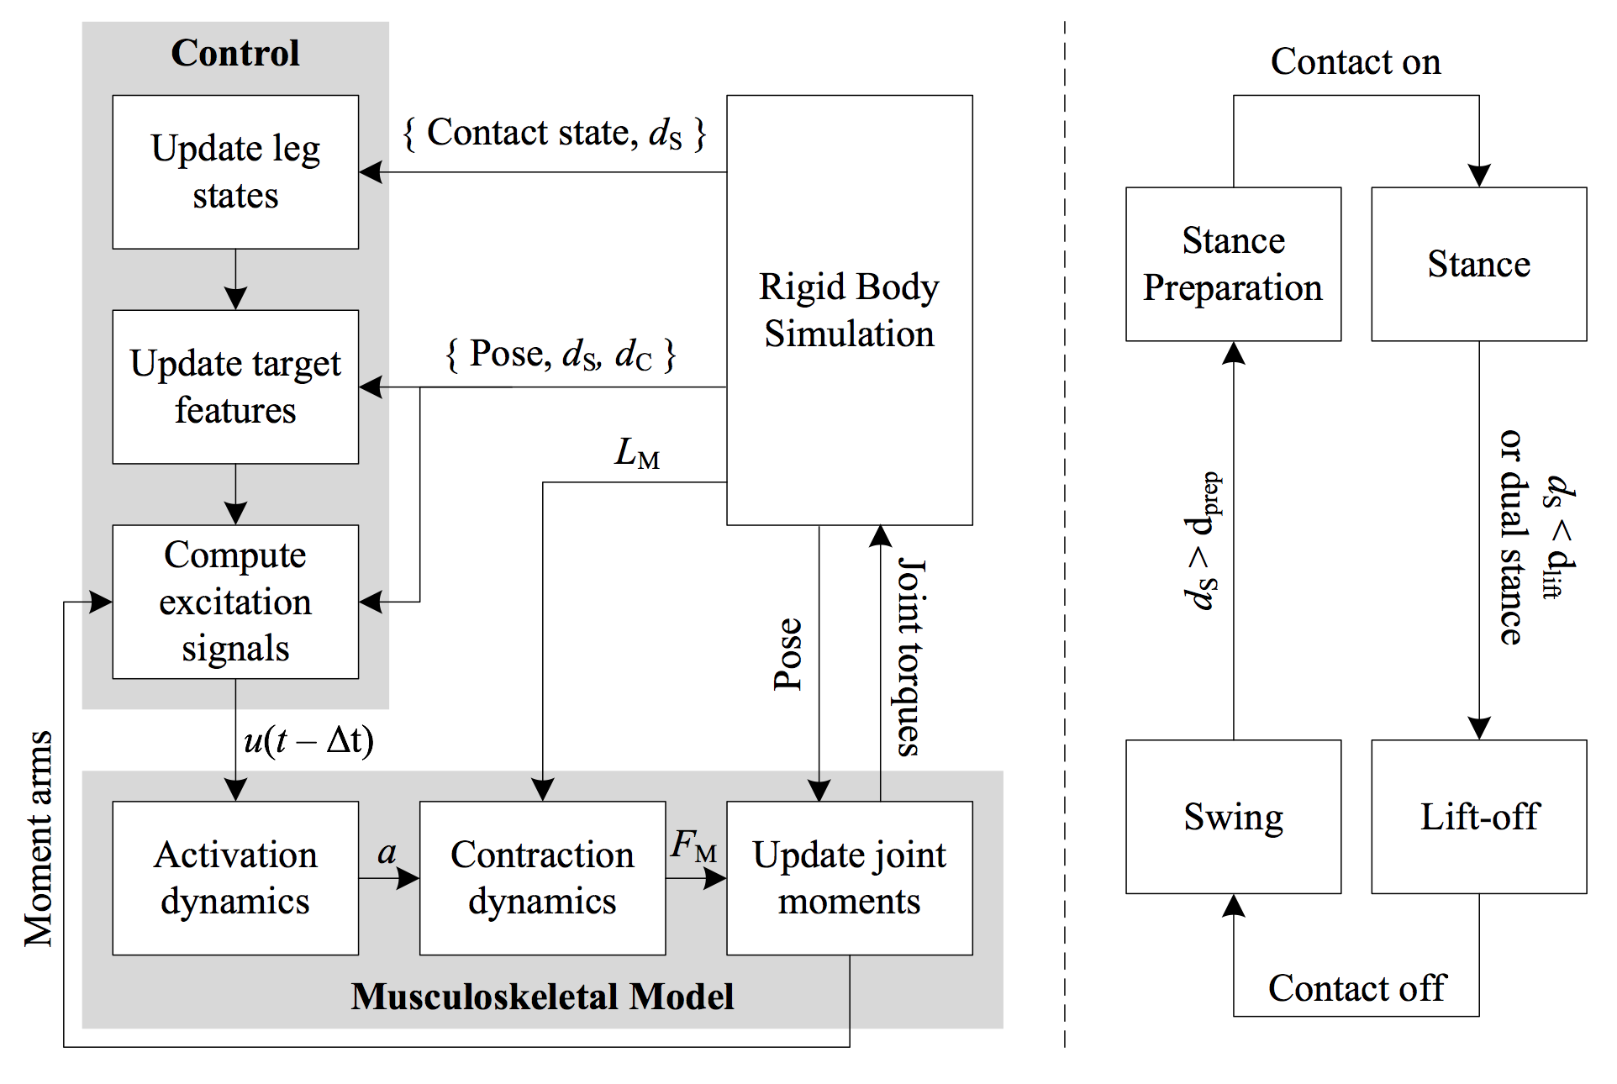
Optimization Approaches
Flexible Muscle-Based Locomotion for Bipedal Creatures
1.
2.
3.
4.
Notes:
FSM (right) updates state of each leg first
1. Control specifies current target features
2. Target features excite neural network control
3. Neural network activates muscles
4. Muscles update rigid body simulation
5. Simulation provides feedback.

Slide 30
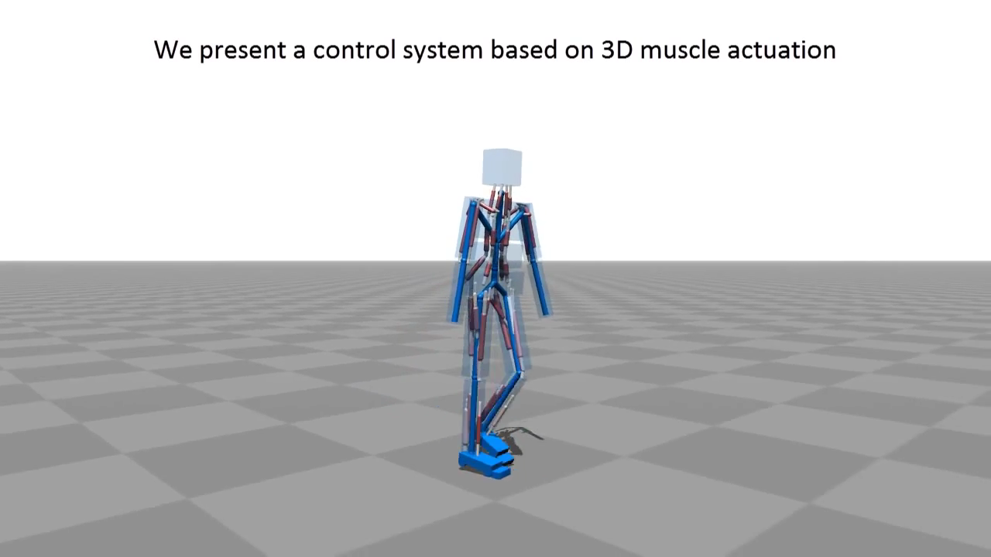
Optimization Approaches
Flexible Muscle-Based Locomotion for Bipedal Creatures
Results: https://www.youtube.com/watch?v=pgaEE27nsQw

Slide 31
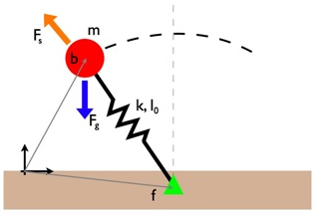
Planning Approaches
Robust Physics-Based Locomotion Using Low-Dimensional Planning [Mordatch et al. 2010]
Bipeds have too many DOF for motion planning
Use a simplified model of bipedal motion to reduce DOF
Spring-loaded inverted pendulum
Describes motion of COM

Slide 32
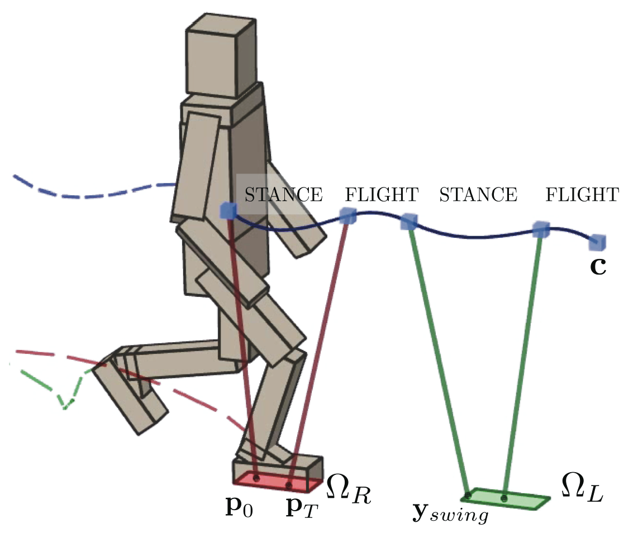
Planning Approaches
Robust Physics-Based Locomotion Using Low-Dimensional Planning [Mordatch et al. 2010]
Use a simplified model of bipedal motion to reduce DOF
Handle as two phases:
stance & flight
Plan for:
  COM motion c
  Center of Pressure motion p₀ to p_{T}
  Next foot position y_{swing}

Slide 33
Planning Approaches
Robust Physics-Based Locomotion Using Low-Dimensional Planning [Mordatch et al. 2010]
Planning done at each step
Optimize joint forces, torques to accomplish plan
Quadratic programming
Objective function:
Minimize deviation of COM/pelvis heading from plan
Head stabilization
Minimize foot contact sliding

Slide 34
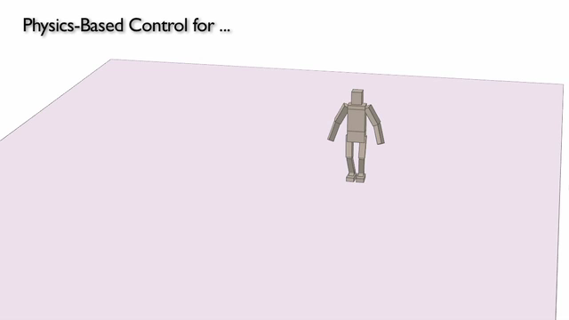
Planning Approaches
Robust Physics-Based Locomotion Using Low-Dimensional Planning [Mordatch et al. 2010]
Results: http://www.dgp.toronto.edu/~mdelasa/slip/

Slide 35
Future Work
Full-body motion – most methods use simplified models, small range of motion
More responsive to turning, dynamic obstacles
Deformable models
Automatic parameter setting (e.g. for objective function weights)
Integration with global planning/local collision avoidance

Slide 36
Questions?

Slide 37
References
Evolving Virtual Creatures
K Sims
ACM SIGGRAPH 1994
http://excelsior.biosci.ohio-state.edu/~carlson/history/PDFs/ani-papers/sims-virtual-creatures.pdf
Beyond the Bones
J Hutchinson, S Gatesy
Nature, 2006
http://www.researchgate.net/publication/40664312_Beyond_the_bones/file/9fcfd5009947e26dc8.pdf
Optimal Gait and Form for Animal Locomotion
K Wampler, Z Popović
ACM TOG, 2009
http://grail.cs.washington.edu/projects/animal-morphology/s2009/Optimal_Gait_and_Form_for_Animal_Locomotion.pdf
Optimizing Walking Controllers
JM Wang, DJ Fleet, A Hertzmann
ACM TOG 2009
http://www.cs.toronto.edu/~fleet/research/Papers/optwalkACMTransGraph.pdf
Robust physics-based locomotion using low-dimensional planning
I Mordatch, M De Lasa, A Hertzmann
ACM TOG, 2010
http://dl.acm.org/citation.cfm?id=1778808

Slide 38
References
Interactive Character Animation using Simulated Physics
T Geijtenbeek, N Pronost, A Egges
Eurographics 2011
http://graphics.cs.cmu.edu/nsp/course/15-869/2012/papers/PhysicsAnimation_EG11.pdf
Locomotion Skills for Simulated Quadrupeds
S Coros, A Karpathy, B Jones, L Reveret
ACM TOG, 2011
http://hal.inria.fr/docs/00/59/76/64/PDF/paper-quadrupeds2011.pdf
Optimizing locomotion controllers using biologically-based actuators and objectives
JM Wang, SR Hamner, SL Delp, V Koltun
ACM TOG, 2012
http://146.163.150.3/~wwhite/CS582/ResearchPapers/Lehan_CharacterLocomotion/OptimizingControllers_ACMToG0712.pdf
Flexible Muscle-Based Locomotion for Bipedal Creatures
T Geijtenbeek, M van de Panne
ACM TOG, 2013
http://courses.washington.edu/bioen520/notes/Geijtenbeek_(Trans_on_Graphics_2013).pdf

