Slide 1
Animating Prairies
By Rohan Chabra

Slide 2
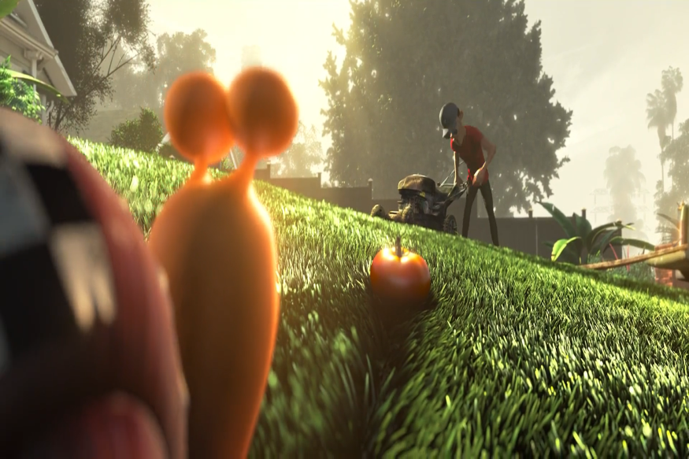
Motivation
Grass is an essential element of modeling in computer games and animation movies.
Far Cry 3 , Game
Turbo, animation movie

Slide 3
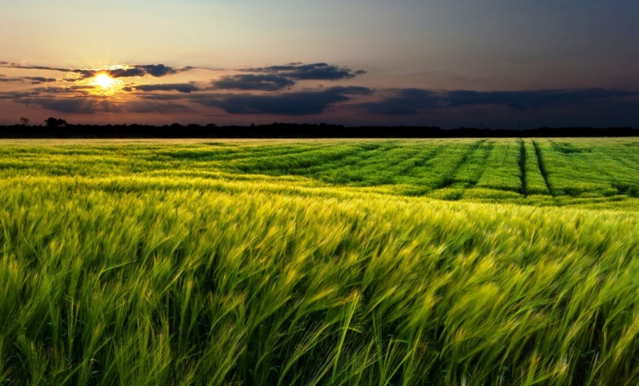
Challenges
To simulate grass in real time is challenging.
There can be millions of grass blades in the scene.
The grass blades interact with the wind forces , with each other and with any other external forces applied by the person walking through them. Hence making the dynamics really complicated.
Natural Meadow Scene

Slide 4
Classification
The whole process of animating prairies can be divided into 3 steps.
Model or representation of grass. Effects due to gravity.
Dynamics of grass in presence of wind fields.
Making the grass responsive to external and inter-grass forces.

Slide 5
Representation of Grass
Ideas
Reeves ,et al. [1985] used particle system to create grass scene.
Wang ,et al [2005] adopted 3D skeleton lines and transparent texture mapping to illuminate grass blades with rich details.
Lengyel et al [2006] used Volumetric textures, or “texels” to represent grass with level of details.

Slide 6
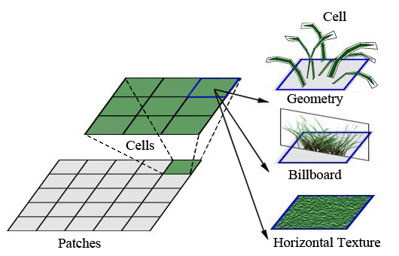
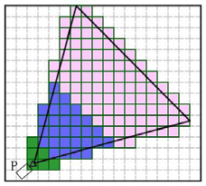
Representation of Grass
Due to huge number of grass blades in a scene the Level of Details approach is usually adopted .
3 types level of details are used to represent grass.
LOD 1 3D-geometry-based.
LOD 2 Billboard-based.
LOD 3 2-D Texture-based.

Slide 7
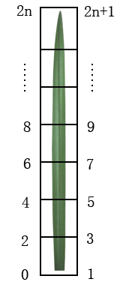
3D Geometry based representation of grass
In reference to Qui et al “Dynamic simulation of grass field swaying in wind “[2012]
A grass blade is split into several segments.
Each segment is assumed to be rigid and can rotate around the joint which links itself to the adjacent segments.
Two-sided quadrilateral strips can be used to approximate a single grass blade. Where each quadrilateral corresponds to a segment.

Slide 8
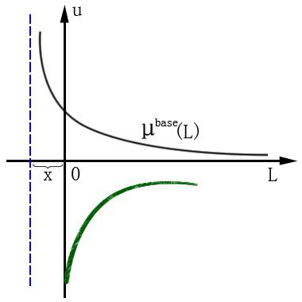
Stiffness coefficient
Stiffness coefficient reflects the ability of grass blade to resist deformation.
Root of grass blade has higher stiffness than the tip.
μ_{i}^{base} = μ^{base}(L) = μ_{root}^{base} /(L+x)
Where L depicts the distance from root to position i. μ_{root}^{base} and μ_{i}^{base} are stiffness coefficient of the root and at position i respectively. Where x is the compensation.

Slide 9
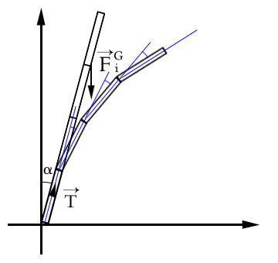
Effect of Gravity
The gravity on each grass blade segment can be depicted as:
f^{G} = ρ_{grass} * l_{length} * g
where ρ_{grass} is the density of grass, l_{length} is the length of each segment, g is acceleration of gravity.
The gravity on joint i can be calculated as:
F^{G} = (n – i) * f^{G}
Where n is the total number of segments.
Initial angle of inclination is α and T is the unit vector of upright grass blade.

Slide 10
Effect of Gravity
Adjacent segments are considered as rigid, and can rotate around the joint.
The torque M_{i}^{G} due to gravity on joint i can be depicted as:
M_{i}^{G} = [(n – i) * l_{length} * T] X F^{G}
μ_{i}^{base} = μ^{base}(l_{length} * i) = μ_{root}^{base} /(l_{length} * i +x)
When the angle between adjacent segments changes, there will be a recovery torque, which is proportional to the angle.
Θ_{i}^{base} = M_{i}^{G} * μ_{i}^{base}

Slide 11
Avoiding Repetitive Patterns
To avoid repetitive patterns 2 approaches can be applied.
Representation of various species:-
Reference length l_{base} is taken.
Stochastic modifier Δl to each blade is applied, where Δl =λ ⋅N(0,1) . λ is the range of absolute value of modifier.
The actual length of each blade can be calculated as l= l_{base} + Δl.
Representation of stochastic distribution:-
Amount of blades in each cell to control the density of grass field
Random angle to each blade is given

Slide 12
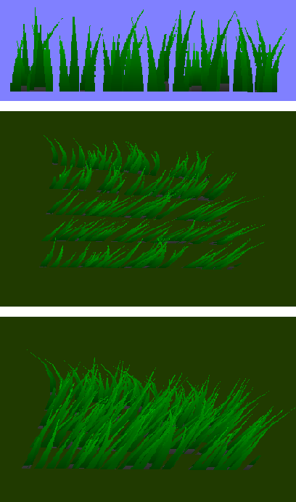
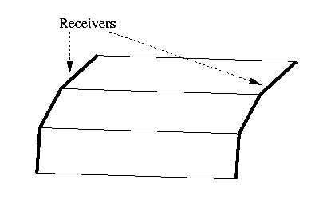
Billboard-based Representation of Grass
Comprised of layers of vertical polygon strips.
Each polygon strip is covered by a semi-transparent texture representing blades of grass.
To break the repetitive patterns, the actual height of each billboard is determined by the sum of reference height and stochastic modifier.
The orientations of billboards are also generated randomly.
Billboard representation
Two vertical edges of a
polygon strip can be animated.

Slide 13
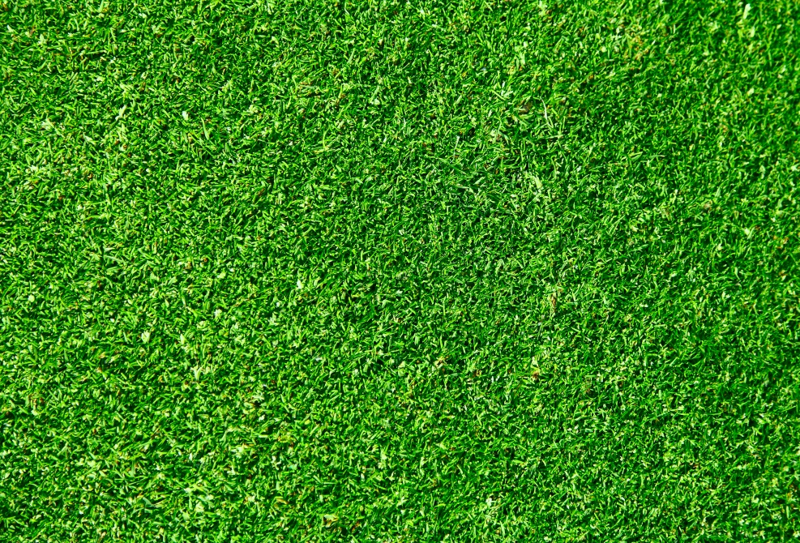
Horizontal Texture-based Representation of Grass
2D texture that is mapped on the terrain for representation of grass in distant regions

Slide 14
Dynamics of grass in presence of wind
Related Work
Perbet et al. [2001] presented procedural animation primitives that implement wind effects.
Li et al. [2008] simplified grass into a line of rigid sticks linked together by spherical joints. Physically based method is used to make the simulation skeleton deformable.
Wang et al. [2005] adopted physically based method to calculate the deformation of grass in wind using Hook’s law.

Slide 15
Procedural based Animation Approach
In reference to Perbet et al.” Animating Prairies in Real-Time” [2001]
Modeling directly wind primitives through their consequences on grass motion, rather than modeling the force or velocity field that causes it.

Slide 16
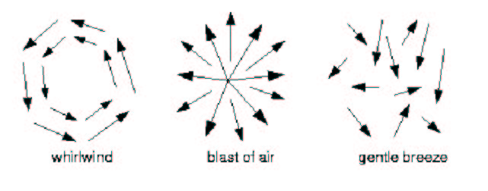
Wind Primitives
Types of wind primitives
Gentle Breeze
Gust
Whirlwind
Blast
Figure : Every wind primitives can be describe as a vectors field.
The direction of a vector is the bending direction and its norm is the
posture index.

Slide 17
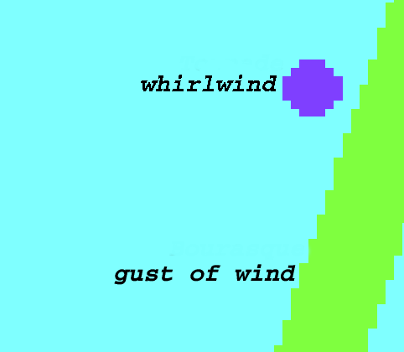
Wind Primitives
Design of wind primitives consists of
A 2D mask that represents the spatial extent of its action, and which may move over the terrain during the animation. In practice, the mask is discretized over the patches of grass that tile the terrain.
An action that is a procedure that sends information which describe the consequence (i.e. the posture index and the direction) of the wind primitive on any blade in the mask via the receivers.
Figure : Masks used for the gust of wind and whirlwind primitives,
seen from above. These masks move over time.

Slide 18
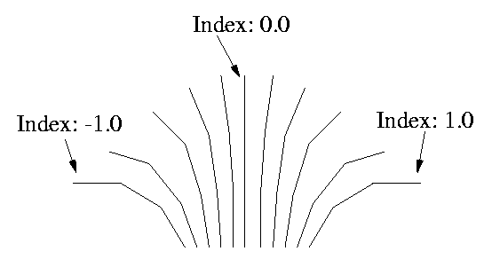
The Receiver Concept
Wind primitives send information to grass through receivers.
Every animate object has an associated receiver.
At each frame, all the receivers receive information from wind primitives.
For each kind of grass, the range of possible bent postures are pre-computed by a physically-based simulator which look at the successive 2D positions s of the blade when a constant wind starts blowing from a given direction.
A given number of characteristic postures, indexed from 1.0 to -1.0, where 0 is the blade of grass’s rest state, are extracted from these simulations.
Figure: Precomputed postures resulting from a physically-based
simulation. It is use by receivers to translate a given index into spatial positions.

Slide 19
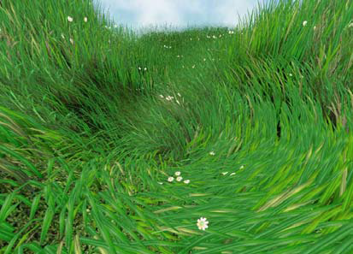
Physically based Animation
In reference to Qui et al [2012]
According to the features of grass blade in real world, a method to simulate the bending and recovery of grass in response to the wind is presented.
Uses various dynamical equations and deformation strategies to calculate grass blade deformation.
Result of whirlpool wind field

Slide 20
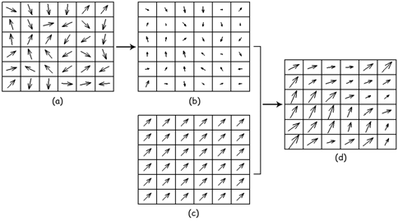
Wind Fields
Two-dimensional vector field is used to construct wind field.
The wind velocity is composed of two parts:
Mean wind, which reflects the major wind force and direction, and belongs to steady wind.
Turbulent wind, which denotes the airflow fluctuating.
The wind velocity can be expressed as:
v(x, y;t) = v’’ (x, y;t) + v′(x, y;t)
Where v’’ is mean wind velocity, while v′ is turbulent wind velocity.
Wind Fields

Slide 21
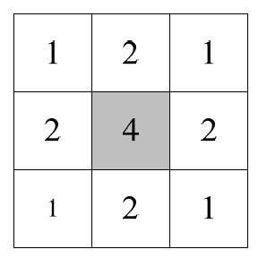
Wind Fields
Region of wind field into a series of square units.
Two-dimensional random vector is generated as the initial value of turbulent wind ,which follows Gaussian distribution.
To smooth the turbulent wind field, weighted average filter is adopted.
Average Filter

Slide 22
Animation in presence of wind
Grass should bend in the direction of wind.
When wind stops, the bended grass will stop bending and oscillate back and forth before recovering to a rest pose.
The procedure to apply animation is different for both 3D geometry and billboards representation of grass elements.

Slide 23
Animation of Geometry-based Grass
Each segment is assumed to be rigid and can rotate around the joint.
The movement of grass can be depicted by the angles between segments.
Simulation is classified into 2 categories:-
Simulation of grass bending and twisting in wind.
Simulation of grass recovery.

Slide 24
Simulation of grass bending and twisting
For a single segment of grass blade, according to the momentum law:
F_{i}^{wind} * t = M_{wind} v
Where F_{i}^{wind} is the wind force on the segment i , v is the velocity of wind and M_{wind} represents mass of wind.
M_{wind =} ρ_{wind} *v*t*S
Where ρ_{wind} is the wind density, S is the area of thrust surface of current segment.
S = l_{length} * l_{width} * sin ϕ
Where S is the area of segment, ϕ is the angle
between wind direction and current segment.

Slide 25
Simulation of grass bending and twisting
According to the equilibrium condition of forces on segment i, the force that makes grass bending can be expressed as:
F_{i}^{bend} = F_{i}^{wind} = v² * ρ_{wind} * l_{length} * l_{width} * sin ϕ
The corresponding torque of F_{i}^{bend} is
M_{i}^{bend} = F_{i}^{bend} * l_{length}
Similarly, the force and torque that makes grass twisting can be calculated as:
F_{i}^{twist} = F_{i}^{wind} = v² * ρ_{wind} * l_{length} * l_{width} * cos ϕ
M_{i}^{twist} = F_{i} ^{twist} * l_{length} * sin(θ_{i} (t) + θ_{i}^{base} )
Where θ_{i}^{base} is the angle between current segment and vertical orientation in the rest state, θi (t) is the angle of current twisting

Slide 26
Simulation of grass recovery
When wind stops, the grass should sway back and forth.
When wind fails, the external force is zero:
Where M_{grass} is the mass of single segment, K is the stiffness coefficient of joint. C is the damping coefficient.

Slide 27
Simulation of grass recovery
For recovery animation, at each time step, the following equations are used to solve linear vibration.
The similar approach can be adopted to calculate twisting angle.

Slide 28
Responsive Grass
Related Work
Guerraz et al. [2003] presented a method to allow virtual objects or characters to crush the grass using procedural approach.
Zhao et al. [2009] proposed GPU-based method to simulate grass-object interaction using bounding box.
Orthmann et al. [2009] put forward a GPU-based approach to model responsive grass using a spring model.

Slide 29
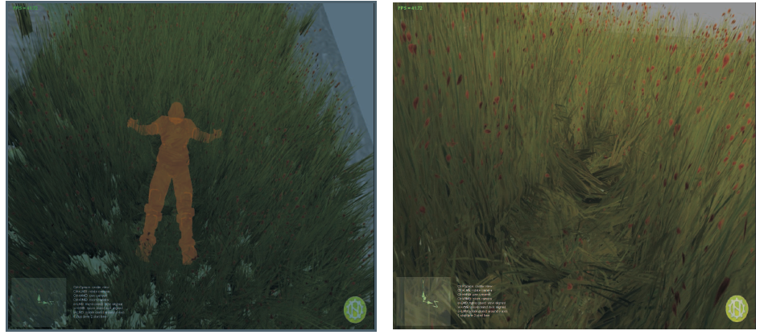
Responsive Grass
In reference to Orthmann et al “GPU-based Responsive Grass” [2009]
Billboards are used to represent grass.
Results of responsive grass

Slide 30
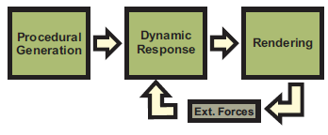
Overview of the System
Procedural Generation:- For a given terrain mesh, a geometry shader automatically generates billboards for grass blades.
Dynamic Response:- A CPU-based broad phase working on the spatial organized grass tiles and a GPU-based narrow phase working on the generated grass billboards constitute the responsive component.
Rendering:- Deformed or undeformed billboards are rendered based on the output of the collision system.
Figure : The system for responsive grass

Slide 31
Billboards as Primitives
Each billboard acts as a primitive and its state is stored with following parameters
Position
Collision State
Texture index, addressing a 2D texture array, which stores different semi-transparent images of grass clumps.

Slide 32
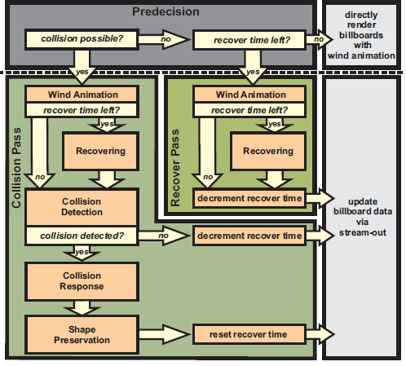
Collision System
The collision system consists of following procedures.
Coarse Handling on the CPU.
Collision Detection.
Collision Response.
Shape Preservation.
Recovering.
Figure : Flow diagram for collision detection, reaction and recovering

Slide 33
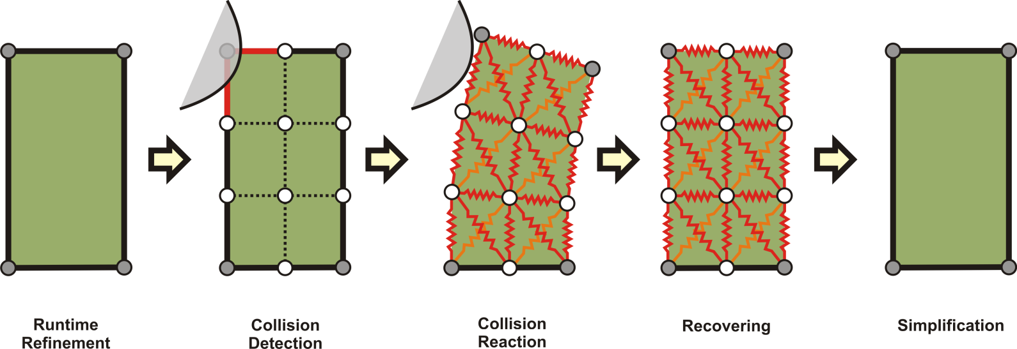
Coarse Handling on the CPU
At each frame, the bounding volumes of all dynamic collision meshes are tested for collision with the axis aligned bounding boxes (AABB) of the octree containing the e grass blades.
Each node is marked as either possibly colliding, non-colliding or recovering.
Possibly colliding nodes are streamed through collision pass on the GPU.
Recovering nodes stays active for a fixed amount of time after the collision when the object has left the AABB of the octree node. During this time a separate module of the system handles the recovering nodes.
Figure 14: Collision detection, reaction and recovering for a single billboard

Slide 34
Collision Detection on the GPU
This system module receives all the vertex information of a potentially colliding billboard at once.
It creates bounding spheres for both animated billboards and dynamic objects and performs a collision test between them.
If the collision test is passed on the bounding sphere level, a second and more exact collision test is performed on a subdivided mesh of the billboard.

Slide 35
Collision Detection on the GPU
Dynamic objects capable of colliding are represented by depth cube maps for efficiency.
Cube maps are computed by projecting the object’s mesh onto the faces of a bounding cube and store the distance to the cube plane and the respective object normal.
Each vertex v = (vx,vy,vz,1)T is transformed to each of the six projection spaces:
Where v^{i} is is the transformed vertex of the billboard and is the tranformation of billboard to i projection surface.

Slide 36
Collision Detection on the GPU
If is not true for all values of i then collision occurs. Here dm^{i} (x,y) is the distance looked up within the distance map dmi at pixel position (x,y).
Where d(v) is the distance between the closest surface point and the vertex.

Slide 37
Collision Response
If a collision has been detected, the vertex is moved out of the object’s shape. Its position is translated along a normal vector n obtained from the depth cube map( of dynamic objects).
v ← v+s*n
s is the reaction strength that is to say the surface normal n multiplied with the smallest distances to the surface d(v).
s = d(v) *n/ |n|

Slide 38
Shape Preservation
As the separate processing of individual vertices may lead to visually unpleasant distortions, a cloth model based on spring constraints is applied to preserve the overall shape of the grass clump.
A spring force f ∈ R3 between two billboard vertices v1 and v2 is defined as:
f = k(|l|−lo)/|l|
where l = v1 −v2 is the direction, lo is the initial length of the spring and k ∈ [0,1] is the stiffness of the spring.
Each spring force directly affects the two connected vertices as following:
v1 ← v1 −r1 ∆t f
v2 ← v2 +r2 ∆t f
where r1 is the responsiveness for vertex v1 and r2 is the
responsiveness for vertex v2 with r1+r2 = 1. Responsiveness is set to zero if the vertex is fixed.

Slide 39
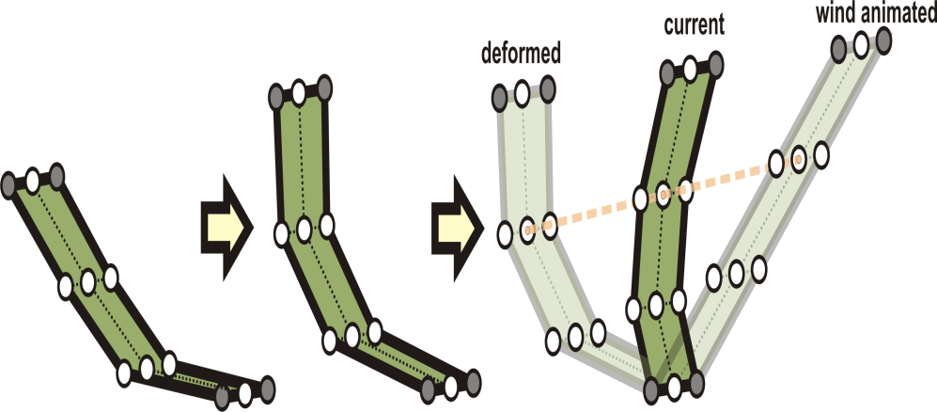
Recovering
The recovering is processed on each billboard that has some recover time left.
The linear interpolation between the deformed vertex and its original position, with respect to the recover time left, results in the current shape of the grass clump as shown in figure.
v ← (1−t^3)*w + t^3*v
where t ∈ [0,1] is the recover time left, w is the vetex position obtained by the wind function and v is the
current respectively last recovered vertex position.
Figure : The interpolation between the vertices of the current mesh (deformed mesh) and the vertices solely affected by the wind animation results in a smooth recovering over time.

Slide 40
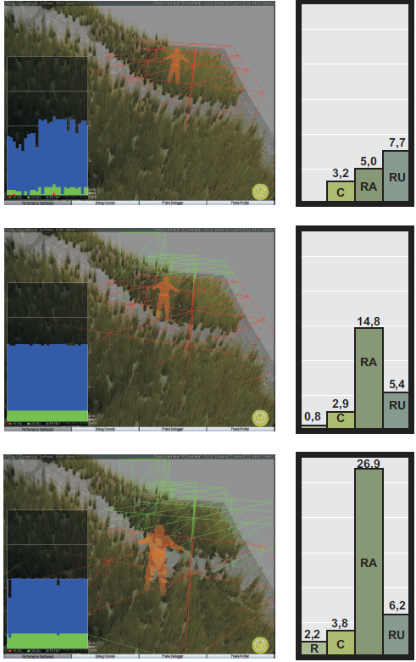
Results
More grass billboards are deformed the more time is spent rendering the collided and recovering grass tiles.
This performance loss is caused by the primitive generation as well as the rendering of the high number of primitives.
Figure: A scene which contains more and more deformed grass billboards. The time spent within each GPU pass is displayed in milliseconds on the right-hand side of the corresponding image. The measured passes are: The recovering pass (R), the pass performing the collision handling (C), the rendering of the possibly affected grass
tiles (RA), and the rendering of the unaffected grass tiles (RU).

Slide 41
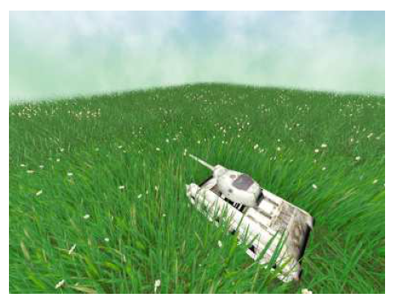
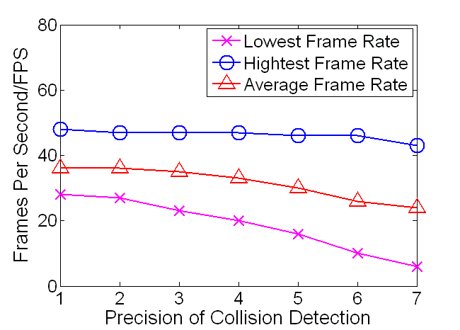
Grass-Grass Interactions
In reference to QIU et al “"A Novel Approach to Simulate the Interaction between Grass and Dynamic Objects."[2013]
Modeling accurate grass-grass interactions requires a high computational cost.
Propagation model to achieve the consecutive bending of grass is used.
Grass can be either Direct-Bending-Grasses (DBG) or Propagation-Bending-Grasses (PBG).
Precision of collision detection can be scaled.

Slide 42
Few definitions
Energy. It refers to the magnitude of the external force vector on a grass blade.
Active status. If the energy of a grass blade is large than the threshold value.
Termination status. If the energy of a grass blade is smaller than the threshold value.
Ancestor. It refers to DBG.
Children. It refers to PBG.
Adjacent relation. A grass blade has adjacent relations with four grass blades.
Parallel relation. For i-th generation children G , its neighbors are neither ancestor nor k-th generation children ( k <= i ), they have parallel relation.

Slide 43
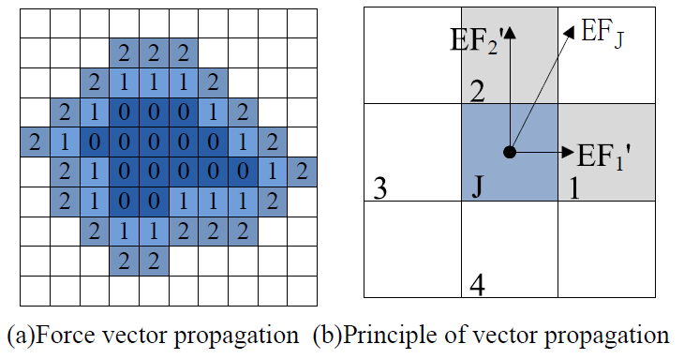
Force Propagation Algorithm
As shown in Fig (b). Assume that child J of generation G has force vector EF_{j} . The threshold value is L . The propagation process of J can be depicted as the following steps:
Estimate status of J . If it is in dead status, propagation is finished. Otherwise, go to step 2.
The force vector on J are orthogonally decomposed to two vectors EF₁’ and EF’_{2.}
The blades who have adjacent relation with EF₁’ and EF’₂ and directly point to them are checked if they have parallel relations with J if true propagation is stopped. Otherwise, the force vectors of the two blades are expressed as follows:
Where Parameter att is local decay factor.
4. Mark the two blades as children of generation G + 1. Current propagation is over.

Slide 44
Results
Results after Grass grass interaction

Slide 45
Vegetation Tools
Many Game engines have vegetation tools that a game artist can use to design a vegetation scene. These tools are really optimized and efficient.
A good example can be, Cry Engine 3 has a vegetation tool. Documentation link:- http://docs.cryengine.com/display/SDKDOC2/Vegetation+Tool
https://www.youtube.com/watch?v=O1rFakKOxeM#t=23

Slide 46
Demos!
http://vimeo.com/17604635 (“Realistic Real-Time Grass Rendering” Master Thesis of Edward Lee.)
https://www.youtube.com/watch?v=NAicuxAJ8Wo(“Rendering Grass Terrains in Real-Time with Dynamic Lighting” by Kévin Boulanger, Sumanta Pattanaik, Kadi Bouatouch)
https://www.youtube.com/watch?v=x5aNENyUXW0(Far Cry Game)

Slide 47
References
W. T. Reeves. Particle systems – a technique for modeling a class of fuzzy objects. ACM Trans. Graphics, 2:91–108, April 1983.
Jerome Lengyel. Real-time hair. In B. P´eroche and H. Rushmeier, editors, Eurographics Workshop on Rendering, pages 243–256. Eurographics, June 2000.
“Animating Prairies in Real-Time” by F. Perbert and M.-P. Cani,Proc. of I3D 2001.
C. B. Wang, Z. Y. Wang, Q. Zhou, et al, “Dynamic modeling and rendering of grass wagging in wind”,Computer Animation and Virtual Worlds, vol.16, pp.377-389, 2005.
William T. Reeves and Ricki Blau. Approximate and probabilistic algorithms for shading and rendering structured particle systems. In B. A. Barsky, editor, Computer Graphics (SIGGRAPH ’85 Proceedings), volume 19(3), pages 313–322, July 1985.
“GPU-based Responsive Grass” by (Jens, Kolb, & Salama, 2009) Journal of WSCG. 2009, vol. 17, no. 1-3, p. 65-72.
(“Rendering Grass Terrains in Real-Time with Dynamic Lighting” by Kévin Boulanger, Sumanta Pattanaik, Kadi Bouatouch) Siggraph 2006 sketch.
H. Qiu, L. T. Chen, J. X. Chen, Dynamic simulation of grass field swaying in wind, Journal of software, Vol.7, No.2, 2012, pp.431-439.
C. F. Li, X. Y. Guo, S. L. Lu, et al, Real-time simulation of meadow, In Proc. SSSC’08,Beijing, China, 2008, pp. 1205-1207.
S. Guerraz, F. Perbet, D. Raulo, et al, A procedural approach to animate interactive natural sceneries, In Proc. CASA’03, New Jersey, USA, 2003, pp. 73-78.
X. K. Zhao, F. X. Li, S. Y. Zhan, Real-time animating and rendering of large scale grass scenery on GPU, In Proc. Itcs’09, KIEV, Ukraine, 2009, pp. 601-604.
QIU, HANG, LEI-TING CHEN, and GUO-PING QIU. "A Novel Approach to Simulate the Interaction between Grass and Dynamic Objects." WSEAS Transactions on Computers 12.7 (2013).

Slide 48
Questions?

