Slide 1
Simulation of explosions
Physical simulation and modeling class presentation

Slide 2
Overview
Introduction
Motivation
Background
Particles
Blast curves
Fluid simulation
Physics of explosions
Mathematical Model
Simulation
Rendering
Notes:
Introduction to explosions – various phenomenon involved
Motivation to simulate explosions
Background work mentioning various techniques used to model explosion effects
Physics primer
Mathematics explaining Navier Stokes equations to model fluid
Simulation
Rendering of various effects in a real-world explosion

Slide 3
Introduction
Sudden release of energy
Pressure wave
Supersonic speed
Compression of air
Interaction with boundaries
Interesting visual effects
Notes:
A sudden burst of energy from a mechanical, chemical, or nuclear source causes a pressure wave to propagate outward through the air.
The blast wave “shocks up," creating a nearly discontinuous jump in pressure, density, and temperature along the wave front.
The wave is substantially denser than the surrounding ﬂuid, allowing it to travel supersonically and to cause a noticeable refraction of light.
The air at the shock front compresses, turning mechanical energy into heat.
The waves reﬂect, diffract, and merge, allowing them to exhibit a wide range of behavior.
An explosion causes a variety of visual effects in addition to the light refraction by the blast wave. :
An initial chemical or nuclear reaction often causes a blinding ﬂash of light.
Dust clouds are created as the blast wave races across the ground, and massive objects are moved, deformed, or fractured.
Hot gases and smoke form a rising fireball that can trigger further combustion or other explosions and scorch surrounding objects.

Slide 4
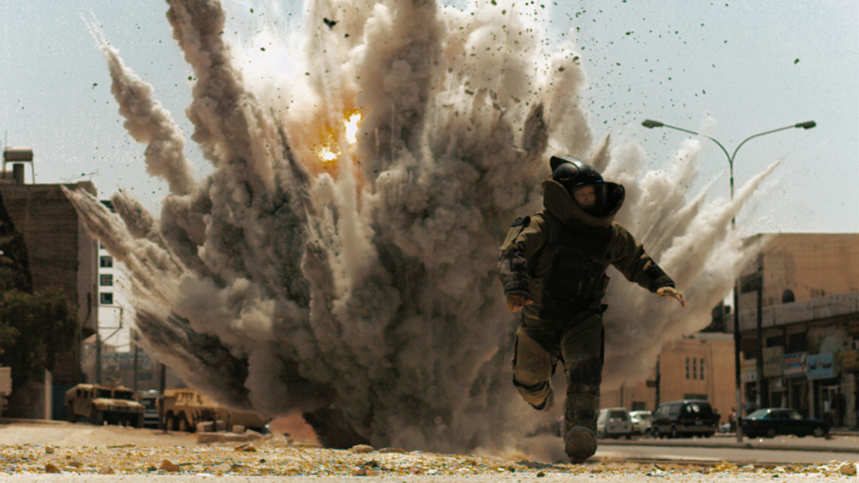
Explosions are…
Dangerous
Costly
Difficult to control
Impossible to undo
Notes:
Used widely in many industries, the special effects industry among them, real explosions are costly, dangerous, difﬁcult to control, and impossible to undo.
That makes them excellent candidates for visual and physical simulation.
The beneﬁts are signiﬁcant, since having a consistent mathematical formulation of a phenomenon can give reproducible user-controlled simulations

Slide 5
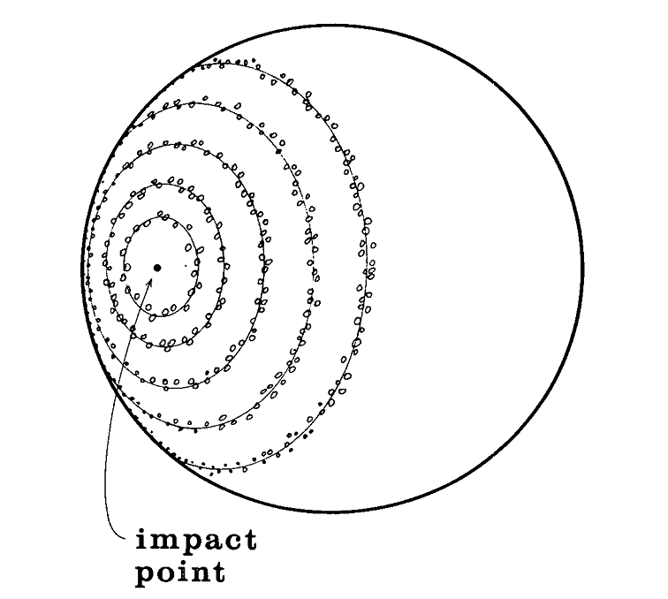
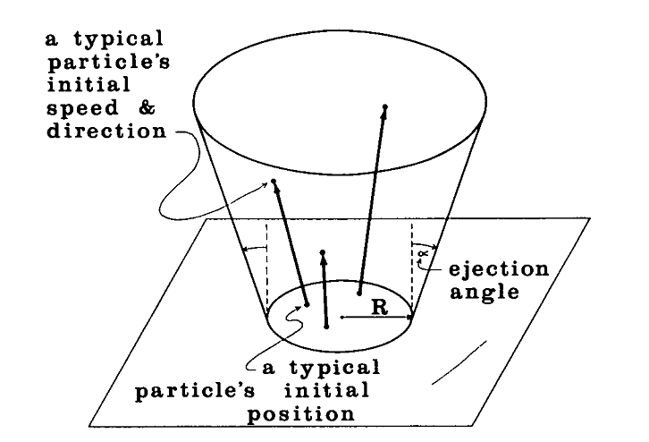
Background - Particles
Earliest attempt by William Reeves
Particle systems for modeling fuzzy objects
Clouds, Fire, Water
Procedural System approach
Generation
Degeneration
Transformation of live particles
Rendering
Genesis Demo in Star Trek II
Drawbacks
Computationally expensive
Cannot model a continuum
Notes:
The earliest attempts at mimicking explosions with a computer simulation used a system of infinitely small objects called particles
Generation can be a stochastic process.
Each particle has a unique attribute state.
Determine which particles are needed to die.
Transformation can be based on any dynamics law e.g a PDE
The Genesis Demo sequence [14] from the movie Star Trek II: The Wrath of Khan [10] was generated by the Computer Graphics project of Lucasfilm Ltd.
The sequence depicts the transformation of a dead, moonlike planet into a warm, earthlike planet by an experimental device called the Genesis bomb.
The wall-of-fire element in the Genesis Demo was generated using a two-level hierarchy of particle systems :
The top-level system was centered at the impact point of the genesis bomb. It generated particles which were themselves particle systems
The second-level particle systems began generating particles at varying times on the basis of their distance from the point of impact. By varying the starting
times of the particle systems, the effect of an expanding wall of fire was produced
Though they were quite revolutionary and dazzling in the eighties and early nineties, particle systems are quite computationally intensive since several million are required for a convincing frame of animation.
Worse yet, the particles cannot collide with each other. Therefore any attempt to model a continuum, such as fluid flow or a blast wave, with particles is exceptionally difficult; the particles cannot maintain a volume.
The fundamental weakness in particle systems is that they are simply points in space; any attempt to give them volume is really just a trick and therefore not physically accurate.

Slide 6
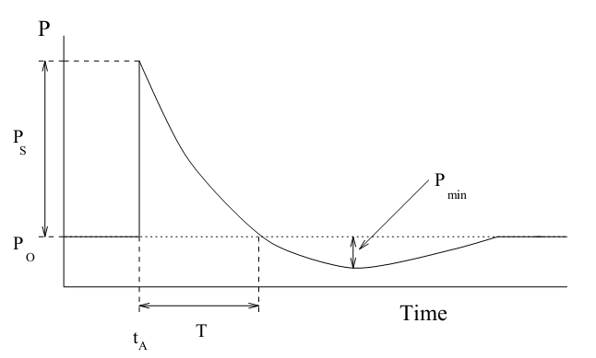
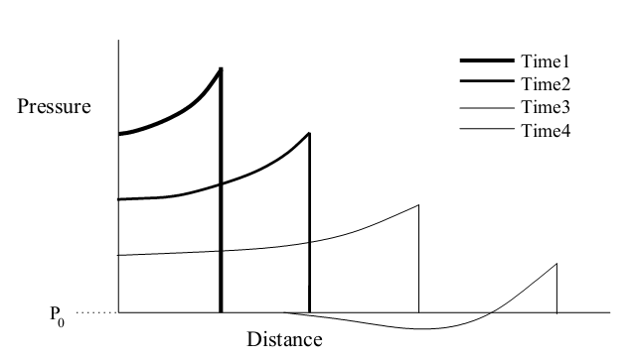
Background – Blast curves
One of the first mathematical models of blast waves propagation
Neff and Fume in 1999
Based on TNT explosion model
Chemical reaction
Violent gas expansion
Formation of compressed air causing a pressure wave
Notes:
The profile of the pressure pulse is shown in Figure 1. Notice that it represents a jump discontinuity where the pressure in-creases by Ps. This is the peak static overpressure and represents the pressure that is felt by a particle moving with the wave. With time, this pressure decays to be-low the ambient pressure P0 due to the overexpansion of gases as described above. Pmin is the minimum pressure reached, ta is the arrival time of the pressure pulse and T is the period of the positive phase of the pulse.
The pulse’s peak overpressure decreases with distance from the centre of the explosion. This affects the shape of the pressure pulse. Pressure pulses for fronts at four different aradii are shown in Figure 2.

Slide 7
Background – Blast curves
Modeling techniques
Full simulation based on NS equations of Fluid dynamics
Simplified equations from Structural engineering research
Approximate the blast wave as a triangular pressure pulse
Modifying the propagation using its distance from explosion center
Isotropic model
Unchanged by obstacles
Notes:
A body of literature in the structural engineering field, extending at least as far back as the 1950s, has attempted to understand the impact of explosives using a combination of empirical data and mathematical models.
The general approach has been to use a combination of empirical data and mathematical models to formulate both a set of curves and a set of formulas that can be used to determine important quantities such as peak over pressure and impulse at a given distance from an explosion.
The blast curve approach is significantly less computationally expensive than a simulation based upon the Euler Equations. Furthermore, a more complete set of data is
available from the blast curves than from the blast equations also used in structural engineering. For these reasons, blast curves are used in our model to provide the
physical data needed.

Slide 8
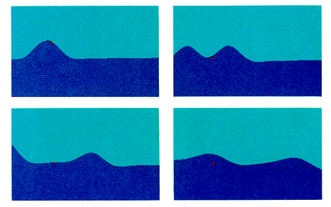
Background – Fluid simulation
Needed to simulate complex phenomenon that reacts to surroundings
Kass and Miller developed a water simulator in 1990
Modeled only the surface of the fluid
Vastly simplified set of PDEs used for shallow water
Flow primitives
Linearly combined to produce a complex flow
Mimic behavior of flow around obstacles
Notes:
Flow primitives : Because animation has less stringent. accuracy requirements, we can avoid computational expense by dividing the system into two parts:
a linear flow regime and an object boundary regime.
The first ranges over all space and the second is used in the close vicinity of objects. In the linear flow regime we use the analytic solutions of the equations instead of solving for the
flow numerically . These solutions define a set of primitives which are given as fluid velocity fields. Solutions such as vortex sinks and uniform flows , can be linearly mixed so as t0 create a complex flow scenario. The primitives enable the design and control of animation sequences.
The second part of the model is the interaction between the
Flow and the objects. This is based upon simplified boundary effects , that describe the forces exerted on object surfaces.
Once the forces acting on objects are known, object motion is governed by Newtonian mechanics

Slide 9
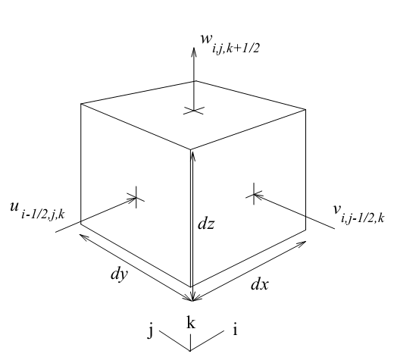
Background – Fluid simulation
In 1996, a system developed using NS equations
Couple momentum and mass conservation
The domain is divided into a grid of voxels
Each cell has a pressure and 3 velocities
Transport fluid between cells
Relaxation step to achieve stability
Coupling with obstacles allowed to achieve wave effects
Reflection
Refraction
Diffraction
Rotational effects
Notes:
It is based on the Navier-Stokes equations which couple momentum and mass conservation to completely describe fluid motion.
Velocity and pressure are defined everywhere within this environment, and updated using a set of finite difference expressions.
The resulting vector and scalar fields are used to drive a height field equation representing the liquid surface – used for rendering the surface
Solid obstacles and the atmosphere are treated as fluid, but with special properties that remain constrained throughout the calculation.
Foster and Metaxas also introduced us to the “relaxation step”, the step in the algorithm where every cell is iteratively adjusted in order to
maintain computational stability. The relaxation step was not reliably stable however, and Jos Stam developed an algorithm in 1999 that eliminated it entirely.
His process,called “Stable Fluids”. Unfortunately, the price for ensured stability is the dissipation of fluid mass and Vorticity.
Two papers in 2001 attempted to bring the interesting turbulence back into fluid simulations.
Foster and Fedkiw [2001] combat the dissipation with a hybrid surface algorithm and
Fedkiw, Stamand Henrik Wann Jensen add turbulence back into the stable fluid system with a vorticity field generated by a physically based heuristic [Fedkiw et al. 2001]

Slide 10
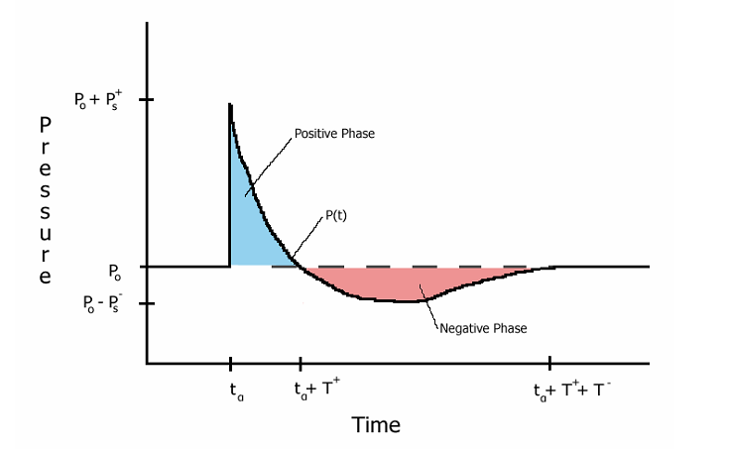
Physics - Shock front
Ideal blast wave
Still and Homogenous atmosphere
Spherically symmetric pressure source
Can model pressure wave as a function of time and distance from blast center
$p_{0}$ : Ambient Pressure
$P_{s}^{+}$ : Peak overpressure
$t_{a}$ : Wave arrival time
$T^{+}$ : Time at which pressure is ambient again
Notes:
Any rapid release of energy in air, such as an explosion, generates a blast wave. The front of this blast wave exhibits a nearly discontinuous increase in pressure, density, and temperature, and is called a shock front
An ideal blast wave, which can be used as a sufficient approximation, is generated under the assumptions that the medium—air—is still and homogenous, and that the source is spherically symmetric.
The shock front of an ideal blast wave is perfectly spherical, and therefore the characteristics of the blast wave are functions only of distance R from the center of the source, and the simulation time t
Before the shock front reaches the given point, the pressure is equal to the ambient pressure p0. At arrival time ta, the pressure rises discontinuously to the peak value of p0 + Ps+ .
The quantity Ps+ is called the peak overpressure. The pressure then decays to ambient in total time ta + T+
(positive phase), drops to a partial vacuum of value p0 - Ps- (negative phase), and eventually returns to the ambient pressure p0 in total time ta + T+ + T-
The pressure profile curve can be accurately de-scribed by the modified Friedlander equation.
time t is measured from time of arrival ta
Ps+, ta, T+, and b allow freedom to customize the pressure profile curve and the initial decay rate for different explosions, at different distances from the source
Given an ideal point source explosion, the peak overpressure Ps+ initially decays as the inverse of the cube of the radius 1/R3,
and as the shock approaches them strength of a sound pulse, the decay approximates the inverse of the radius 1/R

Slide 11
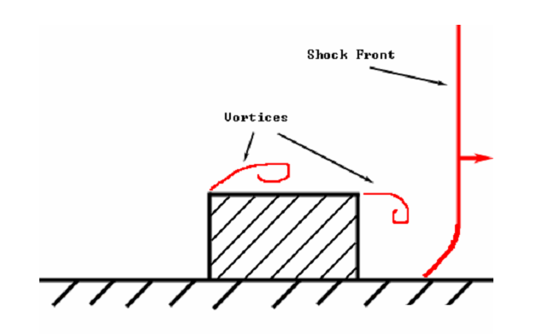
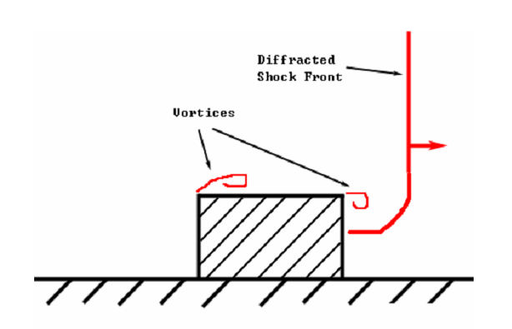
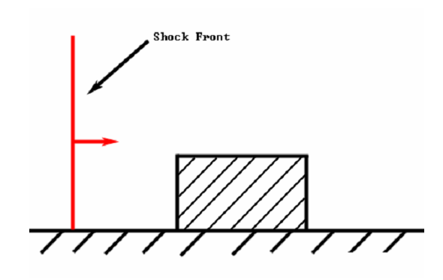
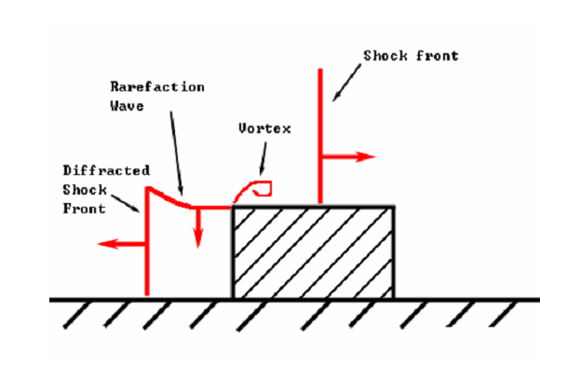
Physics – Diffracted waves
Interaction of shock waves with boundaries and obstacles
Example : Planar shock wave
Notes:
The pressure on the front wall is at its maximum shortly after the wave hits as the
Momentum of the wave pushes more and more air against the object.
When the pressure mounts to the point of reversing the momentum, a reflection wave, r, is created.
Meanwhile, the portion of the wave not hitting the front face continues unabated.
As the reflected wave moves away from the wall, a rarefaction wave moves down the front face.
A vortex forms at the upper left corner of the object where the Venturi effect causes significant spin.
At this point, as depicted in Figure 2.3, the pressure of the reflected wave is po+ Pr, the pressure of the incident wave is a little lower, po+ Ps, and the pressure near the vortex is even slightly less
As the incident blast front passes beyond the rear face of the object, the wave diffracts around it, as shown in Figure 2.4. At this point, another vortex forms and the pressure on the back face begins to build up

Slide 12
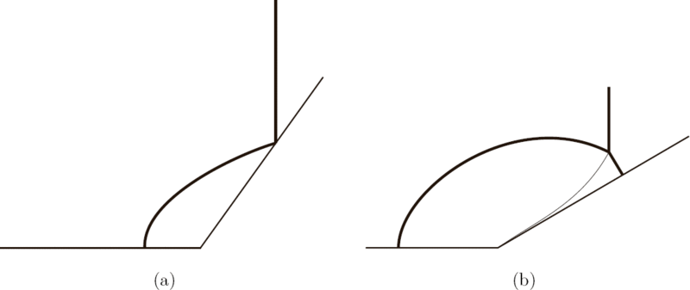
Physics – Mach Stem
Critical angle of incidence
Beyond which normal, acoustic wave reflection does not occur
Reflected wave merges back with incident wave
Creates an intense wave front – Mach stem
Blasts occurring above ground plane are more destructive

Slide 13
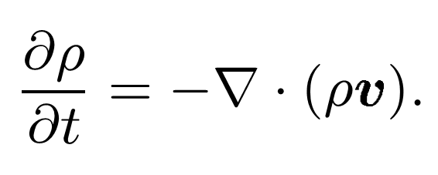
Conservation of Mass
Change of fluid density = Net flux across the fluid boundary
$ρ$ : Density
v : Velocity
Notes:
Del operater : Partial differential vector operatoer

Slide 14
Conservation of momentum
Navier-Stokes equation
Body Forces
Pressure
gradient
Viscous accelerations
Convective transportation of momentum
v : Flow velocity
ρ : Fluid density
f : Body forces such as gravity
µ : Coefficient of viscosity
P : Pressure
Notes:
The first two terms on the right-hand side of the equation model accelerations due to body forces and forces arising from the pressure gradient
The next two terms model accelerations due to viscous forces
The last term is not a force-related term; rather it is a convective term that models the transport of momentum as the fluid flows

Slide 15
Conservation of Energy
First law of Thermodynamics
Change in energy = Amount of heat added and the work done to the system
Work done from pressure and viscosity
Heat transferred from thermal conductivity
N : Internal energy per unit mass
T : Temperature
P : Pressure
v : Velocity
k : Thermal conductivity
ρ : Density
Thermal conduction
Work done by pressure
Viscous dissipation
Convective term
Notes:
The internal energy per unit mass N
temperature T
Pressure P
Velocity v
K = thermal conductivity
Thermal conduction : The first term is thermal conduction of the system. This term reflects changes in
energy due to heat flowing from high to low temperatures

Slide 16
Simulation - Discretization
Regular lattice of cubic cells – voxels
Fluid properties are constant across each voxel
Central finite differences are used to calculate spatial derivatives
Integration Steps
Approximate fluid acceleration at current time
Compute velocity
Approximate change in internal energy using computed velocity
Compute new density
Calculate final v(t + dt) and N(t + dt) using convective terms and new value of density
Update secondary quantities such as temperature
Notes:
Steps :
Approximate the fluid acceleration at the current time, using the non-convective (first four) terms

Slide 17
Simulation – Boundary Conditions
Hard boundaries
Solid objects
Force fluid velocities normal to them to 0
Tangential flow is unaffected
Free boundaries
Blast waves travel through
Model slow, long term effects such as fireballs and dust clouds
Pseudo free
For faster execution
Pressure difference less then a threshold -> free boundary
Prunes out majority of the volume for the blast wave expansion

Slide 18
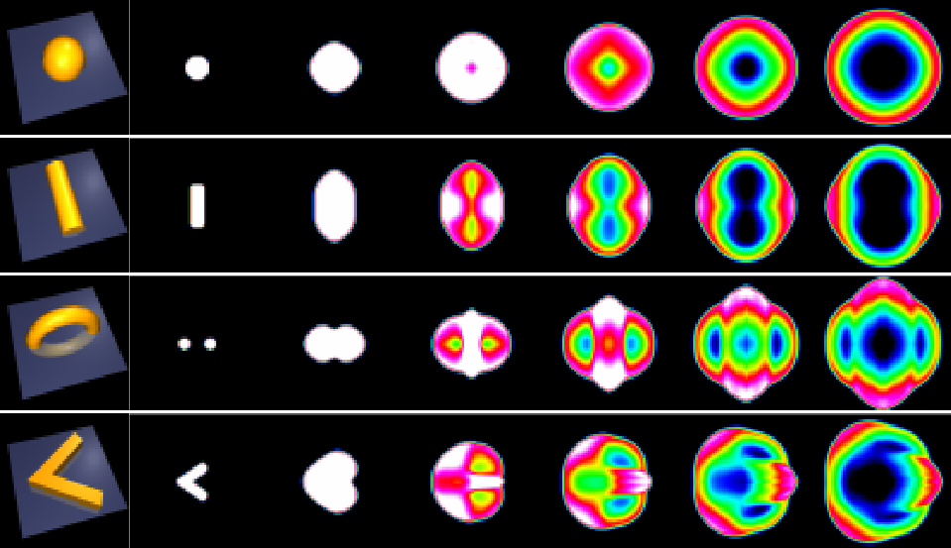
Simulation – Initial conditions
Pressure and Temperature
Detonation = Region of volume with high pressure or temperature
A polygon mesh can be specified
Voxelized to the grid
Allows a variety of effects
Notes:
The user species the pressure and temperature of the air, and the initial values of other variables are determined from the state equations
a chemical explosion might have a temperature of 2900K and a pressure of 1000 atm with the surrounding air at 290K and 1 atm
Figure shows cross-sections of pressure for three-dimensional explosions from equal-volume charges in the shape of a sphere, cylinder, torus, and wedge

Slide 19
Interaction with rigid bodies
2 – way coupling between solids and fluids
Apply forces from the fluid to each polygonal surface of a rigid body
Compute the voxel representation of the rigid body
Displace fluid based on object movement
Update fluid
Notes:
The coupling from fluid to solid allows us to model phenomena such as a projectile being propelled by an explosion.
The coupling from solid to fluid can be used to model a piston compressing or the shock wave formed as a projectile moves through the air supersonically

Slide 20
Fluid to Solid interaction
Hydrostatic pressure
Normal to the surface
Generated by incoherent motion of fluid molecules against the surface
Dynamic forces
Normal and tangent (negligible) to the surface
Coherent motion of continuous fluid
ρ : Density at surface
$v_{rel}$ : Velocity of fluid relative to surface
$\hat{n}$ : Normal vector
A : Area for which the force is assumed constant
Normal force / area
Hydrostatic pressure
Relative to surface
Notes:
We assume that the triangles composing each object are small enough that the force is constant over each triangle.
The force on a triangle with area A. Where the fluid properties are measured at the centroid of the triangle.
The forces are computed for all triangles of an object, and the translational and angular velocities of the object are updated accordingly
Forces can also be applied to flexible objects that deform and fracture.
The explosion simulation results in pressures, velocities, and densities for each voxel in the discretization of the fluid.
The fracture simulation uses this information to compute the forces that should be applied to a finite element model of the objects in the scene.
The force computation is similar to that for rigid objects.

Slide 21
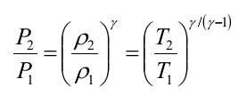
Solid to Fluid interaction
Triangular mesh is converted to voxels
Full cells == Hard boundaries
Partial cells = Modified convection equation according to volume
Forces (from fluid) applied on solid
Rigid body position update -> Revoxelization
Change in volume of partial cells -> Displace fluid
ρ : Density
V : Velocity
P : Pressure
T : Temperature
γ : 1.4 for air
Notes:
Partial filled cells have their convection equation modified to reflect their altered volumes
The change in partial volume of each voxel works like a miniature piston compressing or expanding the gas in that cell.
Since the fluid is compressible, pressure does not vary directly with the change in volume. However, mass is conserved; so the
new density, ρ, is determined by
Pressures and Temperatures are also updated according to the equation
in the case of air,a γ approximately equal to
1.4 is accurate

Slide 22
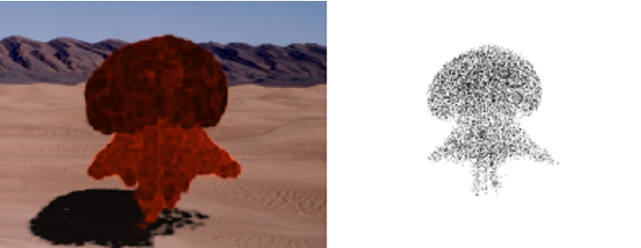
Rendering
Refraction of light
Bending of light from blast wave
Higher refraction index
Captured by ray-tracing through the fluid volume
Fire balls
Composed of detonated material from inside the explosive
Place particles in the explosion shape specified
Massless and flow with fluid
Each particle has a temperature
Interpolated based on its position in the volume

Slide 23
Rendering
Dust clouds
Blast wave propagates disturbing the particles resting on surfaces
Creation rate can be a user-controlled variable
Smaller particles : Lower terminal velocities; More Brownian motion
Rendered as small spheres with Gaussian density
Variance grows according to Mean Brownian diffusion per unit time

Slide 24
References
Reeves, W.T. 1983. Particle systems—a technique for modeling a class of fuzzy objects. ACM Transactions on Graphics 2, (2), 91-108
Paramount Pictures. 1982. Star Trek II: The Wrath of Khan(film)
Neff, M., and Fiume, E. 1999. A visual model for blast waves and fracture. Graphics Interface 99,193-202
Kass, M., AND Miller, G. 1990. Rapid, stable fluid dynamics for computer graphics. In SIGGRAPH 90 Conference Proceedings. 49-57
Wejchert, J., and Haumann, D. 1991. Animation aerodynamics. In SIGGRAPH 91 Conference Proceedings. 19-22
Foster, N., and Metaxas, D. 1996. Realistic animation of liquids. Graphical Models and Image Processing 58, (5), 471-483
Yngve, G., O’Brien, J., and Hodgins, J. 2000. Animating explosions. In SIGGRAPH 2000 Conference Proceedings.29-36
Roach, Matthew Douglas, J. 2005. Physically based simulation of explosions. Master’s thesis

Slide 25
Thank you

