Slide 1
Thin Shell Deformation
Qingyu Zhao 11/17

Slide 2
Questions we want to ask:
    What is a thin shell?
    Why do we want to study it?
    Pros & Cons
    Dynamics

Slide 3
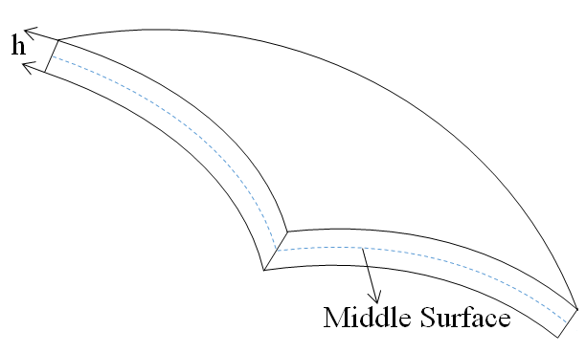
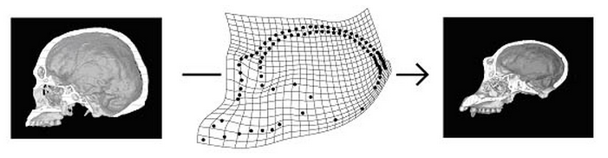
What is a Thin Shell?
Remember Thin Plate:
Interpolation - Thin Plate Splines
  Geometry and deformation is well described by its middle-surface C

Slide 4

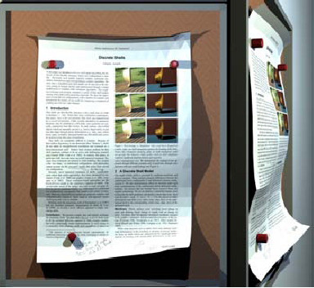
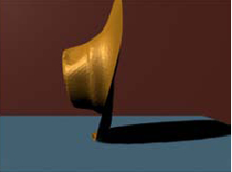
Different Objects modeled as thin shells

Slide 5
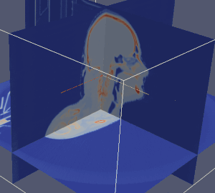
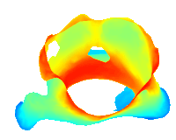
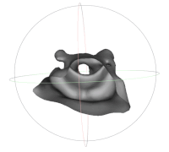
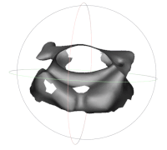
Different Objects modeled as thin shells
Pharyngeal surfaces
Surface registration based on thin shell deformation energy

Slide 6
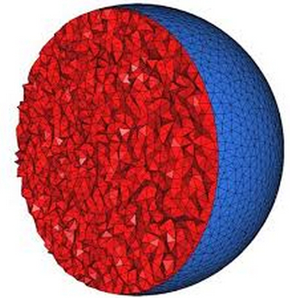
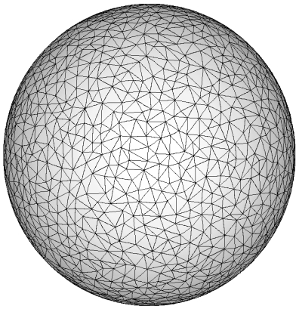
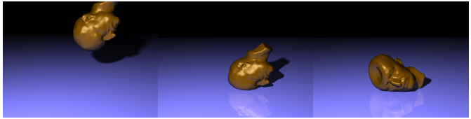
Efficiency: 3D vs. 2D
  Tetrahedralization Surface Triangulation
Deficiency: 3D vs. 2D
Loss of 3D global information

Slide 7
Kinematics of Elastic Thin Shell
The geometry of the shell is well described by its middle-surface C
Physics: underformed C₀ -> deformed C₁
Strain invariant under rigid body motion
Strain should “see” any local change in shape
For thin shells
  Normal strain can be neglected!
  Purely tangential strain
Notes:
Overall deformation energy : integration of all the local deformation energies over the entire surface.
The stain is computed by only using local deformation information.

Slide 8
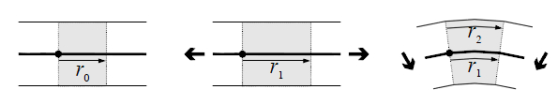
Local Strain (local deformation)
Membrane (stretching ) Strain
Bending Strain
E = E_{m}+E_{c}

Slide 9



Membrane (Stretching) Strain
  For any correspondence p,q on the two surfaces M,N(before and after deformation)
  Under canonical parametrizations, tangential circle got mapped to tangential ellipse
p
q
φ
Tangential transformation

Slide 10



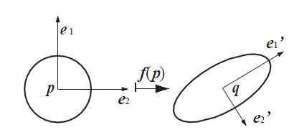
Membrane (Stretching) Strain
Tangential Cauchy-Green Strain tensor:
Jacobian of φ
Two eigenvalues:
Isometric:
This positive definite tensor describes how a circle deforms into an ellipse

Slide 11



Bending Strain
Captured by Shape Operator Change
Local curvature information of a point p is fully characterized by its second fundamental form expressed in tangent plane coordinates, which can be written as a 2 by 2 tensor operator (shape operator)
gives the curvature in the direction of v
Bending Strain : Shape operator difference
Pull back operation

Slide 12
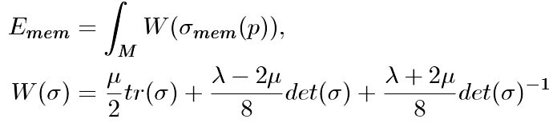

Membrane & Bending Energy
Energy based on strain tensors:
(Frobenius norm)

Slide 13
How to compute energy on discrete surfaces?
Triangle Mesh
Point Sampled
3D Image Embedding

Slide 14
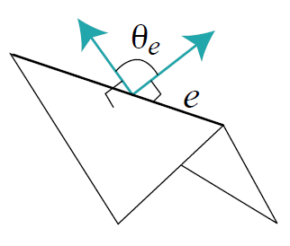

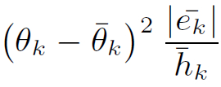
Discretized Energy – Triangle Mesh
Edge lengths |e_{i}| and dihedral angles θ_{k} (probably the simplest implementation)
Stretching
Bending

Slide 15
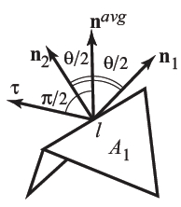
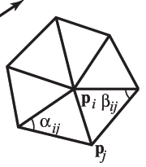
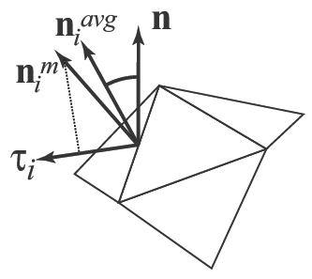
Discretized Energy – Triangle Mesh
What are the underlying assumptions there?
  Stretching: One dimensional stretching
  Bending: Zero- Gaussian curvature -> flat everywhere !
How to produce arbitrary strain tensors?
Use a stencil with more degrees of freedom.
Edge-based
Vertex Ring
Triangle Ring

Slide 16
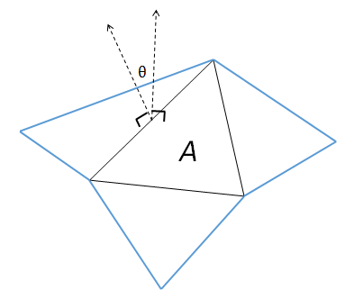
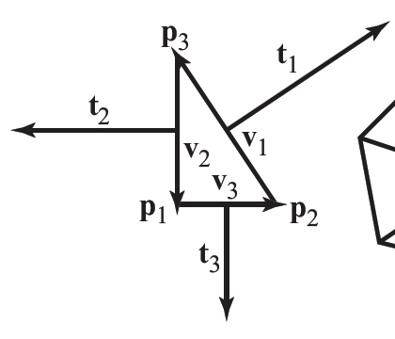
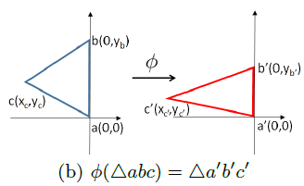

Discretized Energy – Triangle Mesh
Triangle-ring Stencil
Bending
Tangential transformation
Curvature along any direction is a linear combination of the three curvatures along t₁,t₂,t₃
Stretching

Slide 17
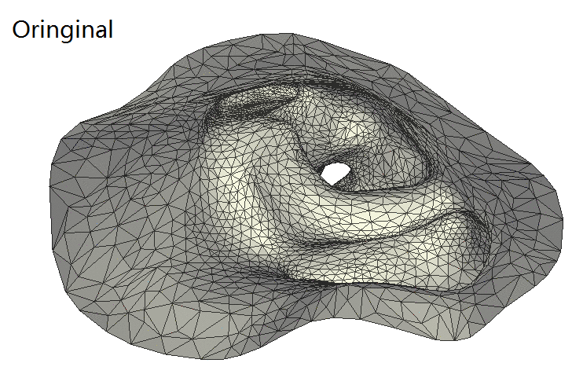
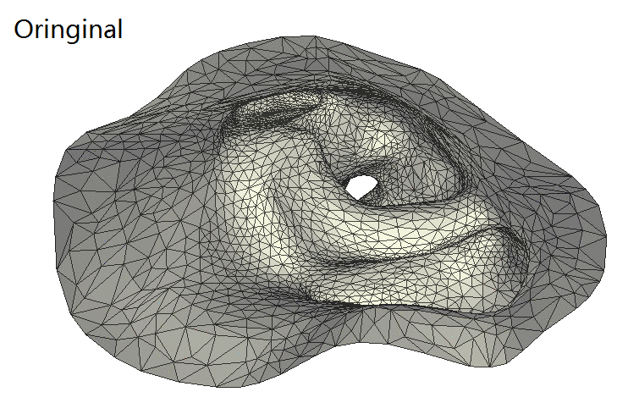
Discretized Energy – Triangle Mesh
Edge-based deformation
Triangle-based deformation

Slide 18
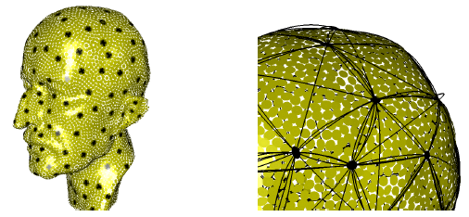
Discretized Energy – Point-Sampled Surface
  Triangulation-free: using so-called fibers (local polynomial curves) to compute first and second order terms
Sample the surface with fibers (different locations and directions)
Measure curvature and arc length in their respective directions

Slide 19
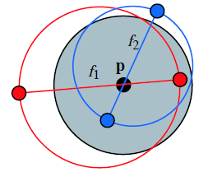
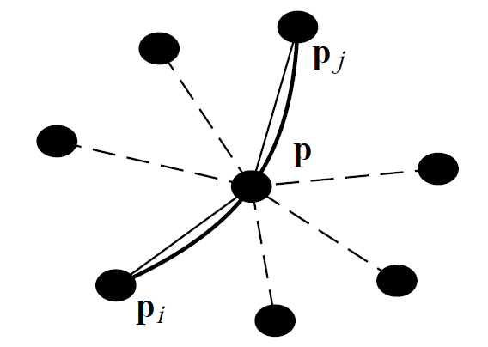
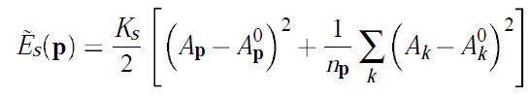

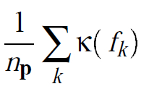
Discretized Energy – Point-Sampled Surface
Stretching energy
  Use the n_{p} fibers through p to approximate a surface area Ap for p. Assume circular local patch
Area change
Length change
Bending Energy
  Use mean curvature to measure curvature change
Fiber fitting around a node
Mean Curvature:H =

Slide 20
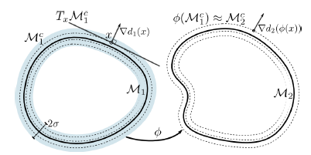
Discretized Energy — Level Set Embedding
Transform 2D surfaces into 3D images
Zero-Level-Set of a signed distance function
Narrow band formulation of shell energy
Adaptive grid

Slide 21


Dynamics
Force computed as the negative gradient of the energy (Stretching E_{s} and Bending E_{b}) w.r.t the nodal positions p_{i}:
Governing equation for the system:
  Newton’s law
Internal force
External force

Slide 22
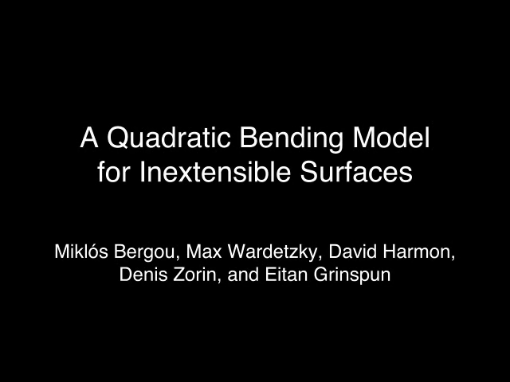
Dynamics
http://www.cs.columbia.edu/cg/quadratic/videos/quadratic.mov

Slide 23
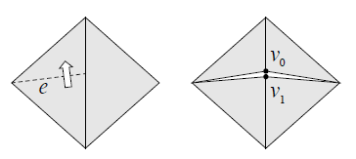
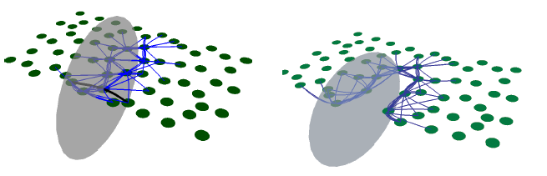
Fracture Events
Fracture happens when principal strain exceeds a material-specific tensile or compressive threshold
Principal strains: eignvalues of the strain tensor
Principal strain directions: eigenvectors of the strain tensor

Slide 24

Fracture Events
http://cs.nyu.edu/~ajsecord/fracture/Lightbulbs.mov

Slide 25
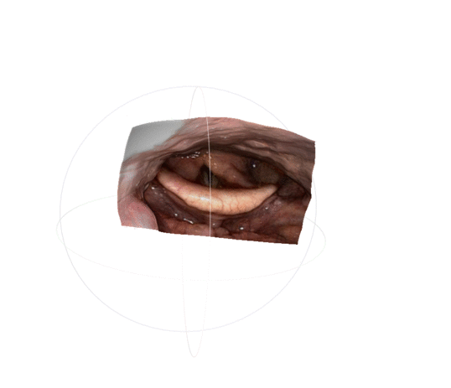
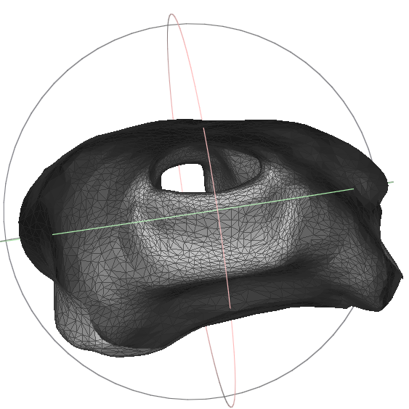
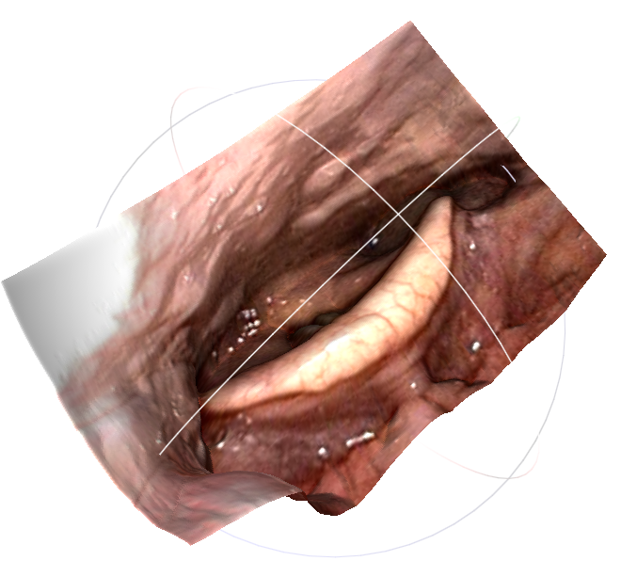
Registration
Align two surfaces
Let one surface attract the other
Use geometric properties to provide virtual forces
CT
Endoscope reconstruction

Slide 26
Thank You!
Reference
“A Discrete Model for Inelastic Deformation of Thin Shells”, Gingold et. al.,2004
“A Thin Shell Approach to the Registration of Implicit Surfaces”, Iglesias, et. al., 2013
“Efficient Animation of Point-Sampled Thin Shells”, Wicke et. al., 2005

