Slide 1
Yarn-Based Cloth Simulation
Tanya Amert
COMP 768
Wednesday 11/9/16

Slide 2
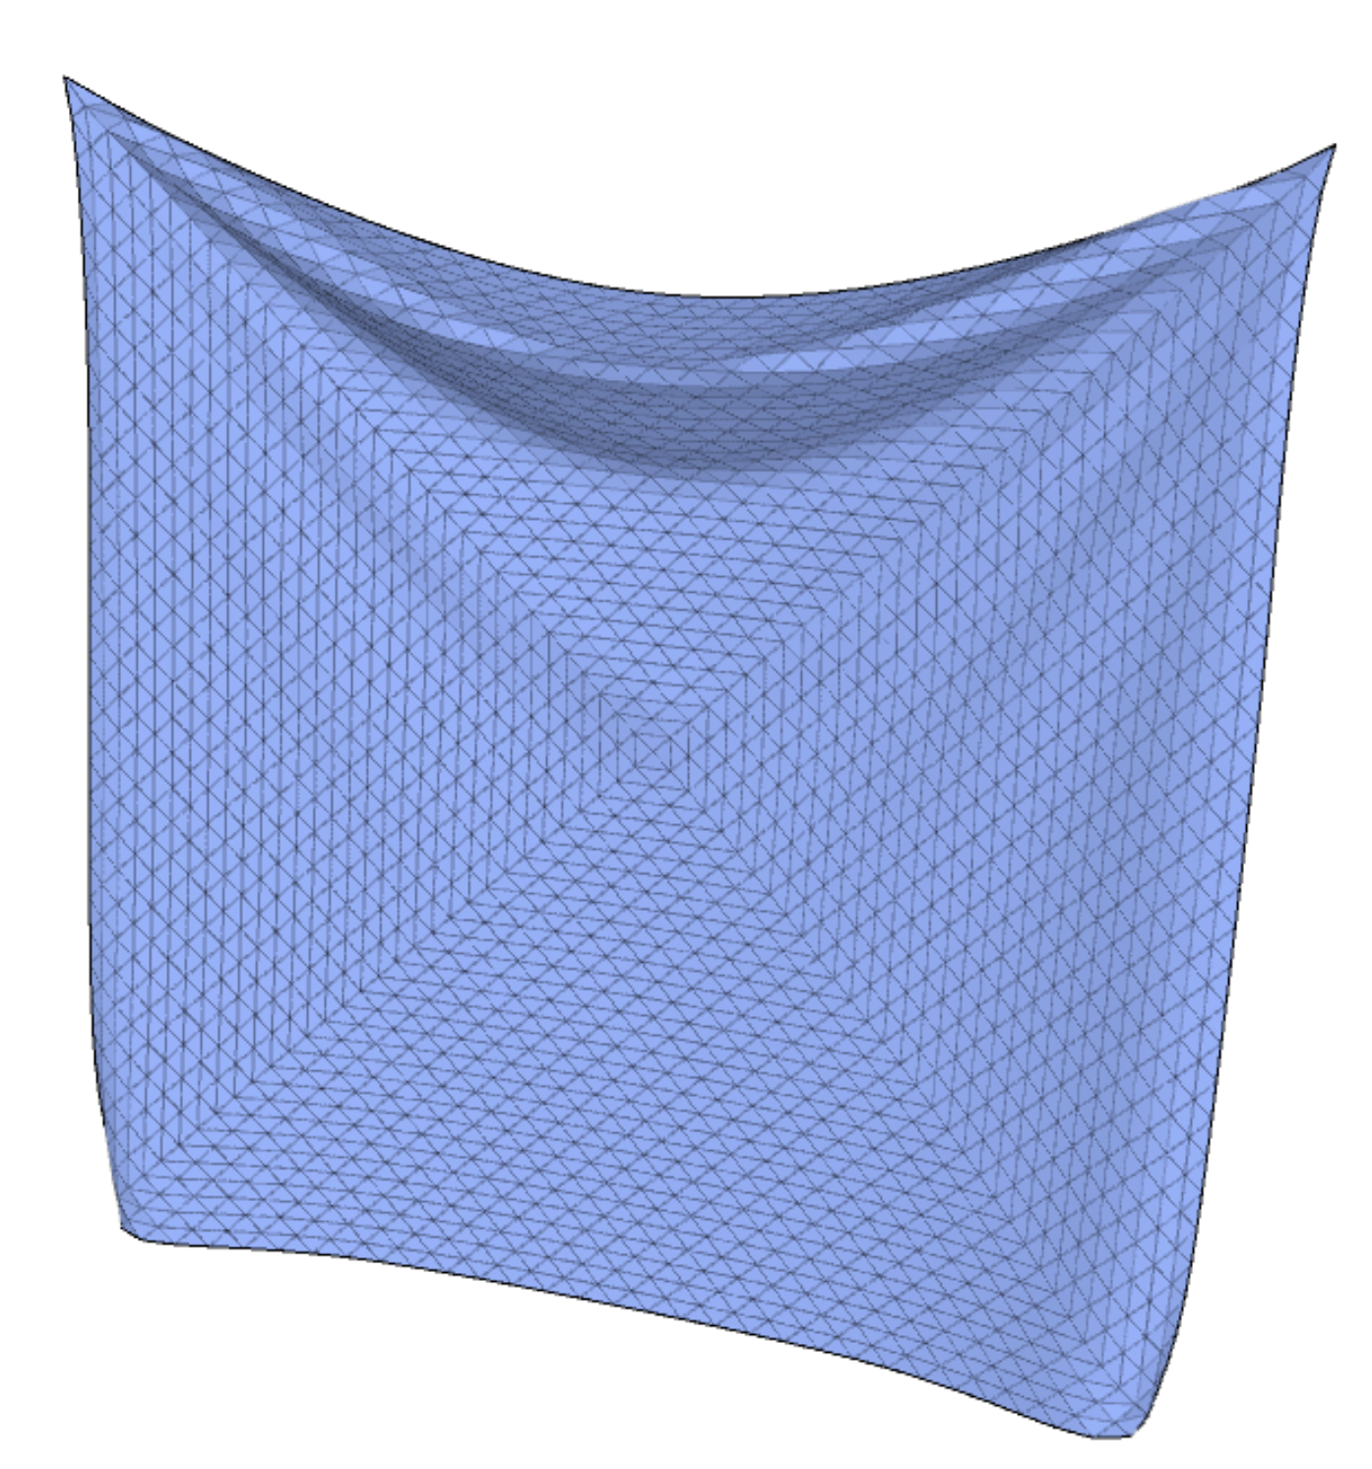
Levels of Abstraction
Sheet-based
  Sheet of homogenous material

Slide 3
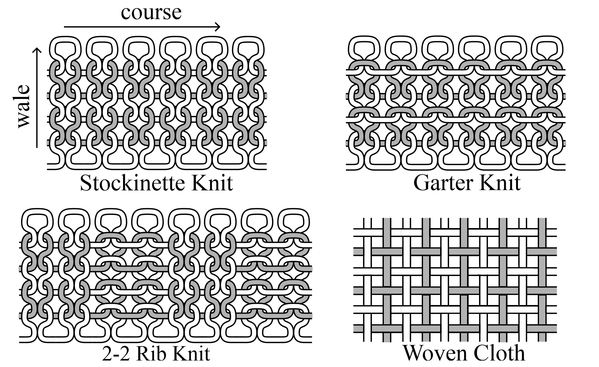
Levels of Abstraction
Sheet-based
  Sheet of homogenous material
    The sheet is a lie!
Yarn-based
  Strands of homogenous material
[Kaldor et al. 2008]

Slide 4
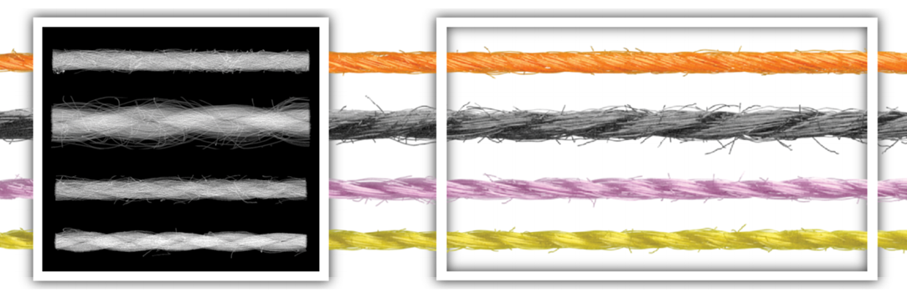
Levels of Abstraction
Sheet-based
  Sheet of homogenous material
    The sheet is a lie!
Yarn-based
  Strands of homogenous material
    The yarn is a lie!
Fibers
  Closer to the real world
    (probably a lie, too)
[Zhao et al. 2016]
Notes:
Sheet: easy to coarsen to accelerate simulation, and only have collision handling when self-collisions occur
Yarn: need high degree of detail, and consist entirely of collisions; affect large-scale
Fibers: affect large-scale appearance

Slide 5
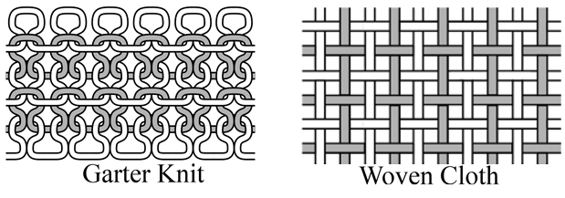
Levels of Abstraction
Sheet-based
  Sheet of homogenous material
    The sheet is a lie!
Yarn-based
  Strands of homogenous material
    The yarn is a lie!
Fibers
  Closer to the real world
    (probably a lie, too)
[Kaldor et al. 2008]
[Zhao et al. 2016]
Notes:
Sheet: easy to coarsen to accelerate simulation, and only have collision handling when self-collisions occur
Yarn: need high degree of detail, and consist entirely of collisions; affect large-scale mechanical behavior of woven and knitted cloth
Fibers: affect large-scale appearance

Slide 6
Overview
Introduction
  Levels of abstraction
  Motivation
  Background
Modeling Yarn-Based Cloth
Applications

Slide 7
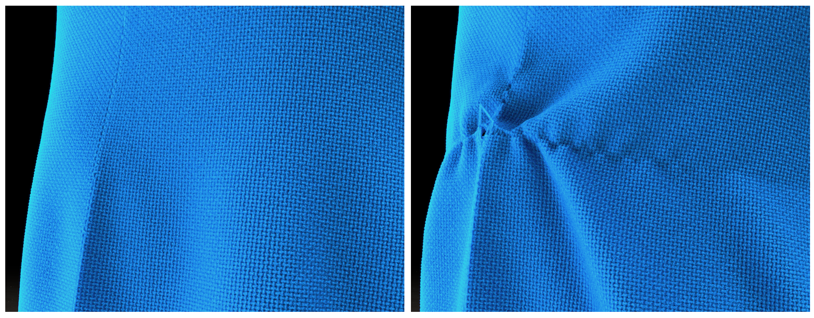
Motivation
Yarn-based cloth allows us to model yarn-level interactions
  E.g., snagging a single yarn
[Cirio et al. 2014]

Slide 8
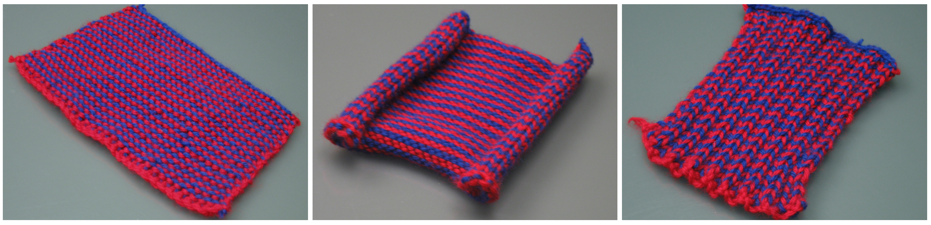
Motivation
Knitted cloth has complex behaviors
  These depend on stitch pattern
[Kaldor et al. 2008]

Slide 9
Overview
Introduction
Modeling Yarn-Based Cloth
  Woven Cloth
  Knitted Cloth
Applications

Slide 10
Overview
Introduction
Modeling Yarn-Based Cloth
  Woven Cloth
  Knitted Cloth
Applications

Slide 11
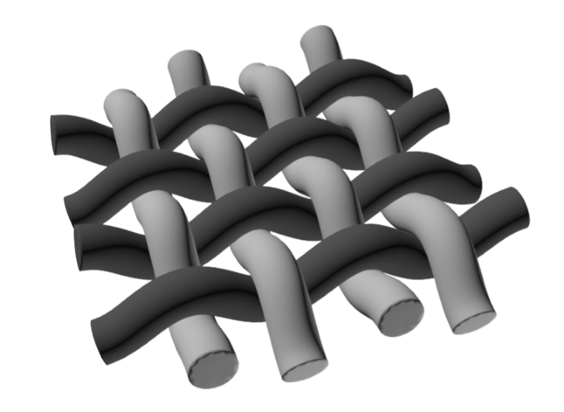
Background – Woven Cloth
Two orthogonal directions
  Dark gray: warp yarns
  Light gray: weft yarns
Held together by friction at yarn-yarn contacts
[Cirio et al. 2014]

Slide 12
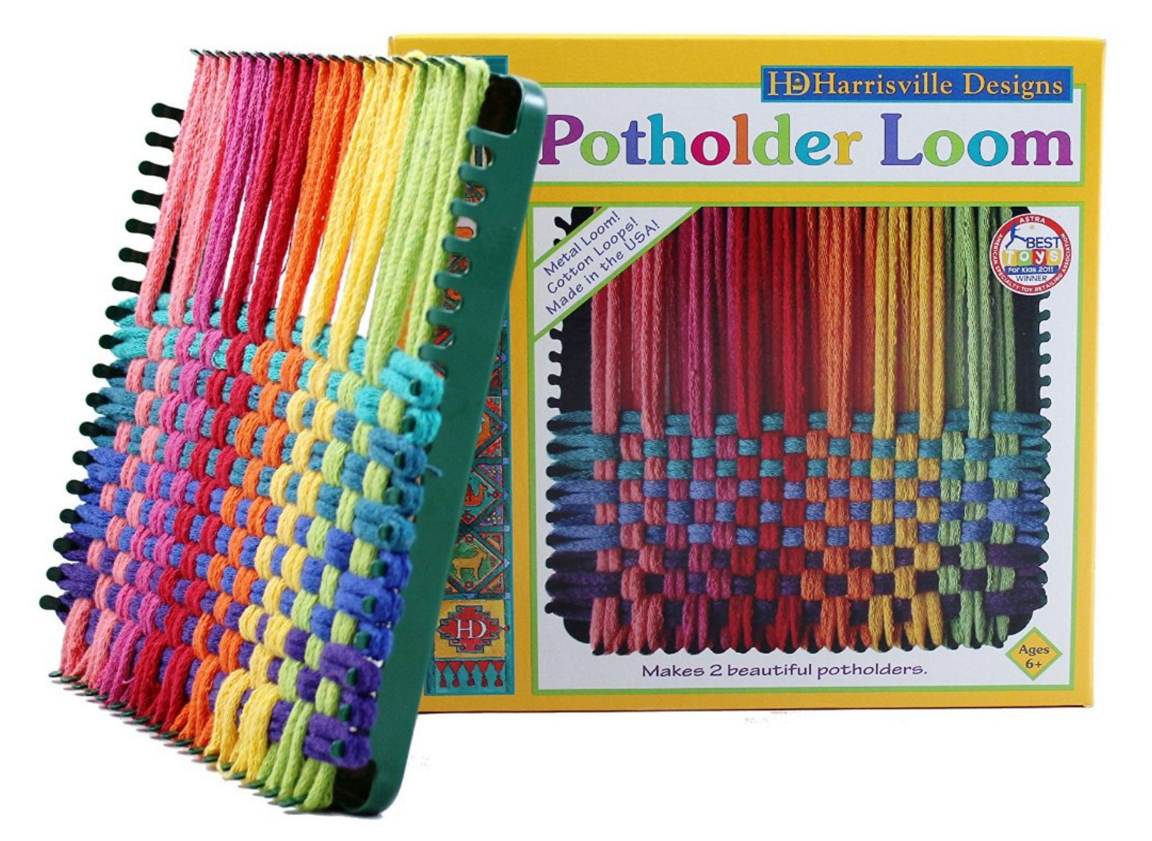
Background – Woven Cloth
Two orthogonal directions
  Dark gray: warp yarns
  Light gray: weft yarns
Held together by friction at yarn-yarn contacts
Easy to learn!
[https://amzn.com/B00000IV3U]

Slide 13
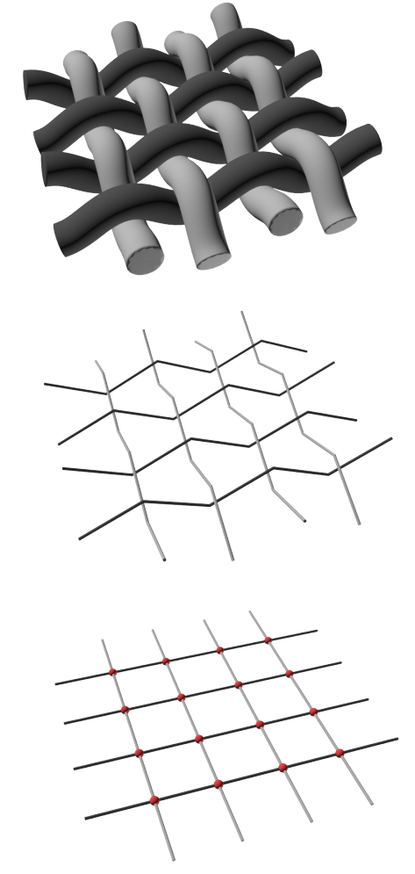
Woven Cloth
Model is focused on yarn-yarn crossings
Interlaced rod segments with “crimp” used for normal force computation
5-DoF nodes are used for all other computations
[Cirio et al. 2014]

Slide 14
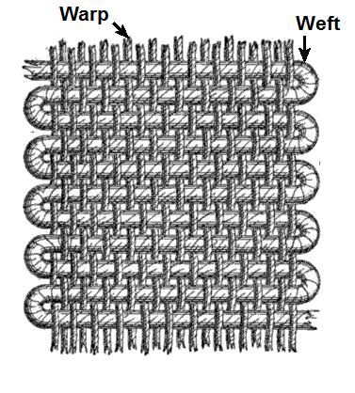
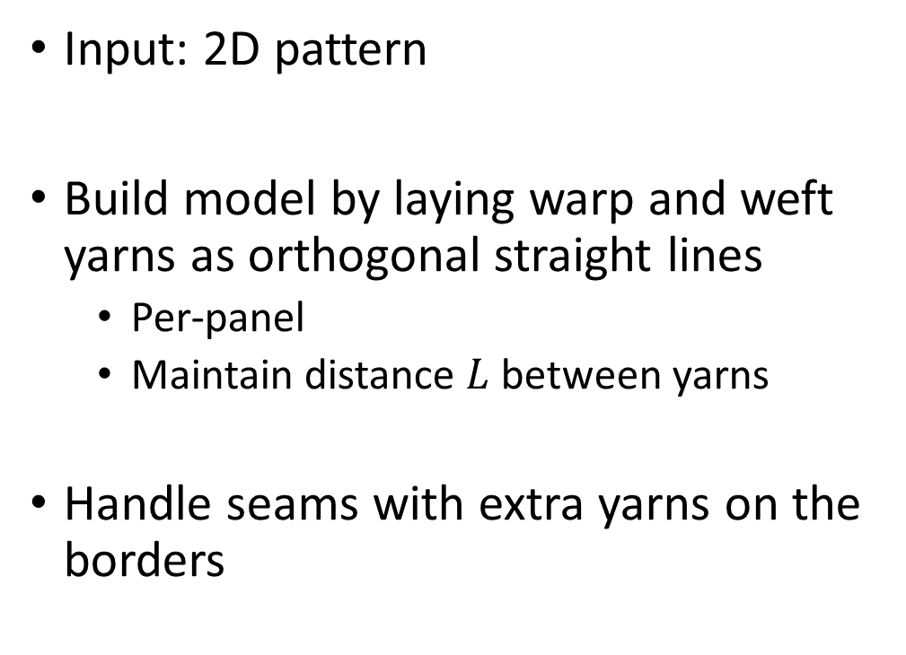
Woven Cloth
Input: 2D pattern
Build model by laying warp and weft yarns as orthogonal straight lines
  Per-panel
  Maintain distance $L$ between yarns
Handle seams with extra yarns on the borders
[en.wikipedia.org/wiki/Weaving]

Slide 15
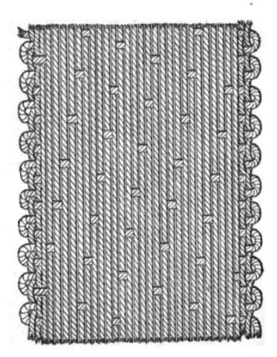
Woven Cloth
A float is a gap between two yarns of the same type
  Influence mechanical properties
Different weave patterns are based on distribution of floats
  Plain weave has no floats
  Satin, twill, etc., have varying float distribution
[en.wikipedia.org/wiki/Satin]

Slide 16
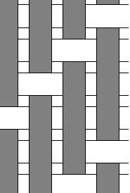
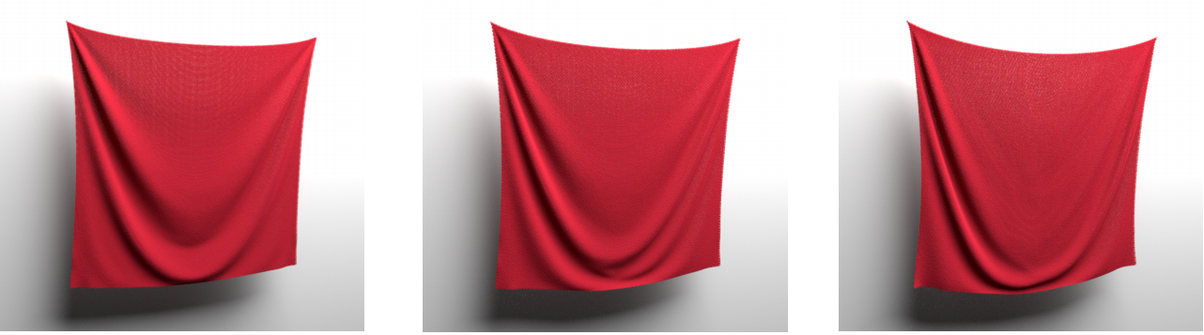
Woven Cloth
As the number of floats increases, the shear resistance decreases
Plain weave
Twill
Satin
[Cirio et al. 2014]
Notes:
Diagrams from Wikipedia, cloth renderings from [Cirio et al. 2014]

Slide 17
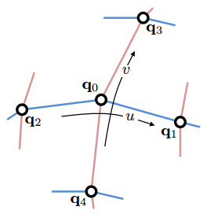
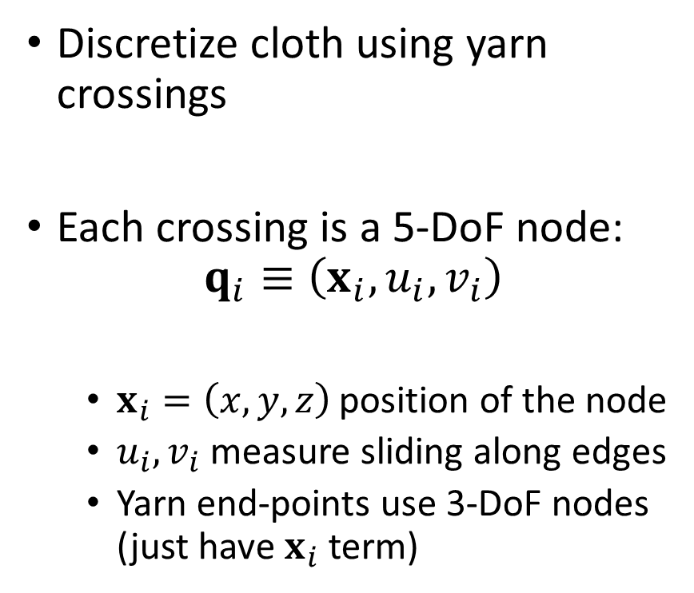
Woven Cloth
Discretize cloth using yarn crossings
Each crossing is a 5-DoF node:
$$q_{i}≡\left(x_{i},u_{i},v_{i}\right)$$
  $x_{i}=\left(x,y,z\right)$ position of the node
  $u_{i},v_{i}$ measure sliding along edges
  Yarn end-points use 3-DoF nodes (just have $x_{i}$ term)
[Cirio et al. 2014]

Slide 18
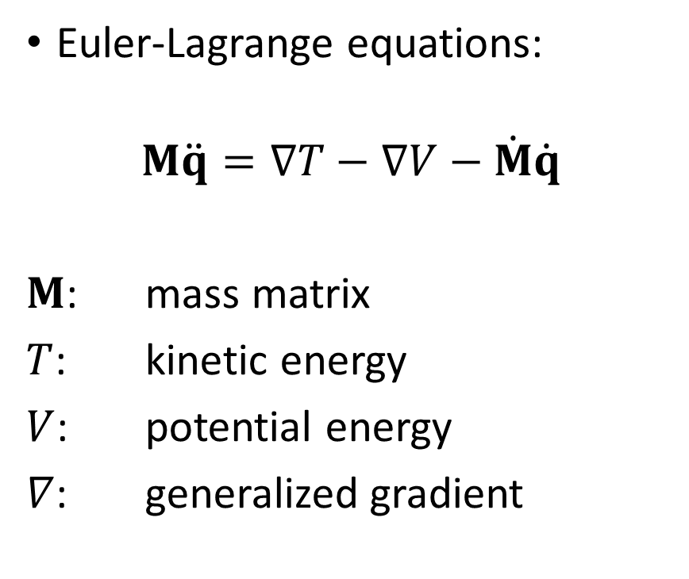
Woven Cloth
Euler-Lagrange equations:
$$M\ddot{q}=∇T−∇V−\dot{M}\dot{q}$$
$M$: mass matrix
$T$: kinetic energy
$V$: potential energy
$∇$: generalized gradient
[Cirio et al. 2014]

Slide 19
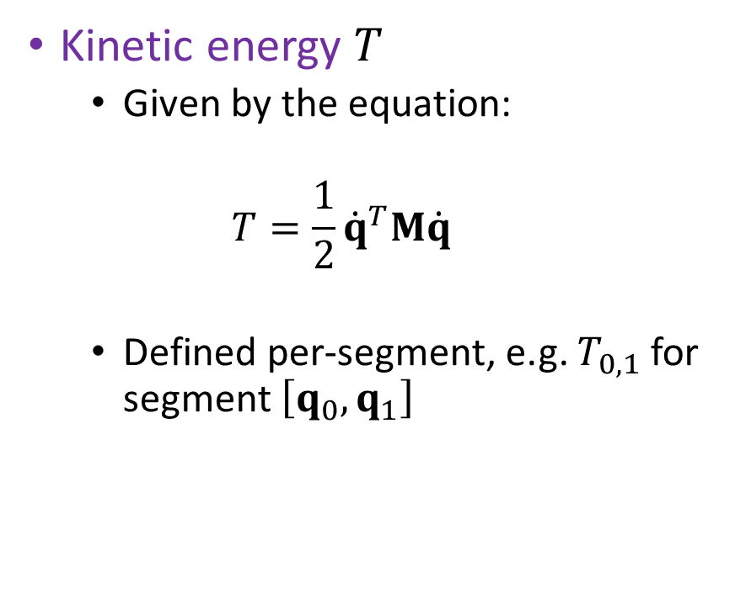
Woven Cloth
Kinetic energy $T$
  Given by the equation:
  $$T=\frac{1}{2}{\dot{q}}^{T}M\dot{q}$$
  Defined per-segment, e.g. $T_{0,1}$ for segment $\left[q_{0},q_{1}\right]$
[Cirio et al. 2014]

Slide 20
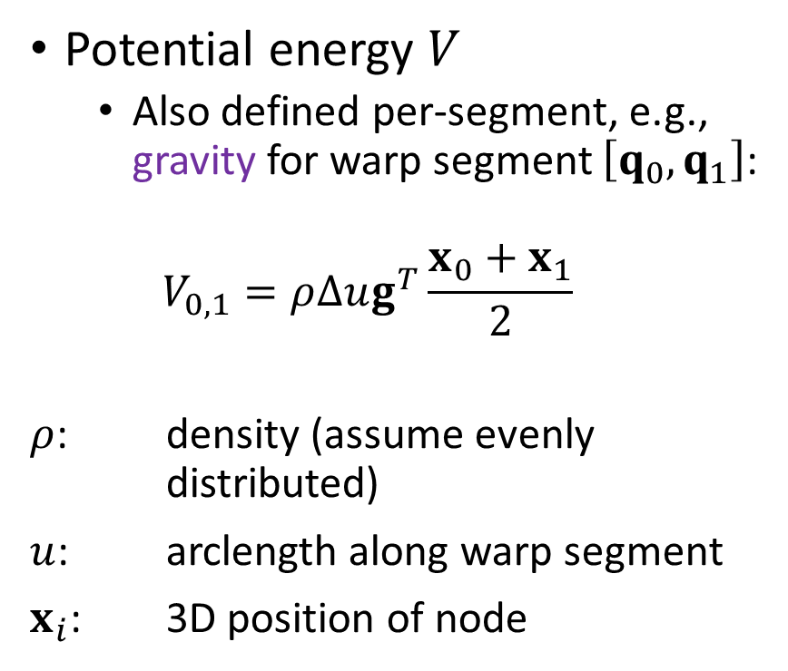
Woven Cloth
Potential energy $V$
  Also defined per-segment, e.g., gravity for warp segment $\left[q_{0},q_{1}\right]$:
  $$V_{0,1}=ρ∆ug^{T}\frac{x_{0}+x_{1}}{2}$$
$ρ$: density (assume evenly
distributed)
$u$: arclength along warp segment
$x_{i}$: 3D position of node
[Cirio et al. 2014]

Slide 21
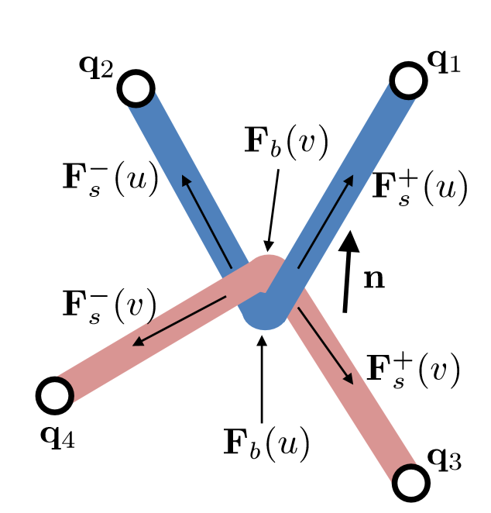
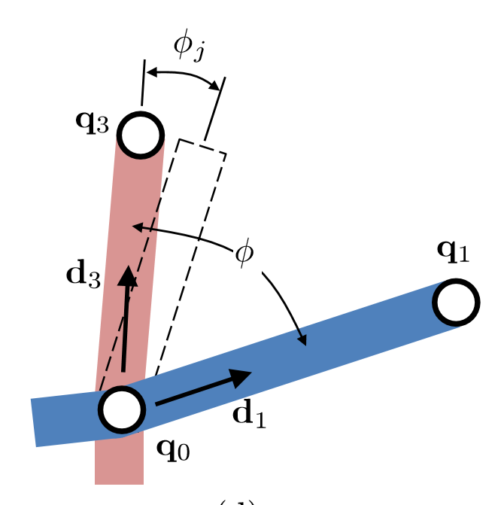
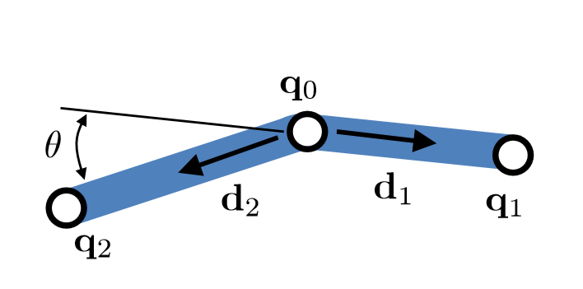
Woven Cloth
Internal forces
  Stretch for each segment
  Bending for each pair of consecutive segments
  Compression, friction, and shear at each yarn crossing
[Cirio et al. 2014]

Slide 22
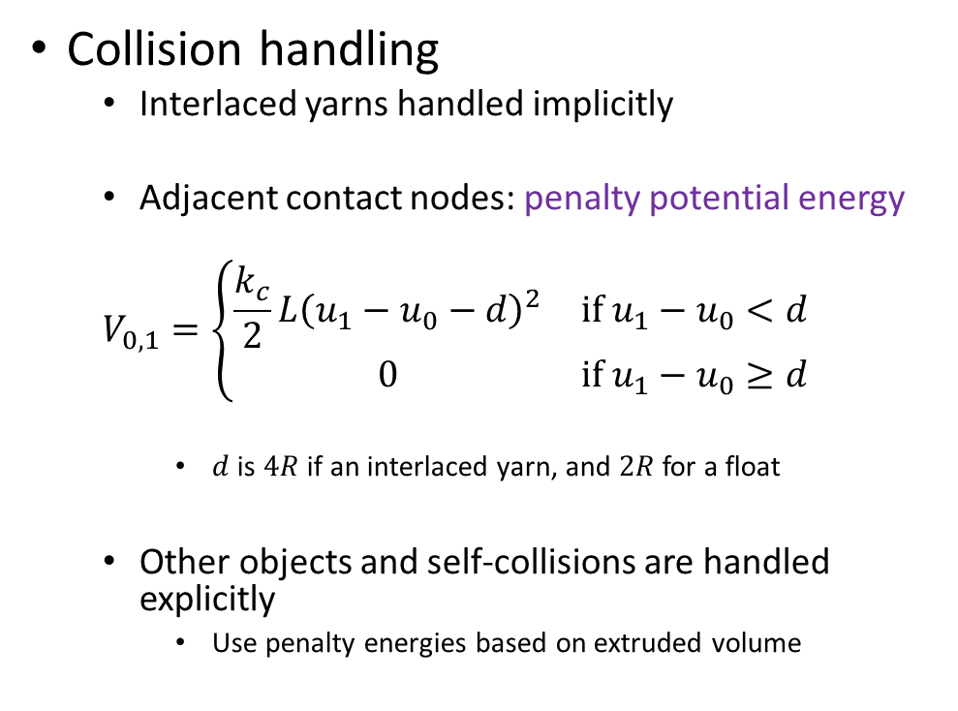
Woven Cloth
Collision handling
  Interlaced yarns handled implicitly
  Adjacent contact nodes: penalty potential energy
  $$V_{0,1}=\left\{\begin{matrix}\frac{k_{c}}{2}L{\left(u_{1}−u_{0}−d\right)}^{2} & if u_{1}−u_{0}<d \\ 0 & if u_{1}−u_{0}≥d\end{matrix}\right.$$
    $d$ is $4R$ if an interlaced yarn, and $2R$ for a float
  Other objects and self-collisions are handled explicitly
    Use penalty energies based on extruded volume
[Cirio et al. 2014]
Notes:
External: volumetric => signed distance fields
Self-collisions: query yarn nodes against small volumetric elements on the surface of the cloth (two triangles per square defined by 4 contacts, height given in normal direction)

Slide 23
Woven Cloth – Results
Benefits
Limitations
Allows for yarn-level modeling of cloth behavior
Avoids computationally intensive collision handling by treating yarn-yarn contacts as persistent nodes
The model described is suited to very simple (albeit common) weaving patterns
Only describes woven cloth, not other configurations, like knitted or crocheted cloth

Slide 24
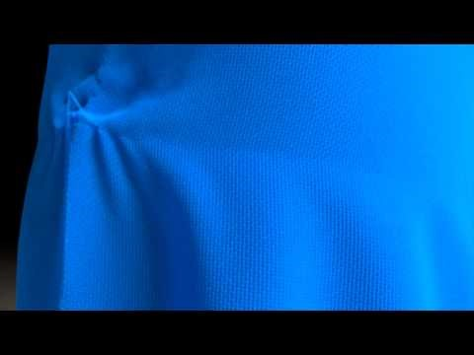
Woven Cloth – Results
[https://youtu.be/6DhInyA0xVY]

Slide 25
Overview
Introduction
Modeling Yarn-Based Cloth
  Woven Cloth
  Knitted Cloth
Applications

Slide 26
Overview
Introduction
Modeling Yarn-Based Cloth
  Woven Cloth
  Knitted Cloth
    Model: persistent contacts
    Model: B-Spline curve
Applications

Slide 27
Background - Knitting
Two directions
  Course
  Wale
Two stitch types
  Knit
  Purl
Held together by interlocking loops
[Kaldor et al. 2008]

Slide 28
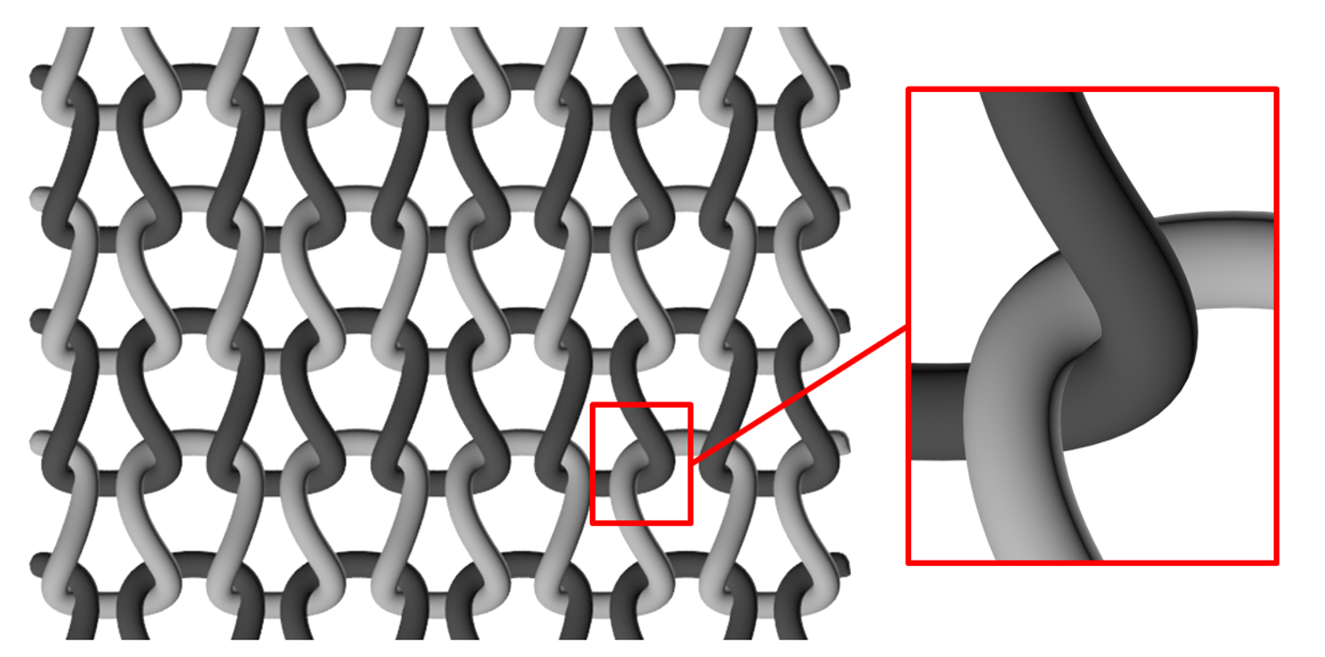
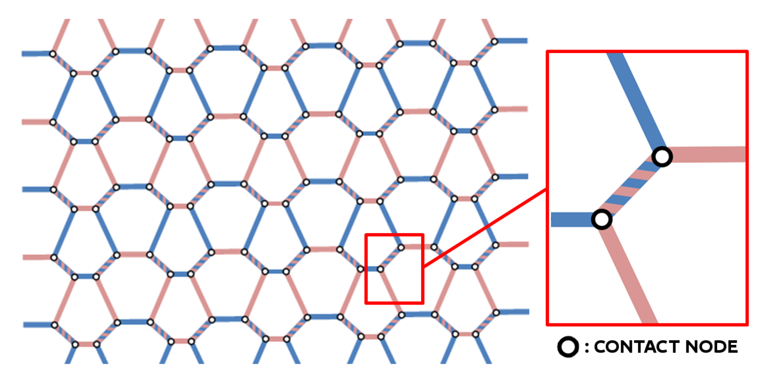
Knitted Cloth – Persistent Contacts
Idea: extend woven cloth model to knitted cloth
  Treat yarn-yarn contacts as persistent nodes
3D visualization of knitted cloth
Discretization of knitted cloth
[Cirio et al. 2015]

Slide 29

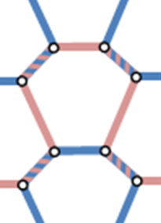

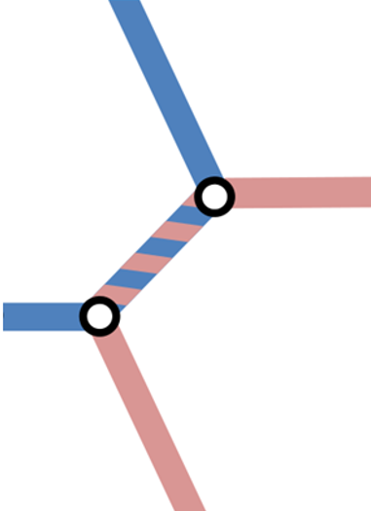
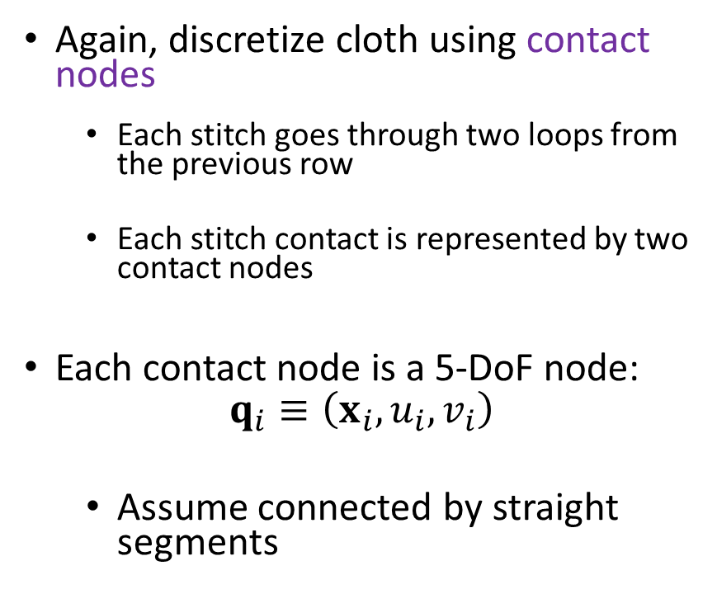
Knitted Cloth – Persistent Contacts
Again, discretize cloth using contact nodes
  Each stitch goes through two loops from the previous row
  Each stitch contact is represented by two contact nodes
Each contact node is a 5-DoF node:
$$q_{i}≡\left(x_{i},u_{i},v_{i}\right)$$
  Assume connected by straight segments
[Cirio et al. 2015]

Slide 30
Knitted Cloth – Persistent Contacts – Results
Benefits
Limitations
Avoids computationally intensive collision handling by treating yarn-yarn contacts as persistent nodes
7x speedup over other approaches (covered later)
Cannot handle complex patterns with more stitch types
Requires complex parameters, in this case hand-tuned

Slide 31
Knitted Cloth – Persistent Contacts – Results
VIDEO from:
Efficient Simulation of Knitted Cloth Using Persistent Contacts
[http://www.gmrv.es/Publications/2015/CLO15/FinalSCA2015.mp4]

Slide 32
Overview
Introduction
Modeling Yarn-Based Cloth
  Woven Cloth
  Knitted Cloth
    Model: persistent contacts
    Model: B-Spline curve
Applications

Slide 33
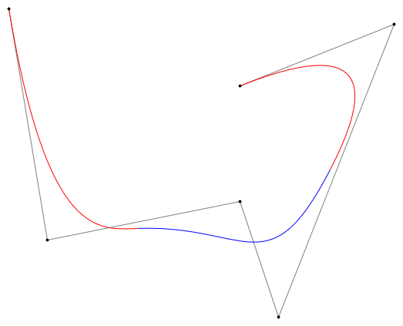
Background – Cubic B-Spline Curves
Curve defined by a set of control points
Approximates control points, staying inside the convex hull
For a long curve with many points, can use cubic spline segments
[https://en.wikipedia.org/wiki/B-spline]

Slide 34
Knitted Cloth – B-Spline Curve
Organized into horizontal rows of knitted stitches
Model yarn as a single cubic B-Spline tube
  Doubles back on itself to start new rows
  Many control points define the overall structure of the cloth (10k+ segments)

Slide 35
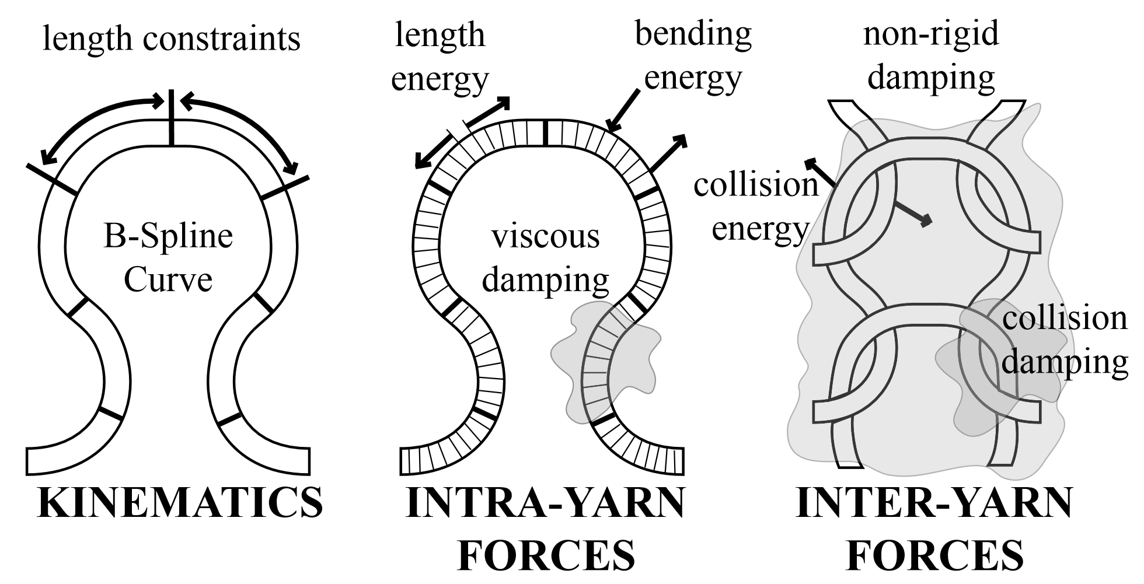
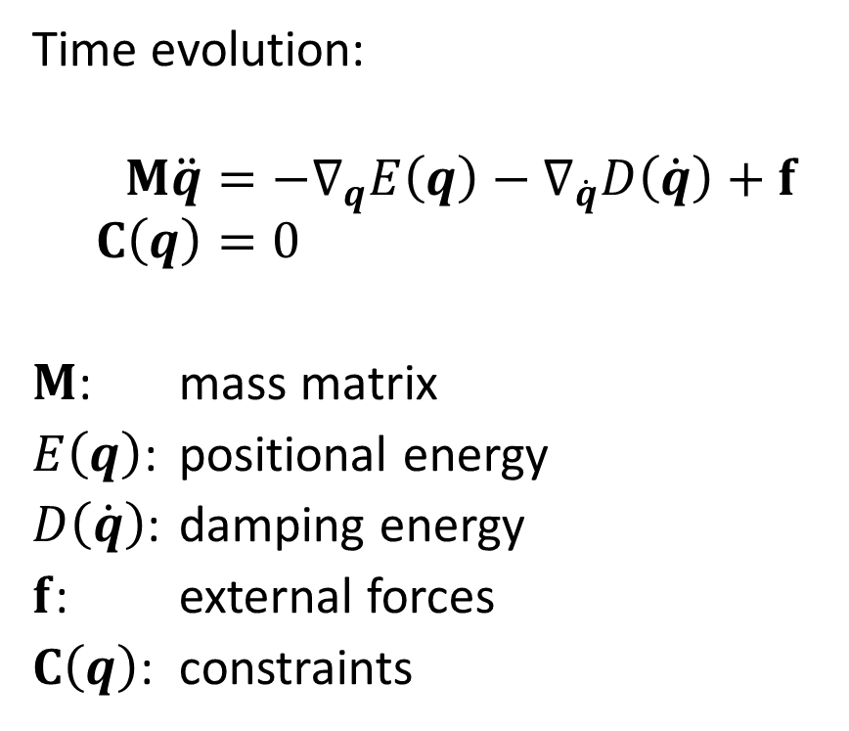
Knitted Cloth – B-Spline Curve
Time evolution:
$$M\ddot{q}=−∇_{q}E\left(q\right)−∇_{\dot{q}}D\left(\dot{q}\right)+f \\ C\left(q\right)=0$$
$M$: mass matrix
$E\left(q\right)$: positional energy
$D\left(\dot{q}\right)$: damping energy
$f$: external forces
$C\left(q\right)$: constraints
[Kaldor et al. 2008]

Slide 36
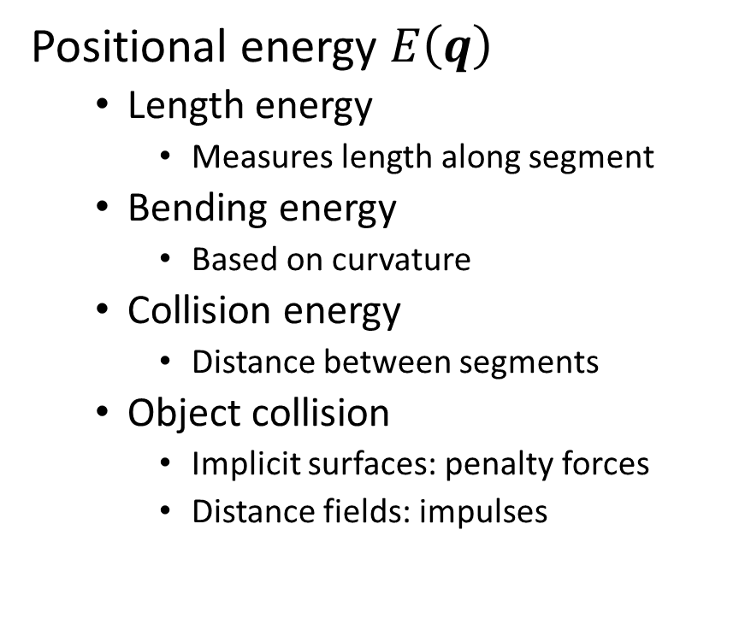
Knitted Cloth – B-Spline Curve
Positional energy $E\left(q\right)$
  Length energy
    Measures length along segment
  Bending energy
    Based on curvature
  Collision energy
    Distance between segments
  Object collision
    Implicit surfaces: penalty forces
    Distance fields: impulses
[Kaldor et al. 2008]

Slide 37
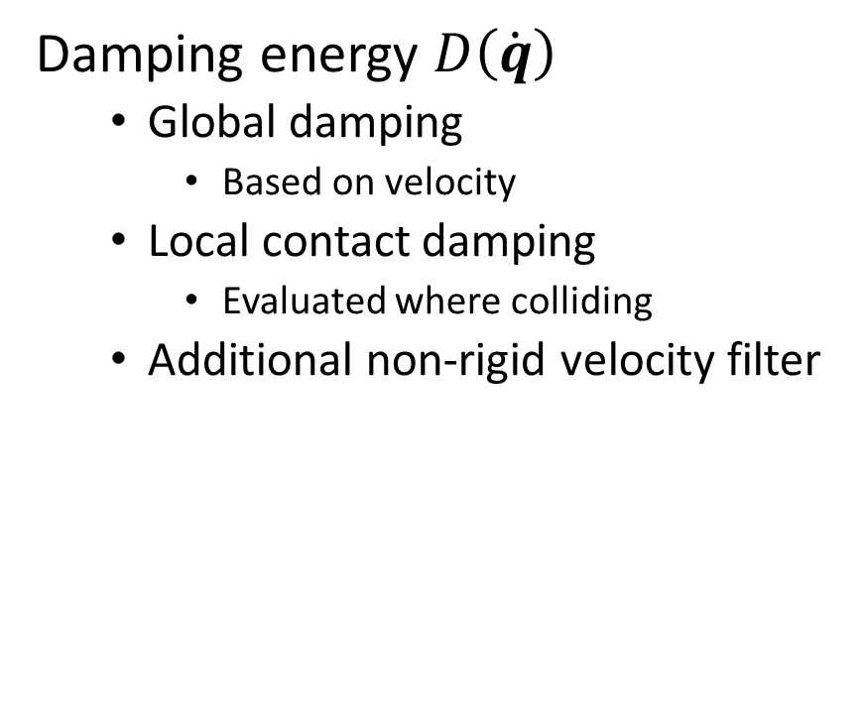
Knitted Cloth – B-Spline Curve
Damping energy $D\left(\dot{q}\right)$
  Global damping
    Based on velocity
  Local contact damping
    Evaluated where colliding
  Additional non-rigid velocity filter
[Kaldor et al. 2008]

Slide 38

Knitted Cloth – B-Spline Curve
Constraints $C\left(q\right)$
  Inextensibility
    Segment length constant
  “glue” ends of yarn to cloth
[Kaldor et al. 2008]

Slide 39
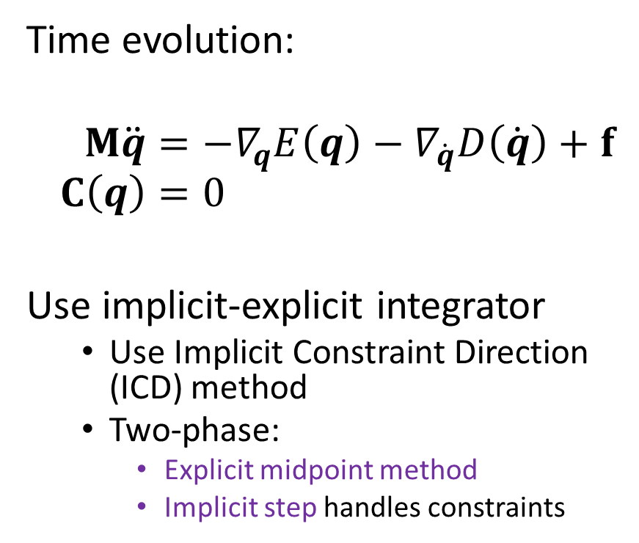
Knitted Cloth – B-Spline Curve
Time evolution:
$$M\ddot{q}=−∇_{q}E\left(q\right)−∇_{\dot{q}}D\left(\dot{q}\right)+f \\ C\left(q\right)=0$$
Use implicit-explicit integrator
  Use Implicit Constraint Direction (ICD) method
  Two-phase:
    Explicit midpoint method
    Implicit step handles constraints
[Kaldor et al. 2008]

Slide 40
Knitted Cloth – B-Spline Curve
Collision Handling
  Yarn segments usually have only a few neighbors
  Use spatial culling with bounding spheres inserted into a static AABB hierarchy
[Kaldor et al. 2008]

Slide 41
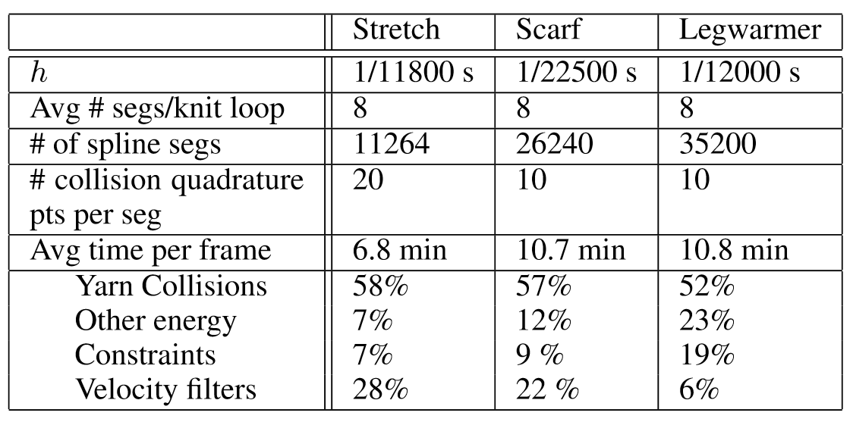
Knitted Cloth – B-Spline Curve – Results
Pros:
Model complex knitted cloth behavior
Cons:
Very time-intensive simulations for even small samples
  42 rows, each with 32 stitches
Require very small time steps
[Kaldor et al. 2008]

Slide 42
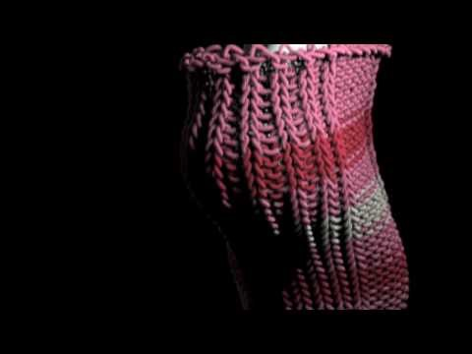
Knitted Cloth – B-Spline Curve – Results
[https://youtu.be/2FTpltiN4ig]

Slide 43
Overview
Introduction
Modeling Yarn-Based Cloth
Applications
  Generating knitted curves
  Knitting machines

Slide 44
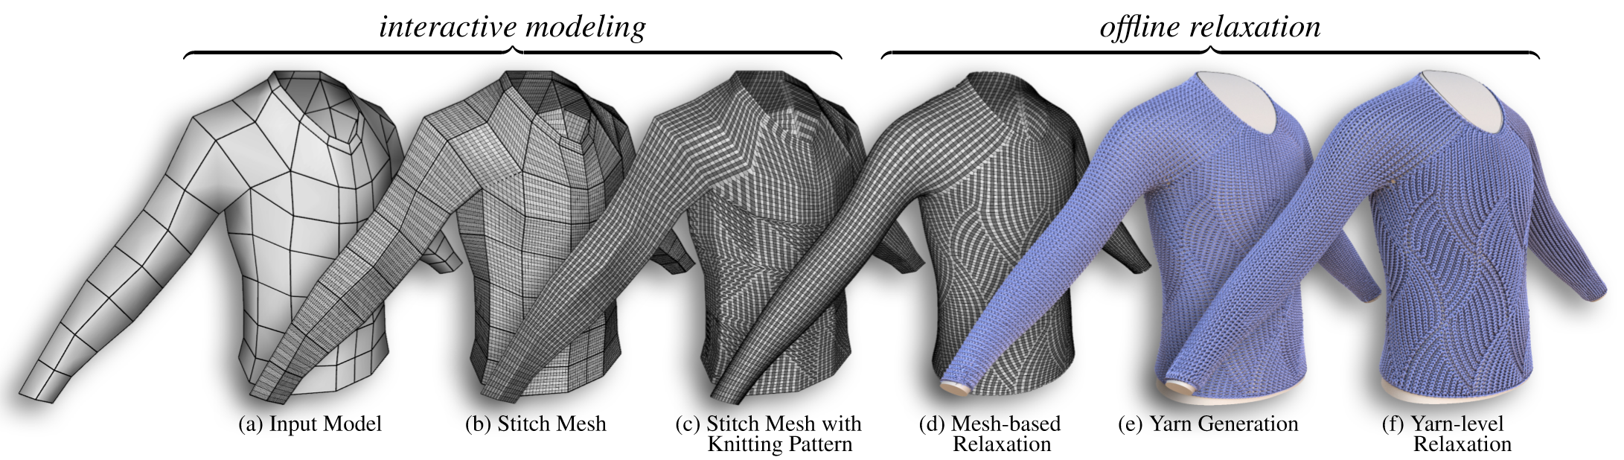
Generating Knitted Meshes
Goal: Given a polygonal mesh, generate a yarn-level model of a garment
Steps:
  Generate stitch mesh for stitch layout
  Relax stitch mesh to create curve model
[Yuksel et al. 2012]

Slide 45
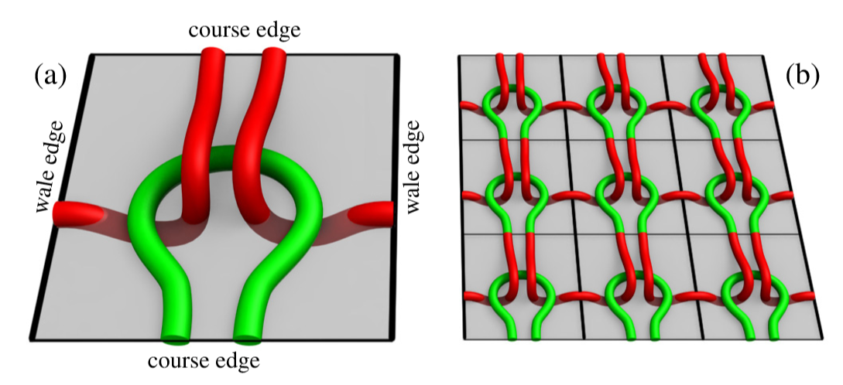
Generating Knitted Meshes
Stitch Mesh: abstraction used to interactively create knitted design
  Made up of polygonal tiles
[Yuksel et al. 2012]

Slide 46
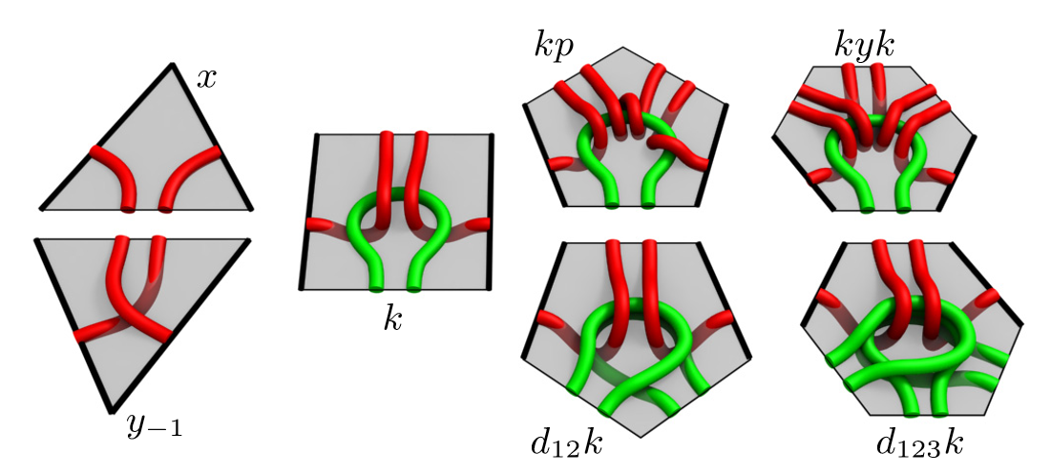
Generating Knitted Meshes
Stitch Mesh: abstraction used to interactively create knitted design
  Handles increases, decreases
[Yuksel et al. 2012]

Slide 47
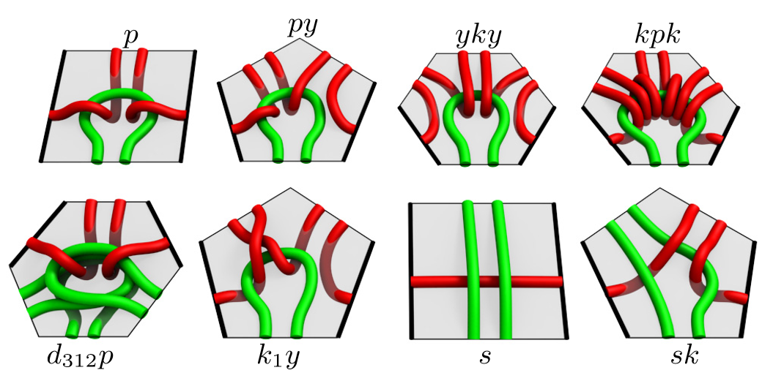
Generating Knitted Meshes
Stitch Mesh: abstraction used to interactively create knitted design
  Allows for choosing stitch types
[Yuksel et al. 2012]

Slide 48
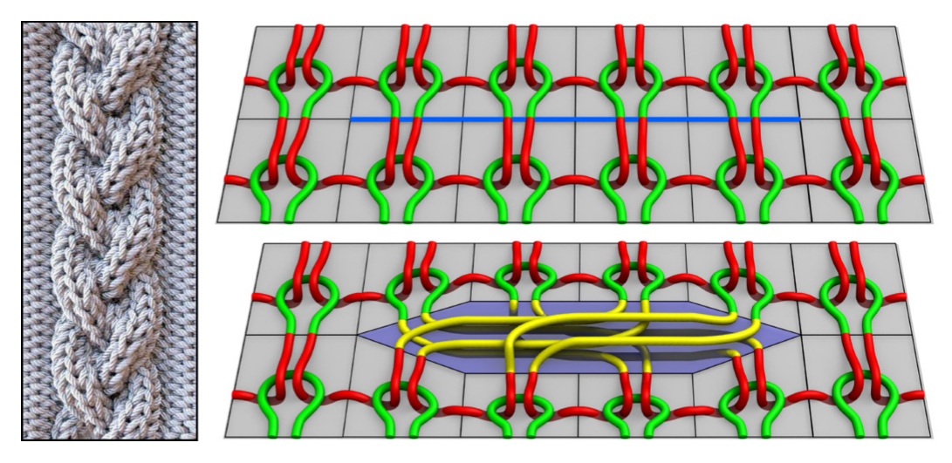
Generating Knitted Meshes
Stitch Mesh: abstraction used to interactively create knitted design
  Can even handle complex stitch patterns, like cables
[Yuksel et al. 2012]

Slide 49
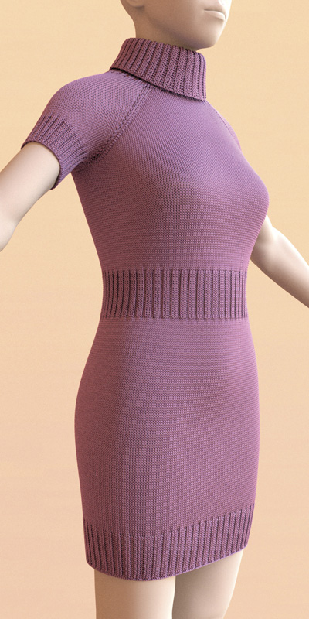
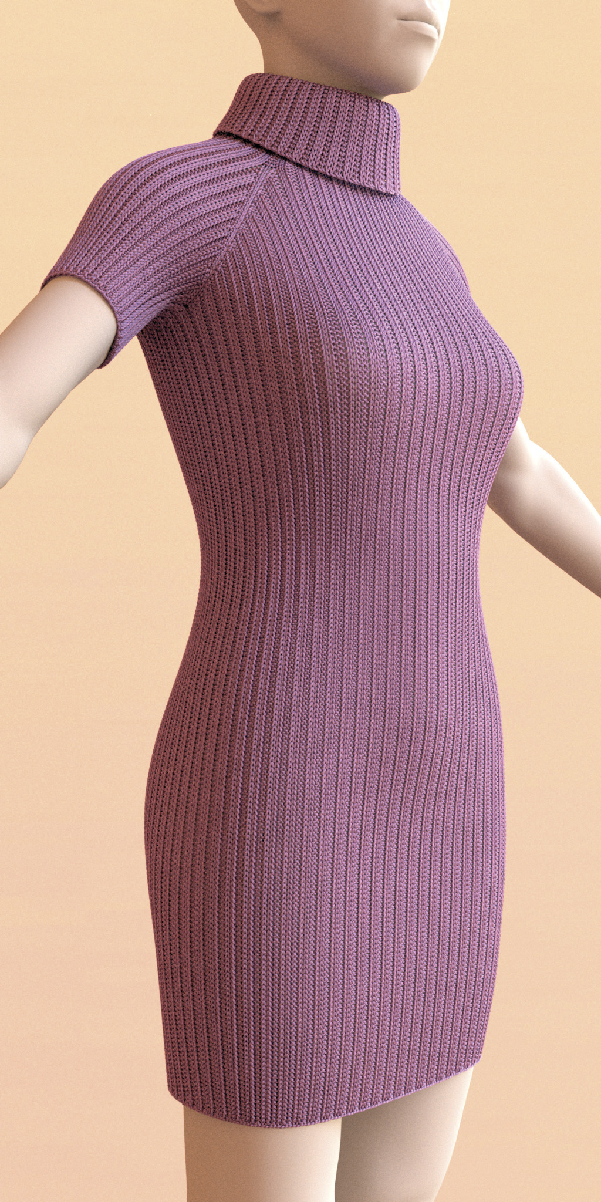
Generating Knitted Meshes – Results
[Yuksel et al. 2012]

Slide 50
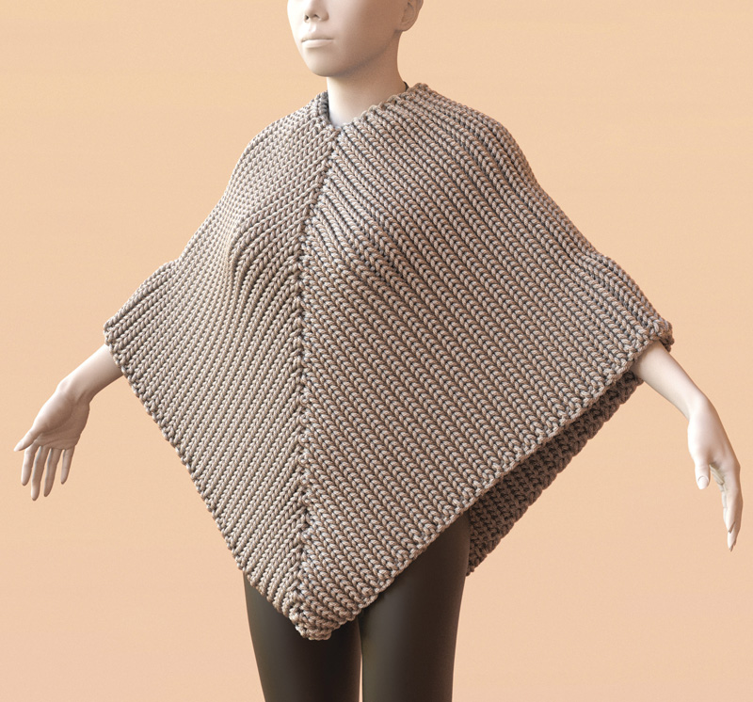
Generating Knitted Meshes – Results
[Yuksel et al. 2012]

Slide 51
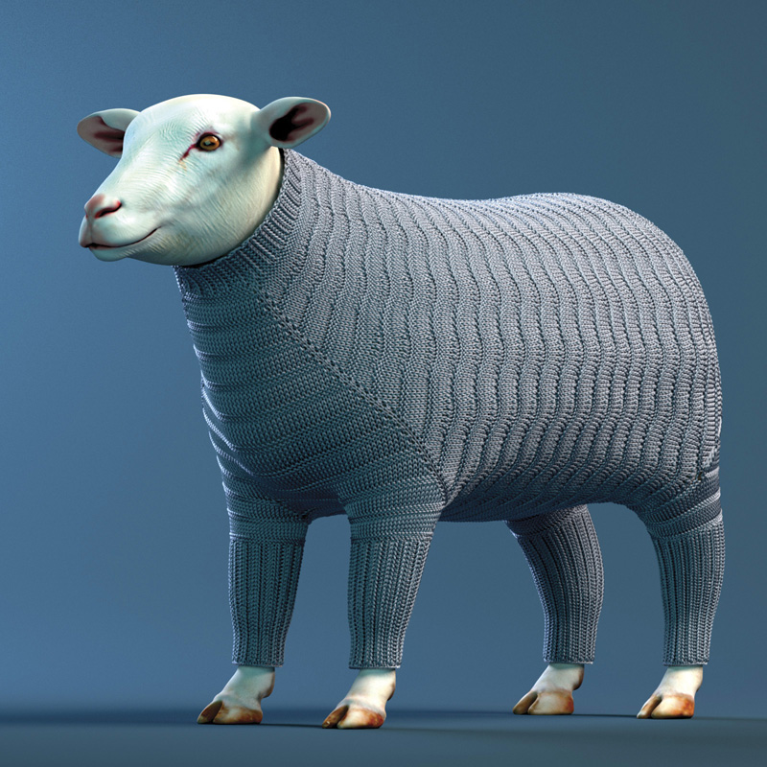
Generating Knitted Meshes – Results
[Yuksel et al. 2012]

Slide 52
Overview
Introduction
Modeling Yarn-Based Cloth
Applications
  Generating knitted curves
  Knitting machines

Slide 53

A Compiler for 3D Machine Knitting
[https://youtu.be/D-kpy44tB4M]

Slide 54
References
CIRIO, G., LOPEZ-MORENO, J., MIRAUT, D., AND OTADUY, M. A. 2014. Yarn-level simulation of woven cloth. ACM Transactions on Graphics (TOG) 33, 6, 207.
CIRIO, G., LOPEZ-MORENO, J., AND OTADUY, M. A. 2015. Efficient simulation of knitted cloth using persistent contacts. In Proc. of the ACM SIGGRAPH / Eurographics Symposium on Computer Animation.
CIRIO, G., LOPEZ-MORENO, J., AND OTADUY, M. 2016. Yarn-level cloth simulation with sliding persistent contacts. IEEE Transactions on Visualization and Computer Graphics.
KALDOR, J. M., JAMES, D. L., AND MARSCHNER, S. 2008. Simulating knitted cloth at the yarn level. In ACM Transactions on Graphics (TOG), vol. 27, ACM, 65.
KALDOR, J. M., JAMES, D. L., AND MARSCHNER, S. 2010. Efficient yarn-based cloth with adaptive contact linearization. In ACM Transactions on Graphics (TOG), vol. 29, ACM, 105.
MCCANN, J., ALBAUGH, L., NARAYANAN, V., GROW, A., MATUSIK, W., MANKOFF, J., AND HODGINS, J. 2016. A compiler for 3d machine knitting. ACM Transactions on Graphics (TOG) 35, 4, 49.
YUKSEL, C., KALDOR, J. M., JAMES, D. L., AND MARSCHNER, S. 2012. Stitch meshes for modeling knitted clothing with yarn-level detail. ACM Transactions on Graphics (TOG) 31, 4, 37.
ZHAO, S., LUAN, F., AND BALA, K. 2016. Fitting procedural yarn models for realistic cloth rendering. ACM Transactions on Graphics (TOG) 35, 4, 51.

