Slide 1
CSMC 412
Operating Systems
Prof. Ashok K Agrawala
Memory Management
Online Set 1

Slide 2
Memory Management
Background
Swapping
Contiguous Memory Allocation
Segmentation
Paging
Structure of the Page Table

Slide 3
CPU and Memory
Basic architecture of a computer system requires the CPU and the main memory
All programs and data accessed by the CPU during the execution of instructions is either in the registers or in the main memory
For the discussion here we are going to ignore the presence of Cache Memory which many CPUs have today and whose presence is managed by the hardware transparently
For executing an instruction
Instruction has to be fetched from the memory
Operand(s) have to be fetched from the memory – if so required
Results may have to be stored in memory – if so required
CPU may make multiple memory accesses for each instruction

Slide 4
Background
Program must be brought (from disk) into memory and placed within a process for it to be run
Main memory and registers are only storage CPU can access directly
Memory unit only sees a stream of addresses + read requests, or address + data and write requests
Register access in one CPU clock (or less)
Main memory can take many cycles, causing a stall
Cache sits between main memory and CPU registers
Protection of memory required to ensure correct operation

Slide 5
View of the memory
An array of cells
Each cell can store several bits (cell width)
8- Byte
16 – Half Word
32 – Word
..
Cells are organized as a linear array with each cell having a unique address
A memory cell is accessed by the CPU by presenting the address of the cell to the memory controller

Slide 6
Address Space
Address Space
$$2^{n}−1$$
The address of a cell consists of say n bits. This gives 2^{n} unique addresses, from 0 to (2^{n} -1)
We can view this address space in any logical organization we desire, treating any number of contiguous cells as a group.
When the number of such cells in a group is a power of 2 then the address can be decomposed easily into the group number and the cell within the group
n bit address
n
k
0
$$2^{k}−1$$
0

Slide 7
Desirable Features
Very large address space
Ability to execute partially loaded programs
Dynamic Relocatability
Sharing
Protection
Achieving these features require a variety of hardware and software support

Slide 8
Binding and Multiple Mappings
Address Space B
Binding
Associating an address to a location in an address space
Mapping
Translating one address to another address
Each address is defined in an address space
Mapping one address space to another address space
Mapping is never done on Byte by Byte
A contagious portion is mapped on to a contagious portion
Address Space A

Slide 9
Address Binding
Programs on disk, ready to be brought into memory to execute form an input queue
Without support, must be loaded into address 0000
Inconvenient to have first user process physical address always at 0000
How can it not be?
Further, addresses represented in different ways at different stages of a program’s life
Source code addresses usually symbolic
Compiled code addresses bind to relocatable addresses
i.e. “14 bytes from beginning of this module”
Linker or loader will bind relocatable addresses to absolute addresses
i.e. 74014
Each binding maps one address space to another

Slide 10
Binding of Instructions and Data to Memory
Address binding of instructions and data to memory addresses can happen at three different stages
Compile time: If memory location known a priori, absolute code can be generated; must recompile code if starting location changes
Load time: Must generate relocatable code if memory location is not known at compile time
Execution time: Binding delayed until run time if the process can be moved during its execution from one memory segment to another
Need hardware support for address maps (e.g., base and limit registers)

Slide 11
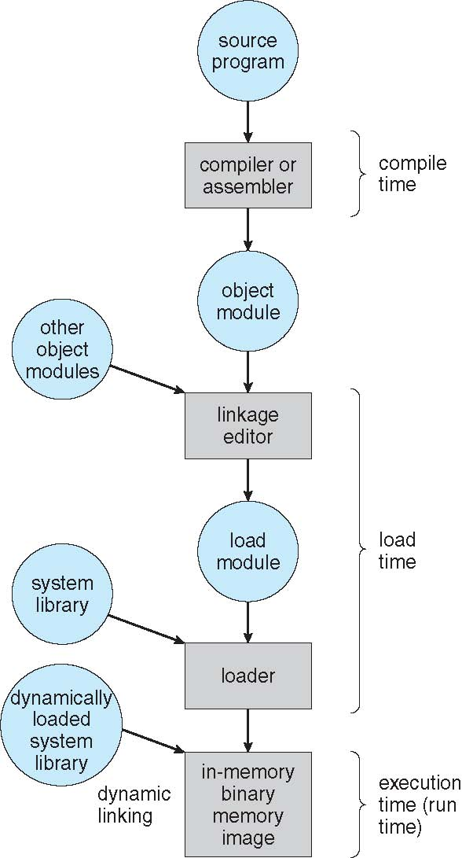
Multistep Processing of a User Program

Slide 12
Dynamic Linking
Static linking – system libraries and program code combined by the loader into the binary program image
Dynamic linking –linking postponed until execution time
Small piece of code, stub, used to locate the appropriate memory-resident library routine
Stub replaces itself with the address of the routine, and executes the routine
Operating system checks if routine is in processes’ memory address
If not in address space, add to address space
Dynamic linking is particularly useful for libraries
System also known as shared libraries

Slide 13
Dynamic Loading
Routine is not loaded until it is called
Better memory-space utilization; unused routine is never loaded
Useful when large amounts of code are needed to handle infrequently occurring cases
No special support from the operating system is required implemented through program design

Slide 14
Overlays
Keep in memory only those instructions and data that are needed at any given time
Needed when process is larger than amount of memory allocated to it
Implemented by user, no special support needed from operating system, programming design of overlay structure is complex

Slide 15
Logical vs. Physical Address Space
The concept of a logical address space that is bound to a separate physical address space is central to proper memory management
Logical address – generated by the CPU; also referred to as virtual address
Physical address – address seen by the memory unit
Logical and physical addresses are the same in compile-time and load-time address-binding schemes; logical (virtual) and physical addresses differ in execution-time address-binding scheme
Logical address space is the set of all logical addresses that can be generated by a program
Physical address space is the set of all physical addresses that can be generated by a program

Slide 16
Memory-Management Unit (MMU)
Hardware device that at run time maps virtual to physical address
Many methods possible, covered in the rest of this chapter
To start, consider simple scheme where the value in the relocation register is added to every address generated by a user process at the time it is sent to memory
Base register now called relocation register
MS-DOS on Intel 80x86 used 4 relocation registers
The user program deals with logical addresses; it never sees the real physical addresses
Execution-time binding occurs when reference is made to location in memory
Logical address bound to physical addresses

Slide 17
Swapping
A process can be swapped temporarily out of memory to a backing store, and then brought back into memory for continued execution
Total physical memory space of processes can exceed physical memory
Backing store – fast disk large enough to accommodate copies of all memory images for all users; must provide direct access to these memory images
Roll out, roll in – swapping variant used for priority-based scheduling algorithms; lower-priority process is swapped out so higher-priority process can be loaded and executed
Major part of swap time is transfer time; total transfer time is directly proportional to the amount of memory swapped
System maintains a ready queue of ready-to-run processes which have memory images on disk

Slide 18
Swapping (Cont.)
Does the swapped out process need to swap back in to same physical addresses?
Depends on address binding method
Plus consider pending I/O to / from process memory space
Modified versions of swapping are found on many systems (i.e., UNIX, Linux, and Windows)
Swapping normally disabled
Started if more than threshold amount of memory allocated
Disabled again once memory demand reduced below threshold

Slide 19
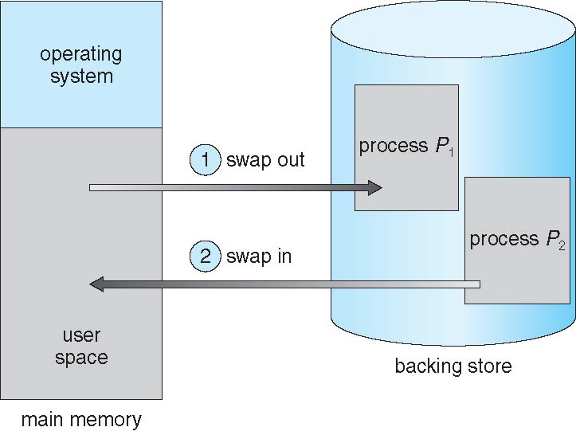
Schematic View of Swapping

Slide 20
Context Switch Time including Swapping
If next processes to be put on CPU is not in memory, need to swap out a process and swap in target process
Context switch time can then be very high
100MB process swapping to hard disk with transfer rate of 50MB/sec
Swap out time of 2000 ms
Plus swap in of same sized process
Total context switch swapping component time of 4000ms (4 seconds)
Can reduce if reduce size of memory swapped – by knowing how much memory really being used
System calls to inform OS of memory use via request_memory() and release_memory()

Slide 21
Context Switch Time and Swapping (Cont.)
Other constraints as well on swapping
Pending I/O – can’t swap out as I/O would occur to wrong process
Or always transfer I/O to kernel space, then to I/O device
Known as double buffering, adds overhead
Standard swapping not used in modern operating systems
But modified version common
Swap only when free memory extremely low

Slide 22
Contiguous Allocation
Main memory must support both OS and user processes
Limited resource, must allocate efficiently
Contiguous allocation is one early method
Main memory usually into two partitions:
Resident operating system, usually held in low memory with interrupt vector
User processes then held in high memory
Each process contained in single contiguous section of memory

Slide 23
Contiguous Allocation (Cont.)
Relocation registers used to protect user processes from each other, and from changing operating-system code and data
Base register contains value of smallest physical address
Limit register contains range of logical addresses – each logical address must be less than the limit register
MMU maps logical address dynamically
Can then allow actions such as kernel code being transient and kernel changing size

Slide 24
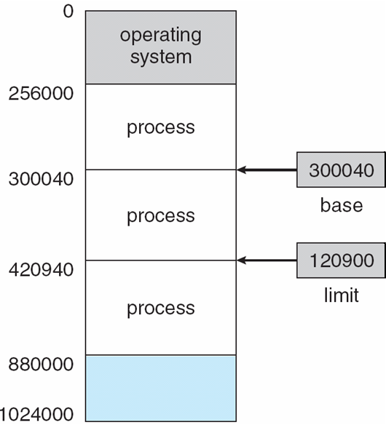
Base and Limit Registers
A pair of base and limit registers define the logical address space
CPU must check every memory access generated in user mode to be sure it is between base and limit for that user

Slide 25
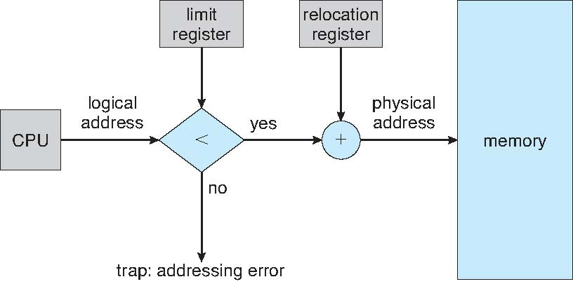
Hardware Support for Relocation and Limit Registers

Slide 26
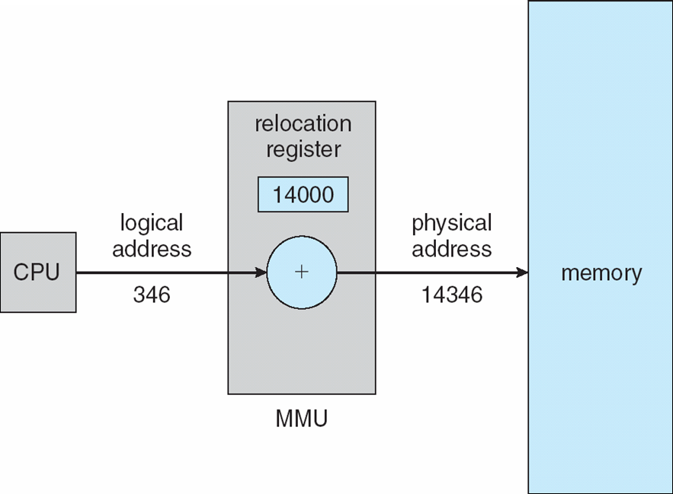
Dynamic relocation using a relocation register
Routine is not loaded until it is called
Better memory-space utilization; unused routine is never loaded
All routines kept on disk in relocatable load format
Useful when large amounts of code are needed to handle infrequently occurring cases
No special support from the operating system is required
Implemented through program design
OS can help by providing libraries to implement dynamic loading

Slide 27
Multiple-partition allocation
Degree of multiprogramming limited by number of partitions
Variable-partition sizes for efficiency (sized to a given process’ needs)
Hole – block of available memory; holes of various size are scattered throughout memory
When a process arrives, it is allocated memory from a hole large enough to accommodate it
Process exiting frees its partition, adjacent free partitions combined
Operating system maintains information about: a) allocated partitions b) free partitions (hole)

Slide 28
Dynamic Storage-Allocation Problem
How to satisfy a request of size n from a list of free holes?
First-fit: Allocate the first hole that is big enough
Best-fit: Allocate the smallest hole that is big enough; must search entire list, unless ordered by size
Produces the smallest leftover hole
Worst-fit: Allocate the largest hole; must also search entire list
Produces the largest leftover hole
First-fit and best-fit better than worst-fit in terms of speed and storage utilization

Slide 29
Fragmentation
External Fragmentation – total memory space exists to satisfy a request, but it is not contiguous
Internal Fragmentation – allocated memory may be slightly larger than requested memory; this size difference is memory internal to a partition, but not being used
First fit analysis reveals that given N blocks allocated, 0.5 N blocks lost to fragmentation
1/3 may be unusable -> 50-percent rule

Slide 30
Fragmentation (Cont.)
Reduce external fragmentation by compaction
Shuffle memory contents to place all free memory together in one large block
Compaction is possible only if relocation is dynamic, and is done at execution time
I/O problem
Latch job in memory while it is involved in I/O
Do I/O only into OS buffers
Now consider that backing store has same fragmentation problems

