Slide 1
CSMC 412
Operating Systems
Prof. Ashok K Agrawala
Memory Management - II
Online Set 2

Slide 2
Memory Management Schemes from I
The logical address space of a process must be resident in the physical memory when this process is executing
Desirable Features:
  Very large address space
  Ability to execute partially loaded programs
  Dynamic Relocatability
  Sharing
  Protection

Slide 3
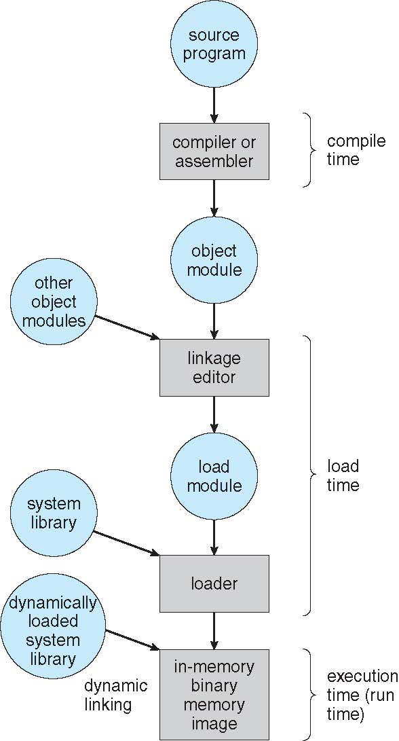
Programmers View
0
Each Module starts with address 0
When linking/loading start from 0 again but only one module can be at location 0. Others have to be relocated.
What if each module was treated independently.
A
B
C
D
0
A
B
C
D

Slide 4
Logical Address Space
Single linear address space
  Address is (d) where d is a number between 0 and 2^{k} – 1, when address uses k bits.
Segmented
  Logical address space consists of a collection of segments where each segment is an independent linear address space
  Address now consists of (s,d) where s is the segment identifier and d an address in the linear address space of the segment
0
A
B
C
D
0
A
B
C
D

Slide 5
Segmentation
Memory-management scheme that supports user view of memory
A program is a collection of segments
  A segment is a logical unit such as:
main program
procedure
function
method
object
local variables, global variables
common block
stack
symbol table
arrays

Slide 6
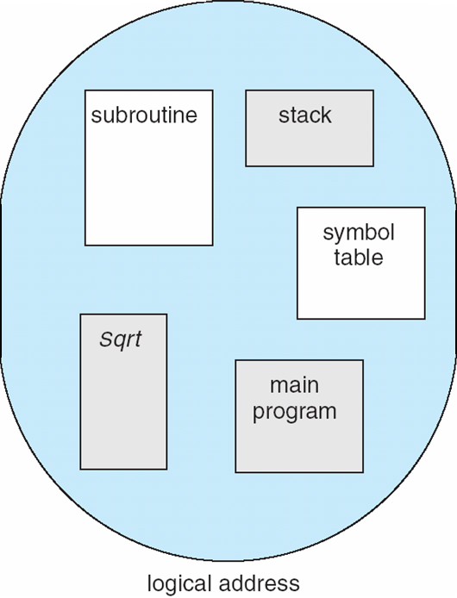
User’s View of a Program

Slide 7
Logical View of Segmentation
1
1
4
2
3
4
2
3
user space
physical memory space

Slide 8
Segmentation Architecture
Logical address consists of a two tuple:
<segment-number, offset>,
Segment table – maps two-dimensional physical addresses; each table entry has:
  base – contains the starting physical address where the segments reside in memory
  limit – specifies the length of the segment
Segment-table base register (STBR) points to the segment table’s location in memory
Segment-table length register (STLR) indicates number of segments used by a program;
segment number s is legal if s < STLR

Slide 9
Segmentation Architecture (Cont.)
Protection
  With each entry in segment table associate:
    validation bit = 0 ⇒ illegal segment
    read/write/execute privileges
Protection bits associated with segments; code sharing occurs at segment level
Since segments vary in length, memory allocation is a dynamic storage-allocation problem
A segmentation example is shown in the following diagram

Slide 10
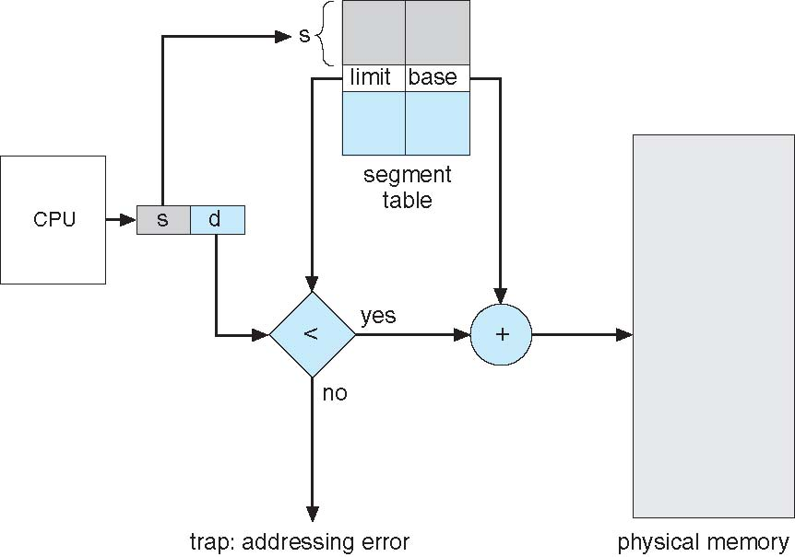
Segmentation Hardware

Slide 11
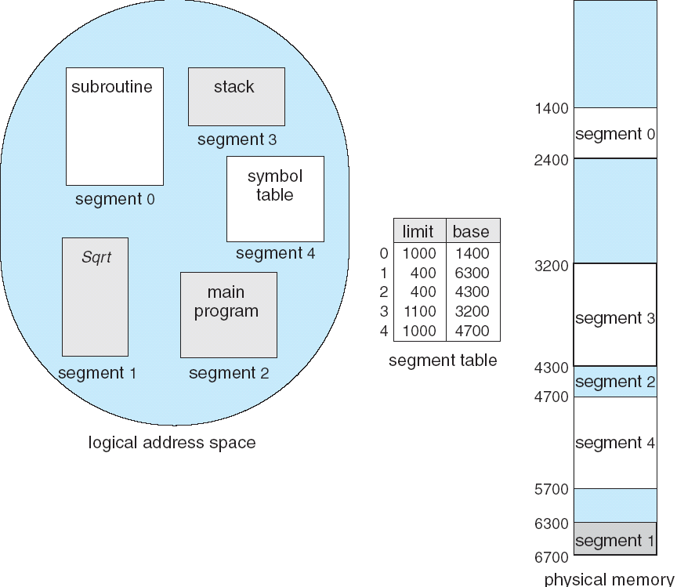
Example of Segmentation

Slide 12
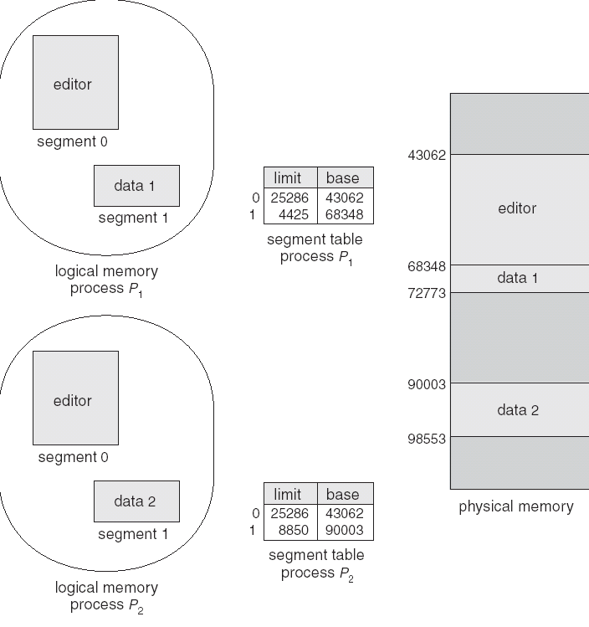
Sharing of Segments

Slide 13
Paging
Used to map a linear, contigious Logical Address Space on to (linear) Physical Address Space
View physical memory consisting of fixed-sized blocks called frames
  Size is power of 2, between 512 bytes and 16 Mbytes
View logical memory consisting of blocks of same size called pages
To run a program of size N pages, need to find N free frames and load program
Set up a page table to translate logical to physical addresses

Slide 14
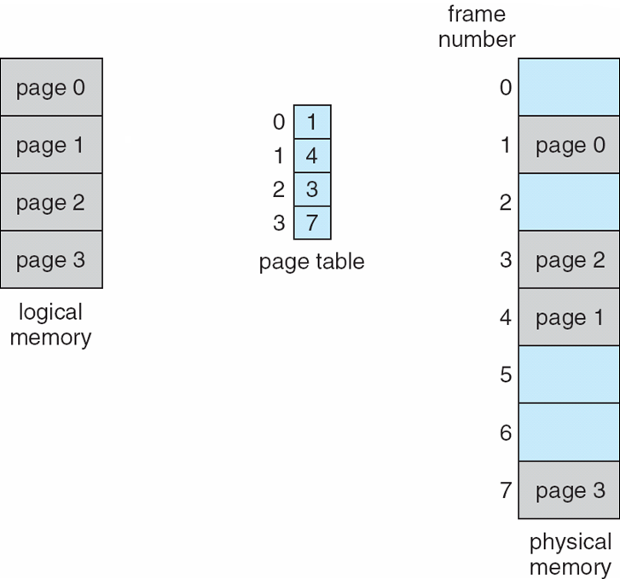
Paging Model of Logical and Physical Memory

Slide 15
Address Translation Scheme
Address generated by CPU is divided into:
  Page number (p) – used as an index into a page table which contains base address of each page in physical memory
  Page offset (d) – combined with base address to define the physical memory address that is sent to the memory unit
  For given logical address space 2^{m} and page size 2^{n}

Slide 16
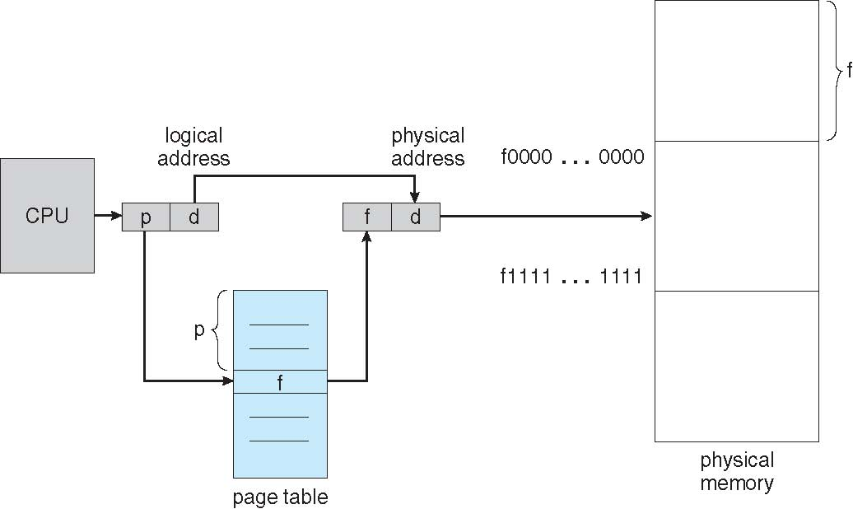
Paging Hardware

Slide 17
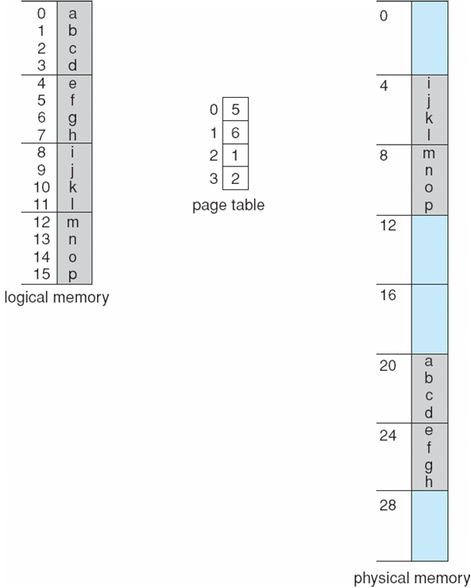
Paging Example
n=2 and m=4 32-byte memory and 4-byte pages

Slide 18
Paging (Cont.)
Calculating internal fragmentation
  Page size = 2,048 bytes
  Process size = 72,766 bytes
  35 pages + 1,086 bytes
  Internal fragmentation of 2,048 - 1,086 = 962 bytes
  Worst case fragmentation = 1 frame – 1 byte
  On average fragmentation = 1 / 2 frame size
  So small frame sizes desirable?
  But each page table entry takes memory to track
  Page sizes growing over time
    Solaris supports two page sizes – 8 KB and 4 MB
Process view and physical memory now very different
By implementation process can only access its own memory

Slide 19
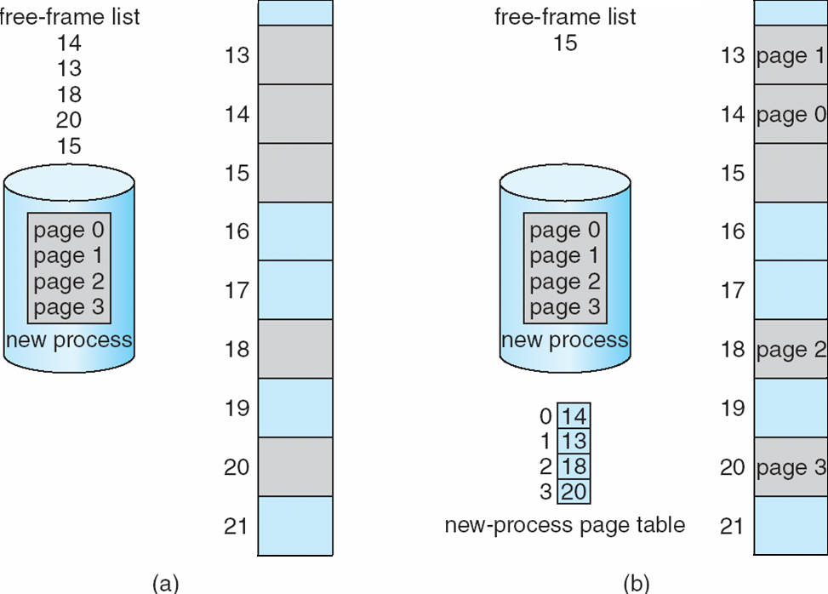
Free Frames
Before allocation
After allocation

Slide 20
Implementation of Page Table
Page table is kept in main memory
Page-table base register (PTBR) points to the page table
Page-table length register (PTLR) indicates size of the page table
In this scheme every data/instruction access requires two memory accesses
  One for the page table and one for the data / instruction
The two memory access problem can be helped some by the use of a special fast-lookup hardware cache called associative memory or translation look-aside buffers (TLBs)

Slide 21
Translation Lookaside Buffer
Keep a list of translations
Provide means for fast look up
Page #
Frame #
Page #
Frame #
Page #
Frame #
Page #
Frame #
Page #
Frame #
Page #
Frame #
Page #
Frame #
Page #
Frame #
Page #
Frame #

Slide 22
Implementation of Page Table (Cont.)
Some TLBs store address-space identifiers (ASIDs) in each TLB entry – uniquely identifies each process to provide address-space protection for that process
  Otherwise need to flush at every context switch
TLBs typically small (64 to 1,024 entries)
On a TLB miss, value is loaded into the TLB for faster access next time
  Replacement policies must be considered
  Some entries can be wired down for permanent fast access

Slide 23
Associative Memory
Associative memory – parallel search
Address translation (p, d)
  If p is in associative register, get frame # out
  Otherwise get frame # from page table in memory

Slide 24
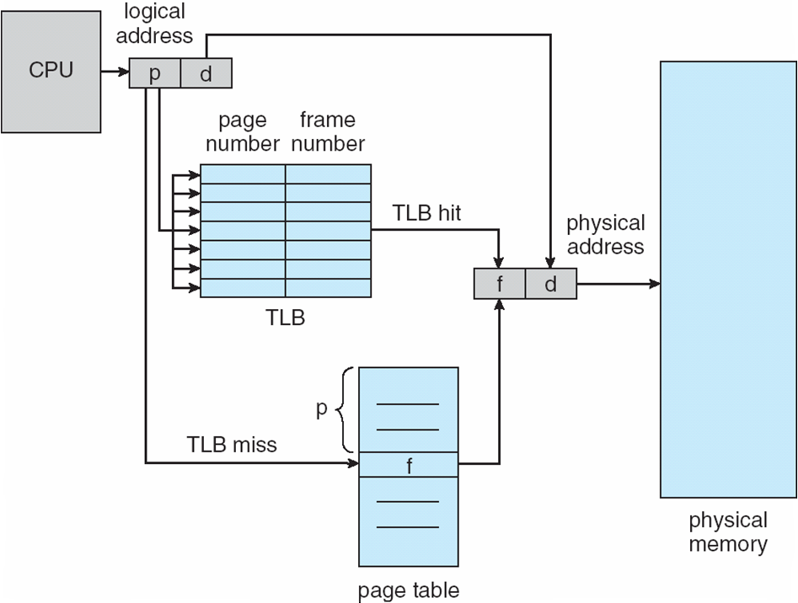
Paging Hardware With TLB

Slide 25
Effective Access Time
Associative Lookup = ε time unit
  Can be < 10% of memory access time
Hit ratio = α
  Hit ratio – percentage of times that a page number is found in the associative registers; ratio related to number of associative registers
Consider α = 80%, ε = 20ns for TLB search, 100ns for memory access
  The time for accessing TLB is often ignored as it is overlapped with memory access.
Effective Access Time (EAT)
Consider α = 80%, ε = 20ns for TLB search, 100ns for memory access
  EAT = 0.80 x 100 + 0.20 x 200 = 120ns
Consider more realistic hit ratio -> α = 99%, ε = 20ns for TLB search, 100ns for memory access
  EAT = 0.99 x 100 + 0.01 x 200 = 101ns

Slide 26
Memory Protection
Memory protection implemented by associating protection bit with each frame to indicate if read-only or read-write access is allowed
  Can also add more bits to indicate page execute-only, and so on
Valid-invalid bit attached to each entry in the page table:
  “valid” indicates that the associated page is in the process’ logical address space, and is thus a legal page
  “invalid” indicates that the page is not in the process’ logical address space
  Or use page-table length register (PTLR)
Any violations result in a trap to the kernel

Slide 27
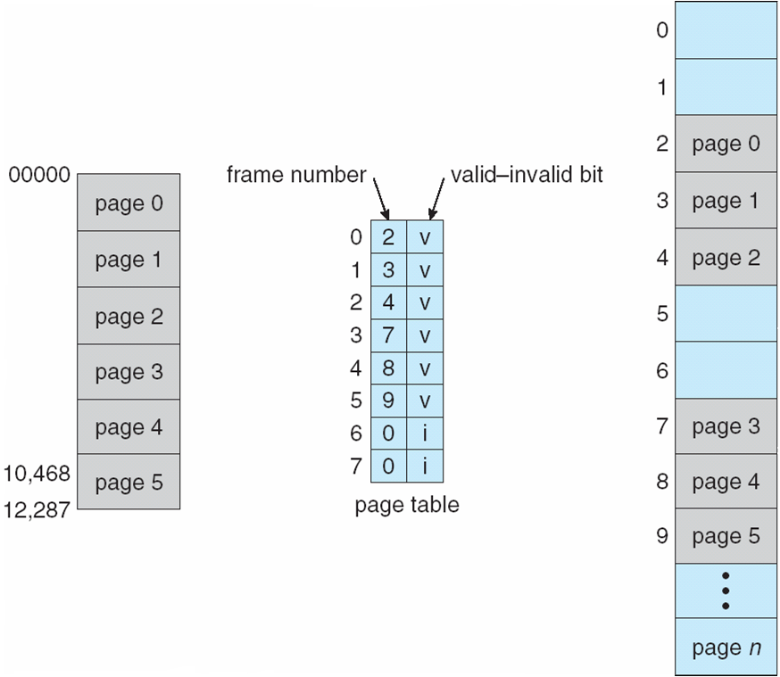
Valid (v) or Invalid (i) Bit In A Page Table

Slide 28
Shared Pages
Shared code
  One copy of read-only (reentrant) code shared among processes (i.e., text editors, compilers, window systems)
  Similar to multiple threads sharing the same process space
  Also useful for interprocess communication if sharing of read-write pages is allowed
Private code and data
  Each process keeps a separate copy of the code and data
  The pages for the private code and data can appear anywhere in the logical address space

