Slide 1
CSMC 412
Operating Systems
Prof. Ashok K Agrawala
Memory Management - III
Online Set3

Slide 2
Memory Management Schemes from II
Segmentation
Paging
Address Translation Mechanisms
Desirable Features:
  Very large address space
  Ability to execute partially loaded programs
  Dynamic Relocatability
  Sharing
  Protection

Slide 3
Shared Pages
Shared code
  One copy of read-only (reentrant) code shared among processes (i.e., text editors, compilers, window systems)
  Similar to multiple threads sharing the same process space
  Also useful for interprocess communication if sharing of read-write pages is allowed
Private code and data
  Each process keeps a separate copy of the code and data
  The pages for the private code and data can appear anywhere in the logical address space

Slide 4
Shared Code
0
Editor
2000
0
4000
1000
5000
5100
7000
1100
5100
5100
1100
2000

Slide 5
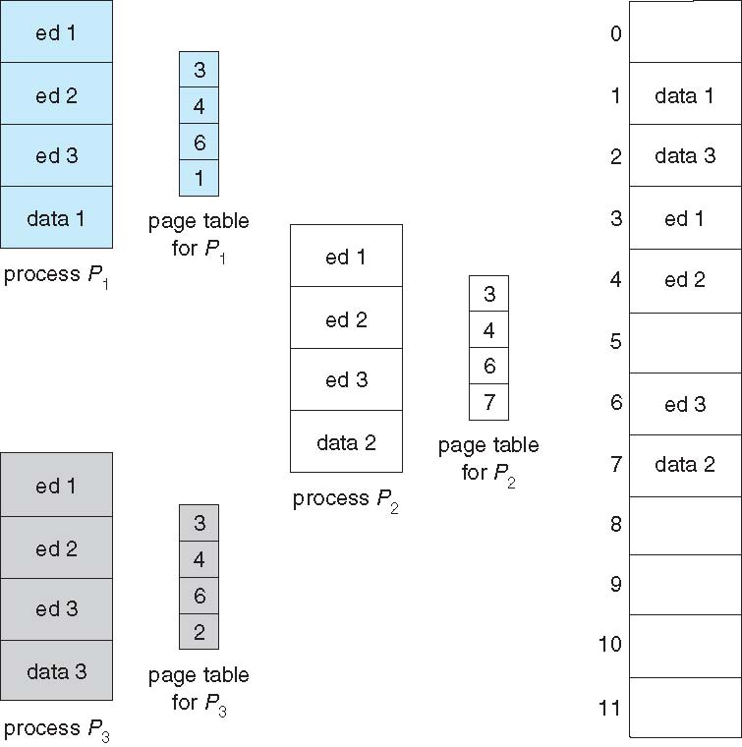
Shared Pages Example

Slide 6
Structure of the Page Table
Memory structures for paging can get huge using straight-forward methods
  Consider a 32-bit logical address space as on modern computers
  Page size of 4 KB (2¹²)
  Page table would have 1 million entries (2³² / 2¹²)
  If each entry is 4 bytes -> 4 MB of physical address space / memory for page table alone
    That amount of memory used to cost a lot
    Don’t want to allocate that contiguously in main memory
Hierarchical Paging
Hashed Page Tables
Inverted Page Tables

Slide 7
Hierarchical Page Tables
Break up the logical address space into multiple page tables
A simple technique is a two-level page table
We then page the page table

Slide 8
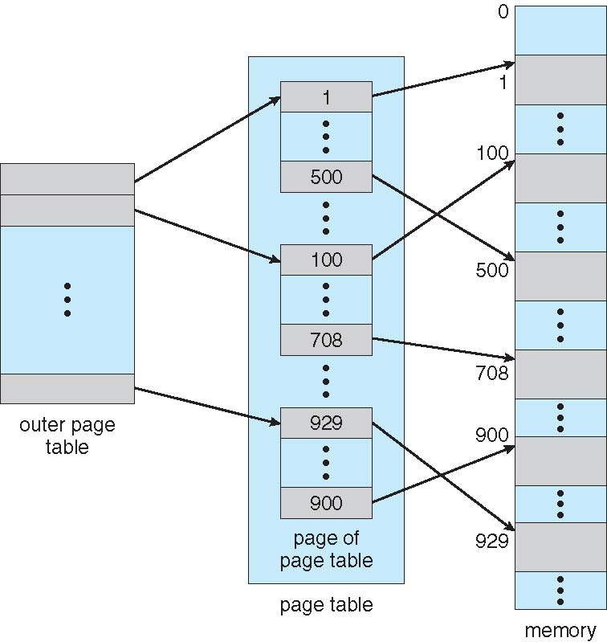
Two-Level Page-Table Scheme

Slide 9
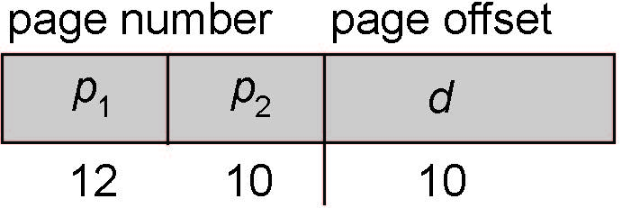
Two-Level Paging Example
A logical address (on 32-bit machine with 1K page size) is divided into:
  a page number consisting of 22 bits
  a page offset consisting of 10 bits
Since the page table is paged, the page number is further divided into:
  a 12-bit page number
  a 10-bit page offset
Thus, a logical address is as follows:
where p₁ is an index into the outer page table, and p₂ is the displacement within the page of the inner page table
Known as forward-mapped page table

Slide 10
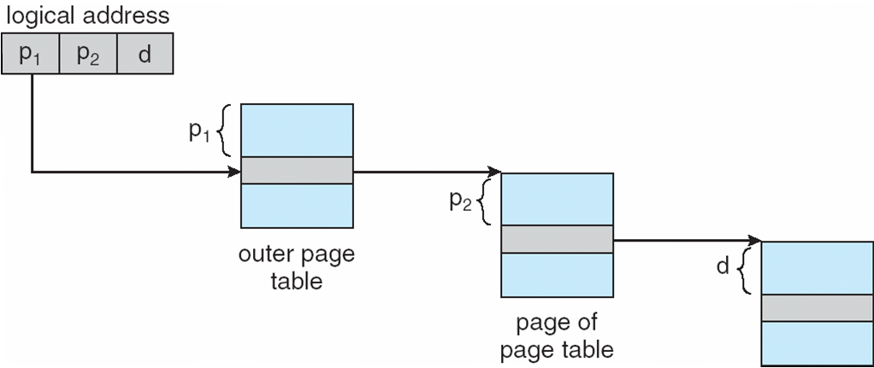
Address-Translation Scheme

Slide 11
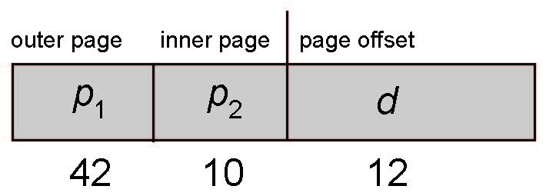
64-bit Logical Address Space
Even two-level paging scheme not sufficient
If page size is 4 KB (2¹²)
  Then page table has 2⁵² entries
  If two level scheme, inner page tables could be 2¹⁰ 4-byte entries
  Address would look like
  Outer page table has 2⁴² entries or 2⁴⁴ bytes
  One solution is to add a 2nd outer page table
  But in the following example the 2nd outer page table is still 2³⁴ bytes in size
    And possibly 4 memory access to get to one physical memory location

Slide 12
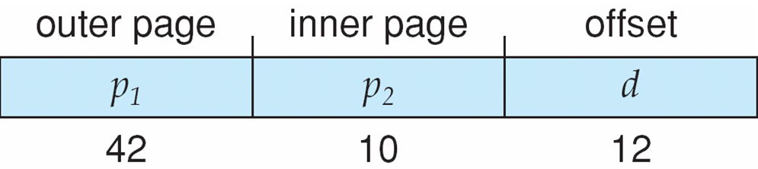
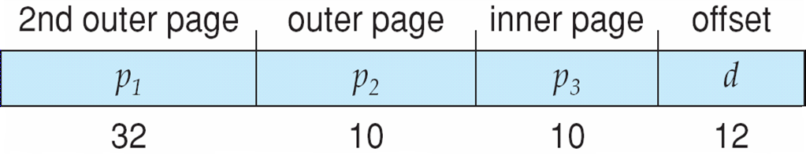
Three-level Paging Scheme

Slide 13
Hashed Page Tables
Common in address spaces > 32 bits
The virtual page number is hashed into a page table
  This page table contains a chain of elements hashing to the same location
Each element contains (1) the virtual page number (2) the value of the mapped page frame (3) a pointer to the next element
Virtual page numbers are compared in this chain searching for a match
  If a match is found, the corresponding physical frame is extracted
Variation for 64-bit addresses is clustered page tables
  Similar to hashed but each entry refers to several pages (such as 16) rather than 1
  Especially useful for sparse address spaces (where memory references are non-contiguous and scattered)

Slide 14
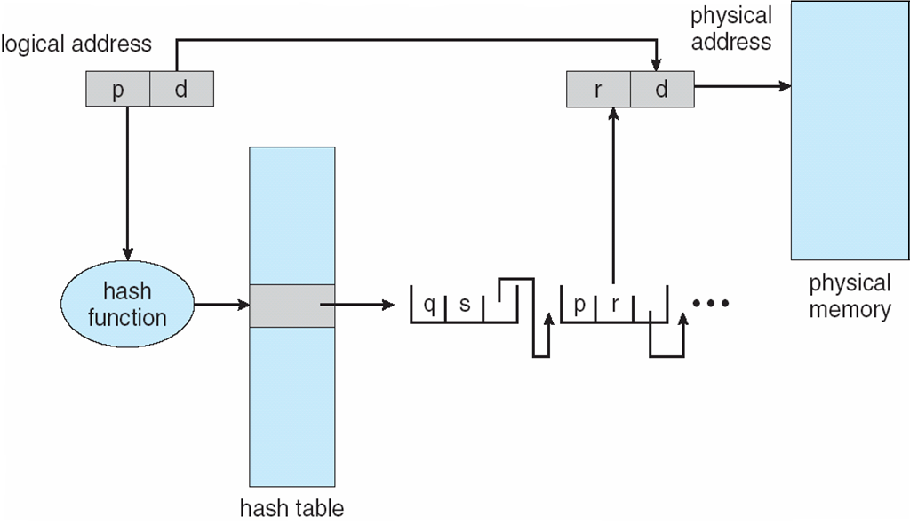
Hashed Page Table

Slide 15
Inverted Page Table
Rather than each process having a page table and keeping track of all possible logical pages, track all physical pages
One entry for each real page of memory
Entry consists of the virtual address of the page stored in that real memory location, with information about the process that owns that page
Decreases memory needed to store each page table, but increases time needed to search the table when a page reference occurs
Use hash table to limit the search to one — or at most a few — page-table entries
  TLB can accelerate access
But how to implement shared memory?
  One mapping of a virtual address to the shared physical address

Slide 16
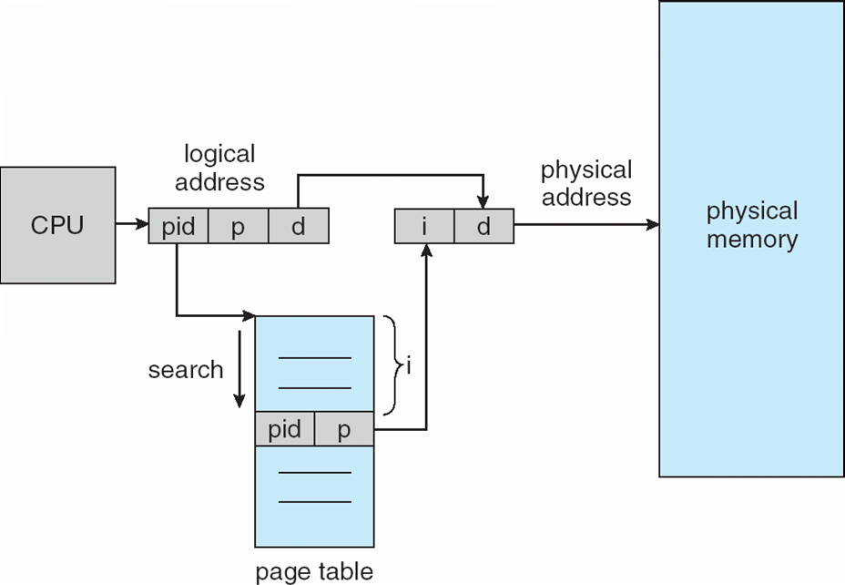
Inverted Page Table Architecture

Slide 17
Example: The Intel 32 and 64-bit Architectures
Dominant industry chips
Pentium CPUs are 32-bit and called IA-32 architecture
Current Intel CPUs are 64-bit and called IA-64 architecture
Many variations in the chips, cover the main ideas here

Slide 18
Example: The Intel IA-32 Architecture
Supports both segmentation and segmentation with paging
  Each segment can be 4 GB
  Up to 16 K segments per process
  Divided into two partitions
    First partition of up to 8 K segments are private to process (kept in local descriptor table (LDT))
    Second partition of up to 8K segments shared among all processes (kept in global descriptor table (GDT))

Slide 19

Example: The Intel IA-32 Architecture (Cont.)
CPU generates logical address
  Selector given to segmentation unit
    Which produces linear addresses
  Linear address given to paging unit
    Which generates physical address in main memory
    Paging units form equivalent of MMU
    Pages sizes can be 4 KB or 4 MB

Slide 20
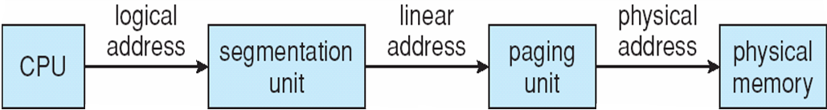
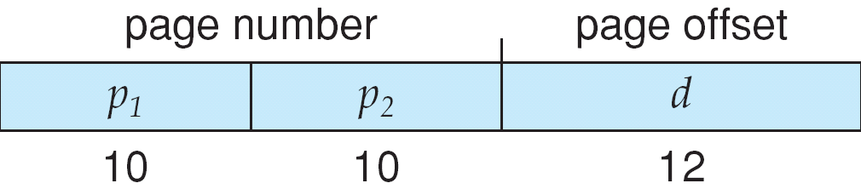
Logical to Physical Address Translation in IA-32

Slide 21
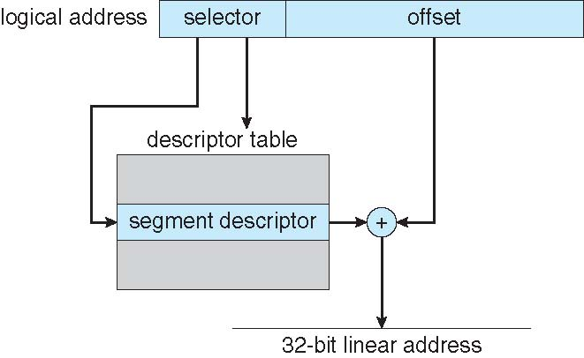
Intel IA-32 Segmentation

Slide 22
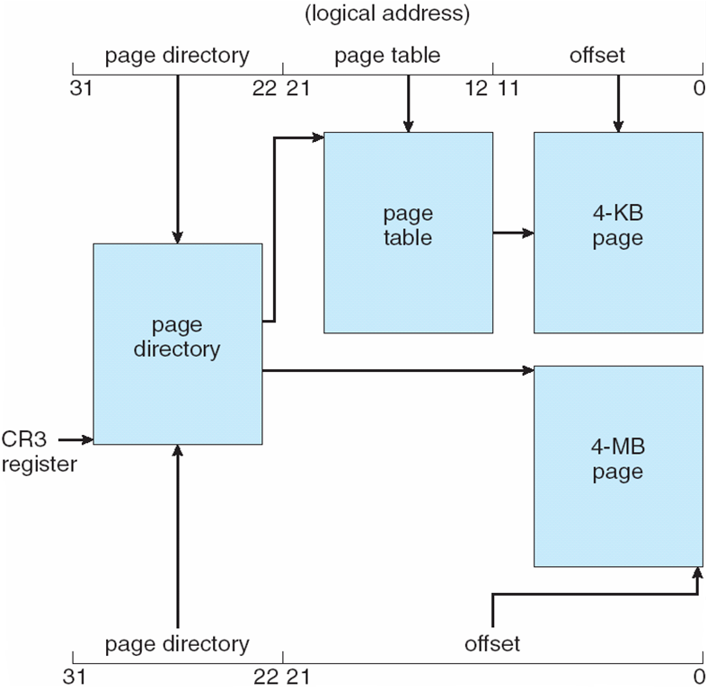
Intel IA-32 Paging Architecture

Slide 23
Intel IA-32 Page Address Extensions
32-bit address limits led Intel to create page address extension (PAE), allowing 32-bit apps access to more than 4GB of memory space
  Paging went to a 3-level scheme
  Top two bits refer to a page directory pointer table
  Page-directory and page-table entries moved to 64-bits in size
  Net effect is increasing address space to 36 bits – 64GB of physical memory

Slide 24
Intel x86-64
Current generation Intel x86 architecture
64 bits is ginormous (> 16 exabytes)
In practice only implement 48 bit addressing
  Page sizes of 4 KB, 2 MB, 1 GB
  Four levels of paging hierarchy
Can also use PAE so virtual addresses are 48 bits and physical addresses are 52 bits

