Slide 1
CSMC 412
Operating Systems
Prof. Ashok K Agrawala
Set 4 Virtual Memory I

Slide 2
Background
Code needs to be in memory to execute, but entire program rarely used
  Error code, unusual routines, large data structures
Entire program code not needed at same time
Consider ability to execute partially-loaded program
  Program no longer constrained by limits of physical memory
  Each program takes less memory while running -> more programs run at the same time
    Increased CPU utilization and throughput with no increase in response time or turnaround time
  Less I/O needed to load or swap programs into memory -> each user program runs faster

Slide 3
Background (Cont.)
Virtual memory – separation of user logical memory from physical memory
  Only part of the program needs to be in memory for execution
  Logical address space can therefore be much larger than physical address space
  Allows address spaces to be shared by several processes
  Allows for more efficient process creation
  More programs running concurrently
  Less I/O needed to load or swap processes

Slide 4
Background (Cont.)
Virtual address space – logical view of how process is stored in memory
  Usually start at address 0, contiguous addresses until end of space
  Meanwhile, physical memory organized in page frames
  MMU must map logical to physical
Virtual memory can be implemented via:
  Demand paging
  Demand segmentation

Slide 5
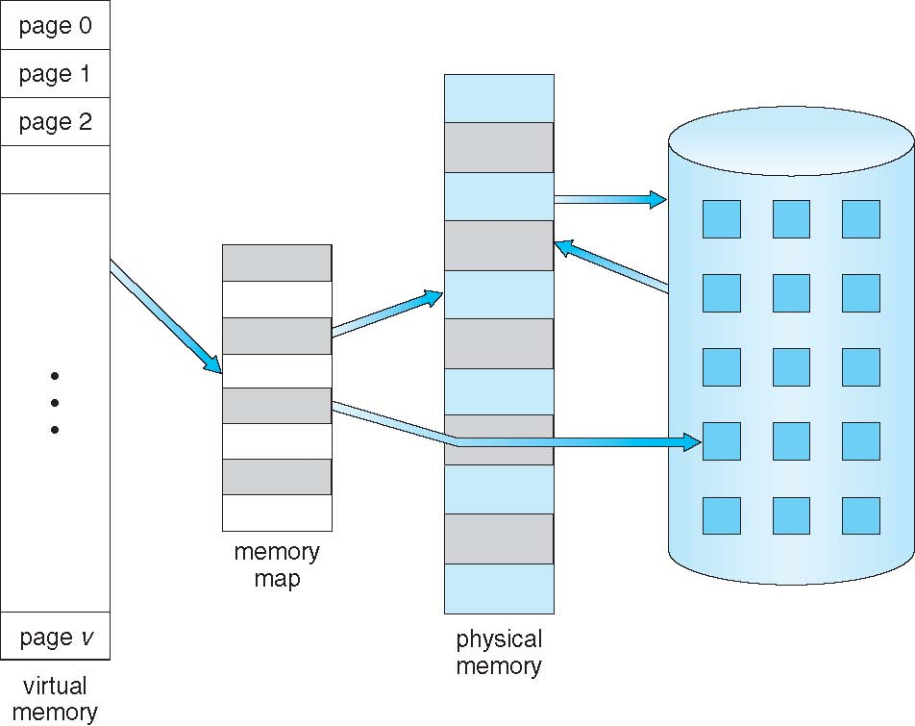
Virtual Memory That is Larger Than Physical Memory

Slide 6
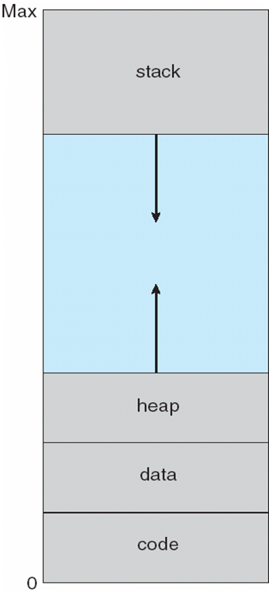
Virtual-address Space
Usually design logical address space for stack to start at Max logical address and grow “down” while heap grows “up”
  Maximizes address space use
  Unused address space between the two is hole
    No physical memory needed until heap or stack grows to a given new page
Enables sparse address spaces with holes left for growth, dynamically linked libraries, etc
System libraries shared via mapping into virtual address space
Shared memory by mapping pages read-write into virtual address space
Pages can be shared during fork(), speeding process creation

Slide 7
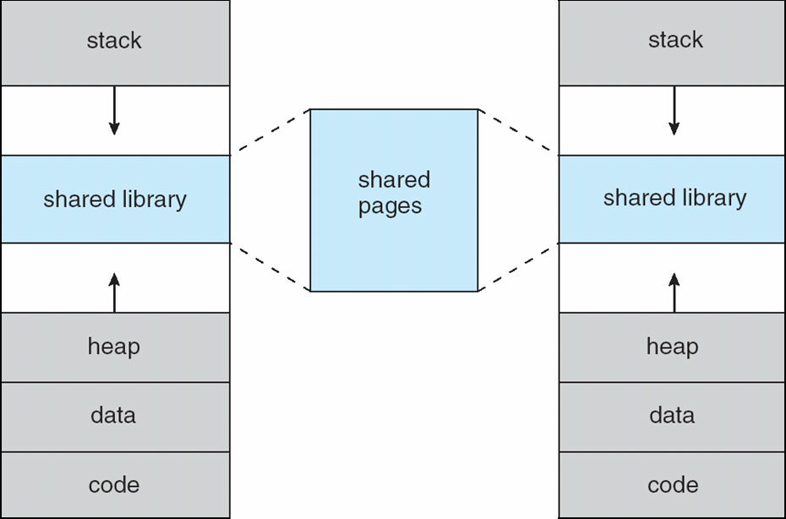
Shared Library Using Virtual Memory

Slide 8
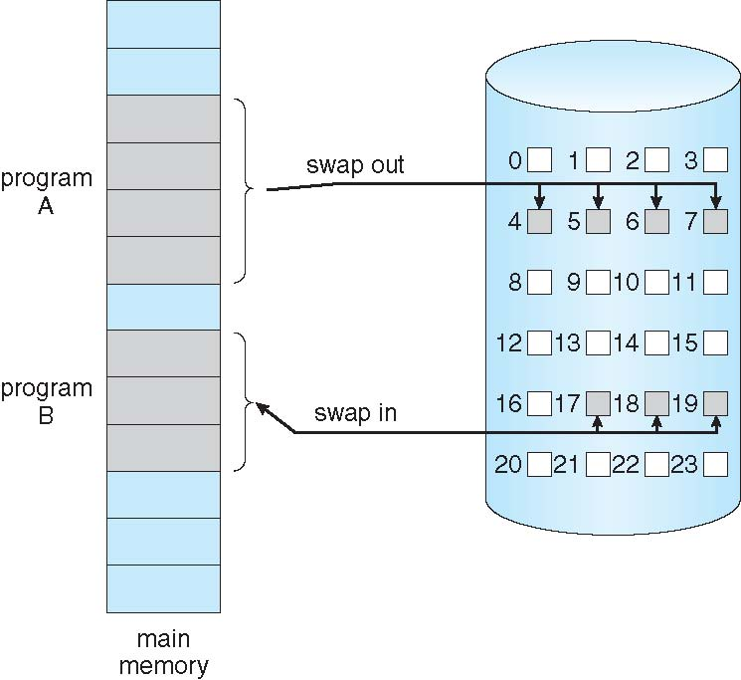
Swapping Using Paging
Could bring entire process into memory at load time
Like paging system with swapping
No external fragmentation

Slide 9
Demand Paging
Bring a page into memory only when it is needed
  Less I/O needed, no unnecessary I/O
  Less memory needed
  Faster response
  More users
Page is needed ⇒ reference to it
  invalid reference ⇒ abort
  not-in-memory ⇒ bring to memory
Lazy swapper – never swaps a page into memory unless page will be needed
  Swapper that deals with pages is a pager

Slide 10
Basic Concepts
With swapping, pager guesses which pages will be used before swapping out again
Instead, pager brings in only those pages into memory
How to determine that set of pages?
  Need new MMU functionality to implement demand paging
If pages needed are already memory resident
  No difference from non demand-paging
If page needed and not memory resident
  Need to detect and load the page into memory from storage
    Without changing program behavior
    Without programmer needing to change code

Slide 11
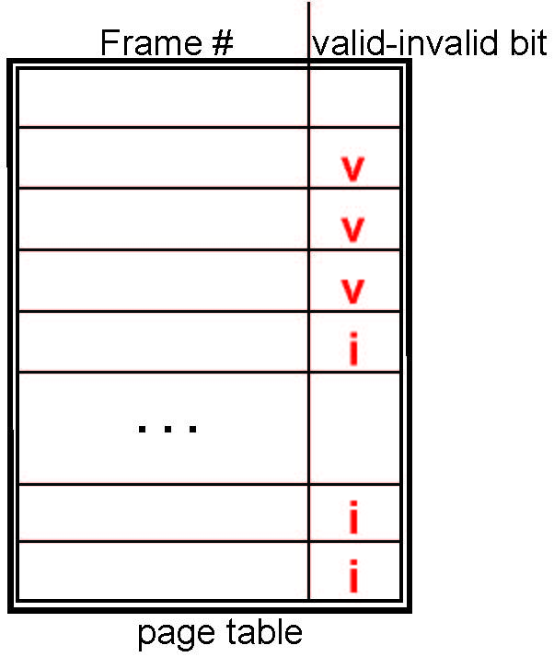
Valid-Invalid Bit
With each page table entry a valid–invalid bit is associated
(v ⇒ in-memory – memory resident, i ⇒ not-in-memory)
Initially valid–invalid bit is set to i on all entries
Example of a page table snapshot:
During MMU address translation, if valid–invalid bit in page table entry is i ⇒ page fault

Slide 12
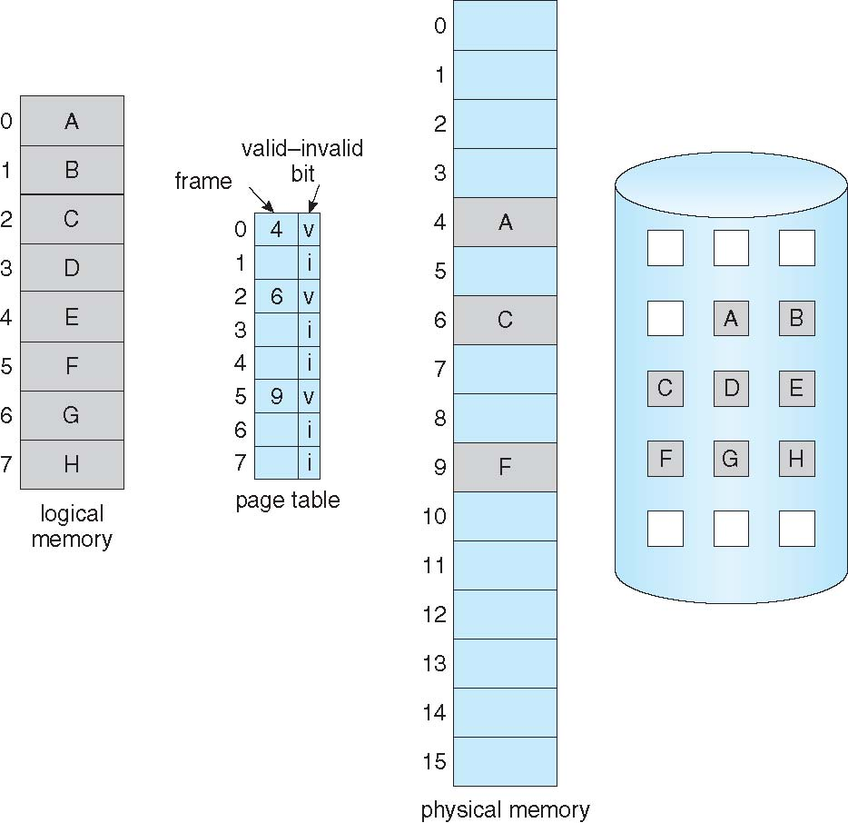
Page Table When Some Pages Are Not in Main Memory

Slide 13
Page Fault
If there is a reference to a page, first reference to that page will trap to operating system:
page fault
Operating system looks at another table to decide:
  Invalid reference ⇒ abort
  Just not in memory
Find free frame
Swap page into frame via scheduled disk operation
Reset tables to indicate page now in memory
Set validation bit = v
Restart the instruction that caused the page fault

Slide 14
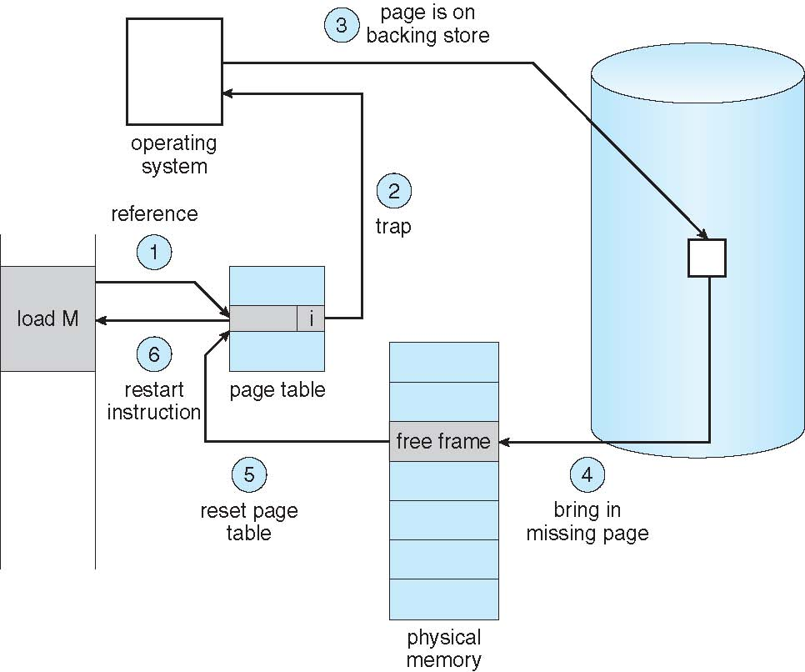
Steps in Handling a Page Fault

Slide 15
Aspects of Demand Paging
Extreme case – start process with no pages in memory
  OS sets instruction pointer to first instruction of process, non-memory-resident -> page fault
  And for every other process pages on first access
  Pure demand paging
A given instruction could access multiple pages -> multiple page faults
  Consider fetch and decode of instruction which adds 2 numbers from memory and stores result back to memory
  Pain decreased because of locality of reference
Hardware support needed for demand paging
  Page table with valid / invalid bit
  Secondary memory (swap device with swap space)
  Instruction restart

Slide 16
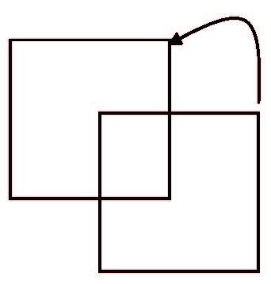
Instruction Restart
Must be able to restart the instruction that caused the page fault
  Save enough state
Consider an instruction that could access several different locations
  block move
  auto increment/decrement location
  Restart the whole operation?
    What if source and destination overlap?

Slide 17
Performance of Demand Paging
Stages in Demand Paging (worse case)
Trap to the operating system
Save the user registers and process state
Determine that the interrupt was a page fault
Check that the page reference was legal and determine the location of the page on the disk
Issue a read from the disk to a free frame:
  Wait in a queue for this device until the read request is serviced
  Wait for the device seek and/or latency time
  Begin the transfer of the page to a free frame
While waiting, allocate the CPU to some other user
Receive an interrupt from the disk I/O subsystem (I/O completed)
Save the registers and process state for the other user
Determine that the interrupt was from the disk
Correct the page table and other tables to show page is now in memory
Wait for the CPU to be allocated to this process again
Restore the user registers, process state, and new page table, and then resume the interrupted instruction

Slide 18
Performance of Demand Paging (Cont.)
Three major activities
  Service the interrupt – careful coding means just several hundred instructions needed
  Read the page – lots of time
  Restart the process – again just a small amount of time
Page Fault Rate 0 ≤ p ≤ 1
  if p = 0 no page faults
  if p = 1, every reference is a fault
Effective Access Time (EAT)
EAT = (1 – p) x memory access
+ p (page fault overhead
+ swap page out
+ swap page in )
Page Fault Service Time

Slide 19
Demand Paging Example
Memory access time = 200 nanoseconds
Average page-fault service time = 8 milliseconds
EAT = (1 – p) x 200 + p (8 milliseconds)
= (1 – p x 200 + p x 8,000,000
= 200 + p x 7,999,800
If one access out of 1,000 causes a page fault, then
EAT = 8.2 microseconds.
This is a slowdown by a factor of 40!!
If want performance degradation < 10 percent
  220 > 200 + 7,999,800 x p
  20 > 7,999,800 x p
  p < .0000025
  < one page fault in every 400,000 memory accesses

Slide 20
Demand Paging Optimizations
Dedicate Swap Space in memory or Disk
  Swap space I/O faster than file system I/O even if on the same device
    Swap space allocated in larger chunks; less management needed than file system
  Copy entire process image to swap space at process load time
    Then page in and out of swap space
    Used in older BSD Unix
Demand page in from program binary on disk, but discard rather than paging out when freeing frame
  Used in Solaris and current BSD
  Still need to write to swap space
    Pages not associated with a file (like stack and heap) – anonymous memory
    Pages modified in memory but not yet written back to the file system
Mobile systems
  Typically don’t support swapping
  Instead, demand page from file system and reclaim read-only pages (such as code)

Slide 21
Copy-on-Write
Copy-on-Write (COW) allows both parent and child processes to initially share the same pages in memory
  If either process modifies a shared page, only then is the page copied
COW allows more efficient process creation as only modified pages are copied
In general, free pages are allocated from a pool of zero-fill-on-demand pages
  Pool should always have free frames for fast demand page execution
    Don’t want to have to free a frame as well as other processing on page fault
  Why zero-out a page before allocating it?
vfork() variation on fork() system call has parent suspend and child using copy-on-write address space of parent
  Designed to have child call exec()
  Very efficient

Slide 22
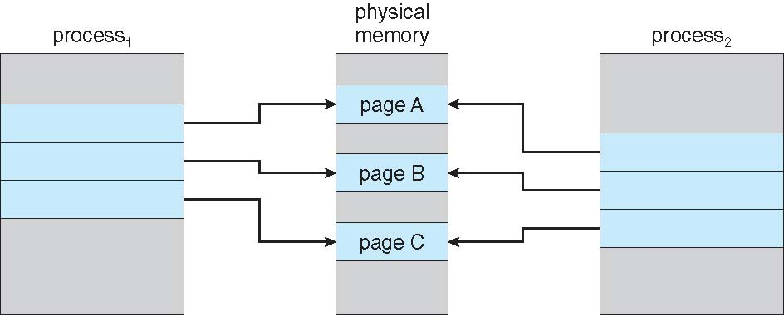
Before Process 1 Modifies Page C

Slide 23
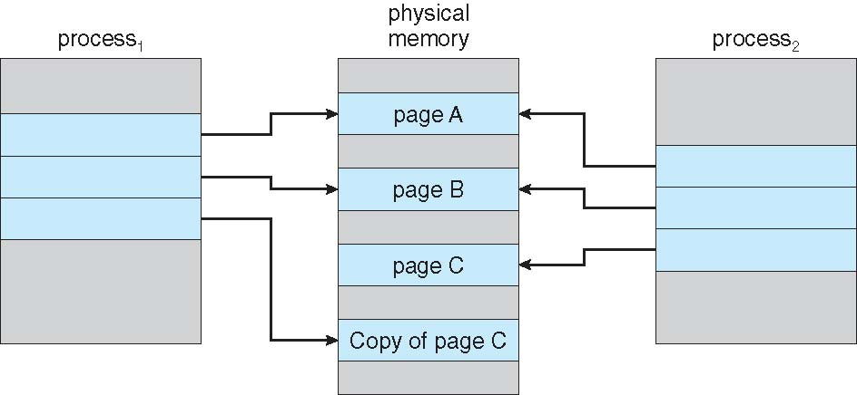
After Process 1 Modifies Page C

