Slide 1
CSMC 412
Operating Systems
Prof. Ashok K Agrawala
Set 5 Virtual Memory II

Slide 2
Virtual Memory
Paging
  How paging works
  Page Fault and its handling
  Demand paging
  Performance

Slide 3
What Happens if There is no Free Frame?
Used up by process pages
Also in demand from the kernel, I/O buffers, etc
How much to allocate to each?
Page replacement – find some page in memory, but not really in use, page it out
  Algorithm – terminate? swap out? replace the page?
  Performance – want an algorithm which will result in minimum number of page faults
Same page may be brought into memory several times

Slide 4
Page Replacement
Use modify (dirty) bit to reduce overhead of page transfers – only modified pages are written to disk
Page replacement completes separation between logical memory and physical memory – large virtual memory can be provided on a smaller physical memory

Slide 5
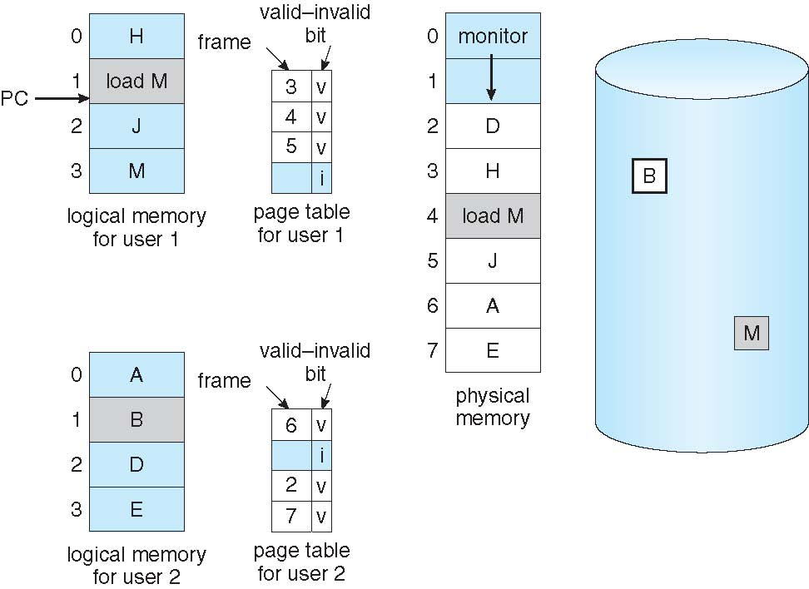
Need For Page Replacement

Slide 6
Basic Page Replacement
Find the location of the desired page on disk
Find a free frame:
- If there is a free frame, use it
- If there is no free frame,
    use a page replacement algorithm to select a victim frame
    - Write victim frame to disk if dirty
Bring the desired page into the (newly) free frame; update the page and frame tables
Continue the process by restarting the instruction that caused the trap
Note now potentially 2 page transfers for page fault – increasing EAT

Slide 7
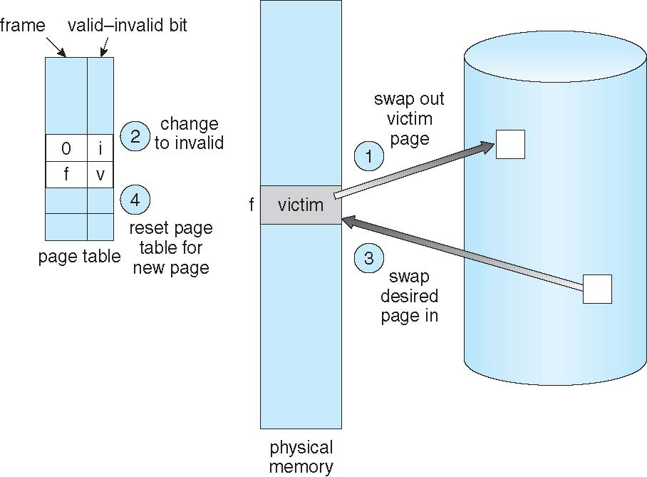
Page Replacement

Slide 8
Page and Frame Replacement Algorithms
Frame-allocation algorithm determines
  How many frames to give each process
  Which frames to replace
Page-replacement algorithm
  Want lowest page-fault rate on both first access and re-access
Evaluate algorithm by running it on a string of memory references (reference string) and computing the number of page faults on that string
  String is just page numbers, not full addresses
  Repeated access to the same page does not cause a page fault
  Results depend on number of frames available
In all our examples, the reference string of referenced page numbers is
7,0,1,2,0,3,0,4,2,3,0,3,0,3,2,1,2,0,1,7,0,1

Slide 9
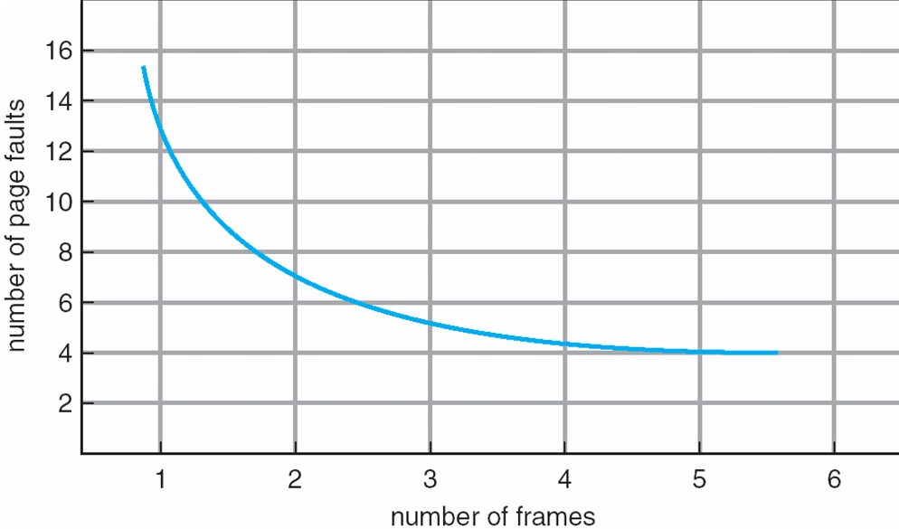
Graph of Page Faults Versus The Number of Frames

Slide 10
First-In-First-Out (FIFO) Algorithm
Reference string: 7,0,1,2,0,3,0,4,2,3,0,3,0,3,2,1,2,0,1,7,0,1
3 frames (3 pages can be in memory at a time per process)
Refrence string |  | 7 | 0 | 1 | 2 | 0 | 3 | 0 | 4 | 2 | 3 | 0 | 3 | 0 | 3 | 2 | 1 | 2 | 0 | 1 | 7 | 0 | 1
Page Frames
0 |  | 7 | 7 | 7 | 2 | 2 | 2 | 2 | 4 | 4 | 4 | 0 | 0 | 0 | 0 | 0 | 0 | 0 | 0 | 0 | 7 | 7 | 7
1 |  |  | 0 | 0 | 0 | 0 | 3 | 3 | 3 | 2 | 2 | 2 | 2 | 2 | 2 | 2 | 1 | 1 | 1 | 1 | 1 | 0 | 0
2 |  |  |  | 1 | 1 | 1 | 1 | 0 | 0 | 0 | 3 | 3 | 3 | 3 | 3 | 3 | 3 | 2 | 2 | 2 | 2 | 2 | 1
 |  | * | * | * | * |  | * | * | * | * | * | * |  |  |  |  | * | * |  |  | * | * | *
15 page-faults
Refrence string |  | 7 | 0 | 1 | 2 | 0 | 3 | 0 | 4 | 2 | 3 | 0 | 3 | 0 | 3 | 2 | 1 | 2 | 0 | 1 | 7 | 0 | 1
Page Frames
0 |  | 7 | 0 | 1 | 2 | 2 | 3 | 3 | 4 | 4 | 4 | 0 | 0 | 0 | 0 | 0 | 1 | 2 | 2 | 2 | 7 | 7 | 7
1 |  |  | 7 | 0 | 1 | 1 | 2 | 2 | 3 | 3 | 3 | 4 | 4 | 4 | 4 | 4 | 0 | 1 | 1 | 1 | 2 | 2 | 2
2 |  |  |  | 7 | 0 | 0 | 1 | 1 | 2 | 2 | 2 | 3 | 3 | 3 | 3 | 3 | 4 | 0 | 0 | 0 | 1 | 1 | 1
3 |  |  |  |  | 7 | 7 | 0 | 0 | 1 | 1 | 1 | 2 | 2 | 2 | 2 | 2 | 3 | 4 | 4 | 4 | 0 | 0 | 0
 |  | * | * | * | * |  | * |  | * |  |  | * |  |  |  |  | * | * |  |  | *
10 page-faults

Slide 11
First-In-First-Out (FIFO) Algorithm
Ref string |  | 1 | 2 | 3 | 4 | 1 | 2 | 5 | 1 | 2 | 3 | 4 | 5
Page Frames
 |  | 1 | 2 | 3 | 4 | 1 | 2 | 5 | 5 | 5 | 3 | 4 | 4
 |  |  | 1 | 2 | 3 | 4 | 1 | 2 | 2 | 2 | 5 | 3 | 3
 |  |  |  | 1 | 2 | 3 | 4 | 1 | 1 | 1 | 2 | 5 | 5
Page Fault | 9 | * | * | * | * | * | * | * |  |  | * | *
Page Frames
 |  | 1 | 2 | 3 | 4 | 4 | 4 | 5 | 1 | 2 | 3 | 4 | 5
 |  |  | 1 | 2 | 3 | 3 | 3 | 4 | 5 | 1 | 2 | 3 | 4
 |  |  |  | 1 | 2 | 2 | 2 | 3 | 4 | 5 | 1 | 2 | 3
 |  |  |  |  | 1 | 1 | 1 | 2 | 3 | 4 | 5 | 1 | 2
Page Fault | 10 | * | * | * | * |  |  | * | * | * | * | * | *
  CanAdding more frames can cause more page faults!
    Belady’s Anomaly
How to track ages of pages?
  Just use a FIFO queue

Slide 12
FIFO Illustrating Belady’s Anomaly

Slide 13
Optimal Algorithm
Replace page that will not be used for longest period of time
  9 is optimal for the example when using 3 Page Frames
How do you know this?
  Can’t read the future
Used for measuring how well your algorithm performs
Ref Str |  | 7 | 0 | 1 | 2 | 0 | 3 | 4 | 2 | 3 | 0 | 3 | 0 | 3 | 2 | 1 | 2 | 0 | 1 | 7 | 0 | 1
PageFrame
0 |  | 7 | 7 | 7 | 2 | 2 | 2 | 2 | 2 | 2 | 2 | 2 | 2 | 2 | 2 | 2 | 2 | 2 | 2 | 7 | 7 | 7
1 |  |  | 0 | 0 | 0 | 0 | 0 | 4 | 4 | 4 | 0 | 0 | 0 | 0 | 0 | 0 | 0 | 0 | 0 | 0 | 0 | 0
2 |  |  |  | 1 | 1 | 1 | 3 | 3 | 3 | 3 | 3 | 3 | 3 | 3 | 3 | 1 | 1 | 1 | 1 | 1 | 1 | 1
 | 9 | * | * | * | * |  | * | * |  |  | * |  |  |  |  | *

Slide 14
Optimal Algorithm
Ref Str |  | 7 | 0 | 1 | 2 | 0 | 3 | 4 | 2 | 3 | 0 | 3 | 0 | 3 | 2 | 1 | 2 | 0 | 1 | 7 | 0 | 1
PageFrame
0 |  | 7 | 7 | 7 | 2 | 2 | 2 | 2 | 2 | 2 | 2 | 2 | 2 | 2 | 2 | 2 | 2 | 2 | 2 | 7 | 7 | 7
1 |  |  | 0 | 0 | 0 | 0 | 0 | 4 | 4 | 4 | 0 | 0 | 0 | 0 | 0 | 0 | 0 | 0 | 0 | 0 | 0 | 0
2 |  |  |  | 1 | 1 | 1 | 3 | 3 | 3 | 3 | 3 | 3 | 3 | 3 | 3 | 1 | 1 | 1 | 1 | 1 | 1 | 1
 | 9 | * | * | * | * |  | * | * |  |  | * |  |  |  |  | * |  |  |  | *
3 Page Frames
Ref Str |  | 7 | 0 | 1 | 2 | 0 | 3 | 4 | 2 | 3 | 0 | 3 | 0 | 3 | 2 | 1 | 2 | 0 | 1 | 7 | 0 | 1
PageFrame
0 |  | 7 | 7 | 7 | 7 | 7 | 3 | 3 | 3 | 3 | 3 | 3 | 3 | 3 | 3 | 3 | 3 | 3 | 3 | 7 | 7 | 7
1 |  |  | 0 | 0 | 0 | 0 | 0 | 0 | 0 | 0 | 0 | 0 | 0 | 0 | 0 | 0 | 0 | 0 | 0 | 0 | 0 | 0
2 |  |  |  | 1 | 1 | 1 | 1 | 4 | 4 | 4 | 4 | 4 | 4 | 4 | 4 | 1 | 1 | 1 | 1 | 1 | 1 | 1
3 |  |  |  |  | 2 | 2 | 2 | 2 | 2 | 2 | 2 | 2 | 2 | 2 | 2 | 2 | 2 | 2 | 2 | 2 | 2 | 2
 | 8 | * | * | * | * |  | * | * |  |  |  |  |  |  |  | * |  |  |  | *
4 Page Frames

Slide 15
Least Recently Used (LRU) Algorithm
Use past knowledge rather than future
Replace page that has not been used in the most amount of time
Associate time of last use with each page
11 faults – better than FIFO but worse than OPT
Generally good algorithm and frequently used
But how to implement?
Ref Str |  | 7 | 0 | 1 | 2 | 0 | 3 | 4 | 2 | 3 | 0 | 3 | 0 | 3 | 2 | 1 | 2 | 0 | 1 | 7 | 0 | 1
PageFrame
 |  | 7 | 0 | 1 | 2 | 0 | 3 | 4 | 2 | 3 | 0 | 3 | 0 | 3 | 2 | 1 | 2 | 0 | 1 | 7 | 0 | 1
 |  |  | 7 | 0 | 1 | 2 | 0 | 3 | 4 | 2 | 3 | 0 | 3 | 0 | 3 | 2 | 1 | 2 | 0 | 1 | 7 | 0
 |  |  |  | 7 | 0 | 1 | 2 | 0 | 3 | 4 | 2 | 2 | 2 | 2 | 0 | 3 | 3 | 1 | 2 | 0 | 1 | 7
 | 11 | * | * | * | * |  | * | * | * |  | * |  |  |  |  | * |  | * |  | *

Slide 16
Least Recently Used (LRU) Algorithm
Ref Str |  | 7 | 0 | 1 | 2 | 0 | 3 | 4 | 2 | 3 | 0 | 3 | 0 | 3 | 2 | 1 | 2 | 0 | 1 | 7 | 0 | 1
PageFrame
 |  | 7 | 0 | 1 | 2 | 0 | 3 | 4 | 2 | 3 | 0 | 3 | 0 | 3 | 2 | 1 | 2 | 0 | 1 | 7 | 0 | 1
 |  |  | 7 | 0 | 1 | 2 | 0 | 3 | 4 | 2 | 3 | 0 | 3 | 0 | 3 | 2 | 1 | 2 | 0 | 1 | 7 | 0
 |  |  |  | 7 | 0 | 1 | 2 | 0 | 3 | 4 | 2 | 2 | 2 | 2 | 0 | 3 | 3 | 1 | 2 | 0 | 1 | 7
 | 11 | * | * | * | * |  | * | * | * |  | * |  |  |  |  | * |  | * |  | *
3 Page Frames
Ref Str |  | 7 | 0 | 1 | 2 | 0 | 3 | 4 | 2 | 3 | 0 | 3 | 0 | 3 | 2 | 1 | 2 | 0 | 1 | 7 | 0 | 1
PageFrame
0 |  | 7 | 0 | 1 | 2 | 0 | 3 | 4 | 2 | 3 | 0 | 3 | 0 | 3 | 2 | 1 | 2 | 0 | 1 | 7 | 0 | 1
1 |  |  | 7 | 0 | 1 | 2 | 0 | 3 | 4 | 2 | 3 | 0 | 3 | 0 | 3 | 2 | 1 | 2 | 0 | 1 | 7 | 0
2 |  |  |  | 7 | 0 | 1 | 2 | 0 | 3 | 4 | 2 | 2 | 2 | 2 | 0 | 3 | 3 | 1 | 2 | 0 | 1 | 7
3 |  |  |  |  | 7 | 7 | 1 | 2 | 0 | 0 | 4 | 4 | 4 | 4 | 4 | 0 | 0 | 3 | 3 | 2 | 2 | 2
 | 8 | * | * | * | * |  | * | * |  |  |  |  |  |  |  | * |  |  |  | *
4 Page Frames

Slide 17
LRU Algorithm (Cont.)
Counter implementation
  Every page entry has a counter; every time page is referenced through this entry, copy the clock into the counter
  When a page needs to be changed, look at the counters to find smallest value
    Search through table needed
Stack implementation
  Keep a stack of page numbers in a double link form:
  Page referenced:
    move it to the top
    requires 6 pointers to be changed
  But each update more expensive
  No search for replacement
LRU and OPT are cases of stack algorithms that don’t have Belady’s Anomaly

Slide 18
Use Of A Stack to Record Most Recent Page References

Slide 19
LRU Approximation Algorithms
LRU needs special hardware and still slow
Reference bit
  With each page associate a bit, initially = 0
  When page is referenced bit set to 1
  Replace any with reference bit = 0 (if one exists)
    We do not know the order, however
Second-chance algorithm
  Generally FIFO, plus hardware-provided reference bit
  Clock replacement
  If page to be replaced has
    Reference bit = 0 -> replace it
    reference bit = 1 then:
      set reference bit 0, leave page in memory
      replace next page, subject to same rules

Slide 20
Second-Chance (clock) Page-Replacement Algorithm

Slide 21
Enhanced Second-Chance Algorithm
Improve algorithm by using reference bit and modify bit (if available) in concert
Take ordered pair (reference, modify)
(0, 0) neither recently used not modified – best page to replace
(0, 1) not recently used but modified – not quite as good, must write out before replacement
(1, 0) recently used but clean – probably will be used again soon
(1, 1) recently used and modified – probably will be used again soon and need to write out before replacement
When page replacement called for, use the clock scheme but use the four classes replace page in lowest non-empty class
  Might need to search circular queue several times

Slide 22
Counting Algorithms
Keep a counter of the number of references that have been made to each page
  Not common
Lease Frequently Used (LFU) Algorithm: replaces page with smallest count
Most Frequently Used (MFU) Algorithm: based on the argument that the page with the smallest count was probably just brought in and has yet to be used

Slide 23
Page-Buffering Algorithms
Keep a pool of free frames, always
  Then frame available when needed, not found at fault time
  Read page into free frame and select victim to evict and add to free pool
  When convenient, evict victim
Possibly, keep list of modified pages
  When backing store otherwise idle, write pages there and set to non-dirty
Possibly, keep free frame contents intact and note what is in them
  If referenced again before reused, no need to load contents again from disk
  Generally useful to reduce penalty if wrong victim frame selected

Slide 24
Applications and Page Replacement
All of these algorithms have OS guessing about future page access
Some applications have better knowledge – i.e. databases
Memory intensive applications can cause double buffering
  OS keeps copy of page in memory as I/O buffer
  Application keeps page in memory for its own work
Operating system can given direct access to the disk, getting out of the way of the applications
  Raw disk mode
Bypasses buffering, locking, etc

Slide 25
Allocation of Frames
Each process needs minimum number of frames
Example: IBM 370 – 6 pages to handle SS MOVE instruction:
  instruction is 6 bytes, might span 2 pages
  2 pages to handle from
  2 pages to handle to
Maximum of course is total frames in the system
Two major allocation schemes
  fixed allocation
  priority allocation
Many variations

Slide 26
Fixed Allocation
Equal allocation – For example, if there are 100 frames (after allocating frames for the OS) and 5 processes, give each process 20 frames
  Keep some as free frame buffer pool
Proportional allocation – Allocate according to the size of process
  Dynamic as degree of multiprogramming, process sizes change

Slide 27
Priority Allocation
Use a proportional allocation scheme using priorities rather than size
If process P_{i} generates a page fault,
  select for replacement one of its frames
  select for replacement a frame from a process with lower priority number

Slide 28
Global vs. Local Allocation
Global replacement – process selects a replacement frame from the set of all frames; one process can take a frame from another
  But then process execution time can vary greatly
  But greater throughput so more common
Local replacement – each process selects from only its own set of allocated frames
  More consistent per-process performance
  But possibly underutilized memory

Slide 29
Non-Uniform Memory Access
So far all memory accessed equally
Many systems are NUMA – speed of access to memory varies
  Consider system boards containing CPUs and memory, interconnected over a system bus
Optimal performance comes from allocating memory “close to” the CPU on which the thread is scheduled
  And modifying the scheduler to schedule the thread on the same system board when possible
  Solved by Solaris by creating lgroups
    Structure to track CPU / Memory low latency groups
    Used my schedule and pager
    When possible schedule all threads of a process and allocate all memory for that process within the lgroup

