Slide 1
CSMC 412
Operating Systems
Prof. Ashok K Agrawala
Set 6 Virtual Memory III

Slide 2
Virtual Memory
Paging
  Demand paging
  Page Replacement Algorithms
    FIFO, Optimal, LRU
    Stack Algorithms
  Implementations
    Approximations
  Strategies
    Global vs. local

Slide 3
Thrashing
If a process does not have “enough” pages, the page-fault rate is very high
  Page fault to get page
  Replace existing frame
  But quickly need replaced frame back
  This leads to:
    Low CPU utilization
    Operating system thinking that it needs to increase the degree of multiprogramming
    Another process added to the system
Thrashing ≡ a process is busy swapping pages in and out

Slide 4
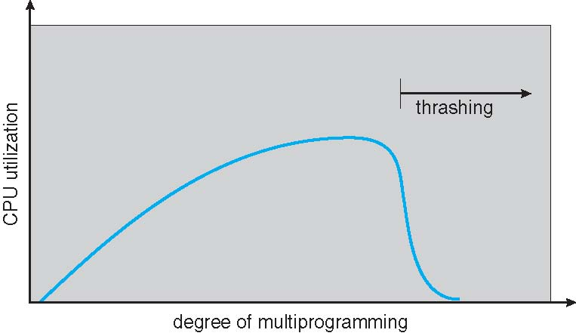
Thrashing (Cont.)

Slide 5
Demand Paging and Thrashing
Why does demand paging work?
Locality model
  Process migrates from one locality to another
  Localities may overlap
Why does thrashing occur?
Σ size of locality > total memory size
  Limit effects by using local or priority page replacement

Slide 6
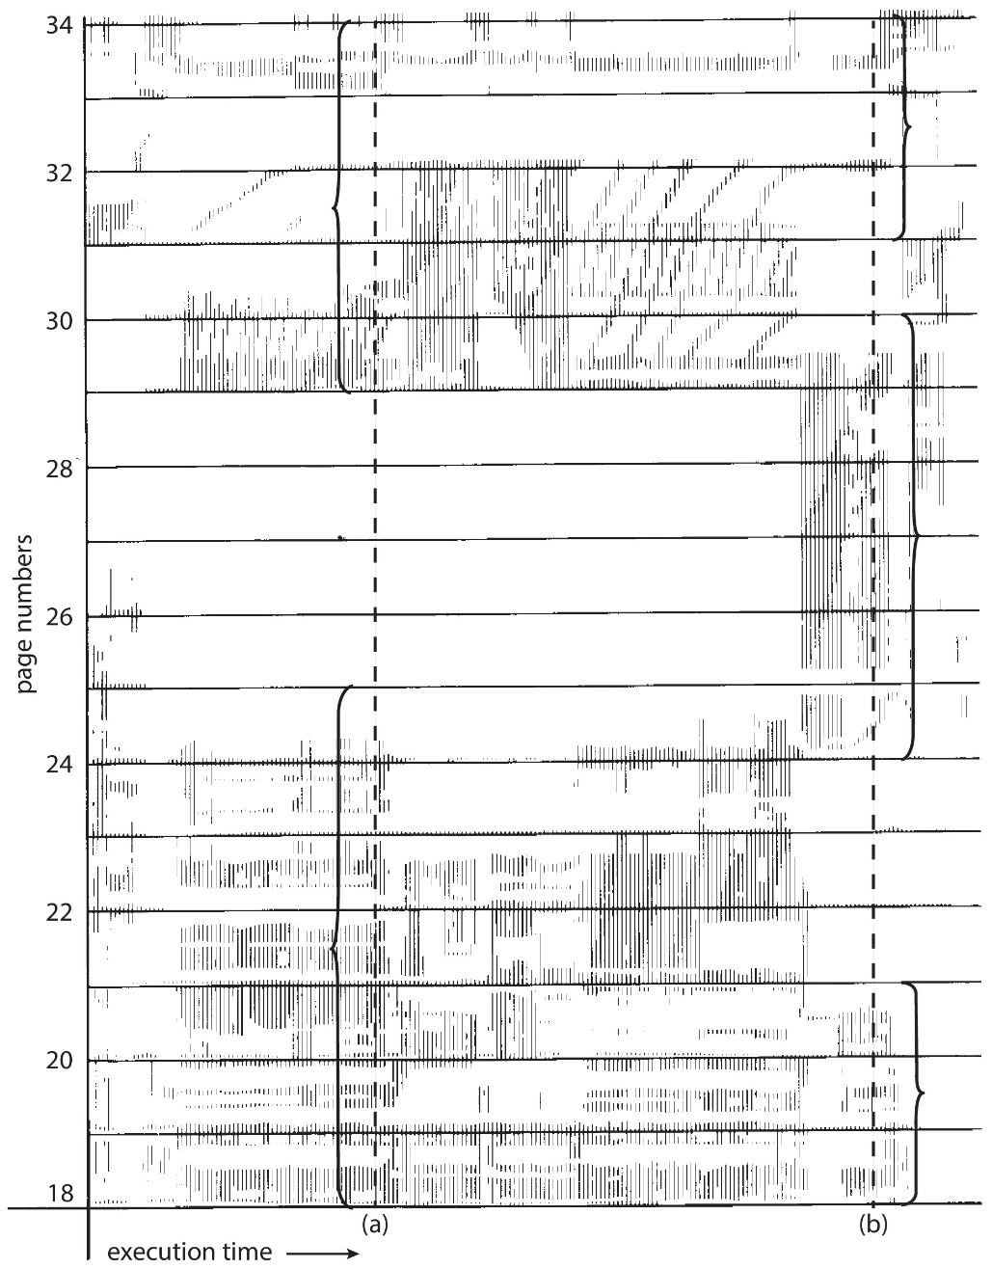
Locality In A Memory-Reference
Pattern
Working set at time a
{18, 19, 20, 21, 22, 23, 24, 29, 30, 33}
Working set at time b
{18, 19, 20, 24, 25, 26, 27, 28, 29, 31, 32, 33}

Slide 7
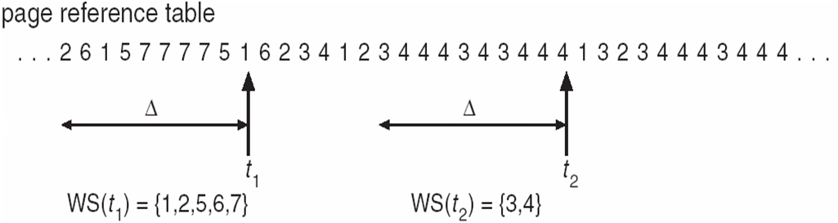
Working-Set Model
Δ ≡ working-set window ≡ a fixed number of page references
Example: 10,000 instructions
WSS_{i} (working set of Process P_{i}) =
total number of pages referenced in the most recent Δ (varies in time)
  if Δ too small will not encompass entire locality
  if Δ too large will encompass several localities
  if Δ = ∞ ⇒ will encompass entire program
D = Σ WSS_{i} ≡ total demand frames
  Approximation of locality
if D > m ⇒ Thrashing
Policy if D > m, then suspend or swap out one of the processes

Slide 8
Keeping Track of the Working Set
Approximate with interval timer + a reference bit
Example: Δ = 10,000
  Timer interrupts after every 5000 time units
  Keep in memory 2 bits for each page
  Whenever a timer interrupts
    Copy reference bits to memory
    Set all reference bits to 0
  If one of the bits for a page (in memory or reference bit) is 1
    ⇒ page in working set
Why is this not completely accurate?
Improvement = 10 bits and interrupt every 1000 time units

Slide 9
Page-Fault Frequency
More direct approach than WSS
Establish “acceptable” page-fault frequency (PFF) rate and use local replacement policy
  If actual rate too low, process loses frame
  If actual rate too high, process gains frame

Slide 10
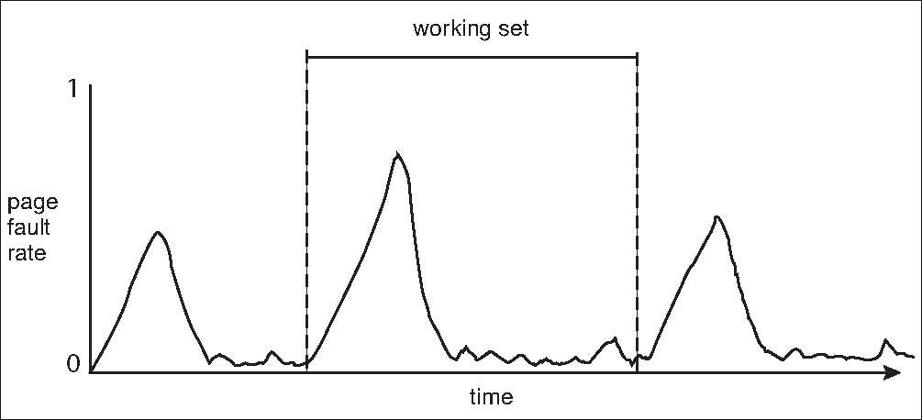
Working Sets and Page Fault Rates
Direct relationship between working set of a process and its page-fault rate
Working set changes over time
Peaks and valleys over time

Slide 11
Memory-Mapped Files
Memory-mapped file I/O allows file I/O to be treated as routine memory access by mapping a disk block to a page in memory
A file is initially read using demand paging
  A page-sized portion of the file is read from the file system into a physical page
  Subsequent reads/writes to/from the file are treated as ordinary memory accesses
Simplifies and speeds file access by driving file I/O through memory rather than read() and write() system calls
Also allows several processes to map the same file allowing the pages in memory to be shared
But when does written data make it to disk?
  Periodically and / or at file close() time
  For example, when the pager scans for dirty pages

Slide 12
Allocating Kernel Memory
Treated differently from user memory
Often allocated from a free-memory pool
  Kernel requests memory for structures of varying sizes
  Some kernel memory needs to be contiguous
    I.e. for device I/O

Slide 13
Buddy System
Allocates memory from fixed-size segment consisting of physically-contiguous pages
Memory allocated using power-of-2 allocator
  Satisfies requests in units sized as power of 2
  Request rounded up to next highest power of 2
  When smaller allocation needed than is available, current chunk split into two buddies of next-lower power of 2
    Continue until appropriate sized chunk available
For example, assume 256KB chunk available, kernel requests 21KB
  Split into A_{L} _{and} A_{R} of 128KB each
    One further divided into B_{L} and B_{R} of 64KB
      One further into C_{L} and C_{R} of 32KB each – one used to satisfy request
Advantage – quickly coalesce unused chunks into larger chunk
Disadvantage - fragmentation

Slide 14
Buddy System Allocator

Slide 15
Slab Allocator
Alternate strategy
Slab is one or more physically contiguous pages
Cache consists of one or more slabs
  (this is not the hardware memory cache of the cpu)
Single cache for each unique kernel data structure
  Each cache filled with objects – instantiations of the data structure
  For example – Cache representing semaphores stores instances of semaphore objects
When cache created, filled with objects marked as free
When structures stored, objects marked as used
If slab is full of used objects, next object allocated from empty slab
  If no empty slabs, new slab allocated
Benefits include no fragmentation, fast memory request satisfaction

Slide 16
Slab Allocation

Slide 17
Slab Allocator in Linux
For example process descriptor is of type struct task_struct
Approx 1.7KB of memory
New task -> allocate new struct from cache
  Will use existing free struct task_struct
Slab can be in three possible states
  Full – all used
  Empty – all free
  Partial – mix of free and used
Upon request, slab allocator
  Uses free struct in partial slab
  If none, takes one from empty slab
  If no empty slab, create new empty

Slide 18
Slab Allocator in Linux (Cont.)
Slab started in Solaris, now wide-spread for both kernel mode and user memory in various OSes
Linux 2.2 had SLAB, now has both SLOB and SLUB allocators
  SLOB for systems with limited memory
    Simple List of Blocks – maintains 3 list objects for small, medium, large objects
  SLUB is performance-optimized SLAB removes per-CPU queues, metadata stored in page structure

Slide 19
Other Considerations -- Prepaging
Prepaging
  To reduce the large number of page faults that occurs at process startup
  Prepage all or some of the pages a process will need, before they are referenced
  But if prepaged pages are unused, I/O and memory was wasted
  Assume s pages are prepaged and α fraction of the pages is used
    Is cost of saved pages faults > or < than the cost of prepaging
    unnecessary pages?

Slide 20
Other Issues – Page Size
Sometimes OS designers have a choice
  Especially if running on custom-built CPU
Page size selection must take into consideration:
  Fragmentation
  Page table size
  Resolution
  I/O overhead
  Number of page faults
  Locality
  TLB size and effectiveness
Always power of 2, usually in the range 2¹² (4,096 bytes) to 2²² (4,194,304 bytes)
On average, growing over time

Slide 21
Other Issues – TLB Reach
TLB Reach - The amount of memory accessible from the TLB
TLB Reach = (TLB Size) X (Page Size)
Ideally, the working set of each process is stored in the TLB
  Otherwise there is a high degree of page faults
Increase the Page Size
  This may lead to an increase in fragmentation as not all applications require a large page size
Provide Multiple Page Sizes
  This allows applications that require larger page sizes the opportunity to use them without an increase in fragmentation

Slide 22
Other Issues – Program Structure
Program structure
  int[128,128] data;
  Each row is stored in one page
  Program 1
for (j = 0; j <128; j++)
for (i = 0; i < 128; i++)
data[i,j] = 0;
  128 x 128 = 16,384 page faults
  Program 2
  for (i = 0; i < 128; i++)
  for (j = 0; j < 128; j++)
  data[i,j] = 0;
  128 page faults

Slide 23
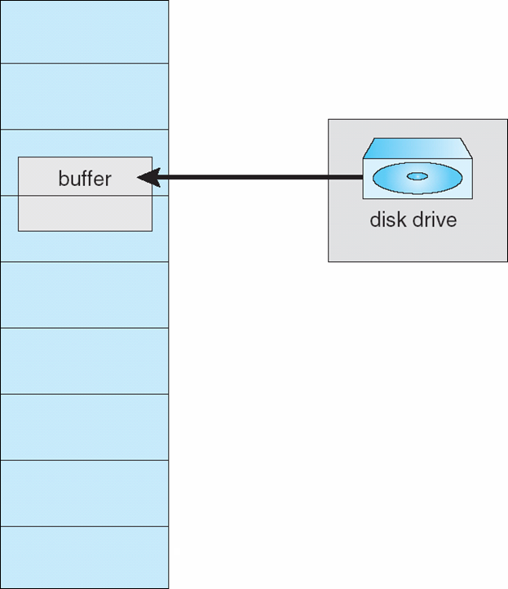
Other Issues – I/O interlock
I/O Interlock – Pages must sometimes be locked into memory
Consider I/O - Pages that are used for copying a file from a device must be locked from being selected for eviction by a page replacement algorithm
Pinning of pages to lock into memory

Slide 24
Operating System Examples
Linux
Windows
Solaris

Slide 25
Linux
Kernel memory – slab allocation
Rest – uses demand paging
  Global page replacement policy
    LRU approximation clock algorithm
  Maintains two lists
    Active List – pages considered to be in use
    Inactive List – pages that have not recently been referenced and are eligible to be reclaimed

Slide 26
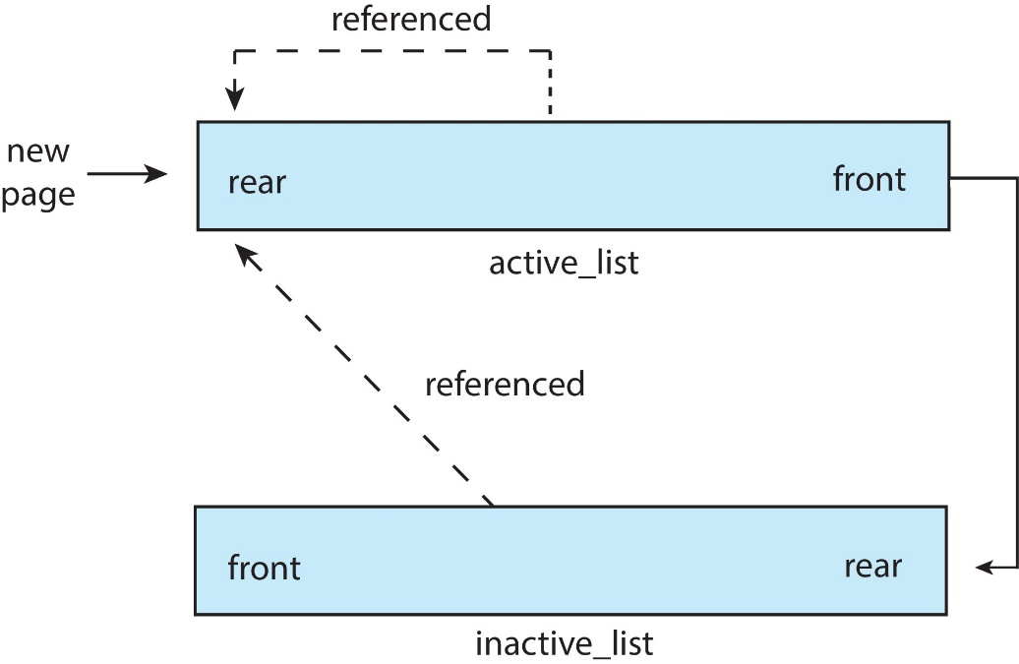
Linux
Accessed bit
  Set when first allocated
    Added to the rear of the active_list
  When referenced access bit set and moved to the rear of the Active_list
Periodically access bits for pages in the active_list are reset
Pages from the front of the Active_list may move to the rear of the Inactive_list
If a page on inactive_list is referenced it is moved to active_list
Free page List
  Paging daemon – kswapd
  Awakens and if the size of Free page list below a threshold
    Reclaims the pages from the front of Inactive_list

Slide 27
Windows
32 bit architecture
  Virtual address space 2 GB – can be extended to 3 GB
  Physical memory – up to 4 GB
64 bit architecture
  128 TB Virtual address space
  Up to 24 TB physical memory (server version supports 128 TB )

Slide 28
Windows
Uses demand paging with clustering. Clustering brings in pages surrounding the faulting page
Processes are assigned working set minimum and working set maximum
Working set minimum is the minimum number of pages the process is guaranteed to have in memory
A process may be assigned as many pages up to its working set maximum
When the amount of free memory in the system falls below a threshold, automatic working set trimming is performed to restore the amount of free memory
Working set trimming removes pages from processes that have pages in excess of their working set minimum

Slide 29
Solaris
Assigns page from the list of free pages
Maintains a list of free pages to assign faulting processes
Lotsfree – threshold parameter (amount of free memory) to begin paging
Desfree – threshold parameter to increasing paging
Minfree – threshold parameter to being swapping
Paging is performed by pageout process
Pageout scans pages using modified clock algorithm
Scanrate is the rate at which pages are scanned. This ranges from slowscan to fastscan
Pageout is called more frequently depending upon the amount of free memory available
Priority paging gives priority to process code pages

Slide 30
Solaris 2 Page Scanner

