Slide 1
CSMC 412
Operating Systems
Prof. Ashok K Agrawala
© 2020 Ashok Agrawala
Set 7 Mass Storage Systems

Slide 2
Mass Storage
Large storage capacity
Non-volatile
Much slower access
Many technologies have been used
  Magnetic
    Drums
    Tapes
    Disks
  Optical
    CD R
    CD rw
  Solid state

Slide 3
Magnetic Devices
Write by magnetizing an area using a recording head
  Area must be moving with respect to the recording head
Read by moving the recorded area against a read head
Often use one head for reading and writing
Movement must be stable
Recording Density – bits/inch, or bits/sq inch
Area
  Drum – cylinder
  Tape – a long ribbon
  Disk – flat platter

Slide 4
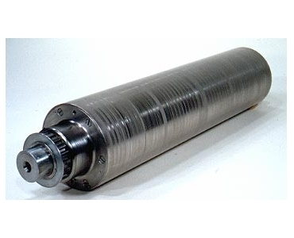
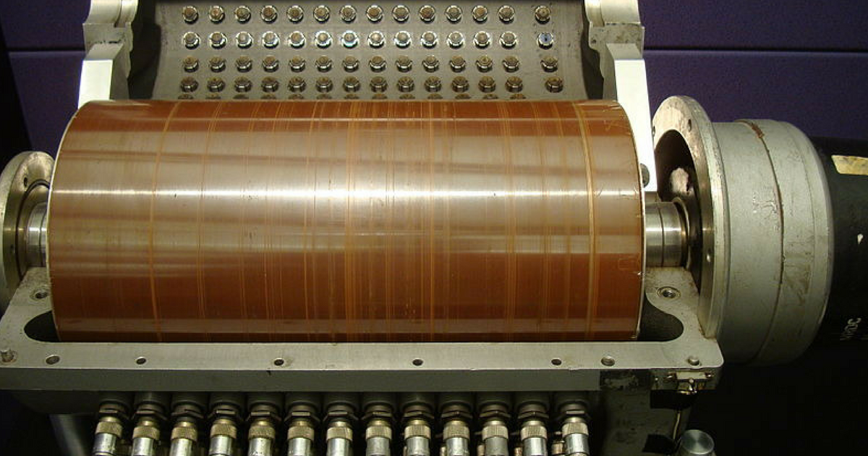
Magnetic Drum

Slide 5
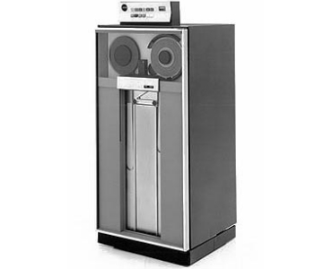
Magnetic Tape
Was early secondary-storage medium
  Evolved from open spools to cartridges
Relatively permanent and holds large quantities of data
Access time slow
Random access ~1000 times slower than disk
Mainly used for backup, storage of infrequently-used data, transfer medium between systems
Kept in spool and wound or rewound past read-write head
Once data under head, transfer rates comparable to disk
  140MB/sec and greater
200GB to 1.5TB typical storage
Common technologies are LTO-{3,4,5} and T10000
IBM 3420

Slide 6
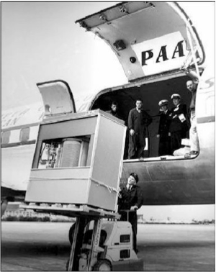
The First Commercial Disk Drive
1956
IBM RAMDAC computer included the IBM Model 350 disk storage system
5M (7 bit) characters
50 x 24” platters
Access time = < 1 second

Slide 7
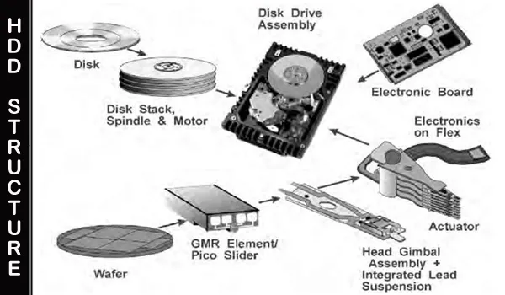
Mass Storage - Disk

Slide 8
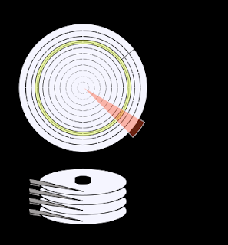
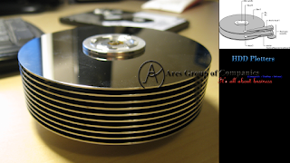
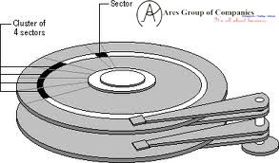
Physical Structure of Recording Surfaces

Slide 9
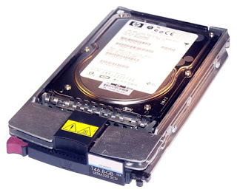
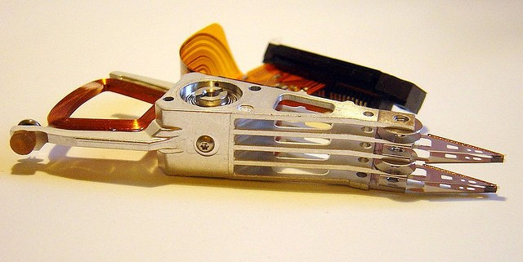
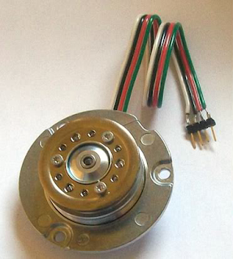
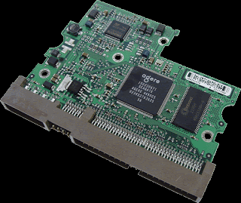
3.5 inch Drive
Head assembly
Logic board
Motor

Slide 10
Moving-head Disk Mechanism
Multiple platters – One head per surface
Track – Area that comes under a head from a surface
Cylinder – In a multiplatter disk, the collection of tracks covered without moving the head assembly
Sector – A track is organized into a collection of sectors. It is the unit of disk access.

Slide 11
Hard Disks
Magnetic disks provide bulk of secondary storage of modern computers
  Drives rotate at 60 to 250 times per second
  Transfer rate is rate at which data flow between drive and computer
  Positioning time (random-access time) is time to move disk arm to desired cylinder (seek time) and time for desired sector to rotate under the disk head (rotational latency)
  Head crash results from disk head making contact with the disk surface -- That’s bad
Disks can be removable
Drive attached to computer via I/O bus
  Busses vary, including EIDE, ATA, SATA, USB, Fibre Channel, SCSI, SAS, Firewire
  Host controller in computer uses bus to talk to disk controller built into drive or storage array

Slide 12
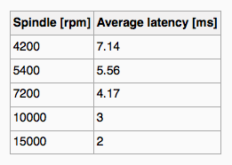
Hard Disks
Platters range from .85” to 14” (historically)
  Commonly 3.5”, 2.5”, and 1.8”
Range from 30GB to 16TB per drive
Performance
  Transfer Rate – theoretical – 6 Gb/sec
  Effective Transfer Rate – real – 1Gb/sec
  Seek time from 3ms to 12ms – 9ms common for desktop drives
  Average seek time measured or calculated based on 1/3 of tracks
  Latency based on spindle speed
    1 / (RPM / 60) = 60 / RPM
  Average latency = ½ latency
(From Wikipedia)

Slide 13
Hard Disk Performance
Access Latency = Average access time = average seek time + average latency
  For fastest disk 3ms + 2ms = 5ms
  For slow disk 9ms + 5.56ms = 14.56ms
Average I/O time = average access time + (amount to transfer / transfer rate) + controller overhead
For example to transfer a 4KB block on a 7200 RPM disk with a 5ms average seek time, 1Gb/sec transfer rate with a .1ms controller overhead =
  5ms + 4.17ms + 0.1ms + transfer time = 9.27 ms
  Transfer time = 4KB / 1Gb/s * 8Gb / GB * 1GB / 1024²KB = 32 / (1024²) = 0.031 ms
  Average I/O time for 4KB block = 9.27ms + .031ms = 9.301ms

Slide 14
Solid-State Disks
Nonvolatile memory used like a hard drive
  Many technology variations
Can be more reliable than HDDs
More expensive per MB
Maybe have shorter life span
Less capacity
But much faster
Busses can be too slow -> connect directly to PCI for example
No moving parts, so no seek time or rotational latency

Slide 15
Disk Structure
Disk drives are addressed as large 1-dimensional arrays of logical blocks, where the logical block is the smallest unit of transfer
  Low-level formatting creates logical blocks on physical media
The 1-dimensional array of logical blocks is mapped into the sectors of the disk sequentially
  Sector 0 is the first sector of the first track on the outermost cylinder
  Mapping proceeds in order through that track, then the rest of the tracks in that cylinder, and then through the rest of the cylinders from outermost to innermost
  Logical to physical address should be easy
    Except for bad sectors
    Non-constant # of sectors per track via constant angular velocity

Slide 16
Disk Attachment
Host-attached storage accessed through I/O ports talking to I/O busses
SCSI itself is a bus, up to 16 devices on one cable, SCSI initiator requests operation and SCSI targets perform tasks
  Each target can have up to 8 logical units (disks attached to device controller)
FC is high-speed serial architecture
  Can be switched fabric with 24-bit address space – the basis of storage area networks (SANs) in which many hosts attach to many storage units
I/O directed to bus ID, device ID, logical unit (LUN)

Slide 17
Storage Array
Can just attach disks, or arrays of disks
Storage Array has controller(s), provides features to attached host(s)
  Ports to connect hosts to array
  Memory, controlling software (sometimes NVRAM, etc)
  A few to thousands of disks
  RAID, hot spares, hot swap (discussed later)
  Shared storage -> more efficiency
  Features found in some file systems
    Snaphots, clones, thin provisioning, replication, deduplication, etc

Slide 18
Storage Area Network
Common in large storage environments
Multiple hosts attached to multiple storage arrays - flexible

Slide 19
Storage Area Network (Cont.)
SAN is one or more storage arrays
  Connected to one or more Fibre Channel switches
Hosts also attach to the switches
Storage made available via LUN Masking from specific arrays to specific servers
Easy to add or remove storage, add new host and allocate it storage
  Over low-latency Fibre Channel fabric
Why have separate storage networks and communications networks?
  Consider iSCSI, FCOE

Slide 20
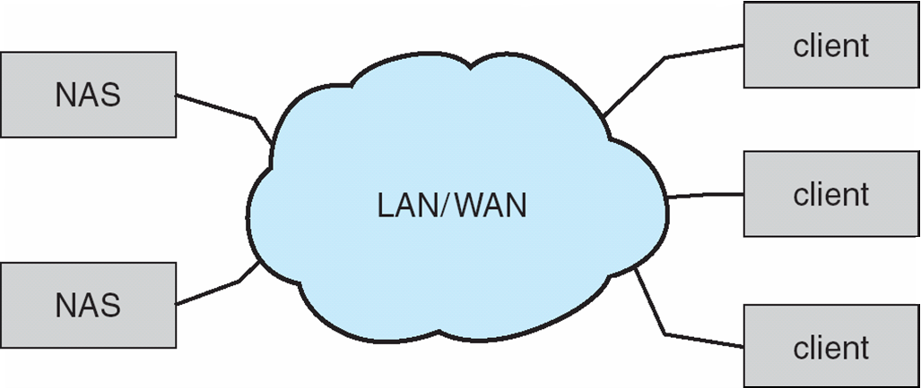
Network-Attached Storage
Network-attached storage (NAS) is storage made available over a network rather than over a local connection (such as a bus)
  Remotely attaching to file systems
NFS and CIFS are common protocols
Implemented via remote procedure calls (RPCs) between host and storage over typically TCP or UDP on IP network
iSCSI protocol uses IP network to carry the SCSI protocol
  Remotely attaching to devices (blocks)

