Slide 1
CSMC 412
Operating Systems
Prof. Ashok K Agrawala
Online Set 10

Slide 2
I/O System
I/O management is a major component of operating system design and operation
Important aspect of computer operation
I/O devices vary greatly
Various methods to control them
Performance management
New types of devices frequent
Ports, busses, device controllers connect to various devices
Device drivers encapsulate device details
Present uniform device-access interface to I/O subsystem

Slide 3
I/O Hardware
Incredible variety of I/O devices
Storage
Transmission
Human-interface
Common concepts – signals from I/O devices interface with computer
Port – connection point for device
Bus - daisy chain or shared direct access
PCI bus common in PCs and servers, PCI Express (PCIe)
expansion bus connects relatively slow devices
Controller (host adapter) – electronics that operate port, bus, device
Sometimes integrated
Sometimes separate circuit board (host adapter)
Contains processor, microcode, private memory, bus controller, etc
Some talk to per-device controller with bus controller, microcode, memory, etc

Slide 4
File System
Provide a simpler way for programs to access the information stored on secondary storage system
Hide the details of I/O system and the physical storage structure
Provide a logical view

Slide 5
File System
File Concept
Access Methods
Disk and Directory Structure
File-System Mounting
File Sharing
Protection

Slide 6
File Concept
File is a logical entity consisting of records
Contiguous logical address space
Records
Types:
Data
numeric
character
binary
Program
Contents defined by file’s creator
Many types
Consider text file, source file, executable file

Slide 7
File Attributes
Name – only information kept in human-readable form
Identifier – unique tag (number) identifies file within file system
Type – needed for systems that support different types
Location – pointer to file location on device
Size – current file size
Protection – controls who can do reading, writing, executing
Time, date, and user identification – data for protection, security, and usage monitoring
Information about files are kept in the directory structure, which is maintained on the disk
Many variations, including extended file attributes such as file checksum
Information kept in the directory structure

Slide 8
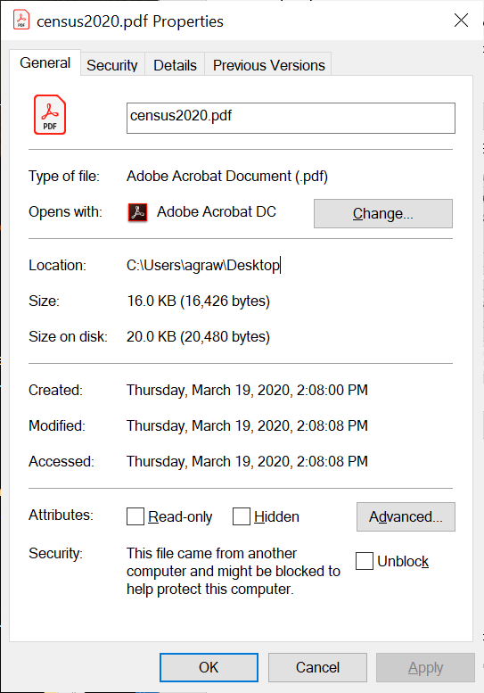
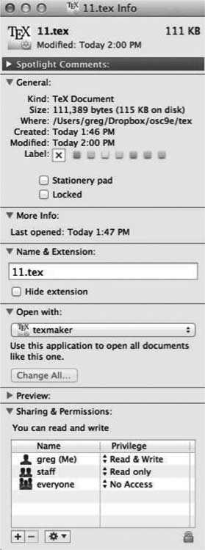
File Information
Windows 10
Mac OS

Slide 9
Accessing a File
Operating System has to keep information about the file to carry out the mapping from logical operations on the file to physical operations to be carried out by the I/O system
Open Files of a Process
Process has to open a file
Information about the file is brought in and usually kept in Process Control Block

Slide 10
Open Files
Several pieces of data are needed to manage open files:
Open-file table: tracks open files
File pointer: pointer to last read/write location, per process that has the file open
File-open count: counter of number of times a file is open – to allow removal of data from open-file table when last processes closes it
Disk location of the file: cache of data access information
Access rights: per-process access mode information

Slide 11
Open File Locking
Provided by some operating systems and file systems
Similar to reader-writer locks
Shared lock similar to reader lock – several processes can acquire concurrently
Exclusive lock similar to writer lock
Mediates access to a file
Mandatory or advisory:
Mandatory – access is denied depending on locks held and requested
Advisory – processes can find status of locks and decide what to do

Slide 12
File Locking Example – Java API
import java.io.*;
import java.nio.channels.*;
public class LockingExample {
public static final boolean EXCLUSIVE = false;
public static final boolean SHARED = true;
public static void main(String arsg[]) throws IOException {
FileLock sharedLock = null;
FileLock exclusiveLock = null;
try {
RandomAccessFile raf = new RandomAccessFile("file.txt", "rw");
// get the channel for the file
FileChannel ch = raf.getChannel();
// this locks the first half of the file - exclusive
exclusiveLock = ch.lock(0, raf.length()/2, EXCLUSIVE);
/** Now modify the data . . . */
// release the lock
exclusiveLock.release();

Slide 13
File Locking Example – Java API (Cont.)
// this locks the second half of the file - shared
sharedLock = ch.lock(raf.length()/2+1, raf.length(), SHARED);
/** Now read the data . . . */
// release the lock
sharedLock.release();
} catch (java.io.IOException ioe) {
System.err.println(ioe);
}finally {
if (exclusiveLock != null)
exclusiveLock.release();
if (sharedLock != null)
sharedLock.release();
}
}
}

Slide 14
File Operations
File is an abstract data type
Create
Write – at write pointer location
Read – at read pointer location
Reposition within file - seek
Delete
Truncate
Open(F_{i}) – search the directory structure on disk for entry F_{i}, and move the content of entry to memory
Close (F_{i}) – move the content of entry F_{i} in memory to directory structure on disk

Slide 15
File Name
File Name | Contents
README | Project overview
MANIFEST | List of project files with brief explanations
INSTALL | Installation instructions
Copying | Licensing information
TODO | Wish list for future extensions
NEWS | Documentation on user-visible changes
Changes | Code change summary
configure | Platform configuration script
Makefile | Build specification
Makefile.SH | Shell script producing the above
config.h | Platform configuration definitions
config_h.SH | Shell script producing the above
patchlevel.h | Defines the project release version
name used to uniquely identify a computer file stored in a file system.
Name may include:
Host
Device
Path/Directory/Folder
File – base name
Type/Extension
Version
Common names:

Slide 16
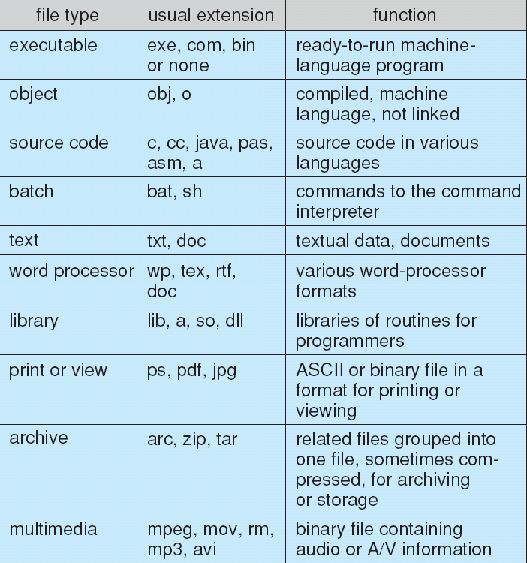
File Types – Name, Extension

Slide 17
File Structure
None - sequence of words, bytes
Simple record structure
Lines
Fixed length
Variable length
Complex Structures
Formatted document
Relocatable load file
Can simulate last two with first method by inserting appropriate control characters
Who decides:
Operating system
Program

Slide 18
Internal File Structure
Disk system
Fixed Block Size – consisting of one or more sectors
All I/O is performed in units of blocks (Physical Record)
File organized in terms of Logical Records
Mapped on to Physical Records
Example – Unix
File – stream of bytes
Each byte is individually addressable
By offset from the beginning
Logical Record Size = 1 Byte
Physical Record Size = One sector – 512 Bytes

Slide 19
Access Methods
Sequential Access
read next
write next
reset
no read after last write
(rewrite)
Direct Access – file is fixed length logical records
read n
write n
position to n
read next
write next
rewrite n
n = relative block number
Relative block numbers allow OS to decide where file should be placed

Slide 20
Sequential-access File

Slide 21
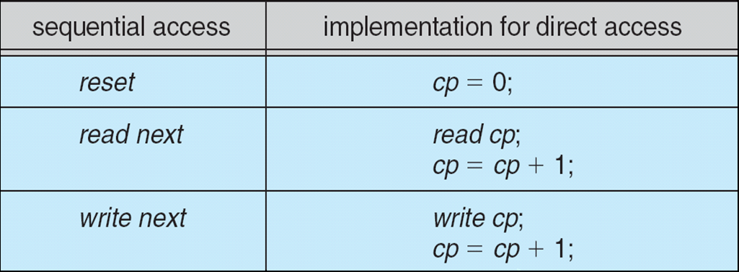
Simulation of Sequential Access on Direct-access File

Slide 22
Other Access Methods
Can be built on top of base methods
Generally involve creation of an index for the file
Keep index in memory for fast determination of location of data to be operated on (consider UPC code plus record of data about that item)
If too large, index (in memory) of the index (on disk)
IBM indexed sequential-access method (ISAM)
Small master index, points to disk blocks of secondary index
File kept sorted on a defined key
All done by the OS
VMS operating system provides index and relative files as another example (see next slide)

Slide 23
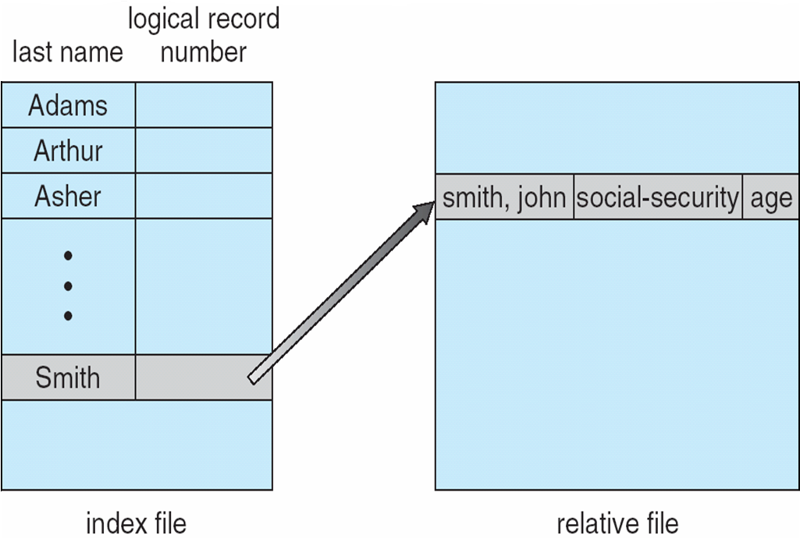
Example of Index and Relative Files

Slide 24
Disk Structure
Disk can be subdivided into partitions
Disks or partitions can be RAID protected against failure
Disk or partition can be used raw – without a file system, or formatted with a file system
Partitions also known as minidisks, slices
Entity containing file system known as a volume
Each volume containing file system also tracks that file system’s info in device directory or volume table of contents
As well as general-purpose file systems there are many special-purpose file systems, frequently all within the same operating system or computer

Slide 25
File System Structure
Typical system has large number of files
Files are organized into Directories or Folders
Directories contain one or more files

Slide 26
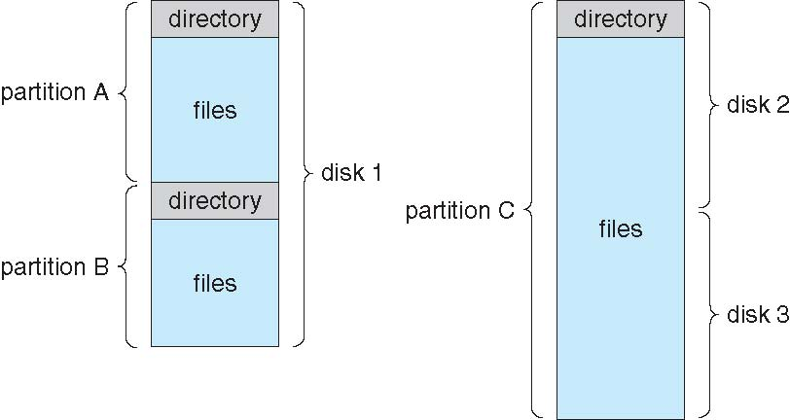
A Typical File-system Organization

