Slide 1
CSMC 412
Operating Systems
Prof. Ashok K Agrawala
Online Set 11
File System II

Slide 2
File System Structure
Typical system has large number of files
Files are organized into Directories or Folders
Directories contain one or more files

Slide 3
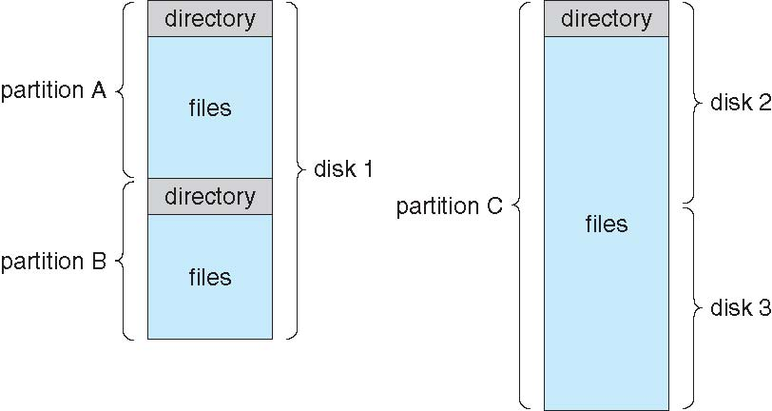
A Typical File-system Organization

Slide 4
Directory Structure
A collection of nodes containing information about all files
Directory
Files
F 1
F 2
F 3
F 4
F n
Both the directory structure and the files reside on disk

Slide 5
Types of File Systems
We mostly talk of general-purpose file systems
But systems frequently have may file systems, some general- and some special- purpose
Consider Solaris has
  tmpfs – memory-based volatile FS for fast, temporary I/O
  objfs – interface into kernel memory to get kernel symbols for debugging
  ctfs – contract file system for managing daemons
  lofs – loopback file system allows one FS to be accessed in place of another
  procfs – kernel interface to process structures
  ufs, zfs – general purpose file systems

Slide 6
Operations Performed on Directory
Search for a file
Create a file
Delete a file
List a directory
Rename a file
Traverse the file system

Slide 7
Directory Organization
The directory is organized logically to obtain
Efficiency – locating a file quickly
Naming – convenient to users
  Two users can have same name for different files
  The same file can have several different names
Grouping – logical grouping of files by properties, (e.g., all Java programs, all games, …)

Slide 8
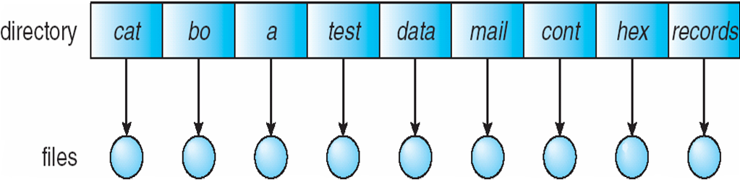
Single-Level Directory
A single directory for all users
Naming problem
Grouping problem

Slide 9
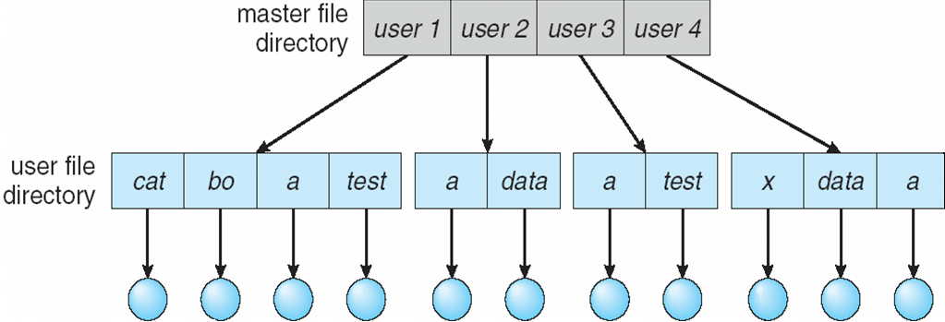
Two-Level Directory
Separate directory for each user
Path name
Can have the same file name for different user
Efficient searching
No grouping capability

Slide 10
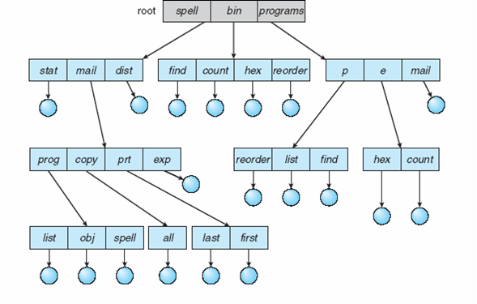
Tree-Structured Directories

Slide 11
Tree-Structured Directories (Cont.)
Efficient searching
Grouping Capability
Current directory (working directory)
  cd /spell/mail/prog
  type list

Slide 12
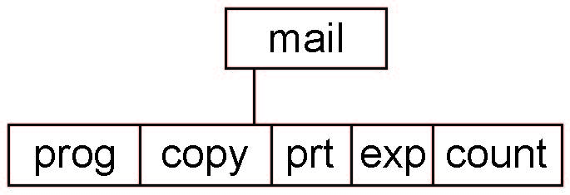
Tree-Structured Directories (Cont)
Absolute or relative path name
Creating a new file is done in current directory
Delete a file
rm <file-name>
Creating a new subdirectory is done in current directory
  mkdir <dir-name>
  Example: if in current directory /mail
  mkdir count
Deleting “mail” ⇒ deleting the entire subtree rooted by “mail”

Slide 13
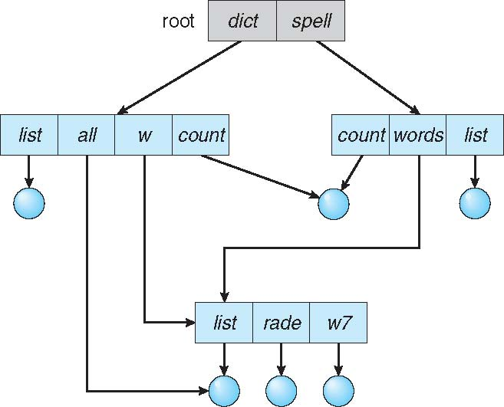
Acyclic-Graph Directories
Have shared subdirectories and files

Slide 14
Acyclic-Graph Directories (Cont.)
Two different names (aliasing)
If dict deletes list ⇒ dangling pointer
Solutions:
  Backpointers, so we can delete all pointers
  Variable size records a problem
  Backpointers using a daisy chain organization
  Entry-hold-count solution
New directory entry type
  Link – another name (pointer) to an existing file
  Resolve the link – follow pointer to locate the file

Slide 15
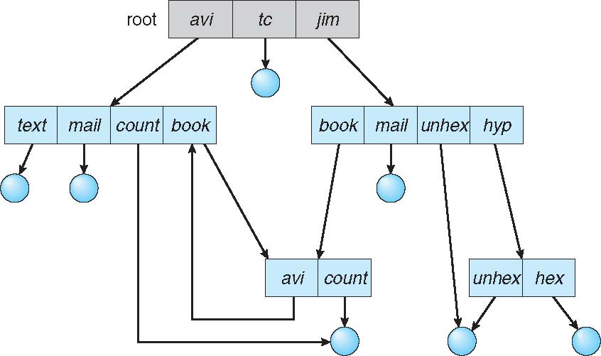
General Graph Directory

Slide 16
General Graph Directory (Cont.)
How do we guarantee no cycles?
  Allow only links to file not subdirectories
  Garbage collection
  Every time a new link is added use a cycle detection algorithm to determine whether it is OK

Slide 17
File System Mounting
A file system must be mounted before it can be accessed
A unmounted file system is mounted at a mount point

Slide 18
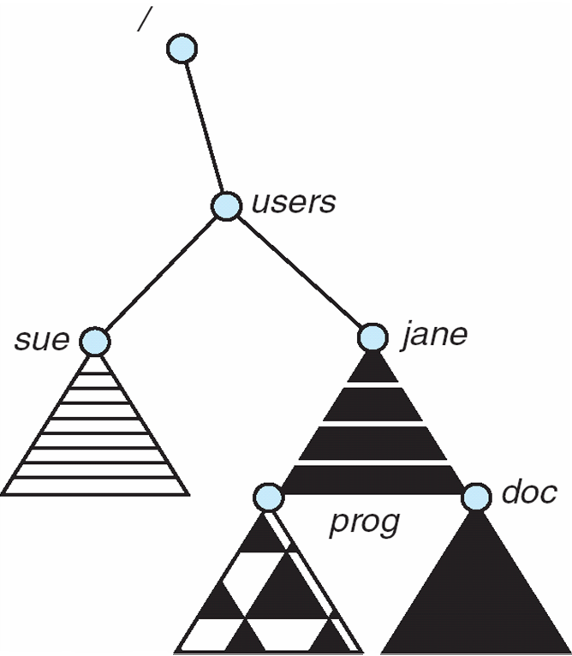
Mount Point

Slide 19
File Sharing
Sharing of files on multi-user systems is desirable
Sharing may be done through a protection scheme
On distributed systems, files may be shared across a network
Network File System (NFS) is a common distributed file-sharing method
If multi-user system
  User IDs identify users, allowing permissions and protections to be per-user
  Group IDs allow users to be in groups, permitting group access rights
  Owner of a file / directory
  Group of a file / directory

Slide 20
File Sharing – Remote File Systems
Uses networking to allow file system access between systems
  Manually via programs like FTP
  Automatically, seamlessly using distributed file systems
  Semi automatically via the world wide web
Client-server model allows clients to mount remote file systems from servers
  Server can serve multiple clients
  Client and user-on-client identification is insecure or complicated
  NFS is standard UNIX client-server file sharing protocol
  CIFS is standard Windows protocol
  Standard operating system file calls are translated into remote calls
Distributed Information Systems (distributed naming services) such as LDAP, DNS, NIS, Active Directory implement unified access to information needed for remote computing

Slide 21
File Sharing – Failure Modes
All file systems have failure modes
  For example corruption of directory structures or other non-user data, called metadata
Remote file systems add new failure modes, due to network failure, server failure
Recovery from failure can involve state information about status of each remote request
Stateless protocols such as NFS v3 include all information in each request, allowing easy recovery but less security

Slide 22
File Sharing – Consistency Semantics
Specify how multiple users are to access a shared file simultaneously
  Similar to process synchronization algorithms
    Tend to be less complex due to disk I/O and network latency (for remote file systems
  Andrew File System (AFS) implemented complex remote file sharing semantics
  Unix file system (UFS) implements:
    Writes to an open file visible immediately to other users of the same open file
    Sharing file pointer to allow multiple users to read and write concurrently
  AFS has session semantics
    Writes only visible to sessions starting after the file is closed

Slide 23
Protection
File owner/creator should be able to control:
  what can be done
  by whom
Types of access
  Read
  Write
  Execute
  Append
  Delete
  List

Slide 24
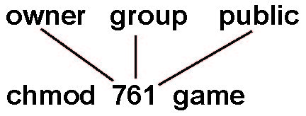
Access Lists and Groups
Mode of access: read, write, execute
Three classes of users on Unix / Linux
RWX
a) owner access 7 ⇒ 1 1 1
RWX
b) group access 6 ⇒ 1 1 0
RWX
c) public access 1 ⇒ 0 0 1
Ask manager to create a group (unique name), say G, and add some users to the group.
For a particular file (say game) or subdirectory, define an appropriate access.
Attach a group to a file
chgrp G game

Slide 25
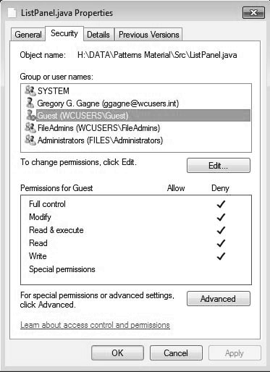
Windows 7 Access-Control List Management

Slide 26
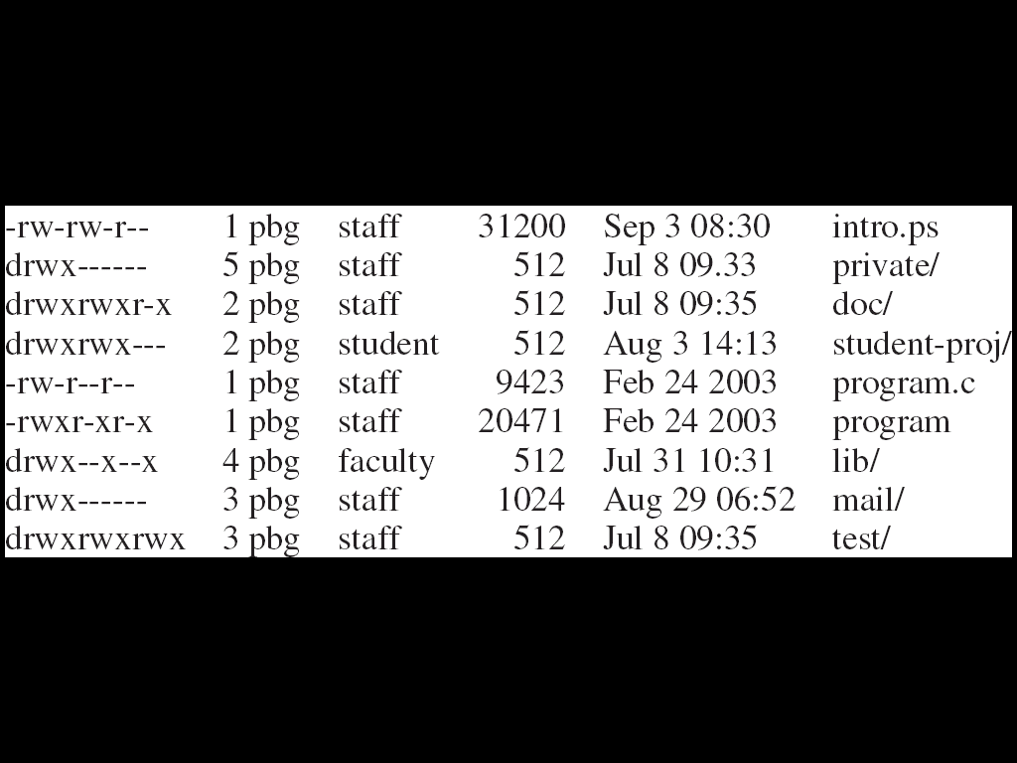
A Sample UNIX Directory Listing

