Slide 1
CSMC 412
Operating Systems
Prof. Ashok K Agrawala
Online Set 12
File System Implementation

Slide 2
File System
Structure
Naming
Directory structure
Operations
…

Slide 3
File system Implementation
Defines
How files and directories are stored
How disk space is managed
How to make everything work efficiently and reliably

Slide 4
File-System Structure
File structure
Logical storage unit
Collection of related information
File system resides on secondary storage (disks)
Provides user interface to storage, mapping logical to physical
Provides efficient and convenient access to disk by allowing data to be stored, located, and retrieved easily
Disk provides in-place rewrite and random/direct access
I/O transfers performed in blocks of sectors (usually 512 bytes)
File control block – storage structure consisting of information about a file
Device driver controls the physical device
File system organized into layers

Slide 5
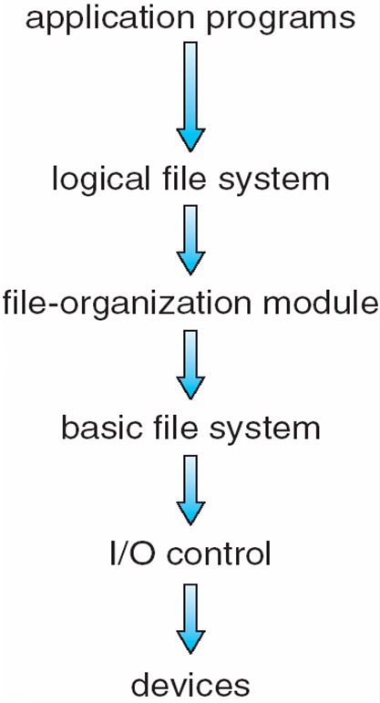
Layered File System

Slide 6
File System Layers
Device drivers manage I/O devices at the I/O control layer
Given commands like “read drive1, cylinder 72, track 2, sector 10, into memory location 1060” outputs low-level hardware specific commands to hardware controller to carry out the operations called for
Basic file system given command like “retrieve block 123” translates to device driver commands
Also manages memory buffers and caches (allocation, freeing, replacement)
Buffers hold data in transit
Caches hold frequently used data
File organization module understands files, logical address, and physical blocks
Translates logical block # to physical block #
Manages free space, disk allocation

Slide 7
File System Layers (Cont.)
Logical file system manages metadata information
Translates file name into file number, file handle, location by maintaining file control blocks (inodes in UNIX)
Directory management
Protection
Layering useful for reducing complexity and redundancy but
adds overhead and can decrease performance.
Translates file name into file number, file handle, location by maintaining file control blocks (inodes in UNIX)
Logical layers can be implemented by any coding method according to OS designer

Slide 8
File System Layers (Cont.)
Many file systems, sometimes many within an operating system
Each with its own format (CD-ROM is ISO 9660; Unix has UFS, FFS; Windows has FAT, FAT32, NTFS as well as floppy, CD, DVD Blu-ray;
Linux has more than 40 types, with extended file system ext2 and ext3 leading; plus distributed file systems, etc.)
New ones still arriving – ZFS, GoogleFS, Oracle ASM, FUSE

Slide 9
File-System Implementation
We have system calls at the API level, but how do we implement their functions?
On-disk and in-memory structures
Boot control block contains info needed by system to boot OS from that volume
Needed if volume contains OS, usually first block of volume
Volume control block (superblock, master file table) contains volume details
Total # of blocks, # of free blocks, block size, free block pointers or array
Directory structure organizes the files
Names and inode numbers, master file table

Slide 10
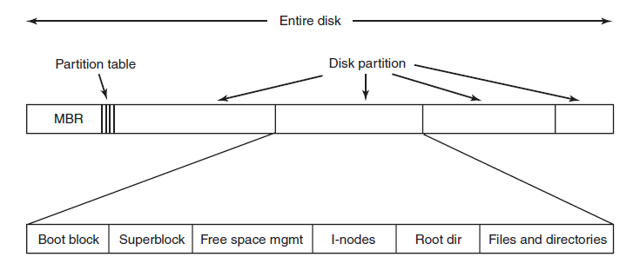
File System Layout

Slide 11
File System Layout
MBR: Master Boot Record
Partition table:
present at the end of MBR
Gives the starting and ending address of each partition
Boot Block: When a computer is booted,
BIOS reads and executes MBR
Locates active partition
Reads the first block – Boot Block – and executes it.
Program in the boot block loads the operating system contained in that partition
Every partition contains a boot block even though it may not have a bootable OS

Slide 12
File System Layout (Cont.)
Volume Control Block – per volume
Number of blocks in the volume
Size of blocks
Free blocks count
Free-block pointers
Free-FCB count
FCB pointer
In UFS it is called a Superblcok
In NTFS it is stored in Master File Table
Directory Structure – per file system
Used to organize files
In UFS - File names and associated inode numbers

Slide 13
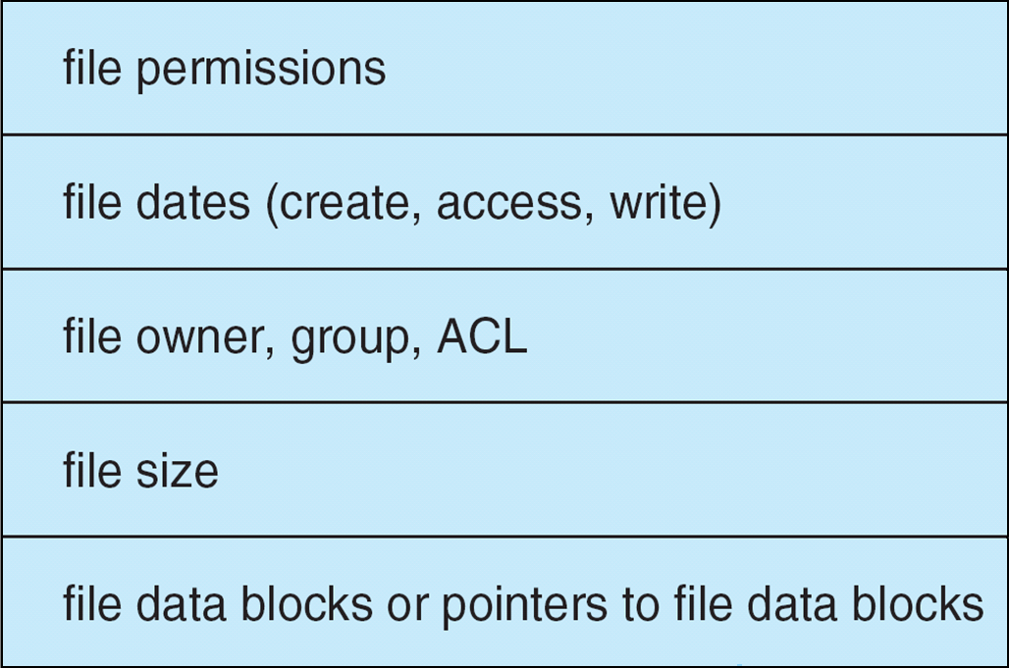
File-System Layout (Cont.)
Per-file File Control Block (FCB) contains many details about the file
In UFS it includes inode number, permissions, size, dates
In NTFS stores into master file table
using relational DB structures
One row per file

Slide 14
Operations
Open
Call passes the file name to the logical file system
Open system call searches the system-wide open-file table
To check if the file is in use by another process
Create a per-process open-file table entry, pointing to the system-wide open-file table entry
Else
Search the directory structure
Copy FCB into a system-wide open-file table entry in the memory
Make an entry in per-process open-file table with a pointer to the system-wide table entry
Per-process open-file table also stores information such as the current location in the file
Returns a pointer to the per-process entry
File descriptor in UFS
File handle in Windows

Slide 15
Operations
Close
Remove per-process table entry
Decrement system-wide entry’s open count
When count goes to zero
Any updated meta data copied to disk-based directory structure
System-wide entry is removed

Slide 16
In-Memory File System Structures
Mount table storing file system mounts, mount points, file system types
The following figure illustrates the necessary file system structures provided by the operating systems
opening a file
reading a file
Plus buffers hold data blocks from secondary storage
Open returns a file handle for subsequent use
Data from read eventually copied to specified user process memory address

Slide 17
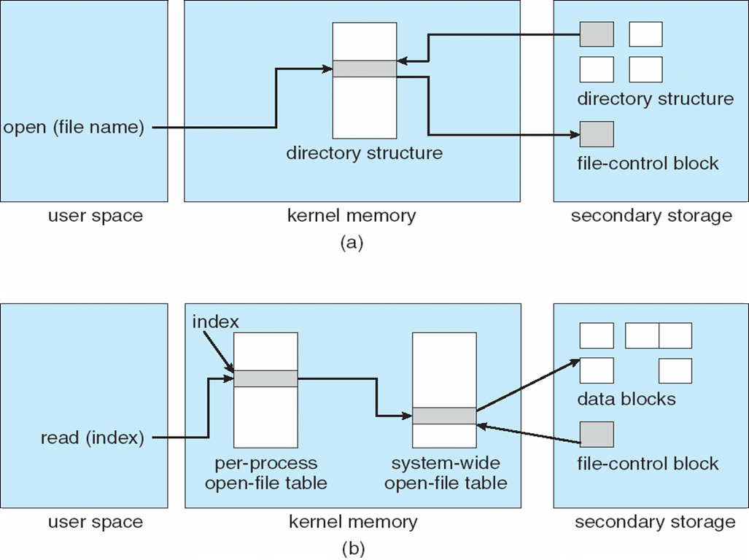
In-Memory File System Structures

Slide 18
Directory Implementation
Linear list of file names with pointer to the data blocks
Simple to program
Time-consuming to execute
Linear search time
Could keep ordered alphabetically via linked list or use B+ tree
Hash Table – linear list with hash data structure
Decreases directory search time
Collisions – situations where two file names hash to the same location
Only good if entries are fixed size, or use chained-overflow method

Slide 19
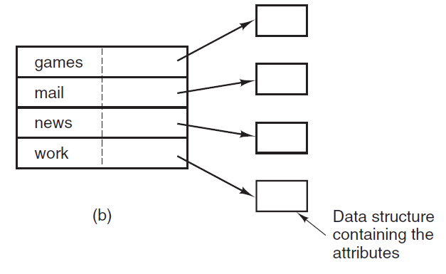
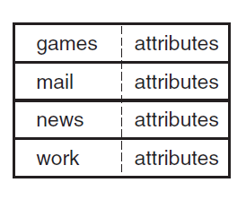
Directory Implementation

Slide 20
Allocation Methods - Contiguous
An allocation method refers to how disk blocks are allocated for files:
Contiguous allocation – each file occupies set of contiguous blocks
Best performance in most cases
Simple – only starting location (block #) and length (number of blocks) are required
Problems include
finding space for file,
knowing file size,
external fragmentation,
need for compaction
off-line (downtime) or on-line

Slide 21
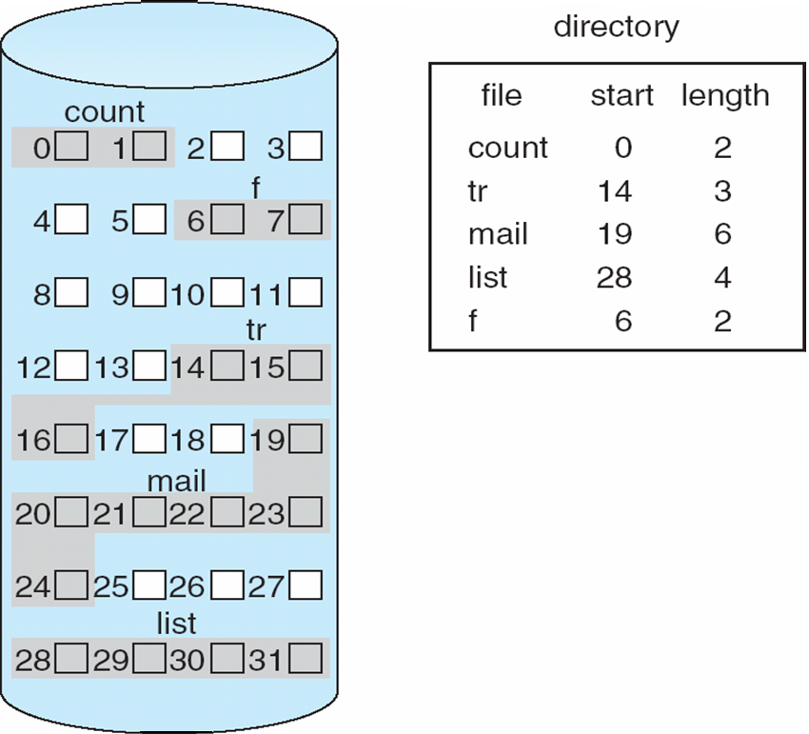
Contiguous Allocation
Mapping from logical to physical
Q
LA/512
R
Block to be accessed = Q + starting address
Displacement into block = R

Slide 22
Extent-Based Systems
Many newer file systems (i.e., Veritas File System) use a modified contiguous allocation scheme
Extent-based file systems allocate disk blocks in extents
Allocate in contiguous chunk of space
An extent is a contiguous block of disks sectors
Extents are allocated for file allocation

Slide 23
Allocation Methods - Linked
Linked allocation – each file a linked list of blocks
File ends at nil pointer
No external fragmentation
Each block contains pointer to next block
No compaction required
Free space management system called when new block needed
Improve efficiency by clustering blocks into groups but increases internal fragmentation
Reliability can be a problem
Locating a block can take many I/Os and disk seeks

Slide 24
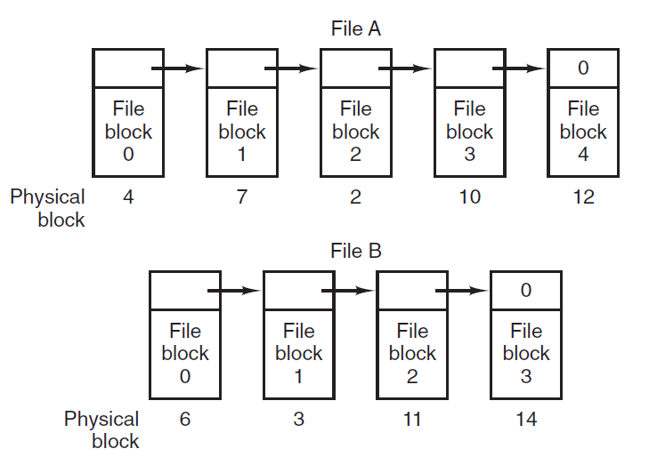
Linked Allocation

Slide 25
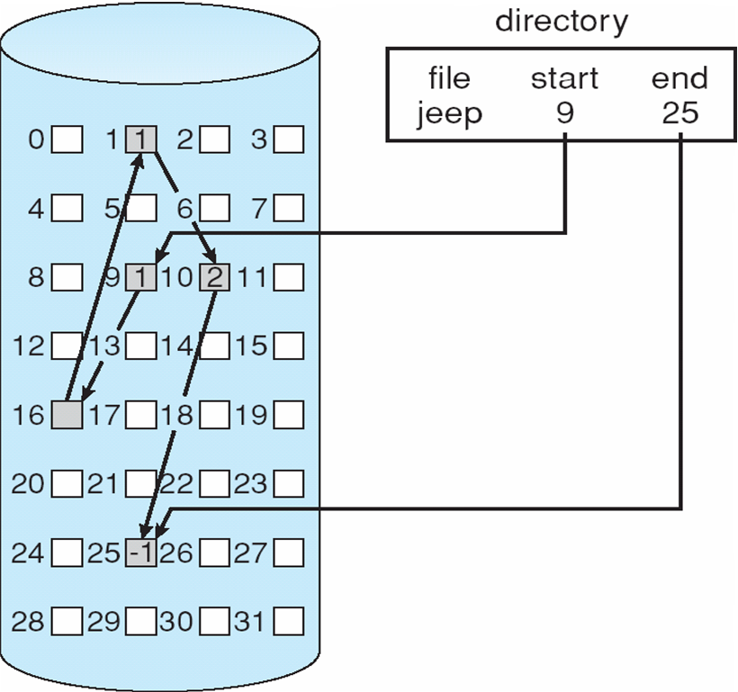
Linked Allocation

Slide 26
Allocation Methods – Linked (Cont.)
FAT (File Allocation Table) variation
Beginning of volume has table, indexed by block number
Much like a linked list, but faster on disk and cacheable
New block allocation simple

Slide 27
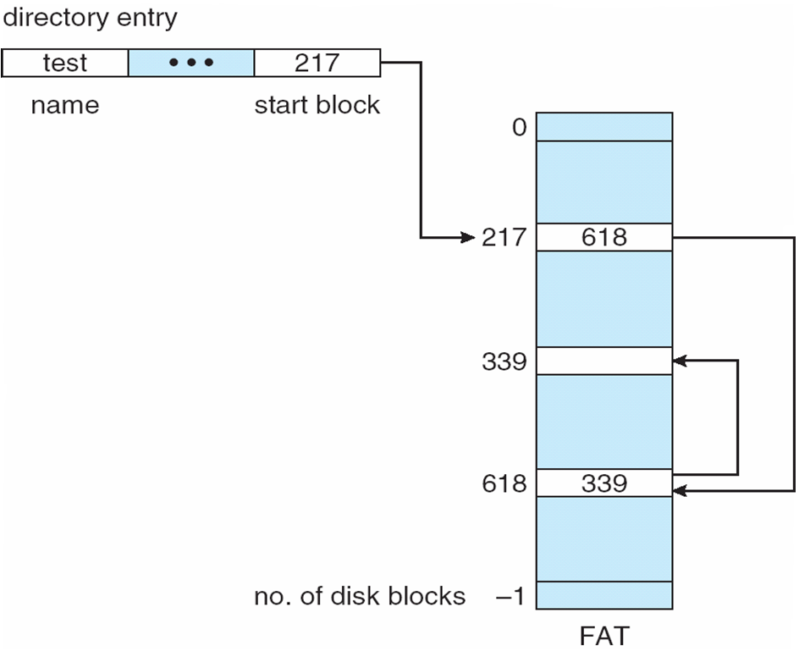
File-Allocation Table

Slide 28
Allocation Methods - Indexed
Indexed allocation
Each file has its own index block(s) of pointers to its data blocks
Logical view

Slide 29
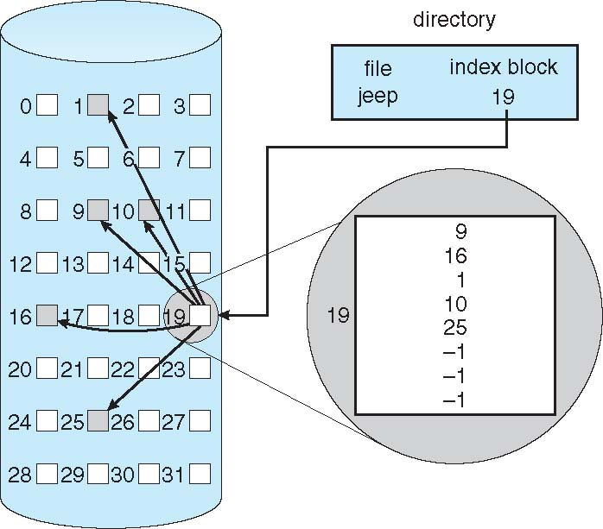
Example of Indexed Allocation

Slide 30
Indexed Allocation (Cont.)
Need index table
Random access
Dynamic access without external fragmentation, but have overhead of index block
Mapping from logical to physical in a file of maximum size of 256K bytes and block size of 512 bytes. We need only 1 block for index table

Slide 31
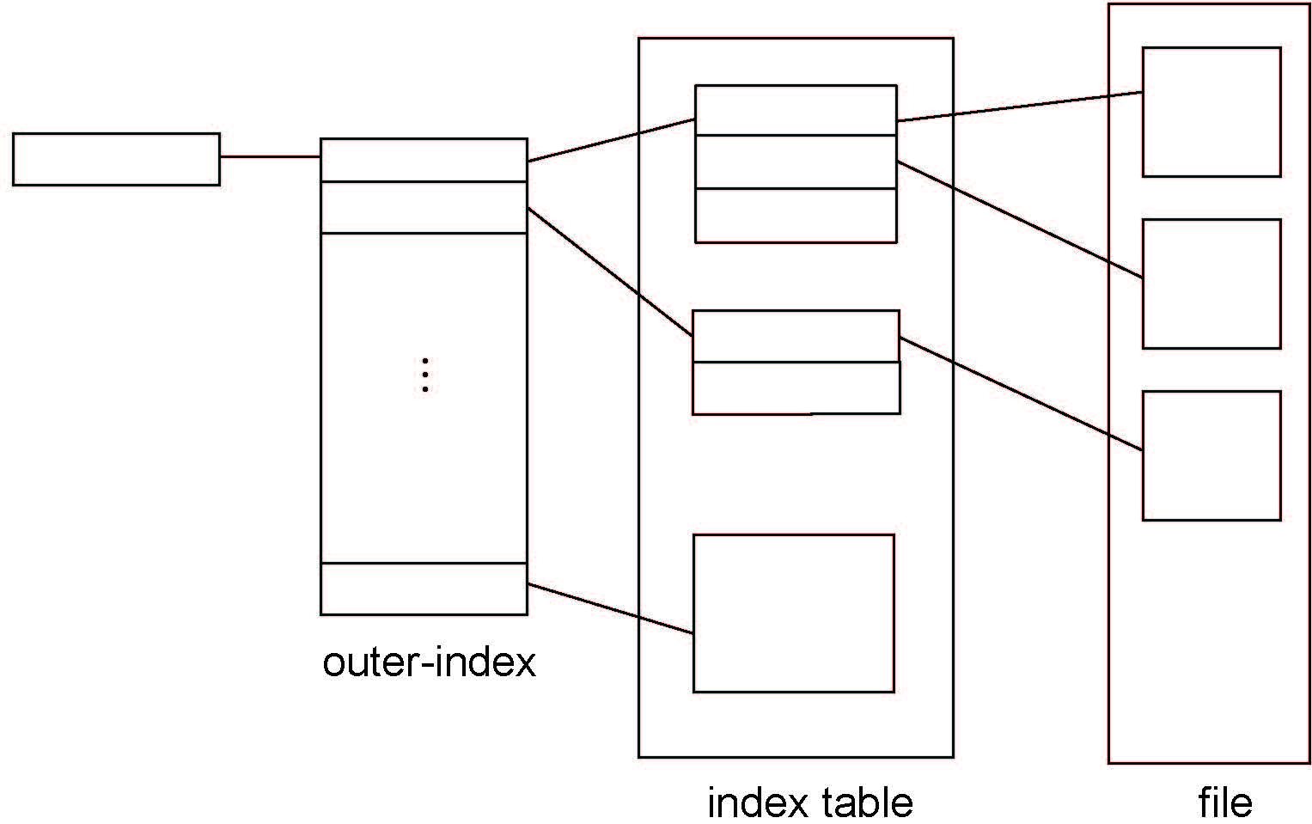
Indexed Allocation – Mapping (Cont.)

Slide 32
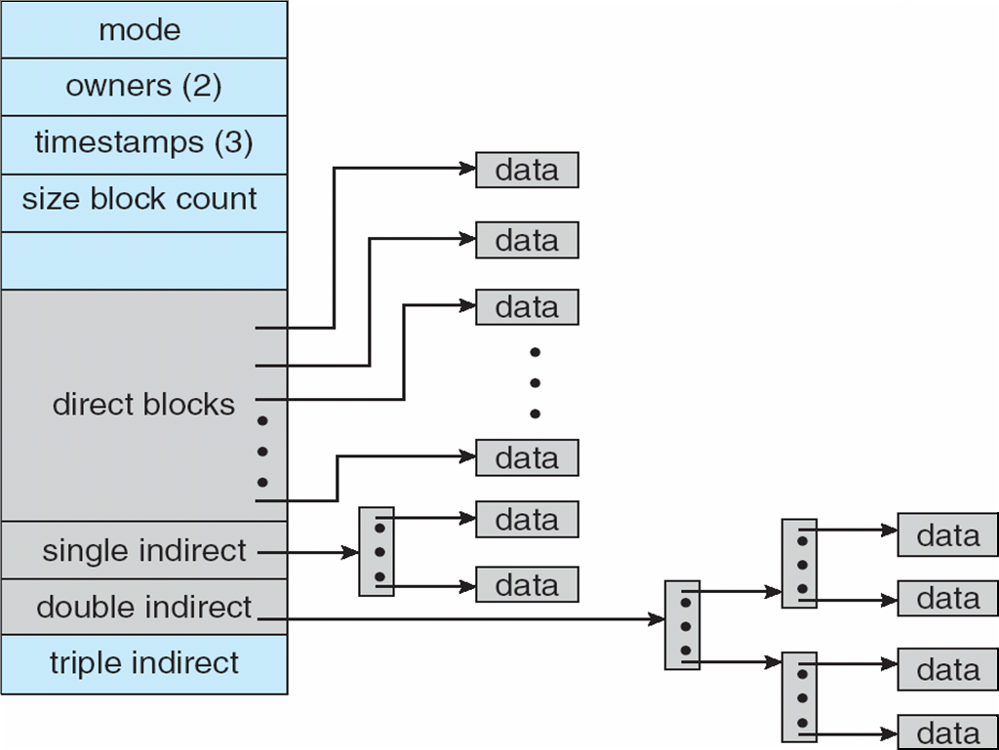
Combined Scheme: UNIX UFS
4K bytes per block, 32-bit addresses
More index blocks than can be addressed with 32-bit file pointer

Slide 33
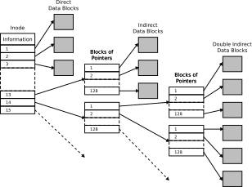
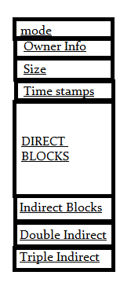
Inode Structure

Slide 34
Performance
Best method depends on file access type
Contiguous great for sequential and random
Linked good for sequential, not random
Declare access type at creation -> select either contiguous or linked
Indexed more complex
Single block access could require 2 index block reads then data block read
Clustering can help improve throughput, reduce CPU overhead

Slide 35
Performance (Cont.)
Adding instructions to the execution path to save one disk I/O is reasonable
Intel Core i9 – 9900K (2019) at 4.7Ghz = 412,090 MIPS
http://en.wikipedia.org/wiki/Instructions_per_second
Typical disk drive at 250 I/Os per second
412,090 MIPS / 250 = 1,648 million instructions during one disk I/O
Fast SSD drives provide 60,000 IOPS
412,090 MIPS / 60,000 = 6.86 millions instructions during one disk I/O

Slide 36
Free-Space Management
File system maintains free-space list to track available blocks/clusters
(Using term “block” for simplicity)
Bit vector or bit map (n blocks)
0
1
2
n-1
…
1 ⇒ block[i] free
0 ⇒ block[i] occupied
bit[i] =

Block number calculation
(number of bits per word) *
(number of 0-value words) +
offset of first 1 bit
CPUs have instructions to return offset within word of first “1” bit

Slide 37
Free-Space Management (Cont.)
Bit map requires extra space
Example:
block size = 4KB = 2¹² bytes
disk size = 2⁴⁰ bytes (1 terabyte)
n = 2⁴⁰/2¹² = 2²⁸ bits (or 32MB)
if clusters of 4 blocks -> 8MB of memory
Easy to get contiguous files

Slide 38
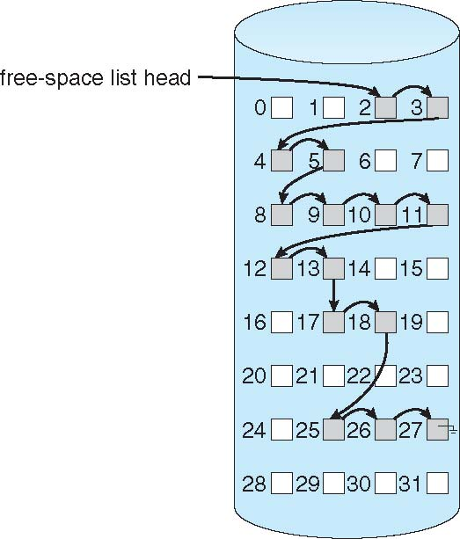
Linked Free Space List on Disk
Linked list (free list)
Cannot get contiguous space easily
No waste of space
No need to traverse the entire list (if # free blocks recorded)

Slide 39
Free-Space Management (Cont.)
Grouping
Modify linked list to store address of next n-1 free blocks in first free block, plus a pointer to next block that contains free-block-pointers (like this one)
Counting
Because space is frequently contiguously used and freed, with contiguous-allocation, extents, or clustering
Keep address of first free block and count of following free blocks
Free space list then has entries containing addresses and counts

Slide 40
Efficiency and Performance
Efficiency dependent on:
Disk allocation and directory algorithms
Types of data kept in file’s directory entry
Pre-allocation or as-needed allocation of metadata structures
Fixed-size or varying-size data structures

Slide 41
Efficiency and Performance (Cont.)
Performance
Keeping data and metadata close together
Buffer cache – separate section of main memory for frequently used blocks
Synchronous writes sometimes requested by apps or needed by OS
No buffering / caching – writes must hit disk before acknowledgement
Asynchronous writes more common, buffer-able, faster
Free-behind and read-ahead – techniques to optimize sequential access
Reads frequently slower than writes

Slide 42
Page Cache
A page cache caches pages rather than disk blocks using virtual memory techniques and addresses
Memory-mapped I/O uses a page cache
Routine I/O through the file system uses the buffer (disk) cache
This leads to the following figure

Slide 43
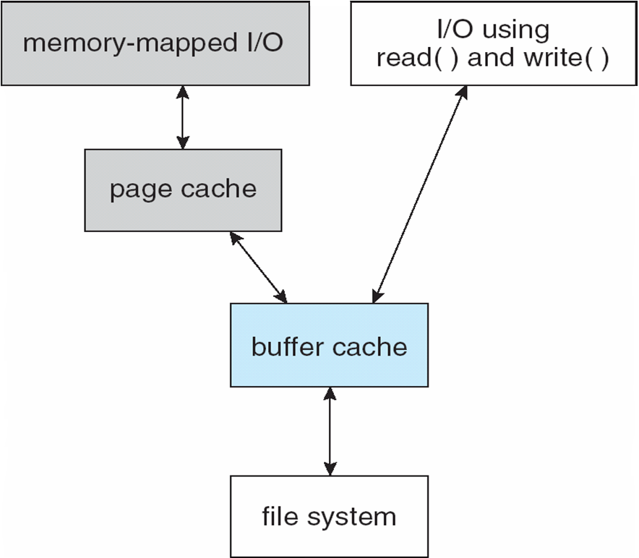
I/O Without a Unified Buffer Cache

Slide 44
Unified Buffer Cache
A unified buffer cache uses the same page cache to cache both memory-mapped pages and ordinary file system I/O to avoid double caching
But which caches get priority, and what replacement algorithms to use?

Slide 45
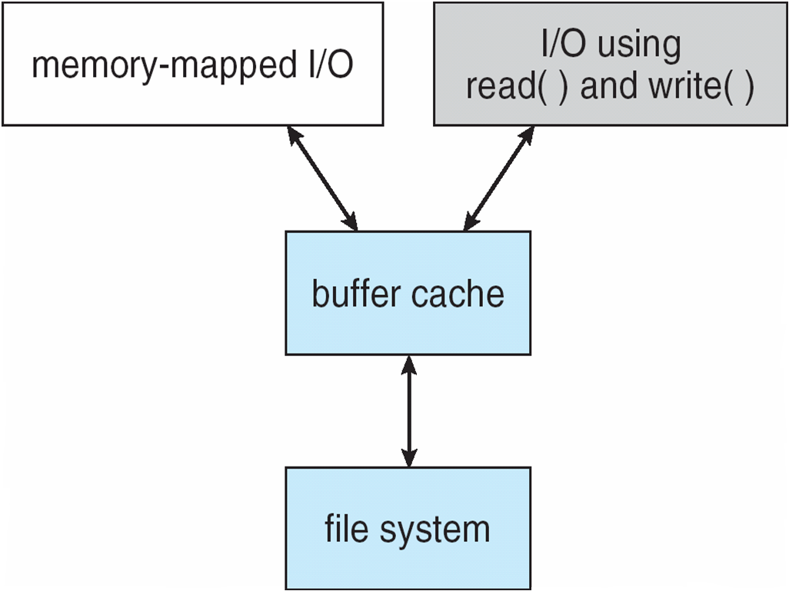
I/O Using a Unified Buffer Cache

Slide 46
Recovery
Consistency checking – compares data in directory structure with data blocks on disk, and tries to fix inconsistencies
Can be slow and sometimes fails
Use system programs to back up data from disk to another storage device (magnetic tape, other magnetic disk, optical)
Recover lost file or disk by restoring data from backup

Slide 47
Log Structured File Systems
Log structured (or journaling) file systems record each metadata update to the file system as a transaction
All transactions are written to a log
A transaction is considered committed once it is written to the log (sequentially)
Sometimes to a separate device or section of disk
However, the file system may not yet be updated
The transactions in the log are asynchronously written to the file system structures
When the file system structures are modified, the transaction is removed from the log
If the file system crashes, all remaining transactions in the log must still be performed
Faster recovery from crash, removes chance of inconsistency of metadata

