Slide 1
CSMC 412
Operating Systems
Prof. Ashok K Agrawala
Online Set 15
Security

Slide 2
Security
The Security Problem
Program Threats
System and Network Threats
Cryptography as a Security Tool
User Authentication
Implementing Security Defenses
Firewalling to Protect Systems and Networks
Computer-Security Classifications
An Example: Windows 7

Slide 3
Structure
Data
Process
User
User Authentication
Access Control
Intrusion

Slide 4
The Security Problem
Security –
Guarding computer resources against unauthorized access, malicious destruction or alteration, and accidental introduction of inconsistency.
Protection –
Controlling the access of processes and users to the resources defined by a computer system.
System is secure if resources used and accessed as intended under all circumstances
Unachievable
Intruders (crackers) attempt to breach security
Threat is potential security violation
Attack is attempt to breach security
Attack can be accidental or malicious
Easier to protect against accidental than malicious misuse

Slide 5
User Authentication
Crucial to identify user correctly, as protection systems depend on user ID
Shared Secret
User identity most often established through passwords, can be considered a special case of either keys or capabilities
Passwords must be kept secret
Frequent change of passwords
History to avoid repeats
Use of “non-guessable” passwords
Log all invalid access attempts (but not the passwords themselves)
Unauthorized transfer
Passwords may also either be encrypted or allowed to be used only once
Does encrypting passwords solve the exposure problem?
Might solve sniffing
Consider shoulder surfing
Consider Trojan horse keystroke logger
How are passwords stored at authenticating site?

Slide 6
Passwords
Encrypt to avoid having to keep secret
But keep secret anyway (i.e. Unix uses superuser-only readably file /etc/shadow)
Use algorithm easy to compute but difficult to invert
Only encrypted password stored, never decrypted
Add “salt” to avoid the same password being encrypted to the same value
One-time passwords
Use a function based on a seed to compute a password, both user and computer
Hardware device / calculator / key fob to generate the password
Changes very frequently
Biometrics
Some physical attribute (fingerprint, hand scan)
Multi-factor authentication
Need two or more factors for authentication
i.e. USB “dongle”, biometric measure, and password

Slide 7
Passwords (cont.)

Slide 8
Biometric Techniques
Finger Print
Iris Scan
Facial Recognition

Slide 9
Two Factor Authentication
Second independent means
SMS
Email
Phone Call

Slide 10
Security Violation Categories
Breach of confidentiality
Unauthorized reading of data
Capturing secret data e.g. credit card information
Breach of integrity
Unauthorized modification of data
Breach of availability
Unauthorized destruction of data
Website defacement
Theft of service
Unauthorized use of resources
Denial of service (DOS)
Prevention of legitimate use

Slide 11
Security Violation Methods
Masquerading (breach authentication)
Pretending to be an authorized user to escalate privileges
Replay attack
As is or with message modification
Man-in-the-middle attack
Intruder sits in data flow, masquerading as sender to receiver and vice versa
Session hijacking
Intercept an already-established session to bypass authentication
Privilege escalation
Common attack type with access beyond what a user or resource is supposed to have

Slide 12
Security Measure Levels
Impossible to have absolute security, but make cost to perpetrator sufficiently high to deter most intruders
Security must occur at four levels to be effective:
Physical
Data centers, servers, connected terminals
Application
Benign or malicious apps can cause security problems
Operating System
Protection mechanisms, debugging
Network
Intercepted communications, interruption, DOS
Security is as weak as the weakest link in the chain
Humans a risk too via phishing and social-engineering attacks
But can too much security be a problem?

Slide 13
Four-layered Model of Security

Slide 14
Program Threats
Many variations, many names
Trojan Horse
Code segment that misuses its environment
Exploits mechanisms for allowing programs written by users to be executed by other users
Spyware, pop-up browser windows, covert channels
Up to 80% of spam delivered by spyware-infected systems
Trap Door
Specific user identifier or password that circumvents normal security procedures
Could be included in a compiler
How to detect them?

Slide 15
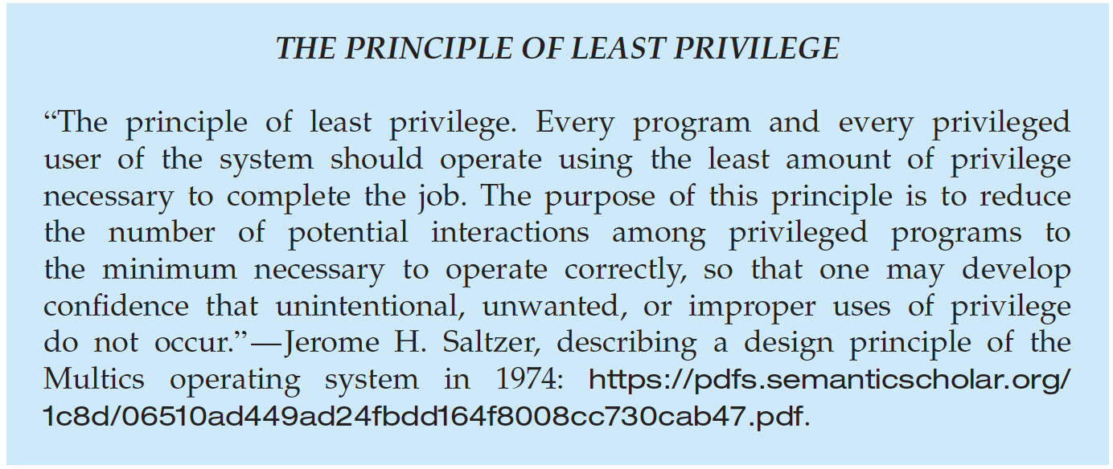
Program Threats (Cont.)
Malware - Software designed to exploit, disable, or damage computer
Trojan Horse – Program that acts in a clandestine manner
Spyware – Program frequently installed with legitimate software to display adds, capture user data
Ransomware – locks up data via encryption, demanding payment to unlock it
Others include trap doors, logic bombs
All try to violate the Principle of Least Privilege
Goal frequently is to leave behind Remote Access Tool (RAT) for repeated access

Slide 16
Code Injection
Code-injection attack occurs when system code is not malicious but has bugs allowing executable code to be added or modified
Results from poor or insecure programming paradigms, commonly in low level languages like C or C++ which allow for direct memory access through pointers
Goal is a buffer overflow in which code is placed in a buffer and execution caused by the attack
Can be run by script kiddies – use tools written but exploit identifiers

Slide 17
C Program with Buffer-overflow Condition
#include <stdio.h>
#define BUFFER SIZE 256
int main(int argc, char *argv[])
{
char buffer[BUFFER SIZE];
if (argc < 2)
return -1;
else {
strcpy(buffer,argv[1]);
return 0;
}
}
Code review can help – programmers review each other’s code, looking for logic flows, programming flaws

Slide 18
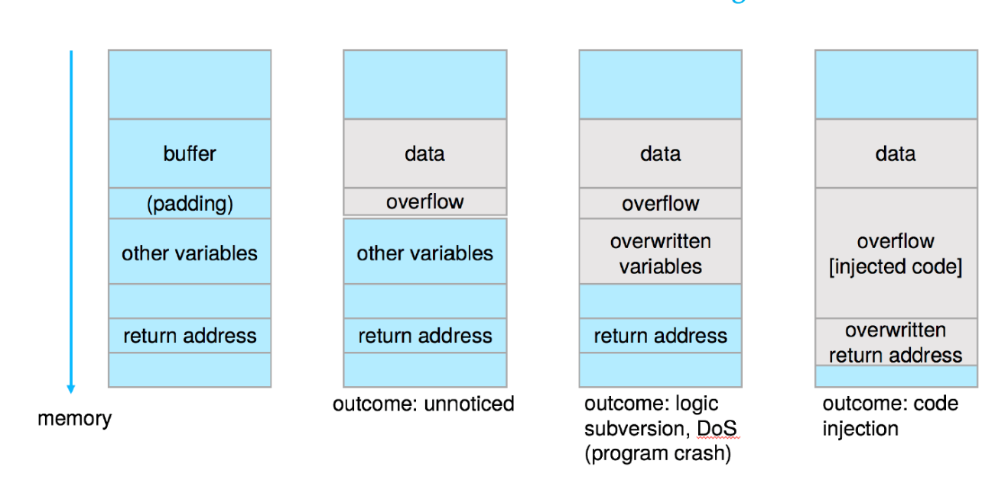
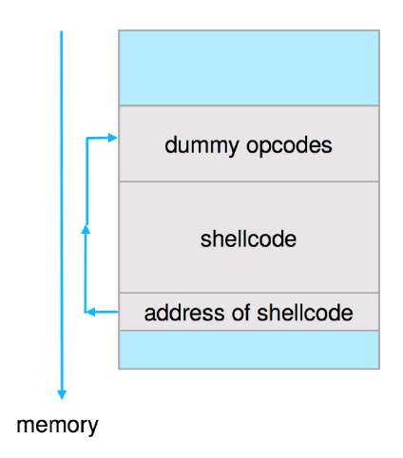
Code Injection (cont.)
Outcomes from code injection include:
Frequently use trampoline to code execution to exploit buffer overflow:

Slide 19
Great Programming Required?
The first step is determining the bug, and second step of writing exploit code
Script kiddies can run pre-written exploit code to attack a given system
Attack code can get a shell with the processes’ owner’s permissions
Or open a network port, delete files, download a program, etc
Depending on bug, attack can be executed across a network using allowed connections, bypassing firewalls
Buffer overflow can be disabled by disabling stack execution or adding bit to page table to indicate “non-executable” state
Available in SPARC and x86
But still have security exploits

Slide 20
Program Threats (Cont.)
Viruses
Code fragment embedded in legitimate program
Self-replicating, designed to infect other computers
Very specific to CPU architecture, operating system, applications
Usually borne via email or as a macro
Visual Basic Macro to reformat hard drive
Sub AutoOpen()
Dim oFS
Set oFS = CreateObject(’’Scripting.FileSystemObject’’)
vs = Shell(’’c:command.com /k format c:’’,vbHide)
End Sub

Slide 21
Program Threats (Cont.)
Virus dropper inserts virus onto the system
Many categories of viruses, literally many thousands of viruses
File / parasitic
Boot / memory
Macro
Rootkit
Source code
Polymorphic to avoid having a virus signature
Encrypted
Stealth
Tunneling
Multipartite
Armored

Slide 22
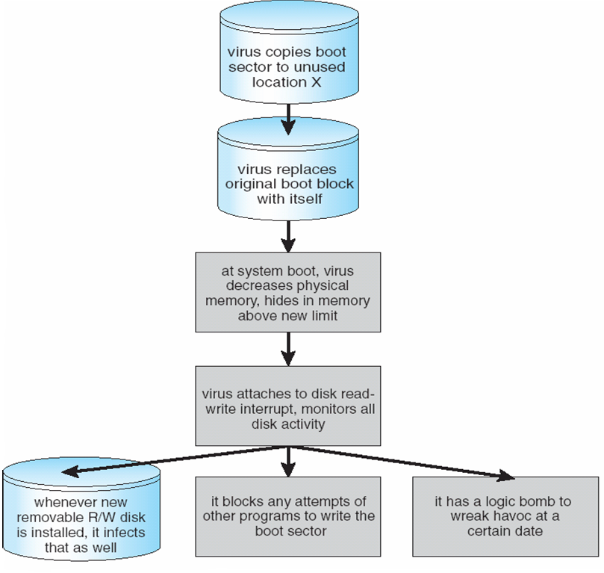
A Boot-sector Computer Virus

Slide 23
The Threat Continues
Attacks still common, still occurring
Attacks moved over time from science experiments to tools of organized crime
Targeting specific companies
Creating botnets to use as tool for spam and DDOS delivery
Keystroke logger to grab passwords, credit card numbers
Why is Windows the target for most attacks?
Most common
Everyone is an administrator
Licensing required?
Monoculture considered harmful

Slide 24
System and Network Threats
Some systems “open” rather than secure by default
Reduce attack surface
But harder to use, more knowledge needed to administer
Network threats harder to detect, prevent
Protection systems weaker
More difficult to have a shared secret on which to base access
No physical limits once system attached to internet
Or on network with system attached to internet
Even determining location of connecting system difficult
IP address is only knowledge

Slide 25
System and Network Threats (Cont.)
Worms – use spawn mechanism; standalone program
Internet worm
Exploited UNIX networking features (remote access) and bugs in finger and sendmail programs
Exploited trust-relationship mechanism used by rsh to access friendly systems without use of password
Grappling hook program uploaded main worm program
99 lines of C code
Hooked system then uploaded main code, tried to attack connected systems
Also tried to break into other users accounts on local system via password guessing
If target system already infected, abort, except for every 7th time

Slide 26
System and Network Threats (Cont.)
Port scanning
Automated attempt to connect to a range of ports on one or a range of IP addresses
Detection of answering service protocol
Detection of OS and version running on system
nmap scans all ports in a given IP range for a response
nessus has a database of protocols and bugs (and exploits) to apply against a system
Frequently launched from zombie systems
To decrease trace-ability

Slide 27
System and Network Threats (Cont.)
Denial of Service
Overload the targeted computer preventing it from doing any useful work
Distributed Denial-of-Service (DDoS) come from multiple sites at once
Consider the start of the IP-connection handshake (SYN)
How many started-connections can the OS handle?
Consider traffic to a web site
How can you tell the difference between being a target and being really popular?
Accidental – CS students writing bad fork() code
Purposeful – extortion, punishment
Port scanning
Automated tool to look for network ports accepting connections
Used for good and evil

Slide 28
Standard Security Attacks

Slide 29
Cryptography
Cryptography is a fundamental building block for security mechanisms.
Introduction »
Substitution ciphers »
Transposition ciphers »
One-time pads »
Fundamental cryptographic principles »

Slide 30
Cryptography as a Security Tool
Broadest security tool available
Internal to a given computer, source and destination of messages can be known and protected
OS creates, manages, protects process IDs, communication ports
Source and destination of messages on network cannot be trusted without cryptography
Local network – IP address?
Consider unauthorized host added
WAN / Internet – how to establish authenticity
Not via IP address

Slide 31
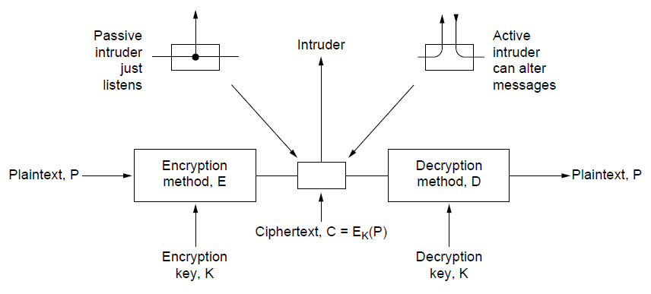
Introduction
The encryption model (for a symmetric-key cipher)
Kerckhoff’s principle: Algorithms (E, D) are public; only the keys (K) are secret
Trudy
Alice
Bob

Slide 32
Substitution Ciphers
Substitution ciphers replace each group of letters in the message with another group of letters to disguise it
Simple single-letter substitution cipher

Slide 33
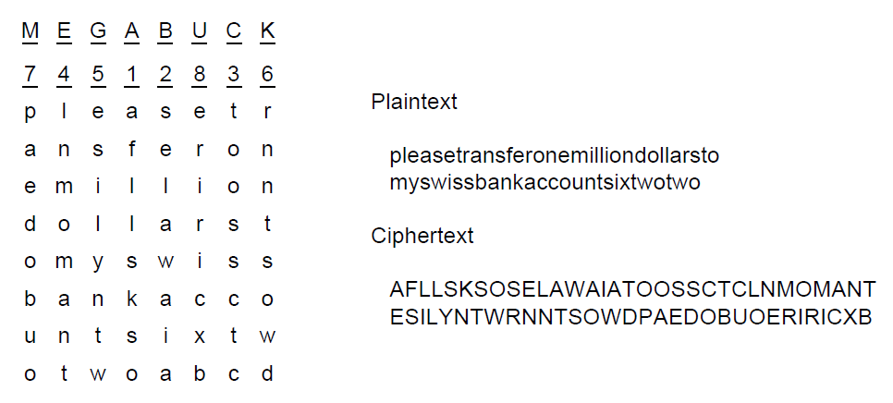
Transposition Ciphers
Transposition ciphers reorder letters to disguise them
Key gives column order
Column 5
6
7
8
Simple column transposition cipher

Slide 34
One-Time Pads (1)
Simple scheme for perfect secrecy:
XOR message with secret pad to encrypt, decrypt
Pad is as long as the message and can’t be reused!
It is a “one-time” pad to guarantee secrecy
Different secret pad decrypts to the wrong plaintext

Slide 35
Fundamental Cryptographic Principles
Messages must contain some redundancy
All encrypted messages decrypt to something
Redundancy lets receiver recognize a valid message
But redundancy helps attackers break the design
Some method is needed to foil replay attacks
Without a way to check if messages are fresh then old messages can be copied and resent
For example, add a date stamp to messages

Slide 36
Symmetric-Key Algorithms
Encryption in which the parties share a secret key
DES – Data Encryption Standard »
AES – Advanced Encryption Standard »
Cipher modes »
Other ciphers »
Cryptanalysis »

Slide 37
Symmetric-Key Algorithms (1)
Use the same secret key to encrypt and decrypt; block ciphers operate a block at a time
Product cipher combines transpositions/substitutions
Permutation
(transposition)
box
Substitution
box
Product with multiple P- and S-boxes

Slide 38
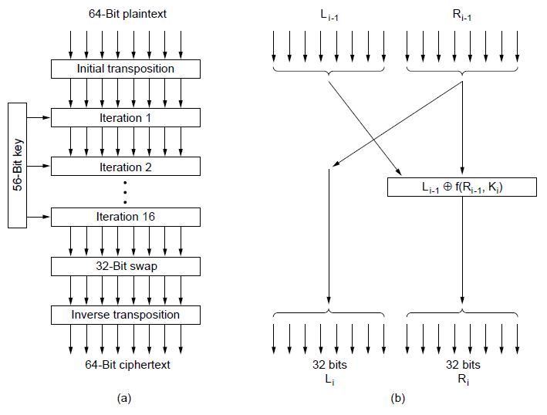
Data Encryption Standard (1)
DES encryption was widely used (but no longer secure)
Contains
transpositions & substitutions
DES steps
A single iteration

Slide 39
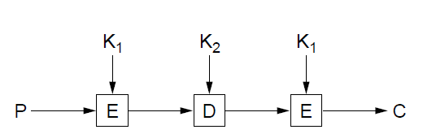
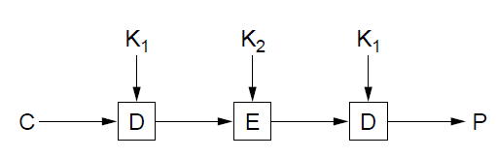
Data Encryption Standard (2)
Triple encryption (“3DES”) with two 56-bit keys
Gives an adequate key strength of 112 bits
Setting K₁ = K₂ allows for compatibility with DES
Triple DES encryption
Triple DES decryption

Slide 40
Advanced Encryption Standard (1)
AES is the successor to DES:
Symmetric block cipher, key lengths up to 256 bits
Openly designed by public competition (1997-2000)
Available for use by everyone
Built as software (e.g., C) or hardware (e.g., x86)
Winner was Rijndael cipher
Now a widely used standard

Slide 41
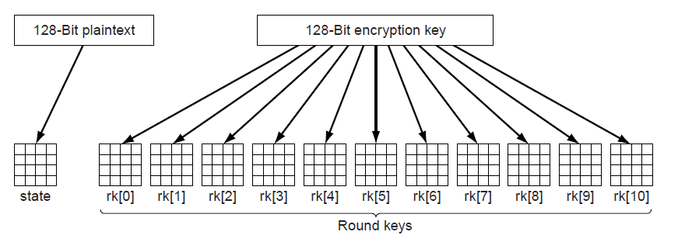
Advanced Encryption Standard (2)
AES uses 10 rounds for 128-bit block and 128-bit key
Each round uses a key derived from 128-bit key
Each round has a mix of substitutions and rotations
All steps are reversible to allow for decryption
Round keys are derived from 128-bit secret key

Slide 42
Cipher Modes (1)
Cipher modes set how long messages are encrypted
Encrypting each block independently, called ECB (Electronic Code Book) mode, is vulnerable to shifts
With ECB mode, switching encrypted blocks gives a different but valid message
Leslie gets a large bonus!

Slide 43
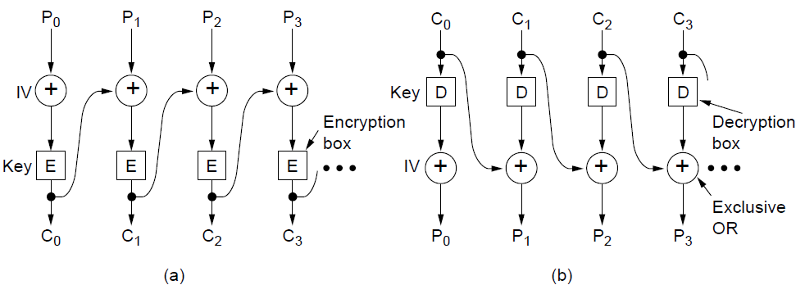
Cipher Modes (2)
CBC (Cipher Block Chaining) is a widely used mode
Chains blocks together with XOR to prevent shifts
Has a random IV (Initial Value) for different output
CBC mode encryption
CBC mode decryption
Notes:
Because of the IV, repeated encryptions of the same message will produce different ciphertext.

Slide 44
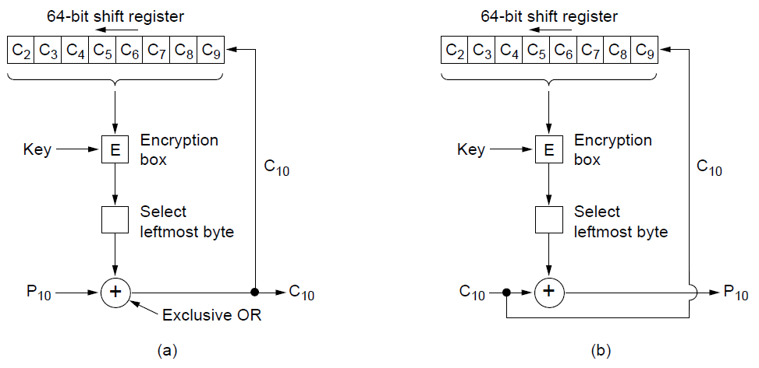
Cipher Modes (3)
There are many other modes with pros / cons, e.g., cipher feedback mode is similar to CBC mode but can operate a byte (rather than a whole block) at a time
Encryption
Decryption

Slide 45
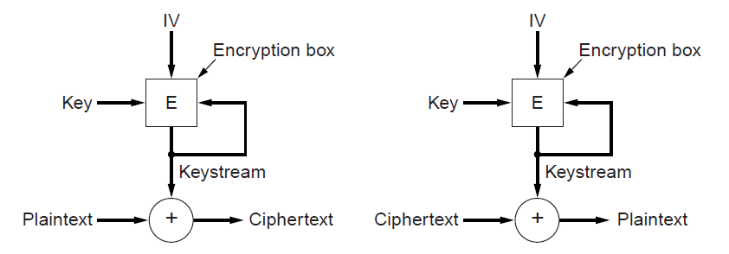
Cipher Modes (4)
A stream cipher uses the key and IV to generate a stream that is a one-time pad; can’t reuse (key, IV) pair
Doesn’t amplify transmission errors like CBC mode
Encryption
Decryption

Slide 46
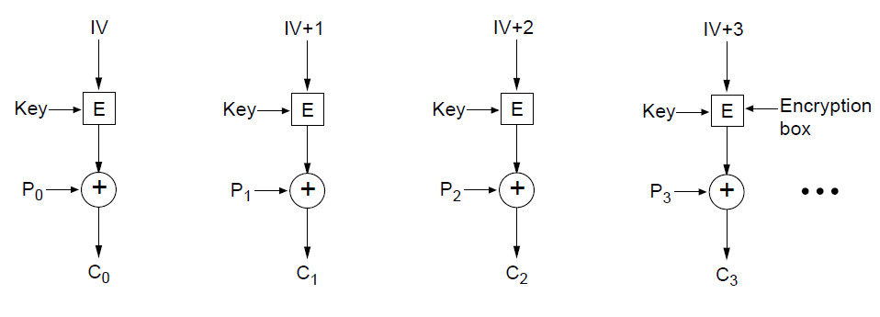
Cipher Modes (5)
Counter mode (encrypt a counter and XOR it with each message block) allows random access for decryption
Encryption above; repeat the operation to decrypt

Slide 47
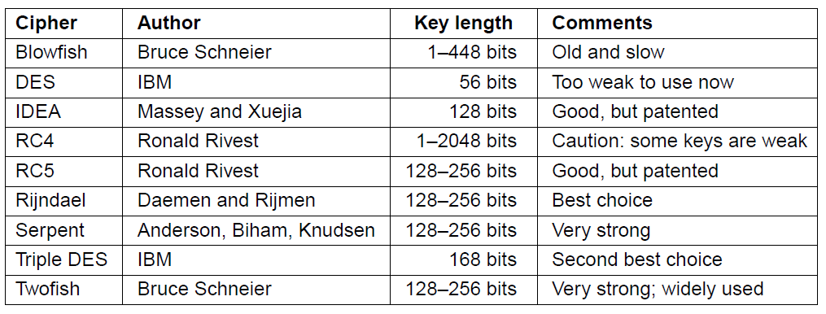
Other Ciphers
Some common symmetric-key cryptographic algorithms
Can be used in combination, e.g., AES over Twofish

Slide 48
Public-Key Algorithms
Encryption in which each party publishes a public part of their key and keep secret a private part of it
RSA (by Rivest, Shamir, Adleman) »

Slide 49
Public-Key Algorithms (1)
Downsides of keys for symmetric-key designs:
Key must be secret, yet be distributed to both parties
For N users there are N² pairwise keys to manage
Public key schemes split the key into public and private parts that are mathematically related:
Private part is not distributed; easy to keep secret
Only one public key per user needs to be managed
Security depends on the chosen mathematical property
Much slower than symmetric-key, e.g., 1000X
So use it to set up per-session symmetric keys

Slide 50
RSA (1)
RSA is a widely used public-key encryption method whose security is based on the difficulty of factoring large numbers
Key generation:
Choose two large primes, p and q
Compute n = p × q and z = ( p − 1) × (q − 1).
Choose d to be relatively prime to z
Find e such that e × d = 1 mod z
Public key is (e, n), and private key is (d, n)
Encryption (of k bit message, for numbers up to n):
Cipher = Plain^{e} (mod n)
Decryption:
Plain = Cipher^{d} (mod n)

Slide 51
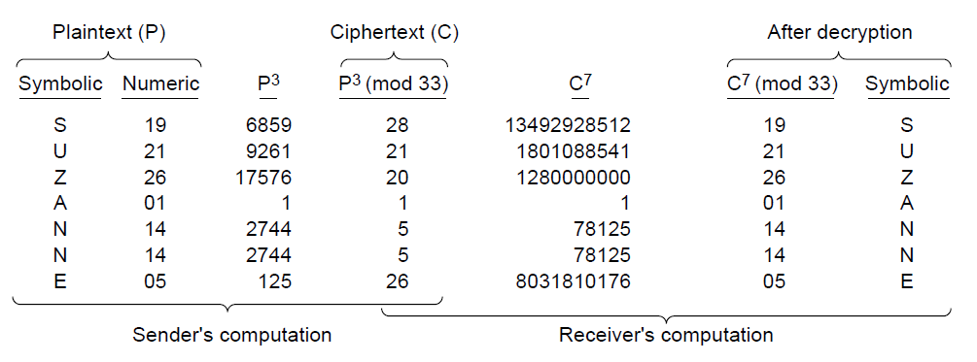
RSA (2)
Small-scale example of RSA encryption
For p=3, q=11 → n=33, z=20 → d=7, e=3
Encryption: C = P³ mod 33
Decryption: P = C⁷ mod 33

Slide 52
Digital Signatures
Lets receiver verify the message is authentic
Symmetric-Key signatures »
Public-Key signatures »
Message digests »
The birthday attack »

Slide 53
Digital Signatures (1)
Requirements for a signature:
Receiver can verify claimed identity of sender.
Sender cannot later repudiate contents of message.
Receiver cannot have concocted message himself.

Slide 54
Symmetric-key Signatures
Alice and Bob each trust and share a key with Big Brother; Big Brother doesn’t trust anyone
A=Alice, B=Bob, P=message, R_{A}=random, t=time
Only Alice can send this encrypted message to BB
Only BB can send this encrypted message to Bob
Notes:
RA and time protect against replays. Time lets very old messages be detected. For recent messages, RA can be checked to see if it has been used before.

Slide 55
Public-Key Signatures
No Big Brother and assumes encryption and decryption are inverses that can be applied in either order
But relies on private key kept and secret
RSA & DSS (Digital Signature Standard) widely used

Slide 56
Message Digests (1)
Message Digest (MD) converts arbitrary-size message (P) into a fixed-size identifier MD(P) with properties:
Given P, easy to compute MD(P).
Given MD(P), effectively impossible to find P.
Given P no one can find P′ so that MD(P′) = MD(P).
Changing 1 bit of P produces very different MD.
Message digests (also called cryptographic hash) can “stand for” messages in protocols, e.g., authentication
Example: SHA-1 160-bit hash, widely used
Example: MD5 128-bit hash – now known broken

Slide 57
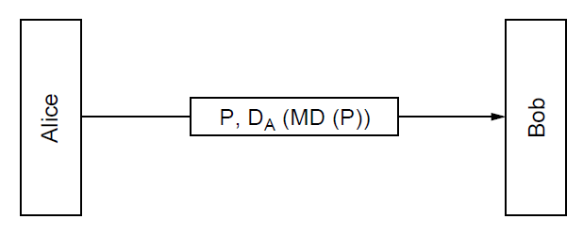
Message Digests (2)
Public-key signature for message authenticity but not confidentiality with a message digest
Message sent in the clear
Alice signs
message digest

Slide 58
Message Digests (3)
In more detail: example of using SHA-1 message digest and RSA public key for signing nonsecret messages

Slide 59
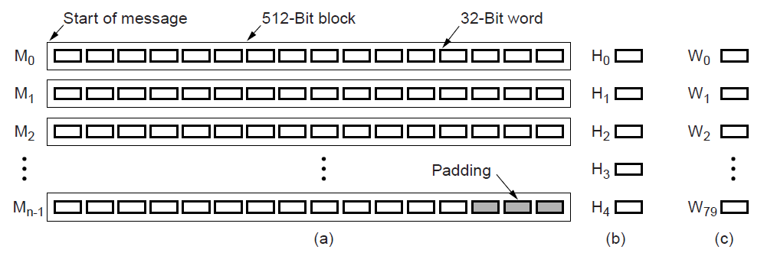
Message Digests (4)
SHA-1 digests the message 512 bits at a time to build a 160-bit hash as five 32-bit components
SHA-1
Message in 512-bit blocks
Five 32-bit hashes output

Slide 60
Management of Public Keys
We need a trusted way to distribute public keys
Certificates »
X.509, the certificate standard »
Public Key infrastructures »

Slide 61
Management of Public Keys (1)
Trudy can subvert encryption if she can fake Bob’s public key; Alice and Bob will not necessarily know
Trudy replaces E_{B} with E_{T} and acts as a “man in the middle”

Slide 62
Certificates
CA (Certification Authority) issues signed statements about public keys; users trust CA and it can be offline
A possible certificate

Slide 63
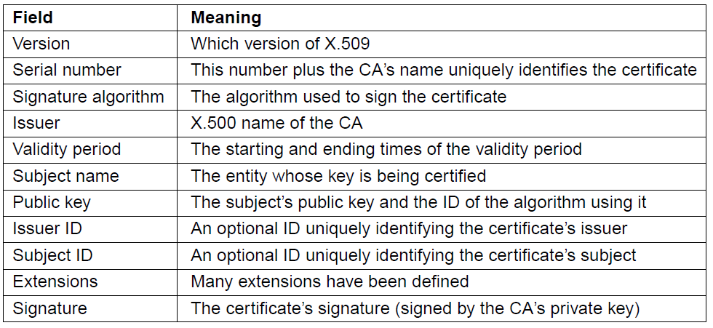
X.509
X.509 is the standard for widely used certificates
Ex: used with SSL for secure Web browsing
Basic fields in X.509 certificates

Slide 64
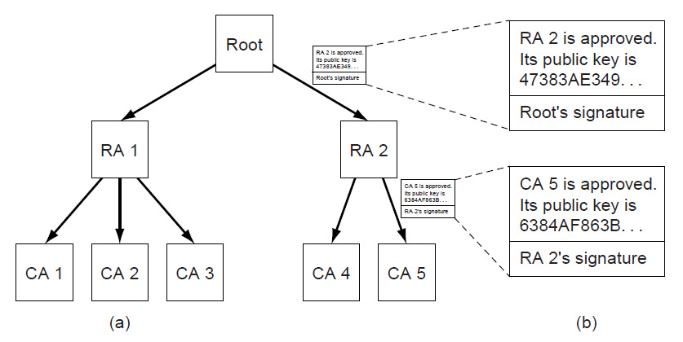
Public Key Infrastructures (PKIs)
PKI is a system for managing public keys using CAs
Scales with hierarchy, may have multiple roots
Also need CRLs (Certificate Revocation Lists)
Trust anchor
Chain of certificates for CA 5
Hierarchical PKI

Slide 65
Cryptography
Means to constrain potential senders (sources) and / or receivers (destinations) of messages
Based on secrets (keys)
Enables
Confirmation of source
Receipt only by certain destination
Trust relationship between sender and receiver

Slide 66
Encryption
Constrains the set of possible receivers of a message
Encryption algorithm consists of
Set K of keys
Set M of Messages
Set C of ciphertexts (encrypted messages)
A function E : K → (M→C). That is, for each k ∈ K, E_{k} is a function for generating ciphertexts from messages
Both E and E_{k} for any k should be efficiently computable functions
A function D : K → (C → M). That is, for each k ∈ K, D_{k} is a function for generating messages from ciphertexts
Both D and D_{k} for any k should be efficiently computable functions

Slide 67
Encryption (Cont.)
An encryption algorithm must provide this essential property: Given a ciphertext c ∈ C, a computer can compute m such that E_{k}(m) = c only if it possesses k
Thus, a computer holding k can decrypt ciphertexts to the plaintexts used to produce them, but a computer not holding k cannot decrypt ciphertexts
Since ciphertexts are generally exposed (for example, sent on the network), it is important that it be infeasible to derive k from the ciphertexts

Slide 68
Symmetric Encryption
Same key used to encrypt and decrypt
Therefore k must be kept secret
DES was most commonly used symmetric block-encryption algorithm (created by US Govt)
Encrypts a block of data at a time
Keys too short so now considered insecure
Triple-DES considered more secure
Algorithm used 3 times using 2 or 3 keys
For example
2001 NIST adopted new block cipher - Advanced Encryption Standard (AES)
Keys of 128, 192, or 256 bits, works on 128 bit blocks
RC4 is most common symmetric stream cipher, but known to have vulnerabilities
Encrypts/decrypts a stream of bytes (i.e., wireless transmission)
Key is a input to pseudo-random-bit generator
Generates an infinite keystream

Slide 69
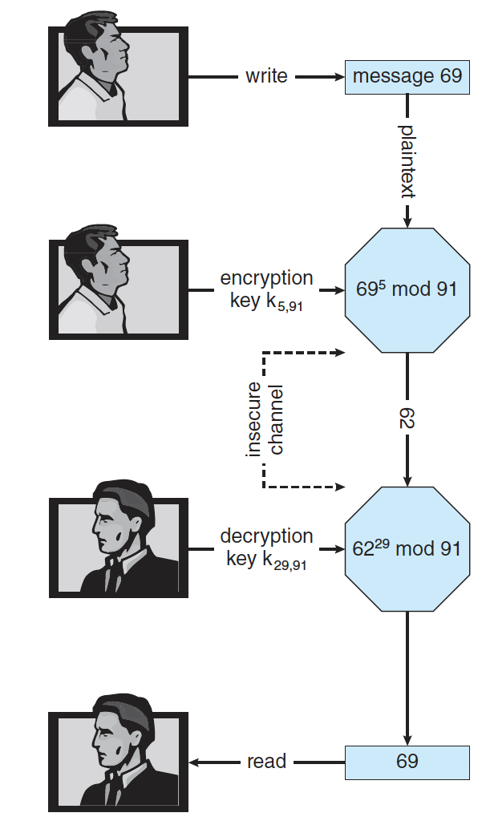
Secure Communication over Insecure Medium

Slide 70
Asymmetric Encryption
Public-key encryption based on each user having two keys:
public key – published key used to encrypt data
private key – key known only to individual user used to decrypt data
Must be an encryption scheme that can be made public without making it easy to figure out the decryption scheme
Most common is RSA block cipher
Efficient algorithm for testing whether or not a number is prime
No efficient algorithm is know for finding the prime factors of a number

Slide 71
Asymmetric Encryption (Cont.)
Formally, it is computationally infeasible to derive k_{d,N} from k_{e,N}, and so k_{e} need not be kept secret and can be widely disseminated
k_{e} is the public key
k_{d} is the private key
N is the product of two large, randomly chosen prime numbers p and q (for example, p and q are 512 bits each)
Encryption algorithm is E_{ke,N}(m) = m^{ke} mod N, where k_{e} satisfies k_{e}k_{d} mod (p−1)(q −1) = 1
The decryption algorithm is then D_{kd,N}(c) = c^{kd} mod N

Slide 72
Asymmetric Encryption Example
For example. make p = 7and q = 13
We then calculate N = 7∗13 = 91 and (p−1)(q−1) = 72
We next select k_{e} relatively prime to 72 and< 72, yielding 5
Finally, we calculate k_{d} such that k_{e}k_{d} mod 72 = 1, yielding 29
We how have our keys
Public key, k_{e,N} = 5, 91
Private key, k_{d,N} = 29, 91
Encrypting the message 69 with the public key results in the cyphertext 62
Cyphertext can be decoded with the private key
Public key can be distributed in cleartext to anyone who wants to communicate with holder of public key

Slide 73
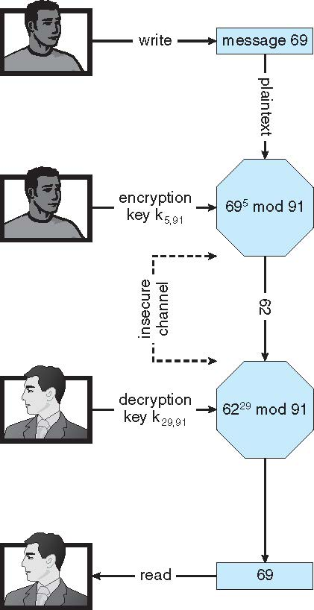
Encryption using RSA Asymmetric Cryptography

Slide 74
Cryptography (Cont.)
Note symmetric cryptography based on transformations, asymmetric based on mathematical functions
Asymmetric much more compute intensive
Typically not used for bulk data encryption

Slide 75
Message Authentication
Constraining set of potential senders of a message
Complementary to encryption
Also can prove message unmodified
Algorithm components
A set K of keys
A set M of messages
A set A of authenticators
A function S : K → (M→ A)
That is, for each k ∈ K, S_{k} is a function for generating authenticators from messages
Both S and S_{k} for any k should be efficiently computable functions
A function V : K → (M × A→ {true, false}). That is, for each k ∈ K, V_{k} is a function for verifying authenticators on messages
Both V and V_{k} for any k should be efficiently computable functions

Slide 76
Authentication (Cont.)
For a message m, a computer can generate an authenticator a ∈ A such that V_{k}(m, a) = true only if it possesses k
Thus, computer holding k can generate authenticators on messages so that any other computer possessing k can verify them
Computer not holding k cannot generate authenticators on messages that can be verified using V_{k}
Since authenticators are generally exposed (for example, they are sent on the network with the messages themselves), it must not be feasible to derive k from the authenticators
Practically, if V_{k}(m,a) = true then we know m has not been modified and that send of message has k
If we share k with only one entity, know where the message originated

Slide 77
Authentication – Hash Functions
Basis of authentication
Creates small, fixed-size block of data message digest (hash value) from m
Hash Function H must be collision resistant on m
Must be infeasible to find an m’ ≠ m such that H(m) = H(m’)
If H(m) = H(m’), then m = m’
The message has not been modified
Common message-digest functions include MD5, which produces a 128-bit hash, and SHA-1, which outputs a 160-bit hash
Not useful as authenticators
For example H(m) can be sent with a message
But if H is known someone could modify m to m’ and recompute H(m’) and modification not detected
So must authenticate H(m)

Slide 78
Authentication - MAC
Symmetric encryption used in message-authentication code (MAC) authentication algorithm
Cryptographic checksum generated from message using secret key
Can securely authenticate short values
If used to authenticate H(m) for an H that is collision resistant, then obtain a way to securely authenticate long message by hashing them first
Note that k is needed to compute both S_{k} and V_{k}, so anyone able to compute one can compute the other

Slide 79
Authentication – Digital Signature
Based on asymmetric keys and digital signature algorithm
Authenticators produced are digital signatures
Very useful – anyone can verify authenticity of a message
In a digital-signature algorithm, computationally infeasible to derive k_{s} from k_{v}
V is a one-way function
Thus, k_{v} is the public key and k_{s} is the private key
Consider the RSA digital-signature algorithm
Similar to the RSA encryption algorithm, but the key use is reversed
Digital signature of message S_{ks} (m) = H(m)^{ks} mod N
The key k_{s} again is a pair (d, N), where N is the product of two large, randomly chosen prime numbers p and q
Verification algorithm is V_{kv}(m, a) (a^{kv} mod N = H(m))
Where k_{v} satisfies k_{v}k_{s} mod (p − 1)(q − 1) = 1

Slide 80
Authentication (Cont.)
Why authentication is a subset of encryption?
Fewer computations (except for RSA digital signatures)
Authenticator usually shorter than message
Sometimes want authentication but not confidentiality
Signed patches et al
Can be basis for non-repudiation

Slide 81
Key Distribution
Delivery of symmetric key is huge challenge
Sometimes done out-of-band
Asymmetric keys can proliferate – stored on key ring
Even asymmetric key distribution needs care – man-in-the-middle attack

Slide 82
Digital Certificates
Proof of who or what owns a public key
Public key digitally signed a trusted party
Trusted party receives proof of identification from entity and certifies that public key belongs to entity
Certificate authority are trusted party – their public keys included with web browser distributions
They vouch for other authorities via digitally signing their keys, and so on

Slide 83
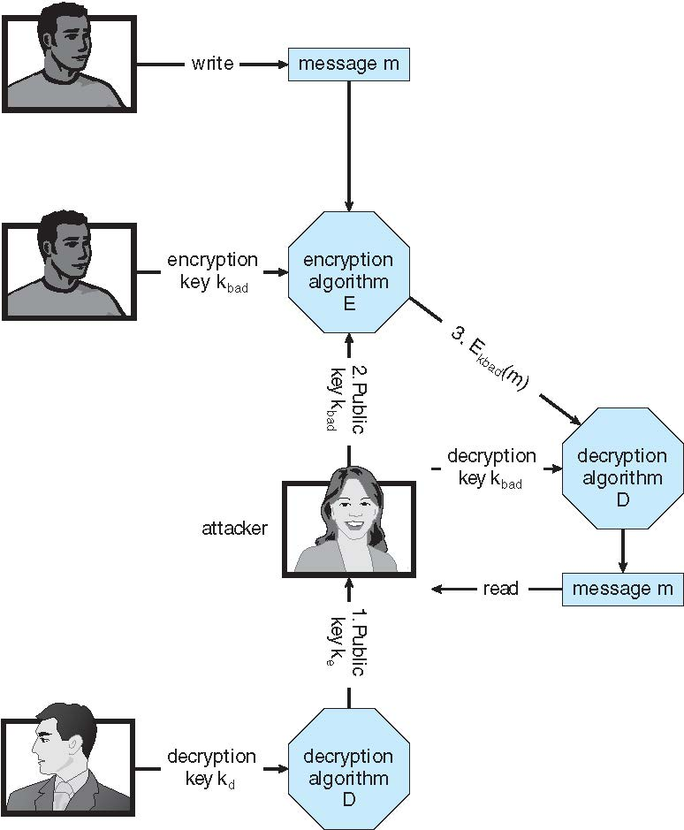
Man-in-the-middle Attack on Asymmetric Cryptography

Slide 84
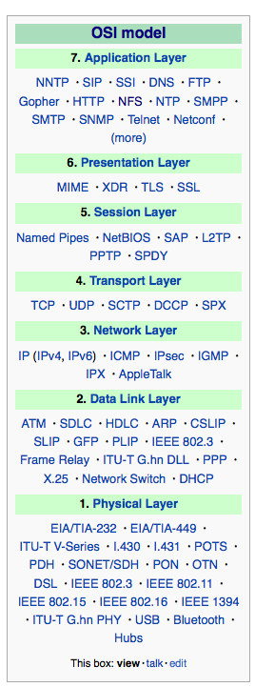
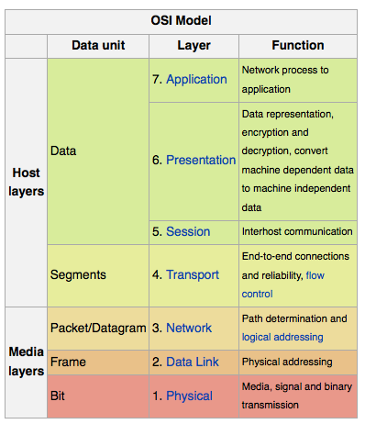
Implementation of Cryptography
Can be done at various layers of ISO Reference Model
SSL at the Transport layer
Network layer is typically IPSec
IKE for key exchange
Basis of Virtual Private Networks (VPNs)
Why not just at lowest level?
Sometimes need more knowledge than available at low levels
i.e. User authentication
i.e. e-mail delivery
Source: http://en.wikipedia.org/wiki/OSI_model

Slide 85
Encryption Example - TLS
Insertion of cryptography at one layer of the ISO network model (the transport layer)
SSL – Secure Socket Layer (also called TLS)
Cryptographic protocol that limits two computers to only exchange messages with each other
Very complicated, with many variations
Used between web servers and browsers for secure communication (credit card numbers)
The server is verified with a certificate assuring client is talking to correct server
Asymmetric cryptography used to establish a secure session key (symmetric encryption) for bulk of communication during session
Communication between each computer then uses symmetric key cryptography

Slide 86
Implementing Security Defenses
Defense in depth is most common security theory – multiple layers of security
Security policy describes what is being secured
Vulnerability assessment compares real state of system / network compared to security policy
Intrusion detection endeavors to detect attempted or successful intrusions
Signature-based detection spots known bad patterns
Anomaly detection spots differences from normal behavior
Can detect zero-day attacks
False-positives and false-negatives a problem
Virus protection
Searching all programs or programs at execution for known virus patterns
Or run in sandbox so can’t damage system
Auditing, accounting, and logging of all or specific system or network activities
Practice safe computing – avoid sources of infection, download from only “good” sites, etc

Slide 87
Firewalling to Protect Systems and Networks
A network firewall is placed between trusted and untrusted hosts
The firewall limits network access between these two security domains
Can be tunneled or spoofed
Tunneling allows disallowed protocol to travel within allowed protocol (i.e., telnet inside of HTTP)
Firewall rules typically based on host name or IP address which can be spoofed
Personal firewall is software layer on given host
Can monitor / limit traffic to and from the host
Application proxy firewall understands application protocol and can control them (i.e., SMTP)
System-call firewall monitors all important system calls and apply rules to them (i.e., this program can execute that system call)

Slide 88
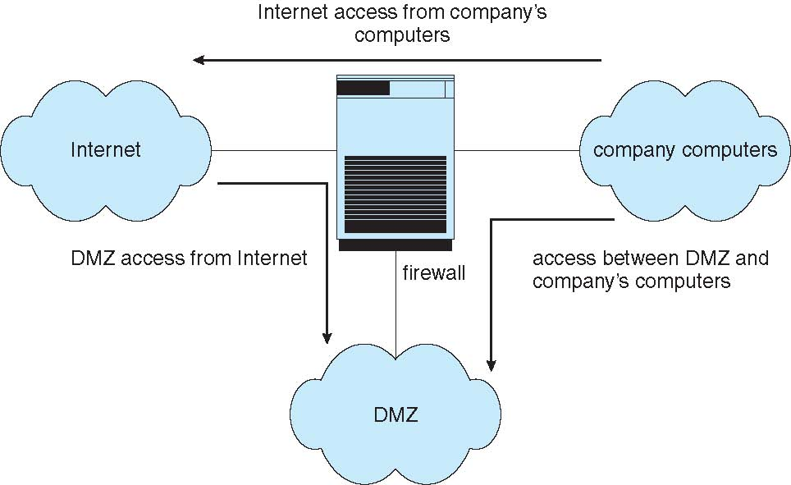
Network Security Through Domain Separation Via Firewall

Slide 89
Computer Security Classifications
U.S. Department of Defense outlines four divisions of computer security: A, B, C, and D
D – Minimal security
C – Provides discretionary protection through auditing
Divided into C1 and C2
C1 identifies cooperating users with the same level of protection
C2 allows user-level access control
B – All the properties of C, however each object may have unique sensitivity labels
Divided into B1, B2, and B3
A – Uses formal design and verification techniques to ensure security

Slide 90
Security Defenses Summarized
By applying appropriate layers of defense, we can keep systems safe from all but the most persistent attackers. In summary, these layers may include the following:
Educate users about safe computing—don’t attach devices of unknown origin to the computer, don’t share passwords, use strong passwords, avoid falling for social engineering appeals, realize that an e-mail is not necessarily a private communication, and so on
Educate users about how to prevent phishing attacks—don’t click on email attachments or links from unknown (or even known) senders; authenticate (for example, via a phone call) that a request is legitimate
Use secure communication when possible
Physically protect computer hardware
Configure the operating system to minimize the attack surface; disable all unused services
Configure system daemons, privileges applications, and services to be as secure as possible

Slide 91
Security Defenses Summarized (cont.)
Use modern hardware and software, as they are likely to have up-to-date security features
Keep systems and applications up to date and patched
Only run applications from trusted sources (such as those that are code signed)
Enable logging and auditing; review the logs periodically, or automate alerts
Install and use antivirus software on systems susceptible to viruses, and keep the software up to date
Use strong passwords and passphrases, and don’t record them where they could be found
Use intrusion detection, firewalling, and other network-based protection systems as appropriate
For important facilities, use periodic vulnerability assessments and other testing methods to test security and response to incidents

Slide 92
Security Defenses Summarized (cont.)
Encrypt mass-storage devices, and consider encrypting important individual files as well
Have a security policy for important systems and facilities, and keep it up to date

Slide 93
Example: Windows 10
Security is based on user accounts
Each user has unique security ID
Login to ID creates security access token
Includes security ID for user, for user’s groups, and special privileges
Every process gets copy of token
System checks token to determine if access allowed or denied
Uses a subject model to ensure access security
A subject tracks and manages permissions for each program that a user runs
Each object in Windows has a security attribute defined by a security descriptor
For example, a file has a security descriptor that indicates the access permissions for all users

Slide 94
Example: Windows 7 (Cont.)
Win added mandatory integrity controls – assigns integrity label to each securable object and subject
Subject must have access requested in discretionary access-control list to gain access to object
Security attributes described by security descriptor
Owner ID, group security ID, discretionary access-control list, system access-control list
Objects are either container objects (containing other objects, for example a file system directory) or noncontainer objects
By default an object created in a container inherits permissions from the parent object
Some Win 10 security challenges result from security settings being weak by default, the number of services included in a Win 10 system, and the number of applications typically installed on a Win 10 system

