Slide 1

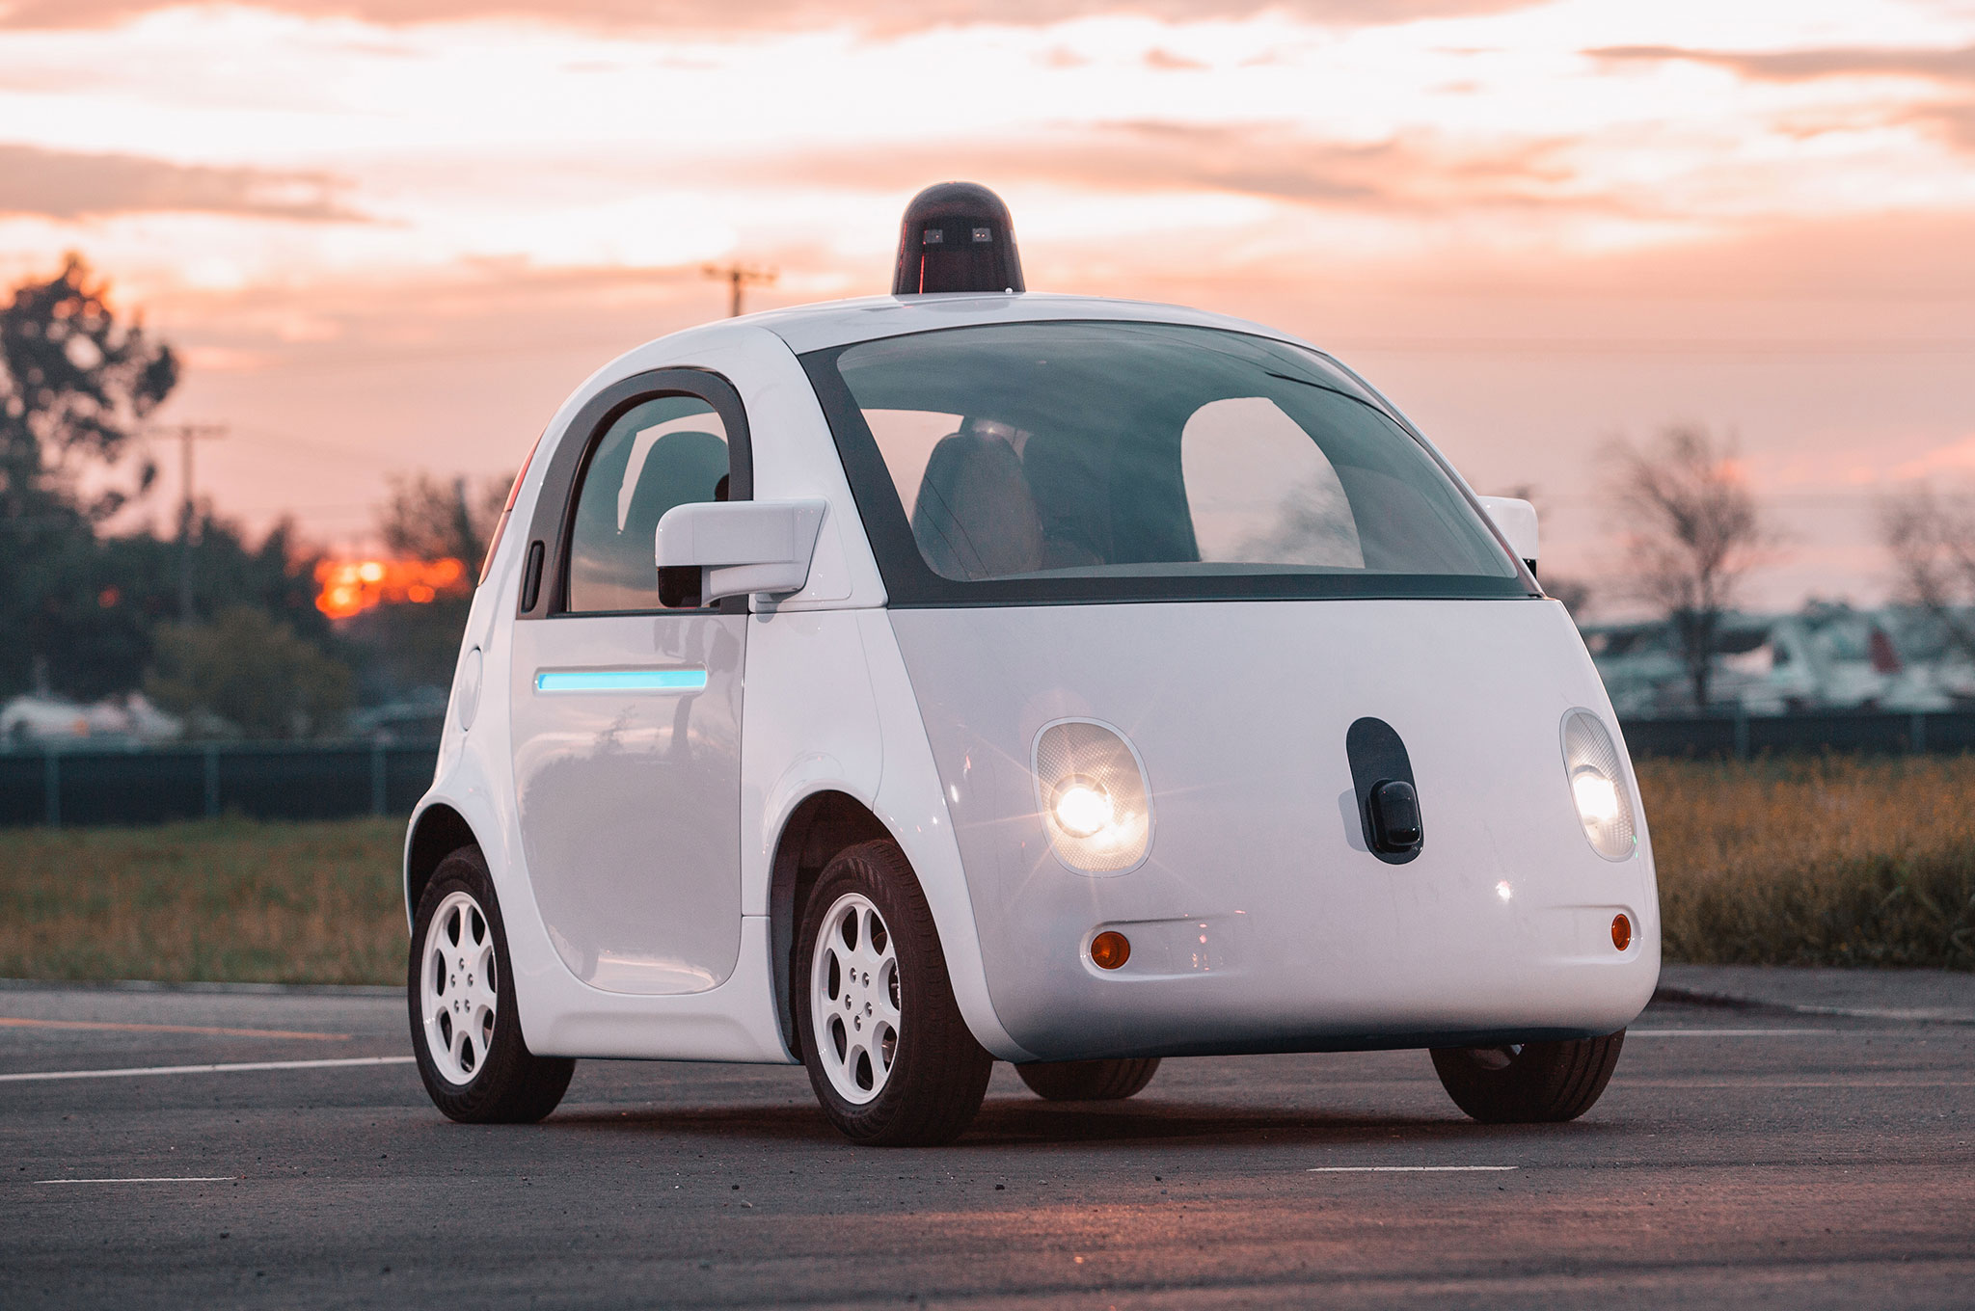

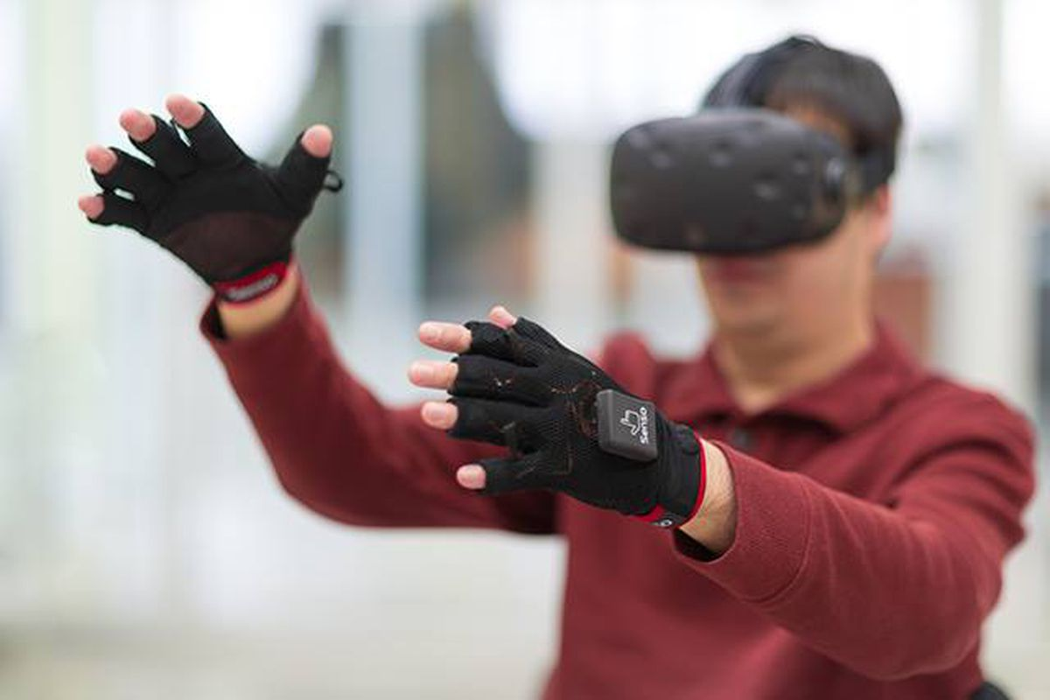

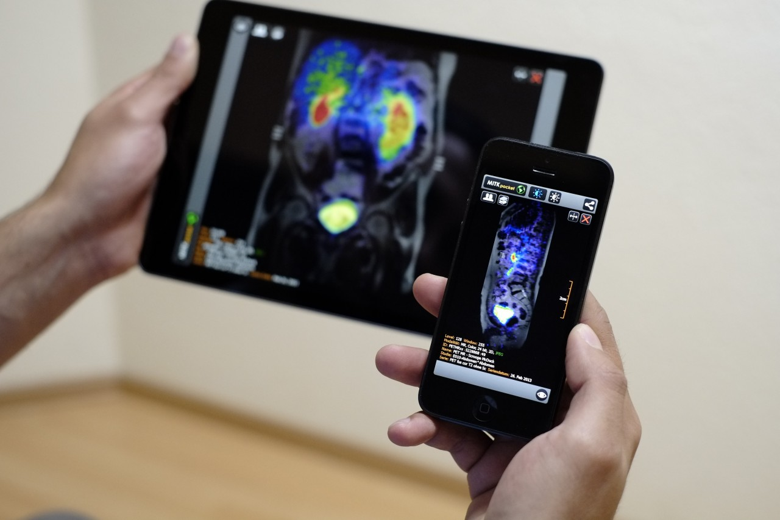
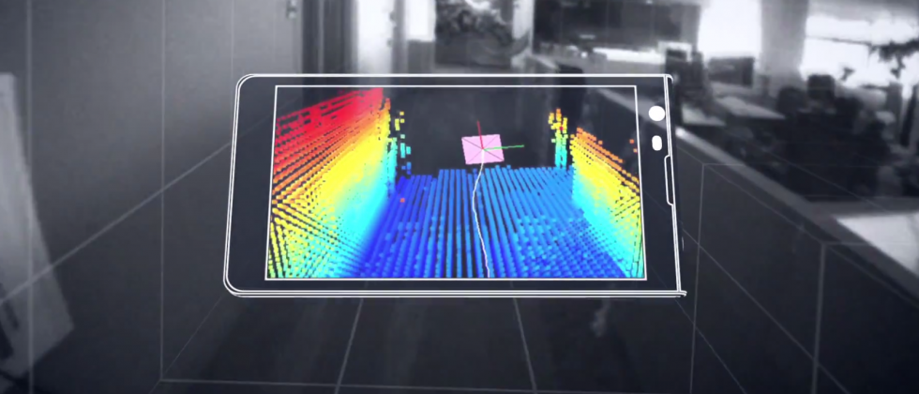
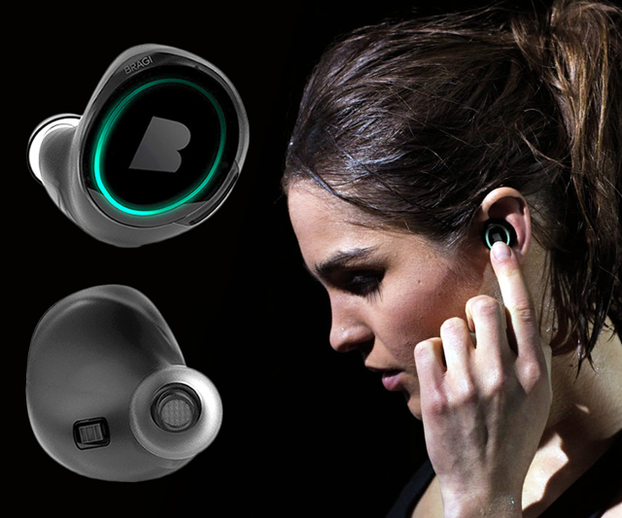
Wireless and Mobile Systems
for the IoT
CMSC 818W : Fall 2020
Lecture 1.2: Mathematical Foundations
for Signal Analysis
Nirupam Roy
M-W 2:00-3:15pm
Online

Slide 2
This zoom session is being recorded.

Slide 3
Time and Frequency domain view

Slide 4
The concept of the Fourier series
Amplitude
Time (sec)
0.00
0.25
0.50
0.75
1.00
1.25
Amplitude
Time (sec)
0.00
0.25
0.50
0.75
1.00
1.25

Slide 5
Frequency components change over time
Amplitude
Time (sec)
0.00
0.25
0.50
0.75
1.00
1.25
FFT
A set of
frequencies

Slide 6
Frequency components change over time
Amplitude
Time (sec)
0.00
0.25
0.50
0.75
1.00
1.25
FFT

Slide 7
Frequency components change over time
Amplitude
Time (sec)
0.00
0.25
0.50
0.75
1.00
1.25
FFT
FFT

Slide 8
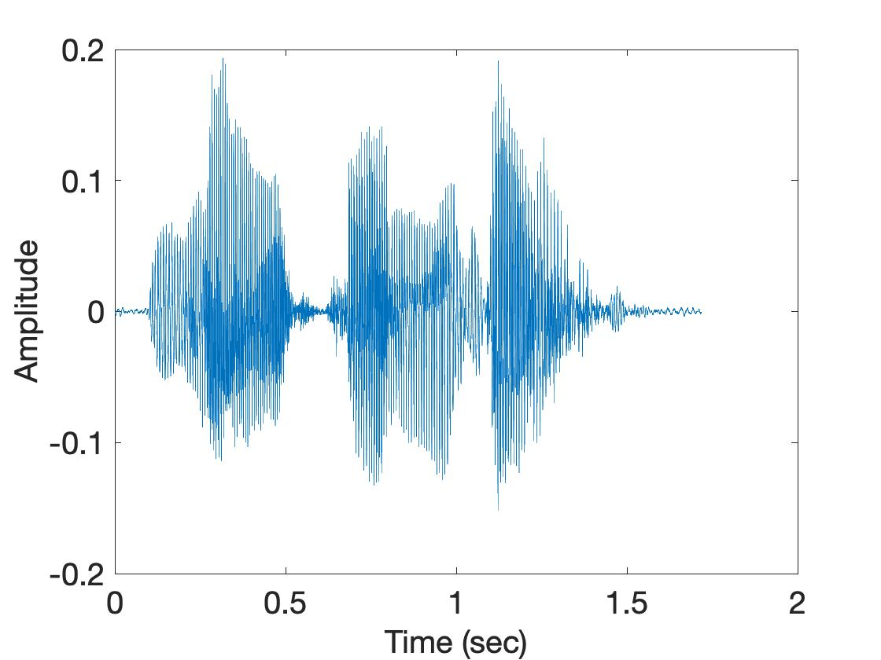
Frequency components change over time
U
M
D

Slide 9
Spectrogram
U
M
D
[
[
[
FFT of overlapping windows
of samples
(Spectrogram)
[
FFT
FFT
FFT
FFT

Slide 10
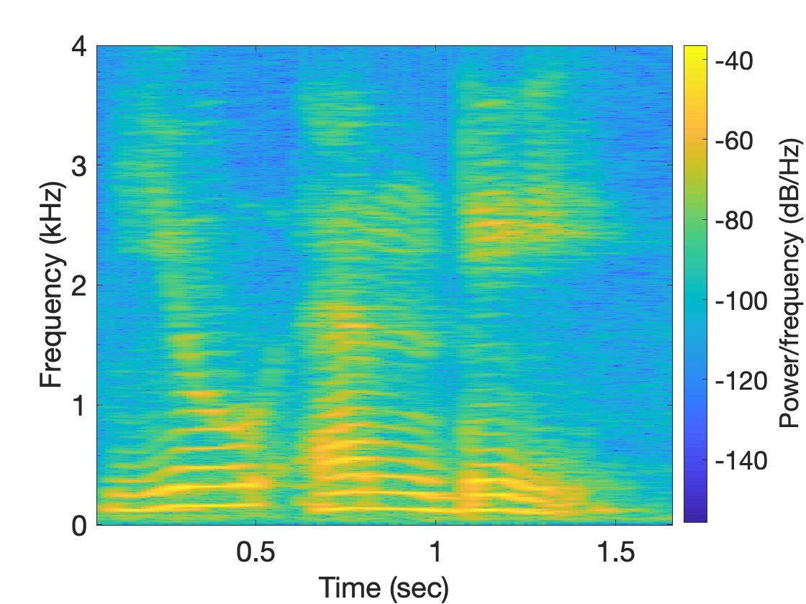
Spectrogram
U
M
D

Slide 11
Why do we need
the frequency domain view?

Slide 12

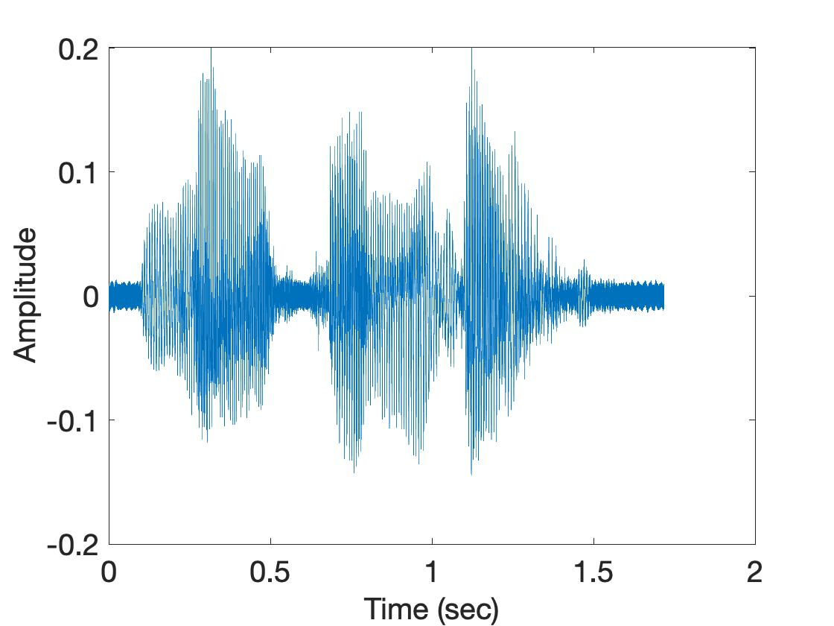
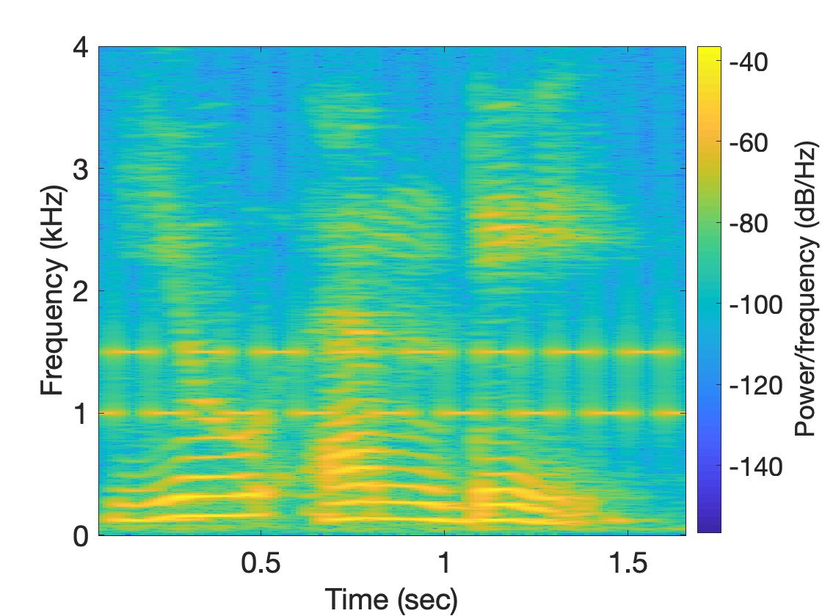
Why do we need the frequency domain view?
Sound
Sound + Noise
Time
domain
Freq.
domain

Slide 13
Analog
Digital
Physical signal
(voice)
Spectrogram plot
on computer
FFT
Time varying voltage
signal
A collection of numbers

Slide 14
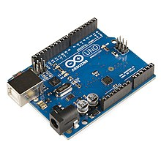
SENSOR
Analog
Analog
A structure or material
That reacts to the physical phenomenon
A circuit that converts the reaction to measurable electrical signal (e.g. voltage)
A physical phenomenon
We want to measure
Interpretation of the signal, storing the data
Digital

Slide 15
Analog
Digital
Physical signal
(voice)
Spectrogram plot
on computer
FFT
Time varying voltage
signal
A collection of numbers
?

Slide 16
Analog
Digital
Physical signal
(voice)
Spectrogram plot
on computer
FFT
Time varying voltage
signal
A collection of numbers
ADC
Analog-to-Digital Converter

Slide 17
Sampling theorem
Amplitude
Time (sec)
0.00
0.25
0.50
0.75
1.00
1.25

Slide 18
Sampling theorem
Amplitude
Time (sec)
0.00
0.25
0.50
0.75
1.00
1.25
Amplitude
Time (sec)
0.00
0.25
0.50
0.75
1.00
1.25
[ 0.34 0.22 0.09 0.21 0.30 0.08 0.09 ]

Slide 19
Sampling theorem
Amplitude
Time (sec)
0.00
0.25
0.50
0.75
1.00
1.25
T = Sampling interval
f_{s}= 1/T = Sample rate (or sampling frequency)
Clock

Slide 20
1-dimensional sampling

Slide 21
1-dimensional sampling
Y
V_{y}
V_{x}
X

Slide 22
1-dimensional sampling
2-dimensional sampling

Slide 23
1-dimensional sampling
2-dimensional sampling
3-dimensional sampling

Slide 24
Sampling theorem
Amplitude
Time (sec)
0.00
0.25
0.50
0.75
1.00
1.25
Amplitude
Time (sec)
0.00
0.25
0.50
0.75
1.00
1.25

Slide 25
Sampling theorem
Amplitude
Time (sec)
0.00
0.25
0.50
0.75
1.00
1.25
Aliasing: Two signals become indistinguishable
after sampling
Amplitude
Time (sec)
0.00
0.25
0.50
0.75
1.00
1.25

Slide 26
Aliasing
Amplitude
Time (sec)
0.00
0.25
0.50
0.75
1.00
1.25
Amplitude
Time (sec)
0.00
0.25
0.50
0.75
1.00
1.25

Slide 27
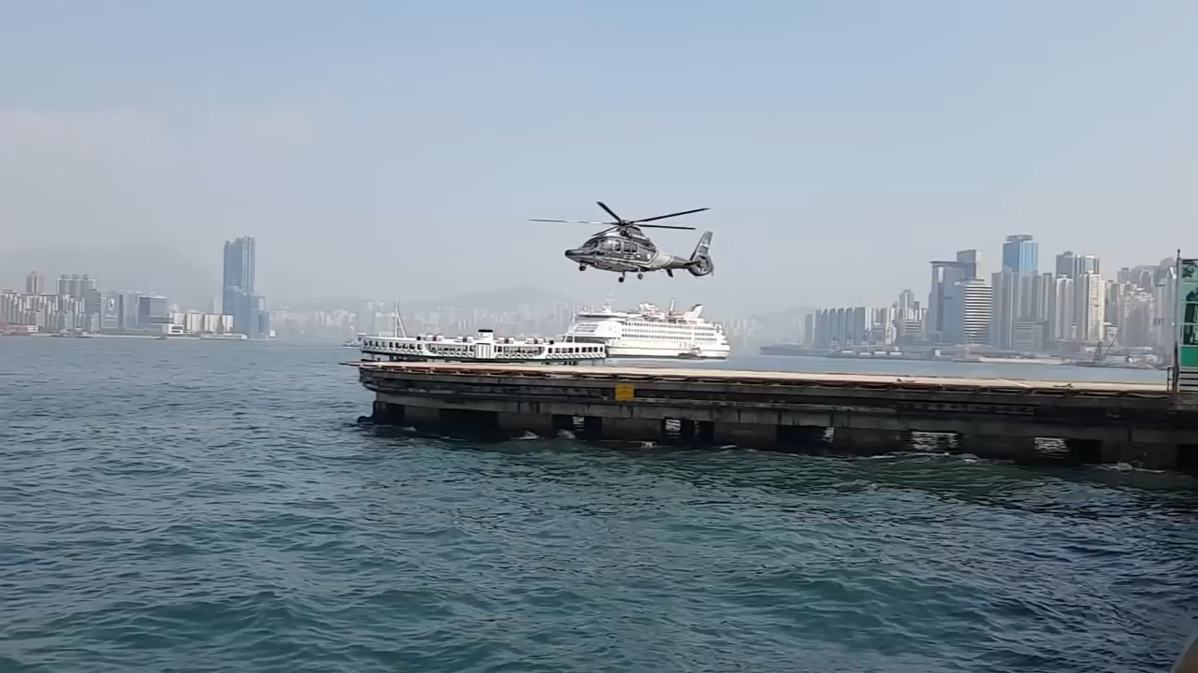
Aliasing

Slide 28
How to find a good sample rate?

Slide 29
How to find a good sample rate?
Nyquist sampling theorem:
In order to uniquely represent a signal F(t) by a set of samples, the sampling rate must be more than twice the highest frequency component present in F(t).
If sample rate is f_{s} and maximum frequency we want to
record is f_{max} , then
f_{s} > 2f_{max}

Slide 30
Amplitude
Time (sec)
0.00
0.25
0.50
0.75
1.00
1.25
Nyquist frequency = Maximum alias-free frequency for a given sample rate.
Nyquist rate = Lower bound of sample rate for a signal

Slide 31
Aliasing
f_{max} = 12 Hz
Amplitude
0
4
8
12
16
Frequency (Hz)

Slide 32
Commonly, the maximum frequency in human voice is 4 kHz, what sample rate will you use in your audio recorder?
Is there any limit on the maximum sample rate you can use?

Slide 33
Mathematical abstractions

Slide 34
Mathematical abstractions
… we use them everyday to
understand our world

Slide 35
A few examples
What is a number?
What is a negative number?
What do they model?
Any other example?

Slide 36
Model for a signal (frequency, amplitude, and phase)

Slide 37


Model for a signal (frequency, amplitude, and phase)
$$A . sin⁡(θ)$$
$$A . cos⁡(θ)$$
Why not use the sinusoid as the model ?

Slide 38
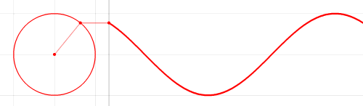

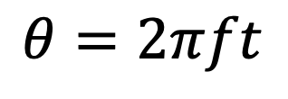



Model for a signal (frequency, amplitude, and phase)
1
$$sin⁡(θ)$$
𝚹
$$cos⁡(θ)$$
$$f cycles per second$$
$$θ=2πft$$
$$2π angles per cycle$$

Slide 39





Frequency, Amplitude, and Phase
$$2π angles per cycle$$
$$f cycles per second$$
A
𝚹
Phase
time = t second
$$=$$
$$A . sin⁡(θ)$$
$$=$$
$$A . sin⁡(2πft)$$
$$A . sin⁡(2πft+φ)$$
-- with initial/additional phase ϕ

Slide 40
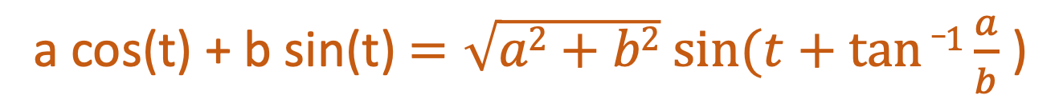
Why do we need both Sine and Cosine ?
A sine function with phase shift can be written as a weighted combination of sine and cosine:
a cos(t) + b sin(t) $=\sqrt{a2+b2} sin⁡(t+tan⁡_1\frac{a}{b}$ )

Slide 41
Model for a signal (frequency, amplitude, and phase)
1
$$sin⁡(θ)$$
𝚹
$$cos⁡(θ)$$
How can we incorporate both Sine and Cosine in the equation?

Slide 42

Model for a signal (frequency, amplitude, and phase)
1
$$sin⁡(θ)$$
𝚹
$$cos⁡(θ)$$
1.
$$\cos\left(θ\right)+sin⁡(θ)$$

Slide 43

Model for a signal (frequency, amplitude, and phase)
1
$$sin⁡(θ)$$
𝚹
$$cos⁡(θ)$$
1.
$$\cos\left(θ\right)+sin⁡(θ)$$
2.
$$<cos\left(θ\right), \sin\left(θ\right)>$$

Slide 44

Model for a signal (frequency, amplitude, and phase)
1
$$sin⁡(θ)$$
𝚹
$$cos⁡(θ)$$
1.
$$\cos\left(θ\right)+sin⁡(θ)$$
2.
$$<cos\left(θ\right), \sin\left(θ\right)>$$
3.
$$\cos\left(θ\right)+j \sin\left(θ\right)$$

Slide 45
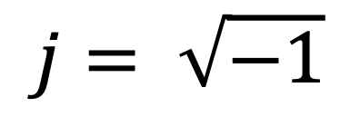
Complex numbers
Imaginary
$$j= \sqrt{−1}$$

Slide 46
Complex numbers

Slide 47
Complex numbers

Slide 48
Complex numbers and Natural exponential
…

Slide 49
Complex numbers and Natural exponential
…
…

Slide 50
Complex numbers and Natural exponential
…
…
…

Slide 51
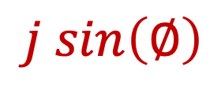

Complex numbers and Natural exponential
…
…
…
$$\cos\left(∅\right)$$
$$j sin\left(∅\right)$$

Slide 52
Complex numbers and Natural exponential

Slide 53
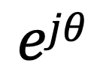
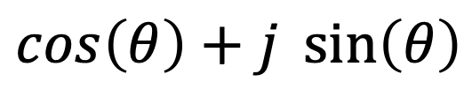

Model for a signal (frequency, amplitude, and phase)
$$\cos\left(θ\right)+j \sin\left(θ\right)$$
$$=$$
$$ejθ$$

Slide 54
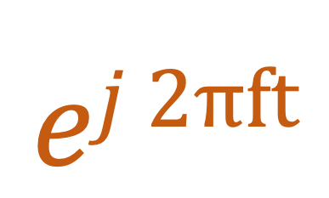

Model for a signal (frequency, amplitude, and phase)
$$ej 2πft$$
$$\cos\left(θ\right)+j \sin\left(θ\right)$$
$$=$$
$$ejθ$$
$$=$$

Slide 55
Model for a signal (frequency, amplitude, and phase)
$$ej 2πft$$
$$\cos\left(θ\right)+j \sin\left(θ\right)$$
$$=$$
$$ejθ$$
$$=$$

Slide 56
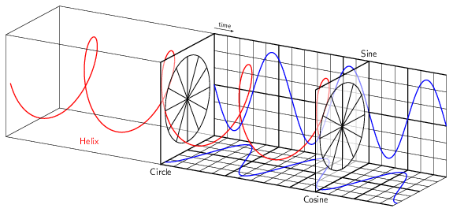
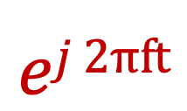
Model for a signal (frequency, amplitude, and phase)
$$ej 2πft$$

Slide 57
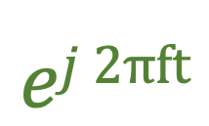
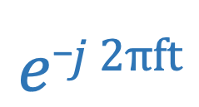
Model for a signal (frequency, amplitude, and phase)
$$ej 2πft$$
$$e_j 2πft$$

Slide 58

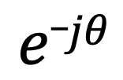


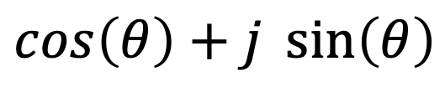

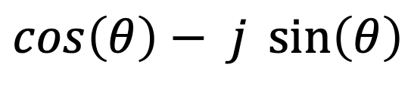

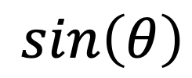
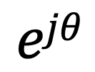

Model for a signal (frequency, amplitude, and phase)
$$ejθ$$
$$=$$
$$\cos\left(θ\right)+j \sin\left(θ\right)$$
$$e_jθ$$
$$=$$
$$\cos\left(θ\right)− j \sin\left(θ\right)$$
How about real sinusoids?
$$\cos\left(θ\right)$$
$$=$$
$$?$$
$$\sin\left(θ\right)$$
$$=$$
$$?$$

Slide 59

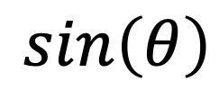



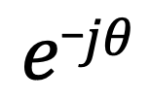
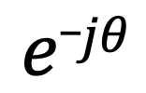
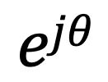
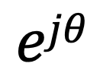
Presenting real signal with the complex model
$$ejθ$$
$$=$$
$$\cos\left(θ\right)+j \sin\left(θ\right)$$
$$e_jθ$$
$$=$$
$$\cos\left(θ\right)− j \sin\left(θ\right)$$
$$ejθ$$
$$+$$
$$e_jθ$$
$$\cos\left(θ\right)$$
$$=$$
2
$$ejθ$$
$$−$$
$$e_jθ$$
$$\sin\left(θ\right)$$
$$=$$
2j

Slide 60
Presenting real signal with the complex model

Slide 61
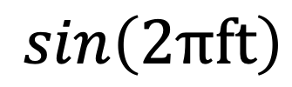
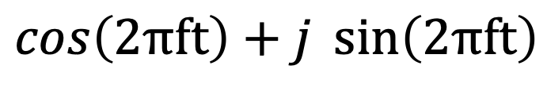


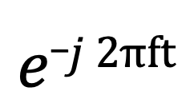
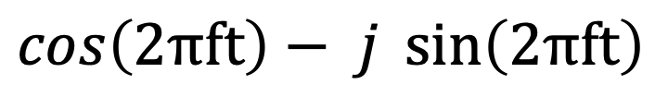
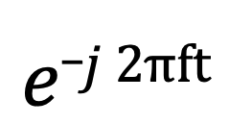
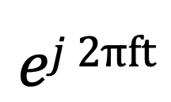
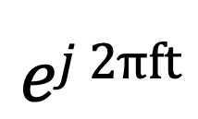
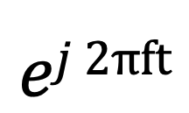
Presenting real signal with the complex model
$$ej 2πft$$
$$=$$
$$\cos\left(2πft\right)+j \sin\left(2πft\right)$$
$$e_j 2πft$$
$$=$$
$$\cos\left(2πft\right)− j \sin\left(2πft\right)$$
$$ej 2πft$$
$$+$$
$$e_j 2πft$$
$$\cos\left(2πft\right)$$
$$=$$
2
$$ej 2πft$$
$$−$$
$$e_j 2πft$$
$$\sin\left(2πft\right)$$
$$=$$
2j

Slide 62
Time Domain and Frequency Domain
Fourier Transform
FFT
Amplitude
Amplitude
IFFT
0.00
0.25
0.50
0
2
4
6
8
Time
Frequency (Hz)
Time domain
Frequency domain
FFT = Fast Fourier Transform
IFFT = Inverse Fast Fourier Transform

Slide 63
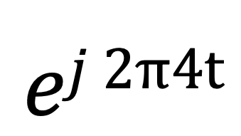
Time Domain and Frequency Domain
Fourier Transform
$$ej 2π4t$$
FFT
Amplitude
0
2
4
6
8
Frequency (Hz)
Time domain
Frequency domain
FFT = Fast Fourier Transform
IFFT = Inverse Fast Fourier Transform

Slide 64

Time Domain and Frequency Domain
Fourier Transform
FFT
?
$$\cos\left(2πft\right)$$
Amplitude
0
2
4
6
8
Frequency (Hz)
Time domain
Frequency domain
FFT = Fast Fourier Transform
IFFT = Inverse Fast Fourier Transform

Slide 65




Time Domain and Frequency Domain
Fourier Transform
FFT
?
$$\cos\left(2πft\right)$$
Amplitude
$$ej 2πft$$
$$+$$
$$e_j 2πft$$
$$=$$
2
0
2
4
6
8
Frequency (Hz)
Time domain
Frequency domain
FFT = Fast Fourier Transform
IFFT = Inverse Fast Fourier Transform

Slide 66
Time Domain and Frequency Domain
Fourier Transform
FFT
$$\cos\left(2πft\right)$$
Amplitude
$$ej 2πft$$
$$+$$
$$e_j 2πft$$
$$=$$
2
-6
-4
-2
0
2
4
6
8
Frequency (Hz)
Time domain
Frequency domain
FFT = Fast Fourier Transform
IFFT = Inverse Fast Fourier Transform

Slide 67

Time Domain and Frequency Domain
Fourier Transform
FFT
$$\cos\left(2π4t\right)$$
Amplitude
$$ej 2πft$$
$$+$$
$$e_j 2πft$$
$$=$$
2
-6
-4
-2
0
2
4
6
8
Frequency (Hz)
Time domain
Frequency domain
FFT = Fast Fourier Transform
IFFT = Inverse Fast Fourier Transform

Slide 68
Matlab demo
function fft_test()
freq = 200;
sampleRate = 1000;
time_ticks = 0:1/sampleRate:1;
realSignal = sin(2*pi*freq*time_ticks);
plot_fft(realSignal, sampleRate);
complexSignal = exp(j*2*pi*freq*time_ticks);
plot_fft(complexSignal, sampleRate);
end

