Slide 1

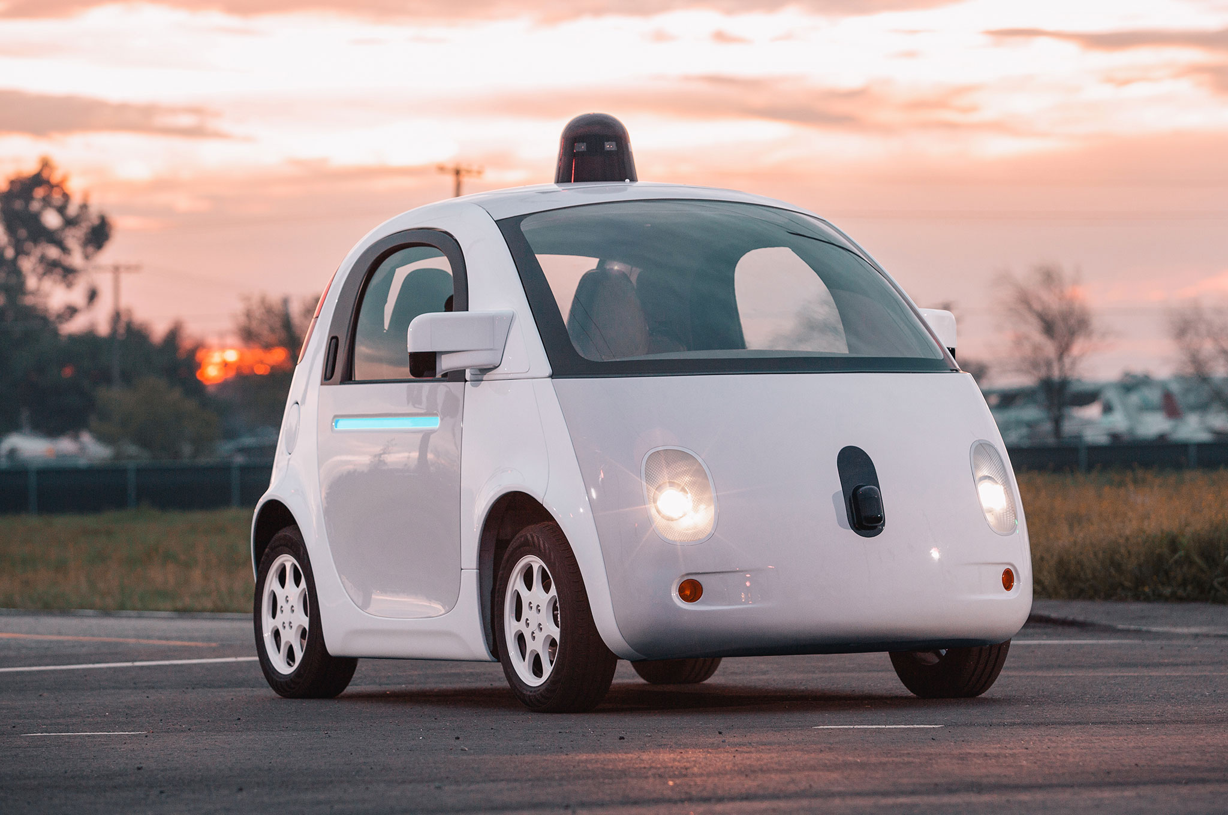
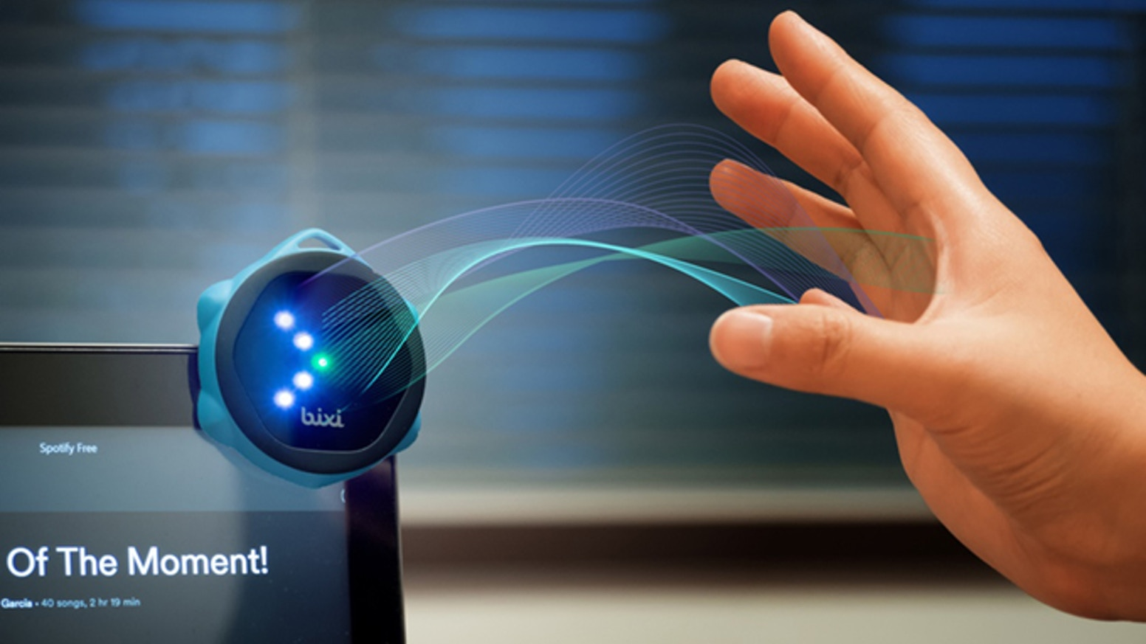


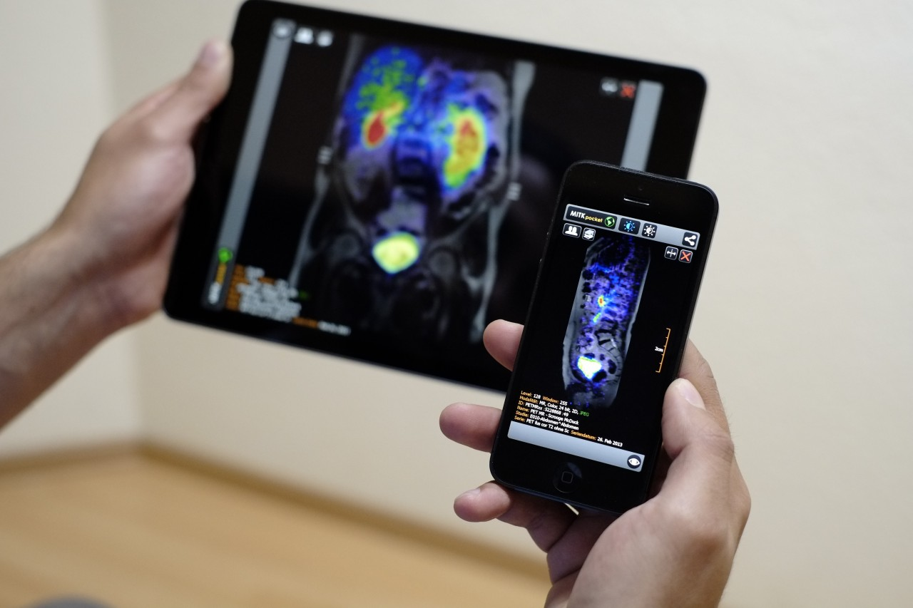
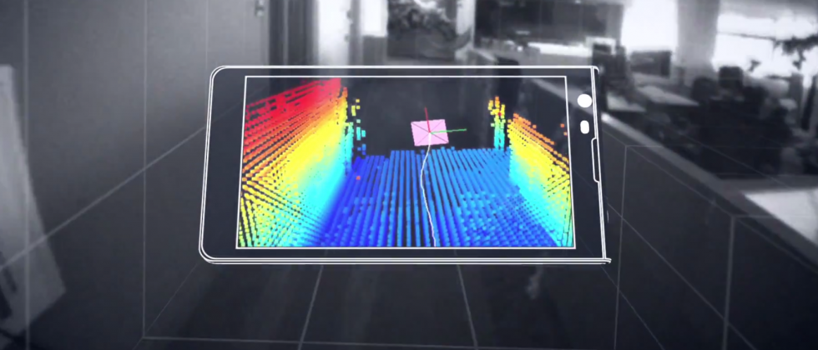
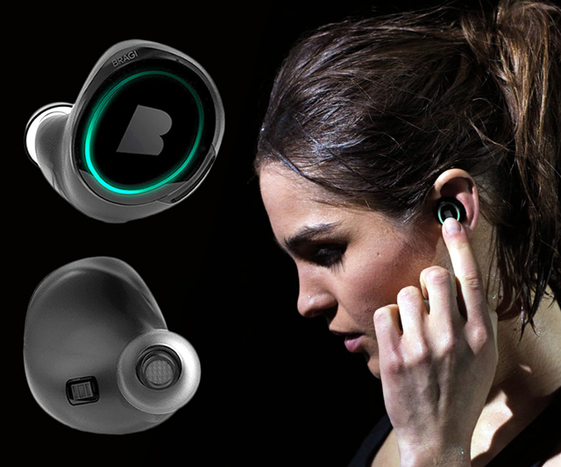
Wireless and Mobile Systems
for the IoT
CMSC 818W : Fall 2020
Lecture 1.4: Properties of the Discrete Fourier Transform
and visualizing DFT coefficients
Nirupam Roy
M-W 2:00-3:15pm
Online

Slide 2
This Zoom session is being recorded.

Slide 3
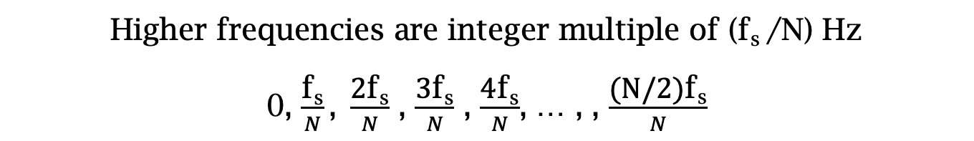
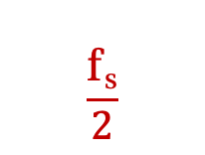

Estimating the real-world frequencies
Sampling frequency = f_{s} (i.e., f_{s} samples per second)
Slowest frequency ($\frac{2π}{N}$ radians per step) = N samples per rotation
= (N/ f_{s}) seconds per rotation
Therefore, the slowest frequency = (f_{s} /N) Hz
Higher frequencies are integer multiple of (f_{s} /N) Hz
0, $\frac{\text{f}\text{s}}{N}\text{, }\frac{\text{2}\text{f}\text{s}}{N}$ , $\frac{\text{3}\text{f}\text{s}}{N}$ , $\frac{\text{4}\text{f}\text{s}}{N}$, … , , $\frac{\text{(}\text{N}\text{/2)}\text{f}\text{s}}{N}$
$$\frac{\text{f}\text{s}}{2}$$
- $\frac{\text{f}\text{s}}{N}\text{, }\text{−}\frac{\text{2}\text{f}\text{s}}{N}$ , - $\frac{\text{3}\text{f}\text{s}}{N}$ , - $\frac{\text{4}\text{f}\text{s}}{N}$, … , , - $\frac{\text{(}\text{N}\text{/2)}\text{f}\text{s}}{N}$

Slide 4

The resolution and the highest frequency
Magnitude/Phase of z_{m}
-4
-3
-2
-1
m = 0
1
2
3
4
Frequency
Resolution
= minimum observable frequency difference =
$\frac{\text{f}\text{s}}{N}$
What if the actual frequency falls in between two frequency bins?

Slide 5
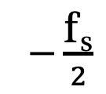
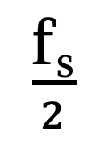
The resolution and the highest frequency
Magnitude/Phase of z_{m}
-4
-3
-2
-1
m = 0
1
2
3
4
Frequency
$−\frac{\text{f}\text{s}}{2}$
$\frac{\text{f}\text{s}}{2}$
Highest frequency =

Slide 6
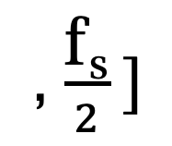
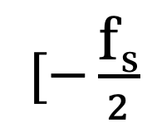
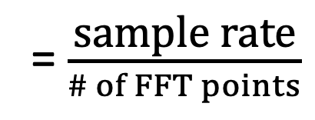
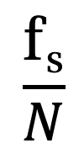
The resolution and the highest frequency
How can we increase the resolution?
$$\frac{\text{f}\text{s}}{N}$$
= $\frac{\text{sample} \text{rate}}{\# of FFT points}$
How can we increase the range of the spectrum?
$[−\frac{\text{f}\text{s}}{2}$
, $\frac{\text{f}\text{s}}{2} ]$

Slide 7
Time resolution v/s Frequency resolution

Slide 8
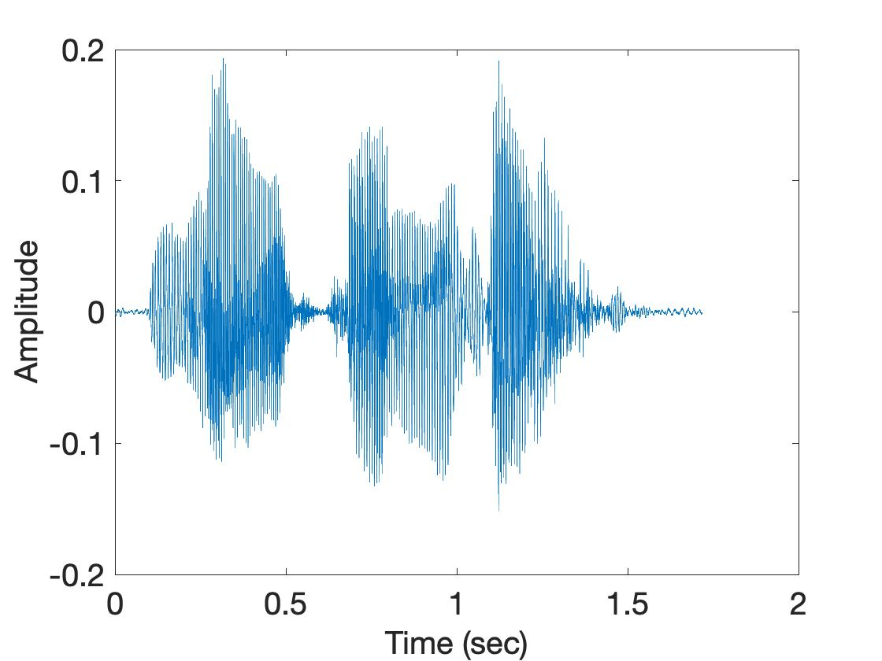
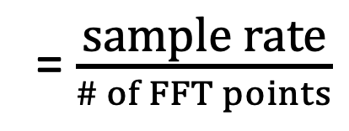
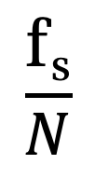
Time resolution v/s Frequency resolution
U
M
D
[
[
DFT
DFT
$$\frac{\text{f}\text{s}}{N}$$
= $\frac{\text{sample} \text{rate}}{\# of FFT points}$
How can we increase the frequency resolution?
How can we increase the time resolution?

Slide 9
Aliasing

Slide 10
Sampling theorem
Amplitude
Time (sec)
0.00
0.25
0.50
0.75
1.00
1.25
Amplitude
Time (sec)
0.00
0.25
0.50
0.75
1.00
1.25
Aliasing: Two signals become indistinguishable after sampling

Slide 11
Time domain samples
Amplitude
Time (sec)
0.00
0.25
0.50
0.75
1.00
1.25
FFT
Amplitude
-6
-4
-2
0
2
4
6
8
Frequency (Hz)
Frequency domain

Slide 12
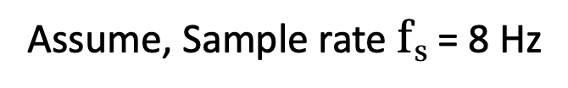
Aliasing: Different frequencies, same name!!
Magnitude/Phase of z_{m}
-4
-3
-2
-1
m = 0
1
2
3
4
Frequency
Assume, Sample rate $\text{f}\text{s}$ = 8 Hz
For a COMPLEX signal, what value will we see if the actual frequency is:
a) 3 Hz
b) -2 Hz
c) 6 Hz
d) -5 Hz
e) 4 Hz and -4Hz

Slide 13
Magnitude/Phase of z_{m}
-4
-3
-2
-1
m = 0
1
2
3
4
Frequency
5
6
7
8

Slide 14
Magnitude/Phase of z_{m}
-4
-3
-2
-1
m = 0
1
2
3
4
Frequency
5
6
7
8

Slide 15
Magnitude/Phase of z_{m}
-4
-3
-2
-1
m = 0
1
2
3
4
Frequency
0
- F_{s}/4
F_{s}/4
F_{s}/2

Slide 16
Aliasing: Different frequencies, same name!!
Magnitude/Phase of z_{m}
-4
-3
-2
-1
m = 0
1
2
3
4
Frequency
Assume, Sample rate $\text{f}\text{s}$ = 8 Hz
For a COMPLEX signal, what value will we see if the actual frequency is:
a) 3 Hz
b) -2 Hz
c) 6 Hz
d) -5 Hz
e) 4 Hz and -4Hz

Slide 17
Aliasing: Different frequencies, same name!!
Magnitude/Phase of z_{m}
-4
-3
-2
-1
m = 0
1
2
3
4
Frequency
Assume, Sample rate $\text{f}\text{s}$ = 8 Hz
For a REAL signal, what value will we see if the actual frequency is:
a) 3 Hz
b) -2 Hz
c) 6 Hz
d) -5 Hz
e) 4 Hz and -4Hz

Slide 18
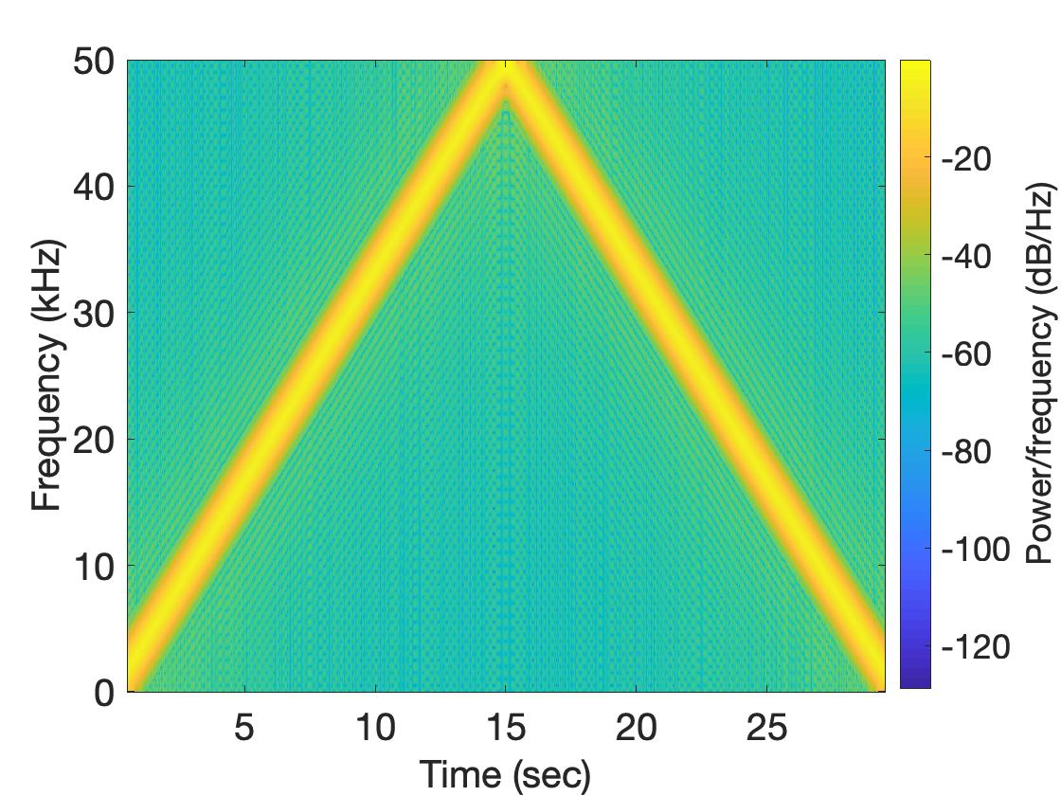
Aliasing: Spectrogram of increasing frequency

Slide 19
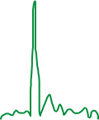

Calculating the aliased frequency value for real signals
Sampling frequency = 10Hz
Nyquist frequency = 5Hz
Amplitude
0
2
4
6
8
Frequency (Hz)

Slide 20

Calculating the aliased frequency value for real signals
Sampling frequency = 10Hz
Nyquist frequency = 5Hz
Amplitude
Received
signal
Amplitude
0
2
4
6
8
0
2
4
6
8
Frequency (Hz)
Frequency (Hz)

Slide 21
Calculating the aliased frequency value for real signals
Sampling frequency = 10Hz
Nyquist frequency = 5Hz
Amplitude
Received
signal
Amplitude
0
2
4
6
8
0
2
4
6
8
Frequency (Hz)
Frequency (Hz)
f_{s} = Sampling frequency
f = Target frequency
f_{a} = Aliased(perceived) frequency
K = Non-negative integer
f_{a} = min(abs(K*f_{s} - f))

Slide 22
Aliasing: A real life scenario
Nyquist frequency
Amplitude
10k
20k
30k
40k
50k
60k
70k
80k
90k
100k
Frequency spectrum
Notes:
to amplify the signal power …
Now, this signal typically contains many more frequencies than the sampling system can handle …

Slide 23
Aliasing: A real life scenario
Nyquist frequency
Amplitude
10k
20k
30k
40k
50k
60k
70k
80k
90k
100k
Frequency spectrum
Notes:
to amplify the signal power …
Now, this signal typically contains many more frequencies than the sampling system can handle …

Slide 24
Aliasing: A real life scenario
Nyquist frequency
Amplitude
10k
20k
30k
40k
50k
60k
70k
80k
90k
100k
Frequency spectrum
We need a “Low-pass filter”
to remove unwanted high frequency signals
Notes:
to amplify the signal power …
Now, this signal typically contains many more frequencies than the sampling system can handle …

Slide 25
Anti-aliasing filter
Nyquist frequency
Amplitude
10k
20k
30k
40k
50k
60k
70k
80k
90k
100k
Frequency spectrum
Sensor
ADC
Anti-aliasing
Filter
Notes:
to amplify the signal power …
Now, this signal typically contains many more frequencies than the sampling system can handle …

Slide 26
Anti-aliasing filter
Nyquist frequency
Amplitude
10k
20k
30k
40k
50k
60k
70k
80k
90k
100k
Frequency spectrum
Sensor
ADC
Anti-aliasing
Filter
Notes:
Hence, a low pass filter…

Slide 27
Anti-aliasing filter
Anti-aliasing
filter
Amplitude
10k
20k
30k
40k
50k
60k
70k
80k
90k
100k
Frequency spectrum
Sensor
ADC
Anti-aliasing
Filter
Notes:
removes the unwanted frequencies above 24 kHz …
And ultimately, this filtered signal is sampled by an ADC to generate digital sound samples

Slide 28
Anti-aliasing filter

Slide 29
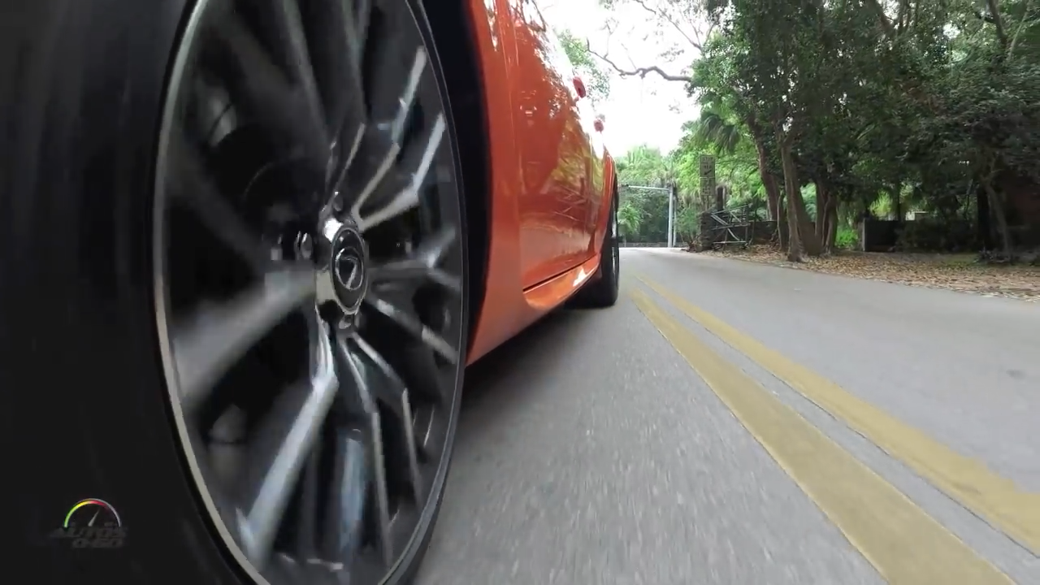
Aliasing in real life
https://www.youtube.com/watch?v=B8EMI3_0TO0

Slide 30
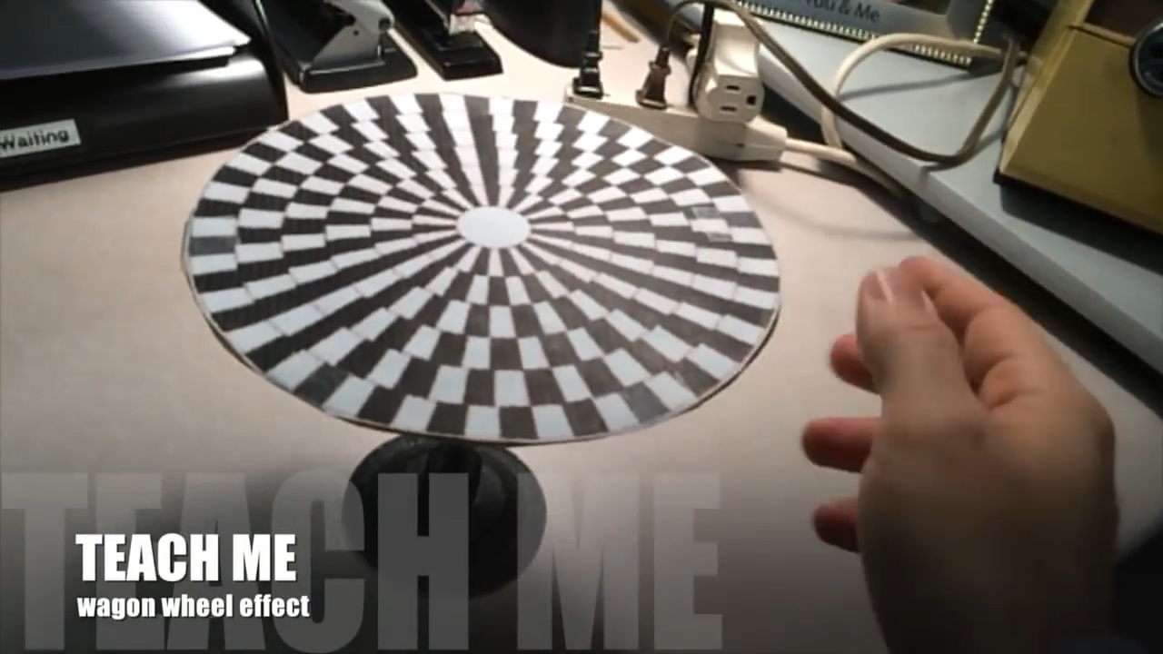
Aliasing in real life
https://www.youtube.com/watch?v=QOwzkND_ooU

Slide 31
A few more ideas…
1) Filtering frequencies
1) Filtering frequencies
2) Multiplying frequency with frequency
3) Sampling a band of frequencies

Slide 32
Matlab demo code

Slide 33
A few more ideas…
1) Filtering frequencies
2) Multiplying frequency with frequency
3) Sampling a band of frequencies

Slide 34








Multiplying two frequencies
Magnitude/Phase of z_{m}
-4
-3
-2
-1
m = 0
1
2
3
4
Frequency
Two signals with frequencies f1 and f2 are multiplied:
$$ej 2π f1 t$$
$$ej 2π f2 t$$
$$ej 2πf1 t$$
$$+$$
$$e_j 2πf1t$$
$$ej 2πf2 t$$
$$+$$
$$e_j 2πf2t$$
2
2

Slide 35
Matlab demo code

Slide 36
A few more ideas…
1) Filtering frequencies
2) Multiplying frequency with frequency
3) Sampling a band of frequencies

Slide 37
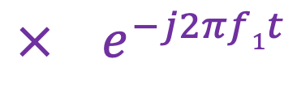
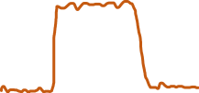



Sample Rate for a Frequency band
$$e^{j2πf1t}$$
$$e^{j2πf2t}$$
Amplitude
$${× e}^{−j2πf1t}$$
0
2
4
6
0
8
Frequency (kHz)
What should be the sample rate?

Slide 38
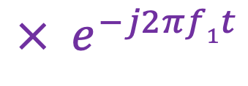
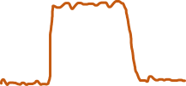

Sample Rate for a Frequency band
$${× e}^{−j2πf1t}$$
Amplitude
Frequency
down-conversion
Amplitude
0
2
4
6
8
0
2
4
6
8
Frequency (kHz)
Frequency (kHz)
What should be the sample rate?
Generally, bandwidth of the signal determines the sample rate.

Slide 39
Programming Assignment #1

Slide 40
Short-time Fourier Transform (STFT)
U
M
D
[
[
[
DFT of overlapping windows
of samples
(Spectrogram/STFT)
[
DFT
DFT
DFT
DFT

Slide 41
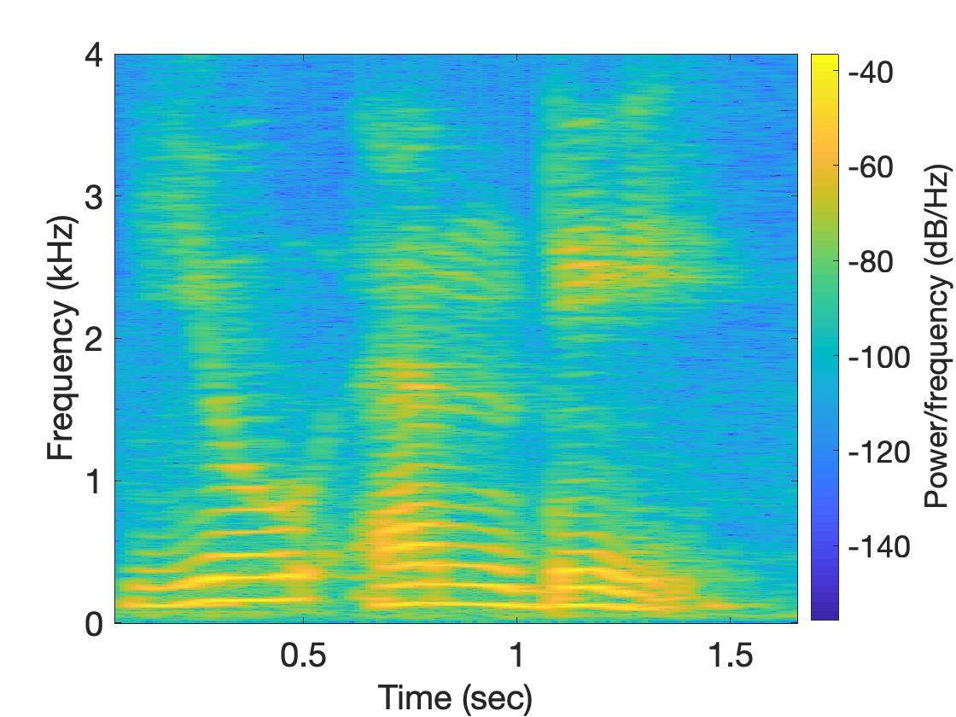
Short-time Fourier Transform (STFT)
U
M
D

Slide 42
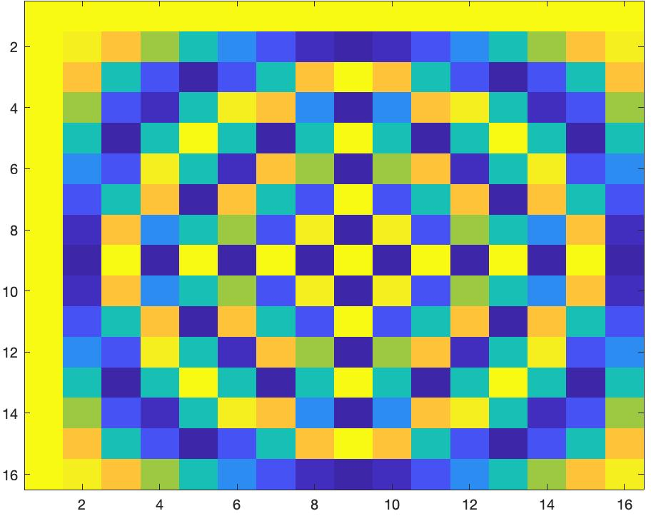
Short-time Fourier Transform (STFT)
*
_{X}
_{Z}
_{F}
=
_{F}
=
_{Matlab function: dftm(N)}
_{X}
=

Slide 43
Short-time Fourier Transform (STFT)
*
_{X}
_{Z}
_{F}
=
_{F}
_{N}
=
_{Matlab function: dftm(N)}
_{N}
_{abs(Z)}
_{X}
_{8N}
=

Slide 44
Short-time Fourier Transform (STFT)
?
_{x}
₌

